Slide 1
8-Hour Training Course
Module 5: Risk and Hazard Communication
Introduction to Nanomaterials and Occupational Health
Bruce Lippy, Ph.D., CIH, CSP
Notes:
Trainer Notes:

Slide 2
This material was produced under grant number SH-21008-10-60-F-48 from the Occupational Safety and Health Administration, U.S. Department of Labor. It does not necessarily reflect the views or policies of the U.S. Department of Labor, nor does mention of trade names, commercial products, or organizations imply endorsement by the U.S. Government.
Notes:
Trainer Notes:
[insert a disclaimer about the limitations of these materials]

Slide 3
Eight-Hour Training Course
Module 1 | Introduction to Nanotechnology and Nanomaterials
Module 2 | What Workers Need to Know about Nanomaterial Toxicology and Environmental Impacts
Module 3 | Assessing Exposure to Nanomaterials in the Workplace
Module 4 | Controlling Exposure to Nanomaterials
LUNCH (on your own)
Module 5 | Risk Management Approaches for Nanomaterial Workplaces
Module 6 | Regulations and Standards Relevant to Nanomaterial Workplaces
Module 7 | Tools and Resources for Further Study
Notes:
Trainer Notes:
Explain where the current module fits within the full eight-hour course, where appropriate. If this module is being offered as a standalone training, you can modify or hide the slide or use it to describe the other available modules.
Use this opportunity to explain where the restrooms and water fountains are located and what emergency evacuation procedures should be followed should the need arise.

Slide 4
Lesson Overview
Purpose
To provide nanoworkers with a basis to compare the risks of nanoparticles against other, more familiar risks. To explain the concept of control banding as an alternative to normal industrial hygiene measurements.
4-4
Notes:
Trainer Notes:
To provide nanoworkers with a basis to compare the risks of nanoparticles against other, more familiar risks.

Slide 5
Lesson Overview
Topics
  What is risk?
  NanoRisk Framework
  Control Banding
  Communicating Hazards to Workers
Notes:
Trainer Notes:
[Review these topics and see if they are of interest to your audience.]
Topics
The concept and importance of the hierarchy of controls
Elimination and the difficulties of substitution
Local exhaust ventilation as the primary engineering controls for nanoparticles
High efficiency particulate filters
The concept and applicability of control banding
Personal protective equipment as the last line of defense against nanoparticle exposures

Slide 6
Learning Objectives
At the end of this module, you will be able to:
Explain the difference between risk and hazard
Explain the standard definition of risk in terms of probability and severity
Explain control banding and give a nanoparticle example
Describe the limitations of the current Hazard Communication efforts around engineered nanoparticles

Slide 7
Topic 1:
What is risk?

Slide 8
Risk is a function of
Severity of possible harm
Probability of the occurrence of that harm

Slide 9

Who’s more uncomfortable flying than driving?
The likelihood of dying on a jet flight is 1 in 8,000,000
This is flying around the clock for more than 438 years before a fatal crash (FAA, 1998)
Odds of dying in car crash: 1/84 (NSC, 2007)

Slide 10
Odds of Dying, 2003
National Safety Council
Event | # of Deaths | One-year Odds | Lifetime Odds
Lightning | 47 | 6,188,298 | 79,746
Animal rider or animal-drawn vehicle | 101 | 2,879,703 | 37,110
Venomous spiders | 8 | 36,356,251 | 468,508

Slide 11
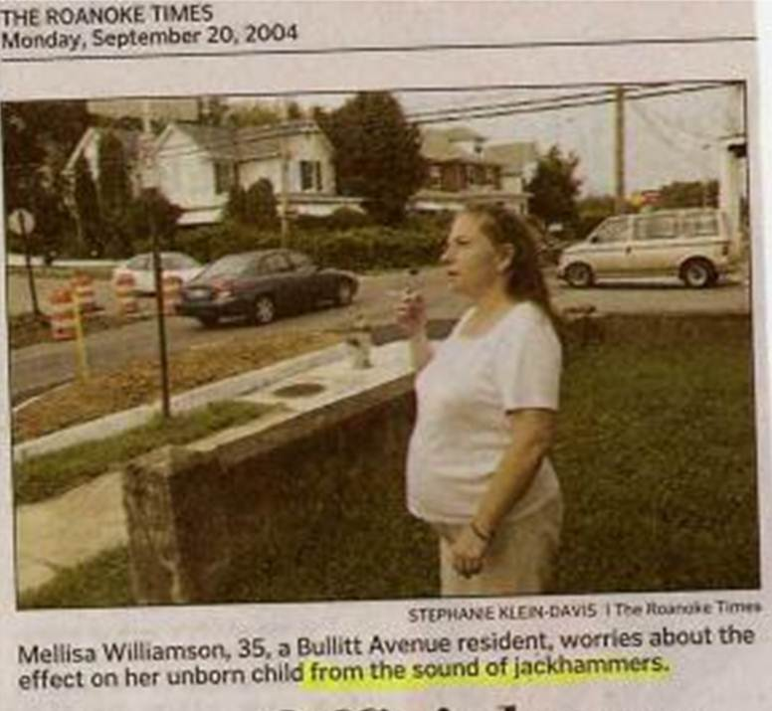
How do most of us do with risk comparisons?
“A Bullitt Avenue resident worries about the effect on her unborn child from the sound of jackhammers.”

Slide 12
What is the precautionary principle? How does it affect Nano?
A moral and political principle which states that if an action or policy might cause severe or irreversible harm to the public, in the absence of a scientific consensus that harm would not ensue, the burden of proof falls on those who would advocate taking the action
“Observe before you project yourself on a parabolic trajectory.” David Appel, Scientific American 1/2001
Notes:
I was grilled about this at my presentation at Mt. Sinai in April, so I wanted to present it now for your consideration after studying it thoroughly on Wikipedia. The formal concept evolved out of the German socio-legal tradition in the 1930s, centering on the concept of good household management. Many of the concepts underpinning the precautionary principle pre-date the term's inception. For example, the essence of the principle is captured in a number of cautionary aphorisms such as "an ounce of prevention is worth a pound of cure", "better safe than sorry", and "look before you leap". The precautionary principle may also be interpreted as the evolution of the ancient medical principle of "first, do no harm" to apply to institutions and institutional decision-making processes rather than individuals. The principle was implemented in an international treaty as early as the 1987 Montreal Protocol, and among other international treaties and declarations [10] is reflected in the 1992 Rio Declaration on Environment and Development (signed at the United Nations Conference on Environment and Development).
“Observe before you project yourself on a parabolic trajectory. The weight of 28.35 grams of prevention is worth 454 grams of cure. Science certainly has much to say on taking precautions. But for the enormously complex and serious problems that now face the world--global warming, loss of biodiversity, toxins in the environment--science doesn't have all the answers, and traditional risk assessment and management may not be up to the job. Indeed, given the scope of such problems, they may never be.
Given the uncertainty, some politicians and activists are insisting on caution first, science second. Although there is no consensus definition of what is termed the precautionary principle, one oft-mentioned statement, from the so-called Wingspread conference in Racine, Wis., in 1998 sums it up: "When an activity raises threats of harm to human health or the environment, precautionary measures should be taken even if some cause and effect relationships are not fully established scientifically. Critics asserted that the principle's definition and goals are vague, leaving its application dependent on the regulators in charge at the moment. All it does, they alleged, is stifle trade and limit innovation. "If someone had evaluated the risk of fire right after it was invented," remarked Julian Morris of the Institute of Economic Affairs in London, "they may well have decided to eat their food raw."
A matter of law in Germany and Sweden, the precautionary principle may soon guide the policy of all of Europe: last February the European Commission outlined when and how it intends to use the precautionary principle. Increasingly, the principle is finding its way into international agreements. It was incorporated for the first time in a fully fledged international treaty last January--namely, the United Nations Biosafety Protocol regulating trade in genetically modified products. Gradually it has begun to work its way into U.S. policy. In an October speech at the National Academy of Sciences in Washington, D.C., New Jersey governor Christine Todd Whitman averred that "policymakers need to take a precautionary approach to environmental protection.... We must acknowledge that uncertainty is inherent in managing natural resources, recognize it is usually easier to prevent environmental damage than to repair it later, and shift the burden of proof away from those advocating protection toward those proposing an action that may be harmful."
Although the U.S. has taken such an approach for years--the 1958 Delaney Clause overseeing pesticide residues in food, for instance, and requirements for environmental impact statements--the more stringent requirements of the precautionary principle have not generally been welcome.”
David Appel, Scientific American 1/2001

Slide 13
Topic 2:
NanoRisk Framework

Slide 14
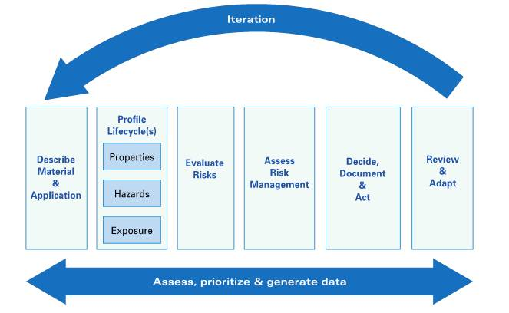
The EDF-DuPont Nano Risk Framework is highly regarded
Notes:
Trainer Notes:
One of the most widely recognized voluntary approaches came from the unusual partnership of the DuPont company and the Environmental Defense Fund. In June 2007, they jointly launched the Nano Risk Framework as a comprehensive, practical and flexible system to address the potential risks of nanoscale materials. The Framework has been widely cited as best practice for industry and valuable input for government policy. The framework has six basic steps (as indicated in the diagram):
27
Describe Material and Its Applications
Profile Lifecycles
Evaluate Risk
Assess Risk Management
Decide, Document, and Act
Review and Adapt

Slide 15
EDF-DuPont Nano Risk Framework
Step 1: Describe material and application
Step 2: Profile lifecycles
Step 3: Evaluate risks
Step 4: Assess risk management
Step 5: Decide, document and act
Step 6: Review and adapt
Notes:
Trainer Notes:
EDF-DuPont Nano Risk Framework
Step 1: Describe material and application
Step 2: Profile lifecycles
Step 3: Evaluate risks
Step 4: Assess risk management
Step 5: Decide, document and act
Step 6: Review and adapt
Through these six steps, the framework seeks to guide a process for risk evaluation and management that is practical, comprehensive, transparent, and flexible. The Framework, and case studies demonstrating its implementation on a variety of nanomaterials and applications, are available for download in PDF form.

Slide 16
Nano Risk Framework case studies are available on the web
TiO₂ light stabilizer by DuPont
Carbon nanotubes
Nano FeO
http://nanoriskframework.org
Notes:
Trainer Notes:
Nano Risk Framework case studies are available on the web:
TiO₂ light stabilizer by Dupont
Carbon nanotubes
Nano FeO

Slide 17
The entire life cycle needs to be considered
Extraction & Processing
Manufacture of
Nanomaterial
Distribution
&
Transport
Manufacture of
Nanoproduct
Distribution
&
Transport
End-of-Life
Use
?
?
Amount of nano waste
Complexity of nano waste
Risk to workers (Lippy)
Graphic courtesy David Rejeski, Wilson Center for Scholars
Notes:
Trainer Notes:
[This is a graphic created by David Rejeski of the Wilson Center for Scholars to depict the entire life cycle of a nanoproduct and to consider the amount and complexity of the waste throughout that life cycle. Bruce Lippy added potential worker risks to the cycle.]

Slide 18
Topic 3:
Control Banding

Slide 19
Control banding is a qualitative administrative approach that defines risks and sets controls
Risk = probability X severity

Slide 20
Two Things Make
Control Banding Possible
There are few
basically different
approaches to
control. So we
can band risks
Many problems
have been met –
and solved –
before
Source: Paul Evans, 3rd International Control Banding Workshop, South Africa, September 2005

Slide 21
Control Banding has been used for years in the pharmaceutical industry
Band No. | Range of exposure concentrations | Hazard group | Control
1 | >1 to 10 mg/m³ dust >50 to 500 ppm vapor | Skin and eye irritants | Use good industrial hygiene practice and general ventilation
2 | >0.1 to 1 mg/m³ dust >5 to 50 ppm vapor | Harmful on single exposure | Use local exhaust ventilation
3 | >0.01 to 0.1 mg/m³ dust >0.5 to 5 ppm vapor | Severely irritating and corrosive | Enclose the process
4 | <0.01 mg/ m³ dust <0.5 ppm vapor | Very toxic on single exposure, reproductive hazard, sensitizer* | Seek expert advice
*Exposure to any concentration of a sensitizer requires expert advice
Notes:
Trainer Notes:
[Go through the chart of control banding, adopted from NIOSH. Introduce the subject and discuss it’s history. Ask students which jobs that they work on may control banding be suitable for. Below is excerpted text from NIOSH that provides background information on control banding.]
The occupational exposure limit (OEL) is the marker that shows the level of control needed for a chemical. Repeated daily exposure by inhaling a chemical at an airborne concentration below its OEL is unlikely to lead to harm in most workers. However, many thousands of chemicals are in use, and it is not possible to have an OEL for every chemical, chemical mixture, fume, or emission. Nonetheless, it is possible to determine the broad hazard group to which a chemical belongs (Table 1) and on that basis to determine the necessary level of control, or control band.
The concept of control banding was developed in the late 1980s by occupational health experts in the pharmaceutical industry. This industry uses large numbers of new chemical compounds with few toxicity data. The experts reasoned that such compounds could be classified into bands by their toxicity and by their need for restriction of exposure. Each band was aligned with a control scheme. Early references on the concept included a manual published by the Association of the British Pharmaceutical Industry in October 1995 and a paper by Naumann et al. [1996] (see reference list below). In the early 1990s, as the European system for classification and labeling developed, occupational health experts began to examine the alignment between the classification, the exposure limit, and data on exposure and control systems [Gardner and Oldershaw 1991].
Control banding is not currently appropriate for many situations, including "hot" processes, open spray applications, gases, and pesticides. These situations involve more complex exposures requiring additional considerations that are not yet fully addressed by current control banding strategies. In addition, control banding does not yet cover safety hazards, environmental issues, or ergonomic issues. Researchers are exploring ways to integrate these additional workplace issues into the control banding concept.

Slide 22
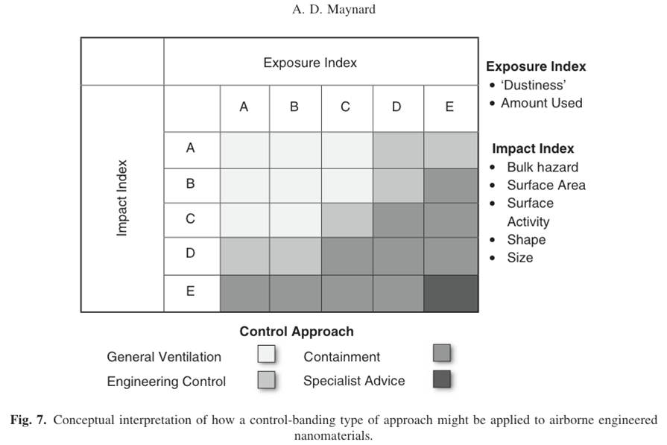
Control Banding was proposed for nanomaterials in 2007 (Maynard)
Notes:
Trainer Notes:
Maynard, AD. (2007) Nanotechnology: the next big thing, or much ado about nothing? Ann Occ Hyg 51(1);1-12.

Slide 23
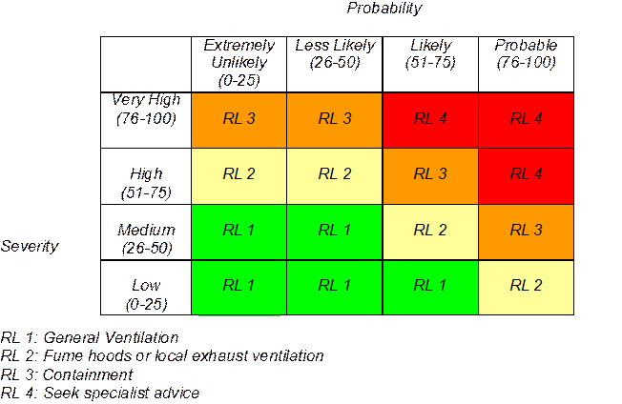
Lawrence Livermore developed a Control Banding Nanotool (Sam Paik, LLNL)
Courtesy Sam Paik and Lawrence Livermore National Laboratory

Slide 24
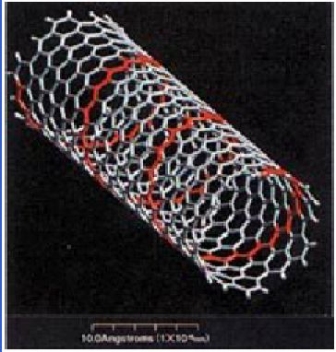
The Nanotool sets Severity Factors
Nanomaterial: 70% of Severity Score
Surface Chemistry (10 pts)
Particle Shape (10 pts)
Particle Diameter (10 pts)
Solubility (10 pts)
Carcinogenicity (6 pts)
Reproductive Toxicity (6 pts)
Mutagenicity (6 pts)
Dermal Toxicity (6 pts)
Asthmagen (6 pts)
Courtesy Sam Paik and Lawrence Livermore National Laboratory
Notes:
Trainer Notes:
Nanomaterial: 70% of Severity Score
Surface Chemistry (10 pts)
Particle Shape (10 pts)
Particle Diameter (10 pts)
Solubility (10 pts)
Carcinogenicity (6 pts)
Reproductive Toxicity (6 pts)
Mutagenicity (6 pts)
Dermal Toxicity (6 pts)
Asthmagen (6 pts)
[Point out that the tool focuses mainly on the nanomaterial, but because often data are not available, the tool only gives 70% of the score to the nanomaterial.]

Slide 25
Factors for the parent material get 30% of severity score
Occupational Exposure Limit (10 pts)
Carcinogenicity (4 pts)
Reproductive Toxicity (4 pts)
Mutagenicity (4 pts)
Dermal Toxicity (4 pts)
Asthmagen (4 pts)
  (Maximum points indicated in parentheses)
Courtesy Sam Paik and Lawrence Livermore National Laboratory
Notes:
Trainer Notes:
Factors for the parent material get 30% of severity score.
Occupational Exposure Limit (10 pts)
Carcinogenicity (4 pts)
Reproductive Toxicity (4 pts)
Mutagenicity (4 pts)
Dermal Toxicity (4 pts)
Asthmagen (4 pts)
[This is an interesting approach because there will invariably be more data on the “macro” sized version of the material, e.g. carbon black or graphite rather than CNT.]

Slide 26
Nanotool uses probability factors, too
Estimated amount of material used (25 pts)
Dustiness/mistiness (30 pts)
Number of employees with similar exposure (15 pts)
Frequency of operation (15 pts)
Duration of operation (15 pts)
Courtesy Sam Paik and Lawrence Livermore National Laboratory
Notes:
Trainer Notes:
Nanotool uses probability factors, too.
Estimated amount of material used (25 pts)
Dustiness/mistiness (30 pts)
Number of employees with similar exposure (15 pts)
Frequency of operation (15 pts)
Duration of operation (15 pts)

Slide 27
Nanotool results were comparable to judgment of professionals
36 operations at LLNL
For 21 activities, CB Nanotool recommendation was equivalent to existing controls
For 9 activities, CB Nanotool recommended higher level of control than existing controls
For 6 activities, CB Nanotool recommended lower level of control than existing controls
Courtesy Sam Paik and Lawrence Livermore National Laboratory
Notes:
Trainer Notes:
Nanotool results were comparable to judgment of professionals.
36 operations at LLNL
For 21 activities, CB Nanotool recommendation was equivalent to existing controls
For 9 activities, CB Nanotool recommended higher level of control than existing controls
For 6 activities, CB Nanotool recommended lower level of control than existing controls

Slide 28
CB Nanotool as LLNL Policy
Overall (30 out of 36), CB Nanotool recommendation was equal to or more conservative than IH expert opinions
LLNL decided to make CB Nanotool recommendation a requirement
CB Nanotool is an essential part of LLNL’s Nanotechnology Safety Program
Courtesy Sam Paik and Lawrence Livermore National Laboratory
Notes:
Trainer Notes:
CB Nanotool as LLNL Policy
Overall (30 out of 36), CB Nanotool recommendation was equal to or more conservative than IH expert opinions
LLNL decided to make CB Nanotool recommendation a requirement
CB Nanotool is an essential part of LLNL’s Nanotechnology Safety Program

Slide 29
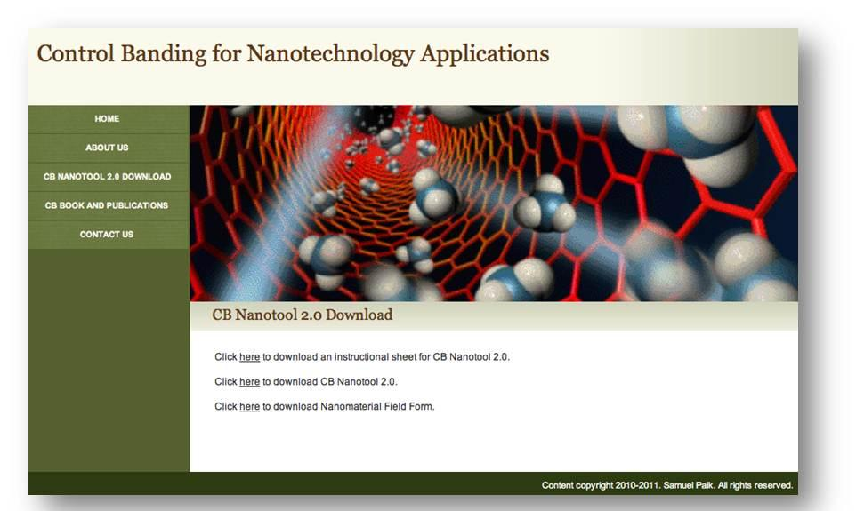
Let’s use the Nanotool in an exercise
http://controlbanding.net/Services.html
Notes:
Trainer Notes:
Let’s use the Nanotool in an exercise.
[The Nanotool is available on the web as a downloadable Excel spreadsheet. The tool contains several examples that can be worked in class.]

Slide 30
Topic 4:
Communicating Hazards to Workers
The difficulties of HAZCOM for nanomaterials

Slide 31
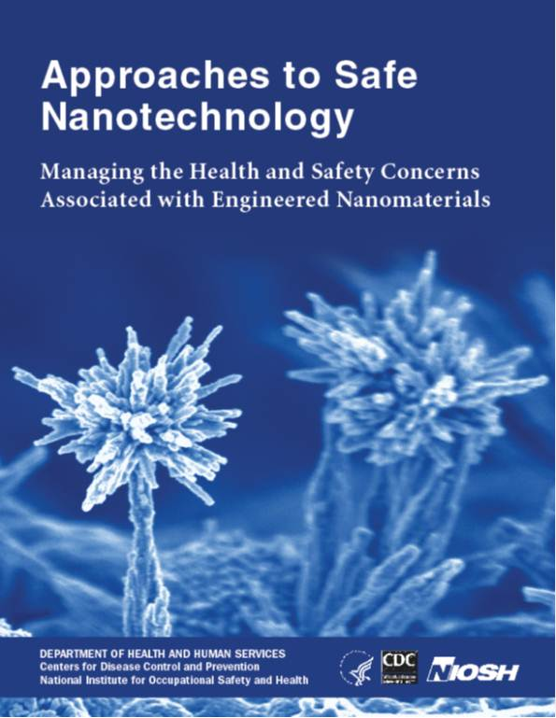
NIOSH has excellent resources
www.cdc.gov/niosh/topics/nanotech

Slide 32

The GoodNanoGuide is a tremendous resource (more in Module 7)
Protected Internet site on occupational practices for the safe handling of nanomaterials
Multiple stakeholders contribute, share and discuss information
Modern, interactive, up-to-date
http://GoodNanoGuide.org
Notes:
32
Trainer Notes:
The GoodNanoGuide is a tremendous resource (more in Module 7)
Protected Internet site on occupational practices for the safe handling of nanomaterials
Multiple stakeholders contribute, share and discuss information
Modern, interactive, up-to-date
[Review this here quickly because Module 7 gives it a great treatment.]

Slide 33
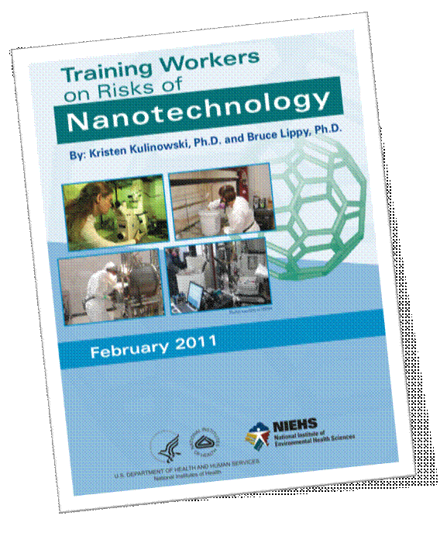
This NIEHS guidance on training workers is in final form http://is.gd/NIEHSnano
Notes:
Trainer Notes:
This NIEHS guidance on training workers is in final form and available on the web.

Slide 34
We haven’t been doing a great job communicating the hazards of standard industrial chemicals
Hazard Communication: A Review of the Science Underpinning the Art of Communication for Health and Safety
Sattler, Lippy & Jordan, May, 1997
Notes:
Trainer Notes:
We haven’t been doing a great job communicating the hazards of standard industrial chemicals

Slide 35
1997 review of Hazcom literature for OSHA was the only one for a decade
University of Maryland contract with OSHA. Report at: www.osha.gov
Accuracy of technical information was a problem
Most studies were based on reported preferences, not behaviors
Populations studied were students not workers
Notes:
One expert panel review established that only 11% of the MSDSs were found to be accurate in all of the following four areas: health effects, first aid, personal protective equipment, and exposure limits. Further, the health effects data on the MSDSs frequently are incomplete and the chronic data are often incorrect or less complete than the acute data.
Kolp, P.W.; Williams, P.L.; and Burtan, R.C. 1995. Assessment of the Accuracy of Material Safety Data Sheets. Journal of the American Industrial Hygiene Association 56:178-183.

Slide 36
Comprehensibility of MSDSs was not good
Literate workers only understood 60% of the health and safety information on sample MSDSs in three different comprehensibility studies:
  Printing Industries of America, 1990
  Kolp, Sattler, Blayney, Sherwood, 1993. Am. J. Ind. Med
  Phillips, 1998
Notes:
On average, literate workers only understood about 60% of the health and safety information on sample MSDSs in three different comprehensibility studies This percentage was remarkably similar across the studies. study was reported in 1990, by the Printing Industries of America (PIA, 1990). The study involved the comprehensibility of MSDS to Master Printers, who had an average of 13.9 years of formal education, or approximately two years beyond high school. In this study, 27 MSDS were selected and analyzed for reading levels using a software program, finding the average reading grade level of 14. The investigators found that employees with 15 years of education or more understood only 66.2%. Based on these results, it was suggested that years of formal education does not significantly increase comprehension of MSDS.
At the time, the PIA made the suggestion that a standardized format be used for MSDS, as well as standardized color-coded sections for easier access to emergency information, and standardized signs and symbols for vital information. They further suggested that MSDS be produced in other languages (this is not required by OSHA) and be written at a reading level no higher than twelfth grade.
Kolp, P.; Sattler, B.; Blayney, M.; Sherwood, T. 1993. Comprehensibility of Material Safety Data Sheets. American Journal of Industrial Medicine (23)1:135-141. This was based on the doctoral research of Barb Sattler and tested workers ability to find and comprehend information in MSDSs.

Slide 37
Findings from a newer review of the literature did not find improvements
Category | Findings
Accuracy and completeness | “Relatively poor”
Awareness and use | “Suboptimal in workplaces studied”
Comprehensibility | “Poor presentation and complex language…low comprehensibility”
Nicol et al. 2008, Am. J. Ind Medicine
Notes:
Accuracy, comprehensibility, and use of material safety data sheets: A review Anne-Marie Nicol, PhD *, A. Christie Hurrell, MA, Desy Wahyuni, MLIS, William McDowall, MSc, Winnie Chu, This article describes a review of the peer-reviewed scientific literature regarding the accuracy, comprehensibility and use of MSDSs in the workplace.
Methods: Articles were retrieved via a systematic search of indexes and databases, followed by hand searching and citation index searching. Two reviewers independently read and coded the articles using an iterative matrix.
Results: Of the 280 unique articles retrieved, 24 fit the review criteria. Eligible articles included a range of methodologies: laboratory analyses, site audits, surveys and qualitative inquiry. Articles were grouped into three main topic categories: accuracy and completeness, awareness and use, and comprehensibility. Accuracy and completeness were found to be relatively poor, with the majority of studies presenting evidence that the MSDSs under review did not contain information on all the chemicals present, including those known to be serious sensitizers or carcinogens. Poor presentation and complex language were consistently associated with low comprehensibility among workers. Awareness and use of MSDSs was suboptimal in workplaces where these factors were studied.
Conclusions: Despite the fact that these studies varied in methodology and spanned a period of more than 15 years, a number of common themes emerged regarding inaccuracies, incompleteness, incomprehensibility and overall low use of MSDSs. The results of the literature review suggest that there are serious problems with the use of MSDSs as hazard communication tools. The article concludes with recommendations for governments, regulatory bodies, and occupational health and safety personnel to seriously reassess the ways in which MSDSs are written, monitored, regulated, and used.

Slide 38
Nicol et al. concluded:
“While MSDSs are still considered to be a mainstay of worker health and safety…there are significant problems with their accuracy and completeness. As such, they may be failing workers as a prevention tool.”
Notes:
While MSDSs are still considered to be a mainstay of worker health and safety, this
research suggests that there are significant problems with their accuracy and
completeness. As such, they may be failing workers as a prevention tool. Beyond
this, many workers are unable to understand MSDSs as they currently exist due to
problems with the complexity of the words that are used to describe hazards and the
way in which MSDSs are laid out. These issues, coupled with a lack of training
and/or poorly enforced MSDS regulations, may contribute to low use and awareness
of MSDSs by workers in various industries. These critiques of MSDSs are not new
and have existed in the published literature since 1992. These critiques also appear to
stand up across different industries, in different countries and for different chemical
exposures. Taken together, these factors indicate a need for governments
and regulatory bodies to seriously re-assess the ways in which MSDS are written,
monitored and regulated. Occupational Health and Safety professionals would be
well served to be aware that current MSDSs suffer from significant problems.
Checking accuracy and completeness may be a useful step prior to using MSDSs for
training purposes and we urge Occupational Health and Safety professionals to
investigate some of the new options, including the ICSC, that are emerging to assist
workers in understanding important health and toxicity information. The goal of
MSDSs will not be achieved unless those who work with chemicals both have access
to, and understand fully, the information they need to protect themselves on the job.

Slide 39

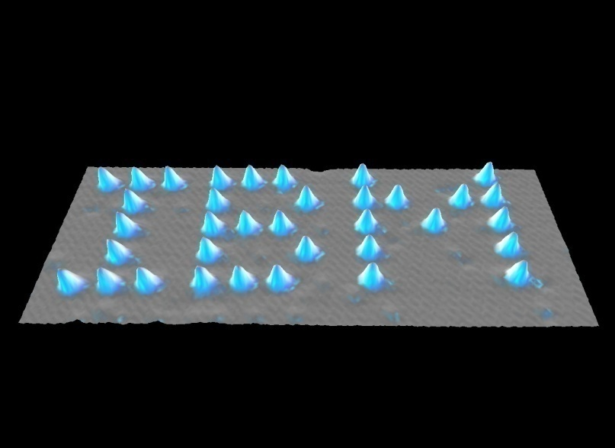
Sheer number of chemicals will become truly daunting
OSHA has 40 year-old standards for 600 chemicals
62,526,489 chemical sequences, Chemical Abstract Service on 02/23/11
112 known elements
10²⁰⁰ to 10⁹⁰⁰ distinct nanoscale particle possibilities
Scanning tunneling image of gold atoms
Writing with atoms (Eigler, 1990)
Notes:
Scanning tunneling microscope (STM) false-color image of two gold atoms on an insulating NaCl film surface. The atom on the left-hand side has been intentionally transferred from its neutral state into a negatively charged ion by means of STM manipulation.
OSHA has 40 year-old standards for 600 chemicals.
37,966,182 organic and inorganic substances, Chemical Abstract Service on 09/18/2008
112 known elements
10²⁰⁰ to 10⁹⁰⁰ distinct nanoscale particle possibilities
Writing with atoms. D.M. Eigler, E.K. Schweizer. Positioning single atoms with a scanning tunneling microscope. Nature 344, 524-526 (1990).

Slide 40
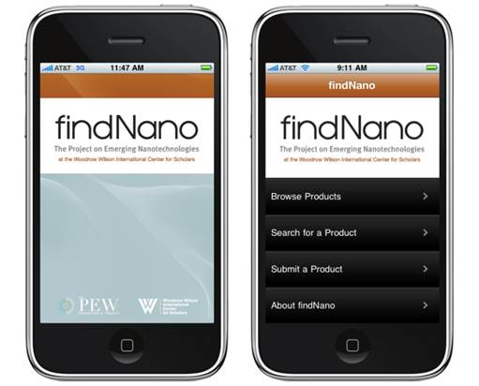
Is it too soon to talk Hazcom for Nano?
Over 1,300 consumer products listed on the Project on Emerging Nanotechnologies website
http://nanotechproject.org
Notes:
Trainer Notes:
Is it too soon to talk Hazcom for Nano?
Over 1,300 consumer products listed on the Project on Emerging Nanotechnologies website
[Point out that this image is an app for the iPhone that allows checking for specific nano products on the Wilson Center website.]

Slide 41


Wilson Center has 1317 products, produced by companies located in 30 countries (03-10-11)
Notes:
Trainer Notes:
This is the most complete database of consumer products. The criterion they used:
1) Readily purchased by consumers
2) Identified as nano-based by the manufacturer OR another source, and
3) The nano-based claims for the product appear reasonable.
As of 3-10-11, there were 1,317 products in this database.

Slide 42
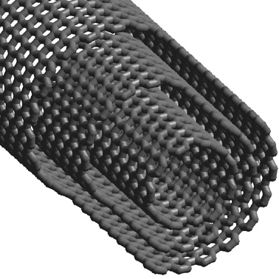
SDS for Multi-walled Carbon Nanotubes, Section 11 Toxicology
“To the best of our knowledge the chemical, physical, and toxicological properties have not been thoroughly investigated.”
Is this language helpful?
Cambridge University,
Department of Metallurgy
Notes:
Note that section 11 says: “May be harmful if absorbed through the skin or swallowed. To the best of our knowledge the chemical, physical, and toxicological properties have not been thoroughly investigated.”
Refreshingly honest, but is it helpful?
Must the toxicology be thoroughly investigated to warn of possibly greater risk?

Slide 43
Lippy Group reviewed NIOSH collection of nano SDSs
N = 49 SDSs
Reviewed all of the SDSs
33% did NOT identify the nano component
52% did NOT have any cautionary language
  Large surface area in relation to particle size enhance physical and chemical properties (nanosilver)
Notes:
Trainer Notes:
Lippy Group reviewed NIOSH collection of nano SDSs
N = 49 SDSs
Reviewed all of the SDSs
33% did NOT identify the nano component
52% did NOT have any cautionary language
Large surface area in relation to particle size enhance physical and chemical properties (nanosilver)

Slide 44
NIOSH just completed a review of SDSs C. Crawford, L. Hodson, and C. Geraci, 2011, AIHce Poster
A total of 29 updated SDSs were reviewed from 22 manufacturers of engineered nanomaterials.
The review revealed that only 5 had improved compared to the 2007-08 versions.
  21 of the 29 (72%) were ranked as not having any significant improvement.
  3 of the 29 (10%) had not changed anything (including the date) since the original NIOSH study.
  Lack of recent toxicological data was main deficiency
Notes:
Trainer Notes:
NIOSH just completed a review of SDSs C. Crawford, L. Hodson, and C. Geraci, 2011, AIHce Poster
A total of 29 updated SDSs were reviewed from 22 manufacturers of engineered nanomaterials.
The review revealed that only 5 had improved compared to the 2007-08 versions.
21 of the 29 (72%) were ranked as not having any significant improvement.
3 of the 29 (10%) had not changed anything (including the date) since the original NIOSH study.
Lack of recent toxicological data was main deficiency

Slide 45
NIOSH looked at 26 new SDSs from 19 manufacturers
15 (58%) contained OELs for the bulk material without providing guidance that the OEL may not be protective for the nanoscale material.
18 (69%) of the 26 new SDSs were classified as in need of serious improvement and
None were classified as good
Notes:
Trainer Notes:
NIOSH looked at 26 new MSDSs from 19 manufacturers
15 (58%) contained OELs for the bulk material without providing guidance that the OEL may not be protective for the nanoscale material.
18 (69%) of the 26 new SDSs were classified as in need of serious improvement and
None were classified as good

Slide 46
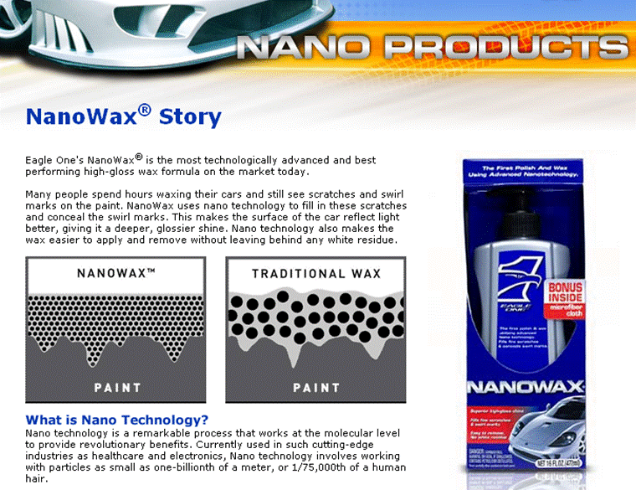
Example SDS: NanoWax
Notes:
Here is another example: a product called NanoWax. The finer particles apparently fill in scratches and swirl marks in the paint and reflect light better. I don’t wash my car, so I can’t vouch for this product.

Slide 47
NanoWax SDS
Section 8: Exposure Controls/PPE
WAX EMULSION: No exposure limits established (NLE)
ALIPHATIC PETROLEUM DISTILLATES (64741-66-8): NLE
ALUMINUM SILICATE (66402-68-4): NLE
POLY(DIMETHYLSILOXANE) (63148-62-9): NLE
ALKYL QUATERNARY AMMONIUM BENTONITE (68953-58-2) : NLE
TETRAGLYCERYL MONOOLEATE (9007-48-1): NLE
GLYCOL (107-21-1)
OSHA PEL 50 ppm - Ceiling
ACGIH TLV 100 mg/m3 - Ceiling as an aerosol
No indication which component is nano-sized. Is it important in this application?
Notes:
Trainer Notes:
If we look at the chemicals in the product, there is no indication which component is nano-sized. I have highlighted aluminum silicate as a likely candidate.
SECTION 8: EXPOSURE CONTROLS/PERSONAL PROTECTION
WAX EMULSION: No exposure limits established (NLE)
ALIPHATIC PETROLEUM DISTILLATES (64741-66-8): NLE
ALUMINUM SILICATE (66402-68-4): NLE
POLY(DIMETHYLSILOXANE) (63148-62-9): NLE
ALKYL QUATERNARY AMMONIUM BENTONITE (68953-58-2) : NLE
TETRAGLYCERYL MONOOLEATE (9007-48-1): NLE
GLYCOL (107-21-1)
OSHA VPEL 50.000 ppm - Ceiling
ACGIH TLV 100.000 mg/m3 - Ceiling as an aerosol
No indication which component is nano-sized. Is it important in this application? I assume the aluminum silicate, but since I never seem to wash my car, I don’t know.

Slide 48
Lippy Group reviewed the use
62% used OSHA Permissible Exposure Limits or ACGIH TLVs for “macro” sized material
32% percent indicated nothing
Only 6% used conditional language about using PELs/TLVs
Notes:
Trainer Notes:
Lippy Group MSDS Review
Use of Occupational Exposure Limits
62% used OSHA Permissible Exposure Limits or ACGIH TLVs for “macro” sized material
32% percent indicated nothing
Only 6% used conditional language about using PELs/TLVs

Slide 49
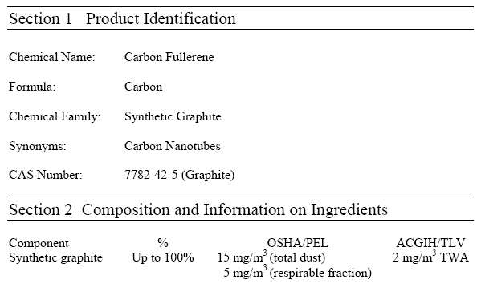
SDS for Carbon Nanotube
“Nuisance” dust standard for synthetic graphite:
15 mg/m³
Notes:
Trainer Notes:
SDS for a carbon nanotube has a PEL of 15 mg/m³ , but NIOSH recommends 0.007 mg/m³

Slide 50
“The MSDSs for carbon nanotubes treat these substances as graphite…but carbon nanotubes are as similar to pencil lead as the soot on my barbeque grill at home is to diamonds.”
Andrew Maynard, University of Michigan Risk Science Center

Slide 51
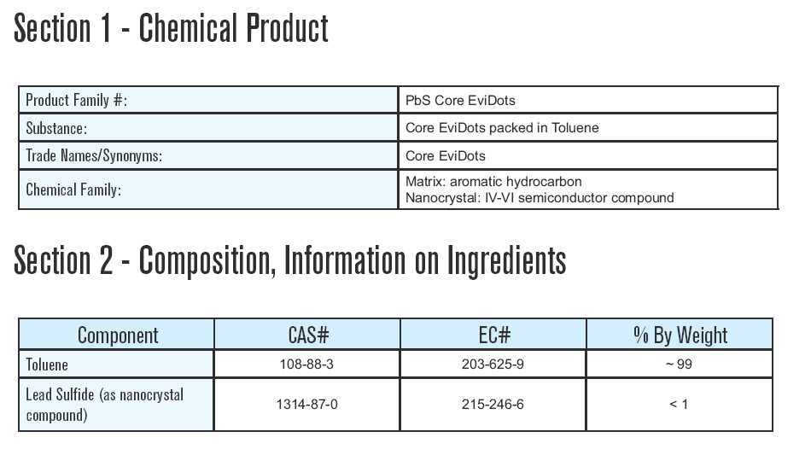
This MSDS for quantum dots of lead sulfide focuses on toluene

Slide 52
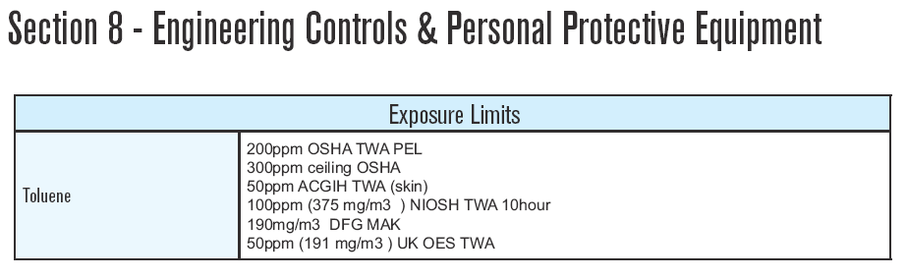
Exposure limit is for toluene, with nothing about PbS dots

Slide 53
Nano language suggested by Dan Levine, Hazcom Expert
(PSS, 9-15-2006)
“Established exposure values do not address the small size of particles found in this product and may not provide adequate protection against occupational exposures.”
Notes:
Trainer Notes:
Here is a suggestion of language from Dan Levine, a Hazcom expert with PSS.
“Established exposure values do not address the small size of particles found in this product and may not provide adequate protection against occupational exposures.”

Slide 54
Nano SDS group exercise
Examine the SDS you are given and determine whether it contains the following:
Identification of nanoscale component?
Cautionary language due to nanoscale component?
PEL or TLV? For which component?
Personal protective equipment?
Engineering controls?
Identification of safety concerns such as flammability or explosivity?
Notes:
Trainer Notes:
[If possible, provide each group a safety data sheet for a different nanoproduct. Ask the group to answer these questions and be prepared to report back to the larger group.]

Slide 55
Learning Objectives
At the end of this module, you will be able to:
Explain the difference between risk and hazard
Explain the standard definition of risk in terms of probability and severity
Explain control banding and give a nanoparticle example
Describe the limitations of the current Hazard Communication efforts around engineered nanoparticles

Slide 56
Questions or Comments?

