Slide 1
Module 6: Regulations and Standards Relevant to Nanomaterial Workplaces Introduction to Nanomaterials and Occupational Health Kristen M .Kulinowski, Ph.D.
8-Hour Training Course
Notes:
Trainer Notes:

Slide 2
Eight-Hour Training Course
Module 1 | Introduction to Nanotechnology and Nanomaterials
Module 2 | What Workers Need to Know about Nanomaterial Toxicology and Environmental Impacts
Module 3 | Assessing Exposure to Nanomaterials in the Workplace
Module 4 | Controlling Exposure to Nanomaterials
LUNCH
Module 5 | Risk Management Approaches for Nanomaterial Workplaces
Module 6 | Regulations and Standards Relevant to Nanomaterial Workplaces
Module 7 | Tools and Resources for Further Study
Notes:
Trainer Notes:
Explain where the current module fits within the full eight-hour course, where appropriate. If this module is being offered as a standalone training, you can modify or hide the slide or use it to describe the other available modules.

Slide 3
Lesson Overview
Purpose
To provide workers with introductory information about OSHA and other standards and regulations relevant for nanomaterial workplaces
Topics
Your rights under the Occupational Safety and Health Act (OSH Act)
Relevant statutes and recent actions taken by EPA
Standards developed for nanomaterial handling
Notes:
Trainer Notes:

Slide 4
Learning Objectives
At the end of this module you should be able to
State your rights under the OSH Act
Articulate which OSHA standards apply to nanomaterial workplaces
Articulate other regulations and standards that are applicable to nanomaterial workplaces
Notes:
Trainer Notes:
Review these objectives with the class and explain that you will return to them at the end of the module to see if the learning objectives have been achieved. You can also post them on a flipchart or repeat this slide as you move between Topics to indicate where you are in the timeline of the module if desired.

Slide 5
Your rights under the Occupational Safety and Health Act (OSH Act)
Topic 1

Slide 6

History of OSHA
OSHA stands for the Occupational Safety and Health Administration, an agency of the U.S. Department of Labor
OSHA’s responsibility is worker safety and health protection
On December 29, 1970, President Nixon signed the OSH Act
This Act created OSHA, the agency, which formally came into being on April 28, 1971
Notes:
Trainer Notes:
Credit: This slide was adapted from a presentation of the Directorate of Training and Education, OSHA Training Institute,
Introduction_to_OSHA_presentation.ppt available at http://www.osha.gov/dte/outreach/construction_generalindustry/teachingaids.html

Slide 7
Applicable OSHA Standards
Occupational Safety and Health Act of 1970 (29 U.S.C. 654)
General Duty Clause Section 5(a)(1) requires employers to “furnish to each of his employees employment and a place of employment which are free from recognized hazards that are causing or are likely to cause death or serious physical harm to his employees.”
Section 5(a)(2) requires employers to "comply with occupational safety and health standards" promulgated under this Act.
Notes:
Trainer Notes:
This content is taken directly from OSHA website.
The OSH Act provides a general right of protection for all regulated workplaces even where no specific standards have been published.

Slide 8
What Rights Do You Have Under OSHA?
You have the right to:
A safe and healthful workplace
Know about hazardous chemicals
Information about injuries and illnesses in your workplace
Complain or request hazard correction from employer
Training
Hazard exposure and medical records
File a complaint with OSHA
Participate in an OSHA inspection
Be free from retaliation for exercising safety and health rights
Notes:
Trainer Notes:
Briefly mention these items and ask the audience if they had been made aware of their rights prior to the class.
This course is not meant to be a comprehensive Intro to OSHA training, so we’ll focus on a few issues of special importance for nanomaterial workplaces, in particular the Right to Know about Hazardous Chemicals.
Credit: This slide was adapted from a presentation of the Directorate of Training and Education, OSHA Training Institute,
Introduction_to_OSHA_presentation.ppt available at http://www.osha.gov/dte/outreach/construction_generalindustry/teachingaids.html

Slide 9
Who is Covered?
Covered by OSH Act
Private-sector employees and employers
US Postal Service
Protected via State plans
Certain State and local government workers (in State programs)
Federal government workers *
Not Covered
Self-employed
Certain farm workers
Workers covered by another Federal agency
MSHA
FAA
Coast Guard, etc.
Notes:
Trainer Notes:
This content is taken directly from OSHA website; you need not cover all this detail but it could be helpful for answering questions.
Most employees in the nation come under OSHA's jurisdiction. OSHA covers private sector employers and employees in all 50 states, the District of Columbia, and other U.S. jurisdictions either directly through Federal OSHA or through an OSHA-approved state program. State-run health and safety programs must be at least as effective as the Federal OSHA program.
State and Local Government Workers Employees who work for state and local governments are not covered by Federal OSHA, but have OSH Act protections if they work in a state that has an OSHA-approved state program. Four additional states and one U.S. territory have OSHA approved plans that cover public sector employees only. This includes: Connecticut, Illinois, New Jersey, New York, and the Virgin Islands. Private sector workers in these four states and the Virgin Islands are covered by Federal OSHA.
Federal Government Workers Federal agencies must have a safety and health program that meet the same standards as private employers. Although OSHA does not fine federal agencies, it does monitor federal agencies and responds to workers' complaints. The United States Postal Service (USPS) is covered by OSHA.
Who is not covered by the OSH Act:
Self-employed;
Immediate family members of farm employers that do not employ outside employees; and
Workers who are protected by another Federal agency (for example, the Mine Safety and Health Administration, the Federal Aviation Administration, the Coast Guard).

Slide 10
States with approved State Plans
Alaska
Arizona
California
Connecticut *
Hawaii
Illinois
Indiana
Iowa
Kentucky
Maryland
Michigan
Minnesota
Nevada
New Jersey *
New Mexico
New York
North Carolina
Oregon
Puerto Rico
South Carolina
Tennessee
Utah
Vermont
Virgin Islands *
Virginia
Washington
Wyoming
*These plans cover public sector (State & local government) employment only.
Notes:
Trainer Notes:
This content is taken directly from OSHA website; you need not cover all this detail but it could be helpful for answering questions.
Twenty-four states, Puerto Rico and the Virgin Islands have OSHA-approved State Plans and have adopted their own standards and enforcement policies. For the most part, these States adopt standards that are identical to Federal OSHA. However, some States have adopted different standards applicable to this topic or may have different enforcement policies.
OSHA approves and monitors State plans and provides up to 50 percent of an approved plan's operating costs. States must set job safety and health standards that are "at least as effective as" comparable federal standards. (Most States adopt standards identical to federal ones.) States have the option to promulgate standards covering hazards not addressed by federal standards.

Slide 11
Is This Worker Protected by OSHA?
Covered by OSHA? | Worker
YES NO | Harry Adams, a miner at Below Ground Inc.
YES NO | Juan Ramírez, one of 3 employees of ABC landscaping.
YES NO | Taylor Ostrowski, an accountant in business for herself.
YES NO | Rob LaFollette, one of 10 carpenters working for Woody, Inc.
Notes:
Trainer Notes:
No. Harry Adams is covered by the Mine Safety and Health Administration
Yes. Juan is an employee of a private sector employer
No. Taylor is self-employed
Yes. Rob is an employee of a private sector employer
Credit: This slide was adapted from a presentation of the Directorate of Training and Education, OSHA Training Institute,
Introduction_to_OSHA_presentation.ppt available at http://www.osha.gov/dte/outreach/construction_generalindustry/teachingaids.html

Slide 12
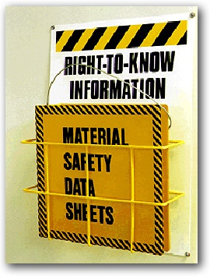
Your Right to Know about Hazardous Chemicals
Employers must have a written, complete hazard communication program that includes information on:
Container labeling,
Material Safety Data Sheets (MSDSs), and
Worker training. The training must include the physical and health hazards of the chemicals and how workers can protect themselves; including specific procedures the employer has implemented to protect workers, such as work practices, emergency procedures, and personal protective equipment.
Notes:
Trainer Notes:
Credit: This slide was adapted from a presentation of the Directorate of Training and Education, OSHA Training Institute,
Introduction_to_OSHA_presentation.ppt available at http://www.osha.gov/dte/outreach/construction_generalindustry/teachingaids.html

Slide 13
OSHA-Identified Nanomaterial Stds
1904, Recording and reporting occupational injuries and illness
1910.132, Personal protective equipment, general requirement
1910.133, Eye and face protection
1910.134, Respiratory protection
1910.138, Hand protection
1910.141, Sanitation
1910.1200, Hazard communication
1910.1450, Occupational exposure to hazardous chemicals in laboratories
Certain substance-specific standards (e.g., 1910.1027, Cadmium)
Notes:
Trainer Notes:
This content is taken directly from OSHA website: http://www.osha.gov/dsg/nanotechnology/nanotech_standards.html
The following are examples of standards that may be applicable in situations where employees are exposed to nanomaterials. As you can see none of these is specific to nanomaterials but all are applicable to workplaces where hazardous substances may be present. The subject-specific standards may be applicable to nanoscale forms of the materials covered in the standard. E.g., 1910.1027, Cadmium, may apply where cadmium selenide quantum dots (nanoparticles) are handled.

Slide 14
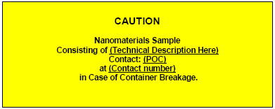
Container Labels
Containers should indicate that the contents contain nanomaterials
There is no OSHA standard for nanomaterial container labels
A simple label can alert others to the presence of a substance of known or uncertain toxicity.
Notes:
Trainer Notes:
Containers should be labeled to indicate that the contents contain nanomaterials. This alerts others to the presence of a substance that may require special handling or have unknown toxicity.
Technical Description = chemical substance e.g., carbon nanotubes, nano-titania (rutile), poly(ethylene glycol)-coated gold-silica nanoshells
POC = Point of Contact
Contact Number = Telephone number of POC
This sample label was created by the Center for High-Rate Nanomanufacturing in its document, “Interim Best Practices for Working with Nanoparticles”

Slide 15
The environmental protection agency
Topic 2
Notes:
Trainer Notes:

Slide 16
Environmental Protection Agency
Statute | Acronym | Topic
Toxic Substances Control Act | TSCA | chemical substances
Federal Insecticide, Fungicide, and Rodenticide Act | FIFRA | pesticides
Clean Air Act | CAA | air pollutants
Clean Water Act | CWA | discharge of pollutants into the navigable waters
Comprehensive Environmental Response, Compensation and Liability Act | CERCLA | uncontrolled releases of hazardous materials
Resource Conservation and Recovery Act | RCRA | solid or hazardous waste
Notes:
Trainer Notes:
EPA has invested the most time and effort to date in understanding the impact of nanomaterials on the agency’s enforcement of the Toxic Substances Control Act (TSCA, “tosca”) and the Federal Insecticide, Fungicide and Rodenticide Act (FIFRA). Other statutes may come into play in the future.
We’ll take a look at TSCA first. Under TSCA, EPA can require manufacturers, processors and importers of chemical substances to notify EPA prior to engaging in commercial activity. EPA can then impose mandatory reporting and testing requirements and can limit the production or use of those substances. TSCA has both testing and reporting requirements for toxic substances that may impact nanomaterial commerce.

Slide 17
Some Branches on TSCA Decision Tree
Is it a chemical substance; i.e., does it have a particular molecular identity?
Is it already listed on the TSCA inventory in a non-nanoscale form?
Is it exempt because it is an intermediate, impurity, or produced in very low volume?
Notes:
Trainer Notes:
The TSCA regulatory process is complex and this is not meant to be an exhaustive compliance course. However, even cursory examination of the TSCA reporting criteria reveals that nanoscale materials are not explicitly accounted for. Each of these three questions reveals regulatory gaps through which nanoscale materials could fall.

Slide 18
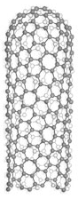
Substances EPA Recognizes as Distinct
Notes:
Trainer Notes:
Regarding the first two decision points, here are several examples of substances that bear similarity to one another but are considered by EPA to have distinct “particular molecular identities”
Substances with different molecular formulas (ethane and propane)
Isomers, or substances with the same molecular formula but a different way of bonding the atoms to each other (n-butanol and 2-butanol)
Substances with the same molecular formula but different crystal structures (shown here are anatase and rutile titanium dioxide)
Allotropes, or variants of a substance consisting of only one atom (note that the carbon nanotube on the left *is* considered to be a distinct substance from diamond and graphite, two other allotropes of carbon)

Slide 19
Substances Defined to be the Same
“Although a nanoscale substance … differs in particle size and may differ in certain physical and/or chemical properties, EPA considers the two forms to be the same chemical substance because they have the same molecular identity.”
What It Is
What It Does
Notes:
Trainer Notes:
Now see how the strict interpretation of the definition of “particular identity” results in nanoscale materials being considered the same as their conventional analogs.
A single C₆₀ molecule is considered the same as a nanoscale aggregate (or crystal) of buckyballs. [There is research that shows differential toxicity of these two forms.]
A nanoscale titanium dioxide powder is considered the same as the relatively benign microscale form. [There is research that shows differential toxicity of these two forms.]
The quote is taken from a 2007 statement made by EPA clarifying its position that the size of the substance is not enough to override the strict interpretation of “molecular identity.” Because microscale titanium dioxide is generally recognized as safe in many applications, including being used as a whitening agent in milkshakes, yogurt and toothpaste, the nanoscale form gets a pass because it has the same molecular identity.
In essence, this statement clarified EPA’s approach as continuing to look at a nanoscale material on the basis of What It Is (chemical composition) rather than basing its regulatory decision making on What It Does (i.e., its physical and chemical properties, toxicity, environmental impacts)

Slide 20
Low-Volume Exemption (LVE)
Is it exempt because it is an intermediate, impurity, or produced in very low volume?
Many nanoscale substances could qualify for an exemption from TSCA reporting and testing requirements if less than 10,000 kg/yr are sold.
Notes:
Trainer Notes:
The other loophole in TSCA is the Low-volume exemption. Substances may be exempt from TSCA reporting and testing requirements if less than 10,000 kg/year are produced.
Some nanoscale materials may be extremely active at very low concentrations as a result of their small size and large surface area-to-volume ratio. Therefore, the appropriateness of this exemption may need to be examined on a case-by-case basis.

Slide 21
Recent Actions taken by EPA (2010)
Designates any use of nanoscale substance as a Significant New Use, which would require 90-day pre-commerce notification (PROPOSED)
Requires companies to report production volume, methods of manufacture and processing, exposure and release information, and available health and safety data (PROPOSED)
Requires manufacturers to conduct testing for health effects, ecological effects, and environmental fate, as well as to provide material characterization data on certain multiwall carbon nanotubes, and nanoscale clays and alumina (PROPOSED)
Notes:
Trainer Notes:
The strict 2007 interpretation of molecular identity is being challenged by EPA in light of the toxicity and environmental impact data. In three proposals released in Fall 2010, EPA signaled its intention to approach regulation of nanoscale materials under TSCA in a new way. Each proposal has been subject to criticism by industry as being unnecessarily burdensome and awaits final approval.
The first rule proposes to designate all nanoscale materials as significant new uses of their non-nanoscale analogs. Significant new uses can be subject to the same restrictions and reporting and testing requirements as new substances. A manufacturer or importer must file a pre-manufacturing notice on each nanoscale material 90 days before commercial activity. This effectively sidesteps the issue of whether a nanoscale material is a new chemical substance and permits EPA to require pre-market testing or submission of other data.
Separate from the issue of whether nanoscale materials are designated as significant new uses, EPA is proposing to amend the reporting requirements under TSCA to require companies to report production volume, methods of manufacture and processing, exposure and release information, and available health and safety data for certain nanoscale materials.
EPA is proposing a test rule to require manufacturers, importers and processors of certain multiwall carbon nanotubes, and nanoscale clays and alumina to conduct health and safety testing.
IMPLICATIONS FOR WORKERS: The federal government’s lead agency for regulating toxic substances has begun to scrutinize nanoscale materials more closely and is beginning to impose testing and reporting requirements that impact nanomaterial workplaces. In particular, EPA has indicated that the employer in workplaces that handle certain nanoscale materials, such as multiwall carbon nanotubes, must provide personal protective equipment and other appropriate engineering controls to safeguard the health and safety of its workers.

Slide 22
Requirements EPA Has Imposed
For certain multiwall carbon nanotubes
Use gloves impervious to nanoscale particles and chemical protective clothing;
Use a NIOSH–approved full-face respirator with an N -100 cartridge while exposed by inhalation in the work area
Distribute the … substance only to a person who agrees to follow the same restrictions
Siloxane modified silica nanoparticles
use with impervious gloves or a NIOSH-approved respirator with an APF of at least 10
Notes:
Trainer Notes:
Details:
These respirators meet the requirements for handling ailoxane modified silica and alumina nanoparticles:
Air-purifying, tight-fitting respirator equipped with N100 (if oil aerosols absent), R100, or P100 filters (either half- or full-face); powered air-purifying respirator equipped with a loose-fitting hood or helmet and High Efficiency Particulate Air (HEPA) filters; powered air-purifying respirator equipped with a tight-fitting facepiece (either half- or full-face) and HEPA filters; supplied-air respirator operated in pressure demand or continuous flow mode and equipped with a hood or helmet, or tight-fitting facepiece (either half- or full-face).
Sources:
MWNT: Consent Order issued in regard to PMN Number P-08-0177
Siloxane modified silica nanoparticles: SNUR issues in regard to PMN Number P–05–673
Siloxane modified alumina nanoparticles: SNUR issues in regard to PMN Number P–05–687

Slide 23

Federal Insecticide, Fungicide and Rodenticide Act (FIFRA)
EPA requires a manufacturer to register a product as a pesticide if that product incorporates a substance intended to destroy pests, including microbes.
E. coli, http://www.lukejerram.com/
Notes:
Trainer Notes:
The next three slides can be omitted without loss of module integrity. They describe actions taken by EPA to limit environmental exposure to a known environmental toxicant, silver. If your course is tightly focused on worker safety, or time is tight, feel free to skip ahead. Otherwise, this makes an interesting anecdote. To skip these slides, either delete them from the document or go into Slide Sorter view, right-click on the slides and choose Hide. The latter will keep the slides in the document but not show them during the Slide Show.
The other statute for which EPA has taken action on nanomaterials is the FIFRA (or pesticide act). In everyday language a pesticide is something that kills cockroaches,
ants, mosquitoes and other nuisance pests. In addition to insects the word ‘pest’ in EPA jargon includes another class of ‘bugs’: microbes. Therefore, any product that claims to kill bacteria, viruses, fungi or other unwanted microbes, is classified as a pesticide or pest control device by the EPA. A product that uses physical or mechanical means to control a pest is a pest control device (e.g., untreated flypaper and UV light disinfection systems) and does not require registration under FIFRA but if it uses a substance to control pests then it is a pesticide and must be registered if it makes a pesticidal claim.

Slide 24


Pesticidal Device or Pesticide?
Notes:
Trainer Notes:
Background:
Silver has been known to be a potent antimicrobial device for millennia. Silver is also highly toxic to many forms of animal life (though not as much to humans); therefore, EPA enforces limits on the release of silver into the natural environment.
Ionic silver (Ag⁺) and nanosilver are being incorporated into an increasing number of household products and sporting goods to make them “germ-free”. These include food storage containers, socks and underwear, disinfectant spray products, toothpastes and others. The rise of silver use in consumer products has led to increased concerns over the release of silver in the environment.
Case Study:
The manufacturer of a new washing machine began marketing its products as superior to conventional machines on the basis that the silver ions released during the wash cycle would actively kill odor-causing bacteria. Clothes can be cleaned at lower water temperature, thereby saving energy, and with less detergent. Moreover, the company claimed that the silver residue left on the fabrics would extend the antibacterial action for up to one month post-wash.
In 2005 EPA made a decision to classify the washing machine as a pesticidal device due to the antibacterial claim made by the manufacturer. This permitted the machine to be sold without further regulation. Several waste water treatment plant operators joined together to petition EPA to reclassify the machine as a pesticide.
Questions:
Why would waste water treatment plant operators care about silver washing machines? Silver is a regulated component of treatment plant effluent. Plant operators are responsible to keep their effluents (liquid) and sludge (solid) releases within federal standards for a variety of toxic substances, including silver. Excess releases of silver from washing machine discharges could result in fines or increased costs to remove the silver. Bonus: Waste treatment plants rely on microbes to digest raw sewage so excess silver could potentially disrupt or deactivate the bacterial workforce within the plant.
What is the technical basis for the waste water treatment plant operators’ petition? The plant owners argued that silver is a substance. Therefore the mechanism of action was not merely physical or mechanical.
What do you think EPA did in response to the petition? In 2007 EPA reclassified the machine as a pesticide and requested information from the manufacturer about the potential impact of the machine on silver levels in the waste treatment system.
Additional Facts:
One source estimates the global production of nanosilver to be 500,000 kg per year.
This real-life case was reported as the first case of federal regulation of a nanomaterial because the product had the word “nano” in its name and the manufacturer’s marketing materials mentioned nanosilver as the active agent. In all likelihood these are simply garden variety silver ions released via electrolysis of a silver metal block.

Slide 25
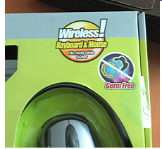

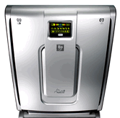
Other EPA Actions on NanoSilver
$208,000 Fine
Suit Filed; Claim removed
$82,400 Fine
Notes:
Trainer Notes:
EPA has taken several other definitive actions against products of nanotechnology that make antimicrobial claims. Without exception the fines were a result of failing to register the products with the EPA prior to promoting them with the antimicrobial claims.
Left: EPA fines ATEN Technology, Inc. $208,000 for failure to register antimicrobial computer products including computer-mouse keyboard combinations that claimed to be “germ-free” [Feb 2008]
Center: EPA files suit against VF Corporation (owner of North Face brand) for failing to register dozens of products containing the AgION antimicrobial foot bed liner [Sept 2009]
Right: EPA fines Kinetic Solutions Inc for failing to register its Rabbit Air air purifiers which tout the use of “Nano-Silver Sterilization - Features a Nano-Silver pre-filter to help kill airborne bacteria, mold and viruses.” [Dec 2010]
Bottom line: If you make an antimicrobial claim, regardless of whether there’s nanotechnology involved or not, you’d better register your product with the EPA.
Additional Facts:
If the manufacturers had not made the antimicrobial claim, the products would not have required registration! Of course, that would take away much of their alleged added value but this highlights a weakness of FIFRA.

Slide 26
Regulatory Activity at the State and Local Levels
Topic 3

Slide 27

States Begin to Fill Regulatory Vacuum
States are “laboratories of democracy”
State regulations may be more stringent than federal
State regulations can fill gaps where federal law is silent
Areas where States may act (have acted)
Disclosure laws
Adopt standards as law
Engage stakeholders to a greater degree
Establish regional initiatives
Full report at http://www.nanotechproject.org/process/assets/files/6112/pen11_keiner.pdf

Slide 28
City of Berkeley Issues Disclosure Rule
“All facilities that manufacture or use manufactured nanoparticles shall submit a separate written disclosure of the current toxicology of the materials reported, to the extent known, and how the facility will safely handle, monitor, contain, dispose, track inventory, prevent releases and mitigate such materials.” December 2006
"This actually is a groundbreaking ordinance. The EPA and the federal government have basically not looked at nano particles."
Berkeley Mayor Tom Bates

Slide 29

State of CA Data Call-Ins
2009
Call-In for CNTs Issued
Fate and transport in the environment
Other relevant information
Deadline for CNT reporting
Analytical test methods
2010
New call-in issued to 49 companies and universities for nano silver, nano zero valent iron, nano TiO₂, nano CeO₂, nano ZnO, quantum dots
22 companies and universities responded
Analytical test methods in environmental matrices
2006
Assembly Bill (AB) 289 passed; amends Health and Safety Code, Chapter 699, sections 57018-57020
Intended to make relevant information on the fate and transport, analysis, and other information on chemicals more available, and to fill information gaps where necessary
Notes:
http://www.dtsc.ca.gov/PollutionPrevention/Chemical_Call_In.cfm

Slide 30
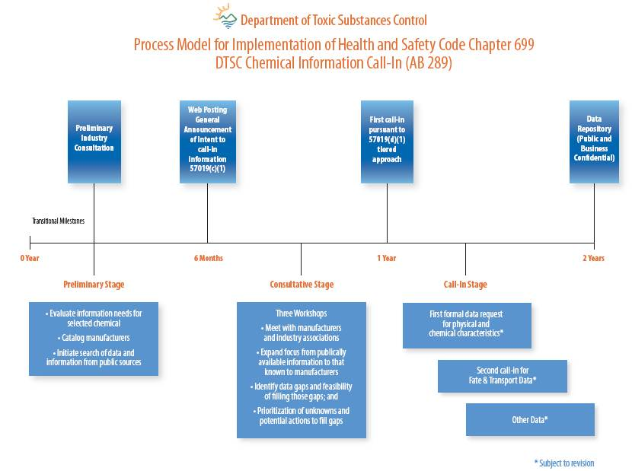

Slide 31


REACH
Registration, Evaluation, Authorization & Restriction of Chemicals
Ensuring a high level of protection of human health
Ensuring a high level of protection of environment
Promotion of alternative test methods
Free circulation of substances on internal market
Enhancing competitiveness and innovation

Slide 32
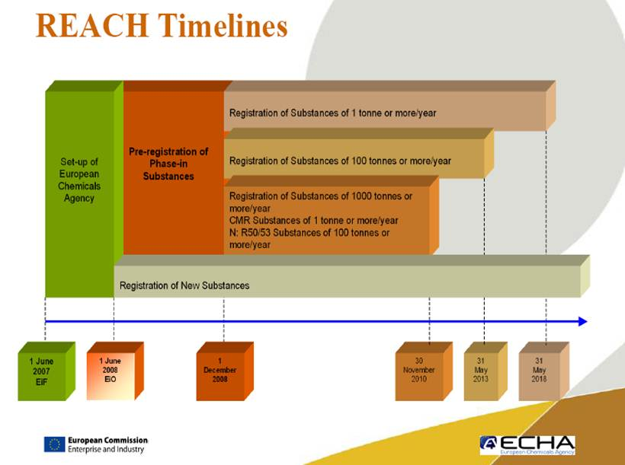

Slide 33
REACH and Nano
Registration threshold ≥ 1 tonne/yr
Applies to total volume even if fraction nano
Restriction and authorization can be applied at lower threshold
Nanomaterials as substance, preparation or contained in an article fall under REACH
Requirements apply to nano even though no specific mention
Methodologies for identifying hazards and evaluating risks of substances at the nano-scale need to be further refined

Slide 34
Standards developed for nanomaterial handling
Topic 4

Slide 35
Voluntary Consensus Standards
Standard Developing Organizations produce standards according to a voluntary consensus process.
The standards are not binding but can be incorporated into regulations or codes.
The standards process can serve as a stop-gap attempt at self-regulation in fast-moving or emerging areas where regulation is not set.
Notes:
Trainer Notes:
Standard developing organizations produce standards via a consensus process. The standards are not binding but can be incorporated into regulations or codes, becoming de facto regulations. Standards often precede the development of regulation because the development process is more rapid. A standard can be developed in as little as 6 months if enough volunteers are willing to write it and guide it through the process.

Slide 36
Other Standards: ISO and ASTM
ASTM E2535-2007: Standard Guide for Handling Unbound Engineered Nanoparticles in Occupational Settings
Practical guidance for reducing unwanted exposure to nanomaterials that could pose an inhalation hazard
ISO/TR 12885:2008 Nanotechnologies—Health and safety practices in occupational settings relevant to nanotechnologies
Review of state of knowledge with general guidance for occupational practice
Notes:
Trainer Notes:
The two most relevant voluntary consensus standards for occupational practice were published by ASTM International and ISO-The International Organization for Standardization
ASTM E2535 focuses on ways to minimize exposure to nanomaterials that have the potential to become aerosolized and inhaled during typical workplace tasks. (Other exposure routes such as dermal contact are not considered.) The document outlines a comprehensive program of occupational hygiene for dealing with nanomaterials for which occupational exposure levels have not yet been established.
Outline:
General Guidance
Materials within Scope: Unbound Engineered Nanoparticles
Principal Elements of a Program to Minimize Exposure
Hazard Assessment and Evaluation
Exposure Assessment and Exposure Risk Evaluation
Exposure Minimization Methods
Exposure Minimization and Handling in Particular Occupational Settings
Responding to Accidental or Unanticipated Releases of UNP
Personal Protective Equipment
Communication of Potential Hazards
ISO created a Technical Committee 229 to create standards for nanotechnologies.
This committee produced a Technical Report ISO/TR 12885 on health and safety practices in 2008.
TR 12885 is more a compilation of known information about safe handling of nanomaterials rather than a hands-on guide. This document relies heavily on NIOSH’s “Approaches to Safe Nanotechnology: An Information Exchange with NIOSH”
Additional Details:
The ASTM standard guide is available for purchase at http://www.ASTM.org by searching for E2535
The ISO standard is available for purchase at http://www.iso.org by searching for 12885

Slide 37
Learning Objectives
At the end of this module you should be able to
State your rights under the OSH Act
Articulate which OSHA standards apply to nanomaterial workplaces
Articulate other regulations and standards that are applicable to nanomaterial workplaces
Notes:
Trainer Notes:
Review these objectives with the class and explain that you will return to them at the end of the module to see if the learning objectives have been achieved. You can also post them on a flipchart or repeat this slide as you move between Topics to indicate where you are in the timeline of the module if desired.

Slide 38
Eight-Hour Training Course
Module 1 | Introduction to Nanotechnology and Nanomaterials
Module 2 | What Workers Need to Know about Nanomaterial Toxicology and Environmental Impacts
Module 3 | Assessing Exposure to Nanomaterials in the Workplace
Module 4 | Controlling Exposure to Nanomaterials
LUNCH
Module 5 | Risk Management Approaches for Nanomaterial Workplaces
Module 6 | Regulations and Standards Relevant to Nanomaterial Workplaces
Module 7 | Tools and Resources for Further Study
Notes:
Trainer Notes:
The information presented today is a snapshot of the current knowledge and understanding of nanomaterial impacts and strategies for occupational management. This knowledge continues to evolve at a rapid pace and specific details presented herein will likely be updated and refined in the coming months and years. Therefore, it is important that you know where to go to get the most up-to-date information you can to keep your knowledge fresh.
The final module in our course will introduce practical tools and resources for you to consult after the course to continue learning about how nanomaterials may impact your workplace.

