Slide 1
8-Hour Training Course
Module 7: Tools and Resources for Further Study
Introduction to Nanomaterials and Occupational Health
Kristen M. Kulinowski, Ph.D.
Notes:
Trainer Notes:

Slide 2
Learning Objectives
At the end of this module you should be able to
Articulate several tools that are available for keeping your knowledge up-to-date
Understand where to find and how to use these tools
Notes:
Trainer Notes:
Review these objectives with the class and explain that you will return to them at the end of the module to see if the learning objectives have been achieved. You can also post them on a flipchart or repeat this slide as you move between Topics to indicate where you are in the timeline of the module if desired.

Slide 3
The GoodNanoGuide
Topic 1

Slide 4
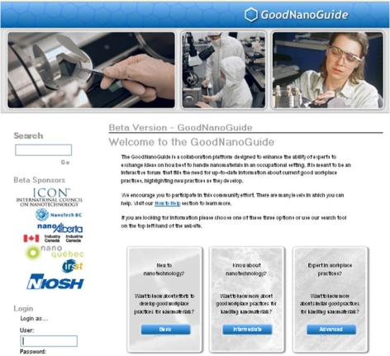
The GoodNanoGuide
http://GoodNanoGuide.org
Protected Internet resource on occupational practices for the safe handling of nanomaterials
Learn best practices
Use interactive information sharing system
See new practices as they are developed
Connect to other key information sources
Community driven; Collaborative

Slide 5
Why a Wiki for Nano Handling Practices?
Features | Guidance Document | Research Paper | Wiki Entry
Describes a specific practice | No | Maybe | YES
Written by practitioners | Maybe | Maybe | YES
Written for practitioners | Maybe | No | YES
Engages global community | No | Maybe | YES
Provides a forum for dialog | No | No | YES
Easily accessed | YES | No | YES

Slide 6
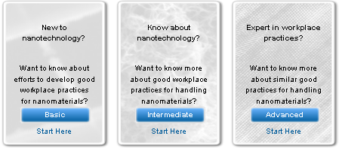
How Content is Organized
Basic
Introduction to Nanotechnology
Nomenclature and Glossary
Intermediate
OHS Reference Manual
Expert
Expert Matrix
Specific Protocols

Slide 7



Interacting with the GoodNanoGuide
No Registration Required
VIEW
Register as a Community Member
COMMENT
Register as an Expert Provider
CONTRIBUTE

Slide 8
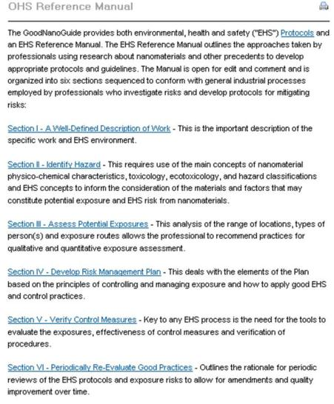
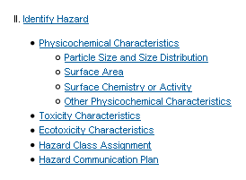
OHS Reference Manual
Intermediate
Notes:
Comprehensive A-Z approach to occupational safety, borrowed largely from DOE NSRC document
Good first place to start for IH professionals not familiar with nano

Slide 9
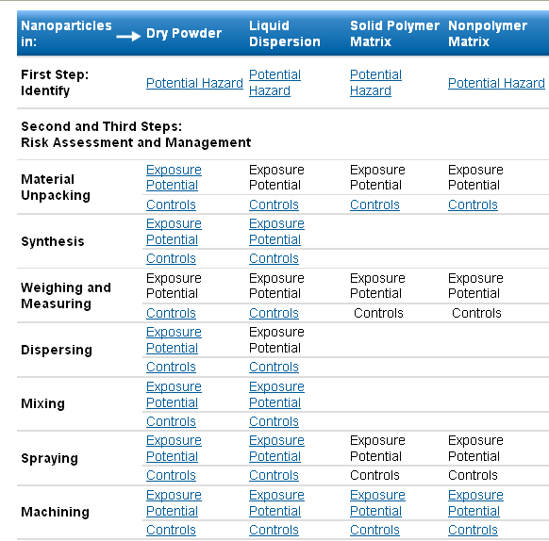
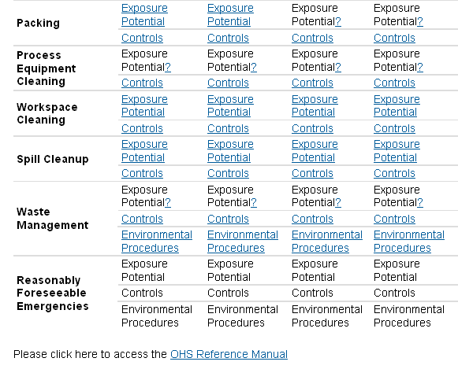
OHS Expert Matrix
Assessment should
Look at the form of the nanoparticle
Consider the entire process
Expert
Notes:
OHS Expert Matrix organizes content into a kind of control banding approach that look at the form of the nanoparticle throughout an entire hypothetical industrial process.

Slide 10
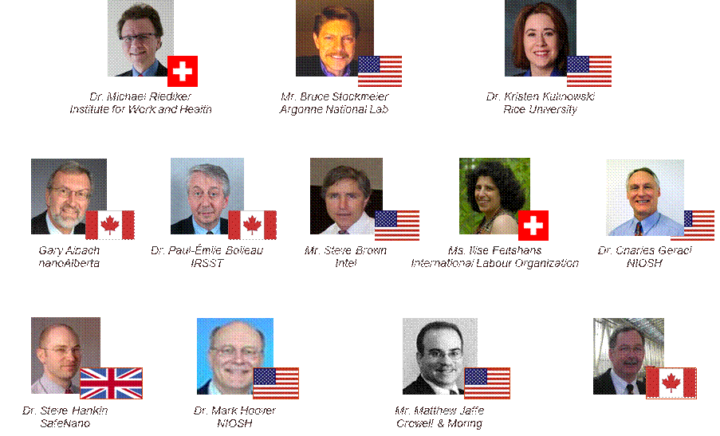
Implementation Committee
Mr. Victor Jones
NanoTechBC

Slide 11
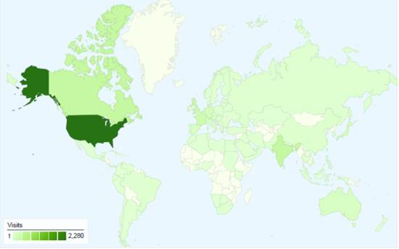
Some Usage Metrics
Country | % of Visits
US | 44%
Canada | 7%
India | 7%
UK | 5%
France | 5%
Germany | 3%
Japan | 2%
Australia | 2%
Spain | 2%
Italy | 2%
700 visits per day; 18,600 page views; 3.62 average page views
4000 unique visitors
100 countries

Slide 12
Sites and Tools Presented so Far
Topic 2

Slide 13
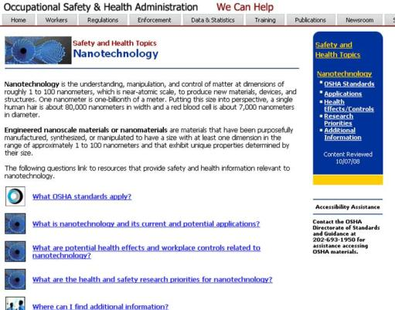
OSHA Nanotechnology Topic Page
http://www.osha.gov/dsg/nanotechnology/nanotechnology.html
What you’ll find here
Relevant OSHA standards
Links to resources on Health Effects and Workplace Assessments and Controls

Slide 14
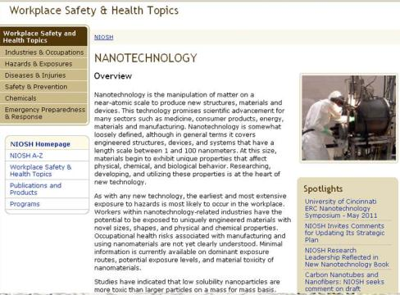
NIOSH Nanotechnology Topic Page
http://www.cdc.gov/niosh/topics/nanotech/default.html
What you’ll find here
Recommendations and Guidance
News on OHS

Slide 15

International Council on Nanotechnology
http://icon.rice.edu
What you’ll find here
News on NanoEHS developments
Virtual Journal of NanoEHS
Industry Survey

Slide 16
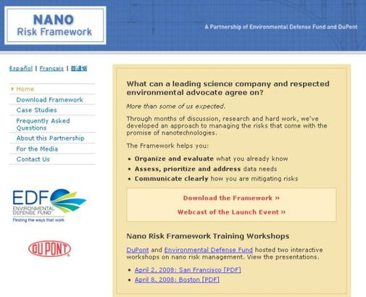
The NanoRisk Framework
http://nanoriskframework.org/
What you’ll find here
The EDF-DuPont framework document
Case Studies

Slide 17
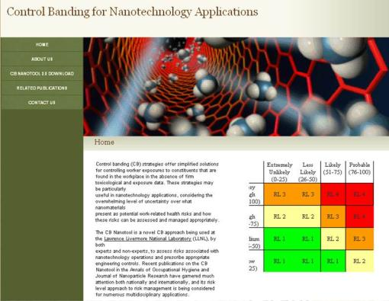
CB Nanotool
http://controlbanding.net/
What you’ll find here
CB Nanotool
Instruction Sheet
Nanomaterial Field Form

Slide 18
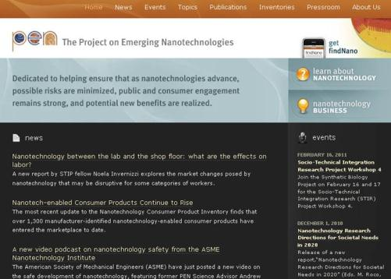
Project on Emerging Nanotechnologies
http://nanotechproject.org/
What you’ll find here
Policy Reports
Consumer Product Inventory

Slide 19
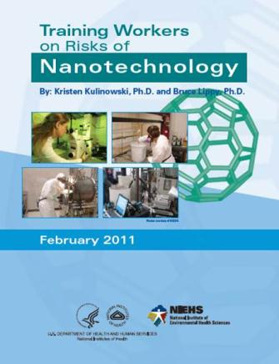
NIEHS Worker Training Document
http://is.gd/NIEHSnano
What you’ll find here
Introductory information on nanotechnology
Guidance for trainers

Slide 20
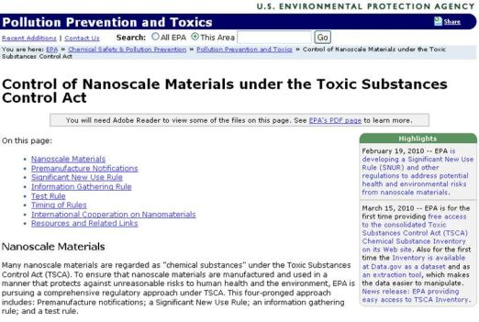
EPA Regulations Relevant to Nanotech
http://www.epa.gov/oppt/nano/;
http://www.epa.gov/pesticides/about/intheworks/nanotechnology.htm
What you’ll find here
Nano and the Toxic Substances act
Nano and the Pesticides act

Slide 21


Standards
http://www.astm.org/Standards/E2535.htm;
http://www.iso.org/iso/catalogue_detail?csnumber=52093
What you’ll find here
ASTM E2535-2007 Standard Guide for Handling Unbound Engineered Nanoscale Particles in Occupational Settings
ISO/TR 12885:2008 Nanotechnologies—Health and safety practices in occupational settings relevant to nanotechnologies

Slide 22
Other Useful Information
Topic 3

Slide 23
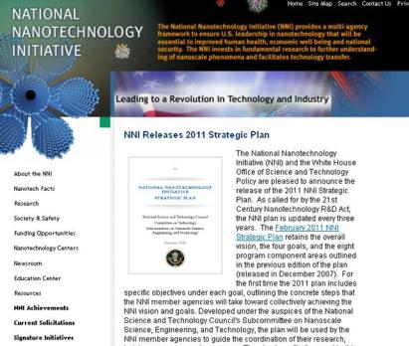
The US National Nanotechnology Initiative
http://nano.gov
What you’ll find here
Nanotech Facts
Occupational Safety Links
Materials for Educators

Slide 24
Learning Objectives
At the end of this module you should be able to
Articulate several tools that are available for keeping your knowledge up-to-date
Understand where to find and how to use these tools
Notes:
Trainer Notes:
Review these objectives with the class and explain that you will return to them at the end of the module to see if the learning objectives have been achieved. You can also post them on a flipchart or repeat this slide as you move between Topics to indicate where you are in the timeline of the module if desired.

Slide 25
Eight-Hour Training Course
Module 1 | Introduction to Nanotechnology and Nanomaterials
Module 2 | What Workers Need to Know about Nanomaterial Toxicology and Environmental Impacts
Module 3 | Assessing Exposure to Nanomaterials in the Workplace
Module 4 | Controlling Exposure to Nanomaterials
LUNCH
Module 5 | Risk Management Approaches for Nanomaterial Workplaces
Module 6 | Regulations and Standards Relevant to Nanomaterial Workplaces
Module 7 | Tools and Resources for Further Study
Notes:
Trainer Notes:
The information presented today is a snapshot of the current knowledge and understanding of nanomaterial impacts and strategies for occupational management. This knowledge continues to evolve at a rapid pace and specific details presented herein will likely be updated and refined in the coming months and years. Therefore, it is important that you know where to go to get the most up-to-date information you can to keep your knowledge fresh.
The final module in our course will introduce practical tools and resources for you to consult after the course to continue learning about how nanomaterials may impact your workplace.

Slide 26
8-Hour Training Course
Course Wrap-Up
Introduction to Nanomaterials and Occupational Health
Notes:
Trainer Notes:

