Slide 1
Susan B. Harwood Grant
Safety and Health in Wind Energy

Slide 2
Course Goals
Identify ten critical processes for building, maintaining and demolishing wind turbines.
Identify the safety and health hazards associated with the ten processes.

Slide 3
Course Goals—continued
Perform a job hazard analysis of your work processes.
Recognize the regulatory standards and requirements relating to your job.

Slide 4
Course Goals—continued
Identify ways to control and eliminate the hazards you find at your worksite.
Recognize and correct obstacles to using safe work practices.

Slide 5
Question 1
What is job hazard analysis?
A tallying of all the hazards found on the job
A technique that focuses on job tasks as a way to identify and correct hazards
A technique for analyzing job hazards and assigning them to appropriate categories
A technique for evaluating employees on the job to make sure they are working safely

Slide 6
Question 2
When considering controls that protect a worker from on-the-job hazards, which type of control is the most important?
Engineering controls
Administrative controls
Training controls
Personal protective equipment

Slide 7
Question 3
Employees who work on scaffolds must be protected from falling if the level of the scaffold is feet above the level below it.
5
10
15
20

Slide 8
Question 4
In a personal fall arrest system, lanyards and vertical lifelines must have a minimum breaking strength of:
2,000 pounds
3,500 pounds
5,000 pounds
6,500 pounds

Slide 9
Question 5
Personal fall arrest systems, when stopping a fall, must be rigged so that no employee can free fall more than feet, nor contact any lower level.
6
8
10
12

Slide 10
Question 6
When fall arrest equipment is used, employers must assure that:
Users have calculated total fall distance.
All equipment is properly inspected before each use.
A rescue plan is in place to rescue a fallen employee.
All of the above.

Slide 11
Question 7
When is it necessary to use lockout/
tagout procedures to prevent electrical injuries?
When anyone is working around electrical equipment
When anyone is working on equipment that has multiple energy sources
When two or more employees are performing maintenance on the same electrical equipment
When there is potential for an unexpected energization of equipment that could cause injury to an employee

Slide 12
Question 8
Ground Fault Circuit Interrupters (GFCI) are required by the National Electrical Code:
When there are wet conditions.
On all temporary power circuits.
On portable generators over 5,000 watts.
All of the above.

Slide 13
Question 9
Who should be given access to electrical installations that are locked in a vault, room, closet or fenced area?
A supervisor only
A qualified person only
Anyone with a legitimate reason for entering
Anyone who needs to work on the installation

Slide 14
Question 10
When may guards be removed from power equipment?
When proper PPE is used
When something is stuck in it
When the equipment is off and locked out
All of the above

Slide 15
Question 11
Equipment such as cranes, forklifts, backhoes and scaffolding must maintain
at least a __________ foot minimum clearance from overhead power lines.
6
10
12
20

Slide 16
Question 12
A stairway, ladder, ramp or other safe means of egress must be located in trench excavations that are or more in depth.
2 feet
3 feet
4 feet
5 feet

Slide 17
Question 13
How far back from an excavation must the spoils be?
2 feet
6 feet
10 feet
12 feet

Slide 18
Question 14
Excavations over 6 feet deep and not obviously visible must be, at minimum:
Barricaded or marked.
Protected by guardrails.
Covered with traffic plates.
No protection is required.

Slide 19
Question 15
How often should vehicles being used at worksites be inspected?
Annually
Monthly
Weekly
Daily, at the beginning of each shift

Slide 20
Question 16
To prevent worker run-over accidents, which of the following should be used?
Back-up alarms
Spotters for equipment
High visibility clothing
All of the above

Slide 21
Question 17
Employees who direct or signal crane movements must be:
Certified.
Qualified by testing.
Wearing a colored vest.
Able to also operate the crane.

Slide 22
Question 18
Employees working from articulating boom lifts must:
Be tied off to the lift.
Be trained to operate the lift.
Keep their feet on the floor of the lift.
All of the above.

Slide 23
Question 19
Which of the following is a sign of heat stress?
Excessive talking
Excessive giggling
Irritability or confusion
Orange skin under the fingernails

Slide 24
Question 20
Which of the following is a sign of cold stress?
Fast talking
Loud talking
Dilated pupils
Uncharacteristic comments

Slide 25
The Ten Critical Processes
Working at heights
Mechanical assembly of large components
Working around electricity

Slide 26
Ten Critical Processes—continued
Working in exposed environments
Wind turbine assembly and erection
Wind turbine component offloading
Tower assembly

Slide 27
Ten Critical Processes—continued
Nacelle placement
Rotor assembly and placement
Mechanical completion and commissioning

Slide 28
Module 2 Objectives
Recognize the employer’s responsibilities under OSHA to provide a safe working environment.
Recognize the employee’s rights under OSHA to work in a safe environment.

Slide 29
Module 2 Objectives—continued
Describe the purpose of the job hazard analysis.
Recognize the important components of a job hazard analysis.
Perform a job hazard analysis on one of your work processes.

Slide 30

OSHA Front Page www.osha.gov
Slide 30

Slide 31
Worker Rights
Under the OSH Act, worker have a right to:
Obtain information relating to the safety of their jobs.
Act to ensure their working environment is safe.
File a complaint with OSHA to ensure their safety.

Slide 32

OSHA Worker Rights Page www.osha.gov
Slide 32

Slide 33
Employer Responsibilities
Under the OSH Act, employers have a responsibility to:
Provide a safe working environment for employees.
Report serious accidents.
Keep records of work-related injuries and illnesses.

Slide 34
Job Hazard Analysis
A technique that focuses on job tasks as a way to identify and correct hazards before they create an injury, illness or death on the job

Slide 35
Steps in a Job Hazard Analysis
Identify a work process.
List every step in that work process.
Ask, “What are the hazards or potential dangers?”
Ask, “What can I do to prevent or control this hazard?”

Slide 36
Basic Job Hazard Analysis Matrix
Steps to Perform Work
Potential Hazards
Controls
Slide 36

Slide 37
Breaking Job Into Key Components
Too Much Detail
Too Little Detail
Right Amount of Detail
Get ladder from storage.
Get new light bulb from storage.
Carry ladder and light bulb to fixture.
Place ladder under fixture.
Ensure light switch is in off position.
Remove light cover.
Twist light bulb counter clockwise until it is free of socket.
Remove old light bulb.
Insert new bulb into socket.
Turn in clockwise until tightened.
Replace light cover.
Descend ladder.
Carry ladder back to storage.
Get ladder and new light bulb.
Change bulb.
Put ladder away and throw out old light bulb.
Get ladder and new light bulb.
Turn light switch off.
Place ladder under light to be changed.
Using ladder, change bulb.
Put ladder back in storage.
Slide 37

Slide 38



Three Types of Control
Engineering controls
Administrative controls
Personal protective equipment

Slide 39
Module 3 Objectives
Analyze wind energy worksites for fall-related hazards.
Identify best practices and important controls for preventing falls.

Slide 40
Module 3 Objectives—continued
Practice the proper use of fall protection gear.
Recognize and use OSHA standards relating to falls and fall protection.

Slide 41
Test Your Knowledge of Falls
What is the leading cause of death from falls among wind turbine workers?
Slipping on ice or another slippery surface
Tripping over a tool or piece of equipment
Falling from the bed of a trailer carrying large equipment
Falling from heights

Slide 42
Test Your Knowledge of Falls
2. What percentage of all construction deaths come from falls?
14%
26%
33%
41%

Slide 43
Test Your Knowledge of Falls
3. In a personal fall arrest system, lanyards and vertical lifelines must have a minimum breaking strength of:
2,000 pounds.
3,500 pounds.
5,000 pounds.
6,500 pounds.

Slide 44
Test Your Knowledge of Falls
4. Personal fall arrest systems, when stopping a fall, must be rigged so that no employee can free fall more than
,
nor
contact any lower level.
6 feet
8 feet
10 feet
12 feet

Slide 45
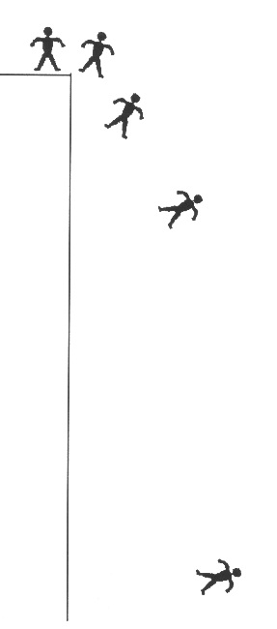
Anatomy of a Fall
.33sec./2 feet
It takes most people about 1/3 of a second to become aware of a problem.
It takes another 1/3 of a second for the body to react.
A body can fall up to 7 feet in 2/3 of a second.
.67 sec./7 feet
1 sec./16 feet
2 sec./64 feet
Slide 45

Slide 46
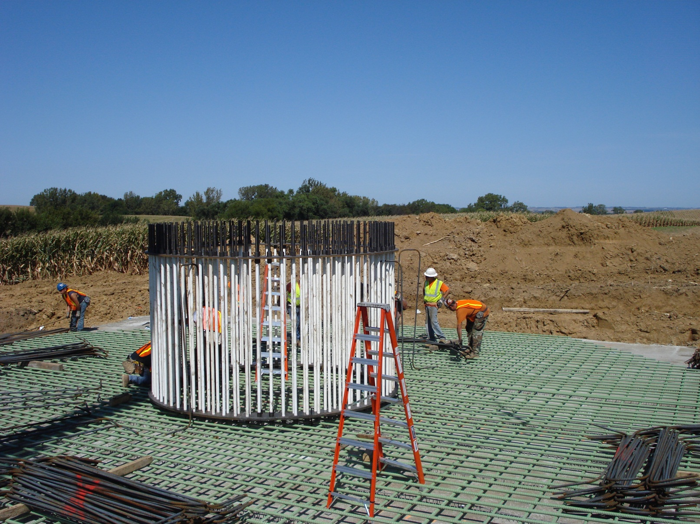
What are the Fall Hazards?
Photo Courtesy of Orion, LLC

Slide 47
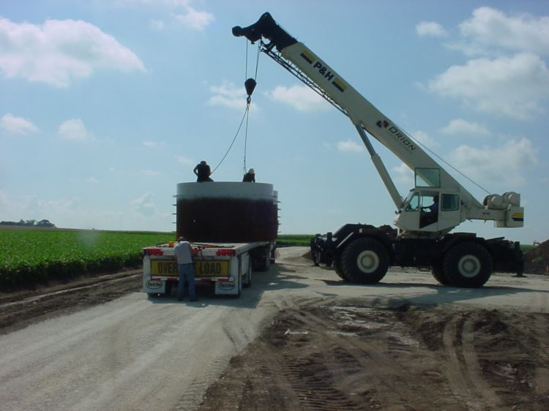
What are the Fall Hazards?
Photo Courtesy of Orion, LLC

Slide 48
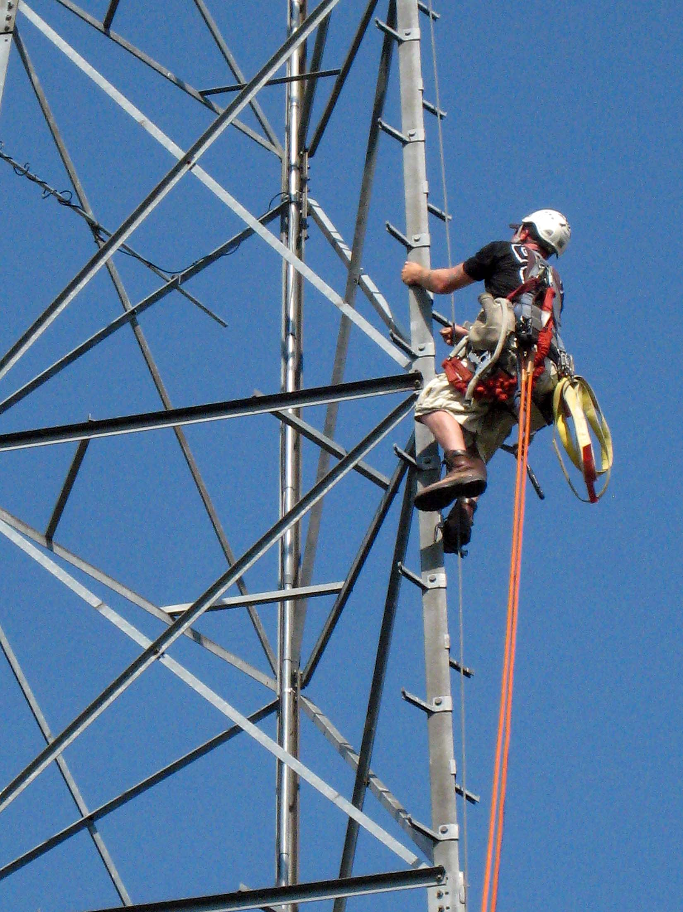
What are the Fall Hazards?
Photo Courtesy Jenny Heinzen

Slide 49
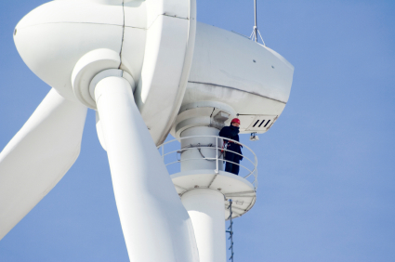
What are the Fall Hazards?
Photo from istockphoto.com

Slide 50
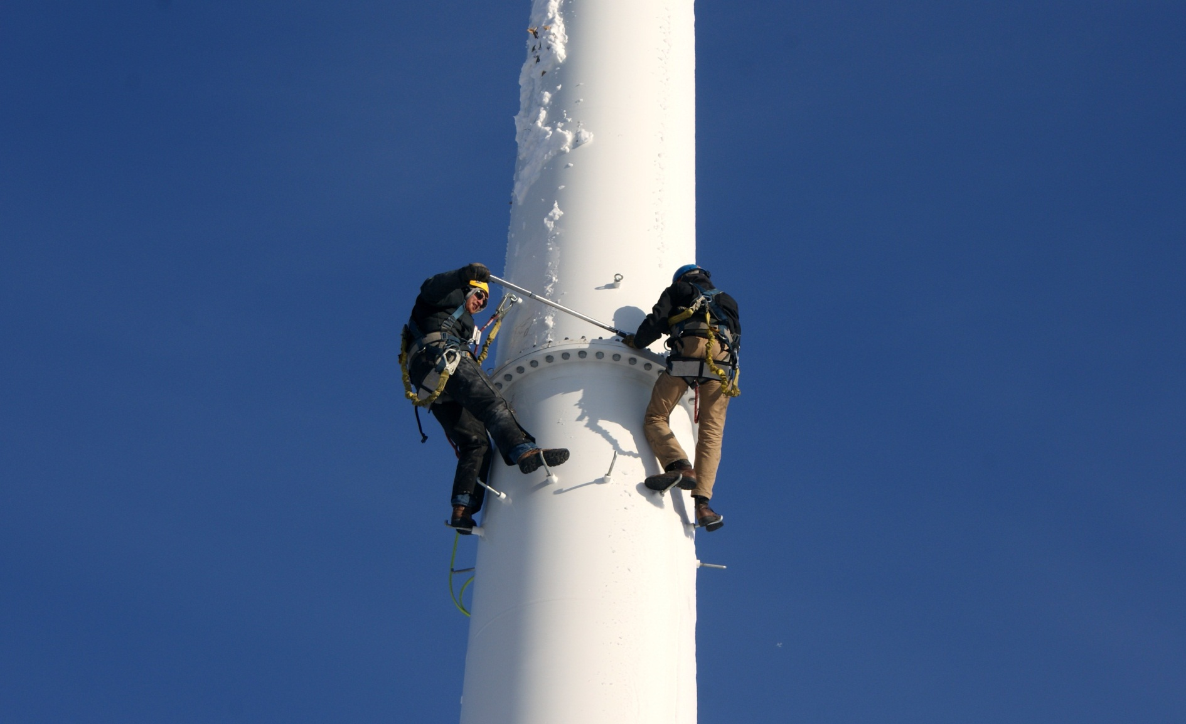
What are the Fall Hazards?
Photo Courtesy of Seventh Generation Energy Systems

Slide 51

Best Practices
Identify one or two items from the best practices list that you plan to improve.

Slide 52
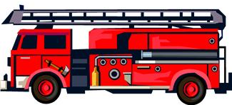
The Rescue Plan
What to do?
What to have on hand?

Slide 53
Module 4 Objectives
Analyze wind energy worksites for electrical hazards.
Recognize the danger of arc flash and identify steps to reduce the danger.
Identify best practices and important controls for preventing electrical injuries and fatalities.

Slide 54
Module 4 Objectives—continued
Practice the proper use of lockout/tagout.
Recognize and use OSHA standards relating to electrical safety.

Slide 55
Test Your Knowledge of Electrical Safety
How many workers die every year in electrical accidents?
150
250
350
450

Slide 56
Test Your Knowledge of Electrical Safety
2. Which industry has more electrocutions every year than any other industry?
Utilities
Landscaping
Construction
Manufacturing

Slide 57
Test Your Knowledge of Electrical Safety
3. When is it necessary to use lockout/tagout procedures to prevent electrical injuries?
When anyone is working around electrical equipment
When anyone is working on equipment that has multiple energy sources
When two or more employees are performing maintenance on the same electrical equipment
When there is the potential for an unexpected energization of equipment that could cause injury to an employee

Slide 58
Test Your Knowledge of Electrical Safety
4. Equipment such as cranes, forklifts, backhoes and scaffolding must maintain at least a foot minimum clearance from overhead power lines.
6
10
12
20

Slide 59
Electrical Harm
Slide 59

Slide 60
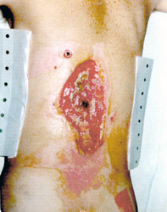
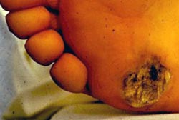
Electrical Damage to the Body
If you touch a power line, or energized equipment, electricity will attempt to travel through your body.
It heats up and burns body tissue internally.
Electricity leaves the body violently, causing burns or even blowing an exit hole.
Entrance Wound
Exit Wound

Slide 61
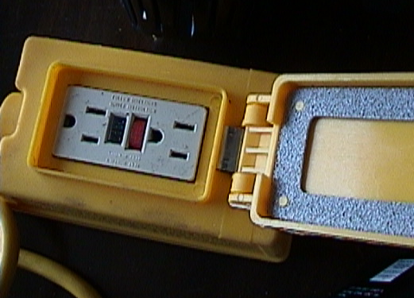
Ground Fault Circuit Interrupters
GFCI
Monitor current flow between the hot and neutral wires
Trip between 4-6 mA in 1/40th of a second
GFCI with open neutral protection must be used on a construction site.

Slide 62
Tool could be hot with the switch off
Hot wire and neutral wire are reversed
Even though a switch is off, the circuit could be ho
Reverse Polarity Diagram
Hot
Switch
Neutral
Tool could be hot with the switch off
Hot wire and neutral wire are reversed
Even though a switch is off, the circuit could be hot
Slide 62

Slide 63
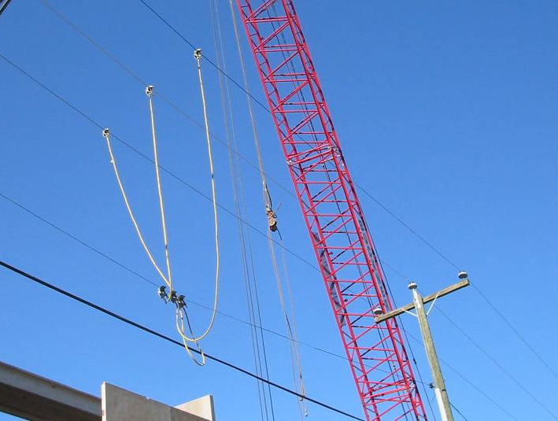
Power Lines
You must assume that all power lines are energized unless the utility company confirms that the power line has been de-energized and visibly grounded at the worksite.

Slide 64
Operations Around Power Lines
(up to 350 kV – 1926.1408)
The employer must make a hazard assessment and must define a work zone by demarcating boundaries.
Option 1 — De-energize and ground the ground line.
Option 2 — Ensure that no part of the equipment, load line or load gets closer than 20 feet to the power line.
Option 3 — If line voltage is known—cannot get closer than minimum distances in Table A.

Slide 65
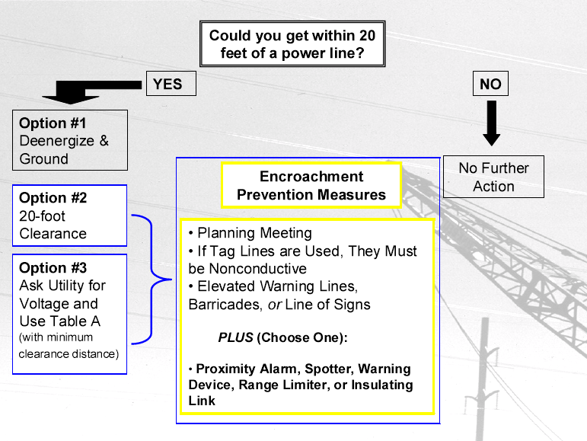
Slide 65

Slide 66
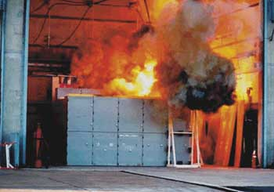
Arc Flash
A short circuit that flashes from one exposed live conductor to another, or from an exposed live conductor to the ground.

Slide 67
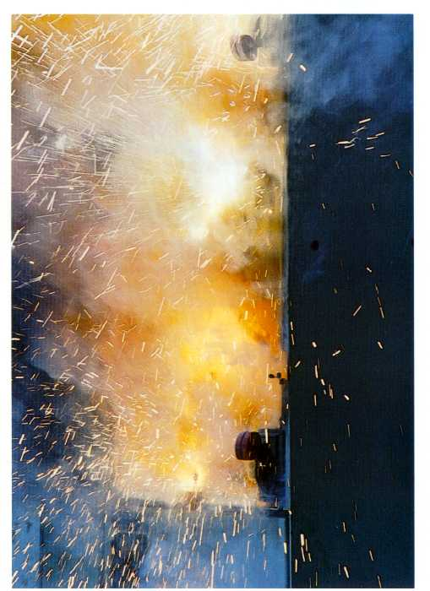
What Happens in an Arc Blast?
Heat builds to 35,000º F
2. Copper expands by a factor of 67,000
3. Metal melts
4. There is intense light
5. There are pressure and sound waves
6. Shrapnel flies

Slide 68
Where Does Arc Blast Occur?
Panel boards
Switchboards
Motors
Transformers
Motor starters
Drive cabinets
Fused disconnects

Slide 69
Causes of Arc Blast
Proximity to a high-amp source with a conductive object
Equipment failure from substandard parts
Improper installation of equipment or outlets
Worn or damaged equipment

Slide 70
Causes of Arc Blast—continued
Broken insulation
A dropped tool that causes a spark
Dust, corrosion or other impurities on the surface of the conductor
Accidental contact (by humans or animals)
Improper work procedures

Slide 71
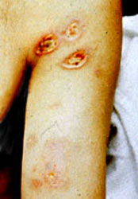
Consequences of Arc Blast
Skin burns
Ignition of clothing
Damage of eyesight
Hearing loss/ruptured eardrums
Lung collapse
Arc Blast Burn

Slide 72
Consequences of Arc Blast—continued
Concussion/loss of memory
Shrapnel wounds
Physical wounds
Loss of life
Lost work time
Loss or damage of equipment

Slide 73
Limits of Approach
Exposed Energized Part
Prohibited Approach Boundary
Flash Protection Boundary
Restricted Approach Boundary
Limited Approach Boundary
Note that the outer boundary is for flash protection. All other boundaries are for shock protection.

Slide 74
Flash Protection Zone
Outer zone of flash protection
Employees in this zone must wear flash protective equipment

Slide 75
Limited Approach Zone
Only qualified people can enter this zone.
Must wear flash protective equipment
Unqualified workers prohibited

Slide 76
Restricted Approach Zone
A person in this zone is in restricted space
Qualified people only
Approved written plan required
PPE required
Must keep as much of body out of restricted zone as possible
No body part may cross prohibited line

Slide 77
Prohibited Approach Zone
Being in this zone is the same as being in contact with the live part
Qualified people only
Must have specified training
Approved written plan and risk hazard analysis
PPE for working on live parts required

Slide 78
Best Practices
Identify one or two items from the best practices list that you plan to improve.

Slide 79
Lockout/Tagout
A safety procedure used to ensure that electrical energy is properly shut off and not started up again until work on the system is complete. It requires the power sources be isolated and rendered inoperable during the maintenance.

Slide 80


Do Not Start
Do Not Energize
Do Not Open
Do Not Operate

Slide 81
Module 5 Objectives
Analyze your worksite for trenching and excavation hazards.
Identify best practices and important controls for preventing trenching and excavation injuries.
Recognize and use OSHA standards relating to trenching and excavation.

Slide 82
Test Your Knowledge of Excavations
How many workers are fatally injured each year by cave-ins from excavations?
28
54
67
83

Slide 83
Test Your Knowledge of Excavations
A stairway, ladder, ramp or other safe means of egress must be located in trench excavations that are or more in depth.
2 feet
3 feet
4 feet
5 feet

Slide 84
Test Your Knowledge of Excavations
How far back from an excavation must the spoils be?
2 feet
6 feet
10 feet
12 feet

Slide 85
Test Your Knowledge of Excavations
When must excavations have protection systems?
Always
When the excavation is deeper than it is wide
When the excavation is over five feet deep, or less than five feet deep and there is an indication of a potential cave-in
When the excavation is over eight feet deep, or less than eight feet deep and there is an indication of a potential cave-in

Slide 86
Best Practices
Identify one or two items from the best practices list that you plan to improve.

Slide 87
OSHA Requirements
Type A
Type B
Type C
20 ft. max
Simple Slope
1
1
1
¾
1
1 ½
Type A
Type B
20 ft. max
1
1
Single Bench
¾
1
Slide 87

Slide 88
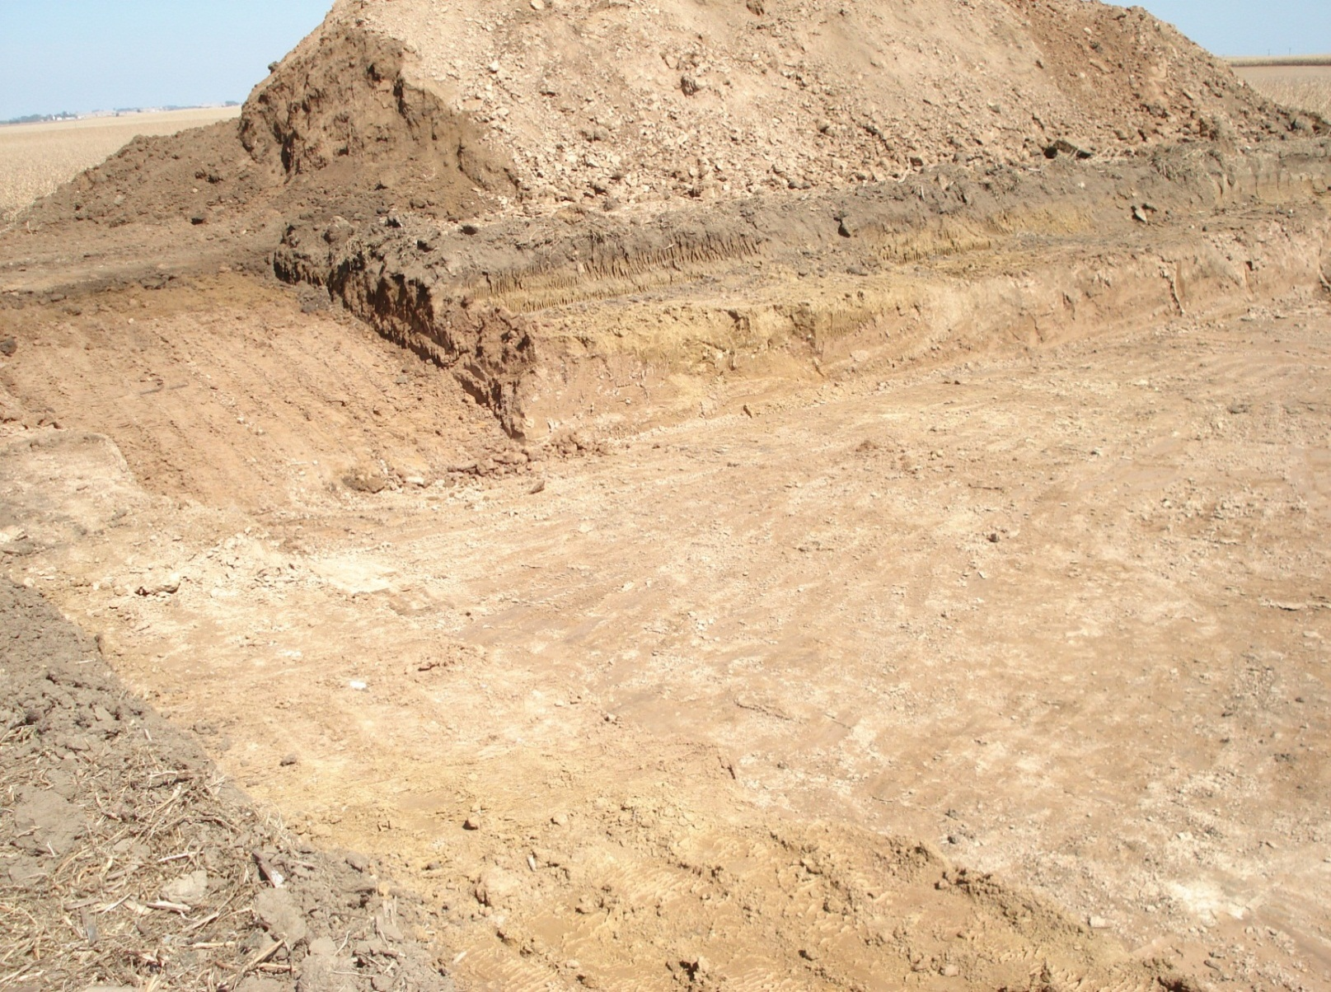
What are the Hazards/Best Practices?
Photo Courtesy of Orion, LLC

Slide 89
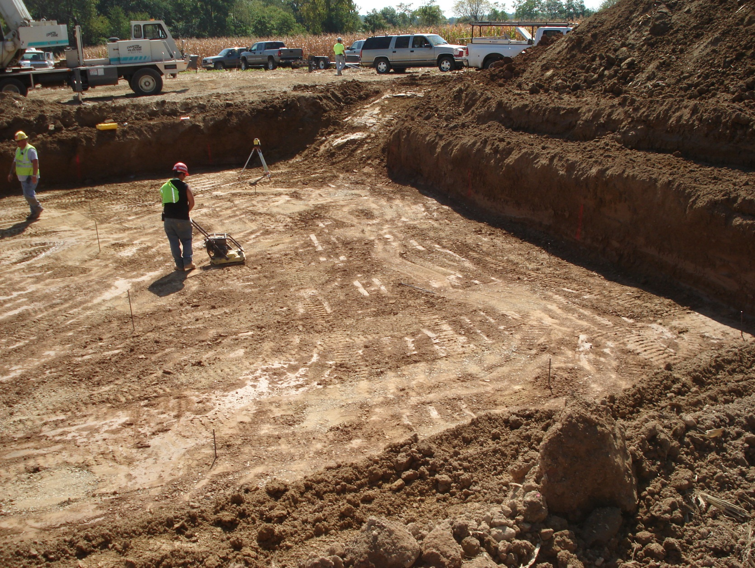
What are the Hazards/Best Practices?
Photo Courtesy of Orion, LLC

Slide 90
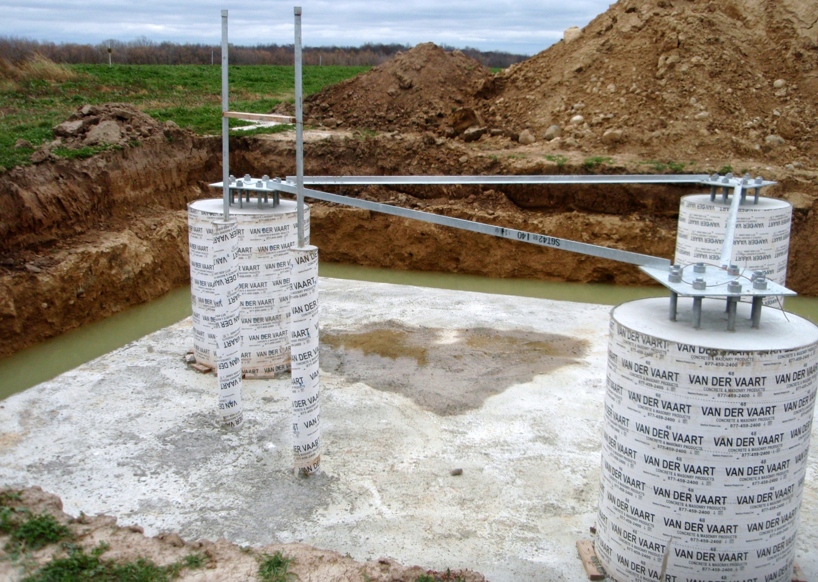
What are the Hazards/Best Practices?
Photo Courtesy of Seventh Generation Energy Systems

Slide 91
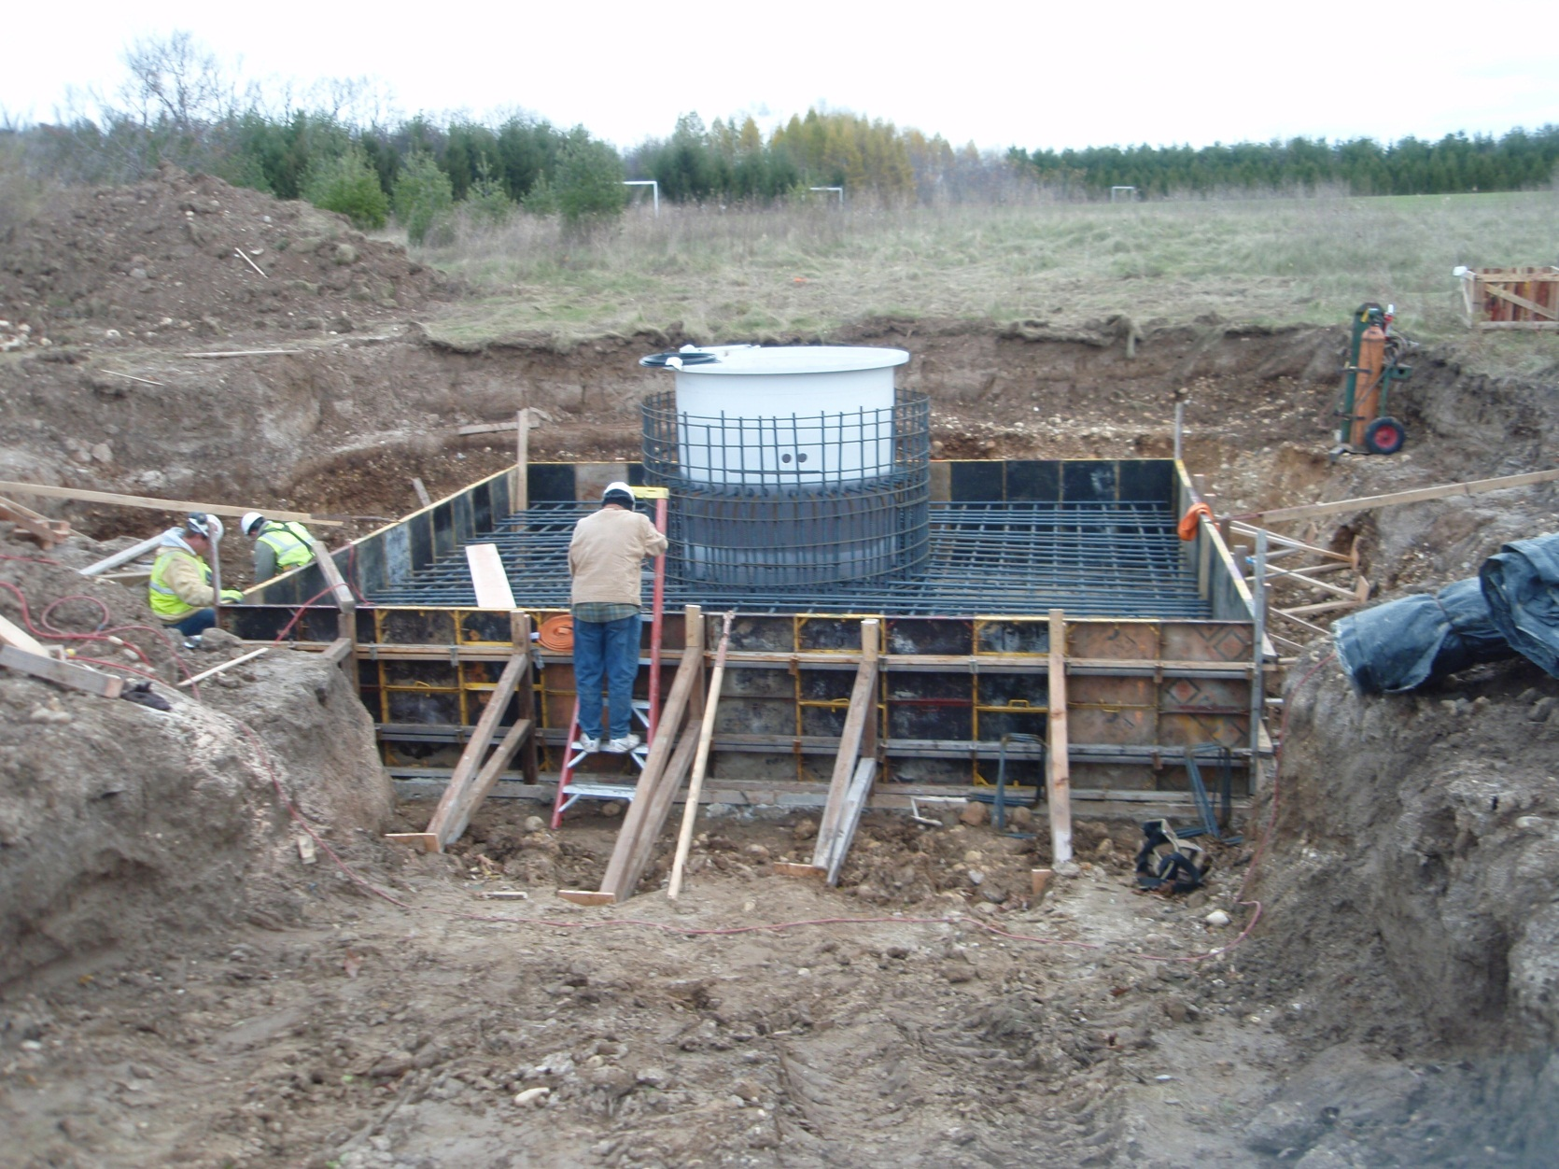
What are the Hazards/Best Practices?
Photo Courtesy of Seventh Generation Energy Systems

Slide 92
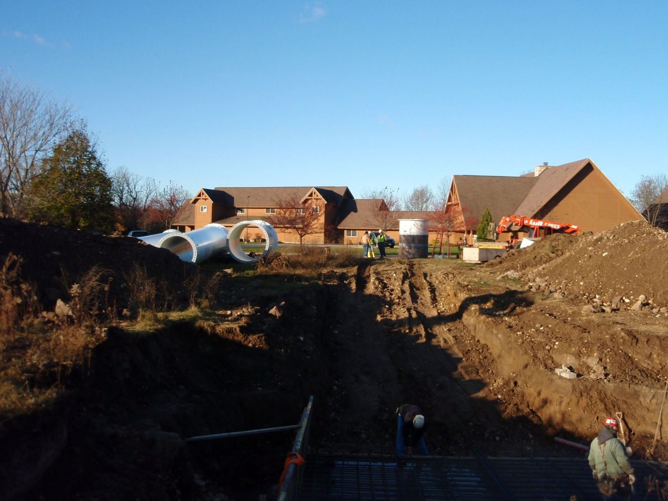
What are the Hazards/Best Practices?
Photo Courtesy of Seventh Generation Energy Systems

Slide 93
Module 6 Objectives
Analyze your worksite for struck-by hazards.
Identify best practices and important controls for preventing struck-by injuries.
Recognize and use OSHA standards relating to the prevention of struck-by injuries.

Slide 94
Test Your Knowledge of Struck-By Hazards
What is the primary cause of struck-by fatalities?
Lack of operator visibility
Being hit by falling objects
Getting struck by heavy equipment
Incorrect or misunderstood hand signals

Slide 95
Test Your Knowledge of Struck-By Hazards
What percentage of struck-by fatalities involves heavy equipment, such as trucks or cranes?
34%
50%
61%
75%

Slide 96
Test Your Knowledge of Struck-By Hazards
Employees who direct or signal crane movements must be:
Certified.
Qualified by testing.
Wearing a colored vest.
Able to also operate a crane.

Slide 97
Test Your Knowledge of Struck-By Hazards
To prevent worker run-over accidents, which of the following should be used?
Back-up alarms
Spotters for equipment
High visibility clothing
All of the above

Slide 98
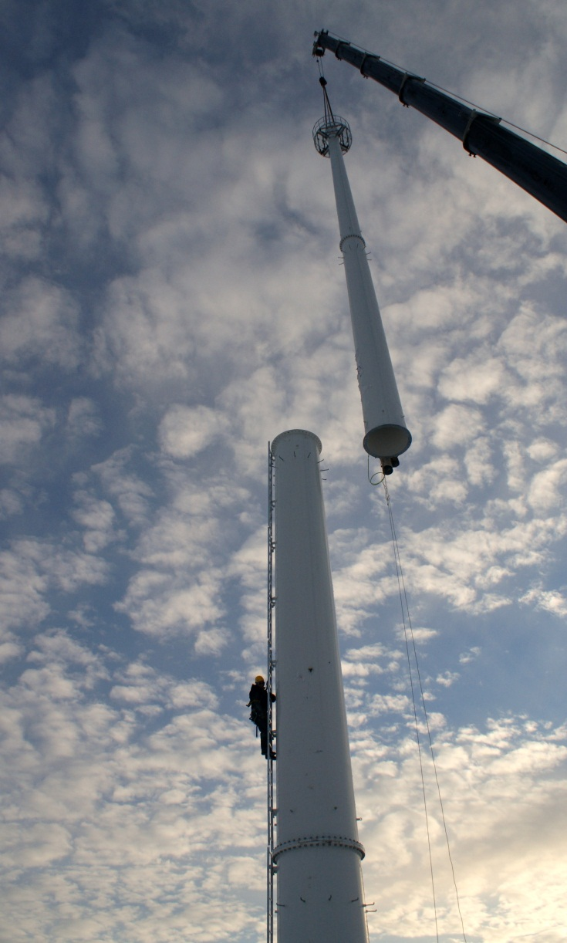
What are the Struck-By Hazards?
Photo Courtesy of Seventh Generation Energy Systems

Slide 99
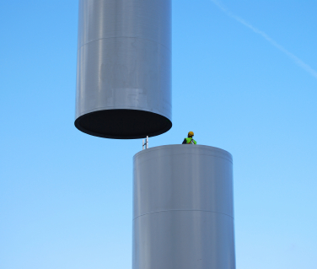
What are the Struck-By Hazards?
Photo from istockphoto.com

Slide 100
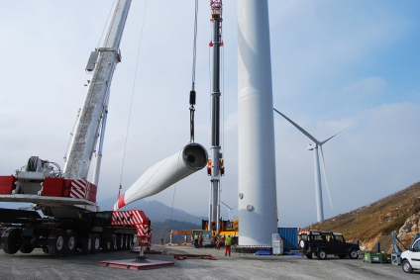
What are the Struck-By Hazards?
Photo Courtesy of Orion, LLC

Slide 101
Best Practices
Identify one or two items from the best practices list that you plan to improve.

Slide 102
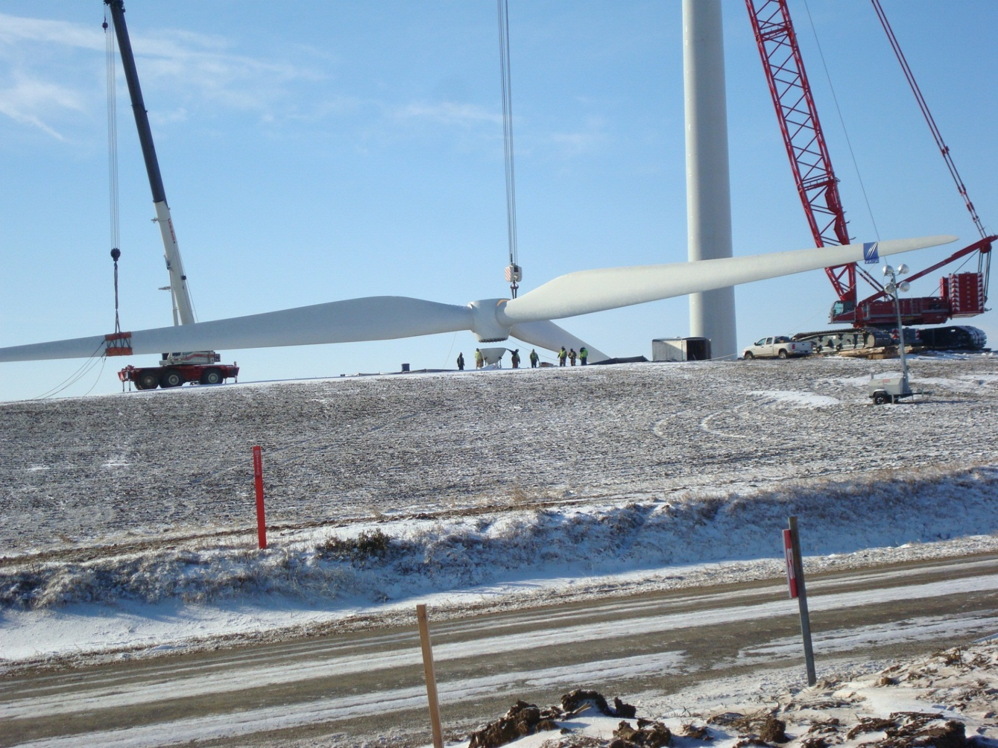
What are the Best Practices?
Photo Courtesy of Orion, LLC

Slide 103
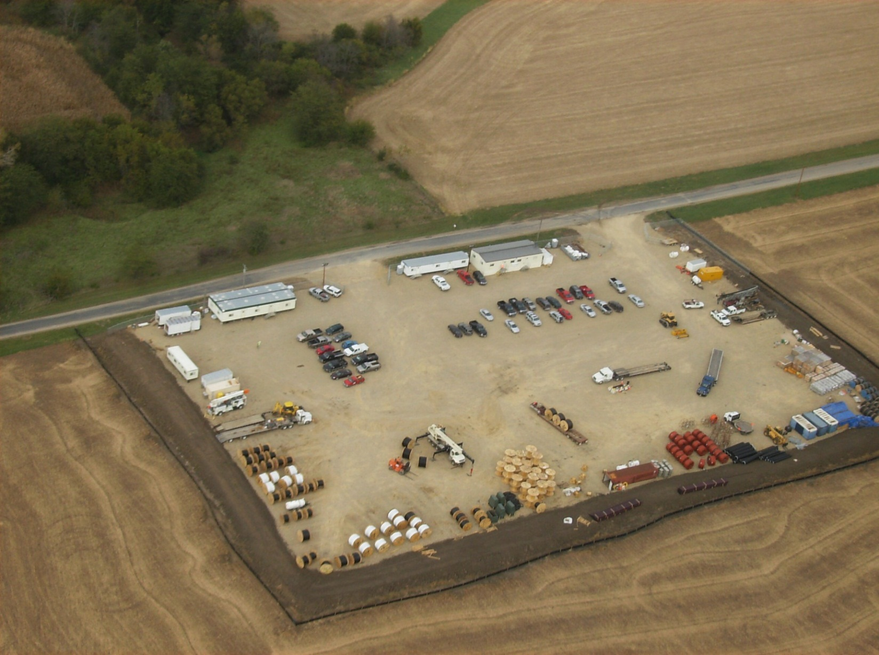
What are the Best Practices?
Photo Courtesy of Orion, LLC

Slide 104
Module 7 Objectives
Explain the factors that affect thermal balance.
Recognize the signs of heat stress.
Recognize the signs of cold stress.
Recognize other potential hazards from working in an outside environment.

Slide 105
Module 7 Objectives—continued
Identify best practices and important controls for keeping safe while working outside.
Identify obstacles to using safe practices at your worksite.
Identify the resources available on your Tools and Resources CD.

Slide 106
Thermal Stress
Diagram Courtesy of Susan Stites, Management Allegories

Slide 107
Factors Affecting Thermal Balance
Climatic conditions
Work demands
Clothing
Personal factors

Slide 108


What are the Signs of . . .
Heat Stress?
Cold Stress?

Slide 109
Best Practices
Identify one or two items from the best practices list that you plan to improve.

Slide 110
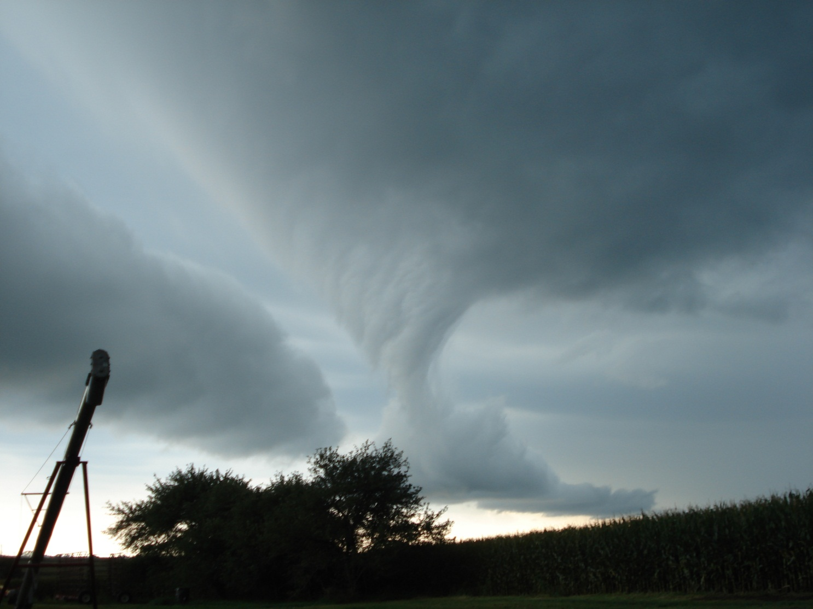
When Nature Strikes
Photo Courtesy of Orion, LLC

Slide 111
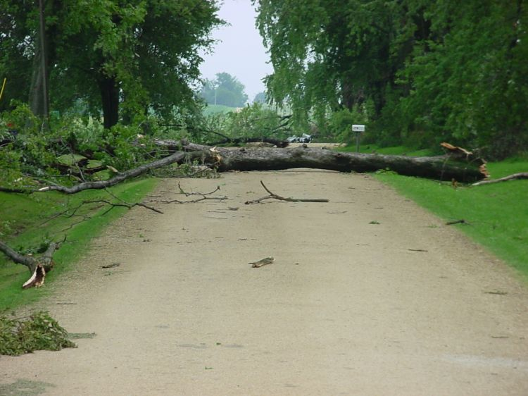
When Nature Strikes
Photo Courtesy of Orion, LLC

Slide 112
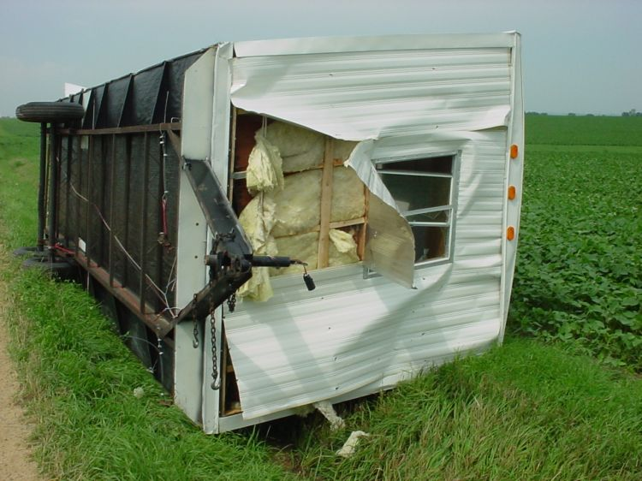
When Nature Strikes
Photo Courtesy of Orion, LLC

Slide 113
Obstacles
What are some of the challenges/ barriers to protecting yourself and other workers?
Which procedures are the most difficult to follow?
How can you motivate others to follow safe working procedures?

