Slide 1
Making it Count
SVFT Injury and Illness Recordkeeping and Recording Procedures
This material was produced under the grant SH-22219-SH1 from the Occupational Safety and Health Administration, U.S. Department of Labor. It does not necessarily reflect the views or policies of the U.S. Department of Labor, nor does mention of trade names, commercial products, or organizations imply endorsement by the U.S. Government.”

Slide 2

Objectives
Discuss why reporting is essential to correcting workplace hazards
Provide information on injury and illness reporting requirements
Communicate State of Connecticut’s procedures for reporting injuries and illnesses
Notes:
DISCUSSION:
Have any of you ever experienced a workplace injury or illness? (show of hands)
How many of you reported that injury or illness to your principal, department chair, or business agent? (show of hands)
Do you think that most of the injuries and illnesses that are happening at your schools are being reported properly? (Brief comments)
Well, here are some workplace injury and illness data from the State of Connecticut to think about.
Image: Power point clip art

Slide 3
What reporting data tells us
The public sector accounted for 11,900 of Connecticut’s 60,200 work-related injuries and illnesses (20%) while providing 13% of the employment.
CONN-OSHA Non-Fatal Injury and Illness Data, 2009
Notes:
A total of 60,200 injuries and illnesses were reported in Connecticut in 2009, for a rate of 4.6 cases per 1000 full-time workers.
The public sector accounted for 11,900 of Connecticut’s 60,200 work-related injuries and illnesses (20%) while providing 13% of the employment.
CITATION: CONN-OSHA Statistics - Non-Fatal Injury and Illness Data for 2009 http://www.ctdol.state.ct.us/osha/2009/NonFatalities/NonFatalities09.htm

Slide 4
What the data tell us Incidence of work-related injuries in Connecticut
CONN-OSHA Non-Fatal Injury and Illness Data, 2009
Notes:
7,100 public education employees in elementary and secondary schools were injured in 2010; 2,600 lost time at work or had job transfers or restrictions because of the injury or illness. And these are “recordable” cases – as you will see later these number don’t capture many injuries and illnesses that occur everyday on the job.
What do these statistics tell you about state and local government workers?
How do education employees compare with the overall rates?
Some experts and researchers believe that there is substantial under-reporting of injuries and illnesses
CITATION: CONN-OSHA Statistics - Non-Fatal Injury and Illness Data for 2009
http://www.ctdol.state.ct.us/osha/2009/NonFatalities/NonFatalities09.htm

Slide 5
What’s Wrong with this Graph?
YOU ARE HERE!!
CONN-OSHA Non-Fatal Injury and Illness Data, 2009
Notes:
In the state category for “educational services”, the rate is far below the average at 2.2 per 1000 FTE’s.
This is where the state vocational system numbers are reported.
Includes colleges and universities … lowers overall rate.
CITATION: CONN-OSHA Statistics - Non-Fatal Injury and Illness Data for 2009
http://www.ctdol.state.ct.us/osha/2009/NonFatalities/NonFatalities09.htm

Slide 6
What the Research Tells Us….
Reporting statistics may not be capturing all the work-related injuries and illnesses
Workers are many times reluctant to report
Underreporting is a huge issue and we may not be getting an accurate picture
Notes:
So, why don’t you think your colleagues report all of their work-related injuries/illnesses?
DISCUSSION:
Capture on a flip chart why people don’t report – maybe have one column for process (don’t know how to report, etc.) and another for other reasons (including “not really that bad”; go to private doctor; retaliation; victim blaming etc.
(Use this later when thinking of ways to improve reporting process and getting colleagues to use the process!)

Slide 7
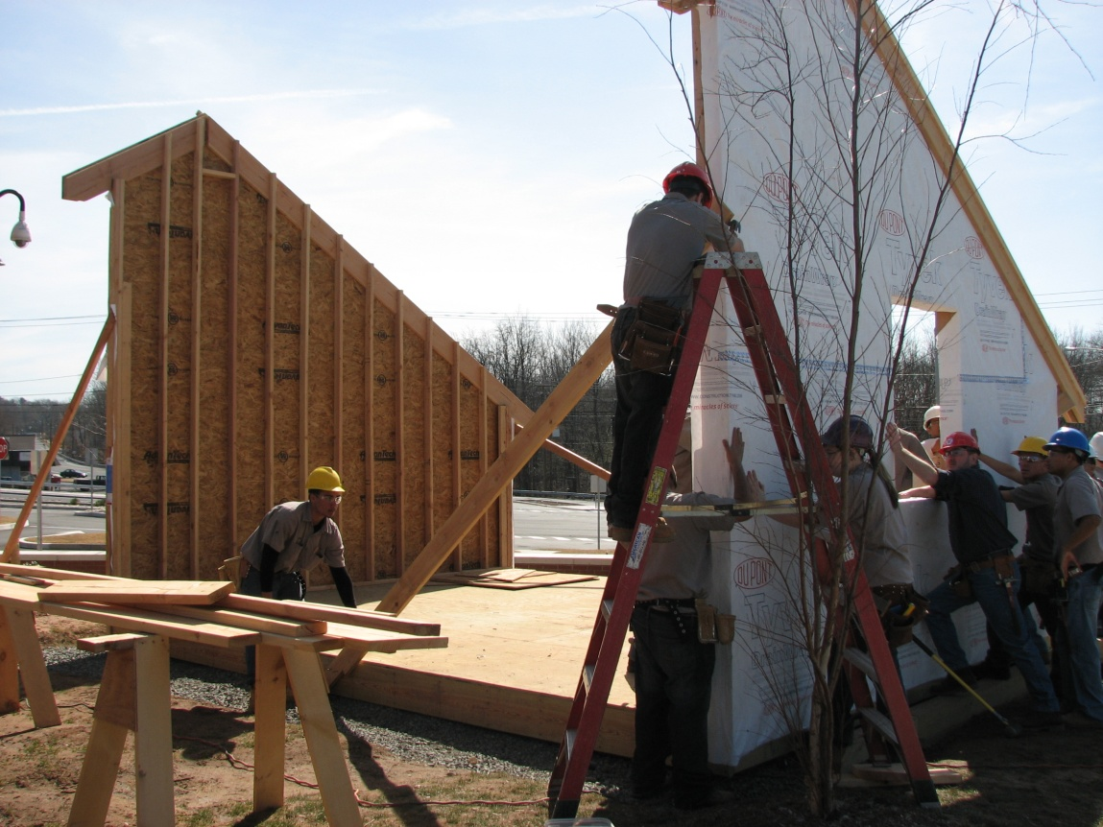
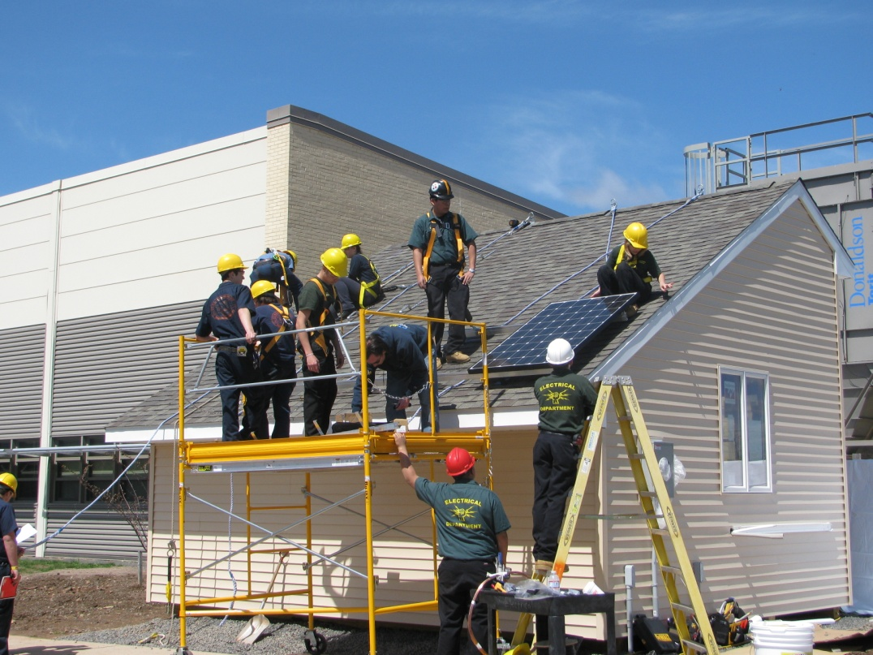
How could accurate reporting help correct hazards?
Are there hazards in your workshops and classrooms that have caused or have the potential to cause injury and/or illness?
Notes:
Do you think there are hazards in your workshops and classrooms that have already caused or have the potential to cause injuries and/or illnesses? Record on flipchart.
How could accurate reporting help correct some of those hazards?
Make the connection that if we want to correct these hazards we have to know about them!
PHOTOS: Courtesy of SVFT

Slide 8

Changing the Culture of Reporting
Think about this:
What recommendations would you make to improve reporting
How would you make the case to your colleagues
Notes:
Challenge of the Day: Think about these questions while we go over some of the mechanics of reporting. We’ll come back to this later.
Image: Power point clip art

Slide 9
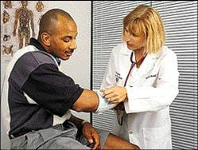
Recordkeeping
Public employers in Connecticut are required to keep a log of injuries and illnesses.
What about the work environment while traveling?
Injuries occurring during travel are work-related if the employee was engaged in work activities in the interest of the employer.
Notes:
OSHA has both standards and regulations. An example of an important regulation: Recordkeeping
The “purpose” section states the basic purpose of the rule: to require employers to collect injury and illness data and report it to the government, but it doesn’t tell how the data are used or why they are important. The records provide the base data for the BLS survey of occupational injuries and illnesses, the Nation’s primary source of occupational injury and illness statistics.
The records are also used by employers and employees to manage safety and health programs at individual workplaces. Analysis of the data is a widely recognized method for discovering workplace safety and health problems, and for tracking progress in solving those problems.
Finally, the data are used by OSHA. They collect the data to help them direct programs and measure performance, and inspectors use the data during inspections to help direct their efforts to the hazards that are hurting workers.
Has anyone ever seen an OSHA 300 Log? Was it easy to understand?
Image: OSHA

Slide 10
Did the employee experience an injury or illness?
YES
Is the injury or illness work-related?
YES
Is the injury or illness a new case?
OSHAs Recording Flowchart
YES
Does the injury or illness meet the general criteria
or the application to specific cases?
YES
RECORD THE INJURY OR ILLNESS
Notes:
An injury or illness is an abnormal condition or disorder. Injuries include cases such as, but not limited to, a cut, fracture, sprain, or amputation. Illnesses include both acute and chronic illnesses, such as, but not limited to, a skin disease, respiratory disorder, or poisoning.
There must be significant aggravation of a pre-existing injury or illness to establish work-relatedness. The workplace event or exposure must aggravate a pre-existing injury or illness enough that it results in greater consequences than what would have occurred but for that event or exposure. This means that the pre-existing condition requires more medical treatment than otherwise needed; more restrictions, more days away, etc.
Consider an injury or illness a “new case” if the employee has not previously experienced a recorded injury or illness of the same type that affects the same part of the body, OR the employee previously experienced a recorded injury or illness of the same type that affected the same part of body but had recovered completely (all signs and symptoms had disappeared) from the previous injury or illness and an event or exposure in the work environment caused the signs or symptoms to reappear.

Slide 11
A case is recordable if it involves
one or more of the following:
death
days away from work
restricted work
job transfer
medical treatment (beyond first aid)
loss of consciousness
other serious or significant cases diagnosed by a physician or licensed health care professional (PLHCP)
occupational injuries and illnesses that meet special recording criteria
Notes:
What is a recordable case is not always cut and dry and easy to figure out. However, these are the main categories of recordable incidents.
Loss of consciousness from a work-related injury or illness is recordable. Loss of consciousness due solely to personal health conditions (diabetes, epilepsy, narcolepsy, etc.) is not recordable.
Significant Diagnosed Injury or Illness: Any serious or significant work-related disorder that is diagnosed by a PLHCP or identified by a positive medical test. These include cases of cancer, chronic irreversible disease, a fractured or cracked bone or tooth, or a punctured eardrum.
Occupational injuries and illnesses that meet special recording criteria:
Needlestick injuries and cuts from sharp objects that are contaminated with another person’s blood or other potentially infectious materials. Potentially infectious materials include human bodily fluids, tissues and organs, and materials infected with the HIV or hepatitis B virus.
An OSHA standard requires medical removal of an employee for medical surveillance.
Hearing loss

Slide 12
Reading an OSHA Log
A: Case Number
B: Employee’s Name
C: Job Title
D: Date of Injury
E: Where Event Occurred
F: Describe injury or illness, parts of body
affected, and object/substance that
directly injured or made person ill
Notes:
Review each column and have them record the scenarios from the workbook on their log.
NOTE: If the outcome or extent of an injury or illness changes after you have recorded the case, simply draw a line through the original entry or, if you wish, delete or white-out the original entry. Then write the new entry where it belongs. Remember, you need to record the most serious outcome for each case.

Slide 13
Reading an OSHA Log
G: Fatality
H: Days Away from Work
I: Job Transfer or Restriction
J: Other Recordable Cases
K: Number of Days Away from Work
L: Number of Days on Job Transfer or Restriction
M: Injury and/or Illness
Notes:
Restricted work activity occurs when, as the result of a work-related injury or illness, an employer or health care professional keeps, or recommends keeping, an employee from doing the routine functions of his or her job or from working the full workday that the employee would have been scheduled to work before the injury or illness occurred.
Count the number of calendar days the employee was on restricted work activity or was away from work as a result of the recordable injury or illness. Do not count the day on which the injury or illness occurred in this number. Begin counting days from the day AFTER the incident occurs. If a single injury or illness involved both days away from work and days of restricted work activity, enter the total number of days for each. You may stop counting days of restricted work activity or days away from work once the total of either or the combination of both reaches 180 days.

Slide 14
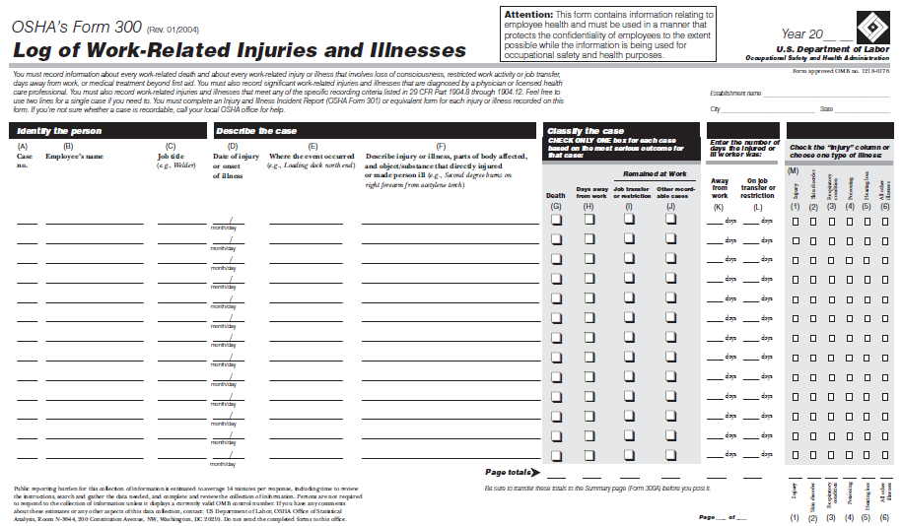
http://www.osha.gov/recordkeeping/RKform300pkg-fillable-enabled.pdf
Notes:
Refer to the OSHA Recordkeeping Packet and the OSHA 300 Log to review with participants.
Do Injury #3 as an example.
Rob, a carpentry teacher, falls from an extension ladder to a concrete patio on an off campus job site. He is seen by an emergency room doctor and diagnosed with a broken arm. He is out of work for 7 days and on restricted duty for 10 days.
How would you record this incident?
(Check Column H, record 7 days in Column K and 10 days in Column L. Leave Column I blank and check (1) in Column M.)

Slide 15
Classifying Illnesses
Skin Diseases or Disorders
Caused by exposure to chemicals, plants, or other substances.
Respiratory Conditions
Associated with breathing hazardous biological agents, chemicals, dust, gases, vapors, or fumes.
Hearing Loss
Changes in hearing thresholds
All Other Illnesses
Such as temperature related illnesses, radiation exposure, or bloodborne pathogen exposure.
Notes:
Spend time on information below and having them sharing stories. Then do case study for illness at the bottom of page.
What often gets missed in reporting are occupational illnesses, such as the following:
Skin diseases or disorders: illnesses involving the worker’s skin that are caused by work exposure to chemicals, plants, or other substances. Contact dermatitis, eczema, or rash caused by primary irritants and sensitizers or poisonous plants; oil acne; friction blisters, chrome ulcers; inflammation of the skin.
Respiratory conditions: illnesses associated with breathing hazardous biological agents, chemicals, dust, gases, vapors, or fumes at work. Silicosis, asbestosis, pneumonitis, pharyngitis, rhinitis or acute congestion; farmer’s lung, beryllium disease, tuberculosis, occupational asthma, reactive airways dysfunction syndrome (RADS), chronic obstructive pulmonary disease (COPD), hypersensitivity pneumonitis, toxic inhalation injury, such as metal fume fever, chronic obstructive bronchitis, and other pneumoconioses.
Hearing Loss: Noise-induced hearing loss is defined for recordkeeping purposes as a change in hearing threshold relative to the baseline audiogram of an average of 10 dB or more in either ear at 2000, 3000 and 4000 hertz Are people getting baselines? How many people think that since they’ve started working they’ve experienced hearing loss?
All other illnesses: All other occupational illnesses. Heatstroke, sunstroke, heat exhaustion, heat stress and other effects of environmental heat; freezing, frostbite, and other effects of exposure to low temperatures; decompression sickness; effects of ionizing radiation (isotopes, x-rays, radium); effects of nonionizing radiation (welding flash, ultra-violet rays, lasers); anthrax; bloodborne pathogenic diseases, such as AIDS, HIV, hepatitis B or hepatitis C; brucellosis; malignant or benign tumors; histoplasmosis; coccidioidomycosis
Poisoning: includes disorders evidenced by abnormal concentrations of toxic substances in blood, other tissues, other bodily fluids, or the breath that are caused by the ingestion or absorption of toxic substances into the body. Poisoning by lead, mercury, cadmium, arsenic, or other metals; poisoning by carbon monoxide, hydrogen sulfide, or other gases; poisoning by benzene, benzol, carbon tetrachloride, or other organic solvents; poisoning by insecticide sprays, such as parathion or lead arsenate; poisoning by other chemicals, such as formaldehyde.
Case Study: John, a body shop teacher, suffered an asthma attack as a result of being in an area where students were spraying foam spray containing isocyanate. He was taken to the emergency room for treatment and told to remain home the rest of the week, four total days.
How would you record this incident? (Check Column H, record 4 days in Column K and check (3) in column M.)
Would this be recordable if this teacher had suffered through the day and went to the doctor after school and received a Rx and other treatment and returned to school the next day? - Would be recordable in Column J and M (3).

Slide 16
The Point
The main point of this presentation is to encourage the reporting of injuries and illnesses, even if they turn out to be not officially “recordable”.
It’s the job of the employer to figure that out.
Notes:
Image: Power point clip art

Slide 17
SVFT: How are Injuries and Illnesses Reported in Your School?
Notes:
DISCUSSION: how things are currently reported … from what I’m guessing it’s different in each school. Need to figure out how to get a standardized reporting system … or a union reporting system.
Group Huddle by School: Hand out flowchart and ask them to spend about 5 minutes talking as a group to see how things are reported in their school. Ask them to keep their thoughts on what they discovered and we’ll come back to it in a few minutes.
Image: Power point clip art

Slide 18
Connecticut Technical High School System
Anyone injured on the job MUST:
Notify their immediate supervisor and/or the principal immediately
In emergency situations, or situations requiring immediate first aid, the school nurse should be contacted.
The supervisor is responsible for reporting the injury to GBS, Inc.
The supervisor is responsible for reporting the injury to the Administration and to the Business Manager and for obtaining the appropriate forms.
Notes:
From the Faculty and Staff Handbook:
Staff Injuries
All staff injuries occurring on school grounds or during a school-sponsored activity must be reported immediately to the employee’s immediate supervisor, and/or the principal. In emergency situations, or situations requiring immediate first aid, the school nurse should be contacted. If the school nurse, or an administrator, determines that the situation is urgent or emergent, EMS will be activated, and the employee’s immediate supervisor notified. Staff injured on school grounds or during a school-sponsored activity when there is no school nurse available should proceed as described below.
Workers’ Compensation
Anyone injured on the job MUST notify their immediate supervisor immediately (department head for instructors, assistant principal for department heads, principal for assistant principals).
The supervisor (department head/assistant principal/principal) is responsible for reporting the injury to the GBS, Inc.
The information that the GBS, Inc. will require is the name, address, telephone number, social security number, date and time of injury, and a brief description of the injury for the employee. The supervisor is responsible for reporting the injury to the Administration and to the Business Manager and for obtaining the appropriate forms.
DISCUSSION: What’ are the problems with this process? What about illnesses?

Slide 19
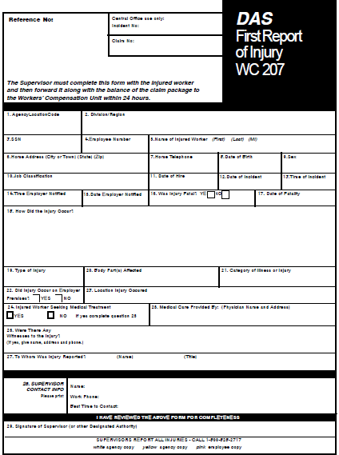
Notes:
OSHA requires that an equivalent form has the same information, is as readable and understandable, and uses the same instructions as the OSHA form it replaces
Refer to “First Report of Injury” form and have a discussion with what works and what some of the limitations of the form are.
PROCESS: Fill out this form for ANY injury and/or illness. Form goes to GBS, Inc. This is the third party insurance company. Worker will receive 3 additional forms from D. Hernandez. The worker will receive an additional packet from GBS, Inc. The worker will also receive a packet from the Workers’ Compensation Commission. It is the worker’s option if they want to fill out FORM 30C to file a WC claim.

Slide 20
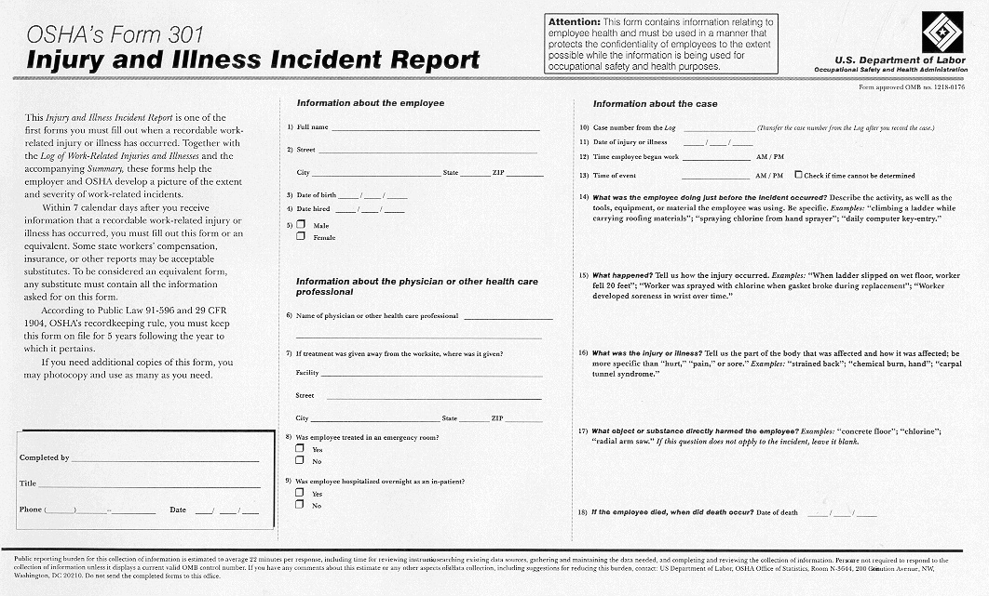
Notes:
The 301 form captures data on each injury and illness (the length of service, what time the injury occurred, what time the employee started work, etc.).
The questions about how the person was injured or became ill are identical to the BLS survey questions, which makes it easier for employers to complete the survey forms when they receive them.
Many employers use a Worker’s Compensation Report, a First Report of Injury or a Company Accident Report as an equivalent form, and they can continue to do this. They just need to make sure that their form includes all of the same data that is found on the 301 form or can be supplemented so that that data is attached to it.
Have participants compare the Connecticut form to the OSHA form – does the Connecticut form capture all the required information?

Slide 21
Employee Involvement
The employer must inform each employee of how to report an injury or illness
Must set up a way for employees to report work-related injuries and illnesses promptly; and
Must tell each employee how to report work-related injuries and illnesses to you
Notes:
The rule requires each employer to set up a way for employees to report injuries and illnesses. Employers also must tell each employee how to report. This is a very basic step to make sure employees report cases so they can get into the records.
Group Huddle by School: Spend a few minutes talking about whether or not this process is working?
Image: Power point clip art

Slide 22
Employers are Required to:
REPORTING AND RECORDING CHECKLIST
Employers must: Report each worker death within 8 hours Report each incident that hospitalizes 3 or more workers within 8 hours Maintain injury & illness records Inform workers how to report an injury or illness to the employer Make records available to workers Allow OSHA access to records Post annual summary of injuries & illnesses from FEBRUARY 1 through APRIL 30
Notes:
This is a summary of the requirements of the reporting regulation.
Refer to OSHA Packet on Recordkeeping – Summary of Injuries and Illnesses – 301A. Review main components of the summary.

Slide 23
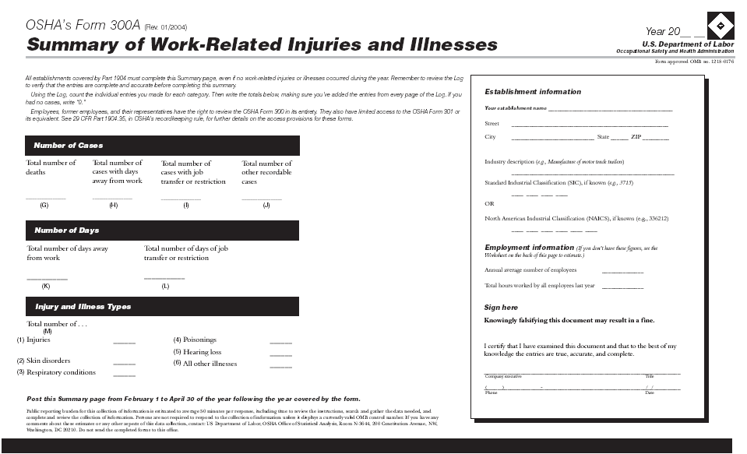
Notes:
There is a separate form for the summary, the 300A. This makes it easier to protect the privacy of injured or ill workers.
The form asks for additional data on the average number of employees and hours worked to make it easier to calculate rates.
Incidence rates are the best way to compare an establishment or an individual company’s data to the national statistics and to their prior performance.
Has everyone seen the 301A summary posted at your school?

Slide 24
Employee Rights
Workers have the right to review and have copies of the current log, as well as the logs stored for the past 5 years.
Full names have to be disclosed on the logs, unless it’s an injury of a private nature.
Workers also have the right to view and have a copy of the annually posted summary of the injuries and illnesses (OSHA 300A).
Notes:
Copy of the annual summary MUST be posted in each establishment in a conspicuous place or places where notices to employees are customarily posted. It can not be altered, defaced or covered by other material. It must posted no later than February 1 of the year following the year covered by the records and kept posted until April 30.
Why is this especially important to a health and safety committee to have as a right? (ask for suggestions – look for patterns of injury; investigate problems to identify solutions; making sure records are accurate, etc.)
NOTE: You must consider the following types of injuries or illnesses to be privacy concern cases: an injury or illness to an intimate body part or to the reproductive system, an injury or illness resulting from a sexual assault, a mental illness, a case of HIV infection, hepatitis, or tuberculosis, a needlestick injury or cut from a sharp object that is contaminated with blood or other potentially infectious material and other illnesses, if the employee independently and voluntarily requests that his or her name not be entered on the log.

Slide 25
Changing the Culture of Reporting
Think about this:
What recommendations would you make to improve reporting
How would you make the case to your colleagues
Notes:
Refer back to the flip chart on why people don’t report (process and other reasons).
Have the group generate recommendations on how to improve reporting process and getting colleagues to use the process. Record on flipchart.
Image: Power point clip art

Slide 26
So Let’s put it all together
Notes:
How do you report your work-related injuries and illnesses in the system?
We have some well-respected thespians here to demonstrate how.
Reporting Case Study: (either act out as a role play or have people read in their groups and then respond)
This is what happened ---
Slipped in puddle in hallway during passing time. Hurt knee. Walked away in embarrassment.
Called nurse for ice pack, and to inquire as to which form I should fill out. Answer unknown.
Called department head to inform them of the incident, and to inquire as to which form I should fill out. No response.
Called main office to inquire as to which form I should fill out. Was told they would look into it.
Called business manager to inquire as to which form I should fill out. Was referred to proper form.
Filled out form, but didn't know some of the information. Submitted it to the business manager. When I inquired as to which medical provider I was supposed to use, I was told I could go to a medical provider of my choice.
When I received the WC paperwork from the state, I learned that I was supposed to go see a medical provider from the designated list. I was also told that I didn't need to bring anything to this appointment, which is also false. I needed a claim number.
This is what should have happened –
As a member of the health and safety committee, what advice would you have given to this worker?
Image: Power point clip art

