Slide 1

Slips, Trips and Falls
“This material was produced under the grant SH-22219-SH1 from the Occupational Safety and Health Administration, U.S. Department of Labor. It does not necessarily reflect the views or policies of the U.S. Department of Labor, nor does mention of trade names, commercial products, or organizations imply endorsement by the U.S. Government.”

Slide 2
At the end of this training, you will be able to:
Identify 2 requirements of OSHA’s walking and working surfaces standard that apply to your workplace.
Identify common causes of slips, trips and falls (STF) within your workplace.
Evaluate your workplace for hazards associated with walking and working surfaces.
Generate ideas on how to control for these identified hazards.

Slide 3
Extent of the Problem
STF are among the most frequent type of reported injuries for public employees
Janitors and cleaners; elementary school teachers; teacher assistants; and secondary school teachers have the highest incidents of reported STFs.
Notes:
According to 2008 Bureau of Labor Statisitcis Data, incident rate for falls in the public sector is 36% compared to 17% in private sector.
Janitors and cleaners; elementary school teachers; teacher assistants; and secondary school teachers have the highest incidents of reported STFs.
QUESTION: What are some common injuries that people get from STF?
QUESTION: What body parts are affected?
SHARE: One or two stories?

Slide 4
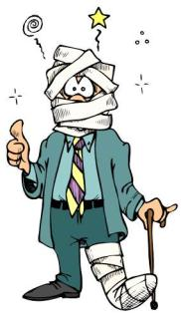
Injuries from Slips, Trips and Falls
Common Affected Body Parts
Common Injuries
Sprains, strains
Bruises, contusions
Fractures
Abrasions, cuts
Knee, ankle, foot
Wrist, elbow
Back
Shoulder
Hip
Head

Slide 5

Slip, Trip and Fall hazards can occur in virtually every type of workplace
Notes:
Slips and trips can happen in any part of the workplace, inside or outdoors. Slips and trips often result in falls and more serious outcomes, including disabling injuries and even death.

Slide 6
NIOSH’s Top 10 Hazards
Contaminants on the Floor
Indoor Walking Surface Irregularities
Outdoor Walking Surface Irregularities
Weather Conditions: Ice and Snow
Inadequate Lighting
Stairs and Handrails
Stepstools and Ladders
Tripping Hazards: Clutter, Loose Cords, etc.
Improper Use of Floor Mats and Runners
Poor Drainage: Pipes and Drains
Notes:
Dotmocracy Activity: Since we won’t be able to cover all of these top hazards in this workshop, we’re going to practice a bit of “dotmocracy.”
Each person has been given five sticky dots. Each person should come to the poster and place any number of their dots next to the things that are most important to them. You can use all your dots on one thing or spread them judiciously.
Once all the dots have been placed, we’ll look at the top three (more or less depending on time allotments) hazards identified by the group through the placement of their dots!
Continue on to page 24 after you’ve done the activities around the top three hazards identified.

Slide 7

Let’s Take a Tour ….

Slide 8
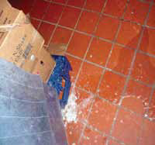
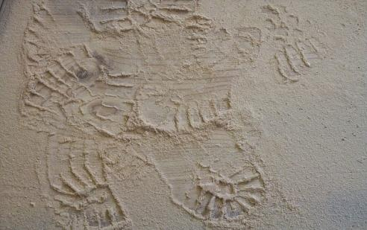
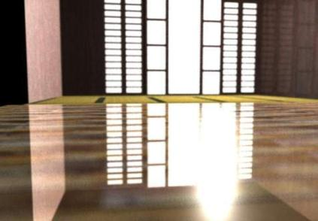
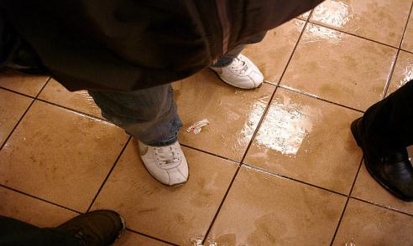
Contaminants on the Floor
Notes:
Activity: What is the hazard?
Have the group identify the hazards represented in these pictures. Have them give other examples of possible contaminants. (which could include the items below).
Contaminants on the floor are the leading cause of STF incidents. Water, grease, and other fluids can make walking surfaces slippery. Highly polished floors, such as marble, terrazzo, or ceramic tile can be extremely slippery even when dry. Freshly waxed surfaces can also be hazardous. Dry contaminants, like wood dust, flour, etc., can also be a STF hazard.
Activity: Where does the hazard occur?
Hand out the “what is the hazard” worksheet to each participant. Ask them to work in small groups to identify specific hazards related to contaminants on the floor in their workplace that they think are most problematic. Then, ask them to identify where these hazards occur in their workplace (which could include the items below).
Food services areas: kitchen, cafeteria, serving line, buffet, ice machines, freezers, dishwashers, sinks, and drains; Vocational shops; Bathrooms; Drinking fountains; Building entrances, where rain and snow are tracked inside
Then, have them work on the final column asking “What are some potential fixes or solutions?” Some examples might include:
Keep floors clean and dry; Use proper cleaning procedures for floors; Wear slip-resistant shoes.; Prevent entry into areas that are wet.
After they’ve worked on their chart, have the groups share their findings in report backs (round robin style – one example per group) and go through as many examples as you have time for.

Slide 9
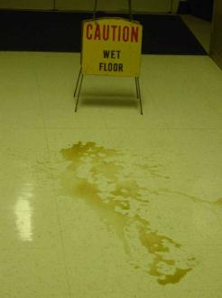
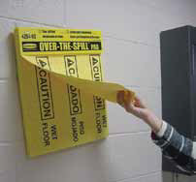
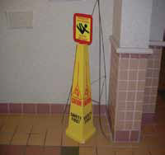
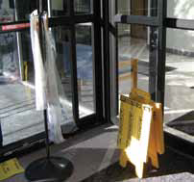
Wall-mounted spill pads for use by employees and visitors
High visibility caution sign with warning sign on top or a flashing light on top could be used
Spill pads and umbrella bags for use in building entryway
Notes:
Some examples of fixes or solutions to wet conditions on the floor.

Slide 10
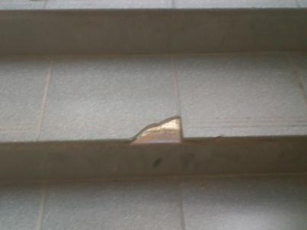
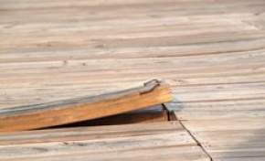
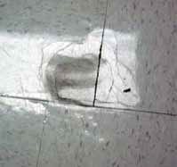
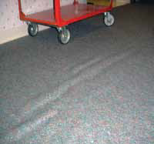
Indoor Walking Surface Irregularities
Notes:
Activity: What is the hazard?
Have the group identify the hazards represented in these pictures. Have them give other examples of possible hazards. (which could include the items below).
Damaged, warped, buckled, or uneven flooring surfaces inside facilities can cause employees to stumble, trip, slip, or fall.
Activity: Where does the hazard occur?
Hand out the “what is the hazard” worksheet to each participant. Ask them to work in small groups to identify specific hazards related to indoor walking surface irregularities in their workplace that they think are most problematic. Then, ask them to identify where these hazards occur in their workplace (which could include the items below).
Building entrances; Hallways; Around drains in the floor; Floor matting
Then, have them work on the final column asking “What are some potential fixes or solutions?” Some examples might include:
Replace or re-stretch loose or buckled carpeting. Remove and replace indented or blistered vinyl tile or broken ceramic tile. Create visual cues. Highlight changes in walkway elevation with Safety Yellow warning paint. Replace smooth flooring materials in areas normally exposed to water, grease and/or particulate matter with rougher-surfaced flooring when renovating or replacing flooring.
After they’ve worked on their chart, have the groups share their findings in report backs (round robin style – one example per group) and go through as many examples as you have time for.

Slide 11
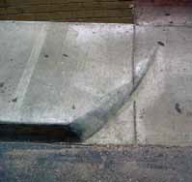
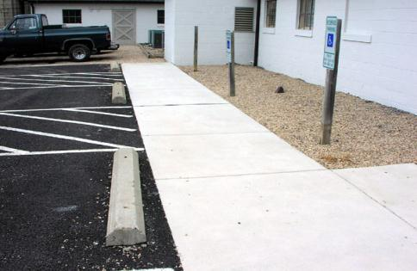
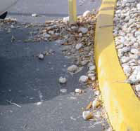
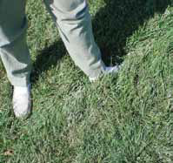
Outdoor Walking Surface Irregularities
Notes:
Activity: What is the hazard?
Have the group identify the hazards represented in these pictures. Have them give other examples of possible sources of hazards (which could include the items below).
Poorly maintained, uneven ground, protruding structures, holes, rocks, leaves, and other debris can cause employees to stumble, trip, slip, or fall. Holes in grassy area between a parking lot and building. Stones and debris on walking surfaces in a parking lot . Area of sloped pavement that should be highlighted with Safety Yellow paint .
Activity: Where does the hazard occur?
Hand out the “what is the hazard” worksheet to each participant. Ask them to work in small groups to identify specific hazards related to outdoor walking surface irregularities at their workplace that they think are most problematic. Then, ask them to identify where these hazards occur in their workplace (which could include the items below).
Entrances ; Lawns ; Parking garages and lots ; Walkways ; Around drains in the ground
Then, have them work on the final column asking “What are some potential fixes or solutions?” Some examples might include:
Patch or fill cracks in walkways greater than ½" wide. Patch, fill, or repave outdoor areas that have deep grooves, cracks, or holes. Create visual cues. Highlight changes in curb or walkway elevation with Safety Yellow warning paint. Concrete wheel stops in parking lots can be a tripping hazard and should not be used. Remove stones and debris from walking surfaces. Ensure that underground watering system structures are covered or highlighted.
After they’ve worked on their chart, have the groups share their findings in report backs (round robin style – one example per group) and go through as many examples as you have time for.

Slide 12
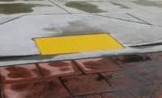
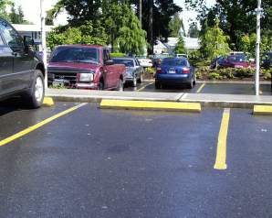
Prevention Solutions
Notes:
Wheelchair accessible curb leading to building entrance is highlighted and the surface is dimpled for better visibility and traction.
Highlight or mark slip and trip hazards for better visibility.

Slide 13
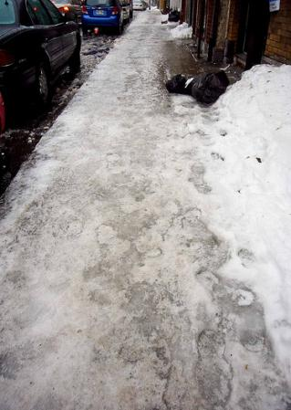
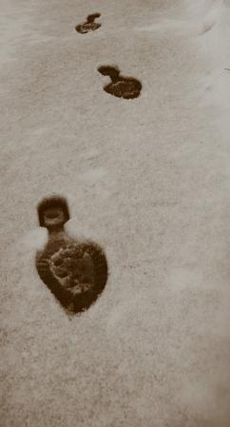
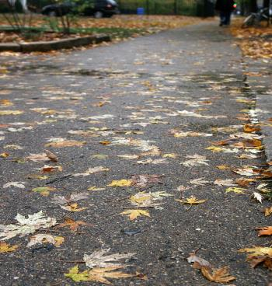
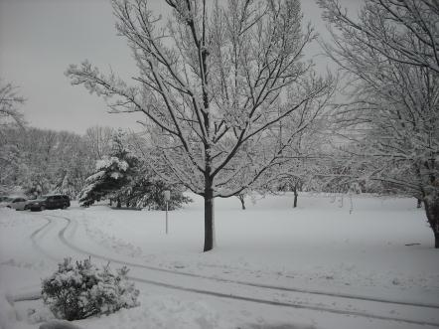

Weather Conditions: Water, Ice, and Snow
Notes:
Activity: What is the hazard?
Have the group identify the hazards represented in these pictures. Have them give other examples of possible situations.
Activity: Where does the hazard occur?
Hand out the “what is the hazard” worksheet to each participant. Ask them to work in small groups to identify specific hazards related to weather conditions at their workplace that they think are most problematic. Then, ask them to identify where these hazards occur in their workplace (which could include the items below).
Entrances; Parking garages and lots; Walkways; Outside stairs
Then, have them work on the final column asking “What are some potential fixes or solutions?” Some examples might include:
Have an aggressive program to promptly remove ice and snow from parking lots, garages, and sidewalks. Distribute winter weather warnings via email to staff when ice and snow are predicted. For staff that does not have access to email, provide notices on bulletin boards. Place freezing weather warning monitors at entrances to employee parking areas . Display phone or pager number for maintenance department via posters and emails to encourage employees to report icy conditions. Place labeled bins filled with ice melting chemicals and scoops that anyone can use immediately on icy patches. Provide additional mats in entrances during winter months and when it rains. Consider slip-resistant footwear (including ice cleats) for employees who work or travel outdoors as part of their jobs.
After they’ve worked on their chart, have the groups share their findings in report backs (round robin style – one example per group) and go through as many examples as you have time for.

Slide 14
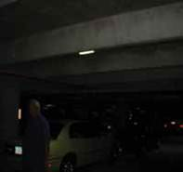
Inadequate Lighting
Need pictures of lighting issues – stairwells, parking lots, etc.
Notes:
Activity: What is the hazard?
Have the group identify the hazards represented in these pictures. Have them give other examples of possible situations .
Activity: Where does the hazard occur?
Hand out the “what is the hazard” worksheet to each participant. Ask them to work in small groups to identify specific hazards related to lighting at their workplace that they think are most problematic. Then, ask them to identify where these hazards occur in their workplace (which could include the items below).
Parking structures; Storage rooms; Hallways; Stairwells; Walkways both inside and outside the facility
Then, have them work on the final column asking “What are some potential fixes or solutions?” Some examples might include:
Install more light fixtures in poorly lit areas. Verify light bulbs have an appropriate brightness. Install light fixtures that emit light from all sides.
After they’ve worked on their chart, have the groups share their findings in report backs (round robin style – one example per group) and go through as many examples as you have time for.

Slide 15
Stairs and Handrails
Need pictures of stairs – poorly marked or uneven; handrails not of appropriate size or height
Notes:
Activity: What is the hazard?
Have the group identify the hazards represented in these pictures. Have them give other examples of possible situations .
Proper construction and maintenance of stairs and handrails can reduce hazards. Stairs that are poorly marked or uneven, as well as handrails that are not of the appropriate size, height, or are poorly maintained can lead to missteps and can cause employees to trip and fall.
Activity: Where does the hazard occur?
Hand out the “what is the hazard” worksheet to each participant. Ask them to work in small groups to identify specific hazards related to stairs and handrail hazards at their workplace that they think are most problematic. Then, ask them to identify where these hazards occur in their workplace (which could include the items below).
Indoor and outdoor stairs; Steps inside classrooms or conference rooms; Elevated and/or sloping walkways; Parking structures; Ramps
Then, have them work on the final column asking “What are some potential fixes or solutions?” Some examples might include:
Mark/highlight step edges and transition areas (changes in elevations). Use anti-skid paint/Slip-resistant strips on steps. Make sure stairs have sufficient lighting and hand rails. Ensure that stairs are kept free of ice, snow, water, and other slippery contaminants. Check that stairwells have adequate lighting. Consider adding a handrail at locations that have less than 4 steps (such as employee shuttle bus stop, building entrances, conference theaters).
After they’ve worked on their chart, have the groups share their findings in report backs (round robin style – one example per group) and go through as many examples as you have time for.

Slide 16
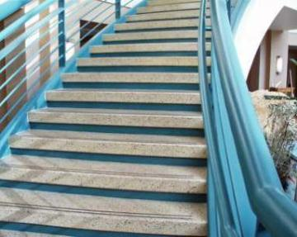
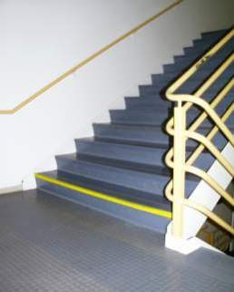
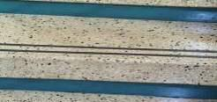
Prevention Solutions

Slide 17

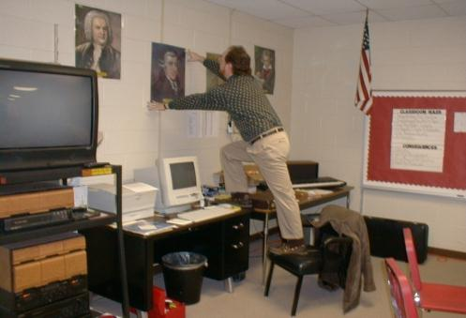
Stepstools and Ladders
Notes:
Activity: What is the hazard?
Have the group identify the hazards represented in these pictures. Have them give other examples of possible situations.
Stepstools and ladders used to work from heights can create a hazardous situation if not used properly.
Activity: Where does the hazard occur?
Hand out the “what is the hazard” worksheet to each participant. Ask them to work in small groups to identify specific hazards related to stepstools and ladders hazards at their workplace that they think are most problematic. Then, ask them to identify where these hazards occur in their workplace (which could include the items below).
Outdoors; Kitchens and pantries; office; Areas with elevated storage
Then, have them work on the final column asking “What are some potential fixes or solutions?” Some examples might include:
Train employees on the proper use of ladders. Wear appropriate footwear for climbing; shoes should have a closed back and sufficient tread on the sole to prevent slipping on ladder rungs or steps. Place ladders and stepstools on level surfaces before climbing. Check that stepladders are fully opened before climbing. Maintain three points of contact with the ladder at all time while ascending and descending (two hands and one foot or one hand and two feet).
After they’ve worked on their chart, have the groups share their findings in report backs (round robin style – one example per group) and go through as many examples as you have time for.

Slide 18
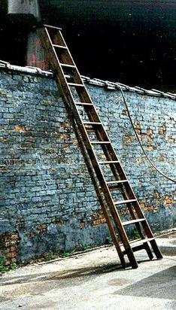
OSHA Walking and Working Surfaces Standard: Subpart D 1910.25-26: Portable Ladders
All ladders must be inspected periodically, kept in good condition at all times, and must be free from sharp edges, splinters, oil grease, or other defects which would affect their use.
Notes:
OSHA has many regulations related to portable ladders –both for their use and maintenance, which we won’t have time to go into during this workshop. However, some important general sections of the standard include the following:
Stepladders must be equipped with a metal spreader or locking device to securely hold the front and back sections in an open position.
Defective ladders must be removed from service and tagged o r marked "Dangerous, Do Not Use“.
Ladders should never be used in a horizontal position as scaffolds or work platforms.
Metal ladders should not be used near electrical equipment.
Ladders should always be placed on secure footings and locked in place.
Short ladders cannot be spliced together to make long ladders.
The top of a regular stepladder cannot be used as a step.

Slide 19

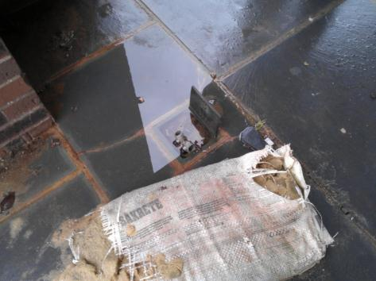
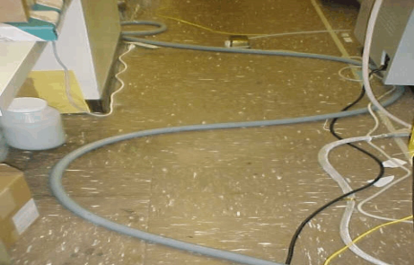
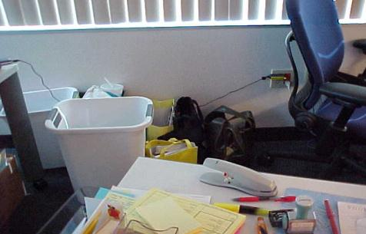
Tripping Hazards: Clutter, Loose Wires, etc.
Notes:
Activity: What is the hazard?
Have the group identify the hazards represented in these pictures. Have them give other examples of possible situations.
Clutter can build up in storage areas, work areas, hallways, and walkways potentially leading to an STF incident. Exposed cords on the floor, stretched across walkways, and tangled near work spaces can catch an employee’s foot and lead to a trip and fall incident. Open cabinet, file, or desk drawers can cause a fall.
Activity: Where does the hazard occur?
Hand out the “what is the hazard” worksheet to each participant. Ask them to work in small groups to identify specific hazards related to tripping hazards at their workplace that they think are most problematic. Then, ask them to identify where these hazards occur in their workplace (which could include the items below).
Computer workstations; Storage areas; Hallways and walkways; etc.
Then, have them work on the final column asking “What are some potential fixes or solutions?” Some examples might include:
Organize storage areas to eliminate clutter. Clear walkways. Use cord organizers to bundle cords. Cover cords on floor with a beveled protective cover or tape cords to flooring. Use retractable cord holders. Mount cords near or underneath the desk.
After they’ve worked on their chart, have the groups share their findings in report backs (round robin style – one example per group) and go through as many examples as you have time for.

Slide 20
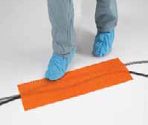
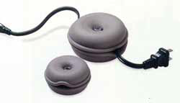
Prevention Solutions
Retractable cord holder
Cords on floor partially secured with cord cover. Cover can extend over the length of the exposed cord.

Slide 21
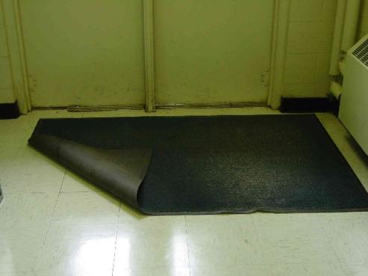
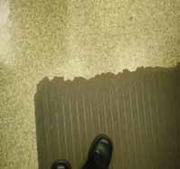
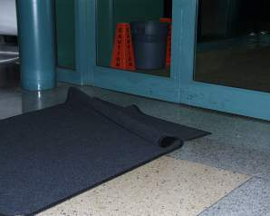
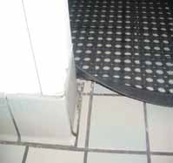
Improper Use of Floor Mats and Runners
Notes:
Activity: What is the hazard?
Have the group identify the hazards represented in these pictures. Have them give other examples of possible situations.
Mats are used to prevent STFs to provide slip-resistant walking surfaces by absorbing liquid, and by removing dirt, debris, and liquid from shoes. Mats are only effective if properly used and maintained. Old or poorly placed mats can contribute to slips, trips, and falls
Activity: Where does the hazard occur?
Hand out the “what is the hazard” worksheet to each participant. Ask them to work in small groups to identify specific hazards related to improper use of floor mats and runners at their workplace that they think are most problematic. Then, ask them to identify where these hazards occur in their workplace (which could include the items below).
Entrances; Food preparation and serving areas; Under sinks; Water fountains
Then, have them work on the final column asking “What are some potential fixes or solutions?” Some examples might include:
Mats and runners at entrances should be sufficiently large so that several footsteps fall on the mat, cleaning contaminants off the shoes, before the shoes contact the flooring. Place additional mats if necessary in entrances during ice, snow, and rainy conditions. If there is water on the floor beyond the last mat, additional mats or runners may be necessary. Use non-slip mats in areas where employees may routinely encounter wet flooring. Use beveled-edge, flat, and continuous or interlocking mats. Replace mats that are curled, ripped, or worn; secure edges with carpet tape if needed. Secure mats from moving. Paint small markers on the floor to remind staff to lay mats in the correct position everyday.
After they’ve worked on their chart, have the groups share their findings in report backs (round robin style – one example per group) and go through as many examples as you have time for.

Slide 22
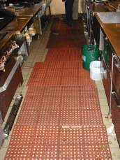
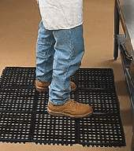
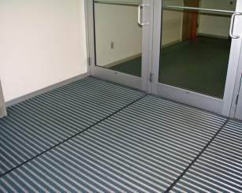
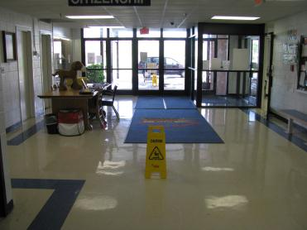
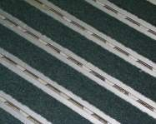
Prevention Solutions
Notes:
Install slip-resistant floors in high risk areas (entrances, kitchens).

Slide 23
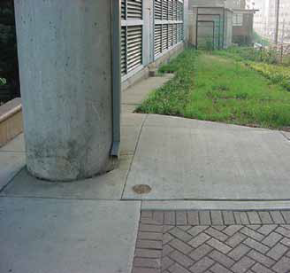
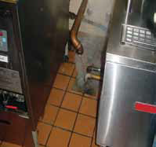
Poor Drainage: Pipes and Drains
Notes:
Activity: What is the hazard?
Have the group identify the hazards represented in these pictures. Have them give other examples of possible situations.
Drains and water pipes that are improperly aligned can cause liquid to spill onto walking surfaces, while clogged drains can cause water to back up onto the floor.
Activity: Where does the hazard occur?
Hand out the “what is the hazard” worksheet to each participant. Ask them to work in small groups to identify specific hazards related to poor drainage at their workplace that they think are most problematic. Then, ask them to identify where these hazards occur in their workplace (which could include the items below).
Drains inside the facility where liquids accumulate (particularly in kitchens and custodial areas). Down spouts that spill rainwater onto sidewalks
Then, have them work on the final column asking “What are some potential fixes or solutions?” Some examples might include:
Check that pipes are correctly aligned with the drain they are emptying into.
Unclog drains regularly, particularly in kitchens.
Redirect downspouts away from sidewalks with high-pedestrian traffic.
After they’ve worked on their chart, have the groups share their findings in report backs (round robin style – one example per group) and go through as many examples as you have time for.

Slide 24
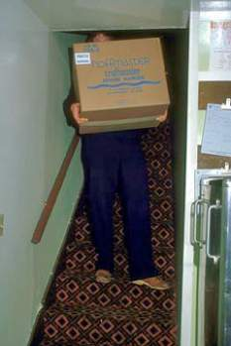
Human Factors Leading to Slips Trips and Falls
Health and physical condition can impair a person’s vision, judgment, and balance.
Carrying or moving cumbersome objects, or too many objects, that obstruct your view impair your balance and prevent you from holding onto handrails
Inattentive Behavior: walking, distractions (e.g., using cell phone, talking and not watching where you’re going, etc.)
Taking shortcuts; not using walkways or designated, cleared pathways; being in a hurry, rushing around
Notes:
QUESTION: What are some human factors that might lead to the occurrence of a slip, trip or a fall?
Generate some ideas and then reveal slide.

Slide 25
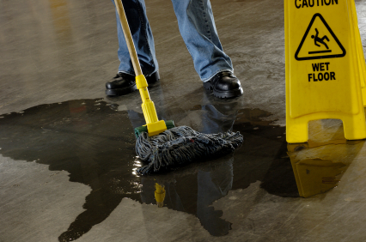
OSHA Walking and Working Surfaces Standard: Subpart D 1910.22: Housekeeping
Good housekeeping includes picking up, wiping up, and cleaning up.
Requires that all places of employment, passageways, storerooms, and service rooms shall be kept clean and orderly and in a sanitary condition.
Notes:
OSHA has a standard that addresses some of the hazards we identified today.
-1910.22: Housekeeping – Requires that all places of employment, passageways, storerooms, and service rooms shall be kept clean and orderly and in a sanitary condition. This includes keeping floors clean and dry, free from protruding nails, splinters, holes or loose boards.

Slide 26
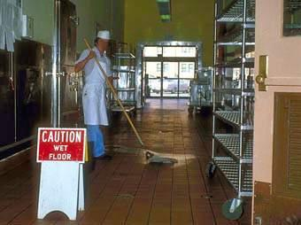
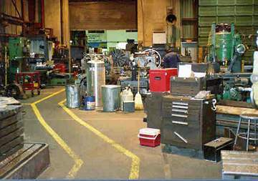
Maintaining Work Areas
Aisles and passageways must be kept clear and in good repair and include safe clearances for mechanical equipment and contain no obstructions that could create a hazard.
Notes:
OSHA also requires that aisles and passageways must be kept clear and in good repair and include safe clearances for mechanical equipment and contain no obstructions that could create a hazard. In warehousing type locations, aisles must be permanently marked.
Prevention is the Key!
Keep walkways, aisles, and stairs clear of materials, equipment, and other hazards.
Securely fasten unanchored loose rugs or mats with skid-resistant backing and carpet tape.
Close desk, cabinet, and file drawers and doors immediately after each use.
Keep the floor around work spaces free of boxes, cords, cables, materials, and other objects.
Keep floors clean and free of water, mud, grease, debris, etc, and damage.
Clean spills immediately. Mop or sweep up any debris.
COVER IF AUDIENCE IS APPLICABLE: Additionally, 1910.22 requires that covers and guardrails must be provided to protect workers from open pits, tanks, vats, ditches, etc. and load ratings must be marked on plates and be conspicuously posted or exceeded. An opening measuring 12 inches or more in its least dimension in a floor, platform, pavement, or yard, through which persons may fall.

Slide 27
Prevention Strategies
Develop and maintain a written housekeeping program.
The program might ideally describe:
How to immediately report STF hazards
Where and how cleaning materials and products are stored
When to use wet floor signs and barriers and where signs are stored
What cleaning methods are appropriate for different areas and surfaces
Notes:
Solutions to problems are different then the strategies needed to get them. One of the best strategies is a proactive plan to prevent STF’s from happening in the first place. This could be accomplished by developing and maintaining a written housekeeping program.
A written housekeeping program can help ensure the quality and consistency of housekeeping procedures.
The program should describe
■How to immediately report STF hazards
■Where and how cleaning materials and products are stored
■When to use wet floor signs and barriers and where signs are stored
■What cleaning methods are appropriate for different areas and surfaces

Slide 28

Tools for STF Prevention
Examine Employee STF Injuries
STF Checklist
Employee Communication: Training and Involvement
Notes:
Let’s look at some potential tools for STF Prevention.

Slide 29
Examine Employee STF Injuries
Review OSHA logs for STF incidents
Review incident reports
Check for “hot spots”
Investigate incidents to find the circumstances to see where prevention measures can be implemented.
SAMPLE INVESTIGATION TOOL
Notes:
One tool that may be helpful to prevent future incidents of STF is to review your employer’s injury records for STF incidents.
Read the narrative descriptions of the incidents to identify what types of STFs are most common in your facility and to identify specific locations where multiple STFs or “injury hot spots” may have happened over the years.
When a STF incident occurs, carefully examine the circumstances of the incident to see where prevention measures can be implemented.
HAND OUT SAMPLE INVESTIGATION TOOL

Slide 30

STF Checklist
Check for hazards on a regular basis
Take pictures!
Have a clear reporting procedure to get things addressed
SAMPLE CHECKLIST
Notes:
Another tool to consider is regular inspections for STF hazards.
It might be helpful to photograph, describe, and keep any reports on file so that changes can be made and documented.
HAND OUT SAMPLE INSPECTION CHECKLIST

Slide 31
Communication: Training and Involvement
All employees are at risk, therefore all employees should be trained on how to recognize STF hazards, and be involved in the development and implementation of prevention strategies.
Notes:
One of the best tools available is training! Slip, trip, and fall awareness and prevention training can be incorporated into routine safety training. Another idea would be to conduct General Awareness campaigns within the workplace (i.e., booths, posters, emails, paycheck inserts, and incentives) educating employees about the risk of STFs at work and what they can do to prevent injuries.

