Slide 1
EMPLOYEE SAFETY AND Ergonomics awareness training AND BEST PRACTICES for electric utilities
Notes:
SCRIPT: In this section we will cover the material in the safety awareness training program and give tips on how to present the material.
LEARNING OBJECTIVE: Introduction

Slide 2
DISCLAIMER
This material was produced under grant number SH-22220-SH1 from the Occupational Safety and Health Administration, U.S. Department of Labor. It does not necessarily reflect the views or policies of the U.S. Department of Labor, nor does mention of trade names, commercial products, or organizations imply endorsement by the U.S. Government.
Notes:
SCRIPT: The presentation materials were developed at the University of Wisconsin-Milwaukee (UWM) through a Susan Harwood Grant provided by the Department of Labor.
LEARNING OBJECTIVE: Grant source

Slide 3
WHAT ARE WE GOING TO DO TODAY?
Pre-test
Safety and Ergonomics Awareness Training and Best Practices
Employee Rights and Responsibilities
State OSHA Plans
Post-test and Feedback questionnaire
Notes:
SCRIPT: This is an outline of what we are going to do today. You have already taken the pre-test. The bulk of the training will cover Safety and Ergonomics Awareness specific to the Electric Utility industry. The remaining topics (Employee Rights & Responsibilities and State OSHA plans) are reminders of the laws and rules for workplace safety. After the training is completed today, you will take the same test again, to determine what you learned.
LEARNING OBJECTIVE: Overview of training objectives

Slide 4
POTENTIAL BENEFITS
LEARN ABOUT:
  Safety and Ergonomics
  Risk factors for potential injuries
  Work practices and share good ideas
IMPROVE:
  Safety
  Job satisfaction
Everyone, can benefit from ergonomics and safety programs and training!!!
!
Notes:
SCRIPT: What are the potential benefits of this course? Give an opportunity for trainees to respond. Today we are going to touch upon some key topics in Safety and Ergonomics relevant to the electric utility industry. We will learn how to identify the risk for injury in your job and share best practices. With this safety training program, we hope to improve your safety and job satisfaction. How will job satisfaction improve if you have a safe workplace? A safe workplace will allow us to go home in the same condition we came to work in. Safety and ergonomic programs and training can benefit everyone. Remember the test before we started the training?
LEARNING OBJECTIVE: Potential benefits of this course

Slide 5
TOP INJURIES IN UTILITY INDUSTRY
!
Top 3
Source: http://www.bls.gov/iif/oshwc/osh/case/ostb2450.pdf
Notes:
SCRIPT: Let us first discuss what the common problems/injuries are in the utility industry, especially for electric utilities. This graph shows all non-fatal injuries, meaning the injury did not result in death, in all utilities and the electric utility industry (including power generation, transmission and distribution). The black bars describe injuries in all utilities, and the orange bars are specific to the electric utility industry. Did you know that slips/trips/falls are the number one cause of non-fatal injuries in all utilities as well as electric? They contribute to a quarter of all injuries. The next two major causes of injuries are overexertion, followed by struck/caught. These top three causes contribute to 65% of all injuries in the electric utility sector. That is why, today we are going to spend the majority of our time discussing these types of injuries.
LEARNING OBJECTIVE: Top 3 causes of non-fatal injuries in utility industry

Slide 6
FATALITIES IN UTILITY INDUSTRY
Exposure to harmful substance/environment
Source: http://www.bls.gov/iif/oshwc/cfoi/cftb0241.pdf
Notes:
SCRIPT: This graph shows all fatal injuries, meaning the injury did result in death. Again, the black bars describe injuries in all utilities, and the orange bars are specific to the electric utility industry. What do you think is the number one cause of deaths in the electric utility sector? Give an opportunity for trainees to respond.
Hopefully, contact with electric current/electrocution will be one of the answers. Yes, that is correct. Two-thirds of deaths in the electric utility field are due to exposure to harmful substances and environments such as exposure to electric current. Note that for all utilities, this number is only 30%. Today we will also be covering two important topics relating to the number one cause of deaths- electrical shock/electrocution and arc flash.
Falls contribute greatly to the remaining one third of deaths in electric utilities.
LEARNING OBJECTIVE: Causes of fatal injuries in utility industry

Slide 7
INJURIES COVERED
MUSCULOSKELETAL DISORDERS (MSDs) :
Various condition(s) that involve damage to bones, joints, ligaments, muscles and tendons, intervertebral discs and nerves
MSDs can be
  Acute
  Cumulative
  Chronic
  and in the most severe cases may be disabling
Notes:
SCRIPT: We characterize the strain, sprain and other injuries that involve damage to bones, joints, ligaments, muscles, tendons, intervertebral discs and nerves as musculoskeletal disorders or MSDs for short. MSDs can be acute, cumulative, or chronic and in the most severe cases may be disabling. An acute injury is an injury that occurs from one incident, such as trying to lift more than you should and immediately feeling pain. The pain from this TYPE OF injury tends to be short-term. Cumulative injuries occur over time, and it may be difficult to attribute the pain or discomfort to one particular moment. Chronic injuries could be a result of an acute or cumulative injury that never fully heals or could be caused by other personal factors, such as arthritis.
LEARNING OBJECTIVE: Musculoskeletal injury definitions and descriptors

Slide 8


SCOPE
GOALS
To evaluate examples of utility work Identify potential risk of injury
Share best practices
Propose solutions
Work safe!
ACTIVITIES OBSERVED
Lifting/carrying
Pushing/pulling
Bending/reaching
Walking
Climbing
Kneeling
Shoveling/digging
Wire cutting
Driving
and much more…
Better practice
!
Poor practice
Slide contains an answer from your test question
Notes:
SCRIPT: What kinds of activities were observed? Well, lifting and carrying, pushing and pulling, bending, reaching… wire cutting, driving. Is there anything missing from the list? Give an opportunity for trainees to respond.
We will learn about the most common risk factors that contribute to injuries. There will be examples from the utility industry (photographs, videos, or customized illustrations). As a group, we will evaluate the work together and identify potential risks for injury. If there is a poor practice, it will be marked with a red “X” and a better practice will be marked with a green check mark. Best practices found during observations will be shared, and as a group we will discuss your ideas for new solutions. Please feel free to ask questions if you do not understand any topic. We are here for your safety!!! Also, a red exclamation mark on the bottom right of the screen means that a test answer is on the slide!
LEARNING OBJECTIVE: This training is specific to the utility worker’s job/activities

Slide 9
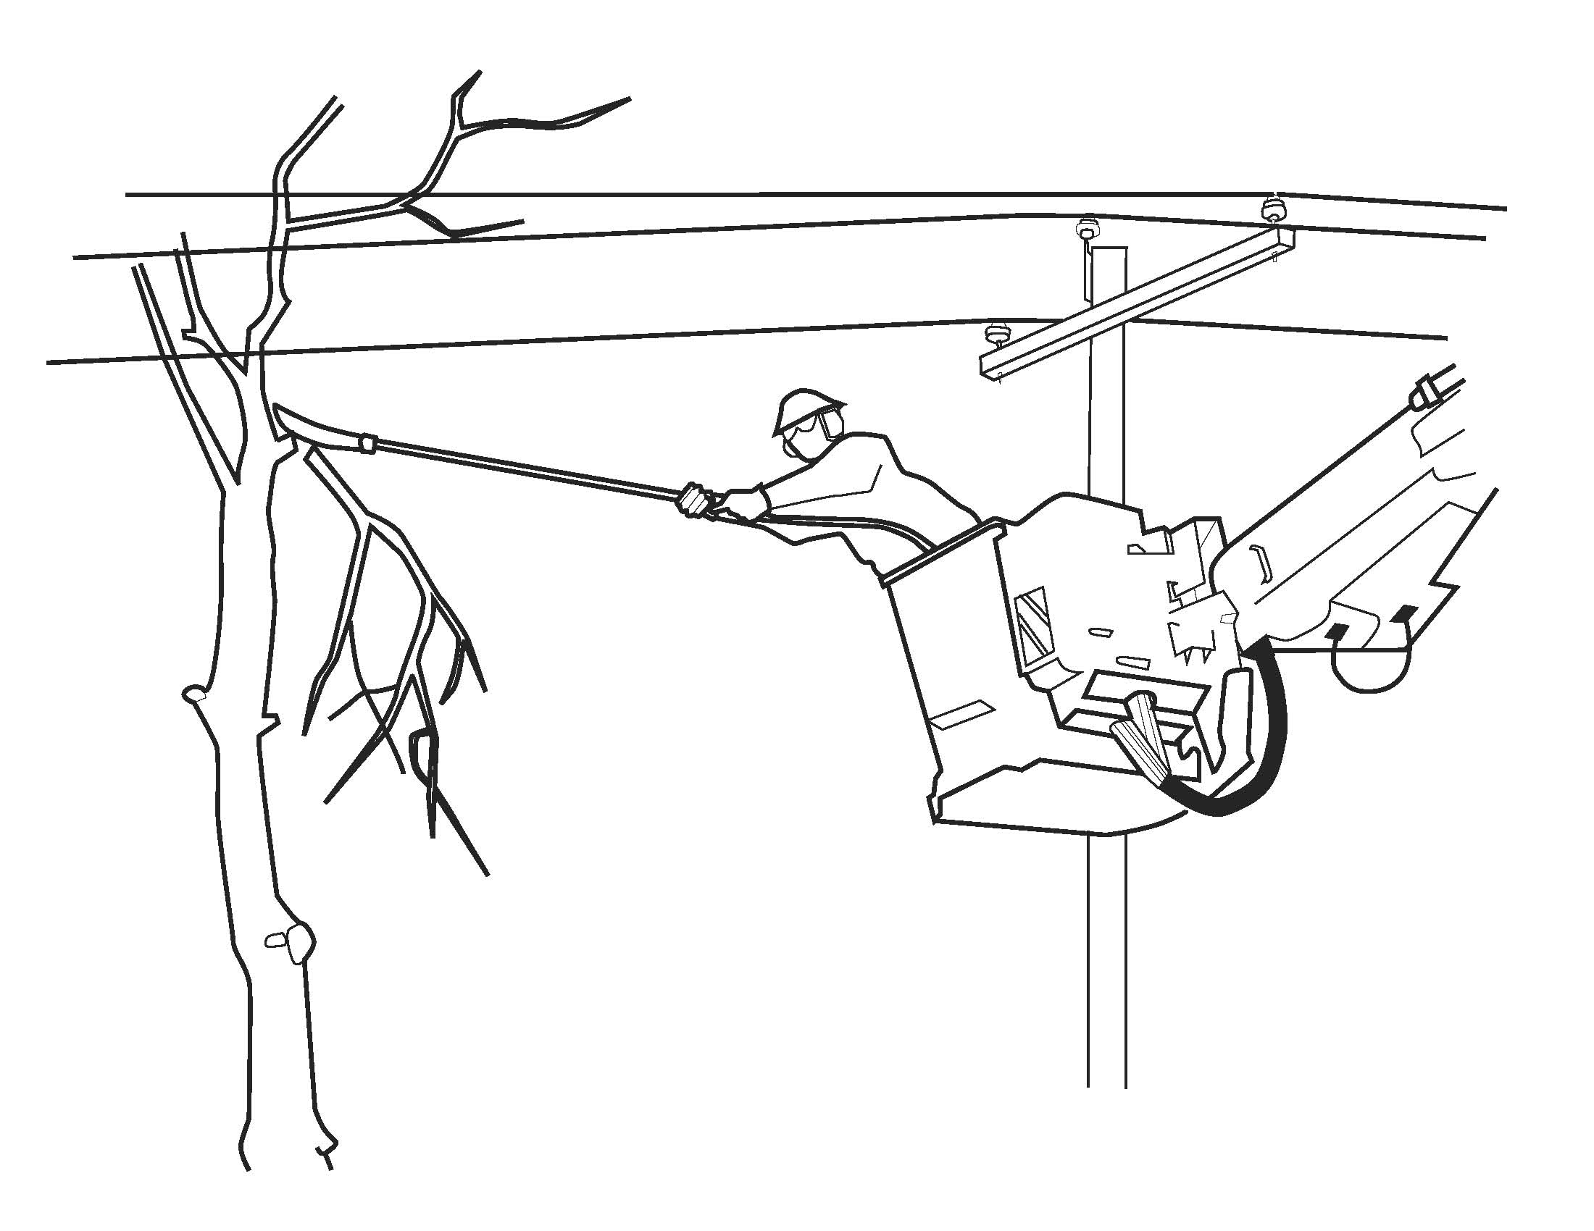
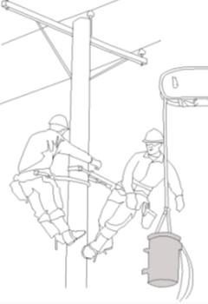
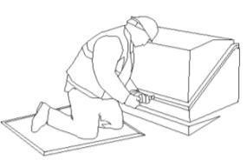
TYPICAL WORK TASKS OBSERVED
Electric line work
Pole installation
Underground work
Changing transformers
Transmission stations
Electric meter installation/service/reading
Tree trimming/brush work
Warehouses and mechanic shops
Vehicles
  Loading and unloading
  Climbing
  Organization
  Driving
Notes:
SCRIPT: The materials were developed based on hours of observations in the field. The team observed electric line work, either for new service or during repairs. Some other tasks involved electric meters - installation and change-out of the meter and reading meters, brush work, maintenance and driving vehicles.
LEARNING OBJECTIVE: This training is specifically designed for electric utility workers

Slide 10
WHAT IS ERGONOMICS AND SAFETY?
ERGONOMICS (ergon – work and nomos – laws)
Considers
  Physical interaction of worker with tools and materials
  Workplace conditions and demands
  Capabilities of the workers
  SAFETY
Considers
  Physical and environmental factors that may affect workers health or cause an injury or even death
Notes:
SCRIPT: So what is ergonomics and safety? Have you ever heard of the word ergonomics? Give an opportunity for trainees to respond. Have any of you ever had safety or ergonomics training before? Give an opportunity for trainees to respond. If someone answers yes, ask what it covered. Ergonomics has been around for some time. There are two parts to the word ergonomics: ergon which means work and nomos which means natural laws. So, ergonomics is the natural laws of work. Who needs to know the natural laws of work? Well, anyone that works. Ergonomics looks at the physical interaction between you and your tools or materials. Ergonomics takes into account the workplace conditions and demands of the job or task, and compares them to the worker’s capabilities. By looking at what the task requires, and a person’s capabilities, tasks can be redesigned to enhance performance and minimize the risk of injury. Safety on the other hand considers a larger scope. Safety programs take into account other environmental aspects of the job, such as the exposure to chemicals.
LEARNING OBJECTIVE: Definition of ergonomics. Learn the differences and similarities between safety and ergonomics

Slide 11
overexertion
Notes:
SCRIPT: This module covers overexertion
LEARNING OBJECTIVE: Introduction to overexertion

Slide 12
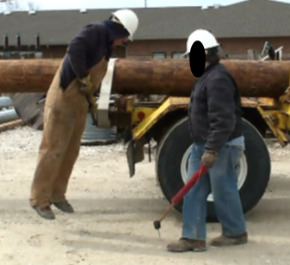
OVEREXERTION
Definition:
  Occurs when a person lifts, lowers, carries, pushes, pulls, handles object(s) in any other manner, or performs any other activity that exceeds their physical capacity.
Pushing down on wrench to fasten cable
Notes:
SCRIPT: What is an overexertion injury? Give an opportunity for trainees to respond. Overexertion injuries occur when you exceed your limits. Have you ever experienced an overexertion injury? Give an opportunity for trainees to respond. An overexertion injury can occur from lifting a load once or from repeated motions. Did you know that you can injure yourself by repeatedly lifting, carrying, pushing or pulling something that weighs less than your maximum capability?
LEARNING OBJECTIVE: Repetitive exertion of less than maximum capacity OR exerting once beyond your capability can cause an overexertion injury.

Slide 13
EXAMPLE INJURY REPORTS
OVEREXERTION
Employee was lifting a cross-arm into bucket and hanging it on the pole. Employee felt lower back pain while lifting the cross-arm.
Employee experienced sharp pain in low back while bending over to tighten a nut on a bolt.
Notes:
SCRIPT: Let’s discuss a couple of examples of overexertion injuries. Read first example on slide. Do you install cross-arms on the pole while in a bucket? The employee was lifting a cross-arm into the bucket and hanging it on the pole and felt pain in the lower back. Does this injury seem possible or familiar to you? What caused the injury? Give an opportunity for trainees to respond. How much do cross-arms weigh? Give an opportunity for trainees to respond. Typically cross-arms are about 70-90 pounds and are held close to the body at chest level while installing. But the employee was working alone in the bucket and did not move close enough to the cross-arm which put stress on his back. Read second example on slide. Does this injury seem possible or familiar to you? Give an opportunity for trainees to respond. What caused the injury? Give an opportunity for trainees to respond. Even though the bolt and wrench are not heavy, working in a bent position for sometime can cause an overexertion injury because of the cumulative effect of exerting oneself below maximum capacity over time.
LEARNING OBJECTIVE: Overexertion injury examples

Slide 14
TYPES OF OVEREXERTION INJURY
Strain – an injury to a muscle or tendon
    Tendon connects muscle to bone
  Example: back strain
Sprain – an injury to a ligament
    Ligament connects bone to bone
  Example: knee sprain
Tendonitis–inflammation of a tendon
    Symptoms include swelling, burning and visible knots
  Example: Tennis Elbow
Carpal Tunnel Syndrome– a hand-wrist condition characterized by compression of the median nerve
    Symptoms include numbness, tingling, or burning sensations in the hands or wrists
Notes:
SCRIPT: This section covers lifting and carrying and how these tasks can cause overexertion injuries. How often have you heard this: “I hurt my back while twisting to lift something”? Give a chance for trainees to respond. What other injuries can lifting/carrying cause? Give a chance for trainees to respond.
LEARNING OBJECTIVE: Introduce trainees to overexertion due to lifting/carrying tasks.

Slide 15
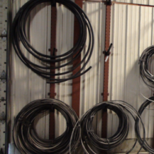
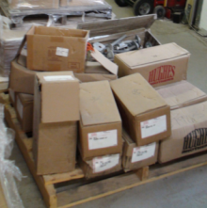
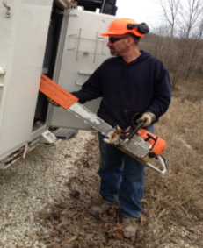
LIFTING
Cables, boxes, tools, tool bags
and much more…
Cables
Boxes
Tools
Notes:
SCRIPT: This section covers lifting and carrying and how these tasks can cause overexertion injuries. How often have you heard this: “I hurt my back while twisting to lift something”? Give a chance for trainees to respond. What other injuries can lifting/carrying cause? Give a chance for trainees to respond.
Figure shows worker lifting an item from a shelf where different items are stored.
LEARNING OBJECTIVE: Introduce trainees to overexertion due to lifting/carrying tasks.

Slide 16
WHAT AFFECTS LIFTING?
Before lifting a load, ask yourself:
  Is it light/heavy?
  Is it located too low/high?
  Do you have to twist or bend sideways to reach it?
  Where do you have to move it?
  How often will you have to lift it?
Bending down to place a box on the pallet
Notes:
SCRIPT: A person can lift the most weight closest to the center (power zone) of his/her body. The further away the load is, in any direction from the center, the less a person can lift.
LEARNING OBJECTIVE: Recognize that the shape of the object, the manner in which it’s weight is distributed, the grip and location also play a role in lifting.

Slide 17
KNOW YOUR LIMITS: LIFTING
 |  | One lift every ….
 |  | 30 minutes |  |  | 8 hours
 | 90% | Floor level to knuckle | Knuckle to shoulder | Shoulder & above | Floor level to knuckle | Knuckle to shoulder | Shoulder & above
Lift a load 30" wide; move it up or down ~10 inches | Male | 37 lbs | 46 lbs | 35 lbs | 44 lbs | 51 lbs | 40 lbs
 | Female | 24 lbs | 26 lbs | 20 lbs | 31 lbs | 31 lbs | 22 lbs
!
Source: Snook, S. H., & Ciriello, V. M. (1991). The design of manual handling tasks: revised tables of maximum acceptable weights and forces. Ergonomics, 34(9), 1197-1213.
Notes:
SCRIPT: The table on this slide shows the allowable/safe maximum load to be lifted based on origin of the lift location and the number of times a load needs to be lifted. The table shows what can be lifted safely by 90% of the population, or nearly every healthy individual. The male population is in black text and females are in the red text. The labels along the top show how often the lift occurs, every 30 minutes or every 8 hours, and below that, it is broken down by where the lift is located: floor level to knuckle, knuckle to shoulder and shoulder and above.
Let’s take one example. Let’s say that a lineman picks up a load (cable) from elbow height on to the shoulder every 30 minutes (lifting cable off floor on to shoulder). The maximum recommended weight is 46 pounds. But if he lifts once every 8 hours, the maximum weight is 51 pounds. So how often you lift changes the maximum weight recommendation. When lifting every 30 minutes, if the load is located below knuckle level, it is recommended that you lift less than if the load is between knuckle and shoulder height. To recap, where the load is located and how often you need to lift the items changes the maximum weight that can be lifted safely, and each person has different capabilities.
LEARNING OBJECTIVE: Lifting load capabilities change depending on load location, lifting frequency, and personal capabilities

Slide 18
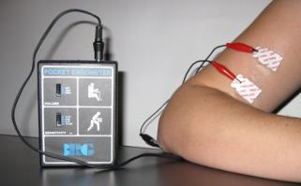
POSTURE AND LIFTING
Let’s hear our muscles work when lifting
Notes:
SCRIPT: Your posture has an effect on the work you can perform. Let’s hear our muscles work in a variety of postures using this ergometer. Ask for a volunteer. Place 2 electrodes (red leads) on the bicep muscle and 1 electrode (black lead) on the elbow. Instruct the person to relax with the arms besides the body. Do you hear anything? Give an opportunity for trainees to respond. Instruct the volunteer to do some bicep curls. Do you hear anything? Give an opportunity for trainees to respond. Instruct the volunteer to relax and lift an object weighing 10 lbs, then lift a heavier object-say 20 lbs. Do you hear the difference when the load is more? Now place the object on the floor and try lifting the object from between your feet, then try lifting it from farther away. Also try lifting from floor to knuckle, knuckle to shoulder and above the shoulder. Do you see the difference?
LEARNING OBJECTIVE: Recognize and avoid hazards; proper work techniques and best practices
Materials needed: ergo meter available at http://www.thehumansolution.com/ergometer.html
Alternative exercise if you don’t have the equipment: Ask trainees if they have ever installed anything into the ceiling (fans, lights, etc). Were you the one holding the fan or were you the one working on the fan? Ask the trainees if they can remember how their body felt while working on this project (shoulders, muscles, easier to fatigue, etc.). Use these examples to emphasize the point of how posture can decrease your strength capabilities.

Slide 19
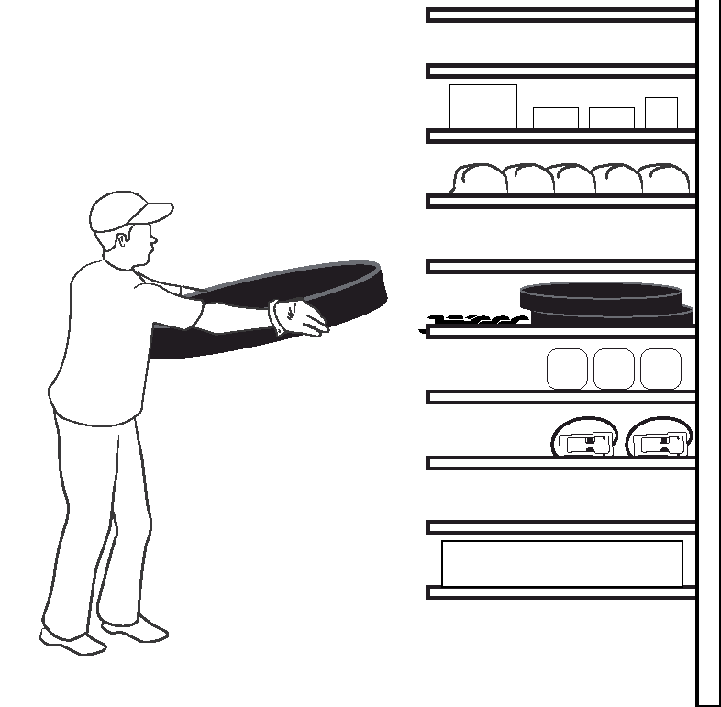
ARE YOU UP TO THE TASK?
Consider:
  Previous injury
  Environment (heat, humidity or cold)
  Physical fitness
  Age
  Gender
  Weight
Ask for help!
  Don’t let this be you:
  “I was in a hurry. I thought I could lift it by myself.”
Notes:
SCRIPT: Everyone’s capabilities are different. Have you ever been injured? Give an opportunity for trainees to respond. If someone says yes, Were you able to do the same work after the injury? What about the heat or cold? Doesn’t the environment change what you can do? Yes, and you need to be aware that everyone is different. In interviewing employees after an injury, employees will often say, “I was in a hurry. I thought I could lift it by myself”. Don’t let this be you!
LEARNING OBJECTIVE: Understanding individual capabilities

Slide 20

WHEN LIFTING
BETTER PRACTICE
Store heavy items in easy to reach places
Find a good grip
Bend your knees and keep your back straight
Keep the load close to your body
Wear shoes with good soles to maintain firm footing
Reduce the size/weight of the load if possible
Use equipment instead of lifting manually, otherwise seek a coworker’s help
AVOID
Overloading
Twisting
If lifting from the floor, keep the load between your legs, not in front of your knees
Notes:
SCRIPT: Here is a checklist of items to remember when lifting. Read some or all items on the list. Add personal examples or ask for an example from the training group.
LEARNING OBJECTIVE: Recognize and avoid hazards; proper work techniques and best practices

Slide 21
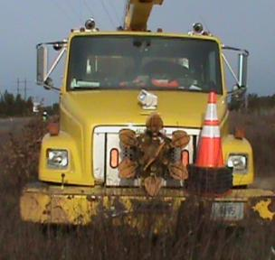
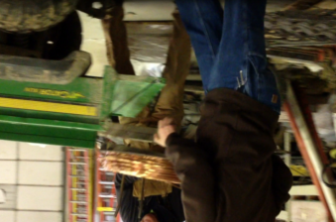
POTENTIAL IMPROVEMENT
LIFTING
Ask another worker to help
  Communicate clearly on when you will start lifting and how you will lift together
Use carts or equipment
instead of lifting manually
Two workers lifting wire reel
Take up reel location on truck
Notes:
SCRIPT: Potential improvements when lifting include asking for help if the item is too heavy (figure on the left) or consider storing the take up reel on a cart and using the crane-type device to move the reel from the cart to the truck (figure on right) and vice-versa.
LEARNING OBJECTIVE: Sharing best practices

Slide 22
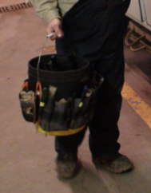
CARRYING
Notes:
SCRIPT: On the job, you carry cables, tools, tool bags/boxes (see figure), take up reels, cross-arms and other items. These items can vary significantly in dimensions and weight and can be easy/difficult to carry.
LEARNING OBJECTIVE: Sharing experiences.

Slide 23
KNOW YOUR LIMITS: CARRYING
 |  | One carry every ….
 |  | 30 minutes |  | 8 hours
 | 90% | 7 ft | 28 ft | 7 ft | 28 ft
Carrying at elbow height | Male ~44 inches | 46 lbs | 37 lbs | 51 lbs | 44 lbs
 | Female ~41 inches | 29 lbs | 26 lbs | 40 lbs | 35 lbs
Source: Snook, S. H., & Ciriello, V. M. (1991). The design of manual handling tasks: revised tables of maximum acceptable weights and forces. Ergonomics, 34(9), 1197-1213.
Notes:
SCRIPT: The table on this slide is similar to the lifting table, but shows that the maximum load that can be safely carried depends on how often and how far you have to carry it. The table shows what can be carried safely by 90% of the population, or nearly every healthy individual. The male population is in black text and females are in red text. The labels along the top show how often the load is carried, every 30 minutes or every 8 hours, and below that, it is broken down by how far the load is carried.
Let’s take one example. Let’s say that the load (a cable) is being carried for 28 feet, every 30 minutes at elbow height. The maximum recommended weight for males is 37 pounds. But, if it the load is carried only once every 8 hours, the maximum weight is 44 pounds. So, how often you carry a load changes the maximum weight recommendation. And when carrying every 30 minutes, if the distance is about 7 feet you can carry 46 pounds while if the distance traveled is 28 feet, the maximum recommended weight is 37 pounds. So the distance you carry the load also affects the recommended maximum weight. To recap, how often you need to carry items and the distance the items are carried changes the maximum load that can be safely carried. And remember that each person has different capabilities (refer to the slide title “know your limits” if needed).
LEARNING OBJECTIVE: Carrying load capabilities change depending on distance traveled, lifting frequency, and personal capabilities

Slide 24
CARRYING
BETTER PRACTICE
Determine how heavy the load is/should you ask for help?
Know where you are going before you start
Find a way to reduce distance
Find a good grip
Reduce the size/weight of the load if possible
Keep the load close to your body
Wear shoes with good soles to maintain firm footing
Consider a cart
Handles
  Grips diameter between 2-2.5” in
  If necessary, add a sleeve or cushion
AVOID
Overloading
Bulky items or blocking your vision
Taking loads up/down stairs or over uneven ground
Long periods of carrying
Sudden movements
Notes:
SCRIPT: Similar to the lifting checklist, here’s the “better practices” and “avoid” list when carrying. Read some or all items on the list. Add personal examples or ask for an example from the training group.
LEARNING OBJECTIVE: Recognize and avoid hazards; proper work techniques and best practices

Slide 25
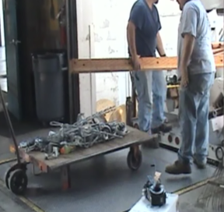
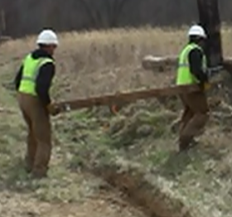
POTENTIAL IMPROVEMENT
If it is too heavy or bulky:
Ask another worker to help
  Communicate clearly on how you will carry together
Not using help to carry cross-arm
Two persons carrying cross-arm
Notes:
SCRIPT: Instead of carrying heavy items alone, get the help of a co-worker.
LEARNING OBJECTIVE: Sharing best practices

Slide 26
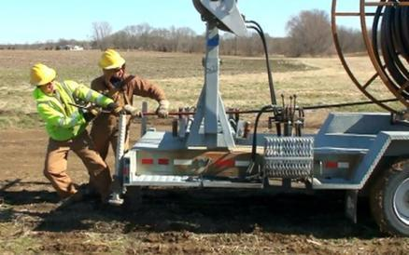
PUSHING/PULLING
Notes:
SCRIPT: This section covers pushing and pulling and how these tasks can cause overexertion injuries.
LEARNING OBJECTIVE: Introduce trainees to overexertion due to pushing/pulling tasks.

Slide 27
EXAMPLE INJURY REPORT
Employee hurt right elbow while pulling on an 18" crescent wrench to loosen anchor bolts.
______________________
Notes:
SCRIPT: Have you had an injury due to pushing/pulling? What other injuries can push cause? Give a chance for trainees to respond.
LEARNING OBJECTIVE: Sharing experiences.

Slide 28
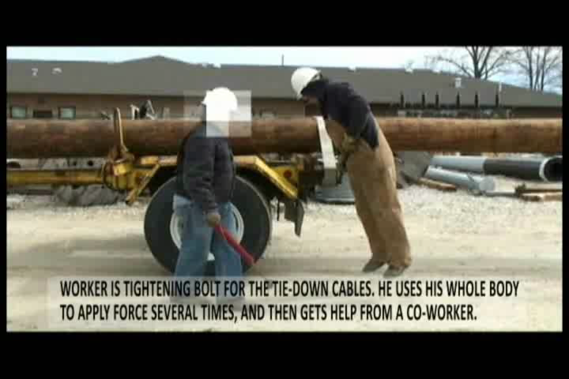
TIGHTENING A BOLT-POLE FRAMING
Notes:
SCRIPT: This video shows a worker tightening the bolt for the cable that holds poles in place on a truck. The worker has a lot of difficulty in performing this task. He uses his whole body to apply force, not once but twice. His co-worker also lends him a hand in the end. Does this happen frequently? Why do you think this task is so difficult? Give a chance for trainees to respond. The reason is the bolt on the truck is heavily rusted!
Using a lubricant and maintaining equipment can avoid this problem!
LEARNING OBJECTIVE: Recognize tasks which are associated with pushing/pulling and the hazards for overexertion injuries

Slide 29
WHEN PUSHING/PULLING
BETTER PRACTICE
Use your body weight
Use both hands
Watch your body position, where will you go if ___ fails?
Use equipment to make the task easier
  Maintain equipment regularly
  Check equipment before use
  Pneumatic wheels are better for uneven ground
  6 wheeled carts are easier to push than 4 wheeled carts
  Combined fixed and swivel casters for easier turns
Wear shoes with good soles to maintain firm footing
Ask for help
AVOID
Pushing/pulling more than you should
Uneven ground/surfaces or water
Pushing/pulling unstable items
Using broken equipment
Pushing/pulling over long distances
Overloading the cart
Notes:
SCRIPT: Similar to the other checklists, this is the “better practices” and “avoid” list for pushing and pulling. Ask for an example.
LEARNING OBJECTIVE: Recognize and avoid hazards; proper work techniques and best practices

Slide 30
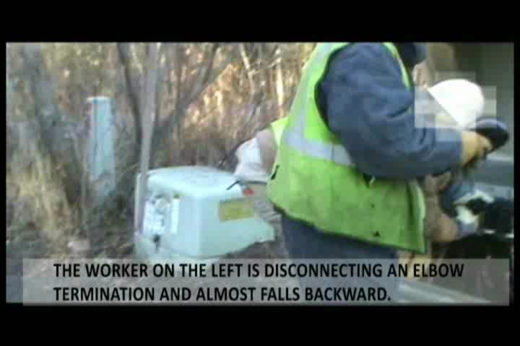
DISCONNECTING AN ELBOW TERMINATION
Notes:
SCRIPT: Disconnecting an elbow termination is a difficult task that places stress on the worker’s low back and shoulders. Did you know that this task requires over 100 lbs of pulling force? The task becomes more difficult if the worker does not have proper footing, the ground is slippery or obstacles are present and there is a risk of falling backwards.
What other problems can this task cause? Give a chance for trainees to respond. Excessive pulling force can also cause the worker to reel back and fall.
Demonstrate the ergofet. Try to attach the ergofet to some handle (cart) to measure pushing/pulling forces. You can also push against a stable surface to demonstrate that it doesn’t take a lot to reach the maximum allowed force.
Ergofet manufacturer: Hoggan.
Available at: http://hogganhealth.com/microfet-ergonomics2.php?product=ergoFET
LEARNING OBJECTIVE: Discuss ways to understand the risks associated with this task and discuss potential solutions.

Slide 31

POTENTIAL IMPROVEMENT
PUSHING/PULLING CABLE THROUGH CONDUIT
Use equipment to improve the task, a capstan winch may help.
Pulling sock
Conduit
Lead wire
Cable
Attach end to capstan winch
Twine
Pulling cable through conduit using a winch
Notes:
SCRIPT: What do you do to push/pull cables through conduit? Skip this if the method is already used. Mention they can use this even for short cable lengths/runs.
Instead of manually pushing/pulling long cables through conduit, use the following procedure including a capstan winch. This procedure will reduce the forces exerted on the hands, arms and shoulders and improve productivity while reducing the time required to perform the task.
Step 1: Insert and pull twine through the conduit using a vacuum pump
Step 2: Connect twine to lead wire and pull lead wire through conduit
Step 3: Attach the cable to the rope using a pulling sock attached to the lead wire and guide the lead wire through the conduit
Step 4: Apply a lubricant to cables to reduce friction, or purchase pre-lubricated conduit
Step 5: Fix the lead wire onto a portable motorized capstan winch (on the truck) and allow the capstan to pull cables through conduit.
Do you have any other potential solutions for improving this task? Give a chance for trainees to respond.
LEARNING OBJECTIVE: Sharing best practices.

Slide 32
POTENTIAL IMPROVEMENT
REMOVING ELBOW TERMINATIONS
Use a lever action pulling tool in combination with the hot stick to remove terminations
Notes:
SCRIPT: A lever action pulling tool in combination with a hot stick can be used to remove terminations. This will provide a mechanical advantage, enable the worker to maintain a better posture and reduce the force required to perform this task. This will reduce the risk of overexertion or falling.
LEARNING OBJECTIVE: Sharing best practices.

Slide 33
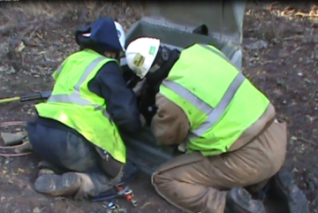
AWKWARD POSTURE
!
Did you know - an awkward posture reduces your strength or ability to perform the task?
  Let’s try an exercise
Notes:
SCRIPT: Read the question on the slide. Let’s try this 2 part exercise. Everyone stand up. If you have a previous injury, or cannot do this exercise, you can be excused from the exercise or refrain from doing it. First, bend forward and try to touch the floor in front of you or touch your toes. Ok, everyone or nearly everyone was able to do that part. Now, twist only your upper body towards one direction. Hold that twist. Now, try to bend forward and touch the floor in front of you or touch your toes. Okay everyone, let’s sit down and discuss what happened. Was it easier or harder to touch the floor while twisting your upper body? Let the audience respond. So why was that difficult or impossible to do? Let the audience respond. In the end summarize audiences response into it is harder to do work when in an awkward posture.
LEARNING OBJECTIVE: Awkward body positions reduce your strength and capabilities.
Use the below SCRIPT for the following activity---Materials needed: hand grip dynamometer if you don’t have the equipment: improvise and use a dumbbell/box/weight etc and ask people to hold object in the various positions.
Hand grip dynamometer manufacturer: Jamar. available at: http://www.thehumansolution.com/dynamometers.html
SCRIPT: This is a grip dynamometer. When you grip the device, it will show the maximum force you exerted. Ask for a volunteer to come up to the front of the room. Ask the volunteer. Can you think of an awkward posture you would need to be in while working? Now get into that position. Ok, take the grip dynamometer and grip as hard as you can. Awkward posture could be with their arm raised over their head or behind their back. Read the number and reset the device. Ok, now take the grip dynamometer and in the good working posture (arms to the side or arm in front of them at elbow at 90 degrees), grip as hard as you can. Read the number. The number should be lower in the awkward posture. Tell the class, a drop of as much as 30% in strength capability can occur while working in an awkward posture. Pass the tool around the class to let everyone try.

Slide 34
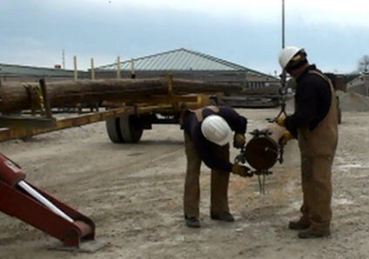
EXAMPLE INJURY REPORTS
AWKWARD POSTURE
“Employee felt a sharp pain in the low back while bending over to tighten a nut on a bolt”
Notes:
SCRIPT: Read the text on the slide. Isn’t it obvious how this injury could occur? Give an opportunity for trainees to respond. How can this task be improved? Give an opportunity for trainees to respond.
LEARNING OBJECTIVE: Recognize the problem and share ideas

Slide 35
AWKWARD POSTURE
May be assumed while:
  Working on a transmission/junction box
  Working in trenches/pits
  Working in the bucket
  Meter reading
  Shoveling
  _________________
Notes:
SCRIPT: A worker can assume an awkward posture while working on any task be it meter reading, shoveling, working in a bucket doing brush or line work, working on a transmission/junction box or working in trenches/pits. Can you think of any other situations where one might assume awkward posture? Give an opportunity for trainees to respond.
LEARNING OBJECTIVE: Recognizing tasks associated with awkward postures.

Slide 36
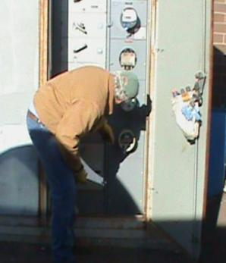
AWKWARD POSTURE EXAMPLE
Meter location can force your body into awkward postures and cause stress to the low back and neck when the meter is:
  Mounted below waist height
  Mounted above shoulder height
  Obstructed
Worker is bending to read meter
Notes:
SCRIPT: Meter reading is another example of a commonly performed task. You can find meters installed in many different positions. They are not always between knee and shoulder height with unobstructed access. They can be mounted low or high, have bushes or other obstacles, be located in dark or cramped quarters, etc. Any of these conditions can cause you to bend, twist, or assume other awkward postures. Awkward postures can put additional stress to your neck, low back, and even shoulders.
LEARNING OBJECTIVE: Recognize and avoid awkward posture

Slide 37
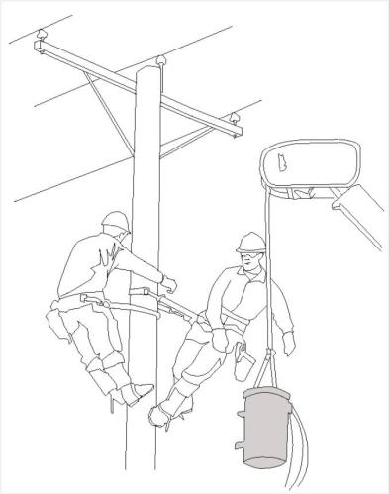
REACHING EXAMPLES
Awkward postures are assumed sometimes while:
  Working with overhead objects
  Working with objects located on the ground
  Obstacles on the way
  ___________________
Installing a transformer while climbing pole
Notes:
SCRIPT: Installing a pole-mounted transformer while climbing can lead to awkward postures - if the transformer is poorly located in relation to both workers, obstacles block movement or in windy conditions. What else can lead to awkward postures while performing this task? Is this always a 2-man job? Give the trainees an opportunity to respond.
LEARNING OBJECTIVE: Share practices

Slide 38
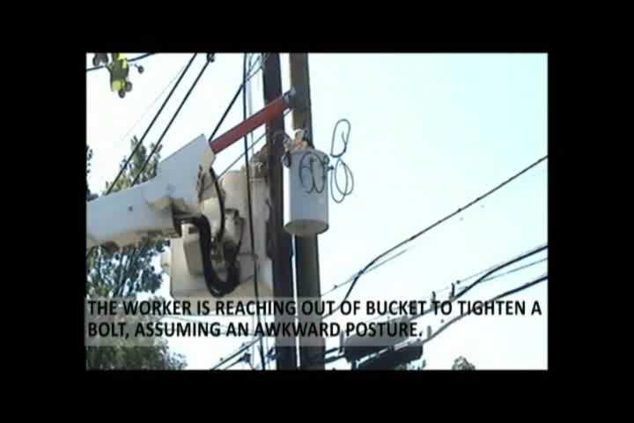
REACHING EXAMPLE
Working overhead , reaching, bending, decreases your strength
!
Notes:
SCRIPT: This video shows a worker reaching out of a bucket to tighten a bolt with a wrench. He spends at least 5 seconds in this awkward posture. Imagine the effect this will have on his back! Can this task be improved? Give the trainees an opportunity to respond.
LEARNING OBJECTIVE: Share practices

Slide 39
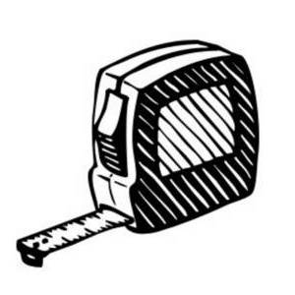
HOW FAR CAN YOU REACH?
Let’s find your reach points?
Over head = ________
Sides = ________
Forward = ________
If your work requires sustained awkward postures,
Try to take short, frequent breaks
Free clipart image, website: http://www.clipartguide.com/_pages/0808-0801-1115-5658.html
Notes:
Activity instructions: Break up into teams of 2 (or 3-5) depending on the group size and # of tape measures.
Ask each team member to write down the following measurements.
Measure from the bony part on the shoulder to the tips of your fingers, with your arms straight and raised above your head. This is your overhead point.
Measure from the bony part on the shoulder to the tips of your fingers, with your arms straight and out to your sides, like a cross. This is your side point.
Measure from the bony part on the shoulder to the tips of your fingers, with your arms straight and raised in front of you. This is your forward point.
SCRIPT: What were your measurements? Give an opportunity for trainees to respond. Answers should include 30 inches and most measurements are similar. The only differences may be due to limited range of motion. What does this number mean? It is how far you can reach without bending or going past your limits, or your zone of reach. This zone defines your comfortable working area without having to bend, reach, twist, etc. So, what do you think, where should tools be stored? Give an opportunity for trainees to respond. Answers should include within your reach. Can all items be stored in this area? No, that’s unrealistic. Remember to store the most frequently used items as close to your reach area as possible.
LEARNING OBJECTIVE: Defining the zone of convenient reach to avoid awkward postures.
Free clipart image, website: http://www.clipartguide.com/_pages/0808-0801-1115-5658.html

Slide 40
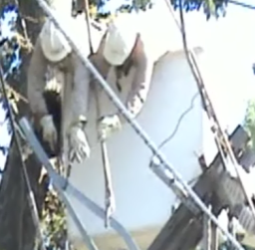
HOW TO MINIMIZE WORKING IN
AWKWARD POSTURES
BETTER PRACTICE
Place/store items within easy reach
Keep working heights below shoulder and above knees
Keep working distance close to your body when possible/safe
Take frequent short breaks
Maintain good housekeeping
Use equipment to minimize awkward postures when possible
AVOID
Over-reaching
Staying in an awkward posture for a long time
Frequent bending
Bending and reaching out of a bucket to grasp a broken branch
Notes:
SCRIPT: Similar to the other checklists, this is the “better practices” and “avoid” list for how to minimize working in awkward postures.
LEARNING OBJECTIVE: Recognize and avoid hazards; proper work techniques and best practices

Slide 41
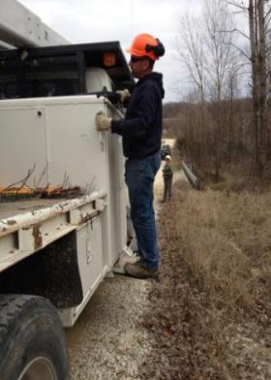
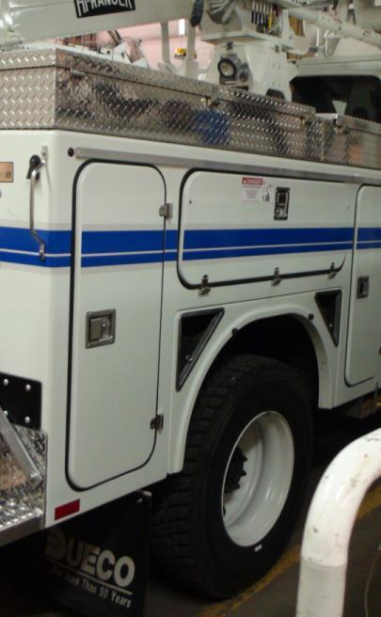
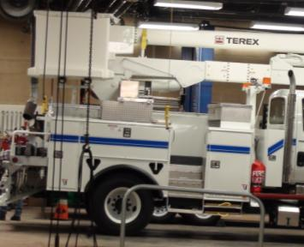
BETTER PRACTICES
Loading/unloading a truck can be strenuous on the shoulders and back
Heavy parts stored in hard to reach places
Store heavy in easily accessible places
Notes:
SCRIPT: Tools/equipment stored in difficult to reach places can lead to reaching, bending and unsafe work practices such as having to stand on the outrigger pad to reach an overhead tool in the picture on the left.
Tools and equipment must be stored in easy to reach places on trucks. Otherwise, the worker may be exposed to undue bending and/reaching causing stress to the shoulders and back.
LEARNING OBJECTIVE: Recognize and avoid awkward posture

Slide 42
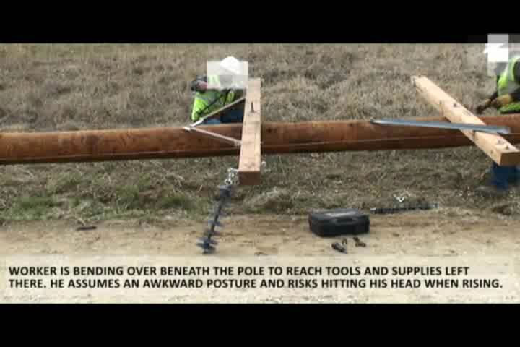
BETTER PRACTICE EXAMPLE
Notes:
SCRIPT: The worker is bending under the pole to reach for the part. Not only is the worker in an awkward posture, but he can also be struck in the head with the pole/cross-arm while rising. This can be avoided by lifting the parts from a closer location.
LEARNING OBJECTIVE: Sharing experience and best practices.

Slide 43
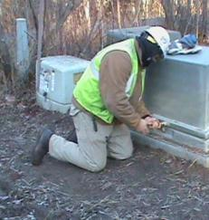
KNEELING
Notes:
SCRIPT: This section covers the best practices related to the tasks that require kneeling.
LEARNING OBJECTIVE: Introduce trainees to proper kneeling techniques.

Slide 44
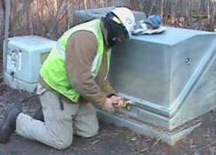
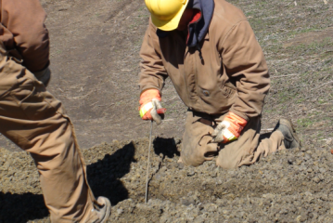
WHAT IS WRONG WITH THESE PICTURES?
Kneeling to check trench depth
Kneeling to open transmission box
Notes:
SCRIPT: What is wrong or missing in all of these pictures? Give an opportunity for trainees to respond. Answers should include, missing protective equipment for the knees.
Not only can prolonged kneeling damage the knee, but kneeling without knee protection can expose the workers to injuries due to sharp/hard objects such as rocks, concrete, etc.,
LEARNING OBJECTIVE: Recognize and avoid hazards; proper work techniques and best practices

Slide 45
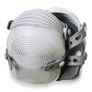
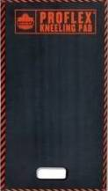
KNEELING
Kneeling pads
BETTER PRACTICE
Use kneeling mat or knee pads regardless of the ground condition
Every 10 minutes take a short break to stretch
Replace mats/pads often
Use a slip protecting pad on a plastic covered mat
AVOID
Prolonged kneeling
Worn out pads/mats
Kneeling mat
!
Notes:
SCRIPT: Similar to the other checklists, this is the “better practices” list for kneeling. Do you have any other suggestions? Give an opportunity for trainees to respond.
Kneeling pads (top figure) or kneeling mats (bottom figure) can be used.
LEARNING OBJECTIVE: Recognize and avoid hazards; proper work techniques and best practices

Slide 46
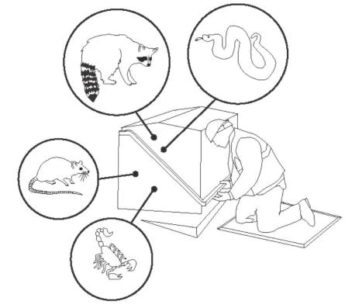
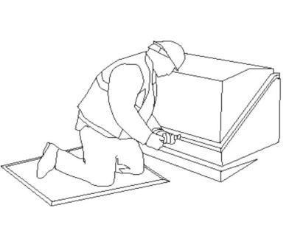
POTENTIAL IMPROVEMENT
KNEELING
Install raised pad-mounted boxes or pedestal boxes with front opening door(s)
  Eliminates/reduces need for kneeling
  Safer in case venomous animals/insects are encountered
Working on transmission box
Notes:
SCRIPT: Can this task be improved? Can the transmission/junction boxes be redesigned to reduce risks? Discuss potential solutions and seek trainees’ response to the problem. Linemen are sometimes exposed to the hazard of animal attacks. A variety of dangerous animals can inhabit an underground transmission box, and a lineman once encountered snakes upon opening a transmission box. For a variety of reasons, workers must exercise caution when opening boxes. Opening the box with a stick or, installing a pedestal type transformer box are options. This would allow the worker easier access to the box and also provide sufficient time for escape.
LEARNING OBJECTIVE: Sharing best practices

Slide 47
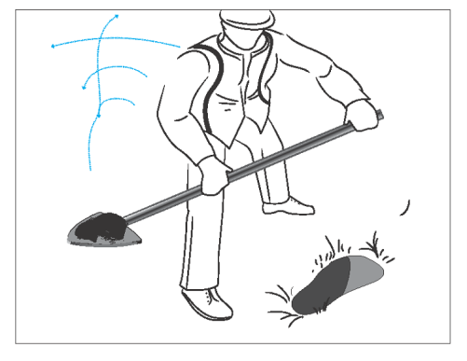
SHOVELING/DIGGING/FILLING
Notes:
SCRIPT: Another task that is performed very commonly is – shoveling, digging and filling of holes and pits.
LEARNING OBJECTIVE: Introduce trainees to overexertion injuries as a result of shoveling, digging, filling.

Slide 48
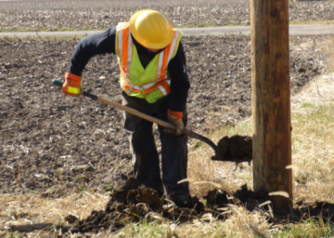
SHOVELING/DIGGING/FILLING
While selecting the right type of shovel consider:
  Shovel weight
  Shovel handle grip
  Length of the shovel handle
  Shovel blade size and shape
  Material (sand, clay, gravel) being moved
  Task (digging, filling, etc)
Filling around a new pole installation
Notes:
SCRIPT: In manual digging, the first important step is selecting the right type of shovel. What do you look for in a shovel? Give an opportunity for trainees to respond. Answers should include what is on the slide.
LEARNING OBJECTIVE: Proper work practices

Slide 49
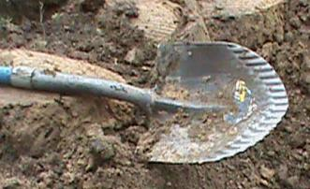
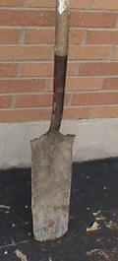
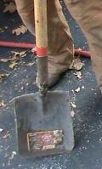
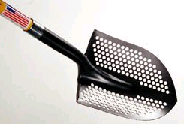

TYPES OF SHOVEL BLADES
Notes:
SCRIPT: Do you have any of these shovels? Give an opportunity for trainees to respond. If they don’t have the shovel with holes – some utilities found this shovel with holes to work well in areas with a lot of water. The water seeps through the holes making the load lighter. If they don’t have the shovel with the serrated edge– some utilities found this shovel to work well in areas with hard to cut soil, but beware - it cuts through plastic pipe too.
Illustrations show various types of shovels used for digging, shoveling, filling
LEARNING OBJECTIVE: Best practices

Slide 50
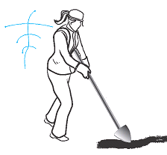
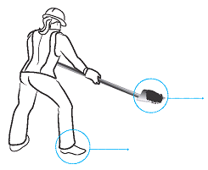
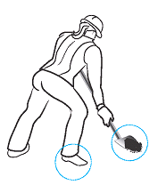
SHOVELING TECHNIQUE
1. WHEN LIFTING,
Put your weight on your front foot
3. WHEN THROWING,
Turn your front foot in the direction of the throw
2. BEFORE THROWING,
Shift your weight to your rear foot
Source: Ergonomic Survival Guide for Laborers, http://www.dir.ca.gov/dosh/puborder.asp
Notes:
SCRIPT: Read through the steps. Do you do this when shoveling? Give an opportunity for trainees to respond.
LEARNING OBJECTIVE: Proper work techniques and best practices
Additional resources are available at http://www.dir.ca.gov/dosh/puborder.asp inn the Ergonomic Survival Guide for Laborers

Slide 51
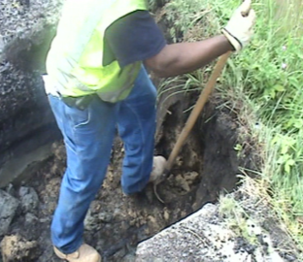
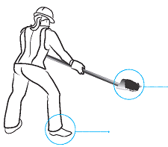
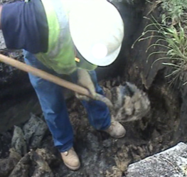
DIGGING TECHNIQUE
1. Push spade down using leg muscles
3. WHEN THROWING
Turn your front foot in the direction of the throw
2. Slide load close to body.
Ensure load is loose from ground before lifting.
Source: Ergonomic Survival Guide for Laborers, http://www.dir.ca.gov/dosh/puborder.asp
Notes:
SCRIPT: Read through the steps. Do you do this when digging? Give an opportunity for trainees to respond.
LEARNING OBJECTIVE: Proper work techniques and best practices
Additional resources are available at http://www.dir.ca.gov/dosh/puborder.asp in the Ergonomic Survival Guide for Laborers

Slide 52
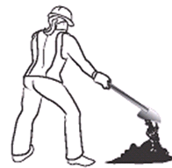

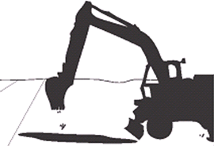
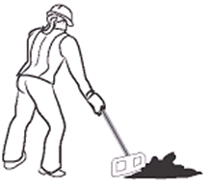
FILLING HOLES
What would you choose and when?
A)
C)
B)
D)
Notes:
SCRIPT: When filling holes, which method would you choose? Give an opportunity for trainees to respond. Hopefully they will pick “D” equipment. You are right, equipment is always best, if it is available. Option C, do you know what that is? Give an opportunity for trainees to respond. Some utilities put down tarps first, and place all the soil onto the tarp. When filling the hole, simply raise the tarp and guide the soil into the hole. Depending on how much soil was removed, this task might require more than one person. Option B is a hoe or rake. Instead of lifting one shovel load at a time as in Option A, the soil can be pulled or pushed into the hole.
LEARNING OBJECTIVE: Recognize and avoid hazards; proper work techniques and best practices

Slide 53
SHOVELING/DIGGING/FILLING
BETTER PRACTICE
Keep distance between your hands
Reduce the size/weight of the load
Ensure a comfortable grip, maintain it
Wear shoes with good soles to maintain firm footing
When possible push, don’t lift
Use equipment (backhoe, vacuum excavation)
Use tarp/blanket sling for removing reusable soil
Use dumpster for haul soil
AVOID
Moving loads long distances
Long time periods without breaks
Reaching
Twisting
Choose the right shovel or spade for the task
Notes:
SCRIPT: Similar to the other checklists, this is the “better practices” and “avoid” for shoveling and digging. Read all items on the list. Add personal examples or ask for an example.
LEARNING OBJECTIVE: Recognize and avoid hazards; proper work techniques and best practices

Slide 54


CABLE CUTTING
Cable cutting can cause stress to the wrists, forearms, shoulders and/or low back if:
Cutting manually
A lot of force is required
Performed in awkward postures
  Bending and cutting on ground
  Cutting cables overhead
  Working in confined spaces
Notes:
SCRIPT: This section will cover the cable cutting task.
Cable cutting can be a strenuous task, especially when performed manually. Forcefully cutting cables places stress on the wrists, forearms, shoulders and back, depending on the position of the worker. This can in turn lead to overexertion injuries.
Do you know of any incidents where workers have been injured while cutting cables? Give an opportunity for employees to respond.
LEARNING OBJECTIVE: Introduction to new section

Slide 55

CABLE CUTTING
BETTER PRACTICE
Use battery operated cable cutters
Ensure proper maintenance including tool grip
Ensure that the cable is secured before cutting so that it does not whip back up
Seek a co-worker’s help to hold the cable if it is energized
Wear appropriate PPE if working with energized cables
AVOID
Manual cutting
Working in awkward postures
Cutting cable at floor level
Notes:
SCRIPT: Similar to the other checklists, this is the “better practices” and “avoid” list for cable cutting. Read all items on the list. Add personal examples or ask for an example.
LEARNING OBJECTIVE: Learn about overexertion during cable cutting

Slide 56


MANUAL OR BATTERY
OPERATED CUTTER?
Using a manual cutter
Using a battery operated cutter
Notes:
SCRIPT: While battery operated cable cutters are more expensive than manual cutters, the benefits of battery operated cutting are worth considering. Using battery operated cutters will (1) reduce the time taken, (2) will reduce risk of injuries from cable lash since worker is able to hold the cable with one hand, (3) eliminate the need to work in awkward postures in some cases and (4) reduce risk of overexertion injuries by eliminating forceful exertions.
Do you think that battery powered tools may not work in some situation? Give an opportunity for employees to respond. Maybe if used in awkward postures!
LEARNING OBJECTIVE: Benefits of using a battery operated cutter for cutting cables

Slide 57
QUESTIONS?
Notes:
SCRIPT: Do you have any other questions?
LEARNING OBJECTIVE: Sharing experiences

Slide 58
Struck/caught
Notes:
SCRIPT: This section covers struck/caught injuries
LEARNING OBJECTIVE: Introduction to struck/caught

Slide 59

STRUCK BY/CAUGHT BETWEEN
STRUCK BY or AGAINST
Is an injury caused by bumping into/against a moving or stationary object(s).
CAUGHT IN or BETWEEN
Is an injury caused by squeezing, pinching or crushing a part of the body in/between/under a moving or stationary object(s).
Notes:
SCRIPT: Workers are often exposed to the risk of being struck by or against objects and caught in between objects while working in the utility industry. Struck/caught injuries can range from a small cut on the hand to death and can involve one or multiple body parts.
You may be accidentally struck by your co-worker’s leg (photo).
LEARNING OBJECTIVE: Understand difference between struck by or against and caught in/between injuries.

Slide 60
WHEN CAN YOU GET STRUCK?
Working in the bucket
  Tree branches, overhead cables/wires, tools/parts
Working below overhead lines
  Tree branches, tools/parts
Working in/around trenches/excavations
  Cables, ladders, parts/tools
Pole framing
  Loose/flying parts, rust, wood dust
Pole setting
  Auger, pole, spade
Working in warehouse
  Moving parts on carts/shelves working with compressed air, powered tools, hammers, saws, drills
Driving
  Vehicle door
Tree trimming/brush work
  Tree branches
  Operating equipment
Notes:
SCRIPT: Workers can be struck at any time while performing a variety of tasks. Some examples are provided. Can you think of any other tasks when a worker may be struck? Give an opportunity for trainees to respond.
Windy conditions can also increase the risk of becoming struck by objects.
LEARNING OBJECTIVE: Learn when workers may be struck by/against objects. Recognize potential hazardous situations.

Slide 61



STRUCK BY EXAMPLES
TREE BRANCH
POLE SETTING
“Employee was struck by
an auger during the pole setting task”
“Employee was struck by a tree branch and knocked out of the bucket”
Notes:
SCRIPT: Pole setting can expose the workers to strike by hazards. Workers may be struck by the auger when it is being manipulated or the spade can engage in the dirt on the auger and potentially strike the worker.
LEARNING OBJECTIVE: Recognize struck by hazards

Slide 62

WORKING IN A TEAM-NEAR MISS
Notes:
SCRIPT: This video shows a three man team installing a new service (underground). What’s wrong with this video? Give an opportunity for trainees to respond. First, the employee in the hole is almost struck by the cable that the employee on the right is trying to straighten out. Next, the employee is struck in the head by the employee standing over him while removing his leg from across the hole. The employee who was struck got lucky. The hard hat actually saved him.
What could be done to avoid struck/caught injuries in this case? Be mindful of other employees working around you.
LEARNING OBJECTIVE: Understanding hazards from working in a team.

Slide 63

STRUCK BY CROSS-ARM
Notes:
SCRIPT: The video shows two linemen placing a framed pole against an existing pole for later installation. One lineman gets struck in the head (wearing hard hat) by the cross-arm when he walks away from the pole not noticing where the cross-arm is located.
LEARNING OBJECTIVE: Sharing experiences.

Slide 64
WHEN CAN YOU GET CAUGHT BETWEEN?
Working with tools
  Chain saw, cable cutters, etc
Tree trimming/brush work
  Tree branches, chain saw
Walking while meter reading/working in the field
  Snow, mud, grass/twigs
Driving
  Between backing vehicle and dock/wall/other equipment; between parts of equipment or vehicle
Working with equipment
  Digger truck, saw, hammer, drill
Working in/around trenches/excavations
  Cave-in, wall collapse
Notes:
SCRIPT: Workers can be caught at any time while performing a variety of tasks. Some examples are provided. Can you think of any other examples when a worker may get caught? Give an opportunity for trainees to respond.
LEARNING OBJECTIVE: Learn when workers may be caught in/between objects. Recognize potential hazardous situations.

Slide 65
STRUCK/CAUGHT INJURIES CAN CAUSE DEATH
EXAMPLE OF FATALITY REPORT
A 26-year-old apprentice lineman was killed when he was caught in a trencher. The apprentice (victim) was removing a small berm by shoveling it back into a partially dug trench. The incident was not witnessed. It was surmised that the victim either lost his balance and fell toward the active machinery or the digging chain caught his clothing and pulled him into the trench, killing him on the spot.
Source: http://www.cdc.gov/niosh/face/stateface/ak/98ak023.html
Notes:
SCRIPT: This is an example of an incident where a worker was killed from being caught in equipment. How do you feel about this? How could this incident have been prevented?
Be extremely cautious when working near trenches and equipment. Do not put your life at risk!
LEARNING OBJECTIVE: Sharing an experience.

Slide 66

WORKING NEAR EQUIPMENT
Notes:
SCRIPT: The video shows a worker indicating where to dig to a co-worker operating the back hoe. What is wrong with this video? Give an opportunity for trainees to respond. The worker removes his foot in time when the back-hoe digs earth right in front of his foot. What else could have gone wrong?
The soil could have caved, pulling the employee into the path of the back hoe.
LEARNING OBJECTIVE: Sharing experiences and ways to avoid being caught/between.

Slide 67


CAUGHT BETWEEN POLE AND BARREL
Refilling hole around pole
Notes:
SCRIPT: The employee was working on an overhead crew replacing a broken pole. After the pole was set, the crew used a digger truck to place a gravel-filled barrel next to the pole so the gravel could be dumped to fill in around the pole. The employee hooked up the load line of the truck to the eyebolt on the side of the barrel so it could be tipped. As the employee was guiding and shaking the tipped barrel to help release the gravel the barrel slipped forward pinching his index finger between the barrel and the pole.
How can this avoided? Give an opportunity for trainees to respond.
LEARNING OBJECTIVE: Sharing experiences and ways to avoid being caught/between.

Slide 68
HOW TO PROTECT YOURSELF FROM BEING
STRUCK BY EQUIPMENT/VEHICLES?
BETTER PRACTICE
  Wear bright , reflective clothing and PPE
  Ensure vehicle operators are aware of your presence and location
  Inspect vehicles before use
  Ensure that equipment (bucket/materials) are properly secured/lowered before driving
  Set parking brakes on vehicles, use wheel chocks on incline
  Use appropriate warning signs
AVOID
Working/walking under suspended loads
Heavy equipment that is in use
Moving vehicles/vehicle parts, especially backing vehicles
Standing in the swing radius of cranes/boom trucks.
Exceeding vehicle’s load or lift capacity
Driving vehicles/equipment on unstable surfaces
Notes:
SCRIPT: Similar to the other checklists, this is the “better practice” and “avoid” for struck by equipment/vehicles. Read some or all items on the list.
LEARNING OBJECTIVE: Recognize and avoid hazards; proper work techniques and best practices

Slide 69
HOW TO PROTECT YOURSELF FROM
STRUCK BY FALLING OBJECTS?
BETTER PRACTICE
  Wear PPE
  Be sure to be trained when working with machines or powered tools
  Inspect tools before use
  Secure materials/ladders against sliding/falling/wind
  Ensure protective covering/grip on tools are maintained well and do not slip off
  Ensure guards/rails are installed to prevent accidental operation of equipment
AVOID
Standing directly under overhead work (cables, trees)
Working/walking under suspended loads
Loose, breaking or shifting materials
Exceeding vehicle’s load or lift capacity
Being in the way of any object in tension (cable, wire, etc.,)
Notes:
SCRIPT: Similar to the other checklists, this is the “better practices” and “avoid” for struck by objects. Read some or all items on the list.
LEARNING OBJECTIVE: Recognize and avoid hazards; proper work techniques and best practices

Slide 70
HOW TO PROTECT YOURSELF FROM BEING
CAUGHT IN/BETWEEN?
BETTER PRACTICE
  Ensure that equipments/tools are de-energized before changing/inspecting parts
  Install guards on /smooth any rough surfaces which can catch clothing/jewelry
  Lower/block blades on equipment when not in use
  Be aware of all moving equipment around you and maintain a safe distance
  Set parking brakes on vehicles, use wheel chocks on incline
AVOID
Wearing loose clothing/jewelry
Removing safety guards when tool is in use
Moving vehicles/vehicle parts, especially backing vehicles
Placing yourself between moving materials and an immovable structure
Working in an unprotected trench (without shoring/sloping) that is more than 5’ deep
Notes:
SCRIPT: Similar to the other checklists, this is the “better practice” and “avoid” for caught incidents. Read some or all items on the list.
LEARNING OBJECTIVE: Recognize and avoid hazards; proper work techniques and best practices

Slide 71

TAGGING EQUIPMENT/USING WARNING SIGNS
Warning sign used on trucks against getting caught between outrigger and ground thereby suffering a crush injury
Replace warning labels as they become old/cannot be read
Warning sign for crushing injury
Notes:
SCRIPT: Tagging equipment and using warning signs remind workers of the hazards present. Replace labels when they become old/cannot be read.
LEARNING OBJECTIVE: Sharing best practices.

Slide 72


BETTER PRACTICES
ACCIDENTAL “STRUCK BY”
The lineman standing under the overhead lines was struck by a cable when it was accidentally dropped by the lineman working in the bucket
BETTER PRACTICE
Notes:
SCRIPT: There are several ways to eliminate the possibility of being hit by falling objects. What do you think can be done? Give trainees time to respond.
LEARNING OBJECTIVE: Eliminate hazard of falling objects

Slide 73



BETTER PRACTICES
ACCIDENTAL EQUIPMENT OPERATION
BETTER PRACTICE
Installing guard on bucket truck controls to prevent accidental operation
Unguarded bucket truck controls at risk of accidental operation by worker’s foot striking against them
Notes:
SCRIPT: Accidental operation of bucket truck controls is possible by falling or flying objects like tree branches, especially under windy conditions. Installing a guard on the controls can prevent accidental operation and injuries resulting from it.
LEARNING OBJECTIVE: Sharing best practices.

Slide 74


BETTER PRACTICES
Install shielding on rough surfaces which can catch onto clothes/jewelry and cause cuts/lacerations
Secure tools in the truck from moving/shifting
Notes:
SCRIPT: Shielding/guarding rough surfaces can prevent clothing/other items, such as cords, wires, etc from being caught. (figure on right)
Another good practice: Securing tools on the vehicle will prevent shifting/moving while vehicle is in motion, as well as will stop parts from falling out when worker opens the cabinet (figure on left).
LEARNING OBJECTIVE: Sharing best practices.

Slide 75


BETTER PRACTICES
Install/construct incline which prevents vehicles from backing into work areas
Place heavier items closer to the floor and lighter items higher in order to prevent injuries from equipment tipping over or breaking and falling on employees
Incline preventing excess backing of vehicles
Spools placed on the rack
Notes:
SCRIPT: Constructing inclines in the loading/docking area can prevent vehicles from backing into work areas/other equipment/personnel.
LEARNING OBJECTIVE: Sharing best practices.

Slide 76
Slips, trips and falls
Notes:
SCRIPT: Our next section will cover how to identify hazards and prevent falling related accidents. Do you remember how falling accidents rank against other types of injuries? Wait for trainees’ response. That’s correct, falls rank 1st in the electric utility industry.
LEARNING OBJECTIVE: Introduction into falling hazards and problem scope

Slide 77


WHAT IS THE DIFFERENCE?
Slip happens when contaminant such as water, ice, mud, wet leaves, oil or snow covers the ground surface and causes it to become slippery.
Trip happens when a person’s foot
contacts an unexpected obstacle causing a momentary loss of balance.
Fall happens when a person loses their balance.
Notes:
SCRIPT: Falling accidents are commonly referred to as “slips, trips and falls”. Let’s discuss what each of these three words mean. A slip happens when contaminant such as water, ice, mud, wet leaves, oil or snow covers the ground surface and causes it to become slippery. A trip happens when a person’s foot contacts an unexpected obstacle like a curb or a tool causing a momentary loss of balance. A fall happens when a person loses their balance. Typically part of a person’s body such as the back, head or hand hits the ground surface during a fall. Does anyone have a fall story? Allow 1-2 trainees to provide stories.
LEARNING OBJECTIVE: Definitions, recognizing the differences between slip/trip and fall

Slide 78


FALLS
From different level
  Fall from utility pole
  Fall into trench
  Fall climbing off bucket truck
From same level
  Slip and fall on ice
  Trip and fall on curb
Notes:
SCRIPT: There are two common categories of falls: falls from a different level and falls from the same level. Falls from different level occur when you fall from one height to a different height. Examples of these types of falls include a fall from a utility pole, a fall into a trench or a fall while climbing out of a bucket truck. Falls from the same level occur when you do not fall from a height or different level. Examples might include falling after slipping on ice or tripping on a curb.
LEARNING OBJECTIVE: Recognize and avoid hazards; proper work techniques and best practices

Slide 79

FALLS FROM DIFFERENT LEVELS
Notes:
SCRIPT: Getting into and out of vehicles or equipment is a common task for utility workers and has a very high potential to lead to a fall injury.
LEARNING OBJECTIVE: Introduction to topic.

Slide 80

GETTING IN & OUT OF EQUIPMENT
What is the rule?
Notes:
SCRIPT: What is the rule used when getting on or off of trucks or equipment? That’s right, 3 point contact. But three point contact is not always possible. In addition, there are other things that you can do besides three point contact when working on or with trucks and equipment.
LEARNING OBJECTIVE: Recognize and avoid hazards; proper work techniques and best practices.

Slide 81

HAVE YOU SEEN OR DONE SOMETHING LIKE THIS?
Notes:
SCRIPT: Think about the truck that you work with. Watch this video and think about if you have ever worked with a truck like this or have a co-worker that has a truck like this. Play video. What hazards do you see? What things are in the way of the person getting into the truck? Does he use 3 point contact? How come? Wait for other answers. The handle is only located on the right side and the step is too small. This makes three point contact very difficult. Keep your managers informed about equipment where 3 point contact is easy and where 3 point contact is difficult. Use extra caution and minimize other hazards like objects in the pathway if 3 point contact is difficult. Different companies will have varying strategies for eliminating these hazards but they cannot fix what they do not know about.
LEARNING OBJECTIVE: Recognize and avoid hazards; proper work techniques and best practices.

Slide 82


CHECK FOR HAZARDS
Check equipment
  Missing or poorly located handles
  Damaged handles and steps
Check the environment
  Obstacles in pathway
  Uneven ground during exiting
  Ice/snow/mud on steps
Notes:
SCRIPT: Make sure to check for hazards when getting in or out of equipment or trucks. Check your points of contact to see if you have missing or poorly located handles. Also, check for damaged steps. If you find any of these hazards, avoid climbing if possible and alert management. If you must climb onto the equipment then use additional caution and be particularly diligent about minimizing other hazards. In addition to checking for handles and steps, inspect the environment for hazards. These hazards include obstacles in your pathway, uneven ground below you and ice, and snow or mud anywhere in your pathway. If possible, remove the hazards.
LEARNING OBJECTIVE: Recognize and avoid hazards; proper work techniques and best practices.

Slide 83



STEP SURFACES
Diamond Plate
BETTER SURFACES SHOULD
Not allow accumulation of water/ice/snow
Be easily cleaned from mud and clay
Not be easily damaged
Be resistant to wear and tear
Dimple
Grid
Notes:
SCRIPT: Different walking surfaces each can have different unique hazards. Which of these surfaces would you rather walk on during rain? How about during snow? Have you found any of these surfaces to get damaged? Diamond plate does not have holes and will not drain. In this picture, you can also see that the diamond texture has become worn smooth and can therefore become more slippery. Grid surfaces have their own hazards. We found instances where this surface could get easily damaged. Grid and dimple surfaces can become dangerous when the holes of these surfaces become clogged either by slush, ice or mud.
LEARNING OBJECTIVE: Recognize and avoid hazards; proper work techniques and best practices.

Slide 84

MOVING AROUND ON EQUIPMENT
Notes:
SCRIPT: Watch this video and see if you can find the moment where this person nearly falls? Have you ever fallen or been knocked off balance while climbing around on a vehicle? What might have happened if he had fallen? While it is important to maintain 3 point contact when getting on a vehicle, falls can also happen while moving around vehicles when 3 point contact is not very easy to do. When walking around on vehicles, make sure to have a clear pathway. In addition, consider reorganizing the trucks so that the tools and materials that you use most frequently are easily accessible. You should not have to climb over other objects to get to a piece of equipment that you use regularly.
LEARNING OBJECTIVE: Recognize and avoid hazards; proper work techniques and best practices.

Slide 85
GETTING IN & OUT OF EQUIPMENT
BETTER PRACTICE
AVOID
Use 3 point contact
Clear mud, ice, tools and supplies from path
Report missing handles, worn or damaged surfaces
Exercise caution when known hazards are on surfaces
Keep frequently used tools and supplies easily accessible and out of the way
Unclog drainage holes and clear mud, snow or ice on the steps
Rushing
Jumping out
Carrying items
Stepping on unsecured objects
Placing tools and supplies in the path
!
Notes:
SCRIPT: Here is your checklist for what to do and what not to do when you are getting in, out and around equipment. Consider keeping this checklist with you or posting it somewhere on your equipment. The things to do are to use 3 point contact, clear your walking path from mud, ice and objects. Report to management when handles are missing that prevent 3 point contact, or have worn and damaged surfaces that can be difficult to use or slippery. If you notice a hazard, make sure to be particularly cautious by taking shorter steps and not carrying heavy objects over the hazard. Also, keep frequently used tools and supplies in an easy to access location. When on equipment, avoid rushing, jumping off of the vehicle, carrying objects when possible, stepping on unsecured objects like supplies and keep tools, tool boxes and supplies out of the pathway.
LEARNING OBJECTIVE: Recognize and avoid hazards; proper work techniques and best practices

Slide 86

HOW COULD THIS BE IMPROVED?
Notes:
SCRIPT: Now that we have discussed more about getting into and out of equipment, what improvements could be made in this video? Correct answers include better handle placement for 3 point contact and a better step and removing the wood block from the pathway.
LEARNING OBJECTIVE: Recognize and avoid hazards; proper work techniques and best practices.

Slide 87
FALLING WHILE USING A BUCKET
BETTER PRACTICE
Do not carry tools while getting into or out of a bucket
Hold handles or edge of bucket
Use all step(s) available (inside and outside of bucket)
Attach fall protection
Check path for new hazards when getting out of bucket
Do not jump down from bucket
Inspect bucket step
Check platform surfaces and steps near bucket
Notes:
SCRIPT: Give stories of falling injuries related to buckets.
Have you ever fallen or seem somebody who has fallen while using a bucket? What are some reasons that you fell? What are some reasons the person in this picture is falling?
LEARNING OBJECTIVE: Recognize and avoid hazards; proper work techniques and best practices.

Slide 88




BUCKET TRUCK HAZARDS FOR FALLING
Notes:
SCRIPT: There are a number of hazards that can lead to a fall when using buckets. Let’s see if you can identify them in these pictures? In the top left picture, what is the hazard? Correct, there is snow that is covering the dimple plate and clogging the holes. In the top right picture, what hazards are there? The non-slip material is wearing off of the bucket. What about in the lower left hand picture, what is the hazard? A fire extinguisher and another object are in the pathway. What about the bottom right picture? Buckets and straps securing the buckets are in the pathway.
LEARNING OBJECTIVE: Recognize and avoid hazards; proper work techniques and best practices

Slide 89

CLIMBING OUT OF A BUCKET
Notes:
SCRIPT: Given what you now know about buckets, what could you do, to make this task safe all the time? Sometimes, not having a step inside the bucket may lead to the worker having to almost jump out of the bucket. Can you think of any reasons why this task may become unsafe and how it can be improved?
LEARNING OBJECTIVE: Recognize and avoid hazards; proper work techniques and best practices

Slide 90
FALLS FROM POLES & TOWERS
Notes:
SCRIPT: Our next section is about falls from poles and towers. How many of you climb poles? How many of you climb towers? Have you ever fallen while doing these activities? Lineman told the UWM team that while on the job, they will: “get shocked, fall and get stung.” Falling should not be an inevitable event for pole climbing and you should not accept that either. Your goal should be 0 falls from poles and this section is intended to provide strategies to prevent falls. A lot of accidents occur when a person is doing something unsafe and something unexpected happens. What could have happened to cause this worker to lose his footing while he moved his climbing belt above the cable line?
LEARNING OBJECTIVE: Introduce fall from poles and towers.

Slide 91
FALL PROTECTION/ARREST
  Fall protection - any protection from falling (fall arrest, netting, etc.)
  Fall arrest - is a type of fall protection in which an employee wears a harness system that is anchored to a secure location
Working on poles, towers and similar structures
  Fall protection equipment is required above 4 feet (1.2 m) if contaminants (ice, high winds, etc) could cause a loss of grip
  Fall arrest equipment is required when above 4 feet (1.2 m) if other fall protection has not been provided.
  Fall arrest/protection equipment is always required for “non-qualified” employees including trainees above 4 feet (1.2 m)
Operating a bucket
  Fall arrest/protection equipment is always required
!
http://www.osha.gov/pls/oshaweb/owadisp.show_document?p_table=standards&p_id=9868
Notes:
SCRIPT: Fall protection is required for many work circumstances. When is fall protection required on poles? Fall protection is required on poles above 4’ if conditions could cause you to lose your footing. When is fall protection required when operating a bucket? It is always required. When is it required on transmission towers? Fall protection is required while working on towers above 4’. Please reinforce this to the trainees.
LEARNING OBJECTIVE: Proper work techniques and best practices.

Slide 92


CLIMBING POLES WHAT COULD GO WRONG?
Insects
Birds
Beehives
Utility cables
Ivy
Ice
Notes:
SCRIPT: In the first picture, what hazards do you see? Does your company have solutions to deal with these hazards? Participants should point out the following. If they do not, discuss bees can sting you and cause you to get distracted. Woodpeckers can weaken the structure of the pole. Vines can interfere with the spurs gripping into the wood. Discuss potential solutions like using bee killer as soon as the bees are noticed, checking the structure for damage if a woodpecker is present, using a ladder (secured to the pole) to get past the vine (works with shell rot as well). What about for the picture on the right, what kind of hazards are here? How do you climb a pole that is covered on one side with ice/snow? You are supposed to be on the icy side so that your climbing belt/fall restraint makes good contact on the cleared side. What other hazards have you experienced while climbing poles?
LEARNING OBJECTIVE: Recognize and avoid hazards.

Slide 93
WHAT DO YOU DO IN THESE SITUATIONS?
Climb over a telephone or cable line
Climb past bottom 5 feet of pole covered in shell rot
Encounter bee hive found in transformer box
Climb pole that is half covered in ice
Notes:
SCRIPT: Let’s discuss what you would do in each of the following scenarios. Ask employees about each scenario and look for solutions. The best practices that we were able to identify for each condition are: Answer to 1: Climb to communications line, put climbing belt over the communications line, detach bucksqueeze and reattach above communications line and then detach climbing belt2: Attach short ladder just past the tree rot mark. Tie the ladder off to pole, attach bucksqueeze, and ascend pole to above tree rot.3. Use bee spray from ground level or from as great a distance as possible (wear eye protection).4. Climb facing side covered in ice (so that gloves/bucksqueeze are on the side free of ice?
LEARNING OBJECTIVE: Proper work techniques and best practices.

Slide 94
AN ARGUMENT FOR FALL RESTRICTING DEVICES
A lineman was climbing to a transformer above a cable line. He climbed up with his safety strap over his shoulder with the intention of securing the strap around the pole above the cable. He grasped a neutral guy wire with his hand while using his other hand to secure his safety strap around the pole. His right hand contacted an energized line on the transformer. As he struggled to pull away he fell backwards, falling and hit the ground head first. He was transferred to a medical center where he was pronounced dead (broken neck).
Source: http://www.cdc.gov/niosh/face/in-house/full8839.html
Notes:
SCRIPT: Pole climbing can be very dangerous and falls can lead to deaths. Here is an example of an accident on a pole that occurred during a typical summer day. Read text of slide. This was likely a preventable accident if the lineman had been wearing a fall protection belt like the bucksqueeze. When using this equipment, you ascend to the cable, attach your climbing strap above the cable and then move your fall restricting device above the pole. Therefore you have fall protection attached at all times while on the pole. This example is why you need to be diligent when climbing poles.
LEARNING OBJECTIVE: Sharing experiences.

Slide 95
PRE-CLIMBING POLE INSPECTION
EQUIPMENT
POLE
Climbing belt/ Fall restriction belt
  Check wear indicator
  Properly adjusted to pole size
Climbing spurs
  Steel and titanium are stronger material than aluminum
  Spike should be sharp
  No cracks or chips in material
  Strap is free of fraying and/damage
Rope
  Check wear indicator
Check for erosion marks on pole
Identify hazards on the pole
  Flyers, staples nails
  Ice/snow on pole
  Bees/wasps/woodpeckers
  Dead branches
  Cables connecting lines
Remove hazards when possible
Identify path
  Free of hazards
  Climb on icy side of pole
Notes:
SCRIPT: There are several precautions that you can take to avoid any “surprises”. Inspect, inspect, and inspect… equipment that you rely on. Read the list. What about the pole? Any visible erosion? Bee nests? Phone cables on the way? Before you climb, identify the path. Remove the hazards, if possible, or think of safe solution.
LEARNING OBJECTIVE: Recognize and avoid hazards; proper work techniques and best practices.

Slide 96
INSULATOR WASHING
Remove salt buildup on transmission insulators
Do not clean insulators on energized lines from tower
  Bucket truck
  Helicopter cleaning
  Clean from ground
De-energized lines can be cleaned from tower
  Fall arrest/protection required above 4’
  Significant falling hazards include:
    High pressure hose
    Wet surfaces/boots
    High winds
Q: Are body belts acceptable?
  A: No, must use a full body harness
  Effective January 1, 1998
http://www.osha.gov/pls/oshaweb/owadisp.show_document?p_table=standards&p_id=9868
http://www.osha.gov/pls/oshaweb/owadisp.show_document?p_id=10758&p_table=STANDARDS
Notes:
Source: http://www.osha.gov/pls/oshaweb/owadisp.show_document?p_id=2770&p_table=DIRECTIVES
SCRIPT: Does your company do insulator washing? Insulator washing is a common activity near the coasts where salt can build up on to insulators for large transmission towers. Insulator washing should be done only from the ground level, bucket truck or a helicopter when applied to energized lines. Insulator washing devices also pulse water to ensure that there is not a consistent conductor back to the hose. De-energized transmission lines can be cleaned from the tower but fall protection is required by OSHA above 4’ although it is recommended above 6’. Be aware of the significant hazards such as the high pressure hoses that can push you back, wet surfaces and boots, and high winds. Can fall belts be used instead of full fall protection? No, a full harness must be used for fall protection.
LEARNING OBJECTIVE: Proper work techniques and best practices related to insulator washing.

Slide 97

TRENCHES AND LADDERS
WHAT IS WRONG WITH THIS PICTURE?
Notes:
SCRIPT: Our next section will cover trenches and ladders.
LEARNING OBJECTIVE: Introduction to topic.

Slide 98

GETTING IN AND OUT OF TRENCH
At what depth do you start using a ladder?
  24”
  36”
  48”
  60”
  How often is an exit required in trenches?
  every 5 feet
  every 15 feet
  every 25 feet
  every 50 feet
!
Notes:
SCRIPT: At what depth is a ladder needed to get into and out of a trench? All trenches or holes below 4’ require a ladder to get in or out of the trench.
LEARNING OBJECTIVE: Recognize and avoid hazards; proper work techniques and best practices.

Slide 99
SETTING UP LADDERS IN TRENCHES
BETTER PRACTICE
AVOID
Properly inspect before use
Place ladder on level surface or use ladder leveler
Extend ladder 36” above surface
Tie off ladder at top
Secure ladder at bottom
For every 4’ up, put ladder 1’ back
Uneven or unstable ground at the top or bottom of the ladder
Using broken or damaged rungs
Notes:
SCRIPT: Here is a list of what to do and to avoid when setting up ladders in trenches. Make sure to properly inspect the ladder before use. Damaged ladders with broken or damaged rungs or rails should never be used. Place the ladder on level surface. A ladder leveler can be used if the surface is sloped. Avoid setting up the ladder in a place where the ground is uneven at the top or bottom of the ladder. The top of the extension ladder should extend 36” above ground. Tie the top and bottom of the ladder off. Stakes can be used if there is nothing else to tie off to. The ladder should be angled so that it goes 1 foot back for every 4 feet up.
LEARNING OBJECTIVE: Recognize and avoid hazards; proper work techniques and best practices.

Slide 100

LADDER SETUP GAME
Can you set up an extension ladder properly?
LET’S TRY!
We will need:
  One or two volunteers
  One extension ladder
  Measuring tape
Notes:
SCRIPT: Ask for 1-2 volunteers and have them set up the ladder. Then check the angle to make sure that it is the proper angle.
Let’s see if you can set up a ladder properly. {Have volunteers set up one of their own ladders. Check the rise and run so that they have feedback on whether they set it up correctly.}
LEARNING OBJECTIVE: Recognize and avoid hazards; proper work techniques and best practices.

Slide 101
CLIMBING TECHNIQUE
BETTER PRACTICE
AVOID
Use 3 point contact
Move tools into hole prior to entering the hole
Wear slip-resistant footwear
Keep entire body between rails
Check for clear/stable ground at top/bottom of ladder before stepping off
Holding tools while climbing
Reaching laterally
Stepping on top 4 rungs of extension ladder
Jumping off of ladder
Notes:
SCRIPT: When climbing a ladder, there are a number of techniques that you should use. Make sure to maintain 3 points of contact when climbing. Move tools into the hole before climbing the ladder so that you do not have to carry them. Wear slip resistant footwear and make sure that it is clear of mud and snow. Keep your body between the rails and do not lean to the side. Get down off of the ladder and move the ladder if you need to work to the left or right of the ladder. Also, check for clear ground at the base and top of the ladder before climbing on to the ladder. Avoid stepping on the top 4 rungs of an extension ladder and avoid jumping off of the ladder.
LEARNING OBJECTIVE: Proper work techniques and best practices.

Slide 102

WHAT IS WRONG WITH THIS PICTURE?
Worker is climbing down into trench using ladder
>36”
Notes:
SCRIPT: What is wrong with this picture? {Allow participants to answer. Explain if they miss any of the following: Person is holding an object in right hand. Ladder is not tied off or even held still at the top.}. When this worker climbs down, the entire ladder shakes and moves because it is not tied off. This movement could lead the ladder to tip over or slide laterally and cause a fall. What is good about this picture? {The ladder is 36” above the top surface}
LEARNING OBJECTIVE: Recognize and avoid hazards; proper work techniques and best practices.

Slide 103

WHAT’S WRONG WITH THIS VIDEO?
Notes:
SCRIPT: What is wrong in this video? The worker takes a big step across the ditch. The ground material moves under his feet causing a near slip and fall into the trench. Has this ever happened to you?
LEARNING OBJECTIVE: Recognize and avoid hazards; proper work techniques and best practices.

Slide 104
WORKING NEAR PITS AND TRENCHES
BETTER PRACTICE
AVOID
Keep pathways clear
Keep wide footing
Exercise additional caution when walking on loose dirt
Leaning into the trench
Standing very close to the edge of the trench
Jumping across trench or taking large steps near trench
Using heavy equipment close to the edge of the hole/trench
Notes:
SCRIPT: Here is a list of what “to do” and “avoid” when working near pits and trenches. Make sure to keep pathways clear. Keep wide and firm footing. If you know that dirt is loose, exercise additional caution. Avoid leaning into the trench, particularly if you are holding heavy objects or standing very close to the ditch unnecessarily. Do not jump across the trench or take big steps near the trench. Step down into the trench and then step back up. Lastly, avoid using heavy equipment when close to the edge of a hole or trench.
LEARNING OBJECTIVE: Proper work techniques and best practices.

Slide 105

SLIPS & TRIPS
Not every slip or trip ends up in a fall!
Notes:
SCRIPT: In this next section, we will discuss falls on the same level. The most common cause for these falls are slips and trips.
LEARNING OBJECTIVE: Introduction to topic.

Slide 106
SLIPPING HAZARDS
ENVIRONMENTAL
OTHER FACTORS
Snow
Ice
Mud
Clay
Wet grass
Leaves
Plastic sheets
Equipment/supplies
Slopes
Loose dirt
Footwear
Long steps
Carrying objects
Dual-tasking while walking
  Talking on cell phone
  Making notes
Walking backwards
Cold/numbed extremities
Notes:
SCRIPT: Slips occur when you step on something slippery and your foot moves out from under you. A number of environmental objects can cause a slip including snow, ice, mud, clay, wet grass and leaves. Objects in your environment can also cause a slip such as plastic sheets especially when they are covered in snow or wet leaves and equipment or supplies. Sloped surfaces and loose dirt also can increase the risk of a slip. Besides the environment, a number of other factors can contribute to slips. Footwear, particularly with worn tread, can cause slips. Taking long steps can cause you to slip. Carrying objects, dual tasking such as making notes and talking on the cell phone and walking backwards can increase the chance that you will not see a hazard and can lead to a slip. When your extremities are numb, your muscles do not work as well and that can affect your ability to recover from a slip and avoid a fall.
LEARNING OBJECTIVE: Recognize and avoid hazards; proper work techniques and best practices.

Slide 107



IDENTIFY SLIPPING HAZARDS
Mud and Sloped Ground
Snow/ice, hidden hazards, sloped ground
Smooth plastic cover on kneeling mat
Notes:
SCRIPT: Try to determine the hazards on this slide. Top left: mud and sloped ground; Top right: snow/ice, hidden hazards under the snow; Bottom: smooth plastic cover on kneeling mat.
LEARNING OBJECTIVE: Recognize and avoid hazards; proper work techniques and best practices.

Slide 108

WHEN GROUND IS COVERED OR CONTAMINATED
BETTER PRACTICE
AVOID
Clear the path if possible
    - or -
Identify safe path by checking for hazards on the ground or under the snow/leaves gravel/mud
  Slippery flooring (vinyl tile, plastic sheet, etc.)
  Uneven ground, small holes, tools, toys, supplies
Multi-tasking
Notes:
SCRIPT: Here is a list of things that you can do when you encounter ground that is contaminated or covered with slip hazards. First, either make a clear path or identify a safe path. Walk the pathway between your vehicle and worksite before carrying your tools to your work site. This way you can identify hazards in the pathway ahead of time and change your pathway if needed. Make sure that you avoid doing other things when walking.
LEARNING OBJECTIVE: Recognize and avoid hazards; proper work techniques and best practices.

Slide 109


FOOTWEAR
Which of these boots has better tread?
Notes:
SCRIPT: Participatory part: Pass out quarters so that people can test their tread depth
Your footwear should have a depth of 3 mm and a width of 2mm. A quarter can be used to check if you have enough tread. The tread channels should be thicker than a quarter and the tread should cover the top of George Washington’s head. Notice that you can find the part of the shoe that you step on during walking by seeing where the shoe tread is worn. The worn part on the heel is the part of the shoe that you should test.
LEARNING OBJECTIVE: Recognize and avoid hazards; proper work techniques and best practices.

Slide 110



SHOE TREAD TESTING
3mm
~2 mm
Width of tread channels should be thicker than a quarter
Tread depth should cover very top of George Washington’s head
!
Notes:
SCRIPT: Participatory part: Pass out quarters so that people can test their tread depth
Your footwear should have a depth of 3 mm and a width of 2mm. A quarter can be used to check if you have enough tread. The tread channels should be thicker than a quarter and the tread should cover the top of George Washington’s head. Notice that you can find the part of the shoe that you step on during walking by seeing where the shoe tread is worn. The worn part on the heel is the part of the shoe that you should test.
LEARNING OBJECTIVE: Recognize and avoid hazards; proper work techniques and best practices.

Slide 111



TEST YOUR TREAD WITH A QUARTER
BAD- NOT DEEP ENOUGH
BAD- NOT WIDE ENOUGH
GOOD
Notes:
SCRIPT: Is the left picture good or bad tread? How about the middle picture? How about the right picture? What is wrong with the left and right treads?
LEARNING OBJECTIVE: Recognize and avoid hazards; proper work techniques and best practices.

Slide 112

TRIPPING HAZARDS
Environmental
  Tools/cable left on ground
  Uneven ground
  Curbs
  Weeds, vines, roots
Other factors
  Debris
  Dual tasking while walking
  Walking backwards
  Wearing bifocal/progressive lens glasses
Notes:
SCRIPT: Tripping is caused when your foot contacts with or becomes tangled in another object which can cause you to lose your balance and fall. Tools and cable left on the ground, uneven ground or curbs can cause a trip. Other factors like dual tasking, walking backwards and wearing bifocal or progressive lens glasses can further increase the likelihood of experiencing a trip. In this picture on the right, what tripping hazards do you see?
LEARNING OBJECTIVE: Recognize and avoid hazards; proper work techniques and best practices.

Slide 113


CAUTION - BIFOCAL GLASSES!
BIFOCAL GLASSES
PROGRESSIVE LENS GLASSES
If wearing bifocals pay extreme caution to:
Uneven terrain
Curbs
Stairs
Notes:
SCRIPT: How many people here wear bifocal glasses or progressive lens glasses? Was it difficult to walk when you first wore them? Some people adjust easily to these types of glasses while other people do not. These glasses can cause blurring or distortion of steps or ground-level objects. If you use bifocals, use extreme caution when walking on: uneven terrain, curbs and stairs. If possible, consider wearing single lens glasses while at work.
LEARNING OBJECTIVE: Recognize and avoid hazards.

Slide 114



HOW MANY TRIPPING HAZARDS DO YOU SEE?
Notes:
SCRIPT: Let’s look at the following pictures and find the tripping hazards. In the first picture what do you see? While this person is loading his vehicle, there are numerous tripping hazards in his way. When we were watching this individual, his foot actually hit these objects frequently, causing him to be unstable. The fact that he was loading objects further impeded his ability to see the tripping hazards. In the second picture, what do you see? There is a cable on the floor that could become entangled with a person’s foot. In addition, there are several objects at the end of this pathway. In the last picture, what do you see? In addition to the slipping hazards that we discussed earlier, there are numerous tripping hazards including fallen trees in the pathway.
LEARNING OBJECTIVE: Recognize and avoid hazards .

Slide 115
STAYING STABLE STANDING EXERCISE
Normal standing (Please stand with your feet shoulder width apart, eyes closed if you can)
Standing on toes (Please stand on your toes, eyes closed if you can)
Stand with one foot in front of the other (Stand with your right foot just in front of your left foot. Close your eyes if you can)
Notes:
SCRIPT: Let’s discuss what it means to be stable. When you are unstable, you are more likely to fall over. Let’s try an exercise to demonstrate being stable. Try standing with your feet shoulder-width apart. If you can, close your eyes. Did you feel unstable? Now try standing on your toes and close your eyes? Did that feel less stable? Lastly, stand with your right foot directly in front of your left foot. Once again, close your eyes if you can. Is that even more difficult to do? Just like using the outriggers on your bucket truck keeps the bucket truck stable, keeping a wide footing on secure ground keeps your body stable.
LEARNING OBJECTIVE: Recognize and avoid hazards; proper work techniques and best practices.

Slide 116

WALKING ON UTILITY POLES
Notes:
SCRIPT: What’s wrong with this video? Is stepping on that moving pole stable or unstable? Why? Stepping on that pole is even less stable than standing on your toes because you were on firm ground and the log is moving.
LEARNING OBJECTIVE: Recognize and avoid hazards; proper work techniques and best practices.

Slide 117
PROTECTING YOURSELF FROM TRIPPING
BETTER PRACTICES
AVOID
Look where you are going
Exhibit additional caution when walking on uneven grounds/curbs
Use extreme caution when wearing bifocals
Do not leave tools on the ground
Identify safe(r) path
_______________________
Walking on unstable surfaces
Stepping on to moving objects
Walking backwards
Dual tasking
Carrying object that obstruct your view
_______________________
Notes:
SCRIPT: When staying stable, keep your feet on the ground and spread shoulder width apart whenever possible. Use extension devices such as a hot stick to put sockets in and pull sockets out of a junction box and make sure there are no hazards behind you. This way you will not have to be leaning into the box when pushing or pulling with high forces. Be particularly cautious when walking around poles and don’t step onto a pole that is suspended in mid-air. When in a bucket, do not lean out of the bucket. Move the bucket to where you need to be.
LEARNING OBJECTIVE: Learn about best practices for protecting yourself from tripping.

Slide 118
ELECTRIC SHOCK AND ELECTROCUTION
“An employee was electrocuted while carrying a ladder which contacted energized overhead lines”
Notes:
SCRIPT: This section covers electrical shock, burns, electrocution.
LEARNING OBJECTIVE: Learn about electrical shock, burns, electrocution.

Slide 119
“SHOCKING” FACTS
From 2003-2007:
  Over 1,200 workers died from contact with electric current
  Over 13,000 workers required time off from work because of injuries due to contact with electric current
Contact with electrical current from | % TOTAL FATAL ACCIDENTS/DEATHS | % TOTAL NON-FATAL ACCIDENTS
Overhead power lines | 43 (#1) | 2
Wiring, transformers, or other electrical components | 28 (#2) | 37
Machines, tools, appliances, or light fixtures | 18 (#3) | 35
Source: http://www.iaei.org/magazine/2009/05/occupational-electrical-injury-and-fatality-trends-and-statistics-1992%E2%80%932007/
Notes:
SCRIPT: This slide presents some fatality facts related to electrocution. Over 4 year period there were over 1200 workers killed at worksites due to contact with electric current, and over 13000 were severely injured.
LEARNING OBJECTIVE: Learn about the severity and scope of the problem.

Slide 120
ELECTRICAL SHOCK
BURNS, ELECTROCUTION
ELECTRIC SHOCK
  Occurs when electric current passes between parts of a person’s body or through the body and ground/earth
BURNS
  Most common shock-related injury
    ELECTROCUTION
  Death as a result of exposure to electric current
    FACT
The person can complete the electrical current path/circuit with the following:
Both wires of electric circuit
One wire of an energized circuit and the ground
A metal part that accidentally becomes energized due to a break in insulation
Another conductor carrying current
Notes:
SCRIPT: Electrical shock occurs when current passes between parts of the body or through the body and ground/earth. The person can complete the electrical current path/circuit with the following, resulting in a shock:
Both wires of electric circuit
One wire of an energized circuit and the ground
A metal part that accidentally becomes energized due to a break in insulation
Another conductor carrying current
Electrical shock can result in painful sensations in the body, internal organ damage, burns (external and internal), respiratory/cardiac arrest and death.
Burns occur commonly as a result of electric shock, but can also occur as a result of an arc flash explosion or contact with overheated conductors or burning clothes.
Death due to exposure from electrical current is called electrocution.
LEARNING OBJECTIVE: Learn how electrical shock, burns and electrocution are caused.

Slide 121
EFFECTS OF ELECTRIC SHOCK
Results can range from a slight tingling sensation to immediate cardiac arrest
Severity of shock depends on:
  How much current flows through the body
  Current path through the body
  Length of time the body remains in circuit
  Current frequency
Notes:
SCRIPT: Electric shock can range from a slight tingle to immediate cardiac arrest and death. How severely a person is affected depends the amount of current flowing through the body, the current’s path through the body (e.g. through the heart), length of time the body remains in circuit and current’s frequency.
LEARNING OBJECTIVE: Introduction to effects of shock on the human body.

Slide 122
HOW MUCH CURRENT IS TOO MUCH?
When current flows from the hand to the foot for 1 second:
Current (mA) | REACTION
1 | Faint tingle
5 | Slight shock felt
6-25 (women) | Painful shock, loss of muscle control *
9-30 (men) | Freezing current or “let go” range *
50-150 | Extreme pain, respiratory arrest, severe muscle contractions, death possible
1,000-4,300 | Heart rhythm stops, muscle contraction and nerve damage , death likely
10,000 | Cardiac arrest, severe burns, death probable
*Person can be thrown away
Source: W.B. Kouwenhoven, “Human Safety and Electric Shock,” Electrical Safety Practices, Monograph, 112, Instrument Society of America, p. 93. November 1968.
Notes:
SCRIPT: This table shows the effects on the human body for different currents flowing from the hand to the foot for 1 sec. Small electric currents (<1mA) passing through the body may sometimes not be felt, but it is necessary to receive medical attention if one thinks that they have come in contact with a electric conductor. Women and men may react differently to some current ranges.
Death is possible for currents above 50mA passing from hand to foot for 1 second.
Remember the body or skin’s resistance is different for different parts and conditions. Dry skin has more electrical resistance than moist/wet skin. Injured body parts lower the resistance of the human body and can allow more current to pass through.
If you may recall that V= I*R, then a small voltage can also cause large amount of current to pass through the body, if the skin’s resistance is lower.
LEARNING OBJECTIVE: Learn about effects of shock on the human body.

Slide 123
FLASH QUIZ
True/False?
Is high voltage more likely to kill than low voltage?
  False. Low voltage is equally likely to kill as high voltage
Voltage is most important in determining extent of injury
  False. The extent of injury depends on how much current flows, through the body, for how long, at what frequency and the path of current through the body
Death cannot occur from contact with underground cables.
  False. About 2% of work-related deaths occur from contact with underground cables.
Notes:
SCRIPT: This is a flash quiz and prizes will be awarded for the right answer. You will be asked a question and you have to answer in True/False.
LEARNING OBJECTIVE: Learn some common myths about electrical accidents and try to avoid them.

Slide 124

HOW DO ELECTRICAL ACCIDENTS HAPPEN?
Electrical accidents result from:
  Improper equipment or installation
    Lack of/break in insulation on equipment (bucket, tools, etc), improper grounding
  Hazardous environment
    Rain, wind, snow, lightning
  Improper work practices
    Not testing equipment for electrical current, not wearing appropriate PPE, etc.,
  Fatigue
Protective shielding on bucket truck is damaged
Notes:
SCRIPT: Electrical accidents can happen as a result of unsafe equipment or installation, unsafe environment or improper work practices. They can happen while performing line work (overhead or underground) and working with electrical tools in the warehouse.
LEARNING OBJECTIVE: Learn how electrical accidents can happen.

Slide 125
EXAMPLES INJURY REPORTS
CLOSE CALL: Lineman accidentally grabbed energized line after removing glove, did not feel anything but observed a hole burnt into his shirt
INJURY: Lineman was removing transformer top to obtain oil sample, electricity shot into palm of left hand
FATALITY: An electrical line mechanic (the victim) was electrocuted while attempting to attach an energized conductor to a crossarm-mounted insulator
Source: http://www.cdc.gov/niosh/face/In-house/full9201.html
Notes:
SCRIPT: These are examples of injury reports about workers who had electrical accidents. Do you know of any other incidents that have happened to you or your co-workers? Give an opportunity for trainees to respond.
LEARNING OBJECTIVE: Sharing experiences.

Slide 126
HOW TO PROTECT YOURSELF AGAINST ELECTRICAL HAZARDS?
BETTER PRACTICE
Use appropriate PPE
Ensure that electrical tools and equipment are grounded before use
De-energize electric equipment before inspection or repair (if possible)
    Exercise extreme caution when working near energized lines
  Communicate clearly with crew members
  Lockout/tagout electrical equipment
  Maintain tools/equipment properly
  Guard or insulate lines to prevent accidental contact
Keep cutting tools sharpened
AVOID
Using broken/uninspected equipment
Working without understanding/knowing the correct procedures
Using equipment with improper grounding
Wiping perspiration while near energized power lines
Making assumptions
Taking shortcuts
Notes:
SCRIPT: This is a list of “better work” practices and what to avoid and protect yourself against general electrical hazards.
LEARNING OBJECTIVE: Sharing experiences.

Slide 127
HOW TO PROTECT YOURSELF WHEN WORKING ON THE GROUND?
BETTER PRACTICE
Maintain minimum safe distance if unqualified to work with electricity or mechanical equipment
Consider equipment’s maximum reach when determining standoff distance
Contractors must call “Call Before You Dig” or “Dig Safe” to check for the presence and location of existing underground electric cables
Do not stand directly under energized overhead lines
AVOID
Contact with the mechanical equipment operated near overhead lines, unless it is located outside the danger zone
Minimum safe distance between the lines and any part of the equipment or load shall be:
Voltage (Phase-phase) | Minimum safe distance*
0 – 50 KV | 10 ft
Over 50-200 KV | 15 ft
Over 200- 345K V | 20 ft
!
*Clearance increases by 4 inches for each additional 10,000 V beyond 50,000 V 1910.269(k)(2)(i)(B)
http://www.osha.gov/pls/oshaweb/owadisp.show_document?p_table=STANDARDS&p_id=10767
Notes:
SCRIPT: This is a list of “better work” practices and what to avoid protecting yourself against electrical hazards while working on the ground.
The minimum safe distance between lines and any part of the equipment or load is provided for different voltages. Remember, when working with the equipment, the minimum safe distance for any voltage below 50KV is 10 feet!! (1910.269(k)(2)(i)(B))
LEARNING OBJECTIVE: Sharing experiences.

Slide 128
GAME TIME
HANGMAN
What is the leading cause of death among electric utility workers?
_ _ _ _ _ _ _ _ _ _ _ _ _
Notes:
SCRIPT: Now, let’s play a game of hangman. Read the question on the slide. You have about 7 chances to guess the right answer, before the man is hanged!
The answer is “ELECTROCUTION”!
LEARNING OBJECTIVE: Sharing experiences.

Slide 129
QUESTIONS?
Notes:
SCRIPT: Do you have any other questions?
LEARNING OBJECTIVE: Sharing experiences.

Slide 130
ARC FLASH AWARENESS
A sudden high-voltage electrical discharge that flows through the air from one conductor to another
Notes:
SCRIPT: This module covers arc flash.
LEARNING OBJECTIVE: Introduction to arc flash.

Slide 131
WHAT CAN CAUSE AN ARC FLASH?
Live electrical equipment
Accidentally dropping tools can cause a fault or short circuit
Improper tools
Corrosion of electrical equipment
Improper work methods
Lack of safety
Notes:
SCRIPT: Many arc flashes occur when maintenance workers are manipulating live electrical equipment, testing or repairing, and accidentally cause a fault or short circuit. Improper tools, improper electrical equipment, corrosion of electrical equipment, improper work techniques, fatigue and lack of electrical safety training are just some of the events that can lead to a devastating arc blast and arc flash. Also, animals, bugs and dirt, just to name a few, are other things that can start an arc flash.
LEARNING OBJECTIVE: Recognize hazards associated with arc flash.

Slide 132
ARC FLASH
CAUSED BY DROPPED TOOL
Notes:
SCRIPT: An employee was working on an electrical panel with a wrench and accidentally drops it causing an arc flash. But he does not suffer injuries because he is wearing appropriate PPE!
LEARNING OBJECTIVE: Recognize arc flash hazards.

Slide 133
ARC FLASH EVALUATION
Needs to be performed when there is a possibility of an arc flash occurring
  Near live equipment
  Winding a breaker
Must be performed by a licensed electrical engineer
Designated engineer then determines the boundary areas
Notes:
SCRIPT: An arc flash evaluation must be performed by a licensed electrical engineer, if there is a possibility of an arc flash occurring. The engineer should also determine boundary areas.
LEARNING OBJECTIVE: Who performs arc flash evaluations.

Slide 134
FLASH PROTECTION BOUNDARIES
4 distinct areas
  Flash protection boundary (blue ring)
  Limited approach (orange ring)
  Restricted approach (red ring)
  Prohibited approach (black circle)
  Boundaries are not always the same!!
!
Flash protection areas
  Source: http://www.osha.gov/dte/grant_materials/fy07/sh-16615-07/electrical_hazards2.ppt
  Also: IEEE C2-2012; National Electric Safety Code
Notes:
SCRIPT: Flash Protection Boundary (outer boundary): The flash boundary is the farthest established boundary from the energy source. If an arc flash occurred, this boundary is where an employee would be exposed to second degree burn. Limited Approach: An approach limit at a distance from an exposed live part where a shock hazard exists. Restricted Approach: An approach limit at a distance from an exposed live part which there is an increased risk of shock. Prohibited Approach (inner boundary): A distance from an exposed part which is considered the same as making contact with the live part.
Source: http://www.osha.gov/dte/grant_materials/fy07/sh-16615-07/electrical_hazards2.ppt
Also: IEEE C2-2012; National Electric Safety Code
LEARNING OBJECTIVE: Arc flash boundaries.

Slide 135
POTENTIAL HAZARDS
Explosion - a 10,000 A arc at 480 volts is equivalent to 800 MW or approximately 8 sticks of dynamite.
Heat – temperatures as high as 35,000°F have been recorded. The temperature of the sun is 9,000°F and a skin temperature of 205°F will cause an incurable burn.
Shrapnel – similar to a hand grenade as metal fragments become projectiles moving at over 700mph.
Pressure Wave - enough to knock a person down that is standing several feet away and cause human lungs to collapse.
Source: http://www.asa.net/Education/SafetyResources/ToolboxTalks/ArcFlashElectricalSafety/tabid/892/Default.aspx
Notes:
SCRIPT: An arc flash is a violent event and involves many hazards, one of which is an explosion and associated with the explosion are heat, shrapnel, and a pressure wave.
LEARNING OBJECTIVE: Potential Hazards.

Slide 136
POTENTIAL INJURIES FROM FLASH HAZARD
Burns – 1st, 2nd, 3rd and 4th degree
Eyes – Blindness
Ears – Deafness
Internal – Pressure waves, electric damage
Cuts & Lacerations – Molten metals
Lungs – Superheated gases, pressure
Falls – Broken bones, sprains, and strains.
Concussion – Brain damage
DEATH
Notes:
SCRIPT: The list of potential injuries is quite long and rather formidable. Discuss the list and impact that an arc flash could have on their life.
LEARNING OBJECTIVE: Potential Injuries.

Slide 137
REQUIRED PERSONAL PROTECTIVE EQUIPMENT
RISK/ HAZARD CATEGORY | POTENTIAL ENERGY (CAL/CM²) | EXAMPLES OF PPE REQUIRED
0 | 2 or lower | Non-melting clothing
1 | 2-4 | FR shirt and pants
2 | 4-8 | FR shirt and pants, cotton underwear
3 | 8-25 | FR shirt, pants, FR coveralls, cotton underwear
4 | 25-40 and higher | FR shirt, pants, full-coverage flash suit, cotton underwear
Notes:
SCRIPT: In order to select the appropriate personal protective equipment it is necessary to know what level of risk/hazard a worker is exposed to. Even when working on de-energized equipment it is still recommended to wear a flame resistant shirt and pants with cotton underwear. While not mention in this chart it is also recommended to wear eye and hearing protection.
LEARNING OBJECTIVE: Personal protective equipment requirements.

Slide 138
HOW TO PROTECT YOURSELF FROM
ARC FLASH?
BETTER PRACTICE
Use appropriate PPE
Inspect equipment for
  Metal fatigue
  Rust, corrosion
  Loose/missing components
De-energize electric equipment before inspection or repair (if possible)
Test to ensure electric equipment is de-energized
  Communicate clearly with crew members
  Use remote tools – substations
AVOID
Working without understanding/knowing the correct procedures
Taking shortcuts
Working when physically exhausted
Entering boundary areas when not required
Notes:
SCRIPT: Similar to other checklists, here’s the “better practices” and “avoid” list when at risk of arc flash. Read some or all items on the list. Add personal examples or ask for an example from the training group.
LEARNING OBJECTIVE: Recognize and avoid hazards; proper work techniques and best practices.

Slide 139
EXAMPLES OF ACCIDENTS
Employee opened a transformer, tested secondary dead, and also observed grounds. Then employee removed all bolts in transformer and the crew moved inside to panel with all supplies and material. The lead employee indicated to start taking the doors off. Lead employee left to go back outside to transformer. Line Mechanic started removing secondary leads in cabinet when wrench came in contact with lower bus bar and flash occurred. Employee received a flash burn on left side of face, ear and wrist.
Notes:
SCRIPT: This is an example of an injury report about a worker who was involved in an arc flash incident. Do you know of any other incidents that have happened to you or your co-workers? Give an opportunity for trainees to respond.
LEARNING OBJECTIVE: Sharing experiences.

Slide 140

VIBRATION
Notes:
SCRIPT: This section covers vibration.
LEARNING OBJECTIVE: Introduction to vibration.

Slide 141


EXPOSURE TO VIBRATION
A person is exposed to vibration when…
he/she comes in contact with a piece of equipment that oscillates up and down or from side to side.
Exposure to vibration has allowable limits!
Using a bucket truck
Electric drill
Notes:
SCRIPT: How many of you work with equipment that oscillates up and down, or moves from side to side? Give time to trainees to respond. If so, then you are actually being exposed to vibration. Vibration has been shown to relate to work-related injuries as well. Because of the potential for injury, there are limits to how much vibration exposure a worker is allowed.
LEARNING OBJECTIVE: Definition of vibration.

Slide 142
VIBRATION
Ranges
  Low, Medium, High Frequency
Affected areas:
  Whole-body
  Various body segments
Vibration energy is absorbed by human tissues and organs
Vibration can cause muscle fatigue
Notes:
SCRIPT: There are different frequency ranges of vibration (low, medium, and high). Vibration can also work on the whole body or affect various body segments. When riding in vehicles or operating heavy equipment you could be exposed to whole body vibration. Using certain tools, such as a jackhammer, your hands, arms, shoulders, and neck are probably being exposed to vibration. The energy from vibration is absorbed by human tissues and organs. Ultimately, vibration can contribute to muscle fatigue and the development of Hand-Arm Vibration Syndrome and/or low back pain.
LEARNING OBJECTIVES: Basics of vibration.

Slide 143



TASKS ASSOCIATED WITH VIBRATION
Cutting cables
Crimping connectors
Attaching cross beams
Driving
Brush/Tree/Pole removal
Concrete work
Operating large equipment
Compacting soil
Powered hand tools
Tampers
All types of vehicles
Notes:
SCRIPT: What job duties expose you to vibration? Give trainees time to respond Hopefully the trainees will use some of these answers…if they do then just give a little explanation. Drilling into a pole to secure a cross beam. Riding in any moving vehicle. Clearing brush, tree branches, or line poles with a chainsaw or brush trimmer. Using a jackhammer, etc.
LEARNING OBJECTIVE: Recognize tasks associated with vibration.

Slide 144
HAND-ARM VIBRATION
TOOL | CONDITION | VIBRATION
Jackhammer | Typical | 12 m/s²
 | Modern tool designs, good operating conditions and trained operators | 5 m/s²
 | Worst tools & operating conditions | 20 m/s²
Hammer drills/ combination hammers | Typical | 9 m/s²
 | Best tools & operating conditions | 6 m/s²
 | Worst tools & operating conditions | 25 m/s²
Scabblers |  | 20-40 m/s²
Angle grinders |  | 2-8 m/s²
Clay spades | Typical | 16 m/s²
Chainsaws | Typical | 6 m/s²
Brush cutters | Typical | 4 m/s²
 | Best | 6 m/s²
4-8 hour exposure to Hand-Arm vibration
Maximum = 4 m/s²
Source: ACGIH Threshold Limit Values (TLVs) for exposure of the hand to vibration
Notes:
SCRIPT: This table shows typical tools used in the utility industry. The second column shows the tool’s maintenance and working condition, and the last column is the amount of vibration output by the tool. Which tool do you use the most? Give trainees time to respond and use the tool that most people use for your example. This example is for a jackhammer – use the numbers for the tool you select. For example, let’s take the jackhammer. A new jackhammer produces an acceleration of 5 m/s^2 in the hands of a skilled operator. A jackhammer that is not well maintained results in higher vibration levels. Even the best jackhammer should not be used continuously for 8 hours, because the maximum allowable 8-hour vibration level for hand/arm vibration is 4 m/s^2. Trainees may be puzzled, make sure you emphasize what continuous operations mean. Continuously operating a tool means that you hold onto the tool and operate it without letting go or taking a break.
LEARNING OBJECTIVE: Identify hazards; proper work practices. Website for table values: http://www.hse.gov.uk/vibration/hav/advicetoemployers/assessrisks.htm
Website for ACGIH TLV values: http://www.ccohs.ca/oshanswers/phys_agents/vibration/vibration_measure.html

Slide 145
WHOLE BODY VIBRATION
Frequency (Hz) | Symptoms
4-10 | Discomfort
 | Abdominal pain
 | Influence on breathing
 | Muscle contraction
5-7 | Chest pain
10-18 | Urge to urinate
13-20 | Head symptoms
13-20 | Influence on speech
20-23 | Increased muscle tone
Rasmussen (1982). Human Body Vibration Exposure and Its Measurement Technical Review. Bruel & Kjaer Instruments, Inc.: Denmark.
Notes:
SCRIPT: Different symptoms arise from different frequencies of vibrations. Whole body vibrations between 4-10 Hz can cause symptoms of discomfort, abdominal pain, influence your breathing, and cause muscle contraction.
LEARNING OBJECTIVES: Different effects of Whole Body Vibration.

Slide 146
HOW TO REDUCE VIBRATION EFFECTS?
BETTER PRACTICES
AVOID
Reduce duration of exposure
Report tool or equipment maintenance issues
Use dampers on tools that vibrate
Maintain tools/equipment/ vehicle’s seat
Wear anti-vibration gloves*
Continuous use of vibrating hand tools
Driving too fast over rough terrain
Vehicles with poor suspension
Working on vibrating platforms
Working with vibrating tools in awkward postures
!
* Make sure that anti-vibration glove frequency range covers the range of the tool vibration frequency
Notes:
SCRIPT: Similar to the other checklists, this is the “better practices” and “avoid” for exposure to vibration. Read some or all items on the list. Add personal examples or ask for an example.
LEARNING OBJECTIVE: Recognize and avoid hazards; proper work techniques and best practices.

Slide 147

NOISE
Any unwanted sound is noise and exposure occurs when a person is near a piece of equipment that makes noise
Notes:
SCRIPT: This section covers noise.
Before moving on to the next slide, ask the following question to interact with the workers. What are some ways noise affects you? Give time for trainees to respond.
LEARNING OBJECTIVE: Introduction to noise.

Slide 148
WHAT CAN NOISE DO?
Noise can:
  Be annoying and distracting
  Cause hearing impairment/loss
  Affect performance and productivity
  Interfere with spoken communication
  Cause Physiological Stress
  Hypertension
  Insomnia
  Slows digestion
  Stress
Notes:
SCRIPT: How can noise affect you? In general, noise can… Read the 1st set of bullet points. Noise can also affect your body or trigger bodily reactions as well including Read the second set of bullet points. Have you ever experienced such reactions when working in a noisy environment? Give time for trainees to respond.
LEARNING OBJECTIVE: Learn the effects of noise.

Slide 149
OSHA NOISE STANDARD FOR
GENERAL INDUSTRY
Duration per Day (Hours) | Sound Level, dBA
8 | 90
6 | 92
4 | 95
3 | 97
2 | 100
1.5 | 102
1 | 105
0.5 | 110
0.25 (=15 minutes) or less | 115
!
Notes:
SCRIPT: OSHA has set its noise standard for an 8 HOUR WORKDAY. Workers can be exposed to a maximum of 90 dB (A) for 8 hours straight. Notice that the higher the sound levels, the less time a worker can be exposed to that noise.
LEARNING OBJECTIVE: Learn the OSHA standard for general industry.

Slide 150
HOW LOUD IS TOO LOUD?
Decibels dB(A) | Exposure level | Sources
140 | Harmful to hearing | Jet engine 25m away; Shotgun blast
130 | Threshold of pain | Jet takeoff 100m away
120 |  | Wood Chipper; Propeller aircraft;
110 | Possible hearing loss | Chainsaw; Live band; Jet takeoff 600m away;
100 |  | Electric mower; Pneumatic drill; Tractor
90 |  | Electric power drill; Open top car ride on motorway; Food blender; Heavy traffic 5m away
80 | Very noisy | Alarm clock; Sink garbage disposal
70 | Upper limit for hearing conversation | Vacuum cleaner; Private car
60 |  | Conversation at 1m; Singing birds
50 | Quiet | Light traffic 30m away; Quiet office
Notes:
SCRIPT: This table gives example of how different noise levels are perceived by and affect human hearing, and various typical sources of noise at that exposure level. For example, normal speech is at about 70 dB (A). In other words, if the noise level of equipment are above 70dB (A), you will have to shout to be heard. At 110 dB (A) you can possibly lose your hearing, and the experience would be like if you are 600m away from a jet take-off! Point out how loud are a Chainsaw 110 dB (A) and Wood Chipper 120dB (A).
LEARNING OBJECTIVE: Varying exposure levels and examples.

Slide 151

LET’S MEASURE YOUR HEARING
  Source: http://www.ultrasonic-ringtones.com/
Notes:
SCRIPT: Now, let’s measure your hearing. Everyone ready? I’m going to click play and raise your hand if you can hear the sound. If you can hear that tone, then you can hear at least as well as if you are 60 years old. If you can hear this next tone, then you can hear as well as if you are 30 years old. If you can hear this final tone...then you can hear as if you are 20 years old and you have EXCELLENT hearing!
LEARNING OBJECTIVE: Interaction with workers on hearing.

Slide 152
HOW TO REDUCE NOISE?
Proper Maintenance – keeping equipment in good condition
Protective Planning – when purchasing new equipment review specifications (e.g. look for low noise emissions, mufflers or other noise reduction devices)
Reduction of Noise at Source – enclose the noise source. Suitable housings can reduce noise by 20-30 dB
Equipment Placement – when placing equipment try to place your vehicle between you and the source of noise.
Personal Sound Protection
  Ear plugs – can reduce noise level by 30 dB (85-100dBA)
  Ear muffs – can reduce noise by 40-50 dB (> 100dBA)
!
Notes:
SCRIPT: There are a variety of ways to reduce your noise exposure level. What do you think can be done? Give trainees time to respond. Hopefully the trainees will use some of these answers…if they do then just give a little explanation. If not, emphasize those ways that can help reduce noise and pose questions such as” How about maintaining your machines/tools?”
LEARNING OBJECTIVE: Ways to reduce noise.

Slide 153
HOW TO REDUCE NOISE EFFECTS?
BETTER PRACTICE
AVOID
Personal hearing protection
Preventative maintenance
Dampening materials
Electric tools
Low vibration tools
Poorly maintained equipment
High noise generating equipment
Standing near equipment
Improper use of hearing protection
Notes:
SCRIPT: Similar to the other checklists, this is the “better practices” and “avoid” for exposure to noise. Read some or all items on the list. Add personal examples or ask for an example.
LEARNING OBJECTIVE: Recognize and avoid hazards; proper work techniques and best practices.

Slide 154

VEHICLE SAFETY
Transportation accidents are the leading cause (39%) of workplace fatalities across all industries
Source: BLS 2010, http://www.bls.gov/iif/oshwc/cfoi/cfch0008.pdf
Notes:
SCRIPT: This section covers vehicle safety.
LEARNING OBJECTIVE: Introduction to vehicle safety.

Slide 155


TRANSPORTATION FACTS
Did you know?
According to the DOT, there is:
  One work zone fatality every 10 hours (2.3 a day)
  One work zone injury every 13 minutes (110 a day)
Sources: http://www.bls.gov/iif/oshwc/cfoi/cfch0008.pdf and http://www.elcosh.org/record/images/
Notes:
SCRIPT: Transportation accidents are the number one cause of deaths across all industries.
Roadside work is dangerous. Did you know that according to the Department of Transportation there is read some or all items on the slide? Add personal examples or ask for an example. Give an opportunity for trainees to respond.
LEARNING OBJECTIVE: Recognize and avoid hazards
Photo is from eLCOSH and copyright free. Image source: http://www.elcosh.org/record/images/
Additional resources available at DOT source: http://safety.fhwa.dot.gov/wz/facts_stats/

Slide 156

DAILY BUCKET TRUCK INSPECTION CHECKLIST
Operating controls and emergency controls
Bucket insulation
Outriggers and guardrails
Personal fall protection gear
Wheels, rims and tires
Any other items specified by the manufacturer
Possible leaks (air, hydraulic fluid, and fuel-system) and loose or missing parts
Clearly marked controls corresponding to their function
Grounding clamps and cables
Note: Aerial lift devices must always be maintained and operated according to the manufacturer's instructions
Notes:
SCRIPT: Here is a short inspection list you should complete daily on the bucket truck.
LEARNING OBJECTIVE: Proper work techniques, best work practices.

Slide 157
COMMON CITATIONS
Lights
Emergency equipment
Leaks
Tires
Broken license plate light
Empty fire extinguisher
Excessive oil or grease leaks
Below minimum tread depth, all tires > ¹/₃₂”, steering tires > ⁴/₃₂”, snow tires > ⁶/₃₂”
The Federal Motor Carrier Safety Administration now prohibits a CMV driver from all hand-held cell phone communication
!
Notes:
SCRIPT: Here are the most common vehicle citations. Read some or all items on the list. Add personal examples or ask for an example. Give an opportunity for trainees to respond. Notice the red exclamation point.
Did you know that all hand –held cell phone communication while driving a commercial vehicle is prohibited?
Additional resources available at: http://www.fmcsa.dot.gov/about/other/faq/cellphone-ban-faqs.aspx
LEARNING OBJECTIVE: Proper work techniques.

Slide 158
THE COMPREHENSIVE BUCKET TRUCK LIST
BETTER PRACTICES
CUSTOMIZING THE TRUCK
  Provide steps, handles for safe entry/exit
  Provide anti-slip material on stepping surfaces
DAILY INSPECTION
  Bucket (breaks in insulation)
  Parts (broken, damaged, loose or missing)
  Tires (bulges, cuts, pressure)
  Pneumatic and hydraulic systems (leaks)
  Welds (cracks, rust)
  Lighting (function)
  Required decals/stickers (presence, legibility)
WHILE DRIVING
  Ensure that only trained personnel operate/drive the vehicle
  Obey traffic rules and be alert always
  Maintain proper clearances
  Exercise extreme caution while backing, use a spotter
  AT WORKSITE
  Ground personnel:
    Properly position outriggers and use pads
    Position wheel chocks
    Ground truck to a properly maintained system neutral, pole ground or properly installed ground rod before working on overhead power lines
    Test resistance to ensure proper grounding
    Stand a safe distance away from the vehicle
    Watch for traffic and overhead hazards
  Personnel in bucket:
    Always keep feet on bucket floor
    Ensure bucket floor is clear of debris
    Always wear fall protection and appropriate PPE
Notes:
SCRIPT: This list of “better practices” is specific to bucket truck use. Read some or all items on the list. Ask if there are any other safe practices that are not covered in this list? Give an opportunity for trainees to respond.
LEARNING OBJECTIVE: Recognize and avoid hazards; proper work techniques and best practices.

Slide 159
THE COMPREHENSIVE BUCKET TRUCK LIST
AVOID
  AT WORKSITE
  Ground personnel:
  Working during lightning situations
  Entering vehicle operation zone
  Drop-offs, holes, bumps, debris
  Other vehicles, falling objects
  Personnel in bucket:
  Working during lightning situations
  Operating the boom under high winds
  Loading the boom above its rated capacity
  Climbing/leaning over the guardrail
  Raising work height using other objects
  Carrying ladders into bucket
WHILE DRIVING
  Driving the truck under the influence of alcohol or other controlled substances
  Driving when the boom is elevated/bucket is not stowed
  Operating on uneven surface
  Driving into holes or debris while lift is elevated
  Parking on uneven ground
Notes:
SCRIPT: This list of what to avoid, specific to bucket truck use. Read some or all items on the list. Ask if there are any other safe practices that are not covered in this list? Give an opportunity for trainees to respond.
LEARNING OBJECTIVE: Recognize and avoid hazards; proper work techniques and best practices.

Slide 160

COMPUTER WORK
BETTER PRACTICES
AVOID
Park vehicle in shaded area or perpendicular to sun
Keep work area clear
Adjust computer and/or body position to improve comfort
Adjust the screen settings-brightness and tilt
Add anti-glare filter to the screen
Working on the computer while driving
Staying in an awkward posture for a long duration
Consider voice activated computers!
Notes:
SCRIPT: Similar to the other checklists, this is the “better practices” and “avoid” list for computer work in a vehicle. Read some or all items on the list. Add personal examples or ask for an example. DON’T FORGET, ONLY WORK ON A COMPUTER WHILE PARKED!!
LEARNING OBJECTIVE: Recognize and avoid hazards; proper work techniques and best practices.

Slide 161
STRUCK BY BOOM OF BUCKET TRUCK
“The driver of the bucket truck started driving without stowing the boom. The boom struck an overhead traffic signal beam and resulted in the bucket truck being overturned. A ground employee who was standing close to the truck was killed when the boom twisted down striking the employee and then crushing him”
Notes:
SCRIPT: In this example, the driver of the bucket truck started driving without stowing the boom. The boom struck an overhead traffic signal beam and resulted in the bucket truck being overturned. A ground employee who was standing close to the truck was killed when the boom twisted down and crushed him after striking him first.
What could have been done? Give an opportunity for trainees to respond.
LEARNING OBJECTIVE: Eliminate struck/caught hazards.

Slide 162

WHAT’S WRONG WITH THIS VIDEO?
Notes:
SCRIPT: In this example, an employee is standing in the back of the truck while the boom is being lowered. Also, this employee raises outriggers while the other employee is exiting the vehicle. The employee in the bucket does not use three point contact to exit the vehicle either.
LEARNING OBJECTIVE: Eliminate struck/caught hazards

Slide 163
ENVIRONMENT
“On average, more than 30 workers die from heat stroke each year.”
Notes:
SCRIPT: This section deals with the environmental factors of hot, cold, windy and rainy weather and how they can impact the worker physically and how temperature can affect their job.
According to UWM team observations and interviews the average utility worker spends more than 75% of the day outside.
Environmental factors make workers jobs more hazardous and reduce productivity. It takes longer to do the same job in extreme heat, cold, wind or in rain!
LEARNING OBJECTIVE: Environmental effects on job

Slide 164
COLD
HOW COLD IS TOO COLD?
- When the body is unable to warm itself
COLD
May result in cold related stress
May create hazardous driving conditions
May pose difficulty for shoveling/digging
May create hazardous pole climbing conditions
May decrease workers physical and mental performance
T
Notes:
SCRIPT: COLD: How cold is too cold? Give an opportunity for trainees to respond. Explain the answer.
How can cold affect your work? Give an opportunity for trainees to respond.
Read all bulleted items on the slide.
LEARNING OBJECTIVE: Potential hazards from cold weather.

Slide 165
TYPES OF INJURY FROM COLD
Freezing Cold Injury
  Frostbite
    Occurs when exposed skin actually freezes and loses water
Nonfreezing Cold Injury
  Hypothermia
    Result of long-term (>10 h) exposure to cold when body heat is lost faster than it can be replaced.
  Cold Injury may affect:
  fingers, toes, nose, neck, cheeks, ears
Notes:
SCRIPT: Discuss the bullets and then ask: Has anyone suffered from Frostbite or Hypothermia? Is so, what caused the injury? What did you learn from the experience? Do you have any long term effects from the occurrence? Gradually warming the area that has frostbite is recommended for treatment. Hypothermia occurs when the body temperature passes below 95°F. Seek medical attention immediately at this point!
LEARNING OBJECTIVE: Recognize and avoid hazards.

Slide 166
COLD STRESS CONTRIBUTORS
  Cold air temperatures
  High velocity air movement
  Dampness of the air
  Contact with cold water or surfaces
  EXAMPLE:
  When the air temperature is 40°F, and the wind speed is
  35 mph, your exposed skin receives conditions equivalent to the air temperature being 11° F.
Notes:
SCRIPT: Not only temperature affects the stress associated with cold, other environmental factors play a role in how hazardous the situation might become. In addition to temperature the strength of the wind and the amount of humidity in the air become compounding factors.
LEARNING OBJECTIVE: Recognize and avoid hazards.

Slide 167
WORKING OUTSIDE IN THE COLD
A BREAK SCHEDULE
Work/Warm-up Schedule for Outside Workers based on a 4 hour shift*
Air Temperature - Sunny Sky °F | No Noticeable Wind |  | Wind 5 mph |  | Wind 10 mph |  | Wind 15 mph |  | Wind 20 mph
 | Work period (min) | # of breaks | Work period (min) | # of breaks | Work period (min) | # of breaks | Work period (min) | # of breaks | Work period (min) | # of breaks
-15° to -19° | (Norm breaks) 1 |  | (Norm breaks) 1 |  | 75 | 2 | 55 | 3 | 40 | 4
-20° to -24° | (Norm breaks) 2 |  | 75 | 2 | 55 | 3 | 40 | 4 | 30 | 5
-25° to -29° | 75 | 2 | 55 | 3 | 40 | 4 | 30 | 5 | Non-emergency work should cease
-30° to -34° | 55 | 3 | 40 | 4 | 30 | 5 | Non-emergency work should cease
-35° to -39° | 40 | 4 | 30 | 5 | Non-emergency work should cease
-40° to -44° | 30 | 5 | Non-emergency work should cease
-45° and below | Non-emergency work should cease
*Adapted from 2008 TLVs® and BEIs ® – Threshold Limit Values for Chemical Substances and Physical Agents and Biological Exposure Indices. Cincinnati: American Conference of Governmental Industrial Hygienists (ACGIH), 2008, page 213
Notes:
CRIPT: This table shows the number of breaks you should take based on how cold it is outside. As the temperature decreases and the winds increase the amount of time a person can be exposed to the cold decreases as the work/warm-up schedule demonstrates. Only in cases of emergency should work continue to be performed in extreme cold conditions but a person should attempt to take breaks and warm up as needed to avoid any serious injuries related to exposure to the cold. The top labels show the wind speed and the side labels show the temperature. Cross the wind speed with the outside temperature and you get the number of breaks you should take.
LEARNING OBJECTIVE: Recognize and avoid hazards:
http://www.ccohs.ca/oshanswers/phys_agents/hot_cold.html
*2008 TLVs and BEIs - Threshold Limit Values for Chemical Substances and Physical Agents and Biological Exposure Indices. Cincinnati: American Conference of Governmental Industrial Hygienists (ACGIH), 2008 - page 213

Slide 168
HOW TO MAKE THINGS BETTER
BETTER PRACTICES
AVOID
Wear at least three layers of clothing
Wear insulated footwear
Wear a hat or hood
Keep feet warm and dry
  - Use waterproof boots
  - Wear foot liners underneath wool socks
Take breaks in warm area
Consume warm, high calorie food
Schedule heavy work during the warmer time of the day
Caffeine
Touching metal surfaces with bare skin
Wearing tight clothing
Alcohol
Cold drinks
Plan for work in cold weather!
Notes:
SCRIPT: This is a list of “better practices” and suggestions to protect yourself against severe cold related problems.
There are many things that can be done to help cope with the cold such as, go over best practices. Ask “How do you deal with the cold?” Wait for response. Then go over the avoid topics.
LEARNING OBJECTIVE: Proper work methods and best practices.

Slide 169
HEAT
WHEN IS HEAT A PROBLEM?
  When a worker is exposed to extreme heat or heavy physical work in hot environments
HEAT
May cause heat stress if the body generates more heat than can be dissipated
May decrease workers physical and mental performance
_____________________________________
Notes:
SCRIPT: Heat can also cause problems for workers and needs to be considered when doing your job. So, When is heat a problem? Wait for a response. The body attempts to dissipate heat by circulated blood and sweating. However when the external temperature nears our body temperature it becomes difficult for the body to dissipate heat. If heat is combined with high levels of humidity then sweating becomes difficult because the sweat will not be able to evaporate, so special precautions must be taken.
LEARNING OBJECTIVE: Recognize and avoid hazards.

Slide 170
SYMPTOMS OF HEAT STRESS
Fatigue
Severe headaches
Nausea
Muscle cramps
Confusion/dizziness or hallucinations
Decreased performance
  Physical
  Mental
Notes:
SCRIPT: When workers are exposed to extreme heat it can result in heat related illnesses. Some of the symptoms associated with heat related illnesses are …. Go over list. Has anyone ever experienced any of these symptoms? Wait for response.
LEARNING OBJECTIVE: Symptoms of heat stress.

Slide 171
TYPES OF HEAT STRESS
Heat Rash
    Leads to swelling and irritation
Heat Fatigue
    Due to lack of acclimatization
    Heat Syncope
        Caused by exposure to heat during inactivity!!
  Heat Cramps
      Due to loss of body salt from over-sweating
Heat Exhaustion
    Dehydration due to lack of water replacement
Heat Stroke – Can be Fatal!
!
Notes:
SCRIPT: These are some of the different types of heat stress, Has anyone ever experienced any of these while working in the heat? Heat syncope is fainting or dizzy feeling that usually happens from extended periods of standing or a sudden rise from sitting or lying.
LEARNING OBJECTIVE: Potential heat illnesses.
Additional information: http://www.cdc.gov/niosh/topics/heatstress/

Slide 172
WORKING OUTSIDE IN THE HEAT
A BREAK SCHEDULE
 | ACCLIMATIZED |  |  |  | NOT ACCLIMATIZED
Work- Rest Cycle | Light | Moderate | Heavy | Very heavy | Light | Moderate | Heavy | Very heavy
75-100% | 87.8 | 82.4 | - | - | 82.4 | 77 | - | -
50-75% | 87.8 | 84.2 | 81.5 | - | 83.3 | 78.8 | 75.2 | -
25-50% | 89.6 | 86 | 84.2 | 82.4 | 85.1 | 80.6 | 77.9 | 76.1
0-25% | 90.5 | 88.7 | 86.9 | 86 | 86 | 84.2 | 82.4 | 80.6
ACGIH Screening Criteria for Heat Stress Exposure (WBGT values in °F) for 8 hour work day, five days per week with conventional breaks
*Adapted from 2008 TLVs® and BEIs ® – Threshold Limit Values for Chemical Substances and Physical Agents and Biological Exposure Indices. Cincinnati: American Conference of Governmental Industrial Hygienists (ACGIH), 2008, page 221
Notes:
SCRIPT: This table shows the work‐rest cycle for hot conditions. The values shown in this table can be measured by a special thermometer called a WBGT – Wet Bulb Globe thermometer. This is not the same temperature that is published in the newspaper or displayed at the bank. This temperature takes into account not only the actual temperature but takes the direct amount of sunlight and the humidity. First the table is divided into two sections, whether you are acclimatized or not acclimatized to the outside environment. Acclimatized means you are “used to” the outside environment, which can take approximately 2 weeks. Within each section, the work is divided into light, moderate, heavy or very heavy work. Light work ‐ sitting or standing to control machines; performing light hand or arm work (e.g. using a table saw); occasional walking; driving Moderate work ‐ walking about with moderate lifting and pushing or pulling; walking at moderate pace; e.g. scrubbing in a standing position Heavy work ‐ pick and shovel work, digging, carrying, pushing/pulling heavy loads; walking at fast pace; e.g. carpenter sawing by hand Very Heavy ‐ very intense activity at fast to maximum pace; e.g. shoveling wet sand. Along the left column is the recommended work‐rest cycle depending on the measured temperature from the WBGT.
LEARNING OBJECTIVE: Recognize and avoid hazards.
http://www.ccohs.ca/oshanswers/phys_agents/hot_cold.html
*Adapted from: 2008 TLVs® and BEIs® - Threshold Limit Values for Chemical Substances and Physical Agents and Biological Exposure Indices. Cincinnati: American Conference of Governmental Industrial Hygienists (ACGIH), 2008, p. 221.

Slide 173
HOW TO MAKE THINGS BETTER?
BETTER PRACTICES
AVOID
Wear clothing to maintain body cooling
Take breaks
Drink plenty of water
Know your own limitations
Allow body to acclimate to heat
Report heat stress problems
Schedule heavy work during the cooler time of the day
Overloading or hurrying
Working in a poor physical state
Poor hydration
Prolonged heavy physical labor
Consumption of alcohol
Consumption of coffee or soda
Allow yourself to get acclimatized to heat!
Notes:
SCRIPT: This is a list of “better practices” and suggestions to protect yourself against heat related problems.
LEARNING OBJECTIVE: Proper work methods and best practices.

Slide 174


ENVIRONMENT
What changes are required …
from summer to winter?
_____________________________
_________________________
Notes:
SCRIPT: How do you change your approach to work depending on the season? How does your clothing change? Do you adjust your daily task depending on the season?
LEARNING OBJECTIVE: Recognize and avoid hazards; proper work techniques and best practices.

Slide 175
WINDY/RAINY
WINDY
RAINY
More likely to experience:
  Electrical shock, electrocution from being blown towards conductors
  Being struck by collapsing materials, cables, tree branches, falling objects
  Bucket truck tip-over
  Overexertion injuries
  Unbalance on the pole
More likely to experience:
  Electrical shock, electrocution
  Arc flash
  Lightning strikes
  Transportation accidents
  Trench cave-ins
  Slips and falls
  Being struck by collapsing materials, wet/broken tree branches, tool slips
  Errors due to poor visibility
Notes:
SCRIPT: The wind and rain can affect lineman performing their job in the field adversely and expose them to hazards more than at other times. High winds can increase the risk of electric shock/electrocution while working near energized overhead lines. Winds can also increase the chances of being struck by objects and tipping the bucket truck over. Rain, whether or not combined with wind, also exposes the worker to similar hazards in addition to slipping and falling or being struck by items that have slipped or collapsed by becoming wet. Trench cave-ins and transportation accidents are possible. Lightning can also strike employees that are located outdoors or in vehicles.
LEARNING OBJECTIVE: Learn about hazards due to working in windy/rainy conditions.

Slide 176

STRUCK BY LIGHTNING
“A bucket truck is struck by lightning while employee is seated inside the cab near the power lines”
Notes:
SCRIPT: Read the slide. Explain that lightning can also strike employees that are located outdoors or in vehicles. Give some other examples.
LEARNING OBJECTIVE: Learn about hazards due to working in windy/rainy conditions.

Slide 177
HOW TO MAKE WORK SAFER?
BETTER PRACTICE
AVOID
Exercise extreme caution in adverse weather conditions
Seek shelter inside the vehicle when you see lightning
Watch for flying/falling objects, overhead hazards
Watch for traffic
Maintain safe clearances
  Working on energized lines
  Climbing poles in high winds
  Operating boom in winds greater than 30 mph
  Holes, trenches, drop-offs
  Operating radio/electronic gadgets when there is lightning threat
All slides in this section were adopted from “Introduction to OSHA” available at http://www.osha.gov/dte/outreach/construction_generalindustry/teachingaids.html
177
Notes:
SCRIPT : This is a list of “better practices” and what to avoid to protect yourself during bad weather.
LEARNING OBJECTIVE: Proper work methods and best practices

Slide 178



PERSONAL PROTECTIVE EQUIPMENT (PPE)
FR clothing
Hard hat
Safety glasses
Ear muffs/plugs
Leather, cotton gloves
Rubber insulating gloves
Rubber sleeves, blankets, line hose
Hot stick
Chaps
Safety shoes
Safety vest
Fall protection harness
Buck squeeze
Climbing hooks, gaffs
Notes:
SCRIPT: In this section we are going to review task specific PPE usage.
LEARNING OBJECTIVE: Observed work techniques and types of PPE used by this working population.

Slide 179
WEAR THE APPROPRIATE PPE
PROTECTION FOR | WHEN YOU MIGHT NEED IT | EXAMPLES
Head | Struck by object(s) hazards, electrical hazards | Class E (ANSI Z89.1-1997) hard hats
Ears | Noise > 85 dBA (use of power tools, wood chipper) | Ear muffs or plugs
Eyes and/or Face | Flying debris Arc flash | Protective safety glasses or goggles Face shield or hood (wear safety glasses/goggles with shield/hood)
Hands | Line work Cuts/lacerations hazards Cold temperatures | Rubber insulating gloves OR hot sticks rated for different voltages (visually inspect before each use) Heavy duty leather gloves Insulating gloves
!
Notes:
SCRIPT: Read all items on the list or ask which items they use. Give an opportunity for trainees to respond.
It is recommended to wear long sleeves and full length pants while performing brushwork i.e. tree trimming or when there are poisonous plants or biting insects in the work area. Sleeves may be taped at the cuffs to help prevent exposure.
LEARNING OBJECTIVE: Proper work techniques and types of PPE used by this working population.

Slide 180
WEAR THE APPROPRIATE PPE
PROTECTION FOR | WHEN YOU MIGHT NEED IT | EXAMPLES
Arms/chest | Electrical hazards | Rubber sleeves, blankets, covers, line hose
Legs | Cut/laceration hazards (using saws and other abrasive materials e.g. brush removal) | Protective chaps
Knees | Kneeling, crawling | Knee pads or mats
Feet | Falling objects, jack hammering | Safety shoes (steel toe), metatarsals
!
Notes:
SCRIPT: Read all items on the list or ask which items they use. Give an opportunity for trainees to respond.
LEARNING OBJECTIVE: Proper work techniques and types of PPE used by this working population.

Slide 181
WEAR THE APPROPRIATE PPE
PROTECTION FOR | WHEN YOU MIGHT NEED IT | EXAMPLES
Whole body | Fire hazards | Flame retardant clothing
 | Fall hazards | Body harness, climbing belts (buck squeeze), hooks, gaffs
 | Struck/caught hazards, poor visibility (working around, vehicles/equipment or at night) | Safety vests Safety cones/warning signs
Notes:
SCRIPT: Read all items on the list or ask which items they use. Give an opportunity for trainees to respond.
Are there any other PPE that we did not cover? Give an opportunity for trainees to respond.
LEARNING OBJECTIVE: Proper work techniques and types of PPE used by this working population.

Slide 182
S.A.F.E.
Staying
Accident
Free
Everywhere
Why is safety important for you?
Notes:
SCRIPT: S.A.F.E. Staying Accident Free Everywhere. Why is safety important for you? Give an opportunity for trainees to respond. Why do you want to avoid an injury? Give an opportunity for trainees to respond.
LEARNING OBJECTIVE: Importance of safety
Alternate: Break-out session, pass out cards and have people draw or write down why safety is important to them. Collect the cards, shuffle them. Read a few aloud.

Slide 183
Questions?
Notes:
SCRIPT: Do you have any other questions?
LEARNING OBJECTIVE: Sharing experiences.

Slide 184
EMPLOYEE RIGHTS AND RESPONSIBILITIES
All slides in this section were adopted from “Introduction to OSHA” available at http://www.osha.gov/dte/outreach/construction_generalindustry/teachingaids.html
Notes:
SCRIPT: In this section we will cover some information related to OSHA. OSHA stands for - <Occupational Safety and Health Administration> What rights do you have under OSHA? Give an opportunity for trainees to respond. What responsibilities does your employer have under OSHA? Give an opportunity for trainees to respond.
LEARNING OBJECTIVE: Understand rights and responsibilities under OSHA.

Slide 185
OUTLINE
What is OSHA?
What rights do you have under OSHA?
What responsibilities does your employer have under OSHA?
Notes:
SCRIPT: In this section we will cover Read some or all items on the list.
LEARNING OBJECTIVE: Understand rights and responsibilities under OSHA.

Slide 186
OSHA
Occupational Safety and Health Administration
  Responsible for worker safety and health protection
  Agency of the U.S. Department of Labor
To contact OSHA, visit http://www.osha.gov
Region V
230 South Dearborn Street, Room 3244
Chicago, Illinois 60604
(312) 353-2220
(312) 353-7774 FAX
On average, 15 workers die every day from job injuries
Notes:
SCRIPT: Read all items on the list.
LEARNING OBJECTIVE: Understand rights and responsibilities under OSHA.

Slide 187
WHAT RIGHTS DO YOU HAVE UNDER OSHA?
You have the right to:
  A safe and healthful workplace
  Know about hazardous chemicals
  Information about injuries and illnesses in your workplace
Notes:
SCRIPT: Read some or all items on the list.
LEARNING OBJECTIVE: Understand rights and responsibilities under OSHA.

Slide 188


DO YOU RECOGNIZE THIS?
A safe and healthful workplace
Know about hazardous chemicals
Notes:
SCRIPT: Do you recognize this poster? Give an opportunity for trainees to respond. The poster could be exchanged for the state version, if applicable. Do you know where the MSDS sheets are kept? Give an opportunity for trainees to respond.
LEARNING OBJECTIVE: Understand rights and responsibilities under OSHA.

Slide 189

DO YOU RECOGNIZE THIS?
Information about injuries and illnesses in your workplace
Notes:
SCRIPT: Is this posted in your workplace somewhere? Give an opportunity for trainees to respond. Do you know what this is for?
LEARNING OBJECTIVE: Understand rights and responsibilities under OSHA.

Slide 190
WHAT RIGHTS DO YOU HAVE UNDER OSHA?
(CONTINUED)
You have the right to:
  Complain or request hazard correction from employer
  Training
  Work-related injuries and illness record review
  Hazard exposure and medical record copies
  File a confidential complaint with OSHA
  Participate in an OSHA inspection
  Be free from retaliation for exercising safety and health rights
!
Notes:
SCRIPT: Read all items on the slide.
LEARNING OBJECTIVE: Understand rights and responsibilities under OSHA.

Slide 191
WHAT RESPONSIBILITIES DOES YOUR EMPLOYER HAVE UNDER OSHA?
Provide a workplace free from recognized hazards and comply with OSHA standards
Provide training required by OSHA standards
Keep records of injuries and illnesses
Perform workplace tests required by some OSHA standards
Provide hearing or other medical exams when required by OSHA standards and provide workers access to their exposure and medical records
Not discriminate against workers who exercise their rights under the Act (Section 11(c))
Post OSHA citations and abatement verification notices
Notify OSHA within 8 hours of a workplace death or when 3 or more workers are hospitalized
Notes:
SCRIPT: Read some or all items on the list or ask which items they use.
LEARNING OBJECTIVE: Understand rights and responsibilities under OSHA.

Slide 192
PERSONAL PROTECTIVE EQUIPMENT (PPE)
29 CFR 1910.132(h)
Employers are required to provide and pay for PPE if it is required to be worn.
Exceptions apply, see http://www.osha.gov/pls/oshaweb/owadisp.show_document?p_table=STANDARDS&p_id=9777
Notes:
SCRIPT: Read out loud: “Employers are required to provide and pay for PPE if it is required to be worn”. Mention that there are exceptions to this responsibility. Ask if employers are aware of this or if there are different opinions. Give an opportunity for trainees to respond.
LEARNING OBJECTIVE: Understand rights and responsibilities under OSHA regarding PPE.

Slide 193
PERSONAL PROTECTIVE EQUIPMENT (PPE)
EMPLOYERS
WORKERS
Perform a "hazard assessment" of the workplace to identify and control physical and health hazards
Identify and provide appropriate PPE for employees
Train employees in the use and care of the PPE
Maintain PPE, including replacing worn or damaged PPE
Periodically review, update and evaluate the effectiveness of the PPE program
Require workers to use and maintain PPE, communicate PPE selection decisions to workers
Properly wear and use PPE
Attend training sessions on PPE
Care for, clean and maintain PPE
Inform a supervisor of the need to repair or replace PPE
Understand PPE limitations in protecting workers
!
Notes:
SCRIPT: Read all items on the list. You can also create an interactive game using this checklist items.
LEARNING OBJECTIVE: Understand rights and responsibilities under OSHA

Slide 194
OSHA STATE PLANS
Notes:
SCRIPT: We will cover OSHA State Plans next.
LEARNING OBJECTIVE: Introduction to state plans

Slide 195


OSHA STATE PLANS
Alaska
Arizona
California
Connecticut
Hawaii
Illinois
Indiana
Iowa
Kentucky
Maryland
Michigan
Minnesota
Nevada
New Mexico
New Jersey
New York
North Carolina
Oregon
Puerto Rico
South Carolina
Tennessee
Utah
Vermont
Virgin Islands
Virginia
Washington
Wyoming
OSHA Region 5
For more information on state OSHA plans, visit http://www.osha.gov/dcsp/osp/faq.html#oshaprogram
Notes:
SCRIPT: OSHA plans exist for 25 states and 2 territories.
LEARNING OBJECTIVE: Intro into new section
Royalty free image: http://www.freeusandworldmaps.com/html/USAandCanada/USPrintable.html

Slide 196
ILLINOIS OSHA STATE PLAN HIGHLIGHTS
Adopts all federal OSHA regulations through Sept 30, 2005
No differences between Federal and State regulations for construction and general industry regarding topics covered
Applies to all state and local government employees
For more information on the state plan contact the Illinois Department of Labor at (217) 782-6206 or visit: http://www.state.il.us/agency/idol/
Notes:
SCRIPT: Cover these points on the slides to learn the differences… only read what pertains to state training in -Illinois.
LEARNING OBJECTIVE: State rules

Slide 197
INDIANA OSHA STATE PLAN HIGHLIGHTS
Adopts all federal OSHA regulations
No differences between Federal and State regulations
Applies to all state, local government and private sector employees
For more information on the state plan contact the Indiana Department of Labor at (317) 232-2378 or visit: http://www.in.gov/dol/iosha.htm
Notes:
SCRIPT: Cover these points on the slides to learn the differences… only read what pertains to state training in –Indiana.
LEARNING OBJECTIVE: State rules

Slide 198
MICHIGAN OSHA STATE PLAN HIGHLIGHTS
Adopts all federal OSHA regulations
Applies to state and local government, as well as private sector employees
General Industry - for most operations and if “replacing in kind”
  Overexertion and awkward posture injuries
    An ergonomics program is required if 30% of all injuries are strains and sprains within a job title/classification
    General duty clause for situations where no standards are present, but hazard is present. E.g. overexertion, heat stress, repetitive motion-ergonomics, mold
    Sample program available
  Struck by/caught in/between/under injuries
    More details are provided by machine type, but follow the federal regulations
Construction standard – new construction only
  A safety team or committee is required
  Accident Prevention Program is required
For more information on the state plan contact the Michigan Department of Labor and Economic Growth at (517) 322-1814 or visit: http://www.michigan.gov/miosha
Notes:
SCRIPT: Cover these points on the slides to learn the differences... only read what pertains to state training in -Michigan.
LEARNING OBJECTIVE: State rules

Slide 199
MINNESOTA OSHA STATE PLAN HIGHLIGHTS
Adopts all federal OSHA regulations
Covers state and local government, as well as private sector employees
Differences http://www.dli.mn.gov/OSHA/FedState.asp
  A workplace accident and injury reduction (AWAIR) program
  Employee right to know
  Employer paid PPE
  Safety committees
  Recordkeeping requirements
  Confined spaces
  Lockout devices in construction
  Powered industrial trucks
For more information on the state plan Minnesota Department of Labor and Industry at (651) 284-5050 or visit: http://www.dli.mn.gov/MnOsha.asp
Notes:
SCRIPT: Cover these points on the slides to learn the differences… only read what pertains to state training in -Minnesota.
LEARNING OBJECTIVE: State rules

Slide 200
Questions?
Notes:
SCRIPT: Do you have any other questions?
LEARNING OBJECTIVE: Sharing experiences

