Slide 1
Safety Administration for Construction - Class #2
This material was produced under grant number SH-22224-11-60-F-18 from the Occupational Safety and Health Administration, U.S. Department of Labor. It does not necessarily reflect the views or policies of the U.S. Department of Labor, nor does mention trade names, commercial products, or organizations imply endorsement by the U.S. Government.

Slide 2

Section 1- All About OSHA
2

Slide 3
Lesson Overview
Purpose:
To provide workers with introductory information about OSHA
Topics:
Why is OSHA important to you?
What rights do you have under OSHA?
What responsibilities does your employer have under OSHA?
What do the OSHA standards say?
How are OSHA inspections conducted?
Where can you go for help?

Slide 4
Why is OSHA Important to You?
OSHA began because, until 1970, there were no national laws for safety and health hazards.
On average, 15 workers die every day from job injuries
Over 5,600 Americans die from workplace injuries annually
Over 4 million non-fatal workplace injuries and illnesses are reported

Slide 5

Discussion Questions
When, during your work experience, did you first hear about OSHA?
What did you think about OSHA then?
What do you think OSHA’s job is?

Slide 6

History of OSHA
OSHA stands for the Occupational Safety and Health Administration, an agency of the U.S. Department of Labor
OSHA’s responsibility is worker safety and health protection
On December 29, 1970, President Nixon signed the OSH Act
This Act created OSHA, the agency, which formally came into being on April 28, 1971

Slide 7
OSHA Coverage Activity
Covered by OSHA? | Worker
YES NO | Harry Adams, a miner at Below Ground Inc.
YES NO | Adrian Smith, one of 3 employees of ABC landscaping.
YES NO | Taylor Dell, an accountant in business for herself.
YES NO | Rob Jones, one of 10 carpenters working for Woody, Inc.

Slide 8
OSHA’s Mission
The mission of OSHA is to save lives, prevent injuries and protect the health of America’s workers.
Some of the things OSHA does to carry out its mission are:
developing job safety and health standards and enforcing them through worksite inspections,
maintaining a reporting and recordkeeping system to keep track of job-related injuries and illnesses, and
providing training programs to increase knowledge about occupational safety and health.

Slide 9
What Rights Do You Have Under OSHA?
You have the right to:
A safe and healthful workplace
Know about hazardous chemicals
Information about injuries and illnesses in your workplace
Complain or request hazard correction from employer
Training
Hazard exposure and medical records
File a complaint with OSHA
Participate in an OSHA inspection
Be free from retaliation for exercising safety and health rights

Slide 10
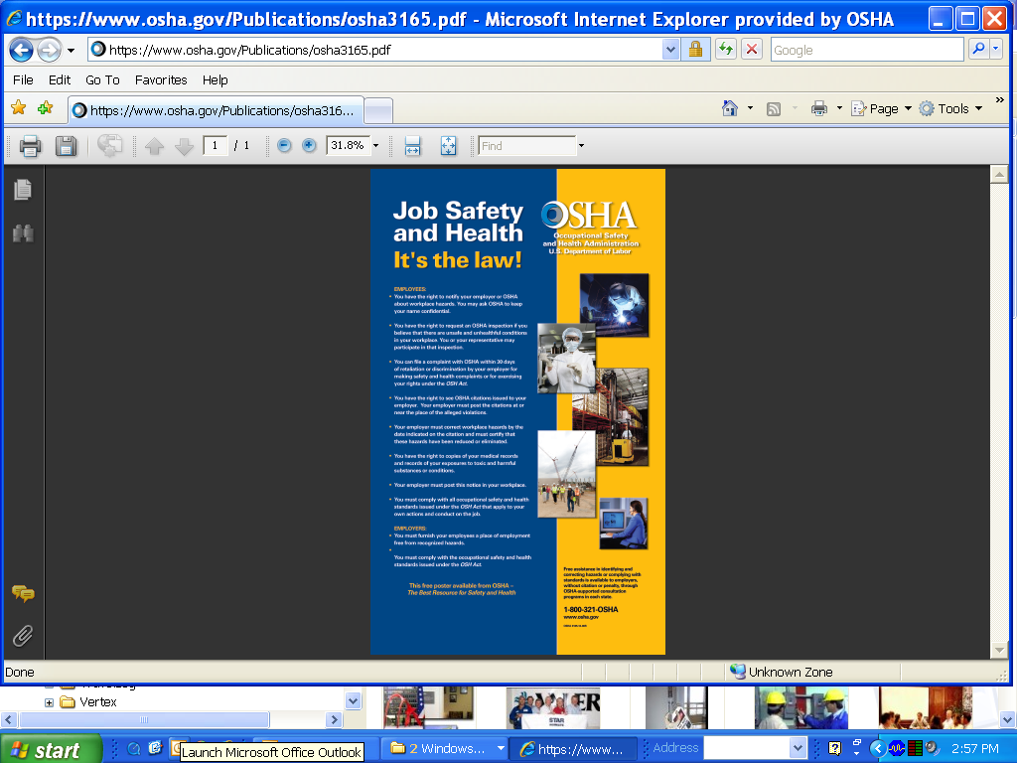
Worker Rights
Handout: OSHA Poster
Have you seen this poster at your place of work?
Creation of OSHA provided workers the right to a safe and healthful workplace
* Poster available on course disk

Slide 11
Your Right to…
The creation of OSHA provided workers the right to a safe and healthful workplace.
Section 5(a)(1) of the OSH Act states: “Each employer shall furnish to each of his employees employment and a place of employment which are free from recognized hazards that are causing or are likely to cause death or serious physical harm to his employees."

Slide 12

Your Right to…
Know About Hazardous Chemicals
Employers must have a written, complete hazard communication program that includes information on:
Container labeling,
Material Safety Data Sheets (MSDSs), and
Worker training. The training must include the physical and health hazards of the chemicals and how workers can protect themselves; including specific procedures the employer has implemented to protect workers, such as work practices, emergency procedures, and personal protective equipment.

Slide 13
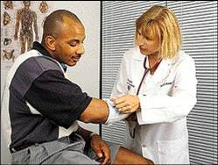
Your Right to…
About Workplace injuries and Illnesses
OSHA’s Recordkeeping rule requires most employers with more than 10 workers to keep a log of injuries and illnesses.
Workers have the right to review the current log, as well as the logs stored for the past 5 years.
Workers also have the right to view the annually posted summary of the injuries and illnesses (OSHA 300A).

Slide 14
Your Right to…
Request Workplace Safety Corrections
Workers may bring up safety and health concerns in the workplace to their employers without fear of discharge or discrimination, as long as the complaint is made in good faith.
OSHA regulations [29CFR 1977.9(c)] protect workers who complain to their employer about unsafe or unhealthful conditions in the workplace.

Slide 15
Your Right to…
Be Free From Retaliation
Workers have the right to be free from retaliation for exercising safety and health rights.
Workers have a right to seek safety and health on the job without fear of punishment.
This right is spelled out in Section 11(c) of the OSH Act.
Workers have 30 days to contact OSHA if they feel they have been punished for exercising their safety and health rights.

Slide 16
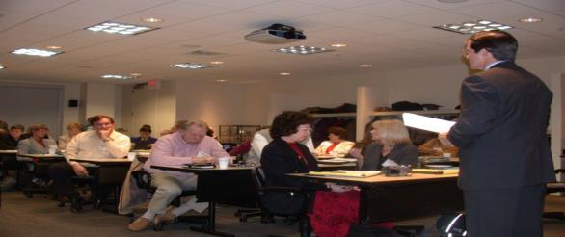
Your Right to…
Training
Workers have a right to get training from employers on a variety of health and safety hazards and standards that employers must follow.
Some required training covers topics such as, lockout-tag out, blood borne pathogens, noise, confined spaces, fall hazards in construction, personal protective equipment, along with a variety of other subjects.

Slide 17
Your Right to…
Examine Exposure & Medical Records
1910.1020: right to examine & copy records
Examples of toxic substances and harmful physical agents are:
Metals and dusts, such as, lead, cadmium, and silica.
Biological agents, such as bacteria, viruses, and fungi.
Physical stress, such as noise, heat, cold, vibration, repetitive motion, and ionizing and non-ionizing radiation.

Slide 18
Your Right to…
File a complaint with OSHA
Workers may file a complaint with OSHA if they believe a violation of a safety or health standard, or an imminent danger situation, exists in the workplace.
Workers may request that their name not be revealed to the employer.
If a worker files a complaint, they have the right to find out OSHA’s action on the complaint and request a review if an inspection is not made.

Slide 19
Your Right to…
Participate in an OSHA Inspection
Employee representative can accompany OSHA inspector
Workers can talk to the inspector privately.
Workers may point out hazards, describe injuries, illnesses or near misses that resulted from those hazards and describe any concern you have about a safety or health issue.
Workers can find out about inspection results, abatement measures and may object to dates set for violation to be corrected.

Slide 20
Employer Responsibilities Under OSHA?
Provide a workplace free from recognized hazards and comply with OSHA standards
Provide training required by OSHA standards
Keep records of injuries and illnesses
Provide medical exams when required by OSHA standards and provide workers access to their exposure and medical records
Not discriminate against workers who exercise their rights under the Act (Section 11(c))
Post OSHA citations and abatement verification notices
Provide and pay for PPE

Slide 21
Employers are Required to:
REPORTING AND RECORDING CHECKLIST
Employers must: Report each worker death Report each incident that hospitalizes 3 or more workers Maintain injury & illness records Inform workers how to report an injury or illness to the employer Make records available to workers Allow OSHA access to records Post annual summary of injuries & illnesses
KEEP RECORDS OF INJURIES AND ILLNESSES

Slide 22
Review Questions
What are some of the responsibilities employers have related to OSHA recordkeeping?
Which section of the OSH Act prohibits employers from discriminating against workers for exercising their safety and health rights?
What are some types of PPE that employers must pay for?

Slide 23
What do the OSHA Standards Say?
OSHA standards fall into four categories:
General Industry
Construction
Maritime
Agriculture
OSHA issues standards for a wide variety of workplace hazards
Where there are no specific OSHA standards, employers must comply with The General Duty Clause, Section 5(a)(1)

Slide 24
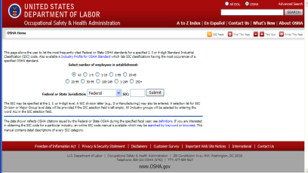
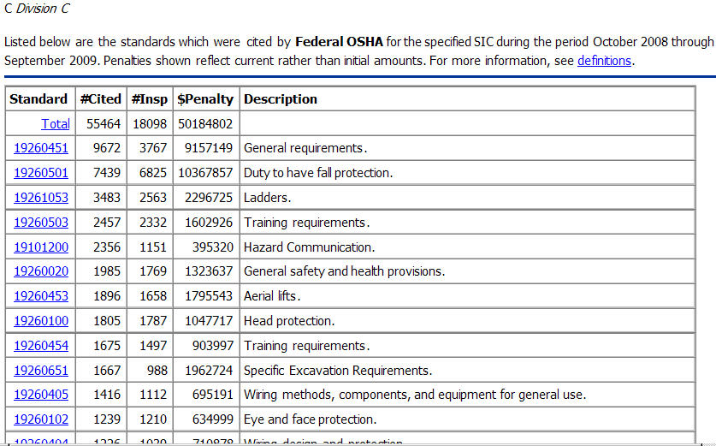
Most Frequently Cited Standards
Click: Most Frequently Cited (MFC) Standards to view current data
To search MFC data on this webpage:
“Select number of employees in establishment,” select ALL or one of the options listed
“Federal or State Jurisdiction,” select Federal or, from the dropdown menu, a specific state
“SIC,” select ALL for all Industry groups, C for Construction, D for Manufacturing (General Industry), or 373 and 449 for Maritime
Shown are search results for: All sizes of establishments, in Federal jurisdiction, with Construction SIC codes

Slide 25
How Are OSHA Inspections Conducted?
The OSH Act authorizes OSHA compliance safety and health officers (CSHOs) to conduct workplace inspections at reasonable times.
OSHA conducts inspections without advance notice, except in rare circumstances (e.g. Imminent Danger)
In fact, anyone who tells an employer about an OSHA inspection in advance can receive fines and a jail term.

Slide 26
OSHA Inspection Priority
Priority | Category of Inspection
1st | Imminent Danger: Reasonable certainty an immediate danger exists
2nd | Fatality/Catastrophe: Reported to OSHA; inspected ASAP
3rd | Complaints/Referrals: Worker or worker representative can file a complaint about a safety or health hazard
4th | Programmed Inspections: Cover industries and employers with high injury and illness rates, specific hazards, or other exposures.

Slide 27
Citations and Penalties
Violation Type | Penalty
WILLFUL A violation that the employer intentionally and knowingly commits or a violation that the employer commits with plain indifference to the law. | OSHA may propose penalties of up to $70,000 for each willful violation, with a minimum penalty of $5,000 for each willful violation.
SERIOUS A violation where there is substantial probability that death or serious physical harm could result and that the employer knew, or should have known, of the hazard. | There is a mandatory penalty for serious violations which may be up to $7,000.
OTHER-THAN-SERIOUS A violation that has a direct relationship to safety and health, but probably would not cause death or serious physical harm. | OSHA may propose a penalty of up to $7,000 for each other-than-serious violation.
REPEATED A violation that is the same or similar to a previous violation. | OSHA may propose penalties of up to $70,000 for each repeated violation.

Slide 28
Where Can you Go For Help?
Sources within the workplace/worksite
Employer or supervisor, co-workers and union representatives
Material Safety Data Sheet (MSDS) for information on chemicals
Labels and warning signs
Employee orientation manuals or other training materials
Work tasks and procedures instruction
Sources outside the workplace/worksite
OSHA website: http://www.osha.gov and OSHA offices (you can call or write)
Compliance Assistance Specialists in the area offices
National Institute for Occupational Safety and Health (NIOSH) – OSHA’s sister agency
OSHA Training Institute Education Centers
Doctors, nurses, other health care providers
Public libraries
Other local, community-based resources

Slide 29
How to file an OSHA complaint
Online - Go to the Online Complaint Form Written complaints that are signed by workers or their representative and submitted to an OSHA Area or Regional office are more likely to result in onsite OSHA inspections. Complaints received on line from workers in OSHA-approved state plan states will be forwarded to the appropriate state plan for response.
Download and Fax/Mail - Download the OSHA complaint form* [En Espanol*] (or request a copy from your local OSHA Regional or Area Office), complete it and then fax or mail it back to your local OSHA Regional or Area Office. Written complaints that are signed by a worker or representative and submitted to the closest OSHA Area Office are more likely to result in onsite OSHA inspections. Please include your name, address and telephone number so we can contact you to follow up. This information is confidential.
Telephone - your local OSHA Regional or Area Office. OSHA staff can discuss your complaint and respond to any questions you have. If there is an emergency or the hazard is immediately life-threatening, call your local OSHA Regional or Area Office or 1-800-321-OSHA.
29

Slide 30
Who can File an OSHA Complaint?
Employees or their representatives have a right to request an inspection of a workplace if they believe there is a violation of a safety or health standard, or if there is any danger that threatens physical harm, or if an "imminent danger" exists. Employee representatives, for the purposes of filing a complaint, are defined as any of the following:
An authorized representative of the employee bargaining unit, such as a certified or recognized labor organization.
An attorney acting for an employee.
Any other person acting in a bona fide representative capacity, including, but not limited to, members of the clergy, social workers, spouses and other family members, and government officials or nonprofit groups and organizations acting upon specific complaints and injuries from individuals who are employees.
In addition, anyone who knows about a workplace safety or health hazard may report unsafe conditions to OSHA, and OSHA will investigate the concerns reported.
30

Slide 31
Summary
This lesson covered:
The importance of OSHA, including the history of safety and health regulation leading to the creation of OSHA and OSHA’s mission;
Worker rights under OSHA;
Employer responsibilities;
OSHA standards;
OSHA inspections; and
Safety and health resources, including how to file a complaint.

Slide 32

Multi-Employer
Worksites
Notes:
Background. OSHA's Field Inspection Reference Manual (FIRM) of September 26, 1994 (CPL 2.103), states at Chapter III, paragraph 6. C., the Agency's citation policy for multi-employer worksites. The Agency has determined that this policy needs clarification. The new policy provides clearer and more detailed guidance.
New Policy is Directive 2-0.124
Multi-Employer Citation Policy 12/10/99

Slide 33
Multi-Employer Worksites
More than one employer may be cited for a hazardous condition
Two-step process:
Determine is a creating, exposing, correcting, or controlling employer.
Employer's actions were sufficient to meet their obligations under OSHA.
Notes:
A single employer may have multiple roles.
Once you determine the role of the employer, go to Step Two to determine if a citation is appropriate.
(NOTE: only exposing employers can be cited for General Duty Clause violations).
Note that the extent of the measures that a controlling employer must take to satisfy its duty is less than what is required of an employer with respect to protecting its own employee.

Slide 34
Who is Responsible for Violations?
The Creating Employer
The employer who actually creates the hazard.
The Exposing Employer
An employer whose own employees are exposed to the hazard.
The Correcting Employer
An employer who is engaged in a common undertaking, on the same worksite, as the exposing employer and is responsible for correcting a hazard.
The Controlling Employer
The employer who is responsible, by contract or through actual practice, for safety and health conditions on the worksite; i.e., the employer who has the authority for ensuring that the hazardous condition is corrected
Notes:
The employer that caused a hazardous condition that violates an OSHA standard.
Employers must not create violative conditions.
An employer that does so is citable even if the only employees exposed are those of other employers at the site.

Slide 35
Exposing Employer Legitimate Defense
The employer did not create the hazard;
The employer did not have the responsibility or the authority to have the hazard corrected
The employer did not have the ability to correct or remove the hazard
The employer can demonstrate that the creating, the controlling and/or the correcting employers, as appropriate, have been specifically notified as the hazard to which his/her employees are exposed
Notes:
Prior to issuing citations to an exposing employer, it must first be determined whether the available facts indicate if that employer has a legitimate defense to the citation

Slide 36
Exposing Employer Legitimate Defense
The employer has instructed his/her employees to recognize the hazard and,
5a. Where feasible, an exposing employer must have taken appropriate alternative means of protecting employees from the hazard.
5b. When extreme circumstances justify it, the exposing employer shall remove his/her employees from the job to avoid citation

Slide 37

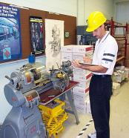
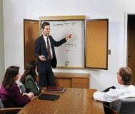

Safety and Health Programs
Notes:
This presentation is designed to assist trainers conducting OSHA 10-hour General Industry outreach training for workers. Since workers are the target audience, this presentation emphasizes hazard identification, avoidance, and control – not standards. No attempt has been made to treat the topic exhaustively. It is essential that trainers tailor their presentations to the needs and understanding of their audience.
This presentation is not a substitute for any of the provisions of the Occupational Safety and Health Act of 1970 or for any standards issued by the U.S. Department of Labor. Mention of trade names, commercial products, or organizations does not imply endorsement by the U.S. Department of Labor.

Slide 38
Checklist for Self Compliance
Do you have an active safety and health program in operation that includes general safety and health program elements as well as the management of hazards specific to your work-site?
Is one person clearly responsible for the safety and health program?
Do you have a safety committee or group made up of management and labor representatives that meets regularly and reports in writing on its activities?
Do you have a working procedure to handle in-house employee complaints regarding safety and health?
Are your employees advised of efforts and accomplishments of the safety and health program made to ensure they will have a workplace that is safe and healthful?
Have you considered incentives for employees or workgroups who excel in reducing workplace injury/illnesses?
38

Slide 39
Behavior Based Safety
Behavior-Based Safety refers to the use of applied behavior analysis models to achieve continuous improvement in safety performance.
According to some safety professionals, safety programs fail because they rely too much on things that come before behavior -- safety rules, procedures, meetings, and so on.
Identify critical problem behaviors. These become action items to work on.
Identify root causes. The “basic things” that need to be fixed to eliminate the problem.
Generate potential actions. Think of as many solutions as possible.
Evaluate possible actions. Choose those that are most productive.
Develop an action plan. To carry out the chosen solutions.
Implement an action plan. Carry it the change. Limit variables.
Conduct follow up. Problem solved? Measure and evaluate.
39

Slide 40
Session Objectives
Discuss the benefits of an effective safety and health program.
Name the four elements of an effective safety and health program.
Name three methods to prevent and control workplace hazards.
Questions-
Why does a company have safety rules if OSHA laws already exist?
What is the purpose of your companies safety manual?
Notes:
Safety and health programs are recommended for all general industry businesses, but, at this point, are voluntary.
Accidents are more expensive than most people realize because of the hidden costs. Some costs are obvious — for example, Workers’ Compensation claims which cover medical costs and indemnity payments for an injured or ill worker. These are the direct costs of accidents.
But what about the costs to train and compensate a replacement worker, repair damaged property, investigate the accident and implement corrective action, and to maintain insurance coverage? Then there are the costs related to schedule delays, added administrative time, lower morale, increased absenteeism, and poorer customer relations. These are the indirect costs of accidents.

Slide 41
What is your role?
Qualified Person – one who, by possession of a recognized degree, certificate, or professional standing, or who by extensive knowledge, training, and experience, has successfully demonstrated his ability to solve or resolve problems relating to the subject matter, the work, or the project.
Competent Person- one who is capable of identifying existing and predictable hazards in the surroundings or working conditions which are unsanitary, hazardous, or dangerous to employees and who has authorization to take prompt corrective measures to eliminate them.
Authorized Person- a person approved or assigned by the employer to perform a specific type of duty or duties or to be at a specific location or locations at the jobsite.
Question:
Who has the authority to appoint a Qualified, Competent or an Authorized Person?
Notes:
The best Safety and Health Programs involve every level of the organization, instilling a safety culture that reduces accidents for workers and improves the bottom line for managers.
What are the common characteristics of a safety and health culture?
Management believes that safety and health on the job is as important a company goal as other organizational objectives, such as cost control, quality, and productivity.
Individuals within the organization believe they have a right to a safe and healthy workplace.
- Each person accepts personal responsibility for ensuring his or her own safety and health.
- Everyone believes he or she has a duty to protect the safety and health of others.

Slide 42

Major Program Elements
Effective occupational safety and health programs include the following four elements:
Management commitment and employee involvement
Workplace hazard analysis
Hazard prevention and control methods
Safety and health training program
Notes:
The best Safety and Health Programs involve every level of the organization, instilling a safety culture that reduces accidents for workers and improves the bottom line for managers.
What are the common characteristics of a safety and health culture?
Management believes that safety and health on the job is as important a company goal as other organizational objectives, such as cost control, quality, and productivity.
Individuals within the organization believe they have a right to a safe and healthy workplace.
- Each person accepts personal responsibility for ensuring his or her own safety and health.
- Everyone believes he or she has a duty to protect the safety and health of others.

Slide 43
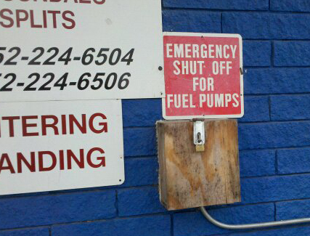
Management Commitment Employee Involvement
Complementary elements;
Management commitment: Provide oversight, motivation and resources to prevent anticipated workplace injuries and illnesses
Employee involvement:
Allow workers to participate in the identification, prevention and remediation of workplace safety and health concerns
Notes:
Management must be committed to safety and health protection as much as other organizational purposes.
Management leadership and employee involvement are tied together because one is not effective without the other. A plant manager can be totally committed, but if employees follow blindly or are not involved, problems will only temporarily be solved.

Slide 44
Management Commitment Elements
What must an employer do to demonstrate management commitment to workplace safety? An employer must:
Establish program responsibilities of managers, supervisors and employees for safety and health in the workplace and hold them accountable for carrying out assigned responsibilities;
Provide managers, supervisors, and employees with the authority, access to relevant information, training and resources they need to carry out their safety and health responsibilities; and
Identify at least one manager, supervisor, or employee to receive and respond to reports regarding workplace safety and health conditions and where appropriate, to initiate corrective action.
Question
How would you define Management Commitment?
Notes:
The best Safety and Health Programs involve every level of the organization, instilling a safety culture that reduces accidents for workers and improves the bottom line for managers.
What are the common characteristics of a safety and health culture?
Management believes that safety and health on the job is as important a company goal as other organizational objectives, such as cost control, quality, and productivity.
Individuals within the organization believe they have a right to a safe and healthy workplace.
- Each person accepts personal responsibility for ensuring his or her own safety and health.
- Everyone believes he or she has a duty to protect the safety and health of others.

Slide 45
Employee Involvement Elements
What must the employer do to ensure employees have opportunities for involvement?
Regularly communicate with employees about workplace safety and health matters
Provide employees with access to information relevant to the program
Provide ways for employees to become involved in hazard identification, assessment, prioritizing hazards, training, and program evaluation
Establish a way for employees to report job-related injuries, illnesses, incidents and hazards promptly and to make recommendations about appropriate ways to control those hazards and provide prompt responses to such reports and recommendations.
Question
How would you define Employee Involvement?
Notes:
The best Safety and Health Programs involve every level of the organization, instilling a safety culture that reduces accidents for workers and improves the bottom line for managers.
What are the common characteristics of a safety and health culture?
Management believes that safety and health on the job is as important a company goal as other organizational objectives, such as cost control, quality, and productivity.
Individuals within the organization believe they have a right to a safe and healthy workplace.
- Each person accepts personal responsibility for ensuring his or her own safety and health.
- Everyone believes he or she has a duty to protect the safety and health of others.

Slide 46
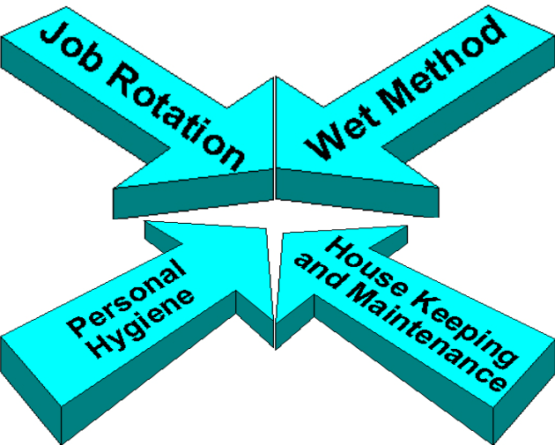
Controlling the Hazards
Prevent and control hazards:
Engineering practices
Administrative controls
Personal protective equipment
Safe work practices communicated
Training
Correction of unsafe performance
Enforcement
Notes:
Engineering controls Where feasible and appropriate, the first and best strategy is to control the hazard at its source. Engineering controls do this, unlike other controls that generally focus on the employee exposed to the hazard. The basic concept is that the work environment and the job itself should be designed to eliminate hazards or reduce exposure to hazards.
Administrative Controls Includes exercise breaks and rotation of workers. These types of controls are normally used in conjunction with other controls.
Personal Protective Equipment PPE is a supplementary method of control via clothing or equipment when hazard exposure cannot be engineered completely out, and when other forms of control cannot provide sufficient additional protection. Remember, PPE is the last level of control!
Safe Work Practices Include your company’s general workplace rules and other operation-specific rules. For example, even when a hazard is enclosed, exposure can occur when maintenance is necessary.

Slide 47
Safety and Health Inspections
Established a system for regular workplace inspections
Develop method to document unsafe acts or conditions
Develop method to document corrective and remedial actions
Provide a reliable system for affected employees to notify supervision about identified hazardous conditions and to receive timely and appropriate responses (without fear of reprisal)
Questions
How does a workplace safety and health inspection benefit employee safety?
Should workplace hazards be documented?
Notes:
Routine site safety and health inspections are designed to catch hazards missed at other stages. This type of inspection should be done at regular intervals, generally on a weekly basis. In addition, procedures should be established that provide a daily inspection of the work area.
You can use a checklist already developed or make your own, based on:
- Past problems
- Standards that apply to your industry
- Input from everyone involved
- Your company's safety practices or rules
Important things to remember about inspections are:
- Inspections should cover every part of the worksite
- They should be done at regular intervals
- In-house inspectors should be trained to recognize and control hazards
- Identified hazards should be tracked to correction
Information from inspections should be used to improve the hazard prevention and control program.

Slide 48
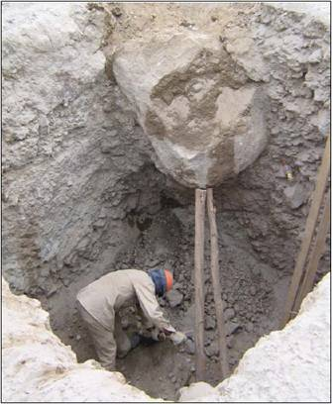
Comprehensive Site Survey
Conduct a baseline safety and health survey
Develop a system for conducting and communicating Job Hazard Analysis
Where can you go for additional help;
OSHA consultation services
Insurance companies
Consultants
Customer Safety Representatives
?????
Notes:
Job Hazard Analysis (JHA)
This involves studying and recording each step of a job, identifying existing or potential job hazards and determining the best way to perform the job to reduce or eliminate hazards. Jobs that were initially designed to be safe may change over time so they have hazards or require unsafe operations. Job safety analysis should form a base for the comprehensive survey. It includes analyzing planned and new facilities, processes, materials, and equipment.
-- See Publication #3071, Job Hazard Analysis
OSHA’ s Consultation Service
For small businesses, OSHA-funded, state-run consultation services can conduct a comprehensive survey at no cost. Many workers’ compensation carriers and other insurance companies offer expert services to help their clients evaluate safety and health hazards. Larger businesses may find the needed expertise at the company or corporate level.
-- See www.osha.gov/oshprogs/consult.html for more information
Industrial hygiene survey: at a minimum, all chemicals and hazardous materials in the plant should be inventoried, the hazard communication program should be reviewed, and air samples analyzed. For many industries, a survey of noise levels, a review of the respirator program, and a review of ergonomic risk factors are needed.

Slide 49
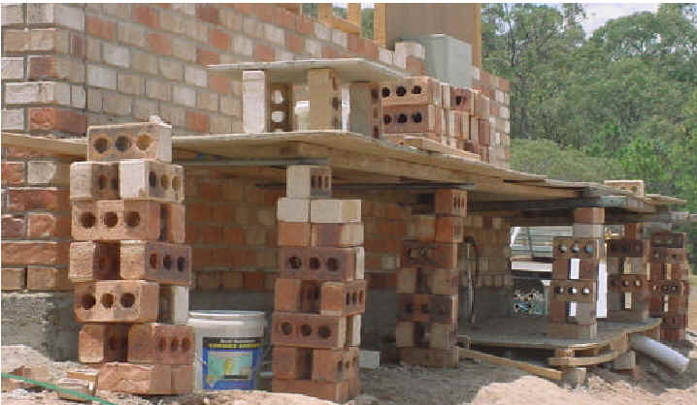
Worksite Safety Planning
Why was this hazard created?
Examine the workplace and identify predictable or likely hazards
Actively analyze the work activities and the worksite to anticipate and prevent harmful occurrences
Communicate identified hazards to affected personnel
Insure identified hazards are effectively remediated and a process to prevent a reoccurrence is implemented
Notes:
Management must provide the resources and authority so all personnel can find the hazards in the worksite and, once found, eliminate or control those hazards.

Slide 50
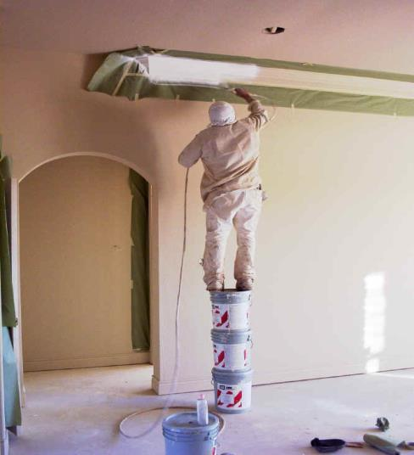
Additional Worksite Planning
Investigate accidents and “near miss” incidents, so that their causes and means for prevention are identified
Analyze injury and illness trends, so that common cause patterns can be identified and prevented
Notes:
Six key questions should be answered in the accident investigation and report: who, what, when, where, why, and how. Thorough interviews with all involved are necessary. The primary purpose of the investigation is to prevent future occurrences. Therefore, the results of the investigation should be used to initiate corrective action.
Review of the OSHA injury and illness forms is the most common form of pattern analysis, but other records of hazards can be analyzed for patterns. Examples are inspection records, workers’ compensation claims, and employee hazard reporting records.

Slide 51
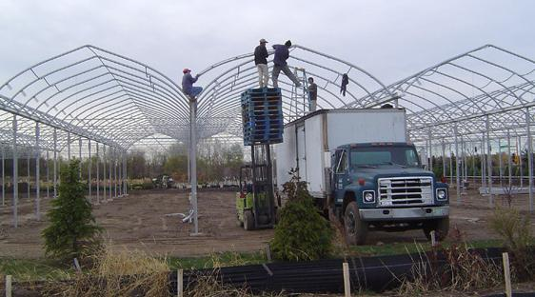
Safety and Health Program Benefits
Can a safety program really affect workplace activities? Can a program;
Reduce and eliminate work related injuries and illnesses
Improve morale and productivity
Protect good customer relationships
Notes:
Safety and health programs are recommended for all general industry businesses, but, at this point, are voluntary.
Accidents are more expensive than most people realize because of the hidden costs. Some costs are obvious — for example, Workers’ Compensation claims which cover medical costs and indemnity payments for an injured or ill worker. These are the direct costs of accidents.
But what about the costs to train and compensate a replacement worker, repair damaged property, investigate the accident and implement corrective action, and to maintain insurance coverage? Then there are the costs related to schedule delays, added administrative time, lower morale, increased absenteeism, and poorer customer relations. These are the indirect costs of accidents.

Slide 52
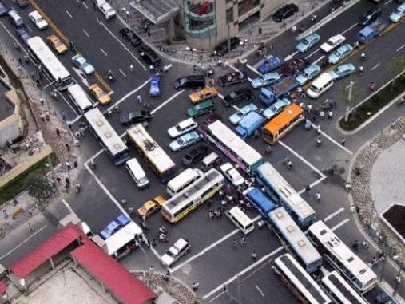
Policy and Goals
How do safety policies affect daily work activities? Do they;
Clearly state workplace safety and health policies
Communicate clear goals and objectives for the safety and health program
Involve top management in implementing the program

Slide 53
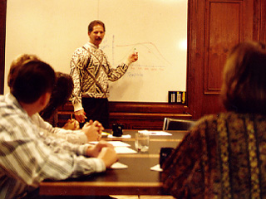
Safety and Health Training
What is the most effective method to insure affected employees are trained? Should training;
Address the safety and health responsibilities of all personnel
Verify affected personnel understand the desired method for preventing anticipated exposures
Documentation include topics covered
Notes:
Training is the backbone of this system. For management to lead, for personnel to analyze the worksite for hazards, and for hazards to be eliminated or controlled, everyone involved must be trained. The scope of the training depends on the size and complexity of the worksite and the hazards involved.
Who Needs Training?
- Target new hires, contract workers, employees who wear PPE and workers in high risk areas. Managers and supervisors should also be included in the training plan.
- Manager training should emphasize their important role in visibly supporting the safety and health program and setting a good example.
- Supervisor training should cover company policies and procedures, hazard detection and control, accident investigation, handling of emergencies, and how to train and reinforce training.
- Long-term workers who have job changes as a result of new processes or materials.
- The entire workforce needs periodic refresher training in responding to emergencies.

Slide 54
Safety and Health Orientation
Employees must understand the hazards they may be exposed to as a result of assigned work operations and how to prevent harm to themselves and others
Orientation training should involve direct supervision of the affected person
Questions
What information should a new or transferred employee take away from an orientation?
What did you take away from your last orientation?

Slide 55
Focused Training Efforts
Research has identified the following variables as being related to a disproportionate share of injuries and illnesses at the worksite on the part of employees:
The age of the employee (younger employees have higher incidence rates).
The length of time on the job (new employees have higher incidence rates).
The size of the firm (in general terms, medium-size firms have higher incidence rates than smaller or larger firms).
The type of work performed (incidence and severity rates vary significantly by SIC Code).
The use of hazardous substances (by SIC Code).
Notes:
For more information:
- See OSHA's Voluntary Safety and Health Program Management Guidelines. Federal Register (1989, January 26), (54 FR 3904).
It is available at the OSHA technical link for Safety and Health Programs at www.osha.gov.

Slide 56
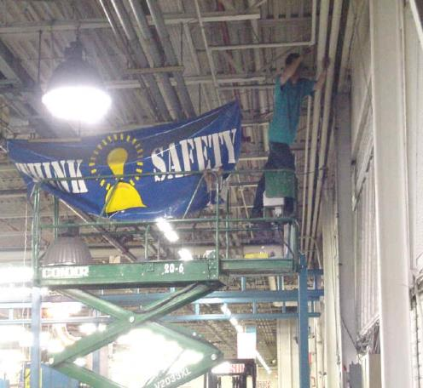
Specific Training Needs
Hazard recognition and corrective actions
Training required by OSHA
Emergency response
Exposures unique to the workplace
Introduction of a new tool, material or process
Changes in site hazards

Slide 57
1926 OSHA Training Requirements
* Can an employer rely solely on the use of video tapes for training?
57

Slide 58
Holding Productive Safety Meetings
Is there a difference between Safety Training and Safety Meetings?
What topics should be discussed?
Who should lead meetings?
How is information from the meeting sent to affected personnel?
Should the information discussed in the meetings be documented?
58

Slide 59
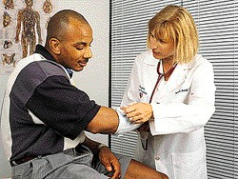
Planning for Workplace Emergencies
Emergency planning
Fire generated by work activities
Natural disasters
Workplace violence or terrorism
Medical treatment
First aid
Injuries requiring medical treatment
Access to emergency services

Slide 60
Summary
Affective safety and health programs;
Affectively reduces or eliminates work related injuries and illnesses
Improves morale and productivity
Insures affected personnel have appropriate training in hazard recognition and prevention
Addresses the four major program elements
Management commitment and employee involvement
Workplace hazard analysis
Hazard prevention and control methods
Safety and health training program
Notes:
For more information:
- See OSHA's Voluntary Safety and Health Program Management Guidelines. Federal Register (1989, January 26), (54 FR 3904).
It is available at the OSHA technical link for Safety and Health Programs at www.osha.gov.

Slide 61
Maintaining Documents
What Documents must be retained?
What Documents must be made available when requested by an affected employee, their designated representative or OSHA?
How long must these Documents be retained?
How are OSHA logs maintained and made available?
How are training records maintained at you company?
Orientation
Tool box talks
Site or task specific training
61

Slide 62
Recording Criteria Decision Tree
1904.4
Notes:
Follow the flowchart with handout
Specific cases refers to 1904.8 through 1904.11

Slide 63
Work-Relatedness
Cases are work-related if:
An event or exposure in the work environment either caused or contributed to the resulting condition
An event or exposure in the work environment significantly aggravated a pre-existing injury or illness
1904.5
Notes:
Page 5946.

Slide 64
Work-Relatedness
Work-relatedness is presumed for injuries and illnesses resulting from events or exposures occurring in the work environment
A case is presumed work-related if, and only if, an event or exposure in the work environment is a discernable cause of the injury or illness or of a significant aggravation to a pre-existing condition. The work event or exposure need only be one of the discernable causes; it need not be the sole or predominant cause

Slide 65
Motivation and Incentive Programs
OSHA is concerned about workplace safety incentive and discipline programs that are based primarily on injury and illness numbers, they often have the effect of discouraging workers from reporting an injury or illness. OSHA strongly disapproves of programs offering workers parties and prizes for not reporting injuries, or bonuses for managers that drive down injury rates, or that discipline workers for reporting an injury.
When programs discourage workers from reporting injuries or illnesses: problems stay concealed, no investigations take place, nothing is learned or corrected, workers remain exposed to harm. OSHA does support programs that reward workers for demonstrating safe work practices, reporting hazards or close calls, participating in safety and health training, or serving on a workplace safety and health committee.
65

