Slide 1
CAF Construction Site Safety Certificate Program
Class 4 - Electricity
This material was produced under grant number SH-22224-11-60-F-18 from the Occupational Safety and Health Administration, U.S. Department of Labor. It does not necessarily reflect the views or policies of the U.S. Department of Labor, nor does mention trade names, commercial products, or organizations imply endorsement by the U.S. Government.

Slide 2

Electricity - The Dangers
About 5 workers are electrocuted every week
Causes 12% of young worker workplace deaths
Takes very little electricity to cause harm
Significant risk of causing fires
Notes:
Whenever you work with power tools or electrical circuits there is a risk of electrical hazards, especially electrical shock. Risks are increased at construction sites because many jobs involve electric power tools.
Electrical trades workers must pay special attention to electrical hazards because they work on electrical circuits. Coming in contact with an electrical voltage can cause current to flow through the body, resulting in electrical shock and burns. Serious injury or even death may occur.
Electricity has long been recognized as a serious workplace hazard, exposing employees to electric shock, electrocution, burns, fires, and explosions. In 1999, for example, 278 workers died from electrocutions at work, accounting for almost 5 percent of all on-the-job fatalities that year, according to the Bureau of Labor Statistics. What makes these statistics more tragic is that most of these fatalities could have been easily avoided.

Slide 3
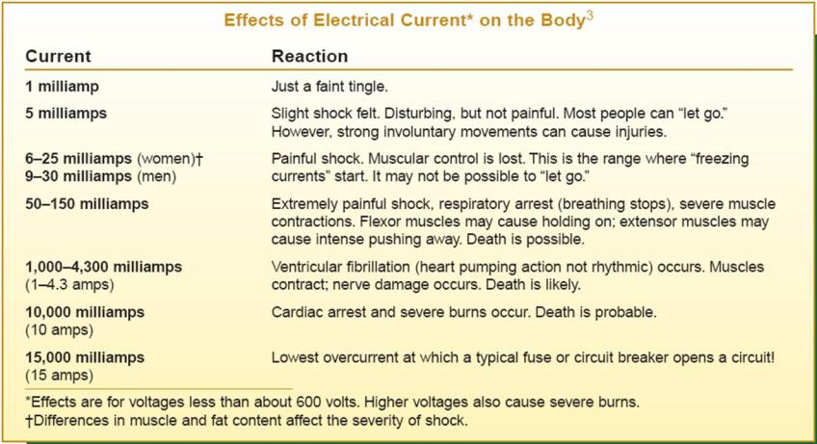
Dangers of Electrical Shock
Notes:
Examples of how small levels of electrical current can cause damage

Slide 4
Electrical Injuries
There are two main types of electrical injuries:
Direct:
Death or Debilitating Injuries
Electrical shock
Burns
Indirect:
Fire
Falls
Notes:
When an electrical shock enters the body it may produce different types of injuries. Electrocution results in internal and external injury to body parts or the entire body – often resulting in death. After receiving a “jolt” of electricity all or part of the body may be temporarily paralyzed and this may cause loss of grip or stability. A person may also involuntarily move as a result of receiving an electrical shock, resulting in a fall. Internal or external burns may result from contact with electricity.

Slide 5
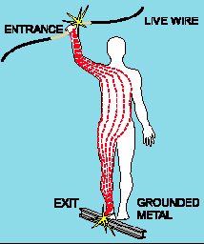
Shock Severity
Severity of the shock depends on:
Path of current through the body
Amount of current flowing through the body (amps)
Duration of the shocking current through the body,
LOW VOLTAGE DOES NOT MEAN LOW HAZARD
Notes:
Other factors that may affect the severity of the shock are:
- The voltage of the current.
- The presence of moisture
- The general health of the person prior to the shock.
Low voltages can be extremely dangerous because, all other factors being equal, the degree of injury increases the longer the body is in contact with the circuit.
The resistance of the body varies based on:
The amount of moisture on the skin (less moisture = more resistance)
The size of the area of contact (smaller area = more resistance)
The pressure applied to the contact point (less pressure = more resistance)
Muscular structure (less muscle = less resistance)

Slide 6
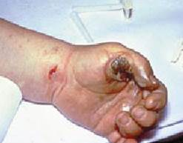
Burns
Most common shock-related injury
Occurs when you touch electrical wiring or equipment that is improperly used or maintained
Typically occurs on hands
Electric shock can also cause indirect injuries
Very serious injury that needs immediate attention
Notes:
Shock-related injuries include burns, internal injuries, and injuries due to
involuntary muscle contractions.
The most common shock-related injury is a burn. Burns suffered in electrical incidents may be one or more of the following three types.
Electrical burns cause tissue damage, and are the result of heat generated by the flow of electrical current through the body. These are one of the most serious injuries you can receive and require immediate attention.
Arc or Flash burns are caused by high temperatures near the body produced by an electrical arc or explosion. Attend to them immediately.
Thermal contact burns occur when skin comes in contact with overheated electric equipment, or when clothing is ignited by an electrical incident.

Slide 7
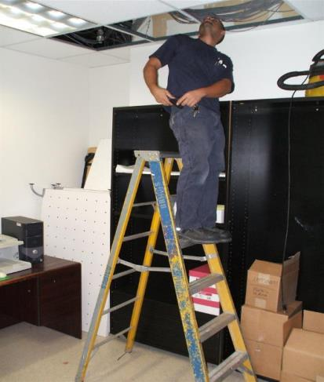
Falls
Workers in elevated locations who experience a shock may fall, resulting in serious injury or death
Notes:
During electrical incidents affect personnel will do whatever it takes to get away from the exposure. Falls cause a great deal of secondary injuries during electrical incidents

Slide 8
CAF Construction Site Safety Certificate Program
Class 4 – Electricity
Electrical Fires – Wiring Designs

Slide 9
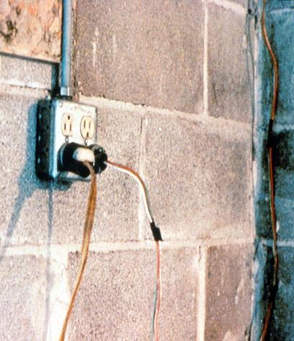
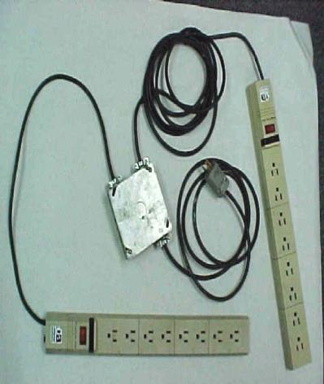
Hazard – Defective Cords & Wires
Notes:
Extension cords may have damaged insulation. Sometimes the insulation inside an electrical tool or appliance is damaged. When insulation is damaged, exposed metal parts may become energized if a live wire inside touches them. Electric hand tools that are old, damaged, or misused may have damaged insulation inside. If you touch damaged power tools or other equipment, you will receive a shock. You are more likely to receive a shock if the tool is not grounded or double-insulated.

Slide 10
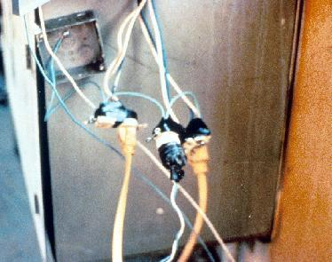
Electrical Hazards and How to Control Them
Electrical accidents are caused by a combination of three factors:
Unsafe equipment and/or installation,
Workplaces made unsafe by the environment, and
Unsafe work practices.
Notes:
Electrical shocks, fires, or falls result from these hazards:
Exposed electrical parts
Overhead power lines
Inadequate wiring
Defective insulation
Improper grounding
Overloaded circuits
Wet conditions
Damaged tools and equipment
Improper PPE

Slide 11
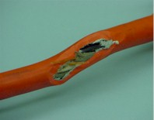
Clues that Electrical Hazards Exist
Tripped circuit breakers or blown fuses
Warm tools, wires, cords, connections, or junction boxes
GFCI that shuts off a circuit
Worn or frayed insulation around wire or connection
Notes:
There are “clues” that electrical hazards exist. For example, if a GFCI keeps tripping while you are using a power tool, there is a problem. Don’t keep resetting the GFCI and continue to work. You must evaluate the “clue” and decide what action should be taken to control the hazard.
There are a number of other conditions that indicate a hazard.
Tripped circuit breakers and blown fuses show that too much current is flowing in a circuit. This could be due to several factors, such as malfunctioning equipment or a short between conductors. You need to determine the cause in order to control the hazard.
An electrical tool, appliance, wire, or connection that feels warm may indicate too much current in the circuit or equipment. You need to evaluate the situation and determine your risk.
An extension cord that feels warm may indicate too much current for the wire size of the cord. You must decide when action needs to be taken.
A cable, fuse box, or junction box that feels warm may indicate too much current in the circuits.
A burning odor may indicate overheated insulation.
Worn, frayed, or damaged insulation around any wire or other conductor is an electrical hazard because the conductors could be exposed. Contact with an exposed wire could cause a shock. Damaged insulation could cause a short, leading to arcing or a fire. Inspect all insulation for scrapes and breaks. You need to evaluate the seriousness of any damage you find and decide how to deal with the hazard.
A GFCI that trips indicates there is current leakage from the circuit First, you must decide the probable cause of the leakage by recognizing any contributing hazards. Then, you must decide what action needs to be taken.

Slide 12
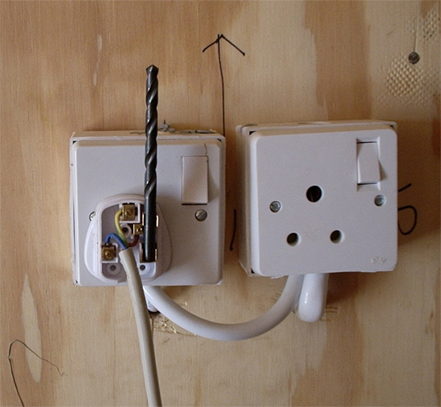
Control – Isolate Electrical Parts
Use guards or barriers and replace covers
Notes:
Reference 1926.403(i)(2)
Except as required or permitted elsewhere in the subpart, live parts of electric equipment operating at 50 volts or more shall be guarded against accidental contact by cabinets or other forms of enclosures, or by any of the following means:
* By location in a room, vault, or similar enclosure that is accessible only to qualified persons.
* By partitions or screens so arranged that only qualified persons will have access to the space within reach of the live parts. Any openings in such partitions or screens shall be so sized and located that persons are not likely to come into accidental contact with the live parts or to bring conducting objects into contact with them.
* By location on a balcony, gallery, or platform so elevated and arranged as to exclude unqualified persons.
* By elevation of 8 feet or more above the floor or other working surface and so installed as to exclude unqualified persons.

Slide 13
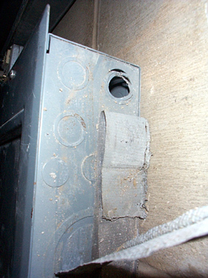
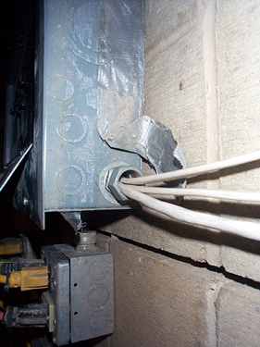
Control – Isolate Electrical Parts - Cabinets, Boxes & Fittings
Notes:
Reference 1926.405(b)(1)
Conductors entering boxes, cabinets, or fittings. Conductors entering boxes, cabinets, or fittings shall be protected from abrasion, and openings through which conductors enter shall be effectively closed. Unused openings in cabinets, boxes, and fittings shall also be effectively closed.
Covers and canopies. All pull boxes, junction boxes, and fittings shall be provided with covers. If metal covers are used, they shall be grounded. In energized installations each outlet box shall have a cover, faceplate, or fixture canopy. Covers of outlet boxes having holes through which flexible cord pendants pass shall be provided with bushings designed for the purpose or shall have smooth, well‑rounded surfaces on which the cords may bear.

Slide 14
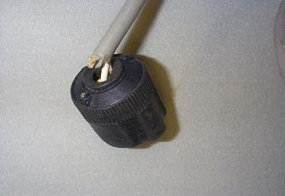
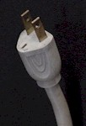
Hazard – Improper Grounding
Tools plugged into improperly grounded circuits may become energized
Broken wire or plug on extension cord
Some of the most frequently violated OSHA standards
Notes:
The most frequently violated OSHA electrical regulation is improper grounding of equipment and circuitry. The metal parts of an electrical wiring system that we touch (switch plates, ceiling light fixtures, conduit, etc.) should be grounded and at 0 volts. If the system is not grounded properly, these parts may become energized. Metal parts of motors, appliances, or electronics that are plugged into improperly grounded circuits may be energized. When a circuit is not grounded properly, a hazard exists because unwanted voltage cannot be safely eliminated. If there is no safe path to ground for fault currents, exposed metal parts in damaged appliances can become energized.
Extension cords may not provide a continuous path to ground because of a broken ground wire or plug.
Electrical systems are often grounded to metal water pipes that serve as a continuous path to ground. If plumbing is used as a path to ground for fault current, all pipes must be made of conductive material (a type of metal). Many electrocutions and fires occur because (during renovation or repair) parts of metal plumbing are replaced with plastic pipe, which does not conduct electricity.

Slide 15
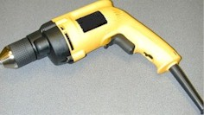
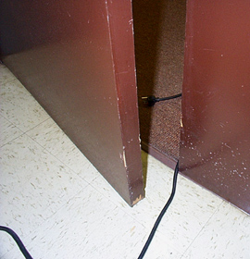
Control – Ground Tools & Equipment
Ground power supply systems, electrical circuits, and electrical equipment
Frequently inspect electrical systems to insure path to ground is continuous
Inspect electrical equipment before use
Don’t remove ground prongs from tools or extension cords
Ground exposed metal parts of equipment
Notes:
A typical extension cord grounding system has four components:
a third wire in the cord, called a ground wire;
a three-prong plug with a grounding prong on one end of the cord;
a three-wire, grounding-type receptacle at the other end of the cord; and
a properly grounded outlet.
Two kinds of grounds are required by the standard:
1. Service or system ground. In this instance, one wire, called the neutral conductor or grounded conductor, is grounded. In an ordinary low-voltage circuit, the white (or gray) wire is grounded at the generator or transformer and again at the service entrance of the building. This type of ground is primarily designed to protect machines, tools, and insulation against damage.
2. For enhanced worker protection, an additional ground, called the equipment ground, must be furnished by providing another path from the tool or machine through which the current can flow to the ground. This additional ground safeguards the electric equipment operator if a malfunction causes the metal frame of the tool to become energized.

Slide 16
Control - Assured Equipment Grounding Conductor Program
Program must cover:
All cord sets
Receptacles not part of a building or structure
Equipment connected by plug and cord
Program requirements include:
Specific procedures adopted by the employer
Competent person to implement the program
Visual inspection for damage of equipment connected by cord and plug
Notes:
Reference 1926.404(b)(1)(iii)
Assured Equipment Grounding Conductor Program (AEGCP).
The employer shall establish and implement AEGCP on construction sites covering all listed above which are available for use or used by employees. This program has the following minimum requirements:
- Daily visual inspections,
- Periodic test inspections (3 months at most for temporary cords and cords exposed to damage, 6 months for fixed cords not exposed)
- Written description,
- A competent person to implement the program, and
- Record of the periodic tests.
When portions of the building(s) or structures(s) which have been completed and no longer expose employees to weather or damp and wet locations, or to other grounding hazards, GFCIs or an assured equipment grounding program may not be required when approved extension cords are plugged into the permanent wiring at construction sites.

Slide 17
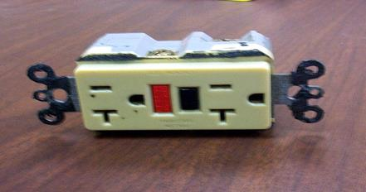
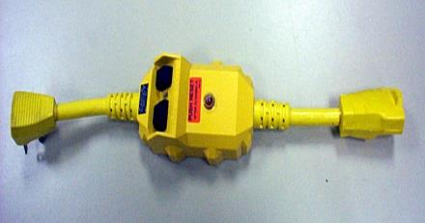
Control – Use GFCI (ground-fault circuit interrupter)
Protects you from shock
Detects difference in current between the black and white wires
If ground fault detected, GFCI shuts off electricity in 1/40th of a second
Use GFCI’s on all 120-volt, single-phase, 15- and 20-ampere receptacles, or have an assured equipment grounding conductor program.
Notes:
Reference 1926.404(b)(1)(i)
GFCI:
Matches the amount of current going to an electrical device against the amount of current returning from the device.
Interrupts the electric power within as little as 1/40 of a second when the amount of current going differs from the amount returning by about 5 mA
Must be tested to ensure it is working correctly.
NEC requires GFCI’s be used in these high-risk situations:
Electricity is used near water.
The user of electrical equipment is grounded (by touching grounded material).
Circuits are providing power to portable tools or outdoor receptacles.
Temporary wiring or extension cords are used.
There is one disadvantage to grounding: a break in the grounding system may occur without the user's knowledge. Using a ground-fault circuit interrupter (GFCI) is one way of overcoming grounding deficiencies.

Slide 18
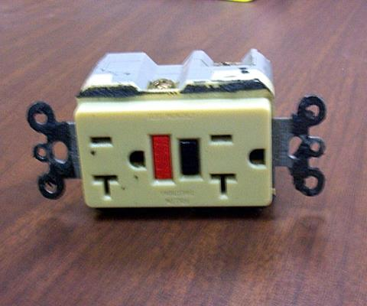
Preventing Electrical Hazards – Proper Wiring and Connectors
Use and test GFCI’s
Check switches and insulation
Use three prong plugs
Use extension cords only when necessary & assure in proper condition and right type for job
Use correct connectors
Notes:
If the polarity is reversed on a GFCI, the lights will test good, but the press to test button will not trip the circuit.

Slide 19
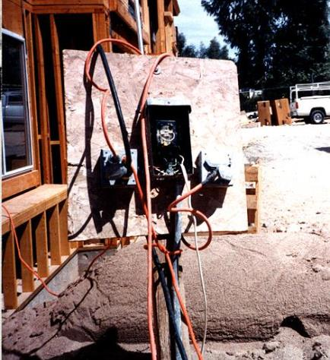
Hazard – Overloaded Circuits
Hazards may result from:
Too many devices plugged into a circuit, causing heated wires and possibly a fire
Damaged tools overheating
Lack of overcurrent protection
Wire insulation melting, which may cause arcing and a fire in the area where the overload exists, even inside a wall
Notes:
If the circuit breakers or fuses are too big (high current rating) for the wires they are supposed to protect, an overload in the circuit will not be detected and the current will not be shut off. A circuit with improper overcurrent protection devices – or one with no overcurrent protection devices at all – is a hazard.

Slide 20
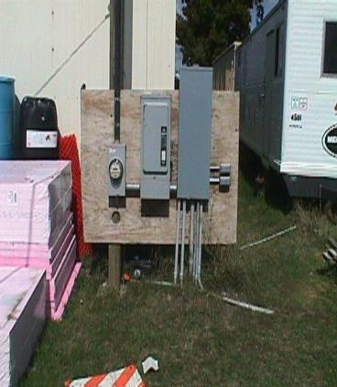
Control - Electrical Protective Devices
Automatically opens circuit if excess current from overload or ground-fault is detected – shutting off electricity
Includes GFCI’s, fuses, and circuit breakers
Fuses and circuit breakers are overcurrent devices. When too much current:
Fuses melt
Circuit breakers trip open
Notes:
To prevent too much current in a circuit, a circuit breaker or fuse is placed in the circuit. If there is too much current in the circuit, the breaker “trips” and opens like a switch. If an overloaded circuit is equipped with a fuse, an internal part of the fuse melts, opening the circuit. Both breakers and fuses do the same thing: open the circuit to shut off the electrical current
The basic idea of an overcurrent device is to make a weak link in the circuit. In the case of a fuse, the fuse is destroyed before another part of the system is destroyed. In the case of a circuit breaker, a set of contacts opens the circuit. Unlike a fuse, a circuit breaker can be re-used by re-closing the contacts. Fuses and circuit breakers are designed to protect equipment and facilities, and in so doing, they also provide considerable protection against shock in most situations. However, the only electrical protective device whose sole purpose is to protect people is the ground-fault circuit-interrupter.

Slide 21
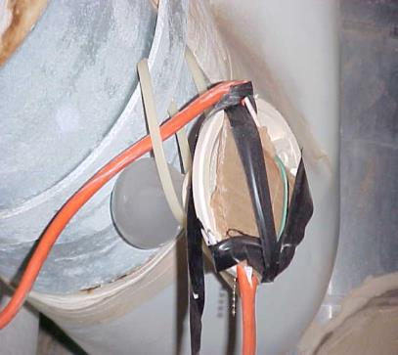
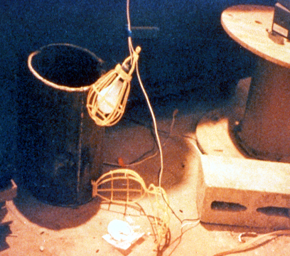
Temporary Lighting
Protect from contact and damage
Do not suspend by cords unless designed to do so
Notes:
Reference 1926.405(a)(2)

Slide 22
CAF Construction Site Safety Certificate Program
Class 4 – Electricity
Energy Control – LO/TO

Slide 23
Is the Equipment Energized?
Never work on electrical equipment until you can verify the energy status
never take someone's word for it
Review established site procedures and precautions
Verify test equipment is working correctly
Do not inspect or test without appropriate PPE
Place your own lockout – tagging device
do not remove others LO/TO devices
Do not allow yourself or others to be placed at risk
Notes:
Questions to be asked to insure energy isolation has been achieved

Slide 24
Why does the work have to be done energized?
Is it possible to work at a zero energy state?
Lockout/tagout is required to ensure equipment remains at a zero energy state.
Even de-energized equipment may require lockout/tagout to prevent it becoming energized while work is performed.
Perform Lockout/tagout every time.
Notes:
Ask the question…Can it be Locked out prior to working energized.

Slide 25
Notes:
Energy control flow chart

Slide 26
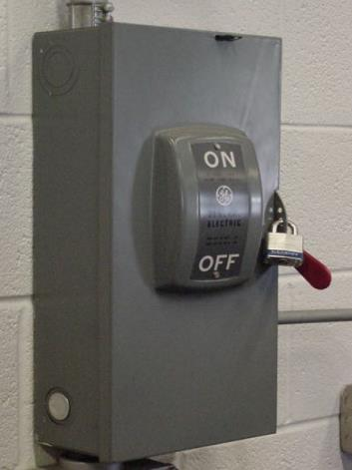
Lockout and Tagging of Circuits
Apply locks to power source after de-energizing
Tag deactivated controls
Tag de-energized equipment and circuits at all points where they can be energized
Tags must identify equipment or circuits being worked on
Notes:
Reference 1926.417:
(a) Controls. Controls that are to be deactivated during the course of work on energized or de-energized equipment or circuits shall be tagged.
(b) Equipment and circuits. Equipment or circuits that are deenergized shall be rendered inoperative and shall have tags attached at all points where such equipment or circuits can be energized.
(c) Tags. Tags shall be placed to identify plainly the equipment or circuits being worked on.
(d) Lockout and tagging. While any employee is exposed to contact with parts of fixed electric equipment or circuits which have been de-energized, the circuits energizing the parts shall be locked out or tagged or both.
Case study
An electrician was removing a metal fish tape from a hole at the base of a metal light pole.
(A fish tape is used to pull wire through a conduit run.) The fish tape became energized, electrocuting him. As a result of its inspection, OSHA issued a citation for three serious violations of the agency’s construction standards.
If the following OSHA requirements had been followed, this death could have been prevented.
• De-energize all circuits before beginning work.
• Always lock out and tag out de-energized equipment.
• Companies must train workers to recognize and avoid unsafe conditions

Slide 27
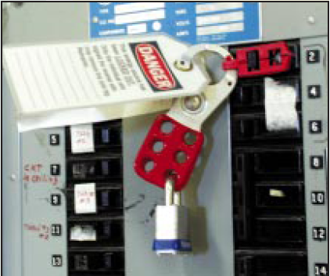
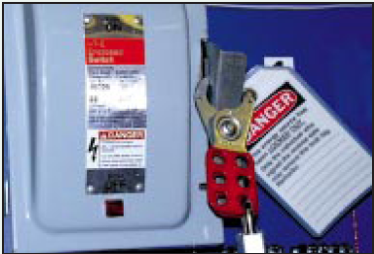
Preventing Electrical Hazards
Plan your work with others
Plan to avoid falls
Plan to lock-out and tag-out equipment
Remove jewelry
Avoid wet conditions and overhead power lines
Notes:
Make your environment safer by doing the following:
Lock and tag out circuits and machines.
Prevent overloaded wiring by using the right size and type of wire.
Prevent exposure to live electrical parts by isolating them.
Prevent exposure to live wires and parts by using insulation.
Prevent shocking currents from electrical systems and tools by grounding them.
Prevent shocking currents by using GFCI’s.
Prevent too much current in circuits by using overcurrent protection devices.

Slide 28
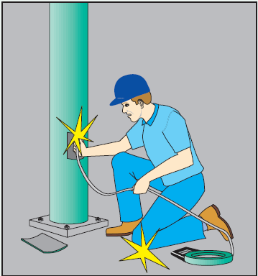
Scenario #1
BRIEF DESCRIPTION OF ACCIDENT An electrician was removing metal fish tape from a hole at the base of a metal light pole. The fish tape became energized, electrocuting him. INSPECTION RESULTS As a result of its inspection, OSHA issued a citation for three serious violations of the agency's construction standards. Had requirements for de-energizing energy sources been followed, the electrocution might have been prevented.
ACCIDENT PREVENTION RECOMMENDATIONS
Ensure all circuits are de-energized before beginning work (29 CFR 1926.416(a)(3)).
Controls to be deactivated during the course of work on energized or de-energized equipment or circuits must be tagged (29 CFR 1926.417(a)).
Employees must be instructed to recognize and avoid unsafe conditions associated with their work (29 CFR 1926.21(b)(2)).
Notes:
‘Electrocution’ example

Slide 29
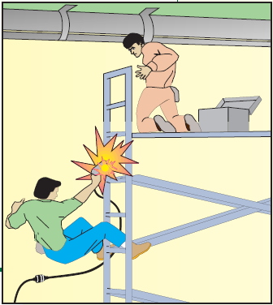
Scenario #2
Accident Type: Electrocution
Weather Conditions: Clear/Hot/Humid
Type of Operation: Window Shutter Installers
Size of Work Crew: 2
Collective Bargaining: N/A
Competent Safety Monitor on Site: No
Safety and Health Program in Effect: Partial
Was the Worksite Inspected Regularly: No
Training and Education Provided: Some
Employee Job Title:Helper
Age & Sex: 17-Male
Experience at this Type of Work: 1 Month
Time on Project: 1 Month
Notes:
When an electrical shock enters the body it may produce different types of injuries. Electrocution results in internal and external injury to body parts or the entire body – often resulting in death. After receiving a “jolt” of electricity all or part of the body may be temporarily paralyzed and this may cause loss of grip or stability. A person may also involuntarily move as a result of receiving an electrical shock, resulting in a fall. Internal or external burns may result from contact with electricity.

Slide 30
Group Activity
1.) Complete a Job Hazard Analysis for assigned task
2.) Complete Lock Out plan for assigned task

Slide 31
CAF Construction Site Safety Certificate Program
Class 4 – Electricity
NFPA 70 E

Slide 32
NFPA 70 E Goal
The new standard follows the 70E-2004 version's "no tolerance policy" on electric shock/contact and predicted second-degree burn in arc flash exposures. Embedded in NFPA 70E-2004 are the following strategies to accomplish this goal:
Creation of an electrically safe work condition by a preference toward de-energizing equipment when feasible.
Training for all workers exposed to potential arc flash or electrical shock hazards. This includes operators who may be "task qualified" to operate a disconnect, electrically unqualified workers and office personnel. All are required to be trained in the basics of electrical safety to prevent unqualified persons from entering live work and arc flash zones.
Notes:
NFPA 70 E should be discussed with course participants even if they do not personally conduct energized work. Site Safety Supervisors need to have and understanding of this process.

Slide 33
NFPA 70 E Goal
“No tolerance policy" strategies continued:
Creation of arc flash boundaries to complement the approach boundaries for shock hazards.
PPE requirements in the standard are the most protective in the world. If heeded, they will reduce the severity of accidents and probably eliminate most electrical fatalities in the workplace.
Notes:
Course participants should gain a working knowledge of NFPA 70 E including the arch flash boundaries

Slide 34
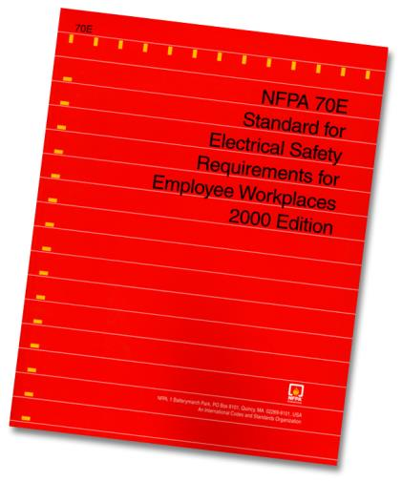
NFPA 70 E Standard
Qualified & Authorized Persons
Plan & Communicate
Equipment
PPE
May be Qualified for Some Applications
May NOT BE Qualified for Some Applications

Slide 35
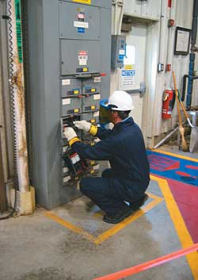
NFPA 70 E
70E-2004 Published by the National Fire Protection Association (NFPA) 70E was written to protect electrical workers who are exposed to electrical shock and arc hazards
Notes:
This slide shows an example of an Arch Flash boundary.

Slide 36
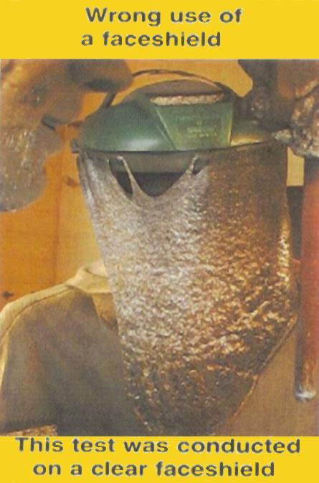
OSHA and NFPA 70 E
OSHA statement:
“ Employers who select and require their employees to use protective clothing as stated in NFPA 70 E standard..... are deemed in compliance"
Notes:
This photo shows what happens when NFPA 70 E rated gear is not used. This is a standard face shield exposed to an arch flash exposure

Slide 37
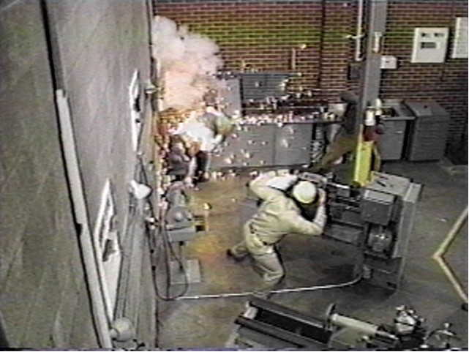
“It won’t happen to me…”
4,000 non-disabling electrical injuries
3,600 disabling electrical contact injuries
One person is fatally electrocuted in the workplace every day
Electrocutions are the fourth leading cause of traumatic occupational fatalities
More than 2,000 workers are sent to burn centers each year with electrical burns
Notes:
This slide shows an active arch flash occurring near a worker at that appears to be unprotected.

Slide 38
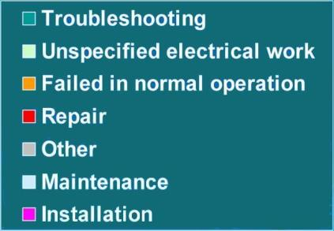
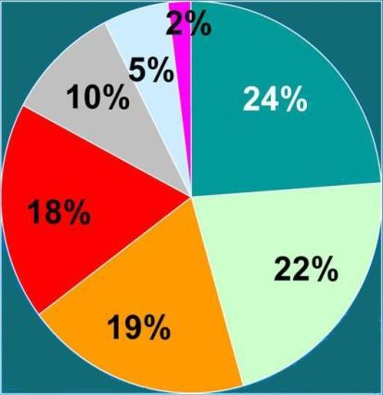
Preliminary Findings
Electrical work activities were involved in more than two thirds of the cases
Notes:
The highest percentage of injured workers occurs during trouble shooting which is constistent with the fact that equipment is usually energized during trouble shooting so the problem can be identified.

Slide 39
OSHA Fines - Write A Check For $193,000
Three employees were burned when a large flash of electricity arced from a 480 volt switchgear, which is the main gateway for power into the sewer plant. The burns sent all three to the hospital for treatment.
Following its inspection, OSHA cited for a "serious" violation of federal training requirements. The "willful" citations included a lack of personal protective gear and failing to de-energize or effectively guard live electrical equipment parts.
Electrical contractor employs about 430 workers nationwide and had 16 on the local project at the time of the accident. Since 1972 the company has been issued 13 serious and 40 other violations, OSHA reported. OSHA proposed fines totaling $193,500.

Slide 40
Electrical Arc
35,000 °F
Molten Metal
Pressure Waves
Sound Waves
Shrapnel
Copper Vapor:
Solid to Vapor
Expands by
67,000 times
Hot Air-Rapid Expansion
Intense Light
Notes:
When an arcing fault occurs, the result can be extremely high temperatures, a tremendous pressure blast and shrapnel (equipment parts) hurling at high velocity (in excess of 700 miles per hour). An accidental slip of a tool or a lose part tumbling across live parts can initiate an arcing fault in the equipment. If a person is in the proximity of an arcing fault, the flash can cause serious injury or death. The point of the 110.16 warning label is to remind qualified workers of the arc flash hazard when working on electrical equipment.
This slide models some of the effects of an arcing fault. At the tips of the arc the temperature can reach 35,000 degrees Fahrenheit. This intense thermal event can create these phenomenon:
Pressure waves (Result of super heating of air & resulting metal vapors)
High decibel sound waves
Molten Metal
Copper vapor
Intense Light
Shrapnel
A phase to ground or phase to phase arcing fault can quickly escalate into a three phase arcing fault due to the expansive cloud of conductive copper vapor which can engulf all phase conductors .
The chain of events during an arcing fault can be extremely rapid. The incident can be so rapid that the human system (eyes, optic nerves, brain, etc.) is incapable of observing and recalling the event in detail. The event occurs too fast.

Slide 41
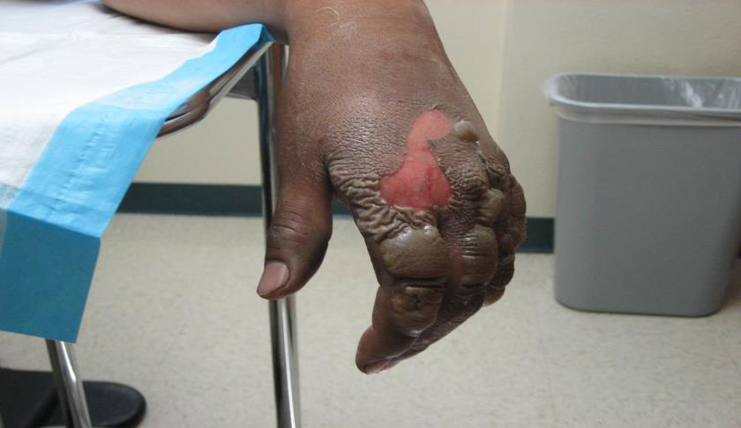
Arc Blast Explosion

Slide 42
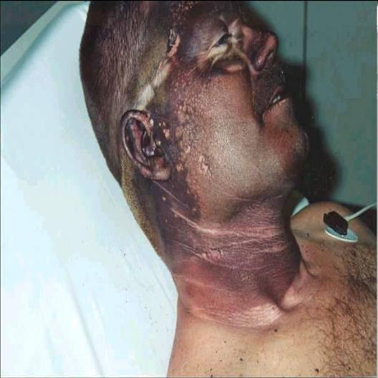
Case Study - Factors Affecting Injury
Electric Arc Duration
Distance Of Worker
Proper Use of PPE
Type/Fit Clothing
Age/Health
Temperature
Range of 15,000 to 34,000 degrees

Slide 43
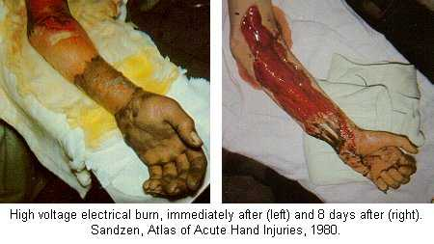
Electrical Burns

Slide 44
Voltage Perspective
Low Voltage
Up To 50
Medium Voltage
51 to 600 Volts
High Voltage
600 Volts/Above
Solenoid
Transformer
In Line Damper Motors
Alarm Systems
Telephone Systems
Data Systems
110/120 Volts
208 Volts
Small motors
240 Volts
Air Conditioning
277 Volts
Light ballasts
480 Volts
Chillers
Heavy Machinery
Large Motors
Switch Gear
Line Service
Building Feeds
Transformers

Slide 45
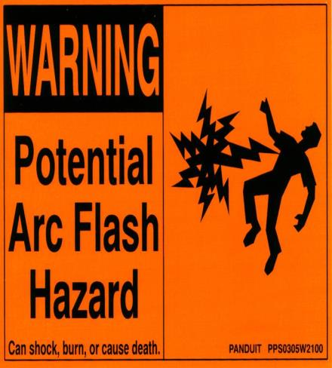
Arc Flash Hazard Labeling
NEC 110.16 Requires Arc Flash Hazard Labels.
NFPA 70E Requires Documented Arc Flash Calculations.
Arc Flash Calculations Require Accurate Fault Current Values.
Arc Flash Calculations Require Over-Current Coordination Study.
600 volts equal to 4 foot, with clearing time of 6 cycles
D_{c} =[2.65 x MVA_{bf} x t]^{½}

Slide 46
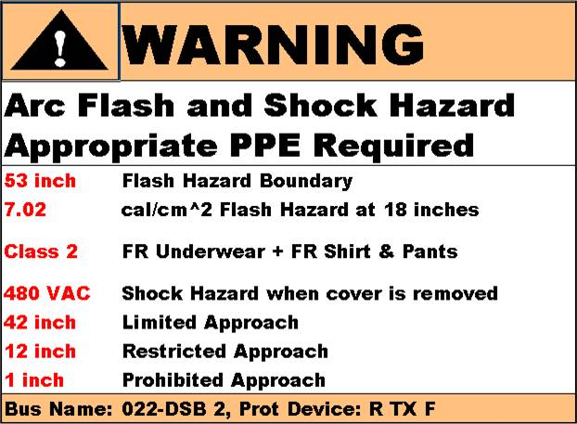
Arc Flash Calculation Steps
Determine System Modes of Operation
Calculate Bolted Fault Current at each Bus
Calculate Arcing Fault Current at each Bus
Calculate Arcing Fault Current seen by each Protective Device
Determine Trip Time for Each Protective Device based on Arcing Fault Current
Calculate Incident Energy at Working Distance
Calculate Arc Flash Boundary
Determine Required PPE
Generate Labels
Notes:
Arc Flash calculation must be conducted by a Qualified person.

Slide 47
Limits Of Approach
Flash Protection Boundary (FPB)
Must wear appropriate PPE
FPB dependent on fault level and time duration.
Equipment
1”
12”
42”
dependent on system voltage level
Limited Shock Boundary: Qualified or Unqualified Persons if accompanied by Qualified Person
Prohibited Shock Boundary: Qualified Persons Only, PPE if direct contact with live part
Restricted Shock Boundary: Qualified Persons Only
Notes:
Approach boundaries for untrained or unqualified persons should be discussed during the course.

Slide 48
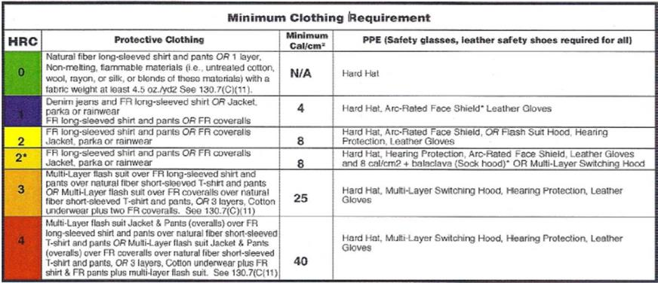
NFPA 70 E Review
NFPA 70 E takes into account that a location may not have ARC Flash Hazard Analysis labeling.
NFPA 70 E & Location SWP allow as an alternative the use referenced charts to determine Hazard Category and the PPE requirements.
Each Situation Unique – Should be evaluated by a Qualified Person
Notes:
This is a sample Arc flash rating calculator. Individual equipment manufacturers my very

Slide 49
Planning and Communication
A plan is an agreed upon series of steps or actions that are necessary to accomplish the work. It describes how the work will be accomplished.
An established Safety Procedures can limit the resulting exposure to an electrical hazard. Companies shall insure Qualified, Authorized and protected personnel perform the work.
Notes:
Established Safety Procedures can limit the resulting exposure to an electrical hazard. Companies shall insure Qualified, Authorized and protected personnel perform the work

Slide 50
What Is A Qualified Person?
A qualified person for electrical work is one that is familiar with, and has knowledge and understanding of the installation, the construction, and operation of the apparatus, and knows the hazards involved.
OSHA definition. One who, by possession of a recognized degree, certificate or professional standing, or who by extensive knowledge, training and experience has successfully demonstrated his/her ability to solve or resolve problems relating to the subject matter, the work or the project. They are trained on the EQUIPMENT and appropriate PPE.
Notes:
OSHA Standard definition of a Qualified person.

Slide 51
Other Important Definitions
Authorized Person: a person approved or assigned by the employer to perform a specific type of duty or duties or to be at a specific location or locations at the jobsite.
Unqualified Persons: They are workers who are skilled or unskilled but who do NOT normally work in an environment where exposed energized electrical equipment or circuits are present. They are considered to be protected from electrical hazards, and are not trained in any way to work with electrical hazards.

Slide 52
Energized Work
Work may only be conducted on energized equipment if special circumstances are involved.
Planning should question why the work needs to be conducted energized.
If it is for convenience only, then that is not a good enough reason.
Only after all other solutions have been considered and eliminated should working on energized equipment be considered.
If there is no alternative to working on energized equipment, all the following steps must be implemented and completed; hazard classification, flash protection boundaries, safety checklist, personal protection equipment, method of procedure and permit to work and employee training before the work is started.
Notes:
Course participants need a clear understanding that the desired method for working on powered equipment is in a ZERO ENERGY State.

Slide 53
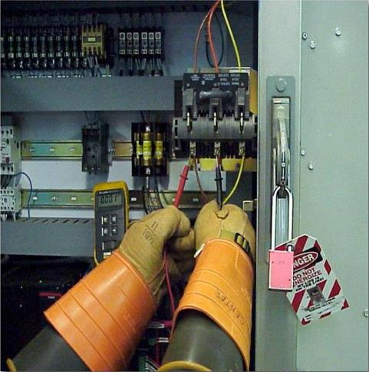
First Choice - Energy Isolation
Provide ZERO Energy State
Verify ZERO Energy State
Inconvenient is not Infeasible
Communicate & Educate Customer
Notes:
Zero Energy most be identified by testing with equipment known to be in good working condition

Slide 54
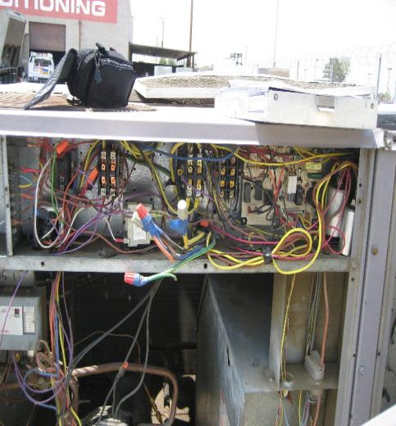
Reminder
When possible remove the energized electrical hazard by working on de-energized circuits and by using your written "LOCK OUT/TAG OUT“ policies and procedures.

Slide 55

Work on or near any energized circuits >240v
Some circumstances may require that we conduct repair and/or renovation activities without disruption of power to branch circuits. In order to accommodate these conditions.
Affected employees must be appropriately trained “Working on or Near Energized Electrical Equipment” and "Authorized” to perform energized work on circuits of 240 volts or higher.
Notes:
Many electrical exposures occur on low voltage equipment ( >600 volts). Course participants need to understand potential hazards near LV equipment.

Slide 56
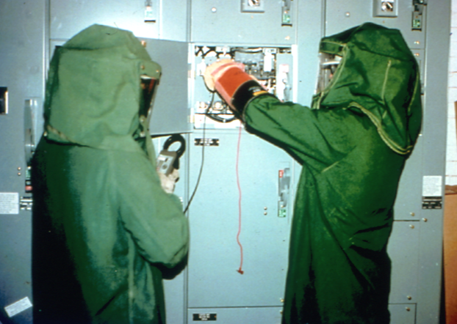
Personal Protection Equipment > 240 to 1000 Volts
Minimum acceptable PPE for over 240 volts up to 1000 volts is cat. 3
Natural Fiber underwear plus FR shirt and FR pants plus FR coverall good for 25 cal/cm2.
Voltage rated gloves and tools.
Safety glasses or goggles.
In some cases double-layer switching hood.
NFPA rated hearing protection will be required.
Heavy-duty leather work shoes are required.
Notes:
Workers need to understand how to use the appropriate level of protective equipment.

Slide 57

When Do We Need To Wear PPE?
Working Hot 51 Volts to 480
Within Proximity
Trouble Shooting
Removing Covers
Ensuring Zero Energy State
Notes:
Employees need to learn the process of working when assigned new equipment prior to use.

Slide 58
Flame Resistant (FR) Clothing For Electrical Work
Melting or burning apparel is difficult to remove and subjects skin tissue to high temperature for an extended period of time.
The most significant arc flash injuries occur as a result of clothing igniting or melting into the skin of the injured person.
Flame Resistant (FR) clothing must be worn in conjunction with rubber insulating gloves for your protection from electrical arcs during the performance of certain Hazard Category work.
Notes:
FR clothing must be used in accordance with manufacturers specifications.

Slide 59
Glove Inspection
The user of insulating gloves must conduct a visual inspection for defects. Gloves must be air-tested before use each day and when there is cause to suspect any damage. The entire surface must be inspected. Insulating gloves must be given an air test by rolling the cuff tightly toward the palm in such a manner that air is entrapped inside the glove, or by using a mechanical inflator.
The glove should be examined for punctures and other defects. Listening for escaping air or holding the gloves against the worker’s cheek to feel for escaping air may enhance puncture detection.
Notes:
Glove failure can be catastrophic and devastating. Proper inspection and testing is critical to worker safety

