Slide 1

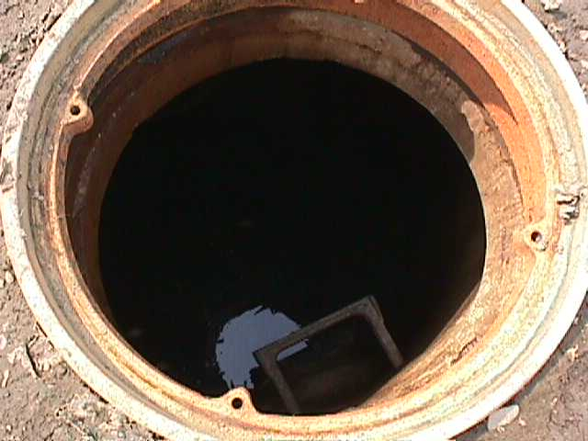
Confined Space
Safety
in
Construction
This material was produced under grant number SH-22224-11-60-F-18 from the Occupational Safety and Health Administration, U.S. Department of Labor. It does not necessarily reflect the views or policies of the U.S. Department of Labor, nor does mention trade names, commercial products, or organizations imply endorsement by the U.S. Government.

Slide 2
Overview
Failure to recognize confined space hazards is high on the list of accident causes
First Priority – Define the hazards of the space:
Restricted areas within the confined space
Voids
The nature of the contaminants present
The size of the space
The type of work to be performed
Notes:
Confined Spaces are one of the most dangerous workplace activities. Workers must be trained in the hazards specific to each entry and the protective measures to be taken to insure worker safety.

Slide 3
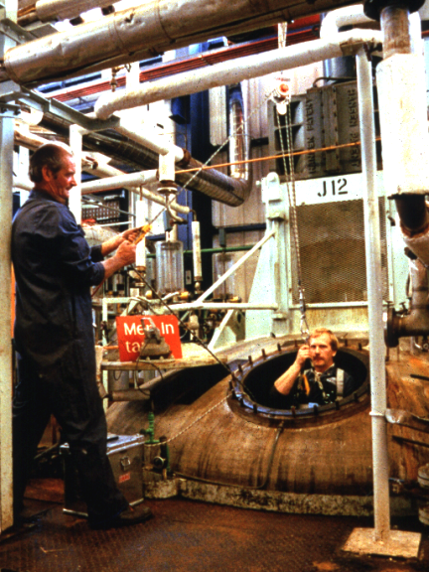
Background
Many workplaces contain spaces which are "confined”.
Their configurations hinder the activities of any employees who enter, work in, and exit them.
Employees who work in process vessels must squeeze in and out through narrow openings or perform their tasks while cramped or contorted.
1993 - 1996 NIOSH report:
276 Confined Space incidents
Resulted in 234 deaths
193 injuries
Up to half of those killed in confined spaces were rescuers
The number of people involved
Notes:
Septic Tanks
Sewage Digester
Pumping/Lifting Stations
Silo’s
Vats
Ducts
Utility Vaults
Boilers & Pipeling

Slide 4
What is a Confined Space?
OSHA Definition
”Confined or enclosed space" means any space having a limited means of egress, which is subject to the accumulation of toxic or flammable contaminants or has an oxygen deficient atmosphere.
Confined or enclosed spaces include, but are not limited to, storage tanks, process vessels, bins, boilers, ventilation or exhaust ducts, sewers, underground utility vaults, tunnels, pipelines, and open top spaces more than 4 feet in depth such as pits, tubs, vaults, and vessels.
NIOSH Definition
Any space which, by design, has limited openings for entry and exit; unfavorable natural ventilation which could contain or produce dangerous air contaminants, and which is not intended for continuous employee occupancy.
Notes:
Confined Space entry can take many forms. Workers must know and understand the hazards specific to each.

Slide 5
29 CFR 1926 Construction Confined Space
1926.21(b)(6)(i)
All employees required to enter into confined or enclosed spaces shall be instructed as to the nature of the hazards involved, the necessary precautions to be taken, and in the use of protective and emergency equipment required. The employer shall comply with any specific regulations that apply to work in dangerous or potentially dangerous areas.
1926.21(b)(6)(ii)
For purposes of paragraph (b)(6)(i) of this section, "confined or enclosed space" means any space having a limited means of egress, which is subject to the accumulation of toxic or flammable contaminants or has an oxygen deficient atmosphere. Confined or enclosed spaces include, but are not limited to, storage tanks, process vessels, bins, boilers, ventilation or exhaust ducts, sewers, underground utility vaults, tunnels, pipelines, and open top spaces more than 4 feet in depth such as pits, tubs, vaults, and vessels.
Notes:
Employers need to have an understanding of OSHA”s regulatory requirements. Construction and General Industry regulations need to be understood and followed.

Slide 6
29 CFR 1910 – Confined Space
1910.146(c)(1) The employer shall evaluate the workplace to determine if any spaces are permit-required confined spaces. 1910.146(c)(2) If the workplace contains permit spaces, the employer shall inform exposed employees, by posting danger signs or by any other equally effective means, of the existence and location of and the danger posed by the permit spaces. NOTE: A sign reading DANGER -- PERMIT-REQUIRED CONFINED SPACE, DO NOT ENTER or using other similar language would satisfy the requirement for a sign.
Notes:
Employers need to have an understanding of OSHA”s regulatory requirements. Construction and General Industry regulations need to be understood and followed.

Slide 7
Categories of Confined Spaces
Open tops and with a depth that will restrict the natural movement of air
Enclosed spaces with very limited openings for entry
Notes:
Affected workers need to understand the hazard associated with the various type of spaces they may be required to enter.

Slide 8
Properties of Gasses - Open Top Confined Spaces
Gases that are heavier than air (butane, propane, and other hydrocarbons) remain in depressions and will flow to low points where they are difficult to remove
Water tanks that appear harmless may develop toxic atmospheres such as hydrogen sulfide from the vaporization of contaminated water
Notes:
Affected workers need to understand the hazard associated with the various type of spaces they may be required to enter.

Slide 9
Properties of Gasses - Closed Vessel Confined Spaces
Gases which are heavier than air such as carbon dioxide and propane, may lie in a tank or vault for hours or even days after the containers have been opened.
Because some gases are odorless, the hazard may be overlooked with fatal results.
Gases that are lighter then air may also be trapped within an enclosed type confined space, especially those with access from the bottom or side.
Inerting
The displacement of the atmosphere in a permit space by a noncombustible gas (such as nitrogen) to such an extent that the resulting atmosphere is noncombustible.
NOTE: This procedure produces an IDLH oxygen-deficient atmosphere.
Notes:
Affected workers need to understand the hazard associated with the various type of spaces they may be required to enter.

Slide 10
Roles and Responsibilities
"Entry Supervisor" means the person (such as the employer, foreman, or crew chief) responsible for determining if acceptable entry conditions are present at a permit space where entry is planned, for authorizing entry and overseeing entry operations, and for terminating entry as required by this section.
"Attendant" means an individual stationed outside one or more permit spaces who monitors the authorized entrants and who performs all attendant's duties assigned in the employer's permit space program.
"Authorized Entrant" means an employee who is authorized by the employer to enter a permit space
Notes:
Roles and Responsibilities may be change as the work requirements change. Training, Communication and an understanding of the project roles must be clearly presented to all affected personnel

Slide 11
Entrant Duties
1910.146(h)(1) Know the hazards that may be faced during entry, including information on the mode, signs or symptoms, and consequences of the exposure;
1910.146(h)(2) Properly use equipment as required by paragraph (d)(4) of this section;
1910.146(h)(3) Communicate with the attendant as necessary to enable the attendant to monitor entrant status and to enable the attendant to alert entrants of the need to evacuate the space as required by paragraph (i)(6) of this section;
Notes:
Roles and Responsibilities may be change as the work requirements change. Training, Communication and an understanding of the project roles must be clearly presented to all affected personnel

Slide 12
Entrant Duties Cont.
1910.146(h)(4) Alert the attendant whenever:
1910.146(h)(4)(i) The entrant recognizes any warning sign or symptom of exposure to a dangerous situation, or
1910.146(h)(4)(ii) The entrant detects a prohibited condition; and
1910.146(h)(5) Exit from the permit space as quickly as possible whenever:
1910.146(h)(5)(i) An order to evacuate is given by the attendant or the entry supervisor,
1910.146(h)(5)(ii) The entrant recognizes any warning sign or symptom of exposure to a dangerous situation,
1910.146(h)(5)(iii) The entrant detects a prohibited condition, or
1910.146(h)(5)(iv) An evacuation alarm is activated.
Notes:
Roles and Responsibilities may be change as the work requirements change. Training, Communication and an understanding of the project roles must be clearly presented to all affected personnel

Slide 13
Duties of Attendants
1910.146(i) Duties of attendants. The employer shall ensure that each attendant:1910.146(i)(1) Knows the hazards that may be faced during entry, including information on the mode, signs or symptoms, and consequences of the exposure;
1910.146(i)(2) Is aware of possible behavioral effects of hazard exposure in authorized entrants;
1910.146(i)(3) Continuously maintains an accurate count of authorized entrants in the permit space and ensures that the means used to identify authorized entrants under paragraph (f)(4) of this section accurately identifies who is in the permit space;
1910.146(i)(4) Remains outside the permit space during entry operations until relieved by another attendant; NOTE: When the employer's permit entry program allows attendant entry for rescue, attendants may enter a permit space to attempt a rescue if they have been trained and equipped for rescue operations as required by paragraph (k)(1) of this section and if they have been relieved as required by paragraph (i)(4) of this section.1910.146(i)(5) Communicates with authorized entrants as necessary to monitor entrant status and to alert entrants of the need to evacuate the space under paragraph (i)(6) of this section;
Notes:
Roles and Responsibilities may be change as the work requirements change. Training, Communication and an understanding of the project roles must be clearly presented to all affected personnel

Slide 14
Attendant Duties Cont.
1910.146(i)(6) Monitors activities inside and outside the space to determine if it is safe for entrants to remain in the space and orders the authorized entrants to evacuate the permit space immediately under any of the following conditions;
1910.146(i)(6)(i) If the attendant detects a prohibited condition;
1910.146(i)(6)(ii) If the attendant detects the behavioral effects of hazard exposure in an authorized entrant;
1910.146(i)(6)(iii) If the attendant detects a situation outside the space that could endanger the authorized entrants; or
1910.146(i)(6)(iv) If the attendant cannot effectively and safely perform all the duties required under paragraph (i) of this section;
Notes:
Roles and Responsibilities may be change as the work requirements change. Training, Communication and an understanding of the project roles must be clearly presented to all affected personnel

Slide 15
Attendant Duties Cont.
1910.146(i)(7) Summon rescue and other emergency services as soon as the attendant determines that authorized entrants may need assistance to escape from permit space hazards;
1910.146(i)(8) Takes the following actions when unauthorized persons approach or enter a permit space while entry is underway:
1910.146(i)(8)(i) Warn the unauthorized persons that they must stay away from the permit space;
1910.146(i)(8)(ii) Advise the unauthorized persons that they must exit immediately if they have entered the permit space; and
1910.146(i)(8)(iii) Inform the authorized entrants and the entry supervisor if unauthorized persons have entered the permit space;
1910.146(i)(9) Performs non-entry rescues as specified by the employer's rescue procedure; and
1910.146(i)(10) Performs no duties that might interfere with the attendant's primary duty to monitor and protect the authorized entrants.
Notes:
Roles and Responsibilities may be change as the work requirements change. Training, Communication and an understanding of the project roles must be clearly presented to all affected personnel

Slide 16
Duties of Entry Supervisor
1910.146(j) Duties of entry supervisors. The employer shall ensure that each entry supervisor:
1910.146(j)(1) Knows the hazards that may be faced during entry, including information on the mode, signs or symptoms, and consequences of the exposure;
1910.146(j)(2) Verifies, by checking that the appropriate entries have been made on the permit, that all tests specified by the permit have been conducted and that all procedures and equipment specified by the permit are in place before endorsing the permit and allowing entry to begin;
1910.146(j)(3) Terminates the entry and cancels the permit as required by paragraph (e)(5) of this section;
Notes:
Roles and Responsibilities may be change as the work requirements change. Training, Communication and an understanding of the project roles must be clearly presented to all affected personnel

Slide 17
Duties of Entry Supervisor Cont.
1910.146(j)(4) Verifies that rescue services are available and that the means for summoning them are operable;
1910.146(j)(5) Removes unauthorized individuals who enter or who attempt to enter the permit space during entry operations; and
910.146(j)(6) Determines, whenever responsibility for a permit space entry operation is transferred and at intervals dictated by the hazards and operations performed within the space, that entry operations remain consistent with terms of the entry permit and that acceptable entry conditions are maintained.
Notes:
Roles and Responsibilities may be change as the work requirements change. Training, Communication and an understanding of the project roles must be clearly presented to all affected personnel

Slide 18
Host Employer Responsibilities
1910.146(c)(8) When an employer (host employer) arranges to have employees of another employer (contractor) perform work that involves permit space entry, the host employer shall:
1910.146(c)(8)(i) Inform the contractor that the workplace contains permit spaces and that permit space entry is allowed only through compliance with a permit space program meeting the requirements of this section;
1910.146(c)(8)(ii) Apprise the contractor of the elements, including the hazards identified and the host employer's experience with the space, that make the space in question a permit space;
1910.146(c)(8)(iii) Apprise the contractor of any precautions or procedures that the host employer has implemented for the protection of employees in or near permit spaces where contractor personnel will be working;
1910.146(c)(8)(iv) Coordinate entry operations with the contractor, when both host employer personnel and contractor personnel will be working in or near permit spaces, as required by paragraph (d)(11) of this section;
1910.146(c)(8)(v) Debrief the contractor at the conclusion of the entry operations regarding the permit space program followed and regarding any hazards confronted or created in permit spaces during entry operations.
Notes:
Roles and Responsibilities may be change as the work requirements change. Training, Communication and an understanding of the project roles must be clearly presented to all affected personnel

Slide 19
Contracted Employer Duties
1910.146(c)(9)(i) Obtain any available information regarding permit space hazards and entry operations from the host employer;
1910.146(c)(9)(ii) Coordinate entry operations with the host employer, when both host employer personnel and contractor personnel will be working in or near permit spaces, as required by paragraph (d)(11) of this section; and
1910.146(c)(9)(iii) Inform the host employer of the permit space program that the contractor will follow and of any hazards confronted or created in permit spaces, either through a debriefing or during the entry operation.
Notes:
Roles and Responsibilities may be change as the work requirements change. Training, Communication and an understanding of the project roles must be clearly presented to all affected personnel

Slide 20
Rescue & Emergency Services
1910.146(k)(1) An employer who designates rescue and emergency services, pursuant to paragraph (d)(9) of this section, shall:
1910.146(k)(1)(i) Evaluate a prospective rescuer's ability to respond to a rescue summons in a timely manner, considering the hazard(s) identified; Note to paragraph (k)(l)(i): What will be considered timely will vary according to the specific hazards involved in each entry. For example, §1910.134, Respiratory Protection, requires that employers provide a standby person or persons capable of immediate action to rescue employee(s) wearing respiratory protection while in work areas defined as IDLH atmospheres.
1910.146(k)(1)(ii) Evaluate a prospective rescue service's ability, in terms of proficiency with rescue-related tasks and equipment, to function appropriately while rescuing entrants from the particular permit space or types of permit spaces identified;
Notes:
Roles and Responsibilities may be change as the work requirements change. Training, Communication and an understanding of the project roles must be clearly presented to all affected personnel

Slide 21
Hazardous
Atmospheres

Slide 22
Atmospheric Testing
1910.146(c)(5)(ii)(C) Pre-Entry Test
Before an employee enters the space, the internal atmosphere shall be tested, with a calibrated direct-reading instrument, for oxygen content, for flammable gases and vapors, and for potential toxic air contaminants, in that order. Any employee who enters the space, or that employee's authorized representative, shall be provided an opportunity to observe the pre-entry testing required by this paragraph.
1910.146(c)(5)(ii)(F) Periodic Testing
The atmosphere within the space shall be periodically tested as necessary to ensure that the continuous forced air ventilation is preventing the accumulation of a hazardous atmosphere. Any employee who enters the space, or that employee's authorized representative, shall be provided with an opportunity to observe the periodic testing required by this paragraph
Notes:
Only trained, qualified personnel should conduct environmental testing. Air quality is a primary concern when exposing workers to a confined space.

Slide 23
Ventilation Considerations
The ventilation air should not create an additional hazard:
Recirculation of contaminants
Improper arrangement of the inlet duct
The substitution of anything other than fresh (normal) air (approximately 20.9% oxygen, 78.1% nitrogen, and 1% argon with small amounts of various other gases).
Notes:
Only trained, qualified personnel should conduct environmental testing. Air quality is a primary concern when exposing workers to a confined space.

Slide 24
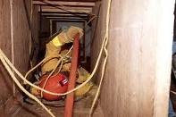


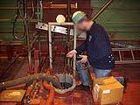
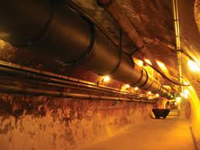
1926.651(g)(1)
Where oxygen deficiency (atmospheres containing less than 19.5 percent oxygen) or a hazardous atmosphere exists or could reasonably be expected to exist, such as in excavations in landfill areas or excavations in areas where hazardous substances are stored nearby, the atmospheres in the excavation shall be tested before employees enter excavations greater than 4 feet (1.22 m) in depth.
Notes:
Only trained, qualified personnel should conduct environmental testing. Air quality is a primary concern when exposing workers to a confined space.

Slide 25
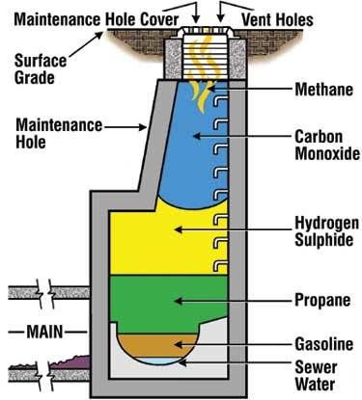
Hazardous atmosphere
Atmospheric oxygen concentration below 19.5 percent or above 23.5 percent;
Atmospheric concentration of any substance for which a dose or a permissible exposure limit is published
Any other atmospheric condition that is immediately dangerous to life or health.
Notes:
Only trained, qualified personnel should conduct environmental testing. Air quality is a primary concern when exposing workers to a confined space.

Slide 26
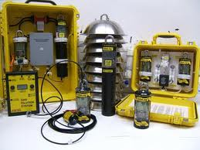
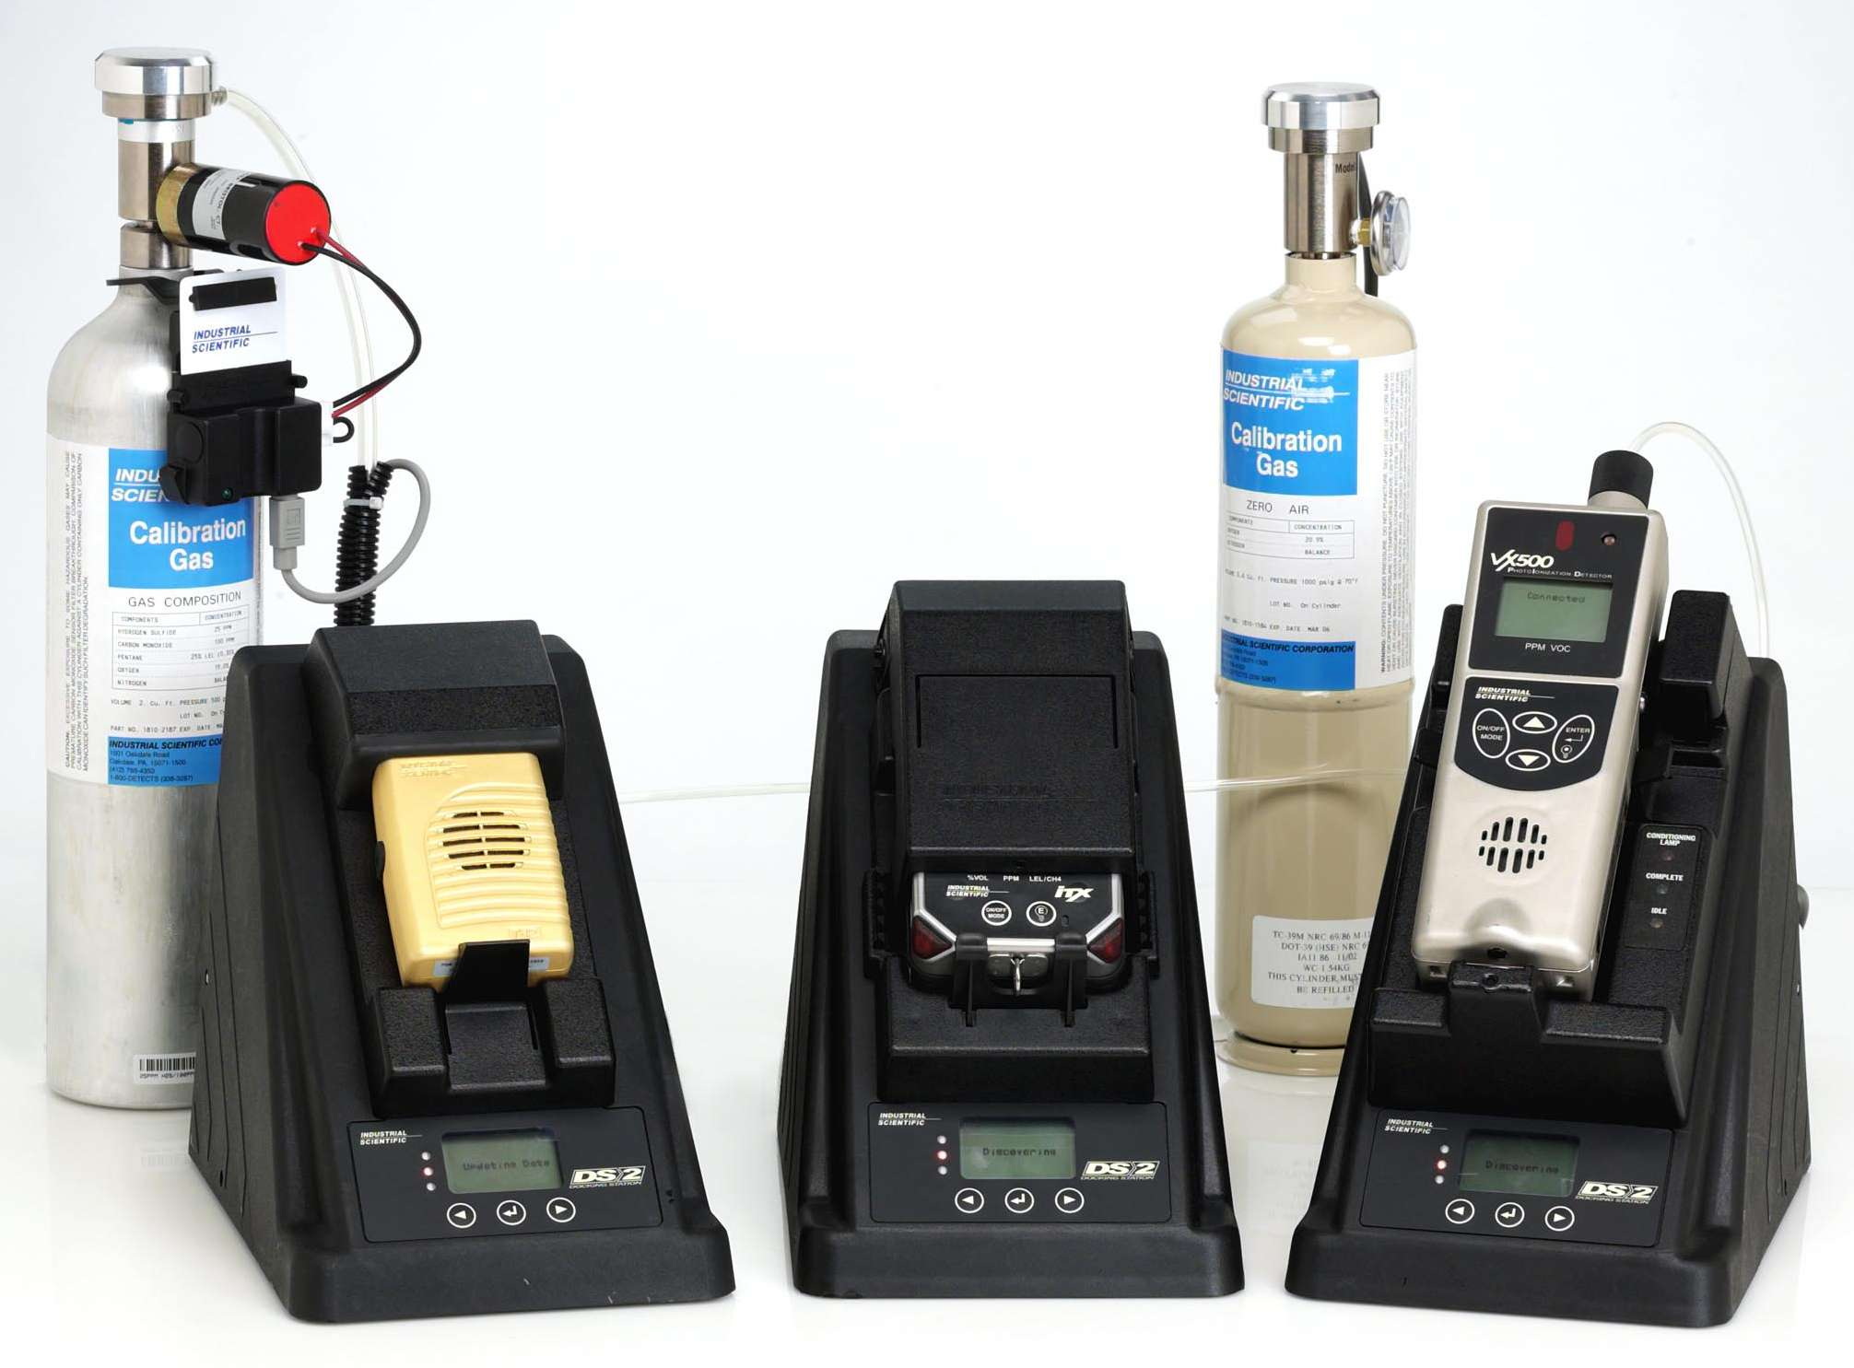
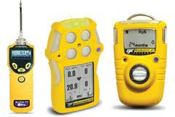
Confined Space Testing
Detection Equipment
Calibrated
Available for use
Documented training
Appropriate for anticipated exposures
Ambient
Remote
Pump or draw
Notes:
Only trained, qualified personnel should conduct environmental testing. Air quality is a primary concern when exposing workers to a confined space.

Slide 27
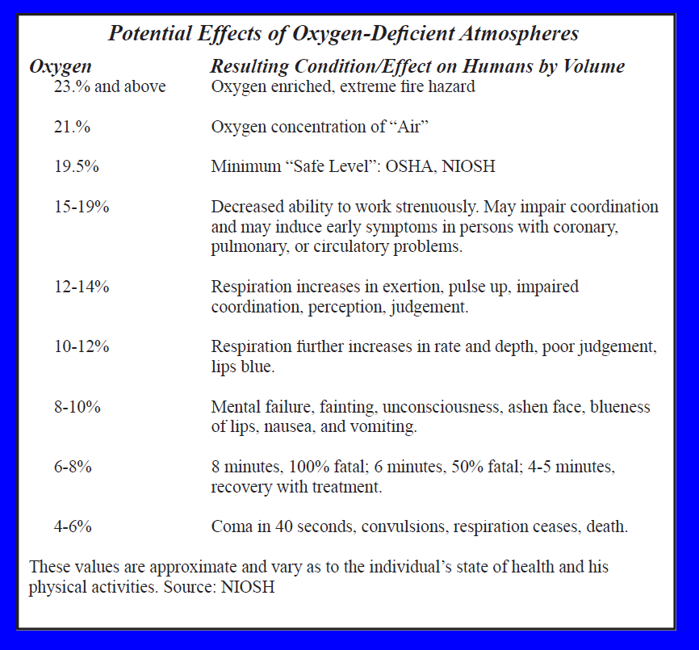
Oxygen-Deficient Atmospheres
NOTE: Exposure to atmospheres containing 12% or less oxygen will bring about unconsciousness without warning and so quickly that individuals cannot help or protect themselves.
Notes:
Only trained, qualified personnel should conduct environmental testing. Air quality is a primary concern when exposing workers to a confined space.

Slide 28
Flammable Atmospheres
The byproducts of work procedures can generate flammable or explosive conditions within a confined space.
Enriched oxygen atmospheres
Vaporization of flammable liquids
Byproducts of work
Chemical reactions
Concentrations of combustible dusts
Notes:
Only trained, qualified personnel should conduct environmental testing. Air quality is a primary concern when exposing workers to a confined space.

Slide 29
Carbon Monoxide (CO)
Colorless, odorless gas
Fatal at 1000 ppm in air
Dangerous at 200 ppm
Any untested atmosphere must be suspect
Carbon monoxide must be tested for specifically
Chemical asphyxiant
Slightly lighter than air
Primary source: incomplete combustion of organic material
Gasoline-fueled combustion engines
PEL = 35 ppm - TWA
TLV = 25 ppm - TWA
BEI: <3.5% COHb; 20 ppm (end-exhaled air)
REL = 200 ppm - STEL; 35 ppm - TWA
IDLH = 1500 ppm
LEL = 12.5%; UEL = 74.2%
Notes:
Only trained, qualified personnel should conduct environmental testing. Air quality is a primary concern when exposing workers to a confined space.

Slide 30

Concentration of CO Necessary to Produce Symptoms
Notes:
Only trained, qualified personnel should conduct environmental testing. Air quality is a primary concern when exposing workers to a confined space.

Slide 31
Carbon Dioxide (CO₂)
Colorless, odorless noncombustible gas
Heavier than air
Common in solid and compressed liquid forms
Carbonation
Inerting
Organic decay (grain elevators, sewers, storage bins, wells)
Fermentation (digestors, molasses pits, beer and wine vats)
PEL = 5,000 ppm
TLV = 5,000 ppm
STEL - 30,000 ppm
IDLH = 50,000 ppm
LEL = none
Notes:
Only trained, qualified personnel should conduct environmental testing. Air quality is a primary concern when exposing workers to a confined space.

Slide 32
Hazardous Atmosphere Recap
Oxygen-deficient atmospheres have less than _____ oxygen available?
20.6 percent
18.7 percent
19.5 percent
21.7 percent
Carbon monoxide is colorless and odorless but leaves a distinct taste of rotten eggs in your mouth.
True
False
Atmospheric testing must be done at the top and bottom of the space only since gases tend to only rise to
the top or sink to the bottom.
True
False
The attendant is the person responsible for the confined space entry and is ultimately responsible for all
activities.
True
False

Slide 33
Physical
Hazards

Slide 34
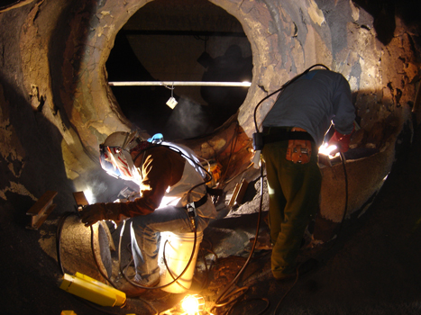
Physical Hazards
Thermal
Air temperature,
Air velocity,
Moisture contained in the air
Radiant heat.
Noise
Reverberation
Communication
Commands
Vibration
Whole body
Segmental (Body part)
Tools
Notes:
Employees must trained and be able to demonstrate an understanding of the confined space entry safe entry requirements. Untrained workers should nit be permitted in the confined space.

Slide 35
Confined Space Entry – Combustion Hazards
CO₂
NOx
Processes which operate by the principle of combustion use up oxygen much faster than the human respiration.
Products of combustion vary with the fuel that is present and the temperature of the combustion reaction. Welding, burning natural gas, propane, gasoline, and diesel engines are examples of combustion processes.
H₂0
CO
O2
fuel
Notes:
Employees must trained and be able to demonstrate an understanding of the confined space entry safe entry requirements. Untrained workers should nit be permitted in the confined space.

Slide 36
1926.353 (b) Welding, cutting and heating
Either general mechanical or local exhaust ventilation meeting the requirements of paragraph (a) of this section shall be provided whenever welding, cutting, or heating is performed in a confined space.
If sufficient ventilation cannot be obtained without blocking the means of access, employees in the confined space shall be protected by air line respirators.
An employee on the outside of such a confined space assigned to maintain communication with those working within it and to aid them in an emergency.
"Lifelines." Where a welder must enter a confined space through a manhole or other small opening, means shall be provided for quickly removing him in case of emergency.
When safety belts and lifelines are used for this purpose they shall be so attached to the welder's body that his body cannot be jammed in a small exit opening.
An attendant with a pre-planned rescue procedure shall be stationed outside to observe the welder at all times and be capable of putting rescue operations into effect.
Notes:
Employees must trained and be able to demonstrate an understanding of the confined space entry safe entry requirements. Untrained workers should nit be permitted in the confined space.

Slide 37
Combination Hazards
The most hazardous kind of confined space is the type that combines limited access and mechanical devices.
Boilers usually contain power-driven equipment which, unless properly isolated, may be inadvertently activated after entry.
Notes:
Employees must trained and be able to demonstrate an understanding of the confined space entry safe entry requirements. Untrained workers should nit be permitted in the confined space.

Slide 38
Entry Permits
A permit, signed by the entry supervisor, must be posted at all entrances or otherwise made available to entrants before they enter a permit space. The permit must verify that pre-entry preparations outlined in the standard have been completed. The duration of entry permits must not exceed the time required to complete an assignment. Entry permits must include:
Name of permit space to be entered, authorized entrant(s), eligible attendants and individuals authorized to be entry supervisors;
Test results;
Tester's initials or signature;
Name and signature of supervisor who authorizes entry;
Purpose of entry and known space hazards;
Measures to be taken to isolate permit spaces and to eliminate or control space hazards;
Name and telephone numbers of rescue and emergency services and means to be used to contact them;
Date and authorized duration of entry;
Acceptable entry conditions;
Communication procedures and equipment to maintain contact during entry;
Additional permits, such as for hot work, that have been issued authorizing work in the permit space;
Special equipment and procedures, including personal protective equipment and alarm systems; and
Any other information needed to ensure employee safety.
Notes:
Employers should have a process to document the safety requirements of a confined space and communicate the process to affected workers. Exposed personnel should have a clear working knowledge of the safe work requirements for the task they are assigned.

Slide 39
Pre-Entry Checklist
Is the Entry Supervisor recognized as a Competent Person?
Are appropriate permits completed and available for review?
Has a functional performance test been conducted on the monitor being used for this shift?
Will the atmosphere be continuously monitored while the space is occupied?
Was a test of the atmosphere in the confined space performed by a Qualified Person?
Was oxygen content between 19.5 percent and 23.5 percent ?
Was flammable vapor less than 10 percent of LEL/LFL?
Were tests for toxic materials less than TLV/PEL?
Have all hazard sources been isolated from the confined space?
Is rescue equipment required for the entry procedure immediately available?
Have emergency services been notified of the confined space entry?
Notes:
Employers should have a process to document the safety requirements of a confined space and communicate the process to affected workers. Exposed personnel should have a clear working knowledge of the safe work requirements for the task they are assigned.

Slide 40

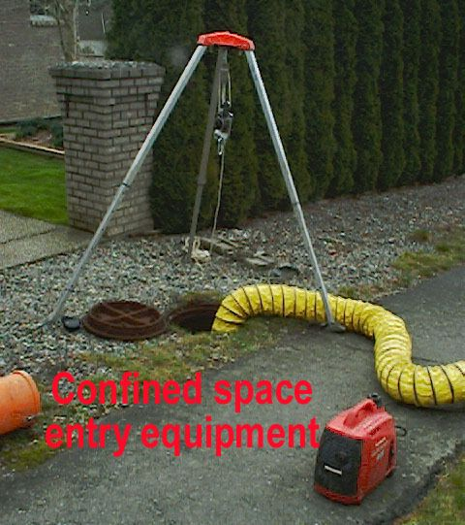
Confined Space Entry and Retrieval Equipment

Slide 41
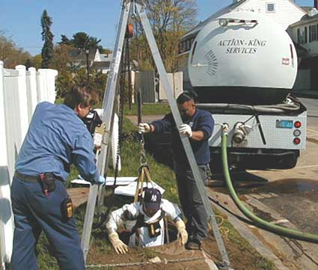
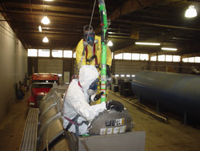
Rescue or Retrieval
Self Rescue
Usually initiated by worker
No rescuer entry required
Entrant must know when to self rescue
Entry Rescue
Responsibilities
Rescue equipment readily available
Supplied Air
Method to retrieve a downed worker
Communication system
Line of site
Passive communication system
Contact with emergency services
Non-Entry Rescue
Responsibilities
Equipment
Communication method
Notes:
Pre-planning and effective rescue and retrieval plans should be communicated to affected workers.

Slide 42
Respirator Use
Training must include an explanation of the following:
Why respirator use is necessary;
Nature of the respiratory hazard and consequences of not fitting, using, and maintaining the respirator properly;
Reason(s) for selecting a particular type of respirator;
Capabilities and limitations of the selected respirator;
How to inspect, put on and remove, and check the seals of the respirator;
Respirator maintenance and storage requirements;
How to use the respirator effectively in emergency situations, including when the respirator malfunctions; and
How to recognize medical signs and symptoms that may limit or prevent the effective use of the respirator.
Notes:
OSHA's revised Respiratory Protection Standard (29 CFR 1910.134 and 29 CFR 1926.103) went into effect April 8, 1998. The final standard replaces the respiratory protection standards adopted by OSHA in 1971. The 29 CFR 1910.139 respirator standard that applied only to respiratory protection against Mycobacterium Tuberculosis was withdrawn December 31, 2003. Establishments whose respiratory protection programs for tuberculosis formerly covered under 29 CFR 1910.139 were required to adapt their programs to comply with the requirements of 29 CFR 1910.134 effective July 2, 2004.

Slide 43
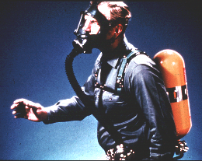
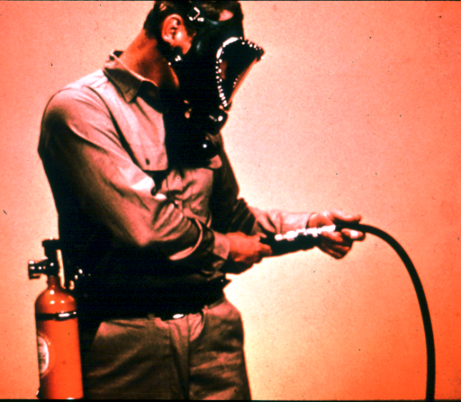
Respirators for IDLH Atmospheres
Full Facepiece Pressure Demand SCBA
Combination Full Facepiece Pressure Demand SAR with Auxiliary Self-Contained Air Supply
Notes:
OSHA's revised Respiratory Protection Standard (29 CFR 1910.134 and 29 CFR 1926.103) went into effect April 8, 1998. The final standard replaces the respiratory protection standards adopted by OSHA in 1971. The 29 CFR 1910.139 respirator standard that applied only to respiratory protection against Mycobacterium Tuberculosis was withdrawn December 31, 2003. Establishments whose respiratory protection programs for tuberculosis formerly covered under 29 CFR 1910.139 were required to adapt their programs to comply with the requirements of 29 CFR 1910.134 effective July 2, 2004

Slide 44
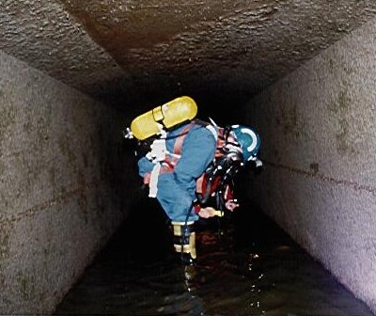
Notes:
OSHA's revised Respiratory Protection Standard (29 CFR 1910.134 and 29 CFR 1926.103) went into effect April 8, 1998. The final standard replaces the respiratory protection standards adopted by OSHA in 1971. The 29 CFR 1910.139 respirator standard that applied only to respiratory protection against Mycobacterium Tuberculosis was withdrawn December 31, 2003. Establishments whose respiratory protection programs for tuberculosis formerly covered under 29 CFR 1910.139 were required to adapt their programs to comply with the requirements of 29 CFR 1910.134 effective July 2, 2004

Slide 45
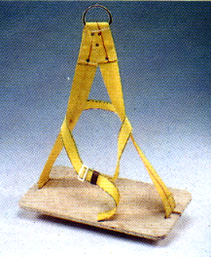
Bosons Chair
Notes:
Employers need to insure affected personnel have a working understanding of the equipment they will be assigned to use during the confined space entry.

Slide 46
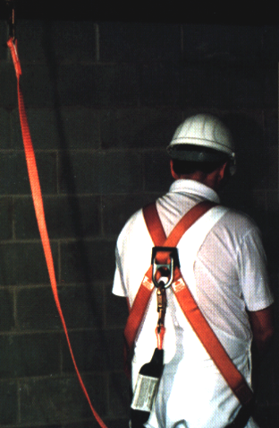
Lanyard
Notes:
Employers need to insure affected personnel have a working understanding of the equipment they will be assigned to use during the confined space entry.

Slide 47
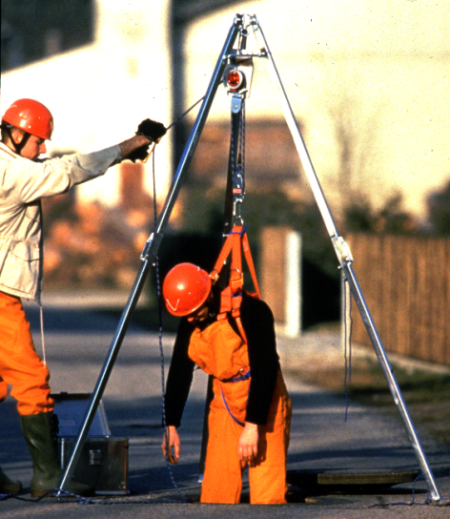
Retrieval System
The equipment (including a retrieval line, chest or full-body harness, wristlets, if appropriate, and a lifting device or anchor) used for non-entry rescue of persons from permit spaces.
Notes:
Employers need to insure affected personnel have a working understanding of the equipment they will be assigned to use during the confined space entry.

Slide 48
Notes:
Employers need to insure affected personnel have a working understanding of the equipment they will be assigned to use during the confined space entry.

Slide 49
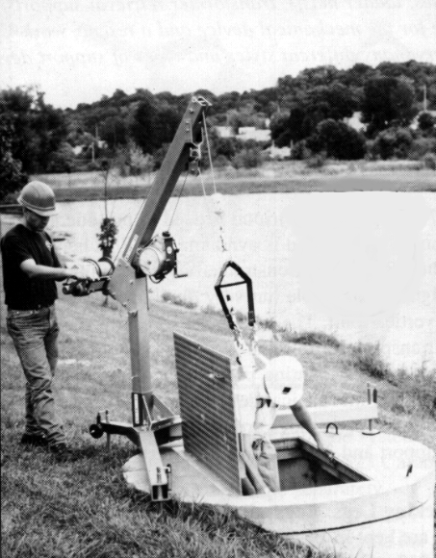
Davit Arm
Notes:
Employers need to insure affected personnel have a working understanding of the equipment they will be assigned to use during the confined space entry.

Slide 50
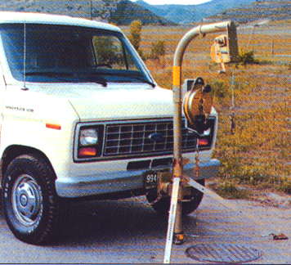
Vehicle-Mounted Davit
Notes:
Employers need to insure affected personnel have a working understanding of the equipment they will be assigned to use during the confined space entry.

Slide 51
Record Retention
1910.146(e)(6)
The employer shall retain each canceled entry permit for at least 1 year to facilitate the review of the permit-required confined space program required by paragraph (d)(14) of this section. Any problems encountered during an entry operation shall be noted on the pertinent permit so that appropriate revisions to the permit space program can be made.
Notes:
The employer shall retain each canceled entry permit for at least 1 year to facilitate the review of the permit-required confined space program

Slide 52
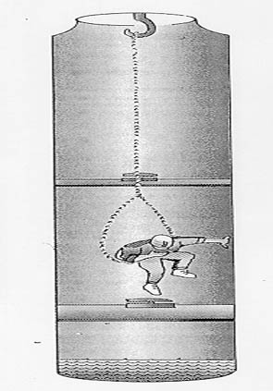
Case Study #1
An employee sitting in a looped chain was lowered approximately 17 feet into a 21-foot deep manhole.
Twenty seconds later he started gasping for air and fell from the chain seat face down into the accumulated water at the bottom of the manhole.
An autopsy determined oxygen deficiency as the cause of death.
Notes:
This case study is designed to have course participants work through the various OSHA regulations in order to gain a better understating of the complexities associated with Permit required confined spaces.

Slide 53
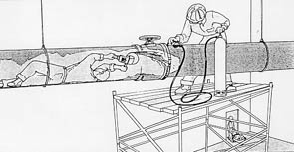
Case Study #2
A welder entered a steel pipe (24 inch diameter) to grind a bad weld at a valve about 30 feet from the entry point.
Before he entered, other crew members decided to add pure oxygen to the pipe near the bad weld.
He had been grinding intermittently for about five minutes when a fire broke out enveloping his clothing.
Notes:
This case study is designed to have course participants work through the various OSHA regulations in order to gain a better understating of the complexities associated with Permit required confined spaces.

Slide 54
OSHA Confined Space Advisor
OSHA's Confined Spaces Advisor is software. It gives users interactive expert help to apply OSHA's Permit Required Confined Spaces Standard (29 CFR 1910.146). Version 1.1 refines and replaces Version 1.0 of March 1997. You can use this Advisor online, or download it and run it in the Windows environment. OSHA also has e-PRCS, interactive, compliance assistance software to help you prepare a written permit-required confined space program. Once installed, the Confined Spaces Advisor software will interview the user about a work space to determine whether and how it is subject to the Permit Required Confined Spaces Standard. It will tell you what aspects of the standard apply to you, based on your answers. The system has:
pop-up (hypertext) definitions of keywords and phrases
sets of frequently asked questions (FAQs) and official interpretation letters
a reformatted and very readable copy of the regulations, and other help
Download the OSHA Confined Spaces Advisor
Notes:
OSHA's Confined Spaces Advisor is software. It gives users interactive expert help to apply OSHA's Permit Required Confined Spaces Standard (29 CFR 1910.146). Version 1.1 refines and replaces Version 1.0 of March 1997. Course participants could be given the opportunity to review the resources during the course to gain a working understanding of the application

Slide 55
Summary
OSHA’s Hazard Communication Standard is based on a simple concept - that employees have both a need and a right to know the hazards and identities of the chemicals they are exposed to when working
Employees also need to know what protective measures are available to prevent adverse effects from occurring
Notes:
See www.osha.gov for more information on hazard communication, including the following publications:
Hazard Communication Guidelines for Compliance – OSHA 3111
(This is the same information that is contained in Appendix E to 1910.1200 and is also available in Spanish.)
Chemical Hazard Communication – OSHA 3084
(This is also available in Spanish.)

Slide 56
The End

