Slide 1
CFR 1926 Subpart D
Occupational Health
&
Environmental Controls
This material was produced under grant number SH-22224-11-60-F-18 from the Occupational Safety and Health Administration, U.S. Department of Labor. It does not necessarily reflect the views or policies of the U.S. Department of Labor, nor does mention of trade names, commercial products, or organizations imply endorsement by the U.S. Government.
Notes:
Review slide.

Slide 2
Lesson Overview
Purpose:
To provide workers with introductory information about construction health hazards and their control.
Topics:
Health Hazards In Construction
Industrial Hygiene
Hazard Communications
Personal Protective Equipment
Notes:
Review slide.

Slide 3
Health Hazards In Construction
Chemical Hazards
Physical Hazards
Biological Hazards
Ergonomic Hazards
Stress Hazards
Notes:
Ask for examples of hazards.

Slide 4

Chemical Hazards
Airborne
Liquid
Solid
Notes:
Describe states.

Slide 5
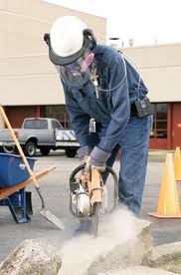
Airborne Contaminants
Dusts – formed from mechanical action
Smoke – formed from combustion
Fumes – formed from volatilizing metal
Mists – tiny water droplets
Vapors – evaporate of liquid
Gases – particles without defined shape or volume
Aerosols – atomized particulate
Notes:
Review slide.

Slide 6
Airborne Particulate Classifications
Breathable
• Small enough to enter airway
Inhalable
• Upper respiratory tract
• 100 microns
Thoracic
• Upper airways of the lungs
• 5-15 microns
Respirable
• Able to reach the alveoli (air sacs) of the lung
• < 5 microns
Note: micron = 1x10^-6 meter
Notes:
Describe what occurs in alveoli.

Slide 7
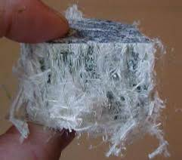
Asbestos
Occurs naturally in the environment
Utilized in thousands of products
Only a hazard when it becomes airborne
OSHA PEL is 0.1 f/cc for 8-hour work day
OSHA Excursion 1.0 f/cc for 30 minutes
OSHA and EPA requirements are extensive
Compliance monitoring achieved by
personal “breathing zone” air sampling.
Notes:
List some products.

Slide 8
Refractory Ceramic Fibers (RCF)
Suspect carcinogen
Not regulated by OSHA
Used as an insulating material
Exposure guideline established by the Refractory
Ceramic Fiber Coalition
• 0.5 f/cc 8-hour TWA Recommended Exposure
Guideline (REG)
National Institute for Occupational Safety & Health
• 0.5 f/cc 8-hour TWA REG
Notes:
Describe where RCF is used and give examples.

Slide 9
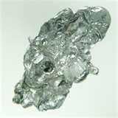
Chemical Hazards - Metals
Toxic
Highly Toxic
Carcinogens
Notes:
Review slide.

Slide 10
Toxic Metals
Toxic Metal Fumes
Antimony, beryllium, cadmium,
chromium, cobalt, copper, iron, lead,
manganese, molybdenum, nickel,
vanadium, and zinc.
Commonly associated with welding
and hot metal operations.
Volatilization produces fume, fume
becomes airborne and breathable.
Notes:
List examples of uses.

Slide 11
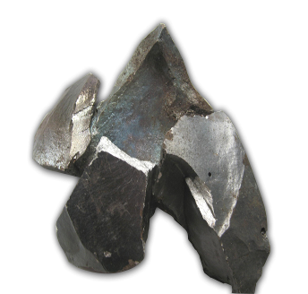
Toxic Metals
Manganese
Suspected to cause Parkinsons
OSHA Ceiling Limit is 5 mg/m3
ACGIH TLV is 0.2 mg/m3 for 8-hours
Notes:
Review slide.

Slide 12
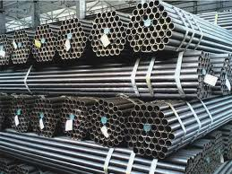
Toxic Metals
Zinc
Galvanized coatings
Causes Metal Fume Fever
• Chills, elevated temperature, flu like
symptoms
OSHA PEL is 5 mg/m3 as zinc oxide fume
for an 8-hour Time Weighted Average (TWA)
Notes:
Review slide. People often ignore because they think it’s the flu.

Slide 13
Highly Toxic Metals
Cadmium
Coating on metal surfaces such as
electroplating and paints
Occurs in alloys and silver solders
Highly toxic and can be fatal in HIGH
concentrations
Cancer is a long term hazard
Ingestion and Inhalation hazard
OSHA PEL is 5 ug/m3 for an 8-hour TWA
Notes:
List why used.

Slide 14
Highly Toxic Metals
Lead
Steel additive
Occurs in painted surfaces
Volatilized into a fume
Abrading creates dust
Ingestion and Inhalation hazard
OSHA PEL is 50 ug/m3 for an 8-hour TWA
OSHA Action Level (AL) is 30 ug/m3 for an 8-hour TWA
Notes:
List types of exposure.

Slide 15

Highly Toxic Metals
Lead in Surface Coatings
HUD has established a limit of 0.5 % by
weight for coatings containing lead
• Many industries adopt this guideline for
determining what surfaces are lead containing
However, OSHA compliance requires personal “breathing zone” air sampling
Any potential for airborne lead exposure requires
Awareness Training for employees; 1926.62(l)(1)(i)
Notes:
Emphasize OSHA requires breathing zone air sampling.

Slide 16
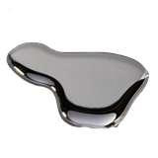
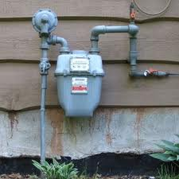
Highly Toxic Metals
Mercury
Naturally occurring element in several
forms
Used in meters, gauges, valves,
switches, batteries and lamps
Silver liquid, limited inhalation hazard
Contaminates surfaces
OSHA PEL for Hg vapor is .1mg/m3
TWA & has a skin designation
Notes:
Who played with as a kid?
It is still found in old factories.

Slide 17
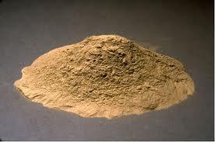
Carcinogenic Metals
Arsenic
Occurs naturally in the
environment
Combined with other elements to form
inorganic arsenic
Exposure occurs through inhalation,
ingestion, skin or eye contact
OSHA PEL is 10 ug/m3 for an 8-hour TWA
OSHA AL is 5 ug/m3 for an 8-hour TWA
Notes:
Also used in some medicines.

Slide 18
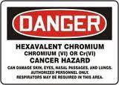
Carcinogenic Metals
Hexavalent Chromium
Dyes, paints, inks and plastics
Surface coatings and electroplating
Produced during oxidation of metals
containing chromium (i.e. “hot work”)
Exposure occurs through inhalation,
skin or eye contact
OSHA PEL is 5 ug/m3 for an 8-hour TWA
OSHA AL is 2.5 ug/m3 for an 8-hour TWA
Notes:
Fairly new regulation.

Slide 19
Dusts
Toxic
• Silica
• Dusts contaminated with PCBs
Soluble / Non-Toxic
• Nuisance
Notes:
Describe being aware of removing concrete that old transformers sat on.

Slide 20
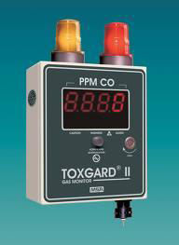
Gases & Vapors
Acute Hazards
Hydrogen Cyanide (HCN)
Hydrogen Sulfide (H2S)
Carbon Monoxide (CO)
Anhydrous Ammonia
Notes:
As for definition.

Slide 21

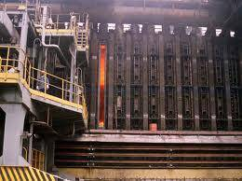
Gases & Vapors
Chronic Hazards
Benzene
Coal Tar Pitch Volatiles
Solvents
Notes:
Ask for definition.

Slide 22
PCBs
What are Polychlorinated biphenyls (PCBs)?
group of manufactured organic chemicals that contain 209 individual chlorinated chemicals - no known natural sources
either oily liquids or solids; colorless to light yellow; no known smell or taste
don't burn easily and are good insulating material
used widely as coolants and lubricants in transformers, capacitors, and other electrical equipment
manufacture stopped in the U.S. in 1977
because they build up in the environment
and cause harmful health effects
Don’t break down easily; found
widely distributed in our environment
and concentrated up the food chain
Notes:
Review slide.

Slide 23
PCBs
Exposures
Food – fish
Surface Soils – run-off
Indoor Air – older transformers leaking
In the Workplace: Industrial accidents
Health Effects
Neurological development of children
Skin and mucous membrane dermatitis
Harmful to the reproductive system
Harmful to the immune system
May cause cancer
Endocrine disruptor
A typical transformer. Note manufacturer’s identification
plate and warning labels.
Notes:
Review slide.

Slide 24

Physical Agents
Ionizing radiation
Non-ionizing radiation
Light
Noise
Vibration
Notes:
As for examples.

Slide 25
Biological Hazards
Plant poisons
Mold allergens
- Individual susceptibility
Healthcare
- Tuberculosis
- HIV and Hepatitis B
Legionella Bacteria
- Cooling towers, coolants on hot surfaces
Notes:
Ask for examples.

Slide 26
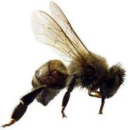
Biological Hazards
Pigeon droppings
• Histoplasmosis
Animal bites
• Rabies/Infection
Insect stings/bites
• Lyme Disease
Notes:
List some precautions for removing bird droppings.

Slide 27
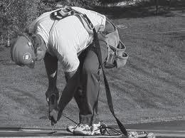
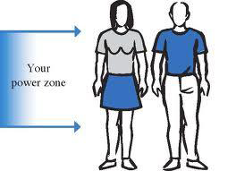
Ergonomic Hazards
Poor tool design
Poor workplace design
Repetitive Stress Disorders
Lower Back Injuries
Cumulative Trauma Disorders
Use the “Power Zone”
Notes:
Describe the power zone.

Slide 28
Stress Hazards
Mental Stress
Heat Stress
Cold Stress
Noise Induced Stress
Notes:
Review slide.

Slide 29
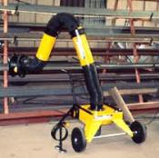

Methods Of Control
Engineering Controls
• substitution
• isolation
• ventilation
• wet methods
Administrative Controls
• work rotation
• work practices
PPE
Notes:
Ask why PPE last in hierarchy of controls.

Slide 30
Subpart D - Occupational Health & Environmental Controls (1926.50 - 66)
Lead - Exposure assessment
First aid training
Gases, vapors, fumes, dusts & mists - Employee exposure
Gases, vapors, fumes, dusts & mists - Controls
Lead - Interim respiratory protection
Notes:
Review slide.

Slide 31

1926.50 Medical Services
Medical personnel available for advice and consultation
Provisions made prior to commencement of the project for prompt medical attention in case of serious injury.
Medical facility readily available and/or person trained in first-aid available at the work site
Notes:
Why important to address prior to starting project?

Slide 32
1926.50 Medical Services
First aid supplies must be easily accessible
Non-mandatory Appendix A references ways to determine first-aid kit contents
Contents must be in a weatherproof container with individual sealed packages for each type of item.
Notes:
Why are indivual sealed packages imprtant?

Slide 33
1926.50 Medical Services
The contents of the first-aid kit shall be checked by the employer before being sent out on each job and
At least weekly on each job to ensure that the expended items are replaced.
Notes:
Consider using log.

Slide 34
1926.50 Medical Services
Proper equipment for prompt transportation of the injured person to a physician or hospital, or
A communication system for contacting necessary ambulance service is required
Notes:
Review slide.

Slide 35
1926.50 Medical Services
Emergency numbers posted
Eyewash required for injurious corrosive materials
Notes:
Review slide.

Slide 36
Sanitation 1926.51
Adequate supply of potable water shall be provided in all places of employment
Portable containers used to dispense drinking water shall be capable of being tightly closed, and equipped with a tap.
Water cannot be dipped from containers.
Notes:
Review slide.

Slide 37
Sanitation 1926.51
Any container used to distribute drinking water shall be clearly marked as to the nature of its contents and not used for any other purpose
The common drinking cup is prohibited
Notes:
Review slide.

Slide 38
"Potable water" means water which meets the quality standards prescribed in the U.S. Public Health Service Drinking Water Standards, published in 42 CFR part 72, or water which is approved for drinking purposes by the State or local authority having jurisdiction.
Notes:
Review slide.

Slide 39
Sanitation - Applicable 1910 Standards
Every enclosed workplace constructed, equipped, and maintained, so far as reasonably practicable, as to prevent the entrance or harborage of rodents, insects, and other vermin.
A continuing and effective extermination program shall be instituted were their presence is detected.
Notes:
Review slide.

Slide 40
Sanitation - Applicable 1910 Standards
Washing facilities required when applying paints, coatings, herbicides, insecticides, or when exposed to other harmful contaminants
They shall be located near the worksite and maintained in a sanitary condition
Lavatories provided with hot &
cold, or tepid running water
Soap/similar cleaning
agent must be provided
Notes:
Give example of someone not providing soap because they felt people didn’t use it anyway – not allowed, you must provide it.

Slide 41
Toilet Provisions: Table D - 1
Number of
Employees
20 or less
1
20 or more
1 toilet seat and 1 urinal per 40 workers
200 or more
1 toilet seat and 1 urinal per 50 workers
Notes:
Don’t have to have male and female as long as they lock from the inside.

Slide 42

1926.52 Noise Exposure
Noise levels in excess of Table D - 2 require administrative or engineering controls to control noise levels
If controls fail to reduce sound levels within the levels of the table PPE must be provided to reduce levels within the table
In all cases where sound levels exceed the values shown in the table, a continuing, effective hearing conservation program must be administered
Notes:
When employees are subjected to sound levels exceeding those listed in Table D-2 of this section, feasible administrative or engineering controls shall be utilized. If such controls fail to reduce sound levels within the levels of the table, personal protective equipment as required in Subpart E, shall be provided and used to reduce sound levels within the levels of the table.

Slide 43
TABLE D - 2 PERMISSIBLE NOISE EXPOSURES
Duration per day, hours
Sound level dBA
slow response
8 ……………………………….
6 ……………………………….
4 ……………………………….
3 ……………………………….
2 ……………………………….
1 1/2 …………………………..
1 ……………………………….
1/2 ……………………………..
1/4 or less …………………...
90
92
95
97
100
102
105
110
115
Notes:
Review slide.

Slide 44
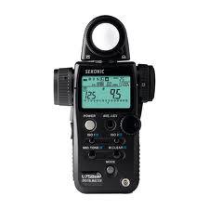
1926.52 Noise Exposure
When the daily noise exposure is composed of two or more periods of noise exposure of different levels, their combined effect should be considered, rather than the individual effect of each.
Use the following formula to
calculate exposure in this
situation:
Notes:
Review slide.

Slide 45
1926.52 Noise Exposure
Fe = (T1 / L1) + (T2 / L2) + ... + (Tn / Ln) where:
Fe = The equivalent noise exposure factor.
T = The period of noise exposure at any essentially constant level.
L = The duration of the permissible noise exposure at the constant level (from Table D-2).
See example calculation on next slide:
Notes:
Review slide.

Slide 46
1926.52 Noise Exposure
If the value of Fe exceeds unity (1) the exposure exceeds permissible levels.
110 dB A 1/4 hour.
100 dB A 1/2 hour.
90 dB A 1 1/2 hours.
Fe = (1/4 / 1/2)+(1/2 / 2)+(1 1/2 / 8)
Fe = 0.500+0.25+0.188
Fe = 0.938
Since the value of Fe does not exceed unity, the exposure is within permissible limits.
Notes:
Review slide.

Slide 47
1926.52 Noise Exposure
Decibel
Level
Example
90
Truck traffic, lawn mower
100
Chain saw, pneumatic drill, excavator
120
Close thunder, rock concert
Jet plane, gunshot blast
Exposure to impulse/impact noise should not exceed 140
140
Notes:
Review slide.

Slide 48
1926.53 Ionizing radiation
In construction and related activities involving the use of sources of ionizing radiation, the pertinent provisions of the Nuclear Regulatory Commission Standards for Protection Against Radiation (10 CFR Part 20), relating to protection against occupational radiation exposure, shall apply.
Competent person needed.
Notes:
Describe competent person.

Slide 49
1926.54 Non-Ionizing radiation
Only qualified and trained employees assigned to install, adjust, and operate laser equipment.
Proof of qualification of the laser equipment operator available and in possession of the operator at all times.
light greater than 0.005 watts (5 milliwatts) exists, shall be provided with anti-laser eye protection
Notes:
The laser beam shall not be directed at employees.
When it is raining or snowing, or when there is dust or fog in the air, the operation of laser systems shall be prohibited where practicable; in any event, employees shall be kept out of range of the area of source and target during such weather conditions.

Slide 50
1926.55 Gases, vapors, fumes, dusts, and mists.
Exposure of employees to inhalation, ingestion, skin absorption, or contact with any material or substance at a concentration above those specified in the "Threshold Limit Values of Airborne Contaminants for 1970" of the American Conference of Governmental Industrial Hygienists, shall be avoided.
See Appendix A to this section.
Notes:
To achieve compliance with paragraph (a) of this section, administrative or engineering controls must first be implemented whenever feasible. When such controls are not feasible to achieve full compliance, protective equipment or other protective measures shall be used to keep the exposure of employees to air contaminants within the limits prescribed in this section. Any equipment and technical measures used for this purpose must first be approved for each particular use by a competent industrial hygienist or other technically qualified person. Whenever respirators are used, their use shall comply with 1926.103.

Slide 51
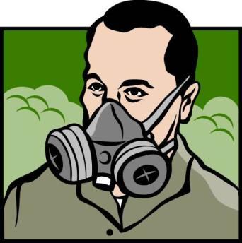
1926.55 Gases, vapors, fumes, dusts, and mists.
Engineering or Administrative controls first
PPE if engineering controls not feasible
All equipment & technical measures approved by competent industrial hygienist or other technically qualified person
Whenever respirators are used, their use shall comply with 1926.103.
Notes:
Paragraphs (a) and (b) of this section do not apply to the exposure of employees to airborne asbestos, tremolite, anthophyllite, or actinolite dust. Whenever any employee is exposed to airborne asbestos, tremolite, anthophyllite, or actinolite dust, the requirements of 1910.1101 or 1926.58 of this title shall apply.
Paragraphs (a) and (b) of this section do not apply to the exposure of employees to formaldehyde. Whenever any employee is exposed to formaldehyde, the requirements of 1910.1048 of this title shall apply.
[39 FR 22801, June 24, 1974, as amended at 51 FR 37007, Oct. 17, 1986; 52 FR 46312, Dec. 4, 1987; 58 FR 35089; June 30, 1993]

Slide 52

1926.56 Illumination
General. Construction areas, ramps, runways, corridors, offices, shops, and storage areas shall be lighted to not less than the minimum illumination intensities listed in Table D-3 while any work is in progress:
Notes:
Review slide.

Slide 53
Foot candles
Area of Operation
5............. General construction area lighting.
3............. General construction areas, concrete placement,
excavation and waste areas, access ways, active
storage areas, loading platforms, refueling, and
field maintenance areas.
5............. Indoors: warehouses, corridors, hallways, and
exitways.
5............. Tunnels, shafts, and general underground work areas:
(Exception: minimum of 10 foot-candles is required
at tunnel and shaft heading during drilling,
mucking, and scaling. Bureau of Mines approved cap
lights shall be acceptable for use in the tunnel
heading)
10............ General construction plant and shops (e.g., batch
plants, screening plants, mechanical and
electrical equipment rooms, carpenter shops,
rigging lofts and active store rooms, mess halls,
and indoor toilets and workrooms.)
30............ First aid stations, infirmaries, and offices.
Notes:
Review slide.

Slide 54
1926.57 Ventilation
"General." Whenever hazardous substances such as dusts, fumes, mists, vapors, or gases exist or are produced in the course of construction work, their concentrations shall not exceed the limits specified in 1926.55(a).
When ventilation is used as an engineering control method, the system shall be installed and operated according to the requirements of this section.
Notes:
Review slide.

Slide 55
1926.57 Ventilation
Exhaust systems designed that dusts, fumes, mists, vapors, or gases are not drawn through the work area of employees.
Notes:
The exhaust system shall be in operation continually during all operations which it is designed to serve. If the employee remains in the contaminated zone, the system shall continue to operate after the cessation of said operations, the length of time to depend upon the individual circumstances and effectiveness of the general ventilation system.

Slide 56
1926.57 Ventilation
Abrasive blasting operations
produces respirable dust.
Concentrations in levels
above those specified in
1926.55 require controls
Notes:
Reference 1926.57 (f)(2)

Slide 57
1926.57 Ventilation
Wherever dry grinding, dry polishing or buffing is performed, and employee exposure, without regard to the use of respirators, exceeds the permissible exposure limits prescribed in 1926.55 or other pertinent sections of this part, a local exhaust ventilation system shall be provided and used to maintain employee exposures within the prescribed limits.
Notes:
Reference 1926.57 (g)(2)

Slide 58
1926.57 Ventilation
Spray booths or spray rooms are to be used to enclose or confine all operations.
Notes:
Reference 1926.57 (h)(2) Spray booths or spray rooms are to be used to enclose or confine all operations. Spray-finishing operations shall be located as provided in sections 201 through 206 of the Standard for Spray Finishing Using Flammable and Combustible Materials, NFPA No. 33-1969.

Slide 59
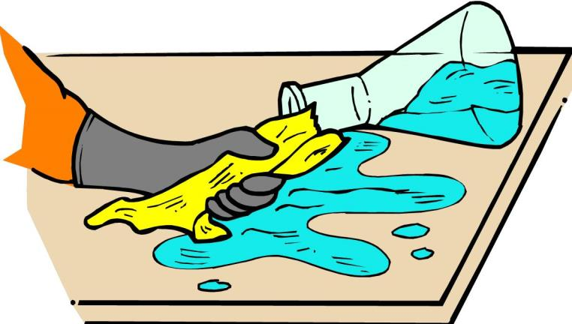
1926.59 = 1910.1200 Hazard Communication
Notes:
Review slide.

Slide 60
Hazard Communication
Material Safety Data Sheets
Labels
Written Program
Training of Employees
Notes:
Review slide.

Slide 61
Major Points
Employees must know the hazards of chemicals such as toxicity, and carcinogenic
Many employees use dangerous chemicals without personal protective equipment
The contractor must have data sheets of other employer’s chemicals if their own employees are exposed
Notes:
An employee cannot protect himself if he does not know the hazards.

Slide 62
Purpose
The purpose of the standard is to make sure that the hazards of chemicals are evaluated
That information concerning their hazards is communicated to employers and employees
Notes:
More than 30 million workers are potentially exposed to one or more chemical hazards. There are an estimated 650,000 existing hazardous chemical products, and hundreds of new ones are being introduced annually. This poses a serious problem for exposed workers and their employers.

Slide 63
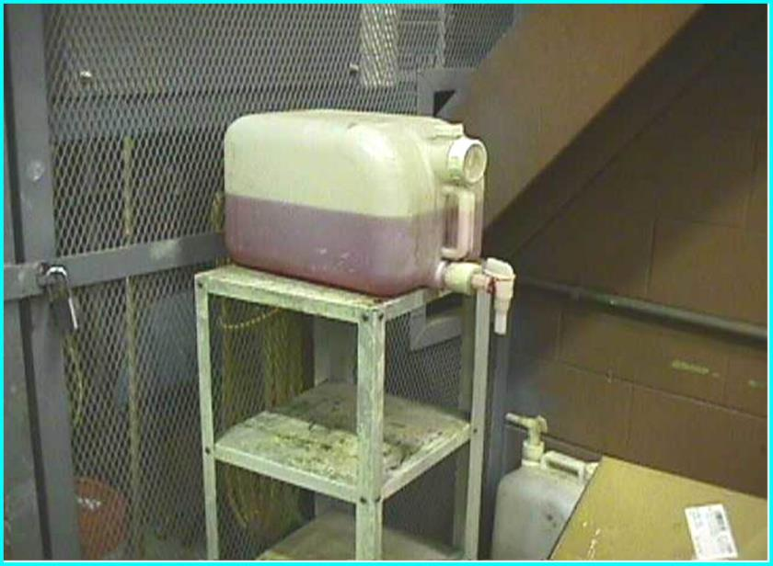
Improper: Container not labeled
Notes:
Could it be fruit drink?

Slide 64
Employers
Employers are required to provide information to their employees about the hazardous chemicals to which they are exposed using:
A hazard communication program
labels and other forms of warnings
material safety data sheets (MSDS)
information and training
Notes:
Review slide.

Slide 65
Labeling Exemptions
Pesticides
Chemicals covered under the Toxic Substance Control Act (TSCA)
Foods or food additives
Distilled Spirits, tobacco
Consumer products, lumber, cosmetics
Hazardous wastes
Notes:
pesticides are covered under the Federal Insecticide Fungicide and Rodenticide Act
Federal Food, Drug and Cosmetic Act
Bureau ATF (booze)
Consumer Products Safety Act

Slide 66
Employer Requirements- Written Program
Employers must develop a written program that covers at least:
Labels and other forms of warnings
Material Safety Data Sheets
Employee Information and Training
Notes:
Give example of written procedures purchased off the shelf. You must at least put in the name of your company – it must be specific to your company.

Slide 67
Employer Requirements- Written Program
Employers must develop a written program that covers at least:
A list of the hazardous chemicals known to be present at the facility along with MSDS’s for each chemical
The methods the employer will use to inform employees of the hazards non-routine tasks
The hazards of chemicals in unlabeled pipes
Notes:
Can be compiled for the entire facility or individual departments

Slide 68
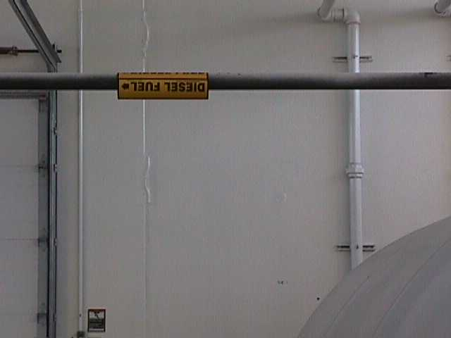
Example of a pipe label.
Notes:
Review slide.

Slide 69
Multi-Employer Workplaces
If employees of other employers could be exposed to hazardous chemicals, the program must include methods to provide contractor employees with on-site access to MSDS for each chemical those workers may be exposed to
The methods used to inform other employers of any precautionary measures to be taken for normal and emergency situations
The employers chemical labeling system
Notes:
If two or more employers have their employees exposed, all exposing employers could be cited.

Slide 70
Labels, Tags and Markings
The employer must ensure that each container of hazardous chemicals in the workplace is labeled, tagged or marked with the following:
Identity of the hazardous chemical
Appropriate hazard warnings
This above labeling information is required of the manufacturer so the employer must ensure that the original labels from the manufacturer are on all containers and remain legible.
Notes:
Review slide.

Slide 71
Container Labeling Exemption for Portable Containers
The employer is not required to label portable containers into which hazardous chemicals are transferred from labeled containers, and which are intended only for the immediate use by the employee who performs the transfer.
Notes:
Emphasize you can only not label if it is for the immediate use of the employee who performs the transfer and it is very easy to lose site of that and suggest they label containers prior to putting in chemicals.

Slide 72
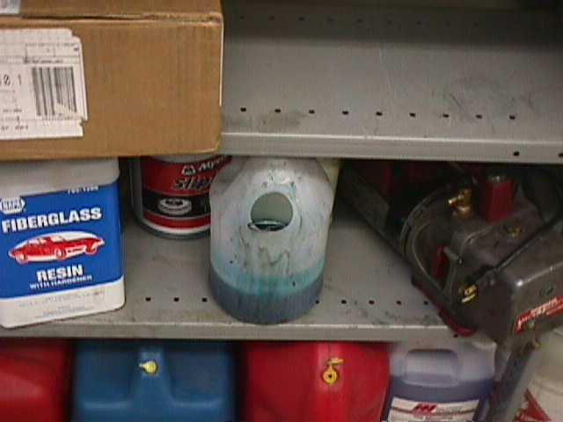
Improper: Containers not labeled
Notes:
Review slide.

Slide 73
The employer need not
affix new labels to comply
with the standard if
existing labels already covey
the required information
Notes:
Review slide.

Slide 74
New Hazard Information
One important function of the individual(s) in charge of maintaining MSDS for the employer is to replace current MSDS with the revised version, when it is received.
Companies can have copies in several locations, so updating all copies requires a conscientious effort by the individual(s) responsible for maintaining MSDS.
Notes:
Make you r system simple, te more stations you have the harder it is to maintain – you must check the revision dates on all MSDS coming in.

Slide 75
MSDS availability off-site
For employees who work off-site:
MSDS may be kept at the central location
In an emergency, the employer must have provisions in place to ensure that employees can immediately obtain the required information
Notes:
You do not need to take all the MSDS with you to a job site as long as someone can be reached at a home office in an emergency. There were two times I inspected a company and they werent able to reach anyone (out to lunch or stepped away from their desk. Est to being copies with you.

Slide 76
MSDS kept in other forms
MSDS may be kept in any form
Including operating procedures, or
Groups of chemicals where it may be more appropriate to address the hazards of a process rather than individual hazardous chemicals
Notes:
Review slide.

Slide 77
Employee Information and Training
Employers must provide employees effective information and training on hazardous chemicals in their work area:
At the time of their initial assignment
Whenever a new physical or health hazard the employees have not previously been trained about is introduced into their work area
Training may cover categories
of hazards or specific chemicals
Notes:
Many people think HAZCOM training is required to be done annually. Not required by the standard but is a best practice.

Slide 78
Employee Information
Employers must inform employees:
Of the training requirements of this section (1910.1200);
Any operations in their work area where hazardous chemicals are present;
The location and availability of the written hazard communication program
Notes:
I have found many employees do not know the location of the written program. And then when they do, it often has a film of dust on it….

Slide 79
Employee Information
Employers must inform employees:
The location and availability of the list of hazardous chemicals
The location and availability of material safety data sheets
Notes:
The list should be maintained with the written program for ease of use.

Slide 80
Employee Training
Employee training shall include at least:
Methods and observations that may be used to detect the presence or release of a hazardous chemical in the work area
The physical and health hazards of chemicals in the work area
Measures employees can take to protect themselves
Details of the employers specific program
Notes:
Such as monitoring done by the employer
continuous monitoring devices
visual appearance or odor
Specific procedures, work practices, emergency procedures and PPE
Explain labeling system, MSDS, how employees can obtain and use haz info.

Slide 81
Hazard
Definitions

Slide 82
IH Terms
PEL – Permissible Exposure Limit (OSHA)
TLV – Threshold Limit Value (ACGIH)
TWA - Time Weighted Average
ACGIH - American Conference of Governmental Industrial Hygienist’s
Notes:
Review slide.

Slide 83
Chemical Exposure Severity & Duration
“Acute” effects usually occur rapidly as a result of short-term exposures, and are of short duration.
“Chronic” effects generally occur as a result of long-term exposure, and are of long duration.
Notes:
Review slide. Ask for examples of each.

Slide 84
Acute Effects
Irritation
Corrosives
Sensitization
Lethal Dose
Notes:
This is a partial list of common effects
Narcosis
Asphyxiation

Slide 85
Chronic Effects
Carcinogenicity
Teratogenicity
Mutagenicity
Notes:
Affect the fetus-birth defects
Affect the individual-chromosomal damage, sterility

Slide 86
Corrosive
Visible destruction, or irreversible damage to body tissue
Acids
Caustics (or bases)
Notes:
Review slide.

Slide 87
Toxic and Highly Toxic
Can cause death or serious injury from a single exposure
Ingestion
Dermal contact
Inhalation
Highly toxic, small dose; severe effects
Toxic, larger dose; severe effects
Notes:
Review slide.

Slide 88
Irritant
Not a corrosive
Causes reversible inflammatory effect
Notes:
Example of red and inflamed or itching, but it goes away over time.

Slide 89
Material Safety Data Sheets (MSDS)
are one of the most important tools
available to employers
for providing information, and protection
to workers from hazardous chemicals
which are used in the workplace.
Notes:
This section will cover the format and content of MSDS
most important sections
exposure limits
physical properties
PPE
emergency procedures

Slide 90
Material Safety Data Sheet U.S. Department of Labor
May be used to comply with Occupational Safety and Health Administration
OSHA's Hazard Communication Standard, (Non-Mandatory Form)
29 CFR 1910.1200. Standard must be consulted for specific requirements.
Form Approved
OMB No. 1218-0072
IDENTITY (As Used on Label and List) Note: Blank spaces are not permitted. If any item is not applicable, or no information is available, the space must be marked to indicate that.
Section I
Manufacturer's Name Emergency Telephone Number
Address (Number, Street, City, State, and ZIP Code) Telephone Number for Information
Date Prepared Signature of Preparer (optional)
Notes:
Review slide.

Slide 91
Section II - Hazard Ingredients/Identity Information
Hazardous Components (Specific Chemical Identity;
Common Name(s)) OSHA PEL ACGIH TLV Other
Limits
Recommended %(optional)
Notes:
Review slide.

Slide 92
Section III - Physical/Chemical Characteristics
Boiling Point Specific Gravity (H₂O = 1)
Vapor Pressure (mm Hg.) Melting Point
Vapor Density (AIR = 1) Evaporation Rate (Butyl Acetate = 1)
Solubility in Water
Appearance and Odor
Notes:
Review slide.

Slide 93
Section IV - Fire and Explosion Hazard Data
Flash Point (Method Used) Flammable Limits LEL UEL
Extinguishing Media
Special Fire Fighting Procedures
Unusual Fire and Explosion Hazards
Notes:
Review slide.

Slide 94
Section V - Reactivity Data
Stability Unstable Conditions to Avoid
Stable
Incompatibility (Materials to Avoid)
Hazardous Decomposition or Byproducts
Hazardous Polymerization May Occur Conditions to Avoid
Will Not Occur
Notes:
Review slide.

Slide 95
Section VI - Health Hazard Data
Route(s) of Entry: Inhalation? Skin? Ingestion?
Health Hazards (Acute and Chronic)
Carcinogenicity: NTP? IARC Monographs? OSHA Regulated?
Signs and Symptoms of Exposure
Medical Conditions Generally Aggravated by Exposure
Emergency and First Aid Procedures
Notes:
Review slide.

Slide 96
Section VII - Precautions for Safe Handling and Use
Steps to Be Taken in Case Material is Released or Spilled
Waste Disposal Method
Precautions to Be taken in Handling and Storing
Other Precautions
Notes:
Review slide.

Slide 97
1926.61 Retention of DOT Markings, Placards and Labels
An employer who receives a package, container or vehicle of hazardous material required to be marked, labeled or placarded in accordance with the U. S. DOT Haz Mat Regulations (49 CFR Parts 171 through 180) shall retain those markings, labels and placards on the package until the packaging is sufficiently cleaned of residue and purged of vapors to remove any potential hazards.
Notes:
Review slide.

Slide 98
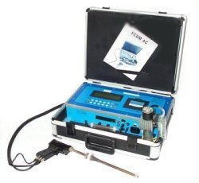
CFR 1926 Subpart Z
Toxic and Hazardous
Substances
1910.1000-1450
1926.1100-1152

Slide 99
Trainer Objectives
Describe the science of Industrial Hygiene (IH).
Describe the use of Tables Z-1, Z-2, and Z-3.
Describe the hazards presented by silica.
Describe the hazards presented by asbestos.
Describe the hazards presented by lead.
Notes:
Review slide.

Slide 100
Introduction
Industrial hygiene is the science (and art) of anticipating, recognizing, evaluating, and controlling workplace conditions that may cause workers' injury or illness
Notes:
Emphasize science and an art. Give examples of determining causes of conditions.

Slide 101
Introduction
OSHA relies on, among many others, industrial hygienists to evaluate jobs for potential health hazards
Developing and setting mandatory occupational safety and health standards involves determining:
The extent of employee exposure to hazards; and,
Deciding what is needed to control these hazards, in order to protect workers

Slide 102
IH Personnel
CIH - Certified Industrial Hygienist has knowledge, experience, and education and passed national exam administered by the American Board Of Industrial Hygiene. Needs continuing education to keep up with the latest technology and issues.
IH - Industrial Hygienist has knowledge, experience, and education to practice IH but has not taken CIH exam.
OHST - Occupational Health and Safety Technologist has practical health & safety knowledge Certified by the Board of Certified Safety Professionals.
IHT – Industrial Hygiene Technician is
specifically trained to do IH exposure
monitoring, done under the supervision
of a CIH or IH.
Notes:
Review slide.

Slide 103
Industrial Hygiene program
Why Do You Need an IH Program?
Protect your workers from hazards that ether you bring into the work place or is there because of the process hazards the process units.
The OSHA regulations require you provide a healthy and safe work place for your employees. (General Duty Clause)
The host facility requires you have IH programs to protect your employees.
Specific work place standards like noise, lead, benzene, hexavalent chromium, just to name a few.
Keep you workman’s compensation cost down.
Protect you and the host company from law suits.
Notes:
Review slide.

Slide 104
Industrial Hygiene program
Proactive process to look at the need to conduct exposure monitoring.
Review the hazards in the work place and determine the need to do exposure monitoring using the hazard risks and the potential for exposures to those hazards.
Develop a sampling strategy, based on the degree of the hazard and the potential for exposure.
Conduct Industrial Hygiene monitoring. This could include quantitative as well as qualitative analysis.
Compare the results to exposure standards and report the results, with corrective actions, if needed.
Notes:
Emphasize proactive.

Slide 105
IH Consultants
Typical IH Bid
Scope of work
Conditions (length of work day, overtime, etc)
Hourly rate
Travel expenses, if applicable
IH Equipment needed and cost (rental)
Laboratory cost
Notes:
Describe a bid process.

Slide 106

IH Consultants
Cost Benefit of contractor sharing of IH services
Labor cost can be shared when several contractors on one job site have the same basic Industrial Hygiene program and the monitoring is conducted by the same person.
For example, one IH Tech can monitor six people in one day just as easy as it takes to monitor three people.
The cost per sample analysis will typically be lower, once certain minimum quantities are achieved.
Notes:
Review slide.

Slide 107
IH Consultants
Analysis Cost
The cost of analysis depends on several factors, varying on which chemical and how fast you need the analysis.
Example: a sample for benzene and other solvents on the same tube or badge may cost about $40 for the first component and $15 for each additional component for a two week turn around.
Example: a chromium VI filter may cost about $50 for a one week turn around, and up to $150 for a same day analysis.
Remember you need to submit a blank per the requirements of the applicable sampling method
Notes:
Review slide.

Slide 108
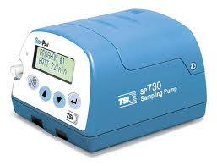
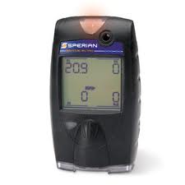
Evaluation
Air Monitoring
How Much?
OSHA Compliance
Labor Relations
Reduce Long-Term Liability
Notes:
Describe how it affects labor relations.

Slide 109
IH Monitoring
Common Mistakes
Wrong sampling method
Not sampling long enough or a high enough flow rate for the sensitivity of the method.
Comparing a short term sample results or area sample results to an 8 hr TWA exposure limit.
Not calibrating equipment before and after each use.
Using a pump calibrator that is out of calibration.
Mislabeling samples
Not documenting notes and information on the samples collected.
Not submitting a blank per the requirements of the applicable sampling method
Notes:
Give example of company having supervisor collect samples but forgot to record the amount of time the sample was takn.

Slide 110
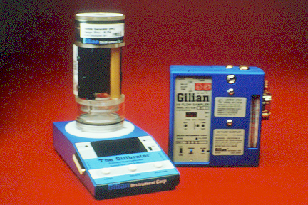
IH Monitoring
Things that can invalidate a sample
Tubing is pulled off of the pump by accident by the worker.
Sample filter falls off sampling device.
Pump stops due to a bad battery or from a flow interrupt.
Obvious tampering with the samples.
Not documenting the monitoring
Notes:
Review slide.

Slide 111
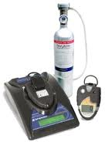
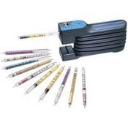

IH Equipment Lab
Handle various types of IH equipment
Place noise dosimeter and/or air pump, hose and cassette on another student
Notes:
Let students place some noise dosimeters and air pumps on other students and how to ask permission and tell person what you are doing. Be sure to let them know that some people think a noise dosimeter is going to record what they say.

Slide 112
Subpart Z Introduction
Subpart Z covers the regulations for toxic and hazardous substances in the workplace
Major sections of Subpart Z include:
1910.1000 Air Contaminants; This section includes OSHA’s Z tables, which set limits on worker exposure to specific listed substances (also see 1926.55 & Appendix A)
1910.1001-1096 Specific regulations for a number of listed potentially hazardous and toxic substances including asbestos (1910.1001); lead (1910.1025) and bloodborne pathogens (1910.1030), among many others (Expanded requirements)
1910.1200 Hazard Communication (1926.59)
Notes:
Review slide.

Slide 113
Standard Interpretations 05/23/1985 - Method for exposure compliance determination for substances regulated under Subpart Z.
“In response to your letter inquiring how the Occupational Safety and Health Administration (OSHA) makes exposure compliance determinations for substances regulated under Subpart Z of 1910.”
“Such determinations consider many factors. Workplace conditions (e.g., production levels, control integrity, work practices, etc.) are examined to ensure that representative samples are collected.”
Notes:
Review slide.

Slide 114
Standard Interpretations 05/23/1985 - Method for exposure compliance determination for substances regulated under Subpart Z.
“Where feasible, the relative results of direct reading and other analytical results are considered.”
“Thus, when OSHA determines that employee exposure to a regulated substance exceeds the permissible limits prescribed by our standards, we then also assess employer compliance with all other applicable provisions of the standard that are dependent on employee exposure levels.”
Notes:
Review slide.

Slide 115
1910.1000 - Air Contaminants
An employee's exposure to any substance listed in Tables Z-1, Z-2, or Z-3 cannot exceed the limits given in the tables, according to the requirements set for each table
To achieve compliance with the requirements of this section a hierarchy of controls must first be determined and implemented whenever feasible:
Engineering controls
Administrative controls
Personal protective equipment
Notes:
Review slide.

Slide 116
Standard Interpretations 06/24/2002 - Hierarchy of controls for exposure to air contaminants
“Employers must use engineering or administrative controls to bring employee exposure to airborne contaminants within the levels permitted under 29 CFR 1910.1000.”
“You may use personal protective equipment (PPE) to supplement engineering and administrative controls only when these controls cannot be feasibly implemented to reduce employee exposure to permissible levels.”
“Thus, when it is not feasible to achieve compliance through administrative or engineering controls, you must also use PPE or other protective measures to prevent employee exposure to air contaminants from exceeding the prescribed limits.”
Notes:
Emphasize PPE last line of defense.

Slide 117
1910.1000(a) - Table Z-1
Lists common chemicals that may be found in the workplace
Limits are given as either:
8-hour Time Weighted Average (TWA) or
Ceiling (C) limits
"Substances with limits preceded by "C" - Ceiling Values." An employee's exposure to any substance in Table Z-1, the exposure limit of which is preceded by a "C", shall at no time exceed the exposure limit given for that substance
Notes:
Have students list chemicals.

Slide 118
1910.1000(a) - Table Z-1
"Other substances" - "8-hour Time Weighted Averages (TWA)”:
An employee's exposure to any substance in Table Z-1, the exposure limit of which is not preceded by a "C", shall not exceed the 8-hour TWA given for that substance in any 8-hour work shift of a 40-hour work week
Notes:
Review slide.

Slide 119
Standard Interpretations 11/10/1999 - OSHA policy regarding PEL adjustments for extend work shifts
As stated in a previous memorandum dated November 8, 1996:
Compliance officers can choose one of two approaches for employees who work extended work shifts beyond 8-hours. The choice taken will depend on the nature of the hazardous chemical.
Notes:
Review slide.

Slide 120
Standard Interpretations 11/10/1999 - OSHA policy regarding PEL adjustments for extend work shifts
“The first approach is to sample what the compliance officer believes to be the worst continuous 8-hour work period of the entire extended work shift.”
“The second approach is to collect multiple samples over the entire work shift. Sampling is done such that multiple personal samples are collected during the first 8-hour work period and additional samples are collected for the extended work shift. Unless a compliance officer is dealing with lead, the PEL in this approach is calculated based upon the worst 8-hours of exposure during the entire work shift.”
Notes:
Review slide.
Often the compliance officer will break up the sampling based on the different work tasks.

Slide 121
1910.1000(a) - Table Z-1
The ceiling and 8 hour TWA’s listed in Table Z-1 are expressed in:
Parts per million (ppm) for gases and vapors from liquids; or,
milligrams per meter cubed (mg/m³) for dusts, fumes & mists
Notes:
Review slide.

Slide 122
1910.1000 TABLE Z-1 (Examples)
Substance
8-hr TWA
Ceiling
Acetone
1000 ppm
Carbon monoxide
50 ppm
Chlorine
1 ppm
Particulates not otherwise regulated (PNOR)
15 mg/M³,
Total dust
5 mg/M³,
Respirable fraction
NOTE: The employer must ensure no employee exceeds any PEL
Notes:
Describe that respirable means it is small enough to get deep into the lungs.

Slide 123
1910.1000(b) - Table Z-2
Table Z-2 was adopted from ANSI* standards
OSHA has developed expanded standards for some of the substances found in Z-2 for example:
Benzene 1910.1028
Cadmium 1910.1027
Formaldehyde 1910.1048
Methylene chloride 1910.1052
*American National Standards Institute
Notes:
Review slide.

Slide 124
1910.1000(b) - Table Z-2
The substances listed can have
limits expressed as:
8-hour TWAs
Ceilings
Peaks
If a substance has both ceiling and peak limits, the peak now becomes the level never to be exceeded
Any employee’s exposure level exceeding the ceiling but under the peak are required to comply with the margin notes provided in the table
Notes:
Review slide.

Slide 125
1910.1000(b) - Table Z-2
Substance
8-hr TWA
Ceiling
Peak
Notes
Carbon Disulfide
20 ppm
30 ppm
100 ppm
30 min
Hydrogen sulfide
20 ppm
50 ppm
10 min
Styrene
100 ppm
200 ppm
600 ppm
5 min in any 3 hrs
Toluene
200 ppm
300 ppm
500 ppm
10 min
* Benzene has an expanded standard 1910.1028. If .1028 does not apply, then the employer will follow limits in Z-2
Notes:
Point out differences on the slide and that the notes refer to the ceilings.

Slide 126
1910.1000(b) - Table Z-2
"Table Z-2." An employee's exposure to any substance listed in Table Z-2 shall not exceed the exposure limits specified as follows:
"8-hour time weighted averages." An employee's exposure to any substance listed in Table Z-2, in any 8-hour work shift of a 40-hour work week, shall not exceed the 8-hour time weighted average limit given for that substance in Table Z-2.
Notes:
Review slide.

Slide 127
1910.1000(b) - Table Z-2
"Acceptable ceiling concentrations." An employee's exposure to a substance listed in Table Z-2 shall not exceed at any time during an 8-hour shift the ceiling concentration limit given for the substance except for:
A time period, and up to a concentration not exceeding the maximum duration and concentration allowed in the column under "acceptable maximum peak above the acceptable ceiling concentration for an 8-hour shift"
Notes:
Emphasize ceiling limit.

Slide 128
1910.1000(b) - Table Z-2
Example:
During an 8-hour work shift, an employee may be exposed to a concentration of Substance A (with a 10 ppm TWA, 25 ppm ceiling and 50 ppm peak) above 25 ppm (but never above 50 ppm) only for a maximum period of 10 minutes.
Such exposure must be compensated by exposures to concentrations less than 10 ppm so that the cumulative exposure for the entire 8-hour work shift does not exceed a weighted average of 10 ppm.
Notes:
Review slide.

Slide 129
1910.1000(c) - Table Z-3
"Table Z-3." An employee's exposure to any substance listed in Table Z-3, in any 8-hour work shift of a 40-hour work week, shall not exceed the 8-hour time weighted average limit given for that substance in the table
Notes:
Review slide.

Slide 130
1910.1000(c) - Table Z-3
OSHA adopted this table from the American Conference of Governmental Industrial Hygienist’s (ACGIH) mineral limits
Notes:
Remind that the ACGIH TLV were recommendations until OSHA turned them into PELs.

Slide 131
1910.1000(c) - Table Z-3
Substance
PEL
Crystalline Silica
(Respirable fraction)
10mg/M³
% Sio2 + 2
Coal dust (< 5% SiO2)
2.4 mg/M³
Nuisance total dust
15 mg/M³
Nuisance respirable dust
5 mg/M³
Notes:
Review slide.

Slide 132
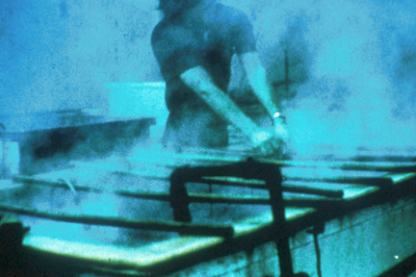
Silica
The Z-3 Table sets the limits for employee exposure to various forms of silica
At least 1.7 million U.S. workers are exposed to respirable crystalline silica in a variety of industries occupations, including construction, sandblasting, and mining
Notes:
Ask what substitutes have been used for sandblasting.

Slide 133

Silica
Silicosis, an irreversible but preventable disease, is the illness most closely associated with occupational exposure to the material, which also is known as silica dust.
Some studies also have linked respirable crystalline silica with risks for lung cancer and some auto-immune diseases.
Notes:
Review slide.

Slide 134
1910.1000(e) - To achieve compliance
To achieve compliance with the requirements of Tables Z-1, Z-2, and Z-3, a hierarchy of controls must first be determined and implemented whenever feasible:
Engineering controls
Administrative controls
Personal protective equipment
Notes:
Review slide.

Slide 135
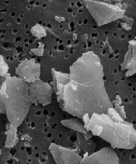
Detailed microscopic view of silica particles on a filter
(Scanning electron micrograph by William Jones, Ph.D.)
Notes:
Discuss how sharp edges damage the avleoli.

Slide 136
1910.1000(e) - To achieve compliance
Any equipment and/or technical measures used for this purpose must be approved for each particular use by a competent industrial hygienist or other technically qualified person
Whenever respirators are used, their use shall comply with 1910.134
Notes:
Discuss competent person.

Slide 137

Asbestos
CFR 1926.1101

Slide 138

Introduction
The asbestos minerals have a tendency to separate into microscopic-size particles that can remain in the air and are easily inhaled. Persons occupationally exposed to asbestos have developed several types of life-threatening diseases, including lung cancer
A fiber of asbestos or related substance is coated by an iron-protein complex and surrounded by macrophages
Notes:
Review slide.

Slide 139
Why is asbestos hazardous?
Asbestos is a mineral that is resistant to chemicals, heat and biochemical defenses
Length of fiber is approximately 1/5000 of an inch
Size and shape allows the fiber to reach the alveoli
Fibers remain in the lung tissue or pierce the alveoli and get lodged in the pleura that surrounds the lung
The asbestos kills macrophages which lead to scarring
Notes:
Draw picture of asbestos fiber and the barbs and how it damages the alveoli similar to silica.

Slide 140
Permissible exposure limit (PELS)
The employer shall ensure that no employee is exposed to an airborne concentration of asbestos in excess of 0.1 fiber per cubic centimeter of air as an eight (8)-hour time-weighted average (TWA).
Notes:
Review slide.
Point out that these fibers can float in the air for a long time.

Slide 141

Main topics of the Standard
Definitions
Classification of asbestos work
Regulated areas
Exposure assessment
Methods of Compliance: Engineering and work practice controls
Prohibited activities
PPE
Hygiene facilities
Training requirements
Medical surveillance
Recordkeeping
Notes:
Review slide.

Slide 142
Standard Interpretations 05/08/1995 - (OSHA) revised asbestos standard
“The standard requires the employer to know the presence, location, and quantity of asbestos-containing material (ACM) and presumed asbestos-containing material (PACM) and to communicate this to employees who work in areas where ACM or PACM is present.”
Notes:
Emphasize potential.

Slide 143
Building Owner Requirements
Building and facility owners shall determine the presence, location and quantity of ACM and/or PACM and inform tenants, their employees and employers of employees (who will inform their employees) who will perform work activities in or near areas which contain it
Notes:
Review slide.

Slide 144
Building Owner Requirements
Posting:
Warning signs shall be provided and displayed at each regulated area.
In addition, warning signs shall be posted at such a distance from such areas so that an employee may read the signs and take necessary protective steps before entering the area.
DANGER ASBESTOS CANCER AND LUNG DISEASE HAZARD AUTHORIZED PERSONNEL ONLY
Notes:
Review slide.

Slide 145
Standard Interpretations 02/21/1996 - Building and/or facility owner notification requirements
“Rule 29 CFR 1926.1101(k)(2)(ii)(B) pertains to employees of the building and/or facility owner.”
“The rule requires the owner to notify his/her maintenance and custodial employees of the presence, location, and quantity of ACM or PACM in the areas of the building or facility where they perform work.”
“In addition, the rule requires the owner to notify his/her other employees who work in or adjacent to areas where work about to take place of the presence, location, and quantity of ACM or PACM in the areas.”
Notes:
Review slide.

Slide 146
Lead
1910.1025
1926.62

Slide 147
Introduction
Overexposure to lead is one of the most common overexposures found in industry.
A leading cause of workplace illness.
OSHA has established the reduction of lead exposure to be a high strategic priority.
Notes:
Give industry examples where lead found.

Slide 148
Introduction
Lead is commonly added to industrial paints because of its characteristic to resist corrosion.
Industries with particularly high potential exposures include: construction work involving welding, cutting, brazing, blasting, etc., on lead paint surfaces;
Oral ingestion represents a major route of exposure in contaminated workplaces.
Notes:
List ways of ingestion.

Slide 149
Introduction
You may not be aware of any immediate symptoms of disease
Lead stored in your tissues can slowly cause irreversible damage, first to individual cells, then to your organs and whole body systems
Notes:
Review slide.

Slide 150
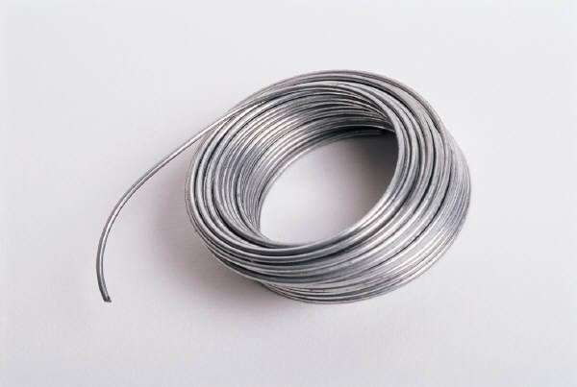
Introduction
You can absorb lead through your digestive system if lead gets into your mouth and is swallowed
If you handle food, cigarettes, chewing tobacco, or make-up which have lead on them or handle them with hands contaminated with lead, this will contribute to ingestion
Notes:
Emphasize hygiene.

Slide 151
Introduction
Taken in large enough doses, lead can kill you in a matter of days
A condition affecting the brain called acute encephalopathy may arise which develops quickly to seizures, coma, and death from cardiorespiratory arrest.
A short term dose of lead can lead to acute encephalopathy
Notes:
Review slide.

Slide 152
Introduction
Chronic overexposure to lead may result in severe damage to your blood-forming, nervous, urinary and reproductive systems
Common symptoms of chronic overexposure include loss of appetite, metallic taste, anxiety, constipation, nausea, weakness, insomnia, headache, nervous irritability, muscle and joint pain or soreness, tremors, numbness, dizziness
Notes:
Review slide.

Slide 153
Scope
Applies to all construction work where an employee may be occupationally exposed to lead, including:
Demolition or salvage operations;
Removal or encapsulation of materials containing lead;
New construction, alteration, repair or renovation;
Installation of products containing lead;
This section does not apply to agricultural operations covered by 29 CFR Part 1928
Notes:
Review slide.

Slide 154
Permissible exposure limit (PEL)
The employer shall assure that no employee is exposed to lead at concentrations greater than 50 ug/m3 averaged over an 8-hour period
For > 8 hours exposure PEL = 400/hours worked
Determine if any employee may be exposed to lead at or above the action level (30 ug/m3).
Determination based on
exposure levels if employee
not using a respirator
Notes:
Reiterate that exposure monitoring is based on not using a repirator (you cant sample inside of a mask).

Slide 155
Initial determination
Each employer who has a workplace or work operation covered by this standard shall determine if any employee may be exposed to lead at or above the action level
Notes:
You must determine what the exposure is to determine what actions are needed.

Slide 156
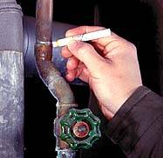
Basis of initial determination
Any information, observations, or calculations which would indicate employee exposure to lead;
Any previous measurements of airborne lead; and
Any employee complaints of symptoms which may be attributable to exposure to lead
Notes:
You must sample. Also, the lead sticks are not acceptable.

Slide 157
Negative Initial Determination
Written Record
Date
Location
Name
SSN
Notes:
Review slide.

Slide 158
Written Compliance Program
A written program is required if occupational exposure to lead exists:
Each employer shall establish and implement a written compliance program to reduce exposures to or below the permissible exposure limit
Notes:
The written program must be specific to your organization.

Slide 159
Written Compliance Program
A description of each operation in which lead is emitted;
e.g. machinery used, material processed, controls in place, crew size, employee job responsibilities, operating procedures and maintenance practices;
A description of the specific means that will be employed to achieve compliance, including:
methods selected for controlling exposure to lead;
Air monitoring data which documents the source of lead emissions;
A schedule for implementation of the program
Notes:
This must be specific.

Slide 160
Additional Requirements
Multi-contractor Site Arrangements
Mechanical Ventilation
Respirator Selection & Use and PPE clothing
Housekeeping
Hygiene and Facility Practices
Medical Requirements
Training
Notes:
Give examples.

Slide 161
Standard Interpretations 04/25/1979 - Training program requirements in the lead standard
“The employer is required by provision (1)(l)(v)(A) of the lead standard to summarize the standard and its appendices for each employee covered by provision (1)(l)(ii).”
Notes:
Review slide.

Slide 162
CFR 1926 Subpart E
Personal Protective
&
Life Saving
Equipment

Slide 163
Learning Objectives/Outcomes
Upon completion of the lesson, participants will be able to:
1. Describe the two primary means of protecting employees from workplace hazards, prior to considering personal protective equipment (PPE).
2. List at least four of the seven items that should be covered during PPE training.
3. Identify at least three elements of an appropriate PPE program.
4. Match the appropriate PPE to a described hazard.
Notes:
Review slide.

Slide 164
Protecting Employees from Workplace Hazards
OSHA regulations require employers to protect their employees from workplace hazards such as machines, work procedures, and hazardous substances that can cause injury
Employers must institute all feasible engineering and work practice controls to eliminate and reduce hazards before using PPE to protect against hazards
Notes:
Why does OSHA want you to use PPE last?

Slide 165

Engineering Controls
If…
You can physically change the machine or
work environment to prevent employee
exposure to the potential hazard
Then…
You can eliminate the hazard with an
engineering control
Notes:
Describe ways to change.

Slide 166
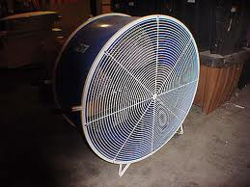
Engineering Controls (cont’d)
Examples…
Initial design specifications
Ventilation
Substitution with less harmful material
Enclosure of process
Isolation of process
Change the process
Notes:
Give examples of each.

Slide 167
Work Practice Controls
If…
You can remove your employees from
exposure to the potential hazard by changing
the way they do their jobs,
Then…
You can eliminate the hazard with a work
practice control
Notes:
Describe some changes.

Slide 168




Work Practice Controls (cont’d)
Examples…
Notes:
Discuss each example.

Slide 169
Responsibilities
Employer
Assess workplace for hazards
Provide PPE
Determine when to use
Instruct employees in proper use
Employee
Use PPE in accordance with instructions
Inspect daily and maintain
Notes:
Review slide.

Slide 170
Examples of PPE
Eyes - safety glasses, goggles
Faces - face shields
Heads - hard hats
Feet - safety shoes
Hands and arms - gloves
Bodies - vests
Hearing - ear plugs, earmuffs
Note:
Rubber insulating equipment (gloves, sleeves,
blankets, etc.) is also considered PPE. However, because
OSHA has specific requirements for them, they are not
discussed in this general guide.
Notes:
Review slide.

Slide 171
Establishing a PPE Program
Procedures for selecting, providing and using PPE
First -- assess the workplace to determine if hazards are present, or are likely to be present, which necessitate the use of PPE
Once the proper PPE has been selected, the employer must provide training to each employee who is required to use PPE
Notes:
Be specific in your program.

Slide 172
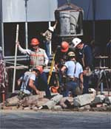
Training
If employees are required to use PPE, train them:
Why it is necessary
How it will protect them
What are its limitations
When and how to wear
How to identify signs of wear
How to clean and disinfect
What is its useful life & how is it disposed
Notes:
Each affected employee must demonstrate an understanding of the required training, and the ability to use PPE properly, before being allowed to perform work requiring the use of PPE.
When the employee does not have the required skill and understanding, retraining is required.
Written certification of completion of training is required.

Slide 173



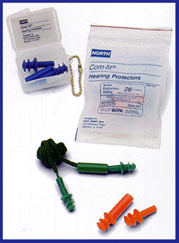
1926.95(a)
"Application." Protective equipment, including personal protective equipment for eyes, face, head, and extremities, protective clothing, respiratory devices, and protective shields and barriers, shall be provided, used, and maintained in a sanitary and reliable condition wherever it is necessary by reason of hazards of processes or environment, chemical hazards, radiological hazards, or mechanical irritants encountered in a manner capable of causing injury or impairment in the function
of any part of the body through absorption, inhalation or physical contact.
Notes:
Review slide.

Slide 174
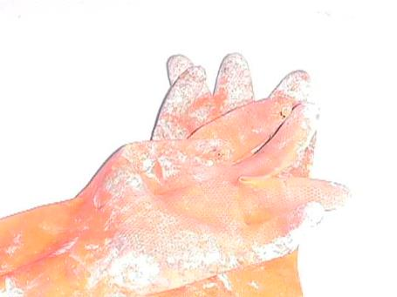
1926.95(b)
"Employee-owned equipment." Where employees provide their own protective equipment, the employer shall be responsible to assure its adequacy, including proper maintenance, and sanitation of such equipment.
Employee owned gloves
Notes:
Give example of audit finding empolyees with more duct tape on gloves than cloth material left.

Slide 175
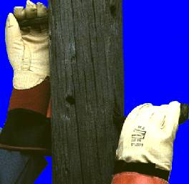

1926.95(c)
"Design." All personal protective equipment shall be of safe design and construction for the work to be performed.
Notes:
What is wrong with picture – no glasses/goggles.

Slide 176
HARD HATS

Slide 177

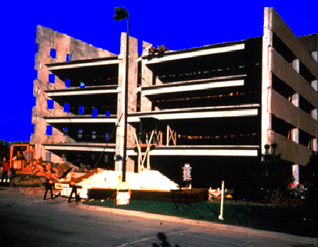
Potential overhead hazards
must be present
Notes:
Overhead hazards must be present for OSHA to consider a requirement – you can require as best practice.

Slide 178

Causes of Head Injuries
Falling objects such as tools
Bumping head against objects, such as pipes or beams
Contact with exposed electrical wiring or components
Improper head protection.
Notes:
See Personal Protective Equipment Fact Sheet, also in Spanish, at
-- www.osha.gov/OshDoc/toc_fact.html
Hard hats were worn by only 16% of workers sustaining head injuries, although two-fifths were required to wear them for certain tasks at specific locations. *
A majority of these workers were injured while performing their normal jobs at regular worksites.
Cuts or bruises to the scalp and forehead occurred in 85% of the cases, concussions in 26%. Over a third of the cases resulted from falling objects striking the head. *
* U.S. Department of Labor, Bureau of Labor Statistics, Accidents Involving Head Injuries, Report 605, (Washington, D.C., Government Printing Office, July 1980)

Slide 179
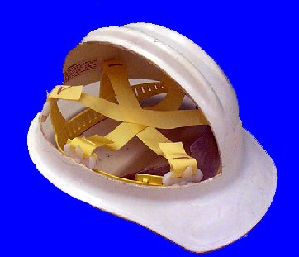
1926.100 Head Protection
(a) Employees working in areas where there is a possible danger of head injury from impact, or from falling or flying objects, or from electrical shock and burns, shall be protected by protective helmets.
(b) Helmets for the protection of employees against impact and penetration of falling and flying objects shall meet the specifications contained in American National Standards Institute, Z89.1-1969, Safety Requirements for Industrial Head Protection.
(c) Helmets for the head protection of employees exposed to high voltage electrical shock and burns shall meet the specifications contained in American National Standards Institute, Z89.2-1971.
Notes:
Review slide.

Slide 180

Classes of Hard Hats
Class A
Used for general service (e.g., mining, building construction, shipbuilding, lumbering, manufacturing)
Provides impact protection but limited voltage protection
Class B
Used for electrical work
Protects against falling objects and
high-voltage shock and burns
2,200
20,000
Notes:
Review slide.

Slide 181

Classes of Hard Hats (cont’d)
Class C
Designed for comfort, offers
limited protection
Protects head that bumps against fixed objects, but does not protect against falling objects, or electrical
shock.
Notes:
Review slide.

Slide 182

BUMP CAP
A bump cap should never be used in construction areas since it is not rated to protect against construction hazards.
Notes:
You should never see bump caps on a construction site. These are for ligth industrial facilities where people may duck ina nad around equipment and you simply want to protect their heads from bumps and not falling objects.

Slide 183
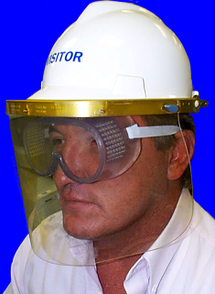
1926.102
Eye and face protection
(a)(1) General. Employees shall be provided with eye and face protection equipment when machines or operations present potential eye or face injury from physical, chemical, or radiation agents.
(a)(2) Eye and face protection equipment
required by this Part shall meet the requirements
specified in American National Standards Institute,
Z87.1-1968, Practice for Occupational and
Educational Eye and Face Protection.
Notes:
Review slide.

Slide 184
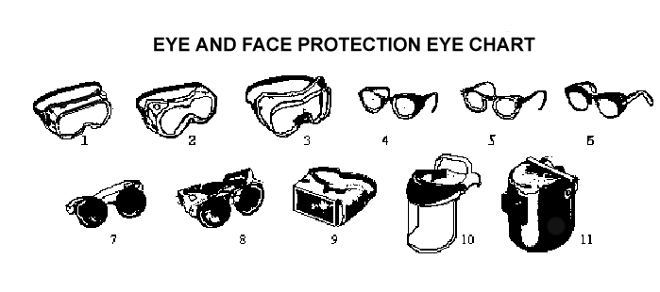
1
2
3
4
5
6
7
8
13
11
9
10
Notes:
Review slide.

Slide 185
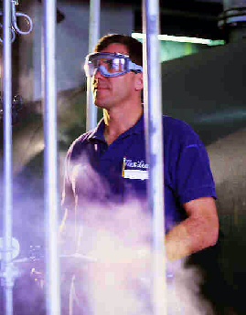
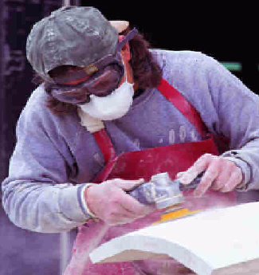
1926.102(a)(3)
Lenses
Employees whose vision requires the use of corrective lenses in spectacles, when required by this regulation to wear eye protection, shall be protected by goggles or spectacles of one of the following types:
(a)(3)(i) Spectacles whose protective lenses provide optical correction;
(a)(3)(ii) Goggles that can be worn over corrective spectacles without disturbing the adjustment of the spectacles;
(a)(3)(iii) Goggles that incorporate corrective lenses mounted behind the protective lenses.
Notes:
Goggles with corrective lenses are best because when goggles go over temple bars of glasses it allows a gap.

Slide 186
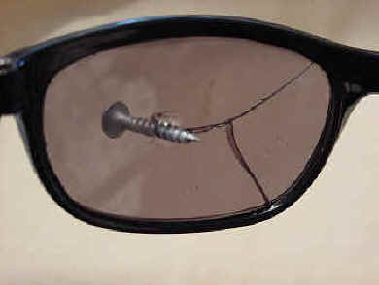
Safety Glasses
Made with metal/plastic safety frames
Most operations require side shields
Used for moderate impact from particles produced by jobs such as carpentry, woodworking, grinding, and scaling
Must meet ANSI Z87.1-1968 at a minimum
Notes:
1926.102(a)(5)
See OSHA Publication 3151, Assessing the Need for Personal Protective Equipment: A Guide for Small Business Employers.
Table 1 and Figure 1 – Selection and Recommendation

Slide 187
Goggles
Protects eyes and area around the eyes from impact, dust, and splashes
Some goggles fit over corrective lenses
Must meet ANSI Z87.1-1968 at a minimum
Notes:
1926.102(a)(3)(ii)
1926.102(a)(5)
Corrective lenses include contacts and glasses.

Slide 188
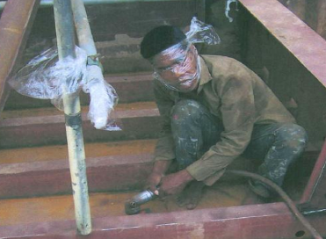
Face Shields
Full face protection
Protects face from dusts and splashes or sprays of hazardous liquids
Does not protect from impact hazards
Wear safety glasses or goggles underneath
Must meet ANSI Z87.1-1968 at a minimum
Improper PPE
Notes:
1926.102(a)(5)
See Personal Protective Equipment Fact Sheet, also in Spanish, at
-- www.osha.gov/OshDoc/toc_fact.html
Only 1% of approximately 770 workers suffering face injuries were wearing face protection; *
A majority of these workers were injured while performing their normal jobs at regular worksites.
* U.S. Department of Labor, Bureau of Labor Statistics, Accidents Involving Head Injuries, Report 605, (Washington, D.C., Government Printing Office, July 1980)

Slide 189
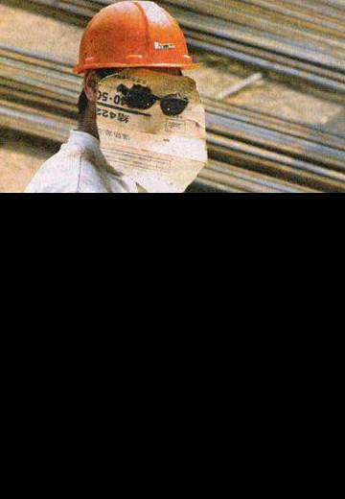
Welding Shields
Protects eyes against burns from radiant light
Protects face and eyes from flying sparks, metal spatter, & slag chips produced during welding, brazing, soldering, and cutting
Improper PPE
Notes:
1926.102(a)(5), 1926.102(b)(1)
Use helmets or hand shields during arc welding or arc cutting operations, except submerged arc welding. Helpers or attendants shall be provided with proper eye protection.
Goggles or other suitable eye protection shall be used during all gas welding or oxygen cutting operations. Spectacles without side shields, with suitable filter lenses are permitted for use during gas welding operations on light work, for torch brazing or for inspection.
All operators and attendants of resistance welding or resistance brazing equipment shall use transparent face shields or goggles, depending on the particular job, to protect their faces or eyes, as required.

Slide 190
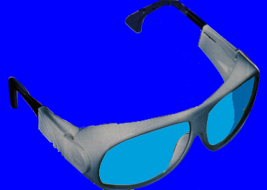
1926.102(b)(2)
Laser protection
(b)(2)(i)
Employees whose occupation or assignment requires exposure to laser beams shall be furnished suitable laser safety goggles which will protect for the specific wavelength of the laser and be of optical density (O.D.) adequate for the energy involved. Table E-3 lists the maximum power or energy density for which adequate protection is afforded by glasses of optical densities from 5
through 8.
Notes:
Laser frequencies are different. The glasses that come with a laser leveler from a hardware store may not protect you from and industrial laser.

Slide 191
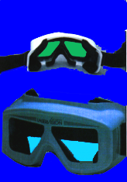
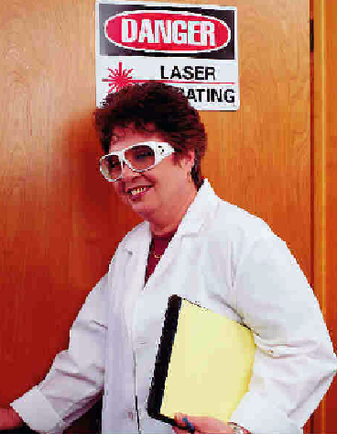
1926.102(b)(2)
Laser protection
(b)(2)(ii) All protective goggles shall bear a label identifying the following data:
(b)(2)(ii)(a) The laser wavelengths for which use is intended;
(b)(2)(ii)(b) The optical density of those wavelengths;
(b)(2)(ii)(c) The visible light transmission.
Notes:
Review slide.

Slide 192
1926.101 Hearing protection
(a) Wherever it is not feasible to reduce the noise levels or duration of exposures to those specified in Table D-2, Permissible Noise Exposures, in 1926.52, ear protective devices shall be provided and used.
(b) Ear protective devices inserted in the ear shall be fitted or determined individually by competent persons.
Examples of Hearing Protectors
Earmuffs
Earplugs
Canal Caps
Notes:
There is now available fit testing equipment for hearing protection.

Slide 193
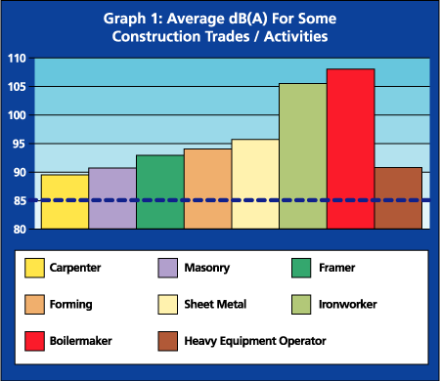
Hearing Protection
Notes:
1926.101
Determining the need to provide hearing protection is complicated.
Employee exposure to excessive noise depends upon several factors:
- How loud is the noise as measured in decibels (dBA)?
- What is the duration of each employee’s exposure to noise?
- Do employees move between separate work areas with different noise levels?
- Is noise generated from one source or multiple sources?
Generally, the louder the noise, the shorter the exposure time before you must provide hearing protection.
See the OSHA technical link for Noise and Hearing Conservation at www.osha-slc.gov/SLTC

Slide 194
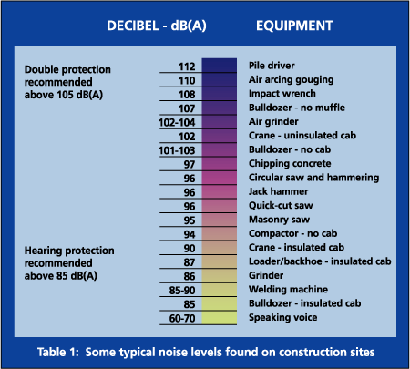
Hearing protection
When it is not feasible to
reduce the noise or
Its duration – use ear
protective devices.
Ear protective devices
inserted in the ear shall
be fitted.
Notes:
Review slide.

Slide 195
When Must Hearing Protection be Provided?
After implementing engineering and work practice controls
When employee’s noise exposure exceeds an 8-hour time-weighted average sound level (TWA) of 90 dBA
When employees are exposed to an 8-hour TWA of 85 dBA and have hearing loss.
Notes:
Review slide.

Slide 196


1926.101(c) Plain cotton is not an
acceptable protective device.
Notes:
Cigarette butts are also not acceptable.

Slide 197
Hand Protection
Notes:
What are some hand hazards?

Slide 198
When Must Hand Protection be Provided?
When any of these are present:
Burns
Bruises
Abrasions
Cuts
Punctures
Fractures
Amputations
Chemical Exposures
Notes:
Review slide.

Slide 199
What Kinds of Protective Gloves are Available?
Durable gloves made of metal mesh, leather, or canvas.
Protects from cuts, burns, heat
Fabric and coated fabric gloves.
Protects from dirt and abrasion
Chemical and liquid resistant gloves.
Protects from burns, irritation, and dermatitis
Insulating rubber gloves.
Reduces exposure to blood
Notes:
There are gloves that also have rubber on the tops of fingers to help absorb impact energy.

Slide 200
Types of Rubber Gloves
Nitrile protects against solvents, harsh chemicals, fats and petroleum products and also provides excellent resistance to cuts and abrasions.
Butyl provides the highest permeation resistance to gas or water vapors

Slide 201
Other Types of Gloves
Kevlar protects against cuts, slashes, and abrasion.
Stainless steel mesh protects against cuts and lacerations.
Notes:
It is best to test your gloves and not just rely on what the supplier tells you.

Slide 202
Body Protection
Notes:
1926.100
See OSHA Publication 3151, Assessing the Need for Personal Protective Equipment: A Guide for Small Business Employers.

Slide 203

Body Protection
Improper PPE
Notes:
1926.95
See OSHA Publication 3151, Assessing the Need for Personal Protective Equipment: A Guide for Small Business Employers.
The photo depicts a hazardous waste operation covered under 1926.65 or 1910.120.

Slide 204
What are the Major Causes of Body Injuries/Illnesses?
Intense heat
Splashes of hot metals and other hot liquids
Impacts from tools, machinery, and materials
Cuts
Hazardous chemicals
Contact with potentially infectious materials, like blood
Radiation
Notes:
Review slide.

Slide 205
Body Protection Criteria for Selection
Provide protective clothing for parts of the body exposed to possible injury
Types of body protection:
Vests
Aprons
Jackets
Coveralls
Full body suits
Coveralls
Notes:
Look at the hazards to determine what is needed.

Slide 206


Body Protection
Cooling Vest
Full Body Suit
Sleeves and Apron
Notes:
Protective clothing comes in a variety of materials, each suited to particular hazards. Conduct your hazard assessment and identify potential sources of bodily injury. Install feasible engineering controls, and institute work practice controls to eliminate the hazards. If the possibility of bodily injury still exists, provide protective clothing constructed of material that will protect against the specific hazards in your workplace.
Different materials will protect against different chemical and physical hazards. When chemical or physical hazards are present, check with the clothing manufacturer to make sure that the material selected will provide protection from the specific chemical or physical hazards in your workplace.

Slide 207

Body Protection
1926.96 Safety-toe footwear for employees shall meet the requirements and specifications in American National Standard for Men's Safety-Toe Footwear, Z41.1-1967.
Notes:
What are some hazards needing foot protection?

Slide 208
When Must Foot Protection be Provided?
When any of these are present:
Heavy objects such as barrels or tools that might roll onto or fall on employees’ feet
Sharp objects such as nails or spikes that might pierce ordinary shoes
Molten metal that might splash on feet
Hot or wet surfaces
Slippery surfaces
Notes:
Review slide.

Slide 209

Safety Shoes
Impact-resistant toes and heat-resistant soles protect against hot surfaces common in roofing and paving
Some have metal insoles to protect against puncture wounds
May be electrically conductive for use in explosive atmospheres, or nonconductive to protect from workplace electrical hazards
Notes:
Conductive Shoes
Electrically conductive shoes protect against the buildup of static electricity. Essentially, these shoes ground the employees wearing them. Employees working in explosive and hazardous locations such as explosives manufacturing facilities or grain elevators must wear conductive shoes to reduce the risk of static electricity buildup on an employee’s body that could produce a spark and cause an explosion or fire. During training, employees must be instructed not to use foot powder or wear socks made of silk, wool, or nylon with conductive shoes. Foot powder insulates and retards the conductive ability of the shoes. Silk, wool, and nylon produce static electricity.
Conductive shoes are not general-purpose shoes and must be removed upon completion of the tasks for which they are required. Employees exposed to electrical hazards must NEVER wear conductive shoes.
Safety-Toe Shoes
Safety-toe shoes are nonconductive and will prevent an employee’s feet from completing an electrical circuit to ground. They protect employees against open circuits of up to 600 volts in dry conditions. Use the shoes with other insulating equipment and precautions to reduce or eliminate the potential for providing a path for hazardous electrical energy.
NOTE: Don’t wear nonconductive footwear in explosive or hazardous locations

Slide 210

1926.104 Safety belts, lifelines, and lanyards
(a) Lifelines, safety belts and lanyards shall be used only for employee safeguarding. Any subjected to in-service loading shall be immediately removed from service and not used again for employee safeguarding.
(b) Lifelines shall be secured above the point of operation to an anchorage or structural member capable of supporting a minimum dead weight of 5,400 pounds.
Notes:
Review slide.

Slide 211

1926.104 Safety belts, lifelines, and lanyards
(c) Lifelines used on rock-scaling operations, or in areas where the lifeline may be subjected to cutting or abrasion, shall be a minimum of 7/8-inch wire core manila rope. For all other lifeline applications, a minimum of 3/4-inch manila or equivalent, with a minimum breaking strength of 5,400 pounds,
shall be used.
(d) Safety belt lanyard shall be a minimum of 1/2-inch nylon, or equivalent, with a maximum length to provide for a fall of no greater than 6 feet. The rope shall have a nominal breaking strength of 5,400
pounds.
Notes:
Review slide.

Slide 212
1926.104 Safety belts, lifelines, and lanyards
(e) All safety belt and lanyard hardware shall be drop forged or pressed steel, cadmium plated in accordance with type 1, Class B plating specified in Federal Specification QQ-P-416. Surface shall be smooth and free of sharp edges.
(f) All safety belt and lanyard hardware, except rivets, shall be capable of withstanding a tensile loading of 4,000 pounds without cracking, breaking, or taking a permanent deformation.
Notes:
Review slide.

Slide 213

1926.105 Safety nets
(a) Safety nets shall be provided when workplaces are more than 25 feet above the ground or water surface, or where the use of ladders scaffolds, catch platforms, temporary floors, or safety lines/belts are impractical.
(b) Where safety net protection is required by this part, operations shall not be undertaken until the net is in place and has been tested.
(c) (1) Nets shall extend 8 feet beyond the edge of the work surface where employees are exposed and shall be installed as close under the work surface as practical but in no case more than 25 feet below such work surface.
(d) The mesh size of nets shall not exceed 6 inches by 6 inches.
Notes:
Review slide. Be sure to inspect your nets – how long have they been in service – any deteriation?

Slide 214


1926.106 Working over or near water
(a) Employees working over or near water, where the danger of drowning exists, shall be provided with U.S. Coast Guard-approved life jacket or buoyant work vests.
(b) Prior to and after each use, the buoyant work vests or life preservers shall be inspected for defects which would alter their strength or buoyancy.
(c) Ring buoys with at least 90 feet of line shall be provided and readily available for emergency rescue operations not to exceed 200 feet spacing.
(d) At least one lifesaving skiff shall be immediately available at locations where employees are working over or adjacent to water.
Notes:
Review slide.

Slide 215
CFR 1910.134
CFR 1926.103
Respiratory Protection

Slide 216
1910.134(a) Permissible practice
1st Priority: Engineering controls:
Enclosure or confinement of the operation,
General and local ventilation, and
Substitution of less toxic materials
When engineering controls are being instituted respirators can be used
Notes:
Why are engineering controls first?

Slide 217
1910.134(a)(2) Employers responsibilities
Respirators:
Provided by the employer
Must provide the respirators which are applicable and suitable for the purpose intended
The employer is responsible for the establishment and maintenance of a respiratory protection program
Notes:
The employer is responsible even if the employee is using a personally owned respirator.

Slide 218
1910.134(c) Respiratory protection program
Requires worksite-specific procedures and elements for required respirator use
The program must be administered by a suitably trained program administrator*
*The Small Entity Compliance Guide contains criteria for the selection of a program administrator and a sample program that meets the requirements of this paragraph. Copies of the Small Entity Compliance Guide are available from the OSHA Office of Publications, Room N 3101, 200 Constitution Avenue, NW, Washington, DC, 20210 (202-219-4667).
Notes:
The procedure must be specific to the work hazards.

Slide 219
1910.134(c) Respiratory protection program
Where respirators are necessary:
Written program
Worksite-specific procedures
Required elements:
Training
Fit testing
Medical evaluations
Maintenance
Procedures for respirator selection
Procedures for routine & emergency use
Evaluating program effectiveness
Notes:
Review slide.

Slide 220
1910.134(c)(2) Where respirator use is not required:
If voluntary respirator use is permissible, provide the respirator users with the information contained in Appendix D and,
Establish and implement those elements of a written respiratory protection program* necessary to ensure that any employee using a respirator voluntarily is medically able to use that respirator
That the respirator is cleaned, stored, and maintained so that its use does not present a health hazard to the user
*Written program not required for voluntary use of dust masks
Notes:
The employer must ensure they cover App D. and that the employee takes care of the respirator.

Slide 221
Appendix D Highlights
If your employer provides respirators for your voluntary use, of if you provide your own respirator, you need to take certain precautions to be sure that the respirator itself does not present a hazard:
Heed all manufacturers instructions
on use, maintenance, cleaning & care
Choose certified respirators
Understand its application and limitations
Don’t mix it up with someone else’s
Notes:
The employer must cover limitations.

Slide 222
1910.134(e) Medical evaluations
Medical evaluations provided before:
Fit testing
Worker respirator use
Identify a physician or other licensed health care professional (PLHCP) to perform medical evaluations using a medical questionnaire:
Obtain the information requested by the questionnaire in Sections 1 and 2, Part A of Appendix C
Notes:
Why must the medical veluation be done even before fit-testing?

Slide 223
Summary
To determine if PPE is needed employers must:
Assess the workplace for hazards
Use engineering and work practice controls to eliminate or reduce hazards before using PPE
Select appropriate PPE to protect employees from hazards that cannot be eliminated
Inform employees why the PPE is necessary and when it must be worn
Train employees how to use and care for their PPE and how to recognize deterioration and failure
Require employees to wear selected PPE
Notes:
For more information:
-- OSHA Publication 3151, Assessing the Need for Personal Protective Equipment: A Guide for Small Business Employers.
It is available at OSHA’s home page (www.osha.gov), or for sale by the U.S. Government Printing Office, Washington, DC.

