Slide 1
ANDAMIOS This material was produced under grant number SH-22234-11 from the Occupational Safety and Health Administration, U.S. Department of Labor. It does not necessarily reflect the views or policies of the U.S. Department of Labor, nor does mention of trade names, commercial products, or organizations imply endorsement by the U.S. Government.

Slide 2
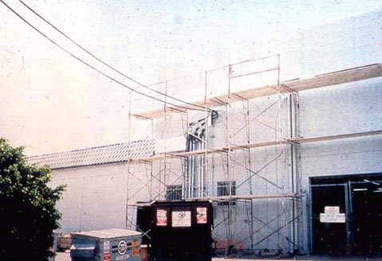
Notes:
Electric Hazards:
Because they may be built in proximity to overhead power lines, and because they are often made of metal, scaffolds can put workers at risk of electrocution. This risk can be removed through proper clearance and maintenance. Check to see if power lines near scaffolds are de-energized or that the scaffolds are at least 10 feet away from energized power lines. Also, make sure that tools and materials are at least 10 feet away from energized power lines.

Slide 3
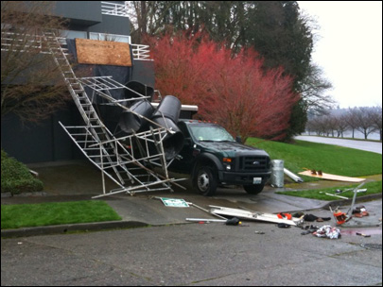
Notes:
Scaffold Collapse:
Scaffolds and scaffold components must be capable of supporting, without failure, their own weight and at least 4 times their maximum intended load. Verify that the scaffold is the correct type for the loads, materials, employees, and weather conditions. Check footings to see if they are level, sound, rigid, and capable of supporting the loaded scaffold. Check metal components for bends, cracks, holes, rust, welding splatter, pits, broken welds, and non-compatible parts.

Slide 4
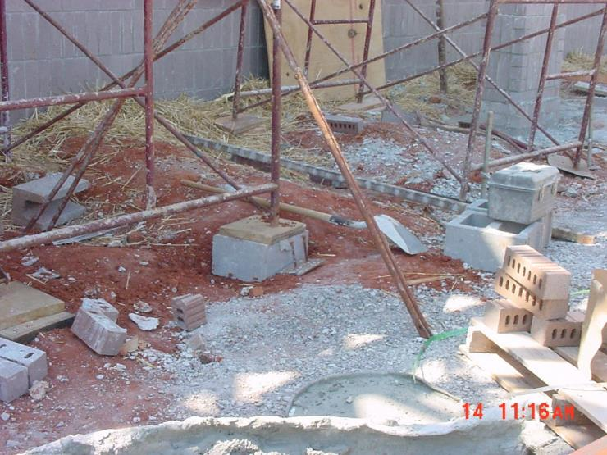
Notes:
Check legs, posts, frames, and uprights to see if they are on base plates and mudsills.

Slide 5
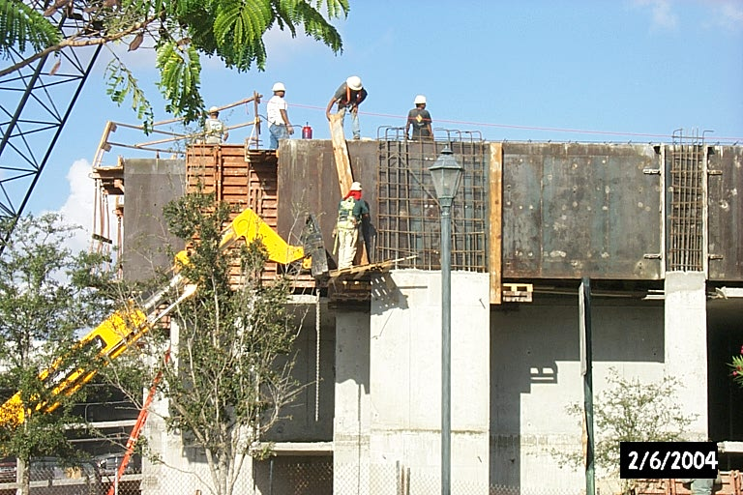
Notes:
Falls:
Fall protection consists of either personal fall-arrest systems or guardrail systems, and must be provided on any scaffold 10 feet or more above a lower level. Also, check for safe access, do not use the cross braces as a ladder for access or exit.

Slide 6
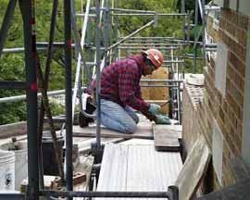
Notes:
Falling Objects:
Nothing that could cause a slip, trip or fall (i.e. tools, scrap material, chemicals, snow, ice, etc.) is allowed to accumulate on the platform. There are two kinds of falling object hazards associated with scaffolds. One concerns the employees on the scaffold itself, and the other concerns employees who may work in or enter the area below the scaffold. Each employee on a scaffold must be protected from falling hand tools, debris, and other small objects, by wearing Hardhats. Also, Toeboards, screens, or guardrail systems should be adopted.

Slide 7
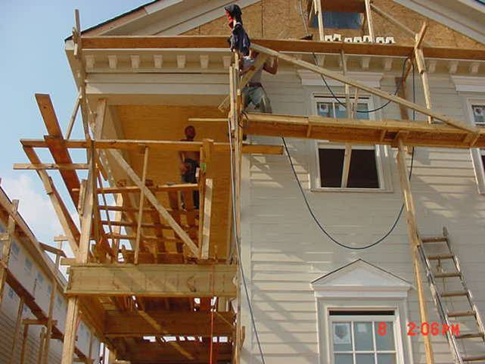
Notes:
Hazard: Fall from scaffold; collapsing scaffold. Standard violated: 1926.451: Employees working on improperly constructed scaffolding system. Corrective Action: Erect proper scaffold system.

Slide 8
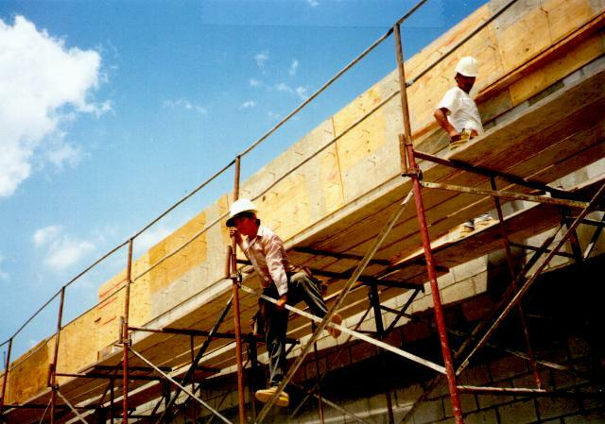
Notes:
Hazard: Fall from scaffold. Standard violated: 1926.451(b), 1926.451(e): Employee climbing cross braces, platform not fully planked. Corrective Action: Provide safe access. Fully plank scaffold platform.

Slide 9
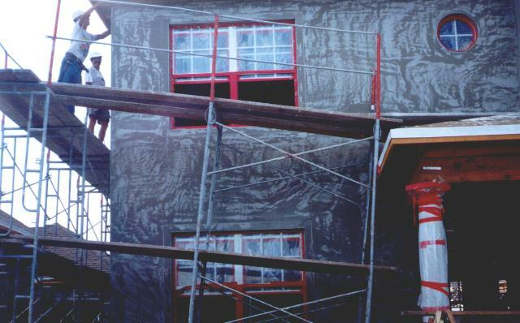
Notes:
Hazard: Fall from scaffold. Standard violated: 1926.451(c): Scaffold not plumb. Cross bracing missing. Corrective Action: Plumb scaffold. Install cross braces.

Slide 10
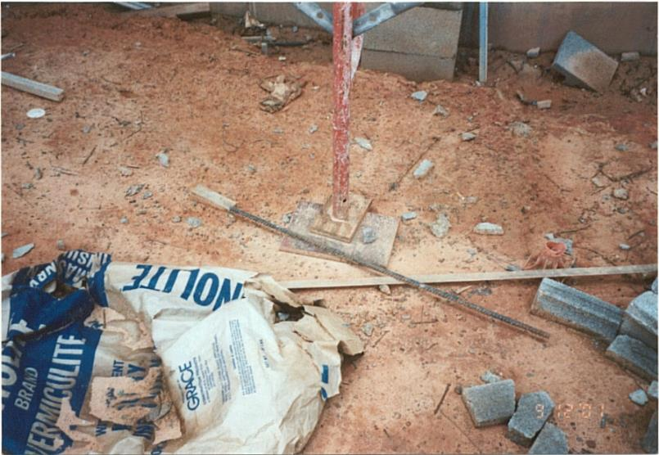
Notes:
Hazard: Fall from scaffold
Standard: 1926.451(c)(2): Supported scaffold poles, legs, posts, frames, and uprights did not bear on base plates and mud sills or adequate firm foundation.
Corrective Action: Properly install base plates and mud sills on scaffolding.

Slide 11
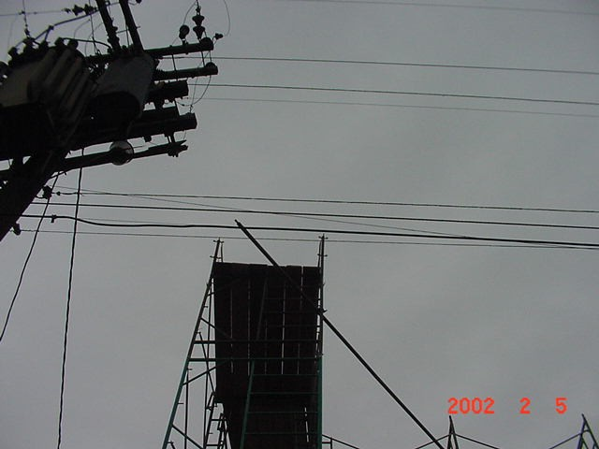
Notes:
Hazard: Electrocution
Standard: 1926.451(f)(6): This scaffold was within 10 feet of the overhead powerline with 300 volts to 50KV.
Corrective Action: The scaffold should not be erected, dismantlled, used or altered near energized powerlines.

Slide 12
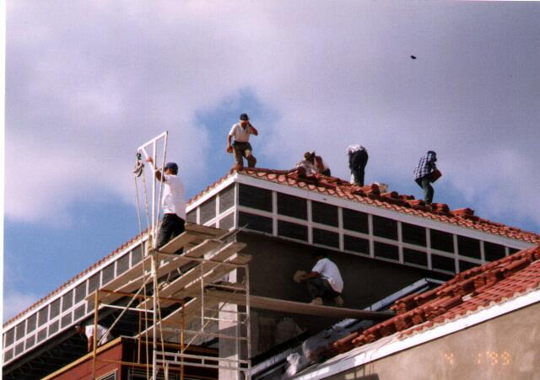
Notes:
Hazard: Fall from scaffold and steep roof. Struck by falling materials. Standard violated: 1926.451(g), 1926.451(b), 1926.100(a), 1926.451(h), 1926.501(b)(11): Fall protection not provided. Scaffold not fully planked. Hard hats and falling object protection not provided. Corrective Action: Install guardrails on scaffold. Fully plank scaffold. Provide hard hats and falling object protection and steep roof fall protection.

Slide 13
Excavaciones y trincheras

Slide 14
¿Cuál es la diferencia entre una excavación y una trinchera?
Notes:
An excavation is a man-made cut, cavity, trench or depression in the earth's surface formed by earth removal. This can include excavations for anything from cellars to highways.

Slide 15
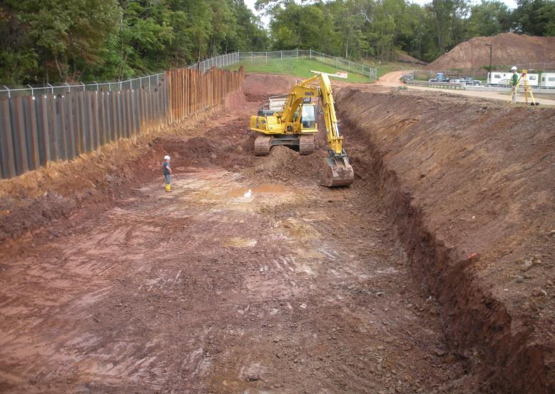
Notes:
An excavation is a man-made cut, cavity, trench or depression in the earth's surface formed by earth removal. This can include excavations for anything from cellars to highways.

Slide 16
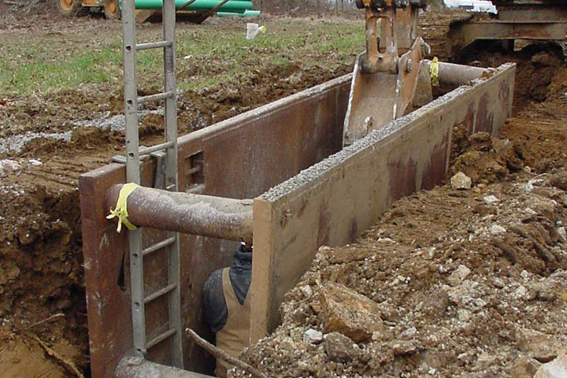
Notes:
A trench is defined as a narrow underground excavation that is deeper than it is wide, and no wider than 15 feet (4.5 meters).

Slide 17
Peligros Asociados con Excavaciones y Trincheras
Notes:
Trenching and excavation work presents serious hazards to all workers involved. Cave-ins pose the greatest risk and are much more likely than other excavation-related accidents to result in worker fatalities. A cave-in can trap you within seconds and kill you within minutes. Two cubic yards of soil weight about 6,000 pounds, if the soil covers you completely, you can suffocate within minutes.
Other potential hazards include falls, falling loads, hazardous atmospheres, lack of oxygen, toxic fumes, explosive gases, buried power lines and incidents involving mobile equipment.

Slide 18
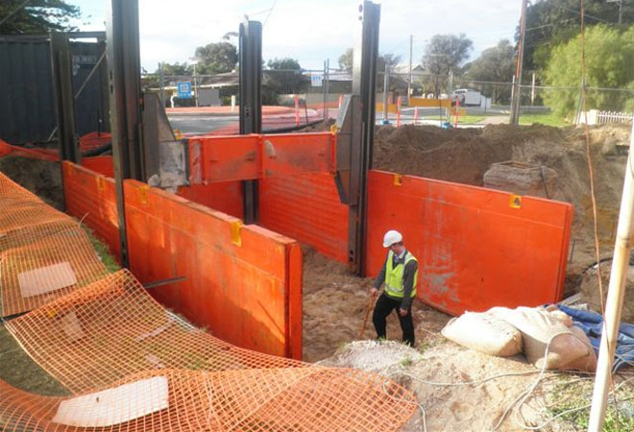

Slide 19
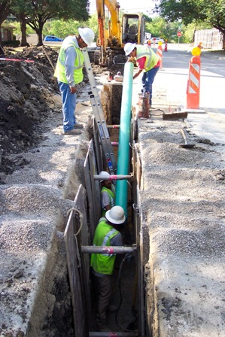

Slide 20
