Slide 1
Material Handling
This material was produced under grant [SH22236SH1]from the Occupational Safety and Health Administration, U.S. Department of Labor. It does not necessarily reflect the views or policies of the U.S. Department of Labor, nor does mention of trade names, commercial
products, or organizations imply endorsement by the U.S. Government

Slide 2
This is an awareness class only. This will not make you a licensed operator.

Slide 3
  Manual Material Handling:
  Carrying
  Lifting
  Lowering
  Machine Material Handling:
      Forklift

Slide 4
Possible Injuries
Lifting, Carrying and Lowering of Material can cause lower back injuries along with neck and shoulder strain
Material Handling with Forklifts can cause struck-by and caught between injuries.
Forklifts can roll-over
Notes:
The weight and bulkiness of objects lifted is a major contributing factor to injuries. Workers also frequently cited body movement as contributing to their injuries. Bending, followed by twisting and turning, were the more commonly cited movements that caused back injuries.
In 2000, 410,000 workplace accidents resulted in back injuries.
Back injuries accounted for more than 20 percent of all occupational illnesses, according to data from the National Safety Council.
By 1994, the U.S. Bureau of Labor Statistics reported there were 613,251 over-exertion cases with lost-workdays. The majority of those cases were due to lifting (367,424), pushing/pulling (93,325), and carrying (68,992). Those cases represent 27 percent of all lost-workday cases.
Struck by accidents accounted for 22% of all injuries in construction in 2000.
Source: Office of Training and Education Material Handling powerpoint

Slide 5
Hazards
Improper lifting, carrying or handling loads that are awkward or heavy
Struck by materials that are stored improperly or by forklifts that are carrying loads
Struck by products that are not properly loaded on the pallet or the load has shifted in transit to the store.
Trying to exit machine while rolling over
Improperly cutting shrink wrap from pallet

Slide 6
Never exit forklift if it starts to rollover
Forklifts can weigh anywhere from 3000lbs-15000lbs. If you attempt to get off when the machine starts to flip, you might get crushed

Slide 7
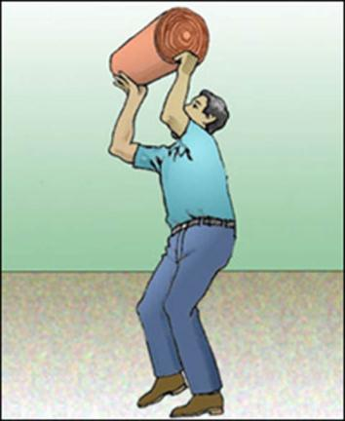
Safe Lifting
Break load into parts
Get help with heavy or bulky items
Lift with legs, keep back straight, do not twist
Use handling aids - such as steps, trestles, shoulder pads, handles, and wheels
Avoid lifting above shoulder level
Notes:
Reference – OSHA Technical Manual - Back Disorders and Injuries
www.osha.gov/dts/osta/otm/otm_vii/otm_vii_1.html

Slide 8
Safe Lifting Training
What should be taught:
How to lift safely
How to avoid unnecessary physical stress and strain
What you can comfortably handle without undue strain
Proper use of equipment
Recognizing potential hazards and how to prevent / correct them
Notes:
Training should include general principles of ergonomics, recognition of hazards and injuries, procedures for reporting hazardous conditions, and methods and procedures for early reporting of injuries.
Safe lifting training should also include:
• Health risks related to improper lifting
• The basic anatomy of the spine, the muscles, and the joints of the trunk, and the contributions of intra-abdominal pressure while lifting.
• Awareness of individual body strengths and weaknesses—determining one’s own lifting capacity.
• Recognition of physical factors that might contribute to an accident and how to avoid the unexpected.
• Knowledge of body responses—warning signals—to be aware of when lifting.
Source:Office of Training and Education, Material Handling Powerpoint

Slide 9
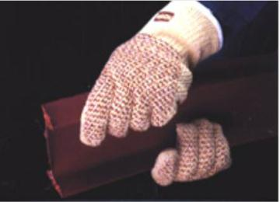
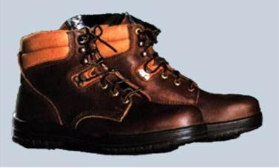
Personal Protective Equipment
For loads with sharp or rough
edges, wear gloves or other
hand and forearm protection
When loads are heavy or bulky,
wear steel-toed safety shoes to
prevent foot injuries if the load
is dropped
Notes:
Source:Office of Training and Education, Material Handling Powerpoint

Slide 10
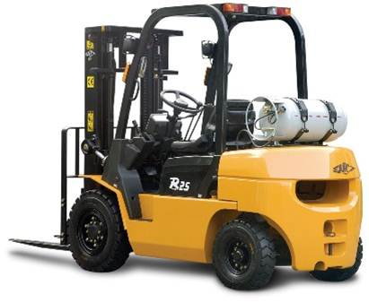
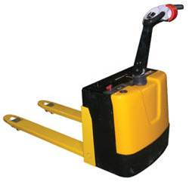
Material Handling Equipment
Notes:
Pictured are a forklift and pallet jack

Slide 11
Equipment Training
All employees must be trained before using Material Handling Equipment and they must demonstrate how to use the equipment

Slide 12
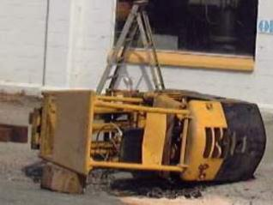
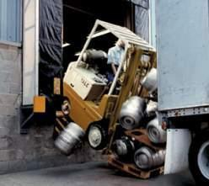
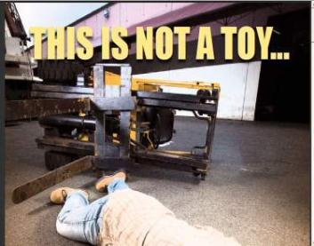
The risk of ignoring forklift safety
Forklifts are extremely useful in a variety of workplaces, but there is great risk of property damage, injury or death if you:
are not trained on forklift safety
- are not familiar with the specific forklift vehicle
- operate the forklift in an unsafe manner
- operate a forklift with a defect or missing parts
Source: New Zealand Dept. of Labor
Source: RiteHite Doors
Source: WorksafeBC
Notes:
Because the cause of so many forklift accidents is lack of proper training, this training is required by L & I regulations for any person who will using a forklift.
Source: Washington State Dept of Labor and Industries (Safe Operation of Forklifts)

Slide 13
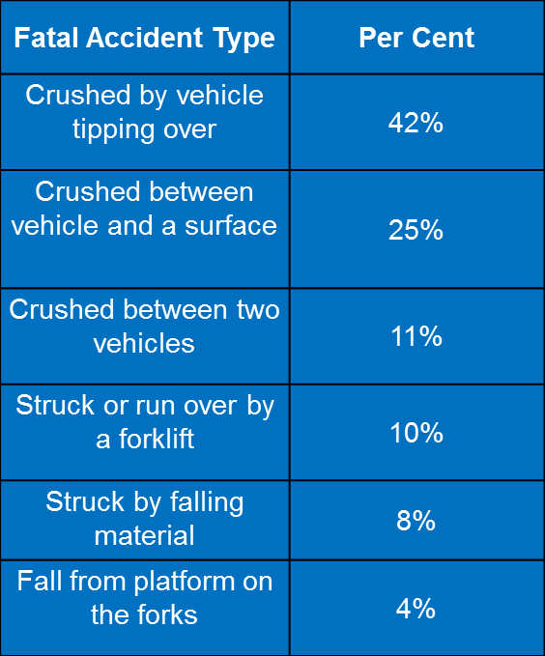
Notes:
Source: Washington State Dept of Labor and Industries (Safe Operation of Forklifts)

Slide 14
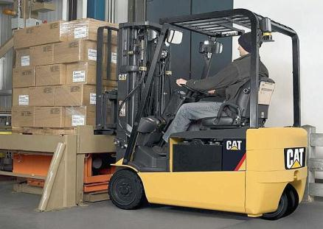
Forklifts and Material Handling
Accident Prevention
To prevent these type accidents, always be on a constant
watch for your surroundings such as pedestrians, blind spots,
and ramp/dock edges.
During forklift operation, always wear your seatbelt and do not ever extend your hands, arms or head outside of the safe zone.
From NCDOL Hazard Alert document 12/2010

Slide 15
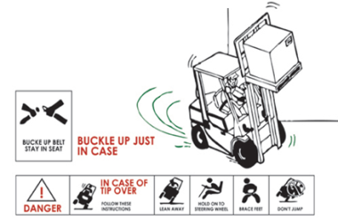
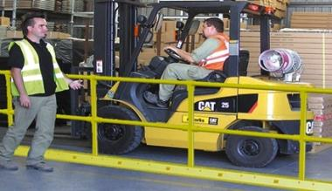
Forklifts and Material Handling
Accident Prevention
If you end up in an unbalanced situation due to loads shifting or wheels leaving floor edges, do not remove your seatbelt and do call out for help. In most cases, the safest place to be is to be belted in your seat.
Always do your best to
designate forklift work zones and pedestrian areas. Use your horn
when needed as you approach blind spots and intersections.
from NCDOL Hazard Alert document 12/2010

Slide 16
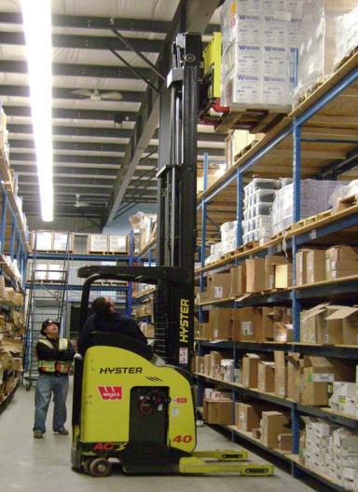
Forklifts and Material Handling
Material Handling
Do not ever stack materials above a safe stacking height. Consider the use of warehouse rack storage when needed.
Follow standard practices when stacking materials to ensure
optimal stability. In addition, consider the use of shrink wrap to enhance the stability of a stack.
Make sure that warehouse racks are not loaded above their rated capacity and store the heaviest materials on the floor or on the lowest rack locations.
Presentation based on information from NCDOL Hazard Alert document 12/2010

Slide 17
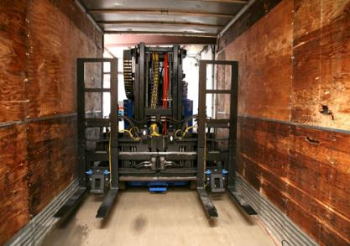
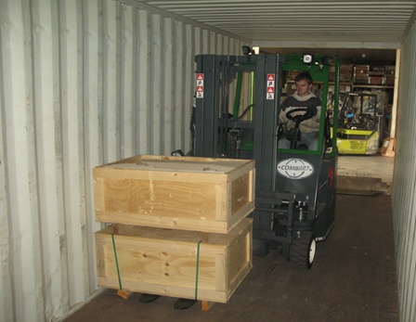
Forklifts and Material Handling
Trailer Loading
Prior to trailer entry from a dock, inspect the trailer floor to ensure good condition. Do not drive forklifts into trailers that have damaged or weak floors.
Make sure that trailers are secured from movement and tipping prior to forklift entry.
from NCDOL Hazard Alert document 12/2010

Slide 18
Forklift Safety Checklist
• Make sure the operator’s manual is on the lift and the load capacity is posted
• Check that steps are free from mud, oil, and grease and that the windows are clean
• Make sure overhead protection is in place (All forklifts must have a cage that the operator sits in)

Slide 19
Check all hydraulic cylinders, hoses, and connectors for leaks
• Inspect the tires
• Make sure the forklift has a fire extinguisher on board, that it’s fully charged, and that it has an up to date inspection tag

Slide 20
Verify that the seatbelt works
• Be sure the seat bottom and back are secure
• Adjust the mirrors to the correct positions

Slide 21
• Test the horn lights and back up alarm
• After starting the forklift, make sure that all gauges are in normal range
• Test the brakes and parking brake to ensure there is no movement when they are applied

Slide 22
• Move the lift forward and backward, and left and right to make sure it maneuvers properly. Listen for loud or unusual noises
• After you’ve moved the lift, check the ground underneath for signs of fluid leaks

Slide 23
A FORKLIFT IS NOT AN AERIAL LIFT. NO ONE IS EVER ALLOWED TO USE THE FORKS OR A PALLET AS AN ELEVATED WORK PLATFORM.

Slide 24
Notes:
Questions

