Slide 1

Using Shipyard Portable Tools
An Injury Prevention Course for Shipyard Workers
This material was produced under grant SH-22239-11-60-F-6 from the Occupational Safety and Health Administration, U.S. Department of Labor. It does not necessarily reflect the views or policies of the U.S. Department of Labor, nor does mention of trade names, commercial products or organizations imply endorsement by the U.S. Government.
1
Notes:
1

Slide 2
PURPOSE AND OBJECTIVES
Course Purpose:
The purpose of this course is to provide shipyard workers with the knowledge to work more safely in shipyards.
Specific Objective:
At the completion of this class it is expected that the shipyard workers in attendance will increase their knowledge in the safe use of hand tools, power tools and cords and chains.
Objective Measurement:
At the completion of this class it is expected that the participants will demonstrate safe shipyard portable tool practices and pass the post-test at the end of training .
This material was produced under grant SH-22239-11-60-F-6 from the Occupational Safety and Health Administration, U.S. Department of Labor. It does not necessarily reflect the views or policies of the U.S. Department of Labor, nor does mention of trade names, commercial products or organizations imply endorsement by the U.S. Government.

Slide 3

YOU AND OSHA
You have rights!
No retribution
Filing a complaint

Slide 4
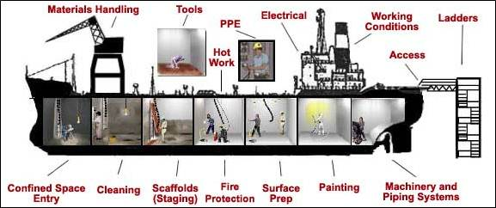
YOU HAVE RIGHTS!
To review standards
To receive training
To request an investigation
Review the OSHA 300 Log

Slide 5
NO RETRIBUTION
Firing or laying off
Blacklisting or demoting
Denying overtime or promotion
Disciplining
Denial of benefits
Failure to hire or rehire
Intimidation
Reassignment affecting future promotions
Reducing pay or hours
Cal OSHA includes suspension

Slide 6
FILING A VALID COMPLAINT
Resolve With Your Company – Follow your chain of command. Go to your Lead, Supervisor or Safety Technician. However, if this fails you should file a valid complaint.
Online - Go to the Online Complaint Form. Written complaints that are signed by workers or their representative and submitted to an OSHA Area or Regional office are more likely to result in onsite OSHA inspections.
Telephone - your local OSHA Regional or Area Office. OSHA staff can discuss your complaint and respond to any questions you have. 1-800-321-OSHA.
Download and Fax/Mail - Download the OSHA complaint form* [En Espanol*] (or request a copy from your local OSHA Regional or Area Office), complete it and then fax or mail it back to your local OSHA Regional or Area Office. Written complaints that are signed by a worker or representative and submitted to the closest OSHA Area Office are more likely to result in onsite OSHA inspections. Please include your name, address and telephone number so we can contact you to follow up. This information is confidential.

Slide 7
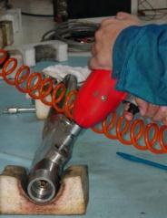
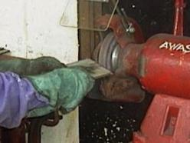
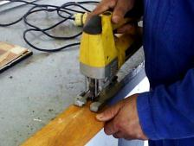
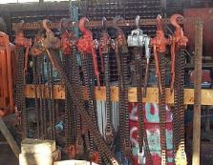
TRAINING TOPICS
Introduction
Hand Tools
Power Tools
Cords and Chains
Types/Hazards/Protection
Summary

Slide 8

PRE-TEST

Slide 9
INTRODUCTION
Shipyard Portable Tools
Visual Inspection
Proper Use and Care
PPE – Gloves, Glasses, Ear Plugs, etc.
Types of Portable Tools

Slide 10

WHAT ARE HAND TOOLS?
the tasks our fingers cannot
An extension for our arms and hands
Any portable piece of equipment to assist our hands
Something we would all be lost without if we did not have them!
speed up operations
Notes:
This slide is done in 4 second gaps so sufficient time can be given to read each line before the next one appears.
If required more detail can be gone into when all the lines are visible. It should be fairly explanatory.

Slide 11
WHAT OSHA SAYS
When working with power tools, you can get an electric shock, lose a finger, lose an eye, or go deaf. It's especially dangerous to use a tool that's defective, that's been modified, or that's not designed for the job. Of course, you can also get injured if you use any tool carelessly.

Slide 12
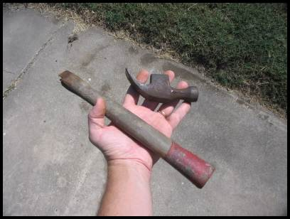
VISUAL INSPECTION
How can we make sure our hand tools are kept in the
best possible condition?
Visually checking before use
Notes:
The first slide is a man using a punch, the incorrect and better pictures will be displayed. Look at the incorrect picture and get class feed back as to the hazards.
When this is complete click the mouse and the next slide will appear. There is a total of 4 slides to look at give some emphasis to the man using the drill as he already has a sticky plaster on his finger from doing it wrong before.
When all the 4 slides are finished, click mouse-space-or direction arrow to get the bottom line come up. Get crew to give you the answer (by using the stop system).then click on mouse again and the stop sign emphasis on the stop system needs to be given here. Some slides have additional pointers with regard to pinch points and tool direction arrows the better slides are not perfect as you can see more hazards in the back ground this could also be pointed out as an exercise in the surrounding area.

Slide 13
PROPER USE AND CARE
You must use hand tools properly.
ALWAYS…….
Have the correct tools before starting a task.
Use them for their intended purpose.
Clean them before and after use.
Store them in the correct container or rack.
Discontinue using worn out hand tools. Replace them.
Notes:
The first slide is a man using a punch, the incorrect and better pictures will be displayed. Look at the incorrect picture and get class feed back as to the hazards.
When this is complete click the mouse and the next slide will appear. There is a total of 4 slides to look at give some emphasis to the man using the drill as he already has a sticky plaster on his finger from doing it wrong before.
When all the 4 slides are finished, click mouse-space-or direction arrow to get the bottom line come up. Get crew to give you the answer (by using the stop system).then click on mouse again and the stop sign emphasis on the stop system needs to be given here. Some slides have additional pointers with regard to pinch points and tool direction arrows the better slides are not perfect as you can see more hazards in the back ground this could also be pointed out as an exercise in the surrounding area.

Slide 14
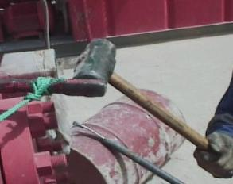
WHAT’S WRONG WITH THIS PICTURE?
____________________
____________________
____________________
____________________
____________________
____________________
____________________
____________________
____________________
____________________
____________________
____________________
____________________
____________________
____________________

Slide 15
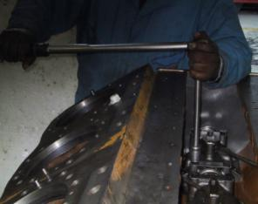
WHAT’S WRONG WITH THIS PICTURE?
____________________
____________________
____________________
____________________
____________________
____________________
____________________
____________________
____________________
____________________
____________________
____________________
____________________
____________________
____________________

Slide 16


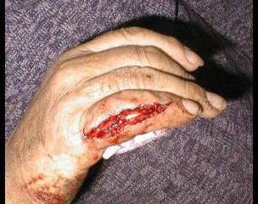
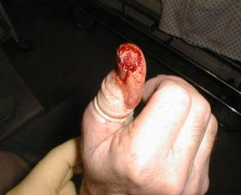
THE RESULTS!
Notes:
This slide will run automatically when slide is clicked onto this one is an attention grabber and shock tactics do work extremely well.
When the main text is showing click on the space bar to start the injuries sequence.
This slide needs to be linked to the finger injuries campaign run last year.it is important to explain to the crews that most tool injuries are to hands and fingers (this is why they are called HAND tools)
Please be sure to warn them that there are some graphic pictures on this slide

Slide 17
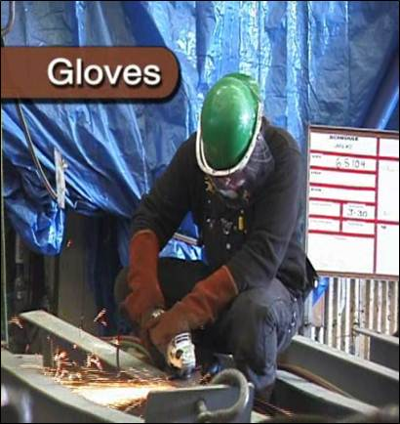
PPE
Remember, at a minimum, when working in any of the host yards in San Diego, you must wear a hard hat, safety glasses, ear plugs, and safety shoes in any production areas at all times. Other PPE may be required based on the job you are doing or the yard you are working in!

Slide 18
EXERCISE
List the hand tools and power tools you use in the shipyard
_______________
_______________
_______________
_______________
_______________
List one hazard you are exposed to for each tool listed
_______________
_______________
_______________
_______________
_______________

Slide 19
SHIPYARD PORTABLE TOOL TYPES
Hand Tools
Power Tools
Cords and Chains

Slide 20
OSHA’S MOST COMMON HAND AND POWER TOOL INJURIES
Electric shock
Flash burns
Hand and Eye injuries
Hearing loss
Crushing, cuts or losing a body part
Ergonomic injuries

Slide 21
INTRODUCTION SUMMARY EXERCISE
What are hand tools considered an extension of?
Which hand tools should be visually checked before each use?

Slide 22
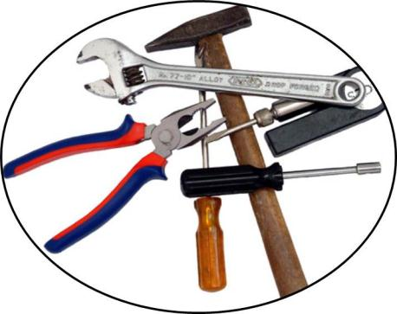
HAND TOOLS
Hammers
Knife
Wrench
Chisel
Screwdriver
Pliers
Cutters and Snips

Slide 23
HAMMER SAFETY
Although hammers appear to be the basic of tools, they can be very dangerous if not used properly and with care. A quality hammer is a safe hammer, but all hammers should be treated with care and respect. “Practice makes perfect” certainly applies to hammering.
Along with remembering to wear safety glasses for all hammering jobs, there are some other general rules to follow when maintaining a high safety level for hammering.

Slide 24
EXERCISE
List below Hammer Hazards
_______________
_______________
_______________
_______________
_______________
_______________
List below protective measures
_______________
_______________
_______________
_______________
_______________
_______________

Slide 25
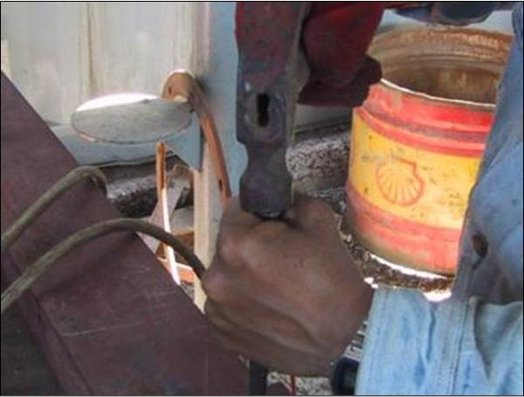
WHAT’S WRONG WITH THIS PICTURE

Slide 26

BETTER

Slide 27
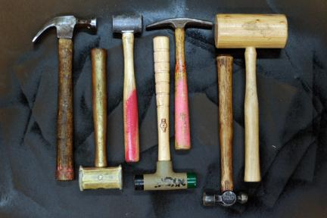
VISUAL INSPECTION
BE SURE HAMMERS:
Are not cracked or split.
Have a head that is securely attached.
Have a handle that is a sufficient length.
Have a head that is not mushroomed and/or has no cracks.
Notes:
Same as previous slide

Slide 28
HAMMER AND NAILS
Hammers and nails are made in a various types, styles and proposed use.
Metal hammer
Claw hammer
Rubber mallet
When driving a nail, the center of the hammer head should always meet the nail head.
Grip the hammer near the end of the handle -- butt end.

Slide 29
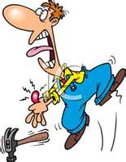
HAMMER AND NAILS HAZARDS
Misusing a hammer can cause personal injury.
Smashed finger
Inspect regularly and before use
Never use a damaged hammer.
Stay focused on the object you are
striking.
Wear Safety Glasses when using
hammers/nails.

Slide 30
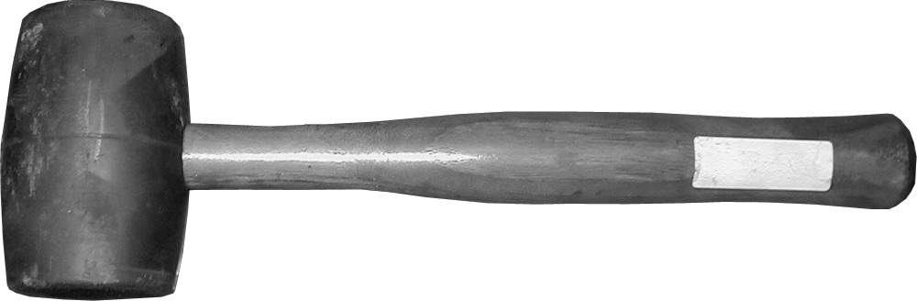
MALLETS
Mallets are a type of hammer with a large striking surface, which allows the technician to exert force over a larger area than a hammer, so as not to harm the part or component.
A rubber mallet is used to deliver a force to an object without harming the surface.

Slide 31
HAMMER RULES
Make sure the handle of the hammer fits tightly on the head.
Do not strike a hard steel surface with the steel hammer.
Do not use the hammer handle for striking and never use it as a pry bar.
Always strike the surface squarely – NO glancing blows.
Always wear safety goggles.
Never strike any hammer with or against another hammer.
Discard a hammer with a chipped or mushroomed face.
Do not use steel hammers on concrete, stone or hard metal objects.
Replace loose or cracked handles.
Discard hammers with cracked claws or eye sections.

Slide 32
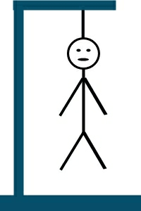
HAMMER “HANGMAN” EXERCISE
_ _ _ _ _ _ I _ _ _ _ _ _ _ _ _
Hammers:
Handles are not cracked or split
head is securely attached.
Make sure the handle is a sufficient length,
head has no cracks or no pieces missing.
Notes:
Same as previous slide

Slide 33
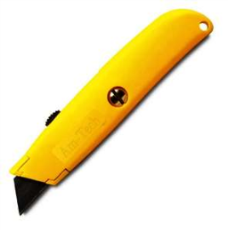
KNIFE SAFETY
The importance of using the right tool the right way applies to all tools, particularly knives. When used improperly, knives cause more disabling injuries than any other hand tool.

Slide 34
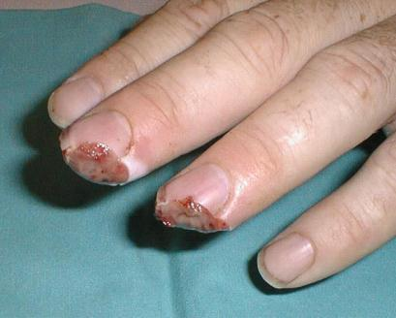
KNIFE HAZARDS
Utility Knives are a common hand tool in the shipyard. They present special hazards!

Slide 35
EXERCISE
List below Knife Hazards
_______________
_______________
_______________
_______________
_______________
_______________
List below protective measures
_______________
_______________
_______________
_______________
_______________
_______________

Slide 36
KNIFE RULES
Cut away from your body, not toward it.
If you drop your knife, let it fall. Don’t attempt to catch it.
Never run with a knife.
Don’t throw a knife to anyone. Hand it to them, handle first.
Never point a knife at anyone.
Lock the blade before each use. If it will not lock… do not use it!
Keep your knife folded or sheathed when carrying or storing.
Do not use a dull blade!
Use the right tool for the job.

Slide 37
MORE KNIFE RULES
Don’t use a knife for prying. It can cause the tip to break, possibly causing injury.
Use in a well-lit area, so you can see what you’re doing.
Do not use a knife on “live” electrical items like appliances.
Keep your knife clean, particularly the locking mechanism.
Keep your knife oiled and sharp. A sharp knife is safer than a dull one.
Don’t try fixing a Buck knife yourself. It is dangerous and voids the warranty.
If you get cut, seek first-aid immediately.
Wear gloves.
Be aware of working in a crowd. You may get bumped!

Slide 38
KNIFE EXERCISE
Stump the class!
With a partner, write two questions from this section that you believe the rest of the class will be challenged in answering correctly. (Questions must be reasonable! If your instructor can’t answer, it doesn’t count!)

Slide 39
WRENCH SAFETY
There are many ways to bang hands and skin knuckles. A common method to achieve this injury is by using the wrong wrench.
Keep wrenches in good condition by storing properly in a rack or tool box.
AGAIN, always use the right wrench for the right job.

Slide 40
EXERCISE
List below Wrench Hazards
_______________
_______________
_______________
_______________
_______________
_______________
List below protective measures
_______________
_______________
_______________
_______________
_______________
_______________

Slide 41
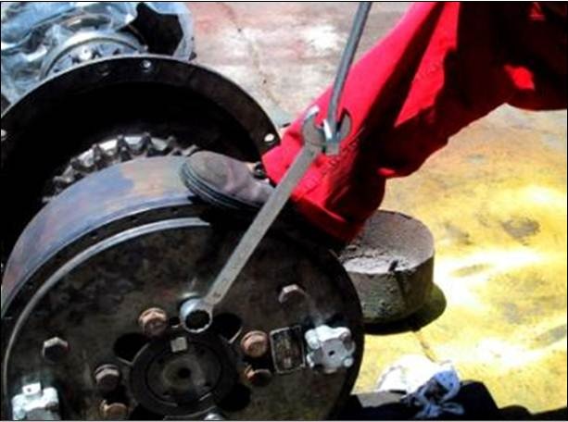
WHAT’S WRONG WITH THIS PICTURE

Slide 42
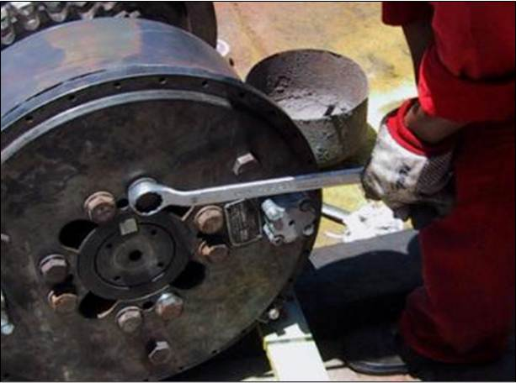
BETTER

Slide 43
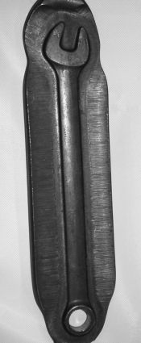
WRENCHES
Wrenches are the most used hand tool by service technicians.
Most wrenches are constructed of forged alloy steel, usually chrome-vanadium steel.

Slide 44
WRENCHES
Do
Keep in good condition
Store in proper place
Make sure wrench fits fastener
Inspect before use
Choose the right wrench for the job
Set good solid footing
Use the right size wrench for the fastener
Don’t
Use as a hammer
Use a damaged wrench
Apply too much torque

Slide 45
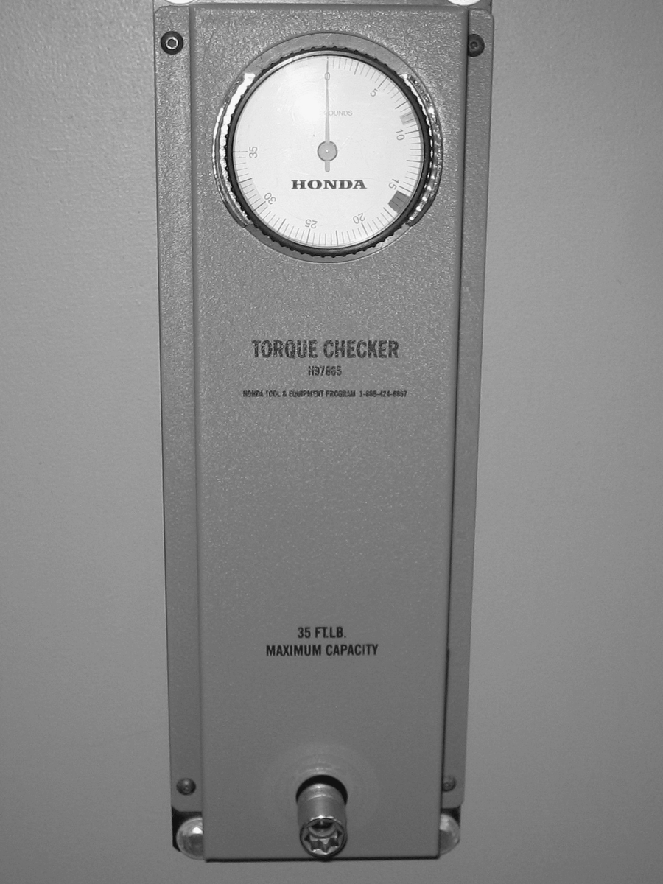
CHECK TORQUE WRENCH CALIBRATION REGULARLY
Torque wrench calibration checker
Most experts recommend that torque wrenches be checked and adjusted as needed at least every year and more often if possible. If you do not know how to calibrate a torque wrench discuss with your supervisor!

Slide 46
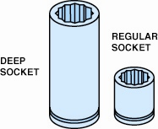
SAFE USE OF SOCKETS AND RATCHETS
Always use the proper size socket that correctly fits the bolt or nut.
All sockets and ratchets should be cleaned after use before being placed back into the toolbox.
Deep sockets allow access to the nut that has a stud plus other locations needing great depth, such as spark plugs.

Slide 47
WRENCH EXERCISE
List 3 wrench safety “Dos” and
2 wrench safety “Don’ts”
________________________________________________________________________________________________________________________________________________________________________________________________________________________________________________________________________________________

Slide 48
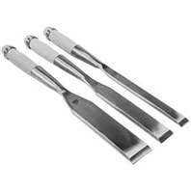
CHISEL SAFETY
A chisel has a straight, sharp cutting end that is used for cutting off rivets or to separate two pieces of an assembly.
There are many misunderstandings about chisels and chiseling. There are several types of chisels and a number of hazards are caused by misuse.

Slide 49

TYPES OF CHISELS
Stone
Concrete
Wood
Cold Chisels – used for cutting and chipping metal

Slide 50
EXERCISE
List below Chisel Hazards
_______________
_______________
_______________
_______________
_______________
_______________
List below protective measures
_______________
_______________
_______________
_______________
_______________
_______________

Slide 51
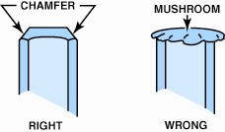
PUNCHES AND CHISELS
Use a grinder or a file to remove the mushroom material on the end of a punch or chisel.

Slide 52
CHISEL HAZARDS
Always be sure the work is secured or clamped.
Never strike a chisel with a hammer that has a loose or damaged handle.
Always strike hammer blows squarely on the chisel head.
Never use a common nail hammer to strike a cold chisel as it may chip the hammer or chisel.
Always plant your feet solidly and comfortably and balance your weight evenly.
Never use a chisel with a head that is mushroomed, chipped or badly battered.
Always leave room for your hammer swing.

Slide 53
HAND TOOLS INJURY PREVENTION
Visually Inspect Chisels:
Make sure that the chisel head has not been damaged
and is not mushroomed. The chisel blade is sharp and no visible defects are seen with no pieces missing.
Always use the right chisel for the job.
Be sure the chisel has a sharp, properly ground cutting edge to perform the job most efficiently and safely.
Always wear Safety Goggles.
Notes:
Same as previous slide

Slide 54
CHISEL EXERCISE
What is a key difference between a “Cold Chisel” and a “Stone Chisel”?
________________________________________________________________________________________________________________________________________________________________________________________________________________________________________________________________________________________

Slide 55
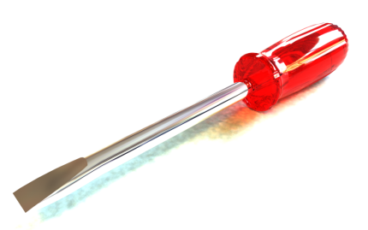
SCREWDRIVERS
Many smaller fasteners are removed and installed by using a screwdriver.
The most commonly used screwdriver is called a flat tip or straight blade.
A flat-tip (straight blade) screwdriver--the width of the blade should match the width of the slot in the fastener being loosened or tightened.

Slide 56
EXERCISE
List below Screwdriver Hazards
_______________
_______________
_______________
_______________
_______________
_______________
List below protective measures
_______________
_______________
_______________
_______________
_______________
_______________

Slide 57
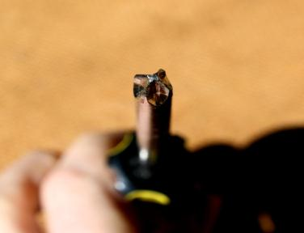
SCREWDRIVERS DOS & DON’TS
Do
Make sure the tip fits the slot – not too loose or tight
Don’t
Use as a chisel
Use for prying, punching, scoring or scraping
Use on a work piece held in your hand
Expose to excessive heat or cold
Depend on handle or covered blade to insulate from electricity
Use with a worn or broken handle

Slide 58
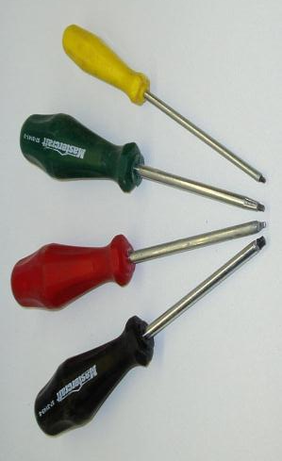
COMMON SCREWDRIVERS

Slide 59
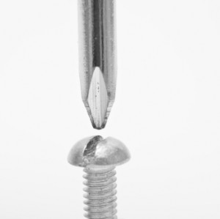
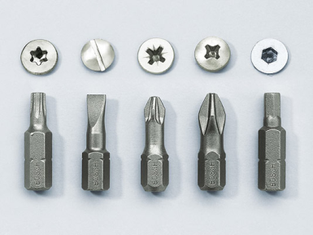
USE THE PROPER SCREWDRIVER!

Slide 60
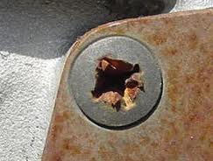
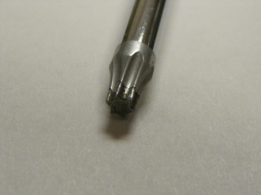
STRIPPED SCREWS AND DRIVER HEADS

Slide 61
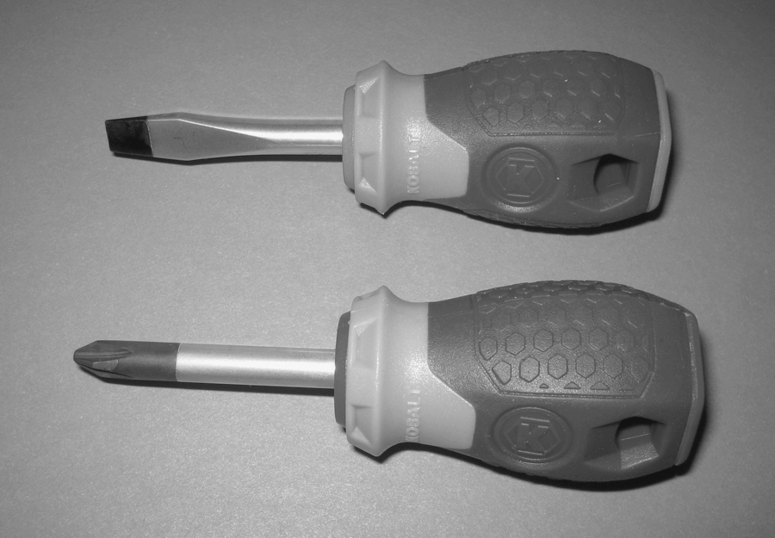
SCREWDRIVERS
Both straight blade and Phillips screwdrivers are available with a short blade and handle for access to fasteners with limited room.
Two stubby screwdrivers that are used to access screws that have limited space above.
A straight blade is on top and a #2 Phillips screwdriver is on the bottom.

Slide 62
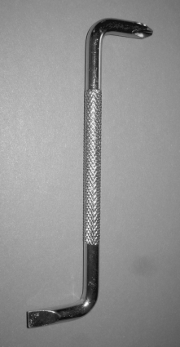
OFFSET SCREWDRIVERS
An offset screwdriver is bent at the ends and is used similar to a wrench.
An offset screwdriver is used to install or remove fasteners that do not have enough space above to use a conventional screwdriver.

Slide 63
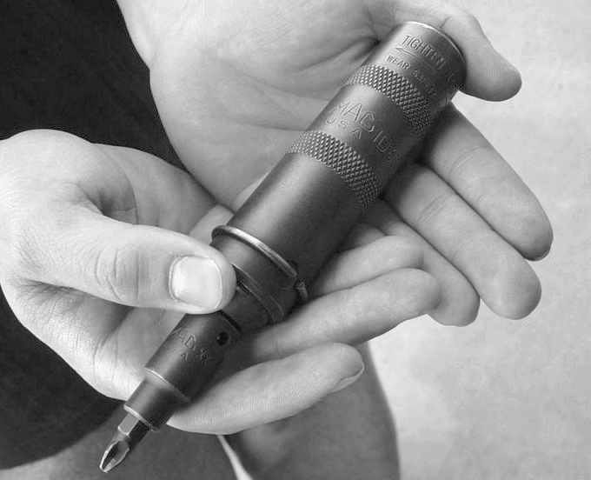
IMPACT SCREWDRIVER
An impact screwdriver is used to break loose or tighten a screw.
A hammer is used to strike the end after the screwdriver holder is placed in the head of the screw and rotated in the desired direction.
An impact screwdriver used to remove slotted or Phillips head fasteners that cannot be broken loose using a standard screwdriver.

Slide 64
SCREWDRIVER EXERCISE
Which type of screwdriver can you use as a chisel?
________________________________________________________________________________________________________________________________________________________________________________________________________________________________________________________________________________________________________________________________

Slide 65
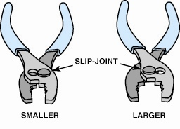
SLIP-JOINT PLIERS
Pliers are capable of holding, twisting, bending, and cutting objects and are an extremely useful classification of tools.
Typical slip-joint pliers, which are also common household pliers.
The slip joint allows the jaws to be opened to two different settings.

Slide 66
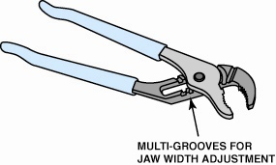
MULTI-GROOVE ADJUSTABLE PLIERS
For gripping larger objects, a set of multi-groove adjustable pliers is a commonly used tool of choice by many service technicians.
Multi-groove adjustable pliers are known by many names, including the trade name “Channel Locks”.

Slide 67
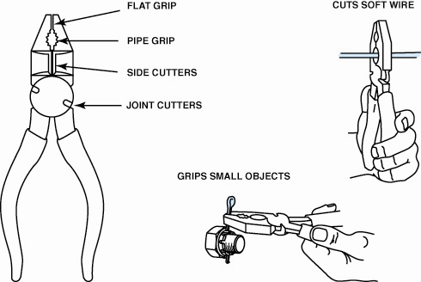
LINESMAN’S PLIERS
A linesman’s pliers are very useful because they can help perform many automotive service jobs.

Slide 68
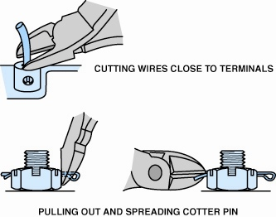
DIAGONAL PLIERS
Diagonal pliers are designed for cutting only.
The cutting jaws are set at an angle to make it easier to cut wires.
Diagonal-cut pliers are another common tool that has many names.

Slide 69
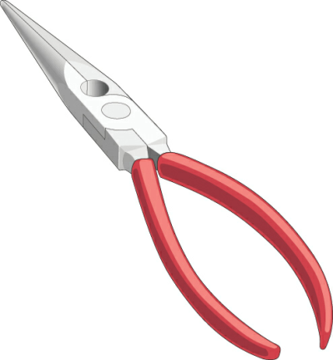
NEEDLE-NOSE PLIERS
Needle-nose pliers are designed to grip small objects or objects in tight locations.
Needle-nose pliers have long, pointed jaws, which allow the tips to reach into narrow openings or groups of small objects.
Needle-nose pliers are used where there is limited access to a wire or pin that needs to be installed or removed.

Slide 70
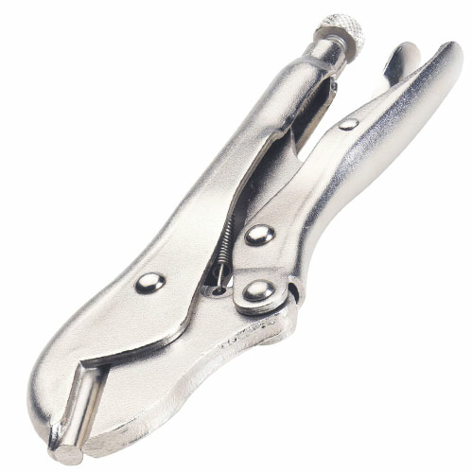
LOCKING PLIERS
Locking pliers are adjustable pliers that can be locked to hold objects from moving.
Locking pliers are best known by their trade name Vise Grips®.

Slide 71
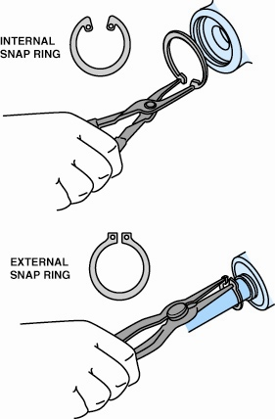
SNAP-RING PLIERS
Snap-ring pliers are used to remove and install snap rings.
Snap-ring pliers are also called lock-ring pliers and are designed to remove internal and external snap rings (lock rings).

Slide 72
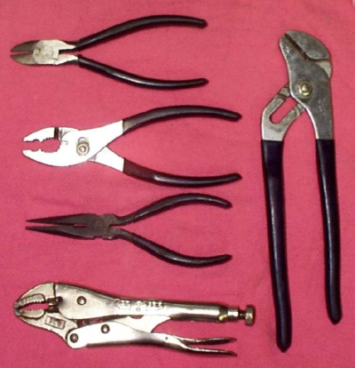
PLIERS QUIZ
Let’s have this quiz. Draw a line from the pliers to the proper description/use.
Slip-joint
Needle Nose
Multi-groove/Channel Lock
Diagonal
Vise Grip/Locking

Slide 73
CUTTERS AND SNIPS
Service technicians are often asked to fabricate sheet metal brackets or heat shields and need to use one or more types of cutters available.
The simplest is called tin snips, which are designed to make straight cuts in a variety of materials, such as sheet steel, aluminum, or even fabric.

Slide 74
EXERCISE
List below Cutter Hazards
_______________
_______________
_______________
_______________
_______________
_______________
List below protective measures
_______________
_______________
_______________
_______________
_______________
_______________

Slide 75
CUTTERS & SNIPS DOS & DON’TS
Do
Always wear safety glasses
Be careful of sharp edges
Wear gloves when working with snips
Oil pivot bolt occasionally
Use only hand pressure
Keep nut and bolt properly adjusted
Use for soft metal only
Use the right size and type for the job
Don’t
Use cheater bars
Use as a hammer, screwdriver or pry bar
Spring the blades. (caused by cutting metal that is too thick)
Try to cut curves with straight cut snips

Slide 76
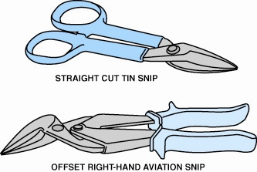
SNIPS
Tin snips are used to cut thin sheets of metal or carpet.

Slide 77
CUTTERS AND SNIPS EXERCISE
What type of snips are used to cut tin?
What bolt should be oiled occasionally?

Slide 78
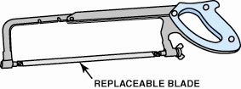
HACKSAWS
A hacksaw is used to cut metals, such as steel, aluminum, brass, or copper.
The cutting blade of a hacksaw is replaceable and the sharpness and number of teeth can be varied to meet the needs of the job.
If cutting sheet metal or thin objects, a blade with more teeth should be used.

Slide 79
HAND TOOL MAINTENANCE
Most hand tools are constructed of rust-resistant metals but they can still rust or corrode if not properly maintained.
For best results and long tool life, the following steps should be taken:
Clean each tool before placing it back into the tool box.
Keep tools separated.
Line the drawers of the tool box with a material that will prevent the tools from moving as the drawers are opened and closed.
Release the tension on all “clicker-type” torque wrenches.
Keep the tool box secure.

Slide 80
WHAT THE REGULATIONS SAY ABOUT HAND TOOLS
Employers shall not issue or permit the use of unsafe hand tools
Wrenches, including adjustable, pipe, end, and socket wrenches shall not be used when jaws are sprung to the point that slippage occurs
Impact tools, such as drift pins, wedges, and chisels, shall be kept free of mushroomed heads
The wooden handles of tools shall be kept free of splinters or cracks and shall be kept tight in the tool

Slide 81
PERSONAL PROTECTIVE EQUIPMENT (PPE)
Employer
Access workplace for hazards.
Provide PPE.
Determine when to use.
Provide PPE Training for employees and instruction on proper use.
Employee
Use PPE in accordance with training received and other instructions.
Inspect daily and maintain in clean and reliable condition.

Slide 82
EXAMPLES OF PPE
Body Parts | Protection
Eye | Safety Glasses, Goggles
Face | Face Shields
Head | Hard Hats
Feet | Safety Shoes
Hands and Arms | Gloves
Bodies | Vests
Hearing | Earplugs, Earmuffs

Slide 83

POWER TOOLS
General Safety
Grinder and
Wheels
Drill
Sawzall

Slide 84
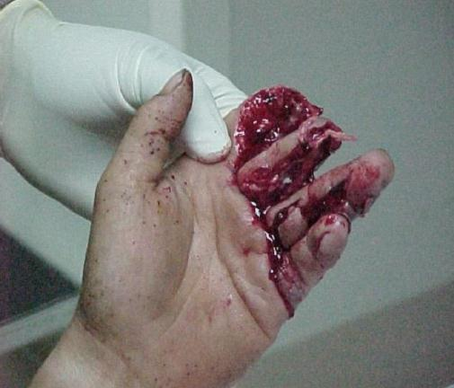
GENERAL SAFETY
Working with power tools, you can get an electric shock, lose a finger, lose an eye, or go deaf. It's especially dangerous to use a tool that's defective, that's been modified, or that's not designed for the job. Of course, you can also get injured if you use any tool carelessly.

Slide 85
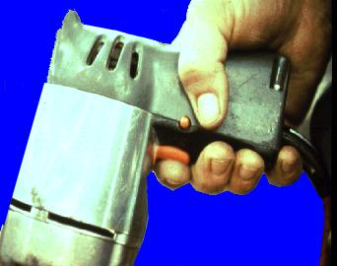
TYPES
The types of power tools are determined by their power source.
Electric
Pneumatic
Liquid Fuel
Hydraulic
Powder-Actuated

Slide 86
SWITCHES
Hand-held power tools must be equipped with one of the following:
A constant pressure switch, which shuts off power upon release (circular saw, chain saw, grinder, hand-held power drill).
On-off switch (routers, planers, laminate trimmers, shears, jig saws, nibblers, scroll saws).

Slide 87
POWER TOOL PRECAUTIONS
Disconnect tools when not in use, before servicing and cleaning, and when changing accessories.
Keep people not involved with the work away from the work.
Secure work with clamps or a vise, freeing both hands to operate the tool.
Don’t hold the switch button while carrying a plugged-in tool.
Keep tools sharp and clean.
Remove damaged electric tools & tag them: “Do Not Use”.
Check electrical cords for damage and insure electrical tool cords are double insulated and/or have a ground prong.

Slide 88
MORE POWER TOOL PRECAUTIONS
Operate within design limits
Use gloves and safety shoes
Store in a dry place
Don’t use in wet locations unless approved for that (use GFCI)
Keep work areas well lit
Ensure cords don’t present a tripping hazard

Slide 89
GENERAL POWER TOOL SAFETY EXERCISE
Stump the class!
With a partner, write two questions from this section that you believe the rest of the class will be challenged in answering correctly. (Questions must be reasonable! If your instructor can’t answer it doesn’t count!)

Slide 90
GRINDERS
Types of Grinders
Hand Grinder
Pedestal Grinder
Abrasive Wheels

Slide 91
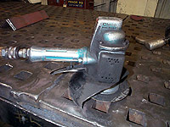
GRINDERS
Ancient man sharpened tools and weapons by rubbing them with a stone.
Modern man uses the same principle by using a grinder. It is one of the most common and useful tools we have.
Without the grinder, our level of efficiency and production would not be possible.

Slide 92

WHAT HAPPENED?

Slide 93
EXERCISE
List below Grinder Hazards
_______________
_______________
_______________
_______________
_______________
_______________
List below protective measures
_______________
_______________
_______________
_______________
_______________
_______________

Slide 94
GENERAL GRINDER SAFETY
Guards and shields in proper place
The tongue guard should be less than ¼ inch from the wheel
Work rests must be adjusted to a maximum opening of 1/8 inch between the wheel and the rest
Inspect and ring-test wheels before mounting to ensure that they are free from cracks or defects.
Wear PPE
Good lighting
Do NOT leave grinder unattended
Do NOT operate beyond recommended speed
Do NOT operate a wheel that is NOT mounted securely

Slide 95
HAND GRINDER
Hand-held grinders are another common tool in the shipyard.
They are also one of the most abused, or misused tools.
While grinders come in many different shapes and sizes, they require specific handling procedures.

Slide 96
HAND GRINDER DOS AND DON’TS
Do
Use guards and shields
Use adapters provided by manufacturer
Start on or near the material
Stop on the material
Give defective tools to your supervisor who will take the tool out of service.
Don’t
Modify by adding nuts, washers, changing the shape of the guard
Move or set the grinder down while moving
Use while standing in water!
Use a wheel that has a maximum rpm < the speed of the motor.

Slide 97
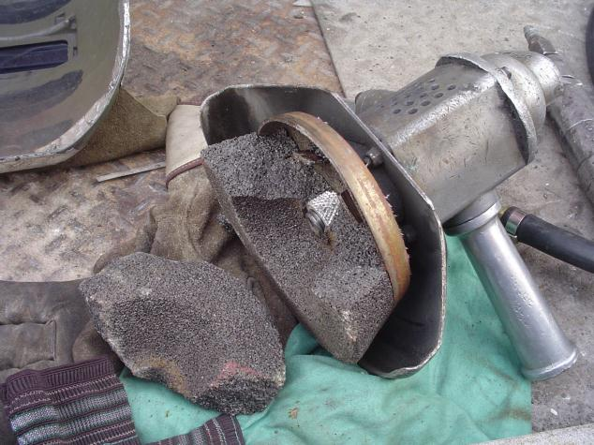
WHAT HAPPENED?

Slide 98

ABRASIVE WHEELS
Abrasive wheels may throw off fragments. It is important to equip guards that:
Cover the spindle end, nut, & flange projections
Maintain proper alignment with the wheel
Don’t exceed the strength of the fastenings
Guard so that a minimal amount
of the wheel is exposed!

Slide 99

INSPECTING ABRASIVE WHEELS
Before mounting you should:
Inspect closely for damage
Perform a sound or ring test to ensure free from cracks and defects
To test, tap wheel gently with a light, non-metallic instrument. If wheel sounds cracked or dead, do not use it because it could fly apart!
Notes:
1926.303 (c)(7)
A stable and undamaged wheel when tapped will give a clear metallic tone or “ring.”

Slide 100

PREVENTING WHEEL CRACKING
Fit the wheel freely on the spindle
Tighten the spindle nut enough to hold the wheel in place without distorting the flange
Let the tool come up to speed prior to grinding or cutting
Don’t stand in front of the wheel as it comes up to full speed
Use eye and/or face protection
Ensure the spindle speed doesn’t exceed the maximum speed marked on the wheel!
Notes:
1926.303 (c)(8), 1926.303 (c)(9)

Slide 101
GRINDER “HANGMAN” EXERCISE
1. _ _ _ _ _ _ _ _
2. _ _ _ _ _ _ AND _ _ _ _ _ _ _
Notes:
Same as previous slide

Slide 102

DRILL SAFETY
A drill motor is a high speed and very powerful tool.
A slight error when using a drill can quickly result in an injury.

Slide 103
EXERCISE
List below Drill Hazards
_______________
_______________
_______________
_______________
_______________
_______________
List below protective measures
_______________
_______________
_______________
_______________
_______________
_______________

Slide 104
DRILL SAFETY DOS
Before you pull the trigger, follow these tips:
Inspect before use.
Ensure bits are sharp, true and in good condition.
Unplug the drill motor before changing or removing bits. The drill motor can turn on with the chuck key in place and cut/rap your hand.
Always mount the chuck key at the end of the power cable just above the plug.
Grip firmly and hold tightly – especially when using larger bits.
Remove the plug from the outlet. Never disconnect the power by pulling on the cord. Be sure the switch is “OFF”.
Plan your task and know what’s on the other side of the hole.
Let the drill bit do the work. Do not apply extra pressure to gain speed.

Slide 105
MORE DOS!
Vary the pressure and don’t let the drill bind.
Slower speeds for thicker wood and high speed for metals.
Withdraw the bit often while drilling to remove chips.
Brush chips away. Don’t blow on them and they could end up in your eyes.
Use a side handle and hold the drill firmly with both hands.
Take your time!!!
Maintain your drill and bits.
Clamp and secure whatever your working on as a general rule.
Mark the center of the hole or use a center punch to mark it. Then place the drill in the center of the hole.
Predrill holes for woodscrews.
Start slowly and slowly increase speed.

Slide 106
DRILL EXERCISE
How often should you inspect a drill?
Regardless of the job, should you predrill all holes?

Slide 107

SAWZALL
The Sawzall, electric power hand saw, is a common and useful tool.
It is so common that hazards in using it are often overlooked.

Slide 108
EXERCISE
List below Sawzall Hazards
_______________
_______________
_______________
_______________
_______________
_______________
List below protective measures
_______________
_______________
_______________
_______________
_______________
_______________

Slide 109

SAWZALL COMMON INJURIES
Cut by saw blade
Electric shock or burn
Falls from tripping over extension cord
Flying particles in eye from materials being cut
Hit by saw falling or when dropped while being used or carried

Slide 110
SAWZALL DOS
Wear eye protection
Ensure guard is working
Wait until the blade stops before lifting
Keep your head away from the path of cut particles
Blow sawdust away from time-to-time…especially from the guard
Place material to be cut on a firm rest
Avoid damaging the electric cord

Slide 111
SAWZALL DON’TS
Remove the blade guard with which your unit is equipped.
Carry by the switch trigger with your finger
Place material or equipment on cords.
Grab the saw by the front metal parts. This can result in electrical shock if you accidentally cut into live electrical wires when sawing into walls or floors.
Use the saw if the handle is cracked or broken. Electrical shock could occur if you touched anything metal that is grounded.
Place materials on your hand, arm or knee.
Use the saw if you or the reciprocal saw are wet or while standing on a damp or wet surface.

Slide 112
MORE DON’TS
Reach under your work while the blade is moving.
Use the unit if the cord shows any sign of damage. Maintain a safe distance at all times between the cord and the machine.
Use strong solvents, brake fluids, gasoline, or petroleum-based products to clean your reciprocating saw. Using a clean cloth when cleaning will keep the handles dry and avoid a buildup of grease and oil.

Slide 113
SAWZALL FINAL WORDS
REMEMBER!
An old saying goes: “Measure twice, cut once.”
When working with a reciprocating saw, you might want to add a few words:
“Think thrice, measure twice, and cut once.”

Slide 114
SAWZALL EXERCISE
Stump the class!
With your partner, write two questions from this section that you believe the rest of the class will be challenged in answering correctly. (Questions must be reasonable! If your instructor can’t answer it doesn’t count!)

Slide 115

CORDS AND CHAINS TYPES
Power Cords
Stringer Lights
Explosion-Proof Lighting
Chain Falls & Come-Alongs

Slide 116
CORDS AND CHAINS
Cords and chains are common in the shipyard. List the types of cords and
chains that you work with in the shipyard.
Cords
_______________
_______________
_______________
_______________
_______________
_______________
Chains
_______________
_______________
_______________
_______________
_______________
_______________

Slide 117
POWER CORDS
Power cords, also known as Extension Cords, are designed to be convenient. But, they can become a dangerous hazard.
All extension cords should be UL-approved and meet electrical code specifications. There are cords for use outdoors. These are entirely different construction than extension lamp cords used indoors.
To use extension cords properly, it is necessary to know what kind of cord should be used for the particular application.
Only use 18-gauge or greater on board a Navy ship.
AGAIN – use the right tool for the right job!

Slide 118

A POWER CORD DON’T!
Don’t carry portable tools by the cord!

Slide 119
MORE POWER CORD DOS & DON’TS
Do
Use the right cord
Inspect the cord
Keep in good condition
Hang cords to avoid tripping hazard
Keep cords away from heat, oil and sharp edges
Remove damaged cords from service!
Don’t
Jerk the cord
Let the cords cross aisles or walkways
Yank cord to disconnect it
Carry power tools by the cord
Use if:
Frayed - Punctured
Kinked - Cracked

Slide 120

STRINGER LIGHTS
Light Stringers are used to provide adequate lighting in “darkness”.
Broken or missing bulbs are very dangerous and the same as using an extension cord with bare wires.
Never use a stringer light as an extension cord!

Slide 121
EXERCISE
List below Lighting Hazards
_______________
_______________
_______________
_______________
_______________
_______________
List below protective measures
_______________
_______________
_______________
_______________
_______________
_______________

Slide 122

STRINGER LIGHTS DOS
Make sure stringer lights are in good condition.
Ensure an unbroken bulb is in every socket.
Be sure that each bulb shall be protected by a cage.
Hang stringers from the overhead using non-conductive material ONLY. Nylon strapping or small diameter manila rope is the preferred material.
Carry a flashlight! Even when stringer lights are installed.

Slide 123
EXPLOSION PROOF LIGHTING
When mechanical cleaning or other work NOT INVOLVING SPRAY PAINTING, stringer lights and florescent tubes are acceptable.
When spray painting or performing work that may create an explosive atmosphere, the stringers and florescent lights MUST BE UNPLUGGED.

Slide 124
EXPLOSION PROOF LIGHTING
Light stringers are NOT explosion proof.
Florescent lights are NOT explosion proof.
Remove stringer lights while spray painting – They are an ignition source and have caused explosions, fires and death!
ONLY explosion proof lights can be used while spray painting.
Always carry a flashlight!

Slide 125
POWER CORD AND LIGHTING EXERCISE
Can you use a stringer as an extension cord if it is 18-gauge?
How should you carry a power tool?

Slide 126
CHAIN FALLS AND COME ALONGS
Heavy material is often into position using a hand-powered hoist called a chain fall.
Chain falls work on the pulley principle, allowing one person to slowly lift hundreds of pounds.
A come-along is a hand- operated, ratchet-lever winch.
It is used for stretching, lifting, straightening and as a safety tie.

Slide 127


CHAIN FALLS AND COME ALONGS
Chain Fall
Come Along

Slide 128
EXERCISE
List below Chain Fall/Come Along
Hazards
_______________
_______________
_______________
_______________
_______________
_______________
List below protective measures
_______________
_______________
_______________
_______________
_______________
_______________

Slide 129
CHAIN FALLS & COME ALONGS
Safe rigging operations require the proper use of chain falls and come alongs. These devices should be used for straight pulls ONLY.
The manufacturers inform us that using the device’s chain for a choker is unsafe. The chain is designed for straight pulls ONLY.
Using the chain as a choker weakens the chain and could cause it to fail.

Slide 130
CHAIN FALLS & COME ALONGS DOS
Be certain the hook latch is closed and not supporting any part of the load.
Operate only centered load
Handle the equipment carefully. A lot of equipment is damaged by dropping.
Protect the load chain from weld spatter
Be sure the load slings or attachments are the right size and seated in the hook saddle
Clear workers from suspended load.
Operate within Safe Working Limit - SWL
Report damage immediately
Be familiar with controls, procedures and warnings
Lift load ONLY if the chain is properly seated in the wheels or sprockets
Protect the load chain from spatter and electrode contact.

Slide 131
CHAIN FALLS & COME ALONGS DON’TS
Lift loads over people
Use a hoist that is twisted, kinked, damaged or worn
Swing the load or load hook
Allow the chain or hook to be used as a ground for welding
Use an extension on come along handles

Slide 132
CHAIN FALL AND COMEALONG “HANGMAN” EXERCISE
1. _ _ _ _ _
2. _ _ _ _ _
Notes:
Same as previous slide

Slide 133

POST-TEST
This material was produced under grant SH-22239-11-60-F-6 from the Occupational Safety and Health Administration, U.S. Department of Labor. It does not necessarily reflect the views or policies of the U.S. Department of Labor, nor does mention of trade names, commercial products or organizations imply endorsement by the U.S. Government.

Slide 134
WHAT I WILL DO DIFFERENTLY
Based on what I learned I will take the following actions:
___________________________________
___________________________________
___________________________________
___________________________________
___________________________________
___________________________________
___________________________________
This material was produced under grant SH-22239-11-60-F-6 from the Occupational Safety and Health Administration, U.S. Department of Labor. It does not necessarily reflect the views or policies of the U.S. Department of Labor, nor does mention of trade names, commercial products or organizations imply endorsement by the U.S. Government.

