Slide 1
Sawmill Safety
Module 2 –
Debarking, Primary and Secondary Breakdown

Slide 2
Timber Products Safety
There is a high incidence of serious and fatal injuries in our industry.
The Timber Products Manufacturers Association along with your employer recognizes the need for improved safety training for the industry.
With a grant from OSHA, TPMA has developed the following training module to contribute toward the need for improved safety training and hazard recognition skills for those employed in America’s timber industry.

Slide 3
This Training Module
Uses adult learning techniques
Photos and video of actual practices at sawmills
Interviews with experienced timber industry workers
Short interactive exercises
New techniques for recognizing hazards

Slide 4
Training Module Worksheet
Since adults learn the most by doing, a worksheet has been prepared to help you retain the most important information.
You will complete the worksheet as we move through the material. This means that you will fill in the blanks or complete lists.
You keep the worksheet as a reference to the key points presented in this module.

Slide 5
Safety:
A process for reducing risk and preventing incidents by effectively managing the movement of people, equipment, material and energy.
Notes:
Let’s get started with a functional definition of safety. It is called a functional definition because it is easy to remember and is fundamental to incident prevention. “Safety is a process for reducing risk and preventing incidents by effectively managing the movement of people, equipment, material and energy”. There are some key words in this definition. The first one is movement. No injury or incident has ever occurred without some form of movement. The other key words are people, equipment, material and energy. They are key because they are the only four things that can move. Think about it, if we were able to effectively control the movement of people, equipment, material and energy in our process, we would have no injuries or incidents.

Slide 6
Incident:
An unplanned event that happens after an unsafe behavior or unsafe condition or both that interrupts the normal progress of an activity and may result in injury or damage.
Notes:
An incident is an unplanned event that happens after an unsafe behavior or unsafe condition or both that interrupts the normal progress of an activity and may result in injury or damage. Three bad things can happen when incidents occur. Someone may be injured, equipment may be damaged or the process may be interrupted. All three are unnecessary, expensive and in one way or another painful. The most important thing to remember is that before every incident there is an unsafe behavior or unsafe condition or a combination of the two. If you wanted to be proactive and prevent incidents, What would you do? I think we can all agree that we would focus on the elimination of unsafe behaviors and unsafe conditions because they always happen before an incident

Slide 7
Hazard:
Any source of danger.
The two major types of hazard are:
Unsafe conditions
and
Unsafe behaviors
Notes:
This is a very simple definition of hazard. A hazard is any source of danger. There are two major types of hazard – unsafe conditions and unsafe behaviors. Incidentally, when we talk about unsafe behaviors we are looking at behavior in the scientific sense – an observable action.

Slide 8
A sequence of events lead to incidents
The Hazards
(Unsafe Behaviors and Unsafe Conditions)
The Event
(Movement)
The Result
(Incident)

Slide 9
What is the Best Way to Prevent Incidents?
Recognize the Hazards
Manage the Movement of People, Equipment, Material and Energy
Notes:
First of all recognize the hazards. Once the hazards are recognized there is an opportunity to manage the movement of people, equipment, material and energy. The objective is to separate people from the hazards in an organized and controlled manner.

Slide 10
Manage the Movement
All incidents are initiated with movement. Either the person moves to the hazard or the hazard moves to the person.
Notes:
Remember that all incidents begin with some form of movement. Either the person moves to the hazard or the hazard moves to the person in an uncontrolled or disorganized environment.

Slide 11

What is the Best Way to Protect Yourself?
Manage Your Movement
Your Family Needs You

Slide 12
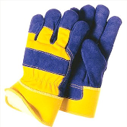
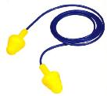
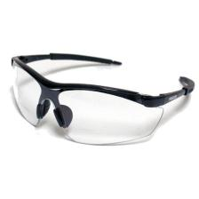
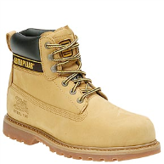

Basic Personal Protective Equipment for Sawmill Workers
Ear Plugs
Gloves
Hard Hat
Safety Glasses
Steel Toed Boots

Slide 13
Sawmill Flow Chart
Log Stage
Debarking
Cutoff Saw
Bandmill
Or
Gang Saws
Headrig

Slide 14
Presenting – “The Sawmill Symphony”*
(Video removed)

Slide 15
#1 Potential for Serious Injury in the Sawmill
The number one potential for serious injury in a sawmill in terms of severity is being caught in – on - or - between the mechanical movement of equipment.

Slide 16
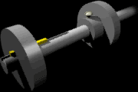
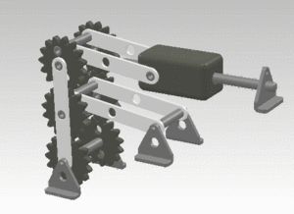

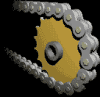
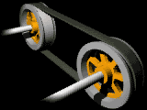
Hazardous Mechanical Movement
Rotating
Reciprocating
In running Nip
Transverse

Slide 17
Event Classification
Contact with objects and equipment.
Caught in, on or between
(Amputations, fractures, crushing injuries etc....)

Slide 18
What you can do to avoid being caught, in or between
Do not climb over guard rails.
Do not wear loose fitting clothing.
Do not operate equipment that is not properly guarded.
Don’t climb on or over conveyors.
Stay out of restricted areas.
Follow specific procedures when clearing jams.

Slide 19
Small Group Exercise
Employee‘s Finger Is Amputated By Chain And Sprocket
Accident: 201179116 -- Report ID: 0950621
On January 11, 2006, Employee #1, working in a sawmill, was cleaning out a jam of saw dust in the chute area of the tail drum, when Employee #2 came to help complete the job. Employee #2 was kneeling under the chain and sprocket, clearing the chute of material. Employee #2 finished, proceeded to stand up, lost his balance, and while falling, grabbed the moving chain on the tail drum. The moving chain pulled his left hand into the sprocket and unguarded hazardous nip point between the chain and the sprocket. The top digit of Employee #2's left ring finger was completely amputated. He was hospitalized for his injury.

Slide 20
Small Group Exercise
Employee‘s Finger Is Amputated By Chain And Sprocket
Accident: 201179116 -- Report ID: 0950621
On January 11, 2006, Employee #1, working in a sawmill, was cleaning out a jam of saw dust in the chute area of the tail drum, when Employee #2 came to help complete the job. Employee #2 was kneeling under the chain and sprocket, clearing the chute of material. Employee #2 finished, proceeded to stand up, lost his balance, and while falling, grabbed the moving chain on the tail drum. The moving chain pulled his left hand into the sprocket and unguarded hazardous nip point between the chain and the sprocket. The top digit of Employee #2's left ring finger was completely amputated. He was hospitalized for his injury.

Slide 21
#2 Potential for Serious Injury in the Sawmill
The number two potential for serious injury in a sawmill in terms of severity is being struck by.

Slide 22
Event Classification
Contact with objects and equipment.
Struck by
(Fractures, punctures, foreign bodies in eye, amputations etc....)

Slide 23

Damaged Sheet Metal Wall

Slide 24
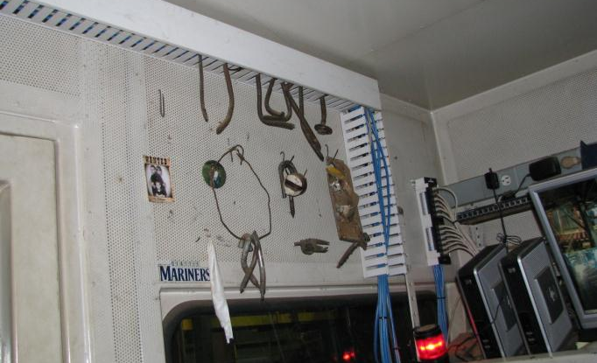
Foreign Object Collection
Hazardous objects can be embedded in logs. Manage your movement and positioning around active operations.

Slide 25
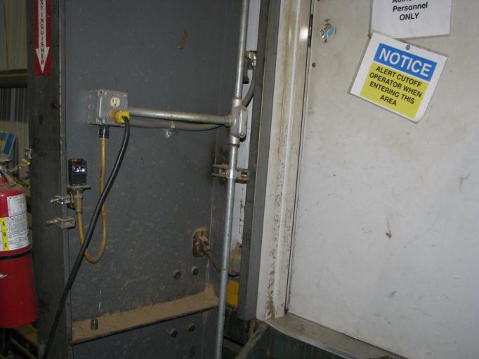
Follow The Rules

Slide 26
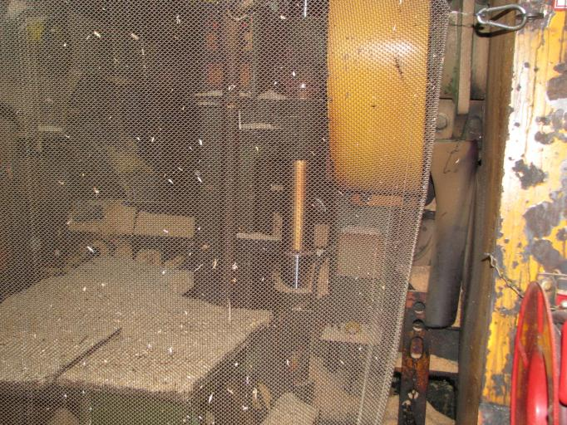
Chain Mail Guard

Slide 27
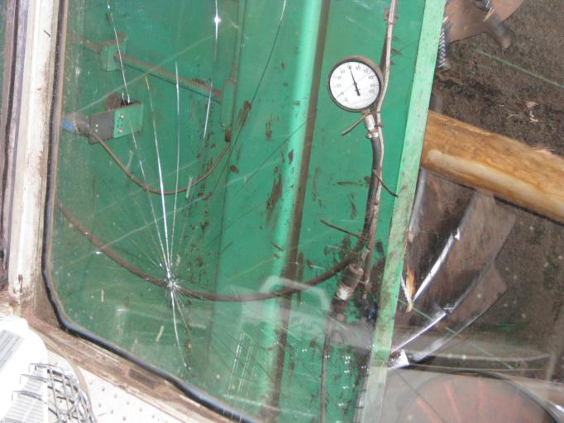
Cracked Protective Window

Slide 28
Employee Struck By Piece of Log
On July 25, 2007, an employee was observing the operation of two unloader arms of a chop saw while standing on a catwalk located about 15 feet away from the saw. A piece of log was picked up by the saw and rotated around the forward side of the saw, throwing it back toward the employee. He was struck in the face and chest and sustained serious injuries. He died two days later.

Slide 29
What you can do to avoid being struck by
Wear the required PPE.
Follow the rules.
Stay behind barriers.
Stay out of the line of fire.
Make sure guards are in place before operating equipment.

Slide 30
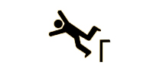
Event Classification
Falls
Fall lower level
(Fatality, head injuries, spinal cord injuries, dislocations, multiple fractures etc....)

Slide 31
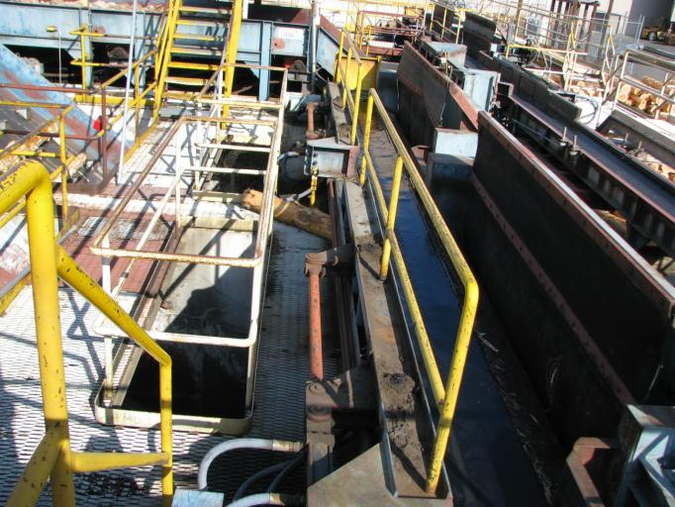
Stairways, Platforms and Floor Openings

Slide 32
So What’s The Problem?
Accident: 201176302 – Employee Fractures Back In 12 ft Fall Into Bin
On October 8, 2004, Employee #1. a sawmill laborer, was working as a Bin Chaser on a lumber sorting machine. He left the walkway and climbed into the bin sorter area to un-jam a board. He fell approximately 12 feet to the floor and fractured bones in his back.

Slide 33
What you can do to avoid falling to a lower level
Stay on engineered stairs, walkways and platforms.
Do not climb over or on guard rails.
Wear fall protection equipment when it is required.

Slide 34
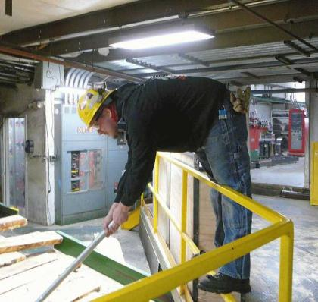
Three Strikes and Maybe His Back Will go Out Too!

Slide 35
Event Classification
Contact with objects and equipment.
Struck against
(Cuts, bruises, fractures, punctures etc....)
Notes:
The American National standard for Information Management for Occupational Safety and Health provides a classification structure for 46 different events and exposures. We are going to take a look at seven of those events and exposures that occur most frequently at sawmills from the arrival of logs to decking . Remember the key words in the definition of safety – well the key word movement is demonstrated well in each event classification that we will discuss. As a matter of fact, I want you to begin thinking of every event classification as some form of movement. The first event classification that we will discuss is STRUCK AGAINST. What movement is involved in this event classification? (The person moves into an object). Generally, the energy involved in struck against events is limited to what the person can generate in movement. Struck Against events produce injuries such as cuts, bruises, fractures and punctures.

Slide 36
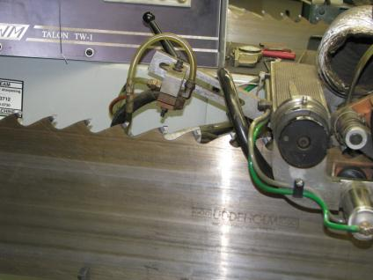
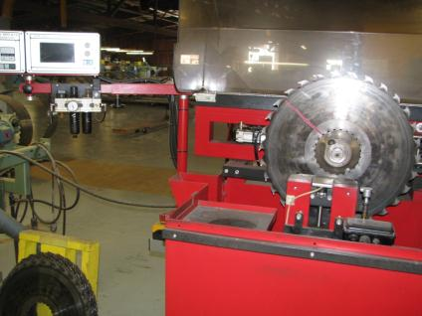
Strike Against Sharp Edges #1

Slide 37
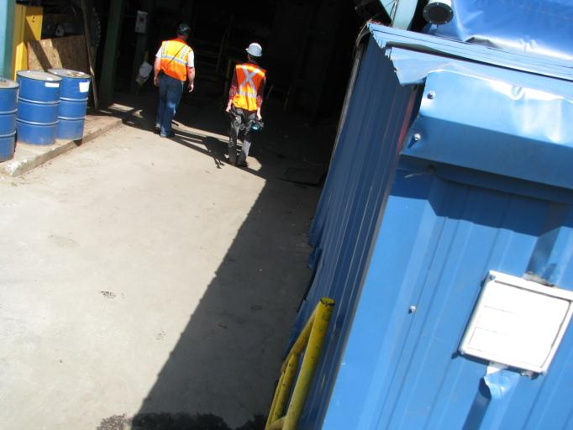
Strike Against Sharp Edges #2
Sharp edges of building at top of stairway

Slide 38
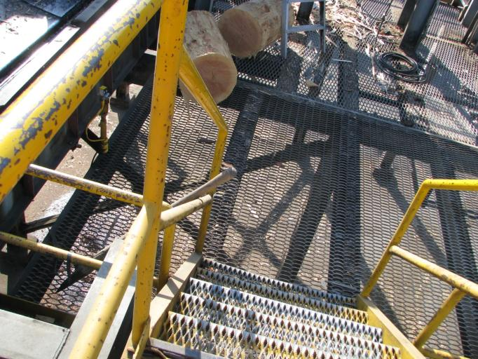
Strike Against Stairway Obstruction

Slide 39
What you can do to avoid striking against something
Look in the direction of travel
Return tools and equipment to their proper storage area
Be alert to changing conditions

Slide 40
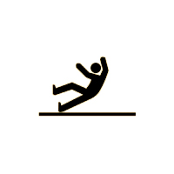
Event Classification
Falls
Fall same level
(Fractures, dislocations, sprains, strains, head injuries etc....)

Slide 41
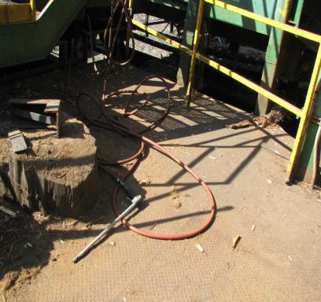
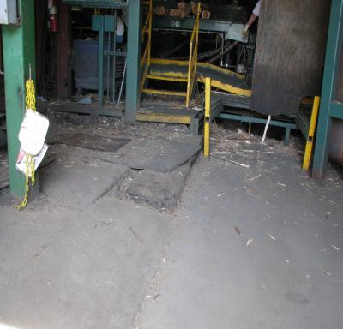
What you can do to avoid falling at the same level #1
Watch your step!
Conditions Change

Slide 42
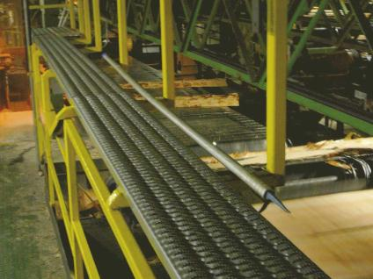
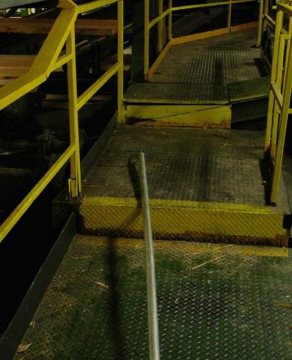
What you can do to avoid falling at the same level #2
Return Tools to Proper Storage

Slide 43
Event Classification
Exposure to harmful substances or environments
Laser Radiation
(Eye and skin damage)

Slide 44


LASERS
LASER stands for Light Amplification by Stimulated Emission of Radiation
Class IIIB LASERS are used in sawmills
These LASERS have moderate power but could be harmful to your eyes
Don’t At Them

Slide 45
Event Classification
Exposure to harmful substances or environments
Noise
(Hearing loss)

Slide 46
Noise and Time
Normal conversation 60-65dB
City Traffic (inside car) 85dB
Below 85-90 decibels - time doesn’t matter much
Above 90 decibels – time really matters
Snowmobile, Motorcycle 100dB 2 hours
Power Mower 107dB 45 minutes
Loud Rock Concert 115dB 15 minutes
Jet engine at 100' 140dB 0 hours
12 Gauge Shotgun Blast 165dB 0 hours

Slide 47
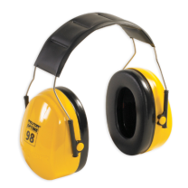
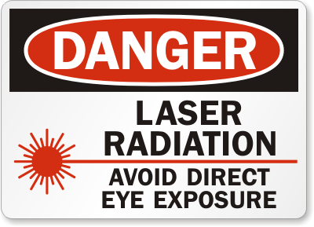
Exposure Protection
Noise
Lasers

Slide 48
Summary
What is the #1 potential for sawmill injury during debarking, primary and secondary breakdown?
Managing your own movement is key to personal safety.
Do not climb over guard rails.
Do not wear loose fitting clothing.
Do not operate equipment that is not properly guarded.
Don’t climb on or over conveyors.
Stay out of restricted areas.
Follow specific procedures when clearing jams.

Slide 49
Summary 2
The event classification “Struck By” produces the second highest number of serious injuries. Protect yourself by managing your movement.
Wear the required PPE
Follow the rules
Stay behind barriers
Stay out of the line of fire
Make sure guards are in place before operating equipment

Slide 50
OSHA NOTICE & DISCLAIMER
“This material was produced under grant SH22245SH1 from the Occupational Safety and Health Administration, U.S. Department of Labor. It does not necessarily reflect the views or policies of the U.S. Department of Labor, nor does mention of trade names, commercial products, or organizations imply endorsement by the U.S. Government”

