Slide 1
Hazards of Extreme Temperatures
Handling Heat & Cold
This material was produced under the grant SH-22246-SH1 from the Occupational Safety and Health Administration, U.S. Department of Labor. It does not necessarily reflect the views or policies of the U.S. Department of Labor, nor does mention of trade names, commercial products, or organizations imply endorsement by the U.S. Government.

Slide 2
Objectives
Why do we care about Extreme Temperatures?
How do we measure extreme temperatures ?
Why do we even bother measuring extreme temperatures?

Slide 3
Why do we care about heat or cold?
Suck it up. That’s just part of the job.
I think there’s more to it than that…
Notes:
Are extreme temperatures a comfort issue or a safety issue?

Slide 4
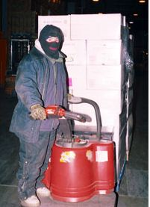
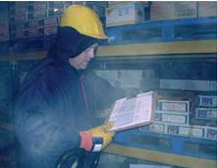
Notes:
Extreme cold is as dangerous as unguarded machinery or other serious safety hazards.
Here is just one example of an amputation due to extreme cold from OSHA’s files. We’ll discuss some aspects of this case later in the training.

Slide 5
On August 11, 2006, Employee #1 was working his first day on the job. At approximately 8:45 p.m., Employee #1 began shaking and showing signs of a seizure.
The Supervisor summoned emergency responders, who transported him to St. Francis Hospital.
Employee #1 remained in the hospital until he suffered multi-organ failure and died.
The temperature observed in the furnace area during OSHA's investigation reached 119 degrees Fahrenheit.
Notes:
http://www.osha.gov/pls/imis/establishment.inspection_detail?id=307169482
Here is an example of how extreme heat is also a serious and potentially deadly safety hazard.

Slide 6
Very hot and very cold environments can be dangerous to your health
Heat
Acute
Possible link to kidney, liver, heart , digestive system, central nervous system & skin problems
Cold
Acute
Chronic
Heat Stroke, Heat Syncope, Other heat illness
Chronic
Hypothermia, frostbite, trench foot
Respiratory and cardiovascular effects
Notes:
It’s clear that there are real hazards associated with working in extreme temperatures. These hazards are not just acute hazards – bad things that can happen immediately, but there are also long term health effects.
We are going to evaluate heat and cold by looking at the potential hazards – who can be affected and how. We will then look at how we evaluate the exposure – How do we measure exposure? How much is too much? What factors are important to consider?
Then we’ll look at controls – can we eliminate or reduce the hazard? What responsibilities do employers have? What can workers do on their own?
Finally, we’ll look at enforcement – What are the laws, and how are they enforced? What role can the union play?

Slide 7
How can we evaluate hot conditions?
Heat Index
No clear guidelines for work place application
Used by National Weather Service since 1979
Wet Bulb Globe Temperature
Recognized work/rest cycles
Used by military since 1956

Slide 8
Why not just use a thermometer?

Slide 9
It’s not the air temperature, it’s the…
Humidity
Air movement
Radiant heat sources
Level of clothing & protective equipment
Physical exertion
Personal factors
Age, heath, medications, etc.
Notes:
In fact, there are a number of factors that combine to influence how our bodies are affected by heat. This has to do with the way we handle heat – we get rid of heat by sending blood to the surface of our bodies, and we speed up the heat loss by sweating. We facilitate the loss of heat to the environment by the evaporation of our sweat. Sweating only cools us off if the sweat can evaporate – so air movement is helpful, low humidity is helpful, more exposed skin is helpful – unless there is a radiant heat source (such as the sun or a hot object that is glowing). Our ability to handle heat is also affected by a number of personal factors such as age, the health of our circulatory system, the medications we take, being pregnant, etc.
We also create heat in our bodies by working and moving.
This is information we all know intuitively – but it’s important to recognize that the air temperature alone is not always enough information to evaluate the heat hazard to an individual or a group of workers.

Slide 10
Temperature vs Heat Index

Slide 11
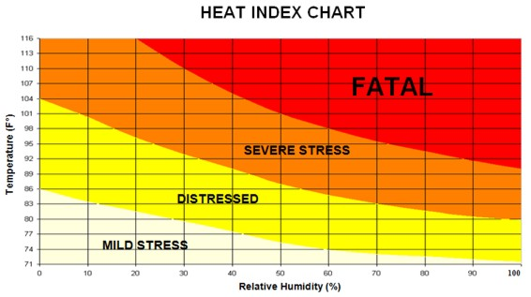
Heat & Humidity = Heat Index
Notes:
It’s not unusual for workplace temperatures to reach the 90’s, but you can see from this chart that can be a serious or even life-threatening condition if the humidity is high.

Slide 12
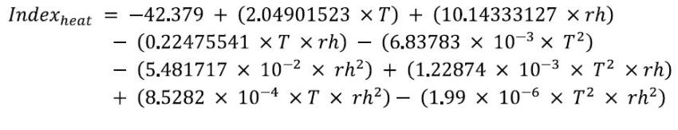
Heat Index
Not just heat + humidity
Easy to measure, but there are no recognized work / rest guidelines based on the Heat Index.
Notes:
The Heat Index is useful – but be sure to use a chart or Heat Index calculator to figure it out. It’s not a simple equation like Heat + Humidity.
A simplified version of the heat index equation is given in this slide. If you decide to use a monitor that measures heat and humidity then you can program the equation into a spreadsheet to get the heat index.

Slide 13
General Duty Clause
The employer did not furnish each of his employees conditions of employment and a place of employment free from recognized hazards that were causing or likely to cause death or serious physical harm to employees in that employees were exposed to hazards associated with working in a hot environment: a)facility, wet kill - where the employer did not fully implement a heat stress related management program with employees working in the Gambrel Table, Shaving Stand, and De- Shackle areas that were exposed to a heat index of 121 degrees Fahrenheit.
http://www.osha.gov/pls/imis/establishment.violation_detail?id=313828857&citation_id=01001
Notes:
OSHA occasionally use the General Duty Clause to address the hazards of hot work places.

Slide 14
What is WBGT?
Looks like temperature or Heat Index but it is NOT the same
NOT the same as Heat Index!
NOT the same as air temperature!
Should only be used in conjunction with applicable work/rest cycles!
Basis for MN Workplace Heat Law
Developed and used in military
Best choice for OUTDOOR work

Slide 15
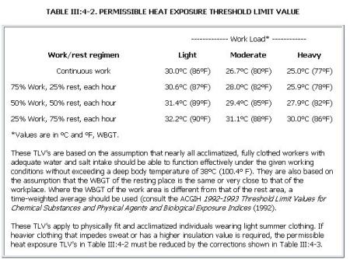
Work/Rest Cycle (WBGT only!)
Notes:
The WGBT table shows that if you are working hard – once the WGBT reaches 78 degrees, you should be resting for 15 minutes out of every hour. By the time the WGBT reaches 86 degrees, the recommendation is to rest for 45 minutes out of every hour.
This can be very confusing because the WGBT is not the same as the air temperature that you read from a regular thermometer. There is no simple conversion. You need a WGBT instrument to measure the temperature in this way.
Please be aware that the work/rest cycle is a guideline only. There is only one state that I know of that has put this guideline into their laws – that is Minnesota.
2. Here is the work/rest cycle we looked at before. Keep in mind the numbers are WGBT not regular thermometer readings.
As mentioned before, there are no work/rest guidelines based on the Heat Index.

Slide 16
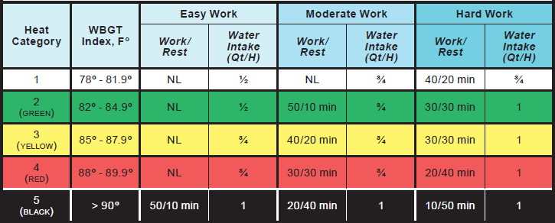

Slide 17
Minnesota Rules 5205.0110, subpart 2a,
Employees shall not be exposed to indoor environmental heat conditions in excess of the values listed in Table 1. The values in Table 1 apply to fully clothed acclimatized workers.
Table 1. Two-hour time-weighted average permissible heat exposure limits.
Work Activity | WBGT
Heavy Work | 77
Moderate Work | 80
Light Work | 86

Slide 18
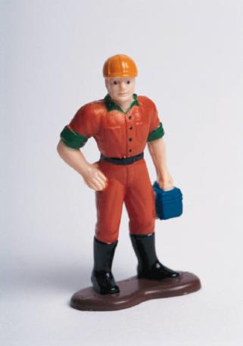
I know! When it gets really hot we’ll ask the company to slow down production!
Is there a problem with this idea?

Slide 19
Management Concerns
Is it a comfort issue or a safety and health issue?
Is it just individual complainers who are lazy or angry?
What are your facts?
How can we justify the cost ?

Slide 20
Where do we start?
Have a plan
Gather objective data
Use good science

Slide 21
Instrument Evaluation Exercise
Work with others to evaluate each of the devices that are on the tables.
If you would like your local to work with the UFCW OSH Department please indicate on the worksheet and turn it in at the end of the session.

Slide 22
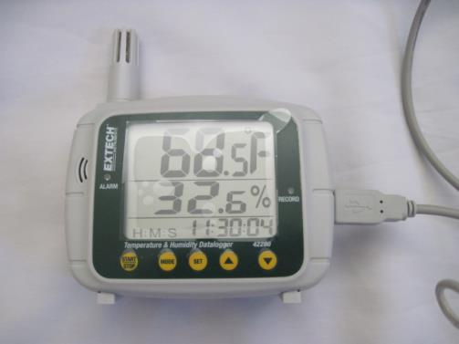
Extech 42280
Data logger
Visible read-out
Heat & Humidity
No Heat Index Calculation
Heat & Humidity alarms
$242.50

Slide 23
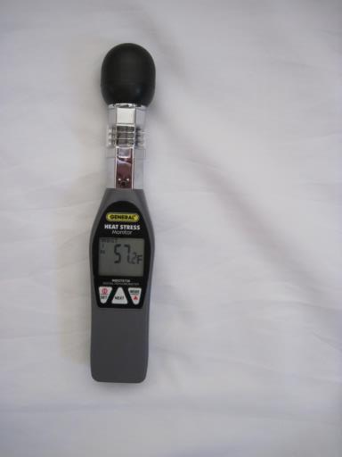
Electronic WBGT
Heat, Humidity & WBGT
Visible Read-Out
No data logging function
Hand held
$135.96

Slide 24
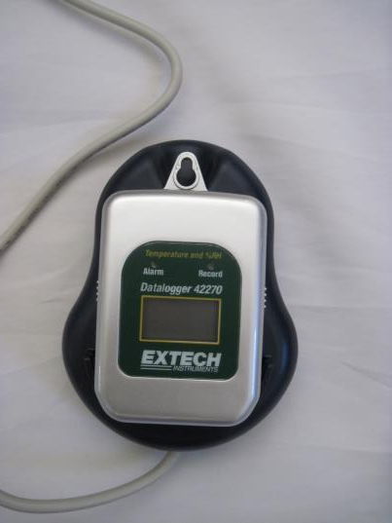
Extech 42270
Heat & Humidity
Visible read-out
Data logging function
Light weight
Multiple data loggers can be used with one docking station
Outdated port technology
$192.75
Additional units - $105.

Slide 25
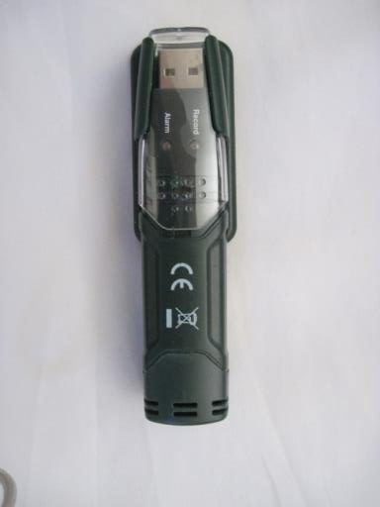
Extech RHT10
Small, easily portable
USB
no visible read-out
Heat & Humidity
No Heat Index
Data logger

Slide 26
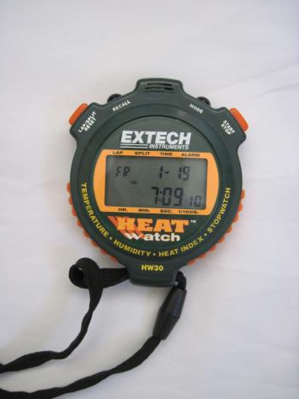
Extech Heat Watch
Small, portable
Heat Humidity, Heat Index & timing functions
No data logging function
Visible read-out

Slide 27
…scientific evidence suggests there is an association between cold exposure and musculoskeletal complaints

Slide 28
Temperature extremes can result in impaired performance
A decrease of 1degree C in core temperature (subclinical hypothermia) may already markedly impair performance and could increase the risk of occupational injuries & accidents.

Slide 29
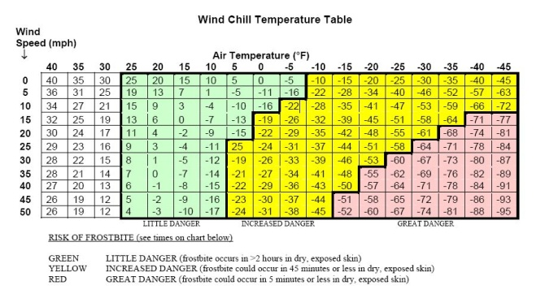
It’s not just the air temperature it’s the…
Notes:
Does anyone see a problem with using this chart for most indoor applications?

Slide 30
Wind chill calculations don’t help much for indoor conditions
0 mph – 4 mph is considered “calm” on wind chill carts
Equivalent to 0 – 352 feet per minute (fpm)
Indoor air is usually moving at less than 100 fpm
Conditions in blast freezers
10 mph (1000 fpm)
-20F to -40F
Notes:
Do wind chill calculations apply to blast freezer conditions?

Slide 31
How can we evaluate cold conditions?
Handheld thermo- anemometer - $30
Personal or Location Temp & Humidity Data Loggers - $170
Thermo-anemometer data logger - $350
Notes:
Even though air movement inside the workplace usually does not reach speeds that can be used in wind chill calculations, air movement has an effect on worker comfort and safety.
Anemometers help identify patterns of air movement.
Temperature and humidity data loggers might be useful in workplaces where the cold is not the result of carefully regulated conditions. In workplaces where cold is a necessary condition of the process you can request those records from the company.
Humidity might not be a useful measure for evaluating cold conditions since the combined effect of humidity and cold temperatures on worker health is not clear.

Slide 32
What can we do about cold conditions?
Eliminate Cold
Engineering Controls
Minimize air velocity
Administrative Controls
Training
PPE
Adequate breaks
Not Applicable
PPE Design
Buddy System
Use wind deflectors and barriers
Insulate metal handles and bars
Functioning exit apparatus on inside doors

Slide 33
Engineering Controls
Cooling equipment and air distribution systems should minimize air velocity. Unit coolers should be placed as far away from workers as possible, and wind deflectors and barriers should be used to protect workers from wind-chill.

Slide 34
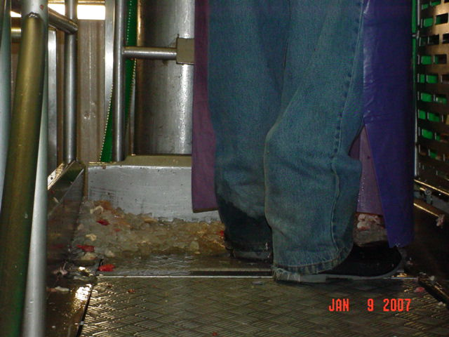
Notes:
Can you identify factors that could be controlled to reduce the effect of working in the cold on this worker?
Ice
Wet pant cuffs
Thin soles
Cold metal standing surface

Slide 35
On August 4, 2004, Employee #1, wearing a thermo-insulated jacket, overalls, and gloves began work in the freezer department of a supermarket chain warehouse. Employee #1's work consisted of selecting produce off warehouse shelves and delivering the product to the designated freezer truck. At the completion of the 8-hour work shift, Employee #1 went home and soon realized that he was in unbearable pain and that the toes on both his feet were black and blistering. Employee #1 immediately left his house and went to the hospital where his feet were treated for frost bite and he was hospitalized.
Notes:
Why didn’t this worker realize there was a problem sooner?

Slide 36
Administrative Controls - Training
Chemical frost bite
Propane
Ammonia
Dry Ice (carbon dioxide)
Signs & Symptoms of cold stress
Mental confusion
Notes:
In most cases, the victim is unaware of frostbite because the frozen tissues are numb.

Slide 37
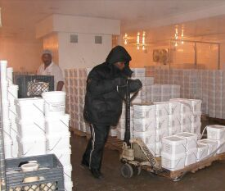
Administrative Controls – Buddy System/ Restricted Exposure Time
Notes:
Conditions in blast freezers can cause frostbite to exposed skin within 5 minutes.

Slide 38
PPE – How do we know if PPE is adequate?
Employee #1 was working in a -10 degrees F freezer. Although he was wearing gloves, they did not provide adequate protection for his hands. The employee was hospitalized for partial amputation of two fingers due to frostbite.
Notes:
Workers can request information about the amount of protection provided by PPE.

Slide 39

There is a standard for testing and rating cold-protective gloves
EN 511
Resistance to Convective cold
Resistance to Conductive cold
Permeability to water
1-4
1-4
0 or 1
Notes:
Convective cold is transferred through the air.
Conductive cold is from touching cold surfaces.

Slide 40
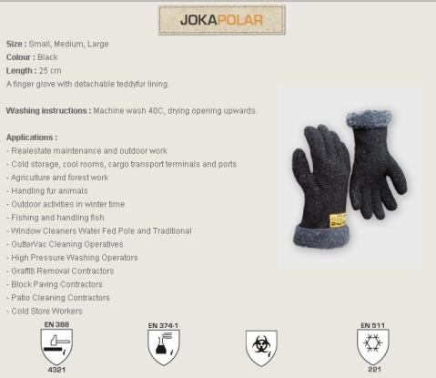
Notes:
Here is an example of EN 511-rated gloves.
This rating is NOT required in the US

Slide 41
Enforcement
OSHA General Duty Clause
Appears to be used only in response to injury
No state regulation of workplace cold

Slide 42
What can we do?
Document conditions & symptoms
Company records for Food Safety purposes
Correlate with complaints / problems
Other?
Notes:
What are your experiences in your workplace?

Slide 43
Summary
Working in extreme temperatures can have immediate and long-term health effects
Humidity and air movement influence the effects of extreme temperatures
There are a number of tools available to help evaluate working conditions
Use the hierarchy of controls to find solutions to temperature-related work problems
What information was useful to you?

