Slide 1
Material Handling Safety
This material was produced under the grant SH-22246-SH1 from the Occupational Safety and Health Administration, U.S. Department of Labor. It does not necessarily reflect the views or policies of the U.S. Department of Labor, nor does mention of trade names, commercial products, or organizations imply endorsement by the U.S. Government.

Slide 2
Objectives
Become familiar with safety regulations on powered industrial trucks
Practice evaluating safety problems
Use OSHA standards to improve working conditions
Notes:
In this training we are going to look at some of the important requirements for safe operation of powered and hand operated material handling equipment.
We’ll base the training on OSHA requirements, and spend some time looking up the specific requirements

Slide 3
Handouts
1910.178 Powered Industrial Trucks
1910.176 Handling Materials – General
Excerpts from slide show

Slide 4
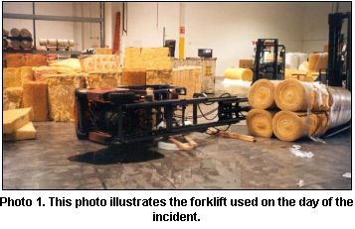
OSHA standards & NIOSH investigations help us recognize and evaluate hazards based on the history of injuries and fatalities in different industries
Notes:
OSHA and NIOSH, the two federal occupational health and safety organizations investigate incidents and try to understand patterns and root causes of how workers get hurt.
Without this analysis, workplace injuries and fatalities would be dismissed as freak accidents or worker carelessness.
This photo is from a NIOSH investigation. You can read these investigations by going to:
http://www.cdc.gov/niosh/face/In-house/full200202.html

Slide 5
Here is the link for National Institute for Occupational Safety and Health Fatality And Control Evaluations (NIOSH FACE) http://www.cdc.gov/niosh/face/default.html

Slide 6
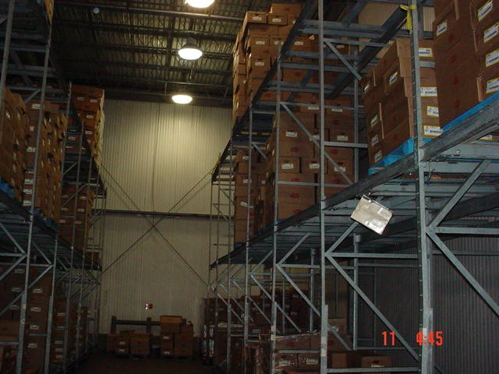
Notes:
Often when people talk about fork truck safety, they focus on operators and what terrible drivers they are. Or, if there are a lot of operators in the group, they focus on other workers who don’t pay attention to their surroundings.
While those things can be a factor, our focus today will be more on the root causes of accidents and injuries involving material handling equipment.
We’ll start with an example from a poultry plant warehouse.
Do you have any initial impressions of this warehouse?

Slide 7
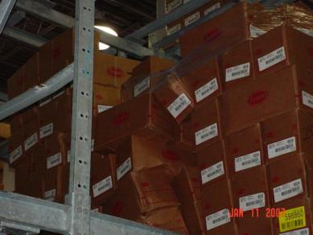
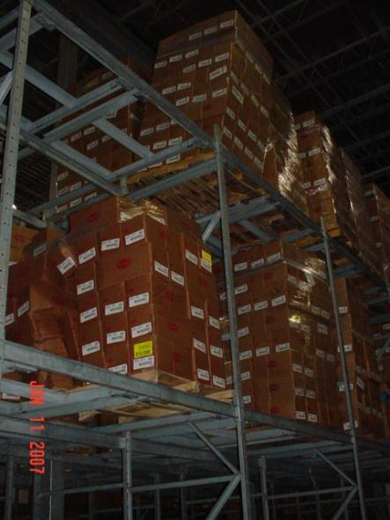
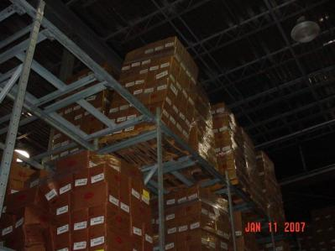
Notes:
You may have noticed that the stacks look unstable.
Why are the stacks so unstable? – maybe the problem here is that the fork truck drivers are being careless?
Let’s look a little closer.

Slide 8
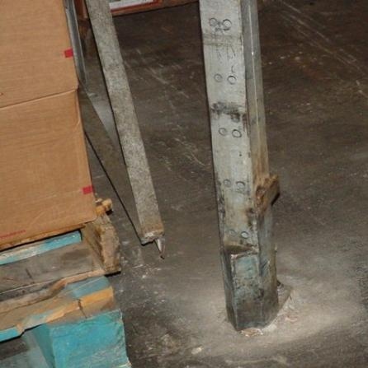
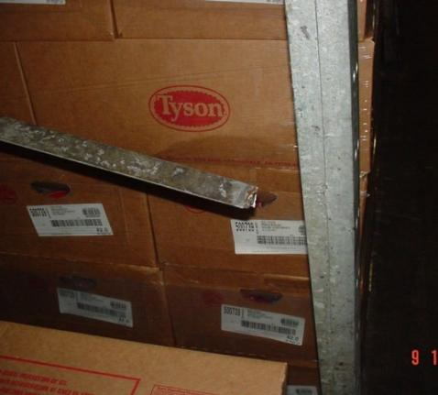
Notes:
It looks as though part of the problem could be that there are broken welds on the stacks.
But why?
Are the stacks coming apart because the welders did a poor job?
Are the stacks unstable because the fork truck drivers keep running into them?
Let’s look for more clues.

Slide 9
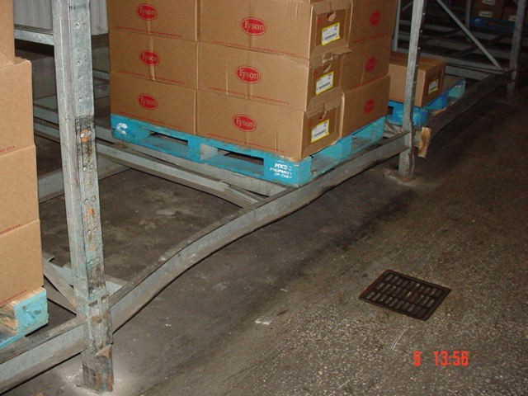
Notes:
Here’s another clue.
Fork trucks are obviously slamming into the stacks.
But why are the fork truck drivers slamming into the stacks?
Are they careless? Does the company need to discipline drivers who are running into the stacks?
Let’s look a little closer.

Slide 10
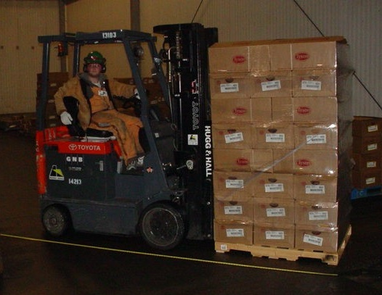
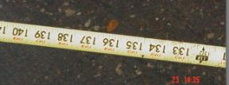
Notes:
The length of the truck with a pallet on its forks is around 132”

Slide 11
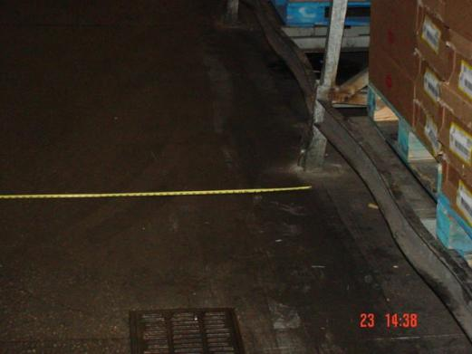
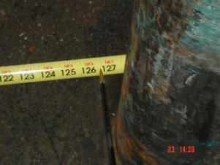
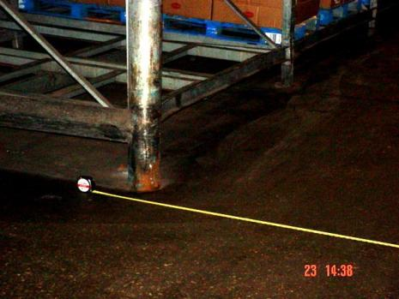
Notes:
The width of the aisle is about 127”
The extra 5” has to come from somewhere.
If the company had ordered the truck drivers to be more careful, would that have solved the problem?
If the welds on the stacks had been repaired, would that have solved the problem?
What if the company had disciplined drivers for careless driving?
The problem can only be fixed when the hazard is identified correctly.

Slide 12
1910.176(a) Use of mechanical equipment.
Where mechanical handling equipment is used, sufficient safe clearances shall be allowed for aisles, at loading docks, through doorways and wherever turns or passage must be made.
Notes:
In the previous example, we saw that what might have appeared to be worker carelessness was actually an OSHA violation on the part of the company.
You may have noticed that this standard applies to all mechanical handling equipment – not just powered equipment.
Let’s take a look at this particular standard so you can have some practice working with the actual OSHA standards.
I’m going to the OSHA website at www.osha.gov. This is a very useful website to get to know.
One interesting and important feature that was added by the new administration is the constant update of worker fatalities – usually around 14 every day.
At the site we go to Standards / General Industry / the scroll down to 176
You can see that 1910.176(a) is the paragraph quoted above.

Slide 13
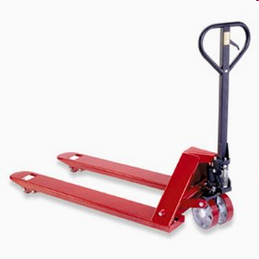
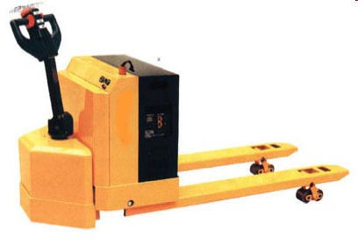
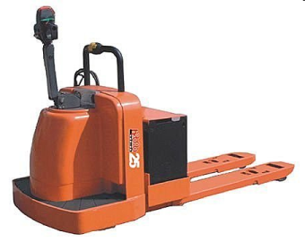
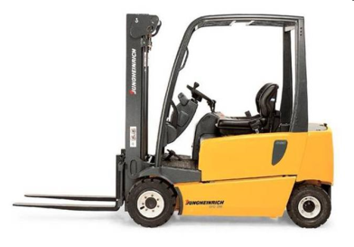
Notes:
Safe clearances must be provided for all material handling equipment.

Slide 14
1910.176(a)
Permanent aisles and passageways shall be appropriately marked
Notes:
One of the standards that most workers are familiar with is the one that requires aisles to be marked.
This is another standard that applies to ALL material handling equipment and you can see it is part of paragraph a.

Slide 15
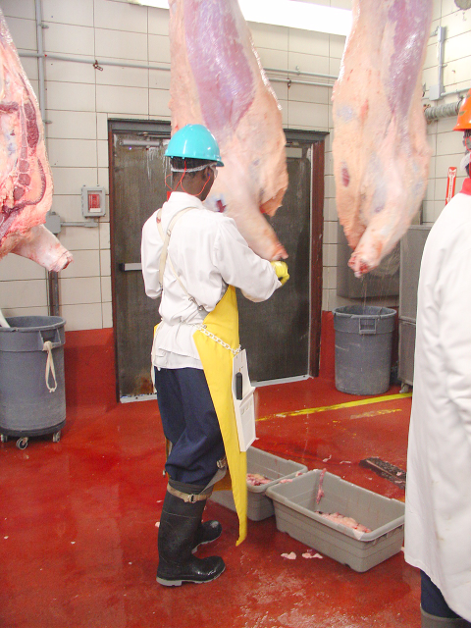
Notes:
This employer has marked the aisleway, and I think it’s safe to assume that mechanical handling equipment is used in this aisle.
It looks as if a temporary work station has been set up in this aisle way.
Is this acceptable?

Slide 16
1910.176(a)
Aisles and passageways shall be kept clear and in good repair, with no obstruction across or in aisles that could create a hazard.

Slide 17

Notes:
We are now going to focus on powered industrial trucks. The OSHA standards we discuss will apply to all powered industrial trucks including pallet jacks , except for one important rule, which applies exclusively to fork trucks – workers under 18 are prohibited from driving fork trucks.
Do any of your employers hire workers under 18?
If so, these stickers should be on all fork lift trucks. You can get the stickers from DOL.

Slide 18
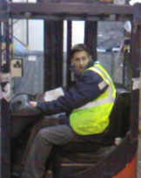
You represent a forklift driver in your plant who is being disciplined for unsafe driving. Everyone knows this guy is a pretty reckless driver.
What information will you request from the company before proceeding with a grievance?
Notes:
Let’s start with a situation you may have encountered in your workplace.
Does it matter what other people think about this driver? Should you still represent him?
How can you represent him in a way that protects his rights as well as the rights of other workers to a safe workplace?
Training curriculum – check to see if all 24 required topics were covered
Name of trainer and their qualifications
Copy of evaluation

Slide 19
1910.178(l)(2)(ii) Training
Training shall consist of a combination of
formal instruction (e.g., lecture, discussion, interactive computer learning, video tape, written material),
practical training (demonstrations performed by the trainer and practical exercises performed by the trainee), and
evaluation of the operator's performance in the workplace.
24 required topics

Slide 20
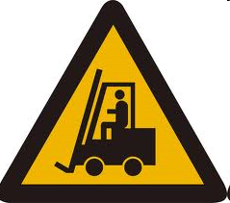
You have determined that the driver received adequate training and that the company followed all the right steps in training and evaluating the driver.
What does OSHA require the company to do next?
Notes:
Does OSHA require the company to discipline the worker?

Slide 21
1910.178(l)(4)(ii)
Refresher training in relevant topics shall be provided to the operator when:
1910.178(l)(4)(ii)(A)The operator has been observed to operate the vehicle in an unsafe manner.
Notes:
Sometimes the company will claim that OSHA requires them to discipline unsafe drivers.
What OSHA actually requires is refresher training.
Refresher training is required under a number of circumstances.
Look at the fork truck standard to see the other conditions that require refresher training.
1910.178(l)(4)Refresher training and evaluation.
1910.178(l)(4)(i)Refresher training, including an evaluation of the effectiveness of that training, shall be conducted as required by paragraph (l)(4)(ii) to ensure that the operator has the knowledge and skills needed to operate the powered industrial truck safely.
1910.178(l)(4)(ii)Refresher training in relevant topics shall be provided to the operator when:
1910.178(l)(4)(ii)(A)The operator has been observed to operate the vehicle in an unsafe manner;
1910.178(l)(4)(ii)(B)The operator has been involved in an accident or near-miss incident;
1910.178(l)(4)(ii)(C)The operator has received an evaluation that reveals that the operator is not operating the truck safely;
1910.178(l)(4)(ii)(D)The operator is assigned to drive a different type of truck; or
1910.178(l)(4)(ii)(E)A condition in the workplace changes in a manner that could affect safe operation of the truck.
1910.178(l)(4)(iii)An evaluation of each powered industrial truck operator's performance shall be conducted at least once every three years

Slide 22
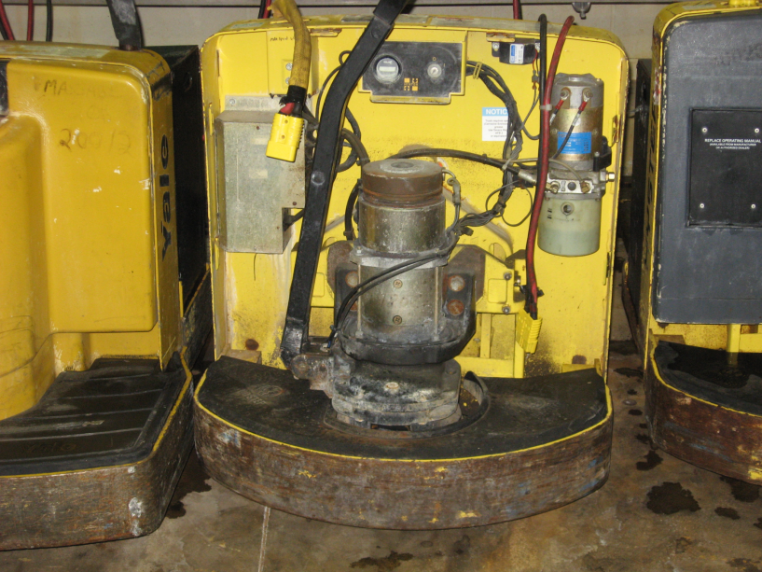
Notes:
Maintenance and repair of powered trucks is another important issue.
Do you see anything wrong with this truck?
You probably noticed that the cowling is missing.

Slide 23
1910.178(p)(1)
If at any time a powered industrial truck is found to be in need of repair, defective, or in any way unsafe, the truck shall be taken out of service until it has been restored to safe operating condition.

Slide 24
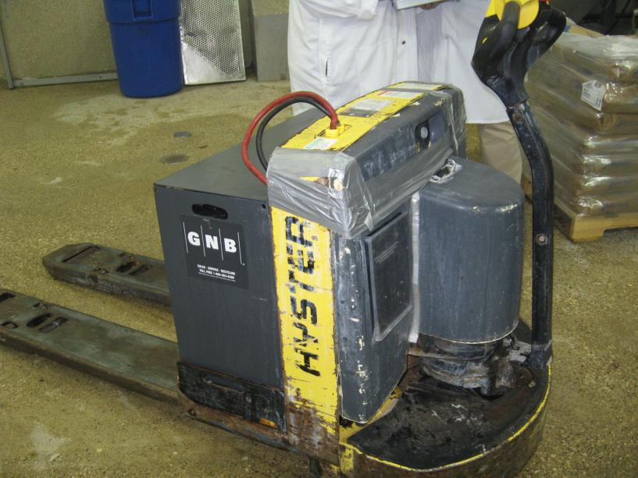
Notes:
Has this truck been repaired?
Is it safe to operate?
Would you remove this truck from service?
If you would remove this truck, how would you describe the hazard?
Sometimes OSHA provides clarification of their standards through Letters of Interpretation.
One way to find out if there are Letters of Interpretation is by referring to the standard on-line.
Go to OSHA web site 1910.178(p) & look at interp 6/17/04
If there is any question or dispute about the need to remove an unsafe truck from service, one way to resolve the issue could be to offer to call the local OSHA office and ask how they would respond to the specific situation.

Slide 25
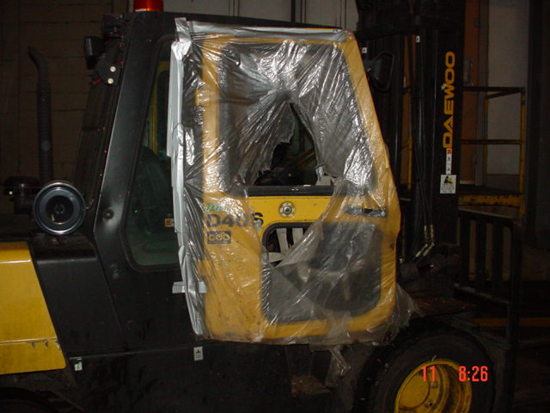
Use or Take Out of Service?
Notes:
Should this truck be operated or taken out of service?
If the operator’s vision is obstructed, is the truck safe to operate?
What if the company agrees that this truck is unsafe to operate and then requires the driver to remove the plastic so he can see? This truck is being operated outdoors in the cold. Can the company require the operator to drive this truck with the door window broken out?

Slide 26
I’ll get that truck repaired this weekend. We don’t have a replacement and we need the truck in order to run production.
It’s been like that for a week. One more day won’t make any difference.
Notes:
Look at interp 8/13/04
A company wrote to OSHA and asked what would happen if an employer said they couldn’t take the truck out of service because they needed it.
OSHA said, :” An employer who does not comply with 1910.178(p)(1) or 1910.178 (q)(7) could be cited by OSHA. Under the OSH Act, a legal defense of "impossibility of compliance" can sometimes be established by an employer. Whether the defense applies in any particular situation will depend on the specific circumstances that are present. “
In other words, they would probably get cited but if they might be able to fight it if they could prove that it was impossible to take the truck out of service.
What do you think? Would it be impossible to take this truck out of service? Why or why not?

Slide 27
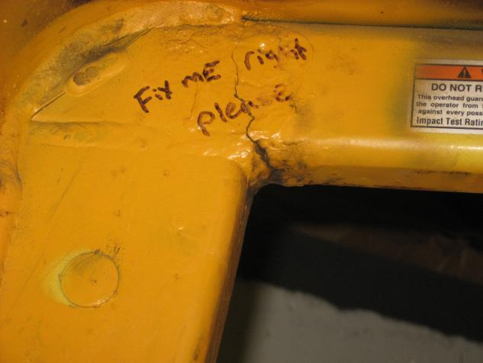
Use or Take Out of Service?
Notes:
Broken weld
What is the hazard?

Slide 28
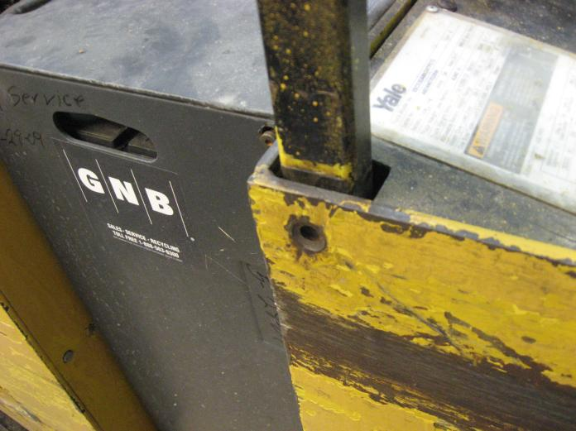
Use or Take Out of Service?
Notes:
Missing bolt
What is the hazard?

Slide 29
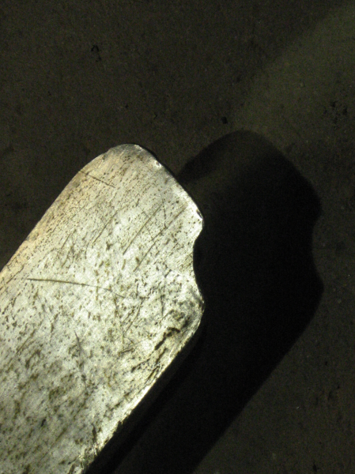
Use or Take Out of Service?
Notes:
What is the hazard?
How could this small defect affect the safe operation of a fork truck?
The ANSI fork truck safety standard says:
6.2.8.1 Inspection. Fork inspection shall be carried out carefully by trained personnel with the aim of detecting any damage, failure, deformation, etc., which might impair safe use. Any fork that shows such a defect shall be withdrawn from service, and shall not be returned to service unless it has been satisfactorily repaired.
Could the accident that damaged this fork have created additional, unseen damage?

Slide 30
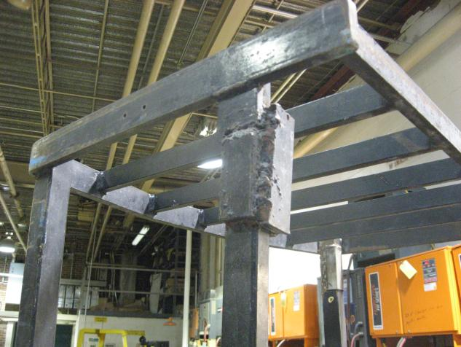
Use or Take Out of Service?
Notes:
This appears to be a modified overhead guard on this forklift.
Is this truck compliant?
Is there any information you could request from the employer to find out if this truck is safe to operate?

Slide 31
1910.178(a)(4)
Modifications and additions which affect capacity and safe operation shall not be performed by the customer or user without manufacturers prior written approval. Capacity, operation, and maintenance instruction plates, tags, or decals shall be changed accordingly.
Notes:
We don’t know if the modified overhead guard has been approved.
OSHA accepts either the manufacturer’s approval or written approval from a Qualified Registered Professional Engineer.
The union can request a copy of the manufacturer’s approval or the PE’s approval.
Look at 3/30/04

Slide 32
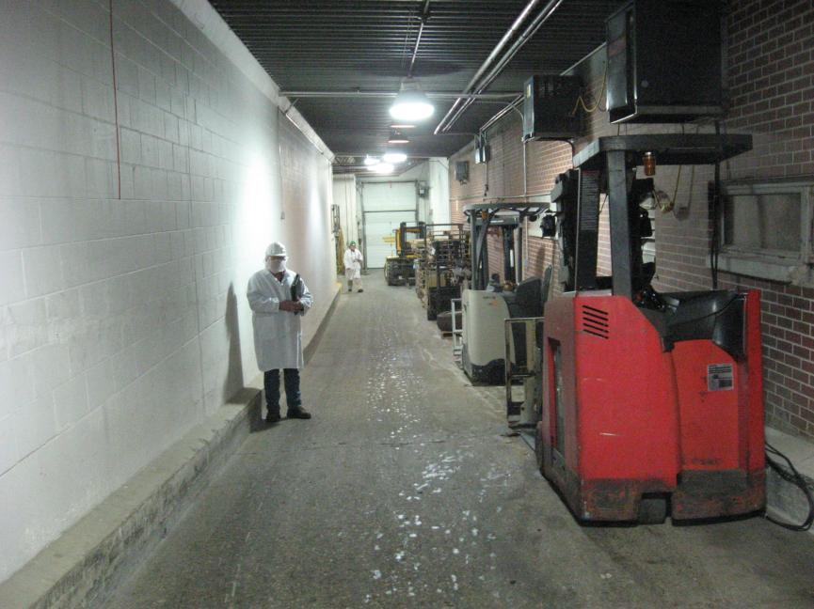
Notes:
Do you see a problem with this battery charging area?

Slide 33
1910.151(c)
Where the eyes or body of any person may be exposed to injurious corrosive materials, suitable facilities for quick drenching or flushing of the eyes and body shall be provided within the work area for immediate emergency use.
Notes:
OSHA would consider the guidelines set by such sources as American National Standards Institute (ANSI) Z358.1-1998, Emergency Eyewash and Shower Equipment, which states, at section 7.4.4, that eyewash facilities are to be located to require no more than 10 seconds to reach but that where a strong acid or caustic is used, the unit should be immediately adjacent to the hazard.

Slide 34
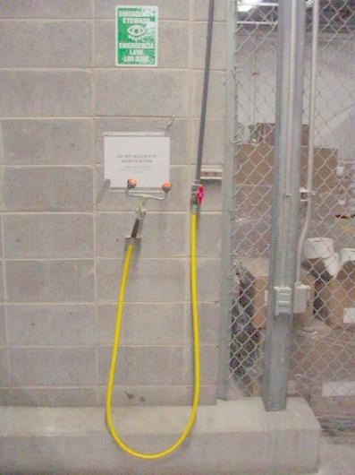
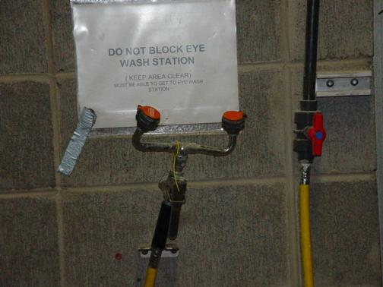
Notes:
Would this be a suitable flushing station?
Most of us have been trained to hold our eyelids open when flushing out chemicals. This makes sense because it is almost impossible to force a stream of water into your eyes without holding them open. This flushing station requires the operator to hold in a lever to get a stream of water. How can they hold their eyelids open at the same time?

Slide 35
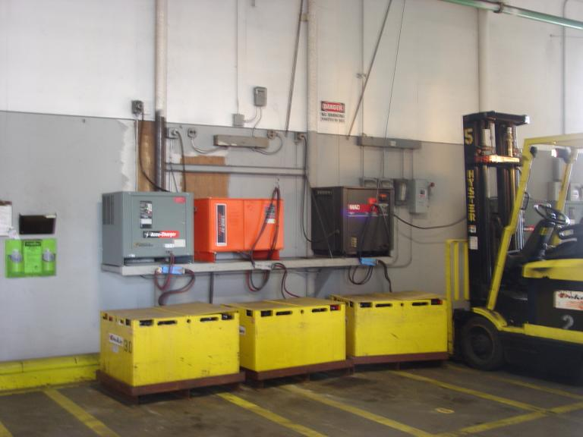
Notes:
What do you think of this flushing station?

Slide 36
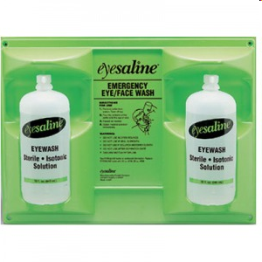
Notes:
When determining whether the eyewash or shower facilities are suitable given the circumstances of a particular worksite, OSHA may refer to the most recent consensus standard regarding eyewash or shower equipment
The ANSI Standard says: A sufficient volume of flushing fluid shall be available to supply the flow rate for a minimum fifteen minute period.
Would these bottles provide 15 minutes of flushing?

Slide 37
1910.178(g)(2)
Facilities shall be provided for flushing and neutralizing spilled electrolyte, for fire protection, for protecting charging apparatus from damage by trucks, and for adequate ventilation for dispersal of fumes from gassing batteries.
Notes:
Do you see a flushing station in this area?

Slide 38
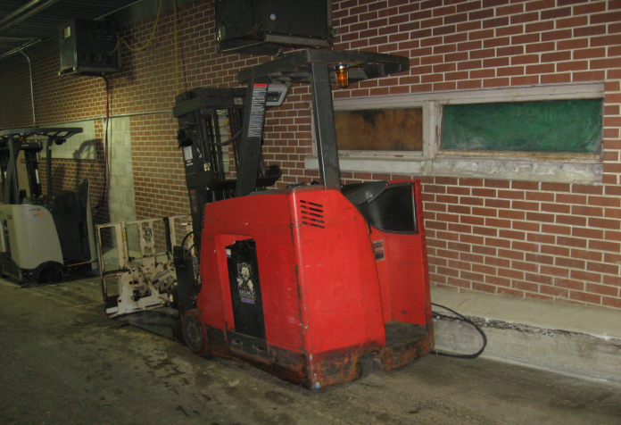
Ventilation?
Notes:
It looks as though the original ventilation for this area is now blocked.
Ventilation is important because batteries off-gas hydrogen gas while they are charging.
Hydrogen gas is…

Slide 39
Notes:
Batteries give off small amounts of hydrogen gas while they are charging.
This battery room blew up after the ventilation had been shut off for a long time

Slide 40
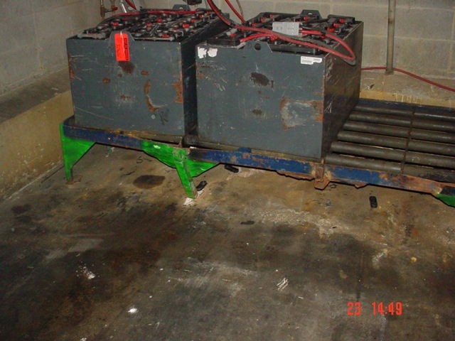
Notes:
Do you see any problems with this battery charging station?
What would happen if the rack were to fail?

Slide 41
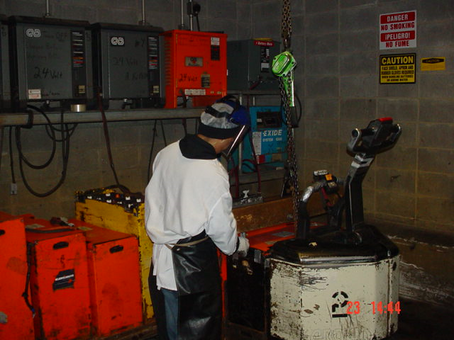
1910.178(g)(4) A conveyor, overhead hoist, or equivalent material handling equipment shall be provided for handling batteries.

Slide 42
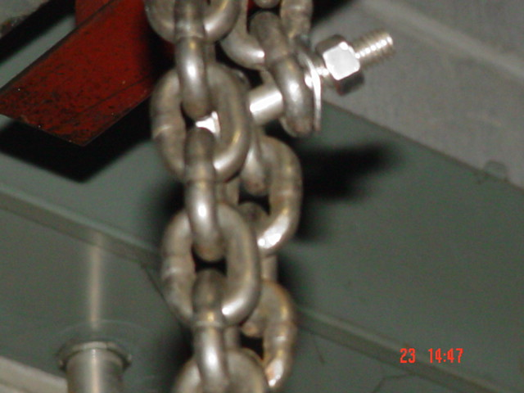
What is the load capacity of this chain?
Notes:
This chain might be rated properly for the weight of the batteries, but the load capacity of this set-up is only as much as the strength of the washer that is holding the bolt on

Slide 43
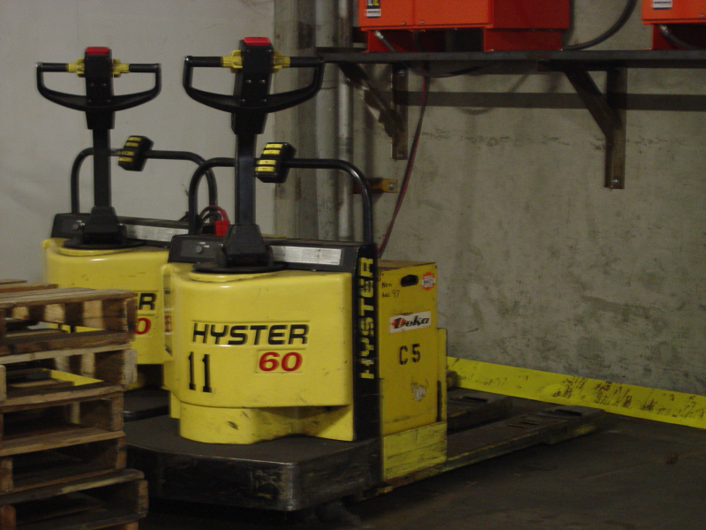
Notes:
What do you think about this charging station?

Slide 44
Material Handling Safety
Physical plant must be safe
Clear, marked, unobstructed work area
Workers must be trained, evaluated & licensed
Training must be equipment-specific and site-specific
Equipment must be safe to operate
Daily inspections
Removal from service when repairs are needed
Service areas, such as battery charging stations, must be safe in design and operation

