Slide 1
Risk Assessment
How do we know what we should be working on?
This material was produced under grant SH222461160 from the Occupational Safety and Health Administration, U.S. Department of Labor. It does not necessarily reflect the views or policies of the U.S. Department of Labor, nor does mention of trade names, commercial products, or organizations imply endorsement by the U.S. Government.

Slide 2
Objectives
Participants will be able to
Describe the process of risk assessment and its application to Workplace Health and Safety
Select Risk Assessment criteria appropriate to the exposures in their workplace
Prioritize hazards based on Risk Assessment criteria
Advocate for their decisions based on Risk Assessment criteria

Slide 3
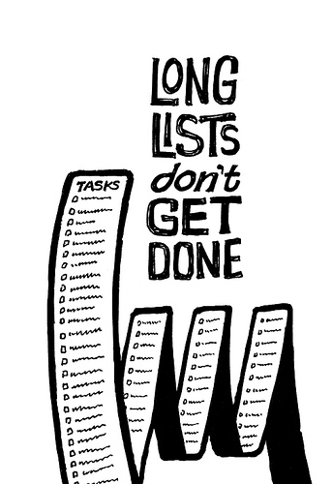
Why bother with Risk Assessment?
Work on most important tasks
Clarify conflicts
Ensure representation of all members
Develop capabilities of the Safety Committee
Notes:
It’s probably accurate to say that every Safety Committee has a much longer list of issues than they can tackle effectively. Some of the items on their list may never get done.
The process of Risk Assessment helps Safety Committees and union activists focus their work on the issues that matter the most.
Without a system for defining priorities, decisions about the issues we work on might be made for less than logical reasons.
For example, sometimes the safety agenda is set by the company. Do you know what process the Company used to set the agenda? The Company may propose that the Safety Committee work on enforcing the use of PPE, but might avoid hazards caused by line speed or inadequate crewing.
Since it is human nature to work on issues that we already understand unfamiliar or poorly understood issues can get moved to the bottom of the list. This could be a problem because unexplored or complicated issues might present serious hazards.
Risk Assessment gives everyone involved common ground for discussing disagreements about working conditions. If the Company and the Union disagree on a safety issue they can use the Risk Assessment technique to explore the source of their disagreement.

Slide 4
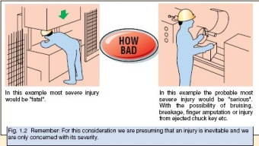
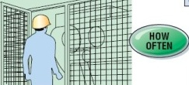
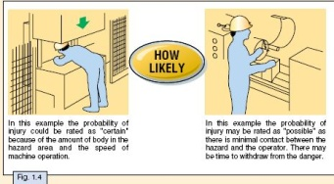
Risk Assessment
Notes:
There are many different styles of doing Risk Assessment.
Almost all of them start by asking three key questions:
How Bad?
How Often?
How Likely?
The answers to these three questions are combined to give a rating of where safety issues stand in relationship to each other.
We will examine these three questions first, and then look at other possible factors that should be considered.

Slide 5
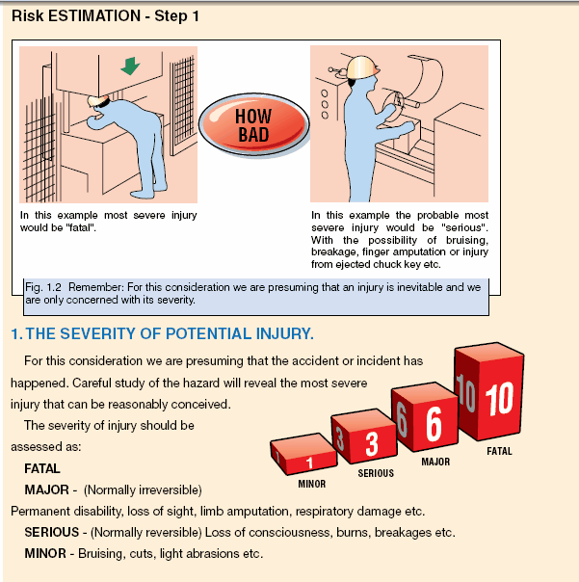
How Bad? / Severity
Notes:
Our first question is “If a worker is exposed to this danger, How Bad would the most severe injury be?”
We consider two things when we answer this question:
We assume that the exposure takes place. In other words, for the examples in this slide we assume that the press ram is coming down unexpectedly; or we assume that the workpiece comes flying out of the unguarded lathe.
We try to keep our answer within the realm of likely injuries. We can all imagine a scenario in which just about any hazard could result in death. The purpose of this exercise is not to imagine the worst possible outcome. Our task is to evaluate the most probable level of severity.
This is not a science. It is based on your judgment, experience and knowledge of the industry. Reasonable people will disagree.

Slide 6
The Range for Severity
Notes:
The scale that is applied to each of the factors is arbitrary and relative.
This means that we have the freedom to define the scale according to our workplace situation.
In this case, the scale we are using has assigned the following definitions and values:
Minor Injuries have been assigned a value of 1. These are injuries such as bruising and light abrasions
Serious Injuries have been assigned a value of 3. These are normally reversible injuries such as loss of consciousness, burns and broken bones.
Major Injuries have been assigned a value of 6 and have been defined as normally irreversible injuries such as limb amputations, permanent respiratory damage, loss of sight, etc.
Fatal Injuries have been assigned a value of 10.

Slide 7
Relative Values
Notes:
We say the numbers are relative because they only have meaning in relation to each other.
In this case we could use a scale of 10/30/60/100 or 2/6/12/20. The result would be the same because the relationship of the numbers to each other is the same.
In this scale:
Minor injuries have the smallest assigned value.
Serious injuries are assigned a value that is three times greater than minor injuries
Major injuries are assigned a value that is twice as high as Serious injuries.
Fatalities are assigned a value that is 10 times the value assigned to minor injuries.

Slide 8
Notes:
Let’s look at the examples in the illustration. The first picture shows a worker with his entire torso under the ram of a press.
We assume that the ram will fall unexpectedly.
What is the most probable level of injury this worker will experience?
Next let’s look at the second picture. This worker is operating a lathe. We assume that the workpiece will fly out of the chuck.
What is the most probable level of injury to this worker if the workpiece comes flying out of the chuck?
Is there a difference in the most probable level of injury in these examples?

Slide 9
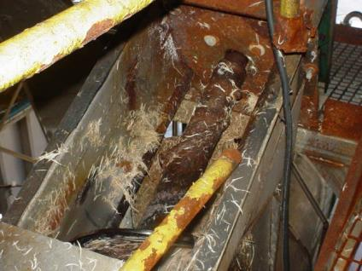
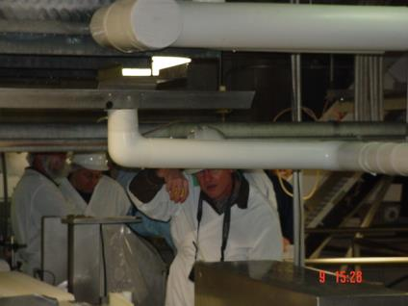
How Bad? / Severity
Notes:
Let’s use some examples from our own industries.
On the left you see an unguarded auger next to a work platform. What would be the most probable level of severity of injury to a worker who got caught in the auger?
On the right is a pipe that runs through a work area at a height of about 5 ft. What would be the most probable level of injury to a worker who ran into the pipe?
Note: Participants might question the contents of the pipe or the integrity of the pipe, or have other questions about the examples. This is a good opportunity to mention that in real life the answers to these questions might require some fact-finding work.

Slide 10

How Bad?
Notes:
What does this sign tell you about the severity of possible injury in this space?
I suggest that you always assign Permit-Required Confined Spaces a severity rating of Fatal.
The classification as a permit-required space has already identified the fact that there is a mechanical, chemical, or entrapment hazard in the space.

Slide 11
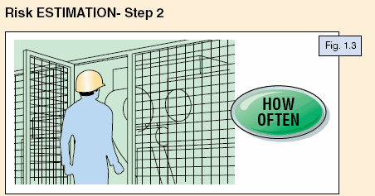
How Often? / Frequency
Notes:
The next question we ask is “How Often?”, or “What is the frequency of exposure?”
The examples we are using to introduce this idea were originally intended to evaluate risk in order to install the right level of machine guarding.
If you were evaluating one machine with one operator the question “How Often?” would be sufficient.

Slide 12
Elements of “How Much?”
How Many?
How Often?
How Long?
Notes:
We are using risk assessment as a tool to help us prioritize issues. We will expand the question of “How Often?” to include other factors. We will rephrase the question as “How Much?”, because we need to consider more than just how often an exposure occurs. We should consider:
the number of workers exposed (How Many?)
the frequency of the exposure (How Often?)
the duration of the exposure (How Long?)
The important point here is that you can adapt Risk Assessment to include the elements that apply to your work situation.

Slide 13
How Much?
How Many?
fewer than 5 workers = 1
1% - 30% of workforce = 2
31% - 50% of workforce = 3
51% - 100% of workforce = 4
Notes:
When you assign values be sure to maintain a balance.
Check to be sure that a hazard that could cause certain death to one or two people does not get lower priority than a hazard that could cause minor harm to a large percentage of the workplace. We will check this scale as we proceed.

Slide 14
How Much?
How Often?
A few times a year = 1
Once a month = 2
Weekly = 3
Daily = 4

Slide 15
How Long?
Less than 2 hours = 1
More than 2 hours = 2

Slide 16


Combine the Elements
How Many? + How Often? + How Long? = How Much?

Slide 17
How Much?
Notes:
When we add the different elements together the range of values that we have assigned to the question “How Much?” goes from 3 to 10.

Slide 18
How Much?
A maintenance worker has to enter and clean waste out of a pit every six months. The job takes less than 2 hours and only involves the entrant and the attendant. This job is classified as a “Permit Required Confined Space Entry” . The maintenance worker has expressed concerns about the entry procedure. He does not think it is safe.
Notes:
Let’s try some examples to get an answer to the question of “How Much?”.
A maintenance worker has to enter and clean waste out of a pit every six months. The job takes less than 2 hours and only involves the entrant and the attendant. This job is classified as a “Permit Required Confined Space Entry” . The maintenance worker has some concerns about the entry procedure.
How Many? – 1 person = 1
How Often? – less than once a month = 1
How Long? – less than 2 hours = 1
How Much? = 1+1+1 = 3

Slide 19

How Much?
Confined Space Example
How Many? – 1 person = 1
How Often? – less than once a month = 1
How Long? – less than 2 hours = 1
How Much? = 1+1+1 = 3

Slide 20
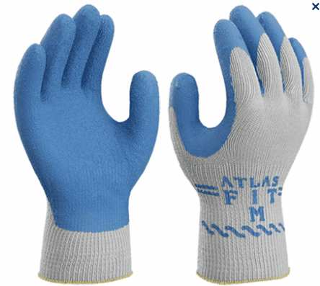
How Much?
Sanitation example
All of the sanitation workers in the plant have been provided with gloves that do not provide sufficient protection. They are exposed to harsh chemicals throughout their entire shift. Some workers have complained of rashes on their hands and wrists.
Notes:
How Many? – more than 5, less than 30% of workforce = 2
How Often? – daily = 4
How Long? – More than 2 hours = 2
2+4+2 = 8

Slide 21
How Much?
Sanitation example
How Many? – more than 5, less than 30% of workforce = 2
How Often? – daily = 4
How Long? – more than 2 hours = 2
How Much? - 2+4+2 = 8

Slide 22
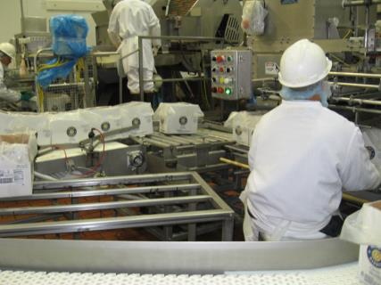
How Much? Production example
A recent increase in production standards has affected almost all production workers. Many workers are complaining of sore wrists and shoulders.

Slide 23
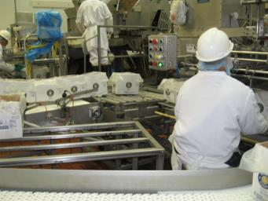
How Much? Production example?
How Many? – 51% - 100% of workforce = 4
How Often? – daily = 4
How Long? – More than 2 hours = 2
4+4+2 = 10

Slide 24
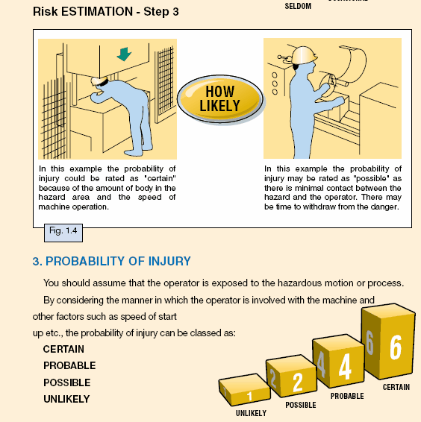
How Likely?
Notes:
The third step in our Risk Assessment is to answer the question – “How Likely?”
This is a confusing step because the question does not mean what many people interpret it to mean.

Slide 25

We cannot predict how likely it is for a complex system to fail!
Notes:
Sometimes people think that the question “How Likely?” refers to the likelihood of a malfunction or accident occurring.
In other words we would have to answer questions such as “How likely is it that the ram on the press would fall unexpectedly?” or “How likely is it that someone could get caught in the auger?”
This kind of prediction would require much more information than we have or could acquire.
We don’t try to predict how likely it is for a complex system to fail.

Slide 26
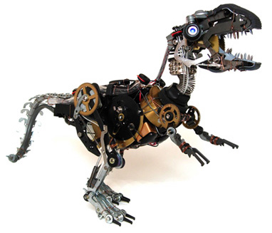
All mechanical systems fail eventually.
Notes:
We know all mechanical systems fail eventually.
It would be next to impossible for us to try to predict when and under what circumstances they will fail.

Slide 27
How Likely?
Notes:
In this step we assume that the operator is exposed to the hazardous motion or process. We assume that the system will fail.
Our question is not, “When will the ram fall unexpectedly?”
Our question is, “When the ram falls unexpectedly, how likely is it that the worker will be injured?”

Slide 28
How Likely?
Notes:
The range of values assigned to this question is:
Unlikely = 1
Possible = 2
Probable = 4
Certain = 6

Slide 29
How Likely?
Notes:
Using this range of values, how would you answer the question - “When the ram falls unexpectedly, how likely is it that the worker will be injured?”
The answer should be “Certain”
Let’s look at the other example.
Would anyone like to volunteer to state the question for the example of the lathe?
The question should be stated something like, “When the workpiece flies out of the lathe, how likely is it that the worker will be injured?”
The answer should be “Possible”

Slide 30
How Likely?
Notes:
Let’s go back to the examples that we have been using from our industries.
Would anyone be willing to state the likelihood question for a worker getting caught in an auger?
The question should be something like: “When a worker gets caught in the auger, how likely is it that the worker will be injured?”
What would you say the likelihood of injury is? Certain? Probable? Possible? Or Unlikely?
The answer should be Certain or Probable.
What about the example of the pipe? How would you state that question?
The question should be something like: “When a worker runs into the pipe, how likely is it that the worker will be injured?”
Or “If a worker has to work around the pipe, how likely is it that the worker will be injured?”
The answer should range from Unlikely to Probable.

Slide 31
How Likely?
Notes:
One reason we pay such close attention to confined spaces is because there are hazards that can interfere with a worker’s ability to self-rescue.
Given that fact, how likely would you say injury would be to a worker who is exposed to a hazard inside a confined space?
The answer should be Possible to Certain

Slide 32
How Likely?
Assume something has already gone wrong and the worker IS exposed to the hazard
Will the exposure to the hazard result in injury?
All mechanical systems fail.
Don’t try to predict when complex systems will fail (unless you are a wizard!)
Notes:
This is the most difficult factor to understand.
If someone tells you – “Oh that machine has been like that for 20 years and nobody has ever gotten hurt.” , that’s a good indication they do not understand the concept.

Slide 33
Add the Results for Each Hazard
Confined Space
How Bad = 10
How Much = 3
How Likely = 4

Slide 34
Compare relative values for different hazards
Notes:
By assigning values for each category in the Risk Assessment model you can create a list of priorities.
We know that life is not that simple, and that there will be other factors for you or your Safety Committee to consider when deciding what issues have priority.
There may be a problem that ranks lower than many others but that is simple and quick to correct.
What are some other factors that might influence your decision of what to work on?
Cost?
Ease of fixing?
How strongly do people feel about the issue?

Slide 35
Imminent Danger
Notes:
If you identify a health and safety hazard that has not been addressed and that is certain or probable to cause major or fatal injuries, you should consider this to be an imminent danger and take immediate action. Some examples of imminent dangers could be improper confined space entry, malfunctioning or by-passed safety components; or improperly locked out machinery.
Imminent danger situations are the only exception to the “Work Now, Grieve Later” rule. Imminent Danger situations must be corrected immediately.

Slide 36
Activity
Break into groups. Each group has the same list of hazards
Go through your list and assign values for each of the three categories – How Bad? / How Much? / How Likely?
Add the values for each hazard separately
Make a new list of hazards ranked in numerical order
Discuss the questions on the handout and be prepared to talk about your answers

Slide 37
Discussion Questions for Groups
Do you agree with the priority order of your issues?
What other factors would you consider?
What was difficult about this exercise?
Do you think that Risk Assessment could be a useful skill?
Notes:
Facilitator Notes:
Have the groups write their issues on flip chart sheets in numerical order.
Ask each group to talk about their process and their opinion of the results (within time limits).
Compare the results of the different groups.
If there are some with the same priority order but different absolute values, take the opportunity to point out that the absolute values are meaningless – the rank order or relative values are what we’re looking for.
If there are any groups that vary widely, ask them to explain their decisions. Use this opportunity to talk about the fact that people will often disagree about the values assigned to each category. The Risk Assessment technique will help identify and clarify disagreements.

Slide 38
Thank you!
Questions?
Comments?
Please fill out evaluations and sign in sheets!

