Slide 1
Protecting welders from hex-chrome
This material was produced under grant SH-22246-11-60-F-11 from the Occupational Safety and Health Administration, U.S. Department of Labor. It does not necessarily reflect the views or policies of the U.S. Department of Labor, nor does mention of trade names, commercial products, or organizations imply endorsement by the U.S. Government.

Slide 2
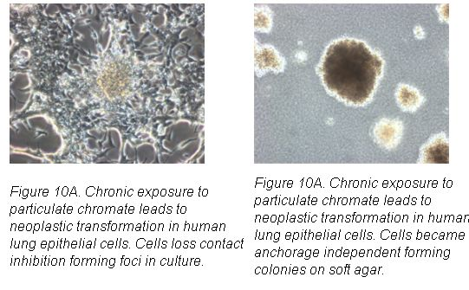
The cancer hazard from hex-chrome is real
Notes:
By the end of May of 2010, employers were required to implement engineering controls to reduce their employee’s risk of lung cancer and other disease caused by exposure to hexavalent chrome.
This standard is based on good science that we have known about for a long time.

Slide 3
UFCW Welding Survey
Are UFCW members exposed to hex-chrome?
Do our members understand the hazards and the OSHA requirements?
Are employers complying with the hex-chrome standard?
What controls are in place?
How well are controls working?
Notes:
Since we know that hex-chrome is present in stainless steel weld fume, the UFCW OSH department sent out a survey to answer these questions.

Slide 4
Thank you!
Local 2
Local 22
Local 227
Local 1776
Local 38
Local 400
Local 700
Notes:
In order to be sure our members get the best possible protection from this new standard, we distributed a survey to all of our food processing locals. Some locals – including 1776 - did a great job of getting completed surveys back to us. Without the help of our other locals we are drawing our conclusions based on a very small portion of our plants.

Slide 5
UFCW Welding Survey
Are UFCW members exposed to hex-chrome?
Yes – 99% of the plants that responded do stainless steel welding

Slide 6
UFCW Welding Survey
Do our members understand the hazards and the OSHA requirements?
NO! Most of the welders who responded to the survey had not received any training on hex-chrome or the OSHA requirements.

Slide 7
UFCW Welding Survey
Are employers complying with the hex-chrome standard?
NO! Most employers have NOT done monitoring.
NO! Most employers have not taken proper steps to control exposures.

Slide 8
Only one of the surveyed plants used the OSHA-required procedure for cleaning contaminated weld dust
1910.1026(j)(2)(i)
The employer shall ensure that surfaces contaminated with chromium (VI) are cleaned by HEPA-filter vacuuming or other methods that minimize the likelihood of exposure to chromium (VI).
Notes:
One quick and accurate way to assess a company’s awareness of the hex-chrome standard is by asking how they clean up weld dust and debris. Dry sweeping is expressly forbidden by the standard.

Slide 9
OK, So where do we start?

Slide 10
The company should have protections to keep weld fume out of my lungs
The company should have a plan to keep weld fume out of my lungs
OR
The company should have documents to prove that welders are not exposed to more than 5 micrograms of chrome IV
Notes:
It helps to keep our goal in mind – we want to reduce worker exposure to weld fume.
The company might have a different goal – they might be focused on compiling the paperwork to prove that the requirements do not apply to them.
Although we want the monitoring to be done properly, it is important to remember that monitoring does not protect workers. Our discussions with the company should focus on how they will reduce exposures.

Slide 11
Strategies for Different Scenarios
Welding is done in confined spaces
The company has Historical Monitoring Data
There are dedicated welders who weld for a significant part of the day
The company has plans to do exposure monitoring
The company has already done monitoring and everything is fine
The company is not aware of the standard
Notes:
As a result of going through the weld surveys, we devised strategies for for action based on 5 possible scenarios. These address conditions in your plant in order of priority. Use one or more of these strategies to get the best protections for the welders you represent..

Slide 12
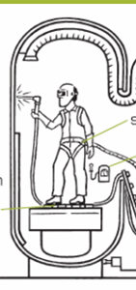
Welding in Confined Spaces
Multiple hazards! It’s not just about the hex-chrome!
Permit should address ALL hazards and how to control them
Exposure monitoring for Chrome IV must be done under conditions of highest exposure
The OSH dept. can help evaluate the company’s Confined Space procedures
Notes:
A significant number of surveys indicate that our members are welding in confined spaces. Some don’t appear to have the necessary equipment or procedures in place to make this safe.
In this case, there maybe hazards that are immediately life-threatening!
Get a copy of the permit and make sure the company has identified all hazards and come up with an adequate plan to control them
Find out from the welders if these measures are actually being followed
Some monitoring should be done when welding is being done in a confined space because that could be the worst case scenario.

Slide 13
Historical Monitoring Data or Objective Data
The company may try to use this data to exempt themselves from the chrome standard
Must include information about ALL conditions
  Shielding gas
  Base material & filler material
  Welding process
  Ventilation and other environmental conditions
Must NOT be more protective than existing conditions
The UFCW OSH office can help you analyze this data
Notes:
Argon is cleaner than CO2
Filler material can be more important than base material
TIG is cleaner than MIG or Stick (for fume)
Detection limits of method used

Slide 14
Dedicated Welders
All I ever do is weld…
Worst-case scenario OR sample ALL affected employees
Results must be shared with ALL affected employees
Notes:
Process and conditions with potential for highest exposure

Slide 15
Where does it say I have to monitor the worst case?
1910.1026(d)(2)(i)
Where an employer does representative sampling instead of sampling all employees in order to meet this requirement, the employer shall sample the employee(s) expected to have the highest chromium (VI) exposures.

Slide 16
The company has plans to do exposure monitoring
Help the company do it right
  Safety committee or sub-committee to review monitoring strategy
  Safety Committee member as observer
  Safety Committee discussion of monitoring results
We can help prepare your safety committee for this process
Notes:
If the company wants to be exempted from the hexavalent chromium standard they have to prove that there are no circumstances under which their employees will be over exposed.

Slide 17

I’m sorry but the company cannot spare an hourly employee to stand around and watch other people work.
1910.1026(d)(6)(i)
Where air monitoring is performed to comply with the requirements of this section, the employer shall provide affected employees or their designated representatives an opportunity to observe any monitoring of employee exposure to chromium (VI).

Slide 18

The company has already done monitoring and everything is FINE
Nope, nothing to worry about…

Slide 19
1910.1026(d)(4)(i)
Within 15 work days after making an exposure determination in accordance with paragraph (d)(2) or paragraph (d)(3) of this section, the employer shall individually notify each affected employee in writing of the results of that determination or post the results in an appropriate location accessible to all affected employees.
Notes:
If monitoring has been completed without the union’s involvement, or if you have any doubts about the accuracy of the results, contact the OSH department to discuss a strategy for challenging the process

Slide 20
The Company is not Aware of the Standard
Use the new standard as a way to improve overall welding safety (training, equipment, procedures)
Remember – our goal is to get the company to invest in controlling exposures NOT spend a lot of resources on measuring exposures
The OSH office can help you develop your goals & strategy
Notes:
One approach would be to meet with the welders you represent to find out the changes they think would make their jobs safer. Talk with the company about making those changes BEFORE they conduct any monitoring. This helps the company because it might prevent them from being covered by the most restrictive measures of the standard. Remind the company that if their monitoring results are above the action level they will have to continue to monitor every six months, and if they come in above the PEL they will have to continue to monitor every three months. Depending on the circumstances, monitoring has the potential to be expensive and/or disruptive. Resources can be more constructively spent on improving ventilation.

Slide 21
From now on respirators will be required for all welding operations.
But, respirators are hot and uncomfortable and they interfere with our work.
Notes:
Often the company tries to take the easy way out by requiring respirators instead of improving ventilation.

Slide 22
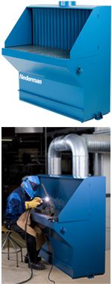
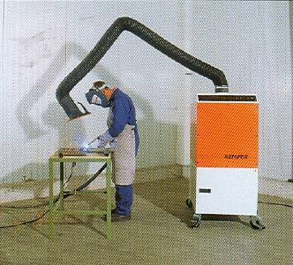
Engineering Controls First!

Slide 23
Respirators are a LAST resort!
1910.1026(f)(1)(i) … the employer shall use engineering and work practice controls to reduce and maintain employee exposure to chromium (VI) to or below the PEL unless the employer can demonstrate that such controls are not feasible. Wherever feasible engineering and work practice controls are not sufficient to reduce employee exposure to or below the PEL, the employer shall use them to reduce employee exposure to the lowest levels achievable, and shall supplement them by the use of respiratory protection that complies with the requirements of paragraph (g) of this section.

Slide 24
From now on, we’ll divide up the dirty welding jobs so everyone shares the risk and nobody’s exposure is too high.
Not So Fast.
1910.1026(f)(2) Prohibition of rotation. The employer shall not rotate employees to different jobs to achieve compliance with the PEL.

Slide 25
NEXT STEPS
Use the survey to evaluate welding safety at the plants you represent
Ensure monitoring is done properly with union participation
Keep focus on engineering controls and worker participation
Use the UFCW OSH Dept. as a resource

