Slide 1

Agricultural Chemical Safety
This material was produced under a grant (SH22284SH1) from the Occupational Safety and Health Administration, U.S. Department of Labor. It does not necessarily reflect the views or policies of the U.S. Department of Labor, nor does the mention of trade names, commercial products, or organization imply endorsement by the U.S. Government.

Slide 2
Statistics:
Involvement in Farming in the U.S.
2.1 Million farmers
2% of the population
Reference: http://www.epa.gov/oecaagct/ag101/demographics.html
Notes:
5
Here in the US it include about 2% of the population and we are seeing a shift from the family farm to larger production units.
Reference: http://www.epa.gov/oecaagct/ag101/demographics.html

Slide 3
Statistics of Injury/Mortality:
U.S. in Agriculture
70,000 Disabling Injuries
557 Fatalities (2011)
24.4 deaths per 100,000 workers
Reference: www.bls.gov/news.release/pdf/cfoi.pdf
Notes:
7
Here in the US are injuries and fatality numbers are getting better but
Voluntary standard for tractor manufactures to install ROPS since 1985
24.4 deaths per 100,000 workers
Reference: www.bls.gov/news.release/pdf/cfoi.pdf
Down from 2010 number of 596 fatalities and 26.8 deaths per 100,000 workers

Slide 4
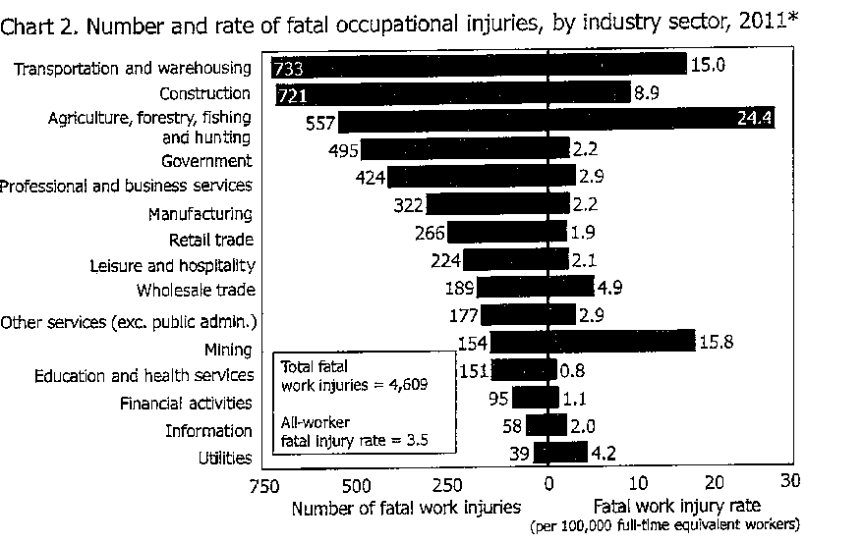

Slide 5
Focus Areas for Presentation
Understanding of the new Hazard Communication Standard
Differentiate between OSHA and the EPA
Personal Protective Equipment
Chemical example: Anhydrous Ammonia
Questions
5

Slide 6
Limitations
This one hour webinar is NOT intended to replace
  Business research and investment into understanding OSHA or EPA standards
  Trainings that reflect OSHA or EPA standards
  Safety professional’s responsibility to follow standards
Notes:
Information is awareness level training and providing resources

Slide 7
OSHA Standards
OSHA has an Agriculture standard (29 CFR 1928)
If the hazard cannot be addressed in the Agriculture Standard (29 CFR 1928) OSHA defers to the General Industry Standard (29 CFR 1910)
If there is not a standard that is applicable to agriculture in the General Industry Standards then go to the General Duty Clause Section 5(a)(1)
Source: www.OSHA.gov
Notes:
Agriculture has an OSHA standard for enforcement and regulations which are applicable to employers with more than 10 employees.
Most of the OSHA standards related to Agriculture deal with machinery, SMV (slow moving vehicle) , anhydrous ammonia, ROPS(roll over protection standard)temporary labor camps, really very few standards.
If during inspection there is not an Agricultural standard -- then OSHA will go to the General Industry Standards
The General Duty Clause can also be referred to if the standard is not found in the other two.
Just because not an Agricultural standard does not mean cannot be held accountable.
Different ways to cite a violation.

Slide 8
OSHA Standards
Section 5(a)(1) of the OSH Act, often referred to as the General Duty Clause, requires employers to "furnish to each of his employees employment and a place of employment which are free from recognized hazards that are causing or are likely to cause death or serious physical harm to his employees".
Section 5(a)(2) requires employers to "comply with occupational safety and health standards promulgated under this Act".
Notes:
If during inspection there is not an Agricultural standard -- then OSHA will go to the General Industry Standards
The General Duty Clause can also be referred to if the standard is not found in the other two.
Just because not an Agricultural standard does not mean cannot be held accountable.
Different ways to cite a violation.
Indicate where to find this information – now available online – it is not necessary to purchase the big book

Slide 9
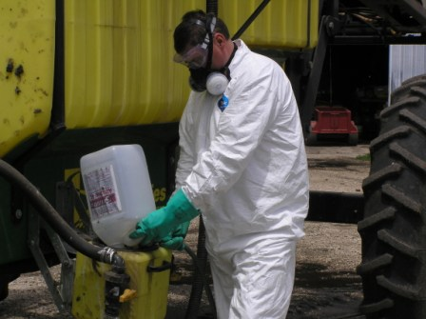
Chemicals
NOTE: Read Label or (SDS) Safety Data Sheets which provides information on respirator and (PPE) Personnel Protective Equipment selection
Notes:
SDS sheets are required for chemicals sold in the United States and provide valuable information on product safety including storage information and the proper Personnel Protective equipment to be worn during application.
Picture is from the Agrisafe collection

Slide 10
Education
Important Education
Read the Label
  Look for “precautionary statement which describes how hazardous the product is and how to best protect yourself.”
  Use of Restricted Pesticides requires specialized training and certification.
    Partner with organization offering the Pesticide Applicator Training

Slide 11


OSHA and EPA
Notes:
Relationship
Role of OSHA – primary role for worker protection
Role of EPA – primary purpose – environmental – cover other things such as Worker Protection (will cover next)
How they work together
Memorandum of understanding
In 1991, EPA and OSHA signed a Memorandum of Understanding, The purpose of this interagency Memorandum of Understanding (MOU) is to establish and improve the working relationship between the Office of Enforcement of the Environmental Protection Agency (EPA) and the Occupational Safety and Health Administration (OSHA) of the Department of Labor.
The goals of the agencies are to improve the combined efforts of the agencies to achieve protection of workers, the public, and the environment at facilities subject to EPA and OSHA jurisdiction; to delineate the general areas of responsibility of each agency; to provide guidelines for coordination of interface activities between the two agencies with the overall goal of identifying and minimizing environmental or workplace hazards.

Slide 12
Hazard Communication
1910.1200, Hazard communication
  In order to ensure chemical safety in the workplace, information about the identities and hazards of the chemicals must be available and understandable to workers. OSHA's Hazard Communication Standard (HCS) requires the development and dissemination of such information

Slide 13
Hazard Communication
New changes to the Occupational Safety and Health Administration's (OSHA) Hazard Communication Standard are bringing the United States into alignment with the Globally Harmonized System of Classification and Labeling of Chemicals (GHS)
The Hazard Communication Standard in 1983 gave the workers the ‘right to know,' but the new Globally Harmonized System gives workers the ‘right to understand.‘
OSHA Fact Sheet
Hazard Communication Standard Final Rule http://www.osha.gov/dsg/hazcom/HCSFactsheet.html
Notes:
New changes to the Occupational Safety and Health Administration's (OSHA) Hazard Communication Standard are bringing the United States into alignment with the Globally Harmonized System of Classification and Labeling of Chemicals (GHS), further improving safety and health protections for America's workers. Building on the success of OSHA's current Hazard Communication Standard, the GHS is expected to prevent injuries and illnesses, save lives and improve trade conditions for chemical manufacturers. The Hazard Communication Standard in 1983 gave the workers the ‘right to know,' but the new Globally Harmonized System gives workers the ‘right to understand.'

Slide 14
In June of 2015 MSDS sheets will be replaced with?
A) MDS sheets
B) SDS sheets
C) ABS sheets
D) None of the above
Notes:
The answer is B Safety Data Sheets

Slide 15
Hazard Communication
For Agriculture, the labeling of pesticides will remain the same (FIFRA)
If it is a pesticide, and the employer would be covered under OSHA (more than 10 people), then the other requirements, such as new Safety Data Sheets (SDSs), formerly MSDS’s, and training would be needed under the new standard.
Notes:
For those under 10 employees I would strongly recommend following the requirements.
Federal Insecticide, Fungicide, and Rodenticide Act (FIFRA)

Slide 16
Hazard Communication Standard
Pictograms and Hazards
Notes:
As of June 1, 2015, the Hazard Communication Standard (HCS) will require pictograms on labels to alert users of the chemical hazards to which they may be exposed. Each pictogram consists of a symbol on a white background framed within a red border and represents a distinct hazard(s). The pictogram on the label is determined by the chemical hazard classification. The next slides are with the new standards

Slide 17

Health Hazard
Carcinogen
Mutagenicity
Reproductive Toxicity
Respiratory Sensitizer
Target Organ Toxicity
Aspiration Toxicity

Slide 18

Flame
Flammables
Pyrophorics
Self-Heating
Emits Flammable Gas
Self-Reactives
Organic Peroxides

Slide 19

Exclamation Mark
Irritant (skin and eye)
Skin Sensitizer
Acute Toxicity
Narcotic Effects
Respiratory Tract Irritant
Hazardous to Ozone Layer (Non-Mandatory)

Slide 20

Gas Cylinder
Gases Under Pressure

Slide 21

Corrosion
Skin Corrosion/Burns
Eye Damage
Corrosive to Metals

Slide 22

Exploding Bomb
Explosives
Self-Reactives
Organic Peroxides

Slide 23

Flame Over Circle
Oxidizers

Slide 24

Skull and Crossbones
Acute Toxicity (fatal or toxic)

Slide 25
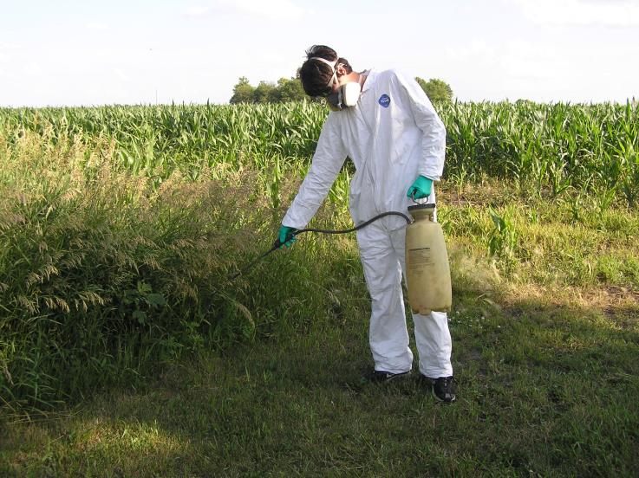
Reduce chemical risk
Notes:
Picture is property of Agrisafe

Slide 26
The forearm will absorb chemicals at the highest rate of any body part?
A) True
B) False
Notes:
Answer: B False

Slide 27
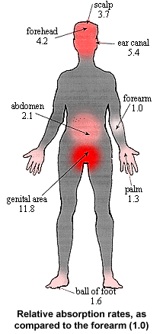
Head to Toe Protection
Absorption rates of body - why PPE is important
Donning and Doffing proper methods of putting PPE on and taking PPE off
Practical use - Long sleeve long pants – when is that okay.
From: Resources in Agricultural Safety, University of Missouri-Columbia
Notes:
For a given chemical, if the forearm was assign a arbitrary base rate of 1.0, in comparison to the forearm, other parts of the body will absorb the same chemical from a range of 1.3 to11.8 times faster than the forearm.
Used by permission

Slide 28
Chemical Exposure Health Risk
Chemicals can cause serous health problems if they are not handled properly
Chemicals enter the body through the mouth, nose, skin and eyes.
Certain chemicals can accumulate in the body, damaging the respiratory and nervous systems.

Slide 29
Reduce Chemical Risk
Wear head protection – waterproof disposable hood or plastic wide brim hat
Wear unlined, chemical resistant gloves (neoprene and nitrile are best) – do not wear cotton or leather
Chemical resistant aprons
Unlined rubber neoprene or PVC boots or shoes willing to discard
Wear eye protection – goggles with indirect vent and fog- free lenses
Disposable coveralls such as Tyvex or long sleeved shirts and pants
If label says wear a respirator – wear one

Slide 30
A Word About Take Home Exposure
Leave boots/shoes outside
Designate a special place in or outside the house for changing clothes
Shower immediately after applying fumigants
If you have a splash, change clothes immediately
Don’t pick up children/pets or hug the wife until clothes have been changed

Slide 31
Laundering
  Discard clothing if thoroughly soaked
  Remove work clothes and gear immediately after handling pesticides
  Wash work clothes as soon as possible after each day’s use
    Keep pesticide work clothes separated from other family clothing
    Clean washer before laundering other clothes
    Line dry clothes
    Keep pesticides, personal protective equipment and contaminated clothing out of reach of children and pets.

Slide 32

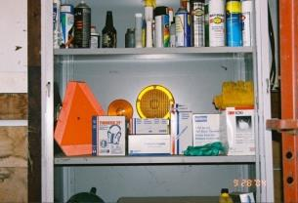
Proper storage
We recommend a central location on the farm for storing most PPE supplies.
This could be a cabinet in the office or machine shed or a tackle box or rubber maid container – the main thing is that PPE is clean and easily accessible.

Slide 33

Anhydrous Ammonia= NH3
Components of NH3 are Air, Water, and Natural Gas.
Major uses for Anhydrous Ammonia include:
Agriculture Fertilizers
and Refrigerants
Notes:
Anhydrous ammonia is an efficient and widely used source of nitrogen fertilizer. Anhydrous ammonia has several advantages, including its relatively easy application and ready availability. However, there are potential dangers involved in handling anhydrous ammonia.
Anhydrous (meaning “without water”) ammonia attracts water, so the moist areas of the eyes, nose, mouth and throat are severely attacked by the damaging effects of anhydrous ammonia.
It must be stored and handled under high pressure, requiring specially designed and well-maintained equipment. In addition, to ensure worker safety, workers must be adequately educated about the procedures and personal protective equipment required to safely handle this product.

Slide 34
Physical Properties
Colorless Liquid or Gas
Boiling Point = - 28^{O} F
Freeze Point = -107.9^{O}F
Physical Temp. = < - 44^{O} F
Odor = Pungent Odor
Odor Threshold = 1 - 50 PPM
Physical State = Liquid or Gas
pH = 10.6 - 11.6
Vapor Density = 0.597
Vapor Pressure = 124.9psi
Solubility = Soluble
Notes:
Anhydrous ammonia has a pungent odor and is detectable at levels ranging from 5–50 parts per million (ppm)
Irritating effects generally begin at levels between 25-50 ppm
More serious effects generally occur at levels greater than 100 ppm
Immediately dangerous to life or health occurs at or above 300 ppm
Source: Nationwide Agribusiness

Slide 35

Effects of Ammonia on the Human Body
Anhydrous will remove the moisture from anything it comes into contact with.

Slide 36
Effects of Ammonia on the Human Body
Inhalation Hazard
High concentrations of Anhydrous Ammonia can cause severe respiratory irritation, chest pain, pulmonary edema and death.
Notes:
What are the immediate health effects of exposure to anhydrous ammonia?
Generally, the severity of symptoms depends on the degree of exposure.
Symptoms include burning of the eyes, nose, and throat after breathing even small amounts. With higher doses, coughing or choking may occur. Exposure to high levels of anhydrous ammonia can cause death from a swollen throat or from chemical burns to the lungs.

Slide 37
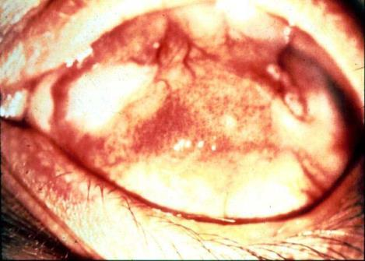
Effects of Ammonia on the Human Body
The eyes are especially susceptible to Anhydrous Ammonia damage.
Always wear proper Chemical Goggles when working with Anhydrous Ammonia.
Notes:
Eye exposure to concentrated gas or liquid can cause serious corneal burns or blindness.
Photo courtesy of the University of Iowa, used with permission

Slide 38
Effects of Ammonia on the Human Body
The effects of Anhydrous Ammonia are often displayed in parts per million.
It is often very difficult to visualize what or how much 1 part per million is.

Slide 39
Effects of Anhydrous Ammonia In
- Parts Per Million – (ppm)
Table 1. Exposure Levels and The Human Body.
Exposure (ppm) | Effect on the Body | Permissible Exposure
50 ppm | Detectable by most people | No injury from prolonged, or repeated exposure
134 ppm | Irritation of nose and throat | Eight hours maximum exposure
700 ppm | Coughing, severe eye irritation, may lead to loss of sight | One hour maximum exposure
1,700 ppm | Serious lung damage, death unless treated | No exposure permissible
2,000 ppm | Skin blisters and burns within seconds | No exposure permissible
5,000 ppm | Suffocation within minutes | No exposure permissible
Table 1. Exposure Levels and The Human Body.
Exposure (ppm) | Effect on the Body | Permissible Exposure
50 ppm | Detectable by most people | No injury from prolonged, or repeated exposure
134 ppm | Irritation of nose and throat | Eight hours maximum exposure
700 ppm | Coughing, severe eye irritation, may lead to loss of sight | One hour maximum exposure
1,700 ppm | Serious lung damage, death unless treated | No exposure permissible
2,000 ppm | Skin blisters and burns within seconds | No exposure permissible
5,000 ppm | Suffocation within minutes | No exposure permissible
Notes:
Information from North Dakota State University

Slide 40
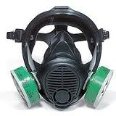



Personal Protective
Equipment (PPE)
Notes:
If an ammonia hose ruptures or a valve is unintentionally opened, the high pressure from the tank can cause ammonia to spray into your eyes, face, and other parts of your body before you can react. That’s why it’s critically important to wear only well-maintained personal protective equipment when handling or applying anhydrous ammonia. Be sure you know where the Personal Protective Equipment it is located and how to use it properly.
Personal protective equipment recommendations include wearing the following:
A full-face respirator with ammonia cartridges and pre-filters.
Cotton-lined rubber gloves when connecting or disconnecting nurse tanks and applicators. Gloves are not necessary for escape from a sudden release, but they will provide skin protection.
Non-vented chemical splash goggles if a full-face respirator isn’t available.
Clothing should be heavy duty and of tightly woven fabric that can be tightly closed at the cuffs and collar.
A cap or head covering is also recommended, but short sleeves or short pants should never be worn.
Plus, always carry a small “squirt” bottle of water to dilute or wash-off any NH3 that may contact your eyes or skin. It can be small enough to carried in your shirt pocket.

Slide 41

Respirators
Approved respirators
Maintain and clean respirators
Replace outdated canisters
Notes:
Even a small blast of anhydrous ammonia can be extremely harmful to the skin, eyes and mucous membranes in the nose, mouth and throat. Worse, inhaling anhydrous ammonia vapors can result in death. A full-face respirator with ammonia cartridges and pre-filters gives you the most protection and best chance of escaping an anhydrous ammonia release. That’s why it’s important to always keep one easily accessible in the tractor cab.
Like with all safety equipment, respirators must be properly maintained and cleaned, and cartridges and pre-filters must be replaced regularly to ensure proper function.

Slide 42

Gloves
Approved NH₃ cotton-lined gloves
Cuff the ends
Wash gloves after use
Notes:
Do to anhydrous ammonia’s caustic effects, gloves should always be worn when handling anhydrous ammonia. Suitable gloves are made of rubber, which is impervious to ammonia, and cotton-lined to protect your fingers from freezing due to the cold (-28 degrees Fahrenheit) ammonia. Suitable gloves have long cuffs that should be turned back to prevent drips from running down your arms when hands are elevated. The fit should be loose enough for easy removal, but snug enough for good protection.
Remember to wash your gloves after every use. When drying gloves make sure to hang them up or lay them out. This keeps the gloves in functioning condition.

Slide 43



Goggles
Notes:
You must always wear proper eye protection when handling or applying anhydrous ammonia. If a full-face respirator is NOT available, then you must wear non-vented or indirect-vented chemical splash goggles the entire time you are applying anhydrous ammonia and when connecting and disconnecting nurse tanks and applicators. Chemical splash goggles should be worn in the tractor cab the entire time anhydrous ammonia is being applied.
Under no circumstances should you wear contact lenses when handling or applying anhydrous ammonia. Contact lenses inhibit the effect of the emergency water and may become fused to the eyeball.

Slide 44
Clothing
Long sleeve cotton shirt
Long pants
Close toe shoes/steel toe boots
Notes:
Because anhydrous ammonia spray causes a freeze-dry effect like frostbite when it hits skin, clothing should be heavy duty and of a tightly woven fabric. Light weight, thin fabrics do not slow down or prevent anhydrous ammonia from passing through. So if light weight, thin fabrics are worn, freezing and chemical burns may occur during a anhydrous ammonia release.
The proper shirt is also long sleeve and tightly closed at the cuffs and collar. Pants should be long and close-toe shoes, preferably steel-toe boots, should be worn.

Slide 45
Anhydrous Ammonia Response Aid
Flush the exposed area with WATER for a minimum of 15 minutes or longer.

Slide 46
First Aid
If the eyes are involved:
The eye lid will attempt to stay closed. This is a natural reaction.
Holding the eye lid open, flush the eye or eyes with an abundant supply of water for at least 15 minutes or longer.

Slide 47
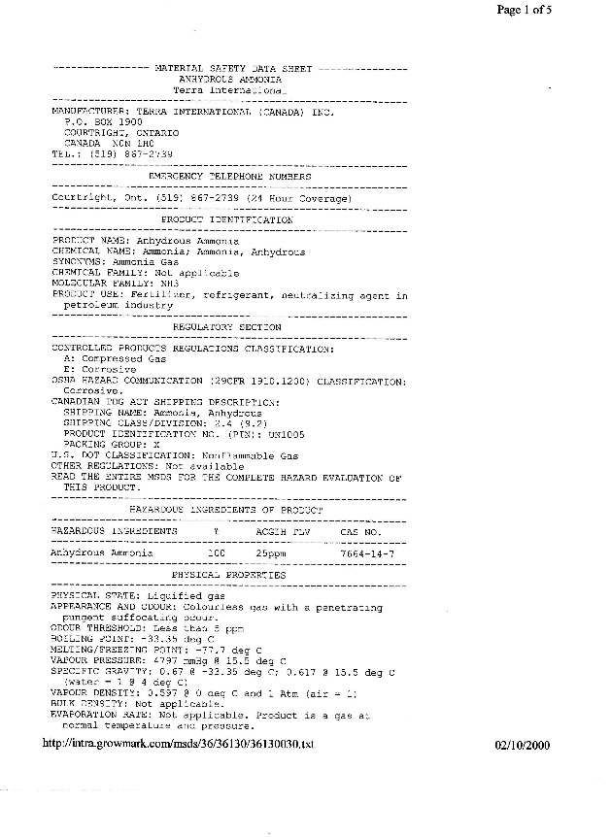
First Aid
Obtain a Safety Data Sheet and seek Medical Attention Immediately.

Slide 48
First Aid
ABSOLUTELY NO SALVES, OILS OR OINTMENTS FOR AT LEAST 24 HOURS AFTER EXPOSURE.
Salves, oils, and ointments trap the Ammonia in the pores of the skin and will not allow the ammonia to evaporate.

Slide 49

REMEMBER
WATER
WATER WATER
Is the key!
Always have a water source available for use in the event of exposure.
Notes:
We can’t talk about anhydrous ammonia safety without mentioning the importance of water. In addition to the small “squirt” bottle of water you should carry in your shirt pocket, a five-gallon container of water must be attached to all nurse tanks. Extra water and a towel should also be carried in the tractor cab to be used to wrap the head prior to exiting the cab in the event of a release. Before making an application of anhydrous ammonia, make sure all containers are full of clean, fresh water.

Slide 50
CASE STUDY #IABUNH775
Anhydrous exposure
  In May, a 30 year old male was applying anhydrous ammonia when he realized he had a plugged applicator. He was just finished with the field, so he went to the farmstead to make repairs. When he started to unplug the point, the pressure blew the plug out, spraying anhydrous ammonia in his face and down the front of his open shirt. He had no water to rinse the area. His wife heard his screams, called for help, then ran to his aid. EMS arrived and found the patient writhing on the ground. They grabbed a hose and rinsed the patient off for fifteen minutes, also removing his clothes. The patient has redness and swelling to his head and upper torso.
Notes:
Case study is provided by the University of Iowa, used by permission

Slide 51
The Boiling Point of Anhydrous Ammonia
A) 212 degree F
B) 58 degrees F
C) -28 degrees F
D) None of the above
Notes:
Answer: D all of the above

Slide 52

Resources
National Pesticide PPE Training Solutions Committee
Notes:
Brochure focuses on some of the basics of PPE but does not substitute for following the pesticide label, the PPE user instructions, and all applicable government regulations to reduce exposure. The required PPE must be handled properly from purchase through disposal, whether you apply a pesticide at home, or work in an agricultural or non-agricultural occupation.
The plan is to use it as a template for creating the comprehensive brochure with the committee.
1) Anyone can order quantities of the actual brochure from me for their pesticide safety/stewardship outreach efforts. The brochures are free.
2) The PDF version of the brochure will be available on the Pesticide Environmental Stewardship (PES) website, the NACAA website, and the Syngenta website in a week or so. Any other organization desiring to post the brochure or link to it is welcome to do so.
3) With the addition of this brochure, there will now be seven general pesticide stewardship brochures on the PES website (http://pesticidestewardship.org/Pages/Resources.aspx). Anyone can view or download these brochures from PES, or order quantities for pesticide stewardship outreach. PES also welcomes new partners that provide content, editorial assistance, or financial support, so any organization that assisted with the PPE brochure is already eligible to join!
4) All of the partners on these seven brochures have also agreed to provide the Word versions to any organization desiring to modify or extract content, and/or put their own logo on the brochure. The goal is widespread distribution of basic messages related to pesticide stewardship and safety.
It was a pleasure working with the National Pesticide PPE Training Solutions Committee. After committee members review the PPE brochure, we would welcome opinions on whether it should be translated to Spanish “as is�, or used to prepare a two-sided handout at the 6-8th grade reading level in English and Spanish. These were previous requests from members of the Committee.

Slide 53
Resources
TyVex : EPA LOP (levels of protection) http://www2.dupont.com/personal-protection/en-us/dpt/article/epa-guidelines.html
Personal Protective Equipment - EPA Interpreting PPE Statements on Pesticide Labels http://www.epa.gov/pesticides/safety/workers/equip.htm
EPA Label Review Manual – Chapter 10 http://www.epa.gov/oppfead1/labeling/lrm/chap-10.pdf
Respirators – NIOSH/ CDC Respirator Certified Equipment List Search http://www2a.cdc.gov/drds/cel/cel_form_code.asp

Slide 54
OSHA Resources
www.osha.gov
OSHA Respiratory selection e-tool
Respiratory uses
Medical Requirements
Maintenance and care of respirators
Fit testing
Written Programs
Voluntary Use of Respirators
Respiratory Change Schedules
Respirator Selection

Slide 55
OSHA Resources
Respirators QuickCard™
(OSHA 3280 - 2005) (English: HTML PDF )
(OSHA 3280 - 2005) (Spanish: HTML PDF )
Respiratory Protection Standard: Small Entity Compliance Guide
(English: PDF )
Respiratory Protection: Assigned Protection Factors for the Revised Respiratory Protection Standard
(OSHA 3352 - 2009) (English: HTML PDF )
Respiratory Protection: Respiratory Infection Control - Respirators Versus Surgical Masks Fact Sheet
(English: HTML PDF)

Slide 56
Employee Rights and Responsibilities
You have the right to:
  A safe and healthful workplace
  Know about hazardous chemicals
  Information about injuries and illnesses in your workplace
  Complain or request hazard correction from employer
Notes:
56

Slide 57
Employee Rights and Responsibilities
You have the right to:
  Training
  Access to Hazard exposure and medical records
  File a complaint with OSHA
  Participate in an OSHA inspection
  Be free from retaliation for exercising safety and health rights
Notes:
57

Slide 58
Employee Rights and Responsibilities
OSHA website: www.osha.gov and OSHA offices: Call or Write (800-321-OSHA)
Compliance Assistance Specialists in the area offices
National Institute for Occupational Safety and Health (NIOSH) – OSHA’s sister agency
OSHA Training Institute Education Centers
Doctors, nurses, other health care providers
Public libraries
Other local, community-based resources
Notes:
58

Slide 59
Disclaimers
This material was produced under a grant (SH22284SH1) from the Occupational Safety and Health Administration, U.S. Department of Labor. It does not necessarily reflect the views or policies of the U.S. Department of Labor, nor does the mention of trade names, commercial products, or organization imply endorsement by the U.S. Government.
Notes:
Material possible from
US Dept of Health and Human Services
EPA
OSHA

