Slide 1

Cholinesterase Monitoring
This material was produced under a grant (SH22284SH1) from the Occupational Safety and Health Administration, U.S. Department of Labor. It does not necessarily reflect the views or policies of the U.S. Department of Labor, nor does the mention of trade names, commercial products, or organization imply endorsement by the U.S. Government.

Slide 2

Disclaimers
This material was produced under a grant (SH22284SH1) from the Occupational Safety and Health Administration, U.S. Department of Labor. It does not necessarily reflect the views or policies of the U.S. Department of Labor, nor does the mention of trade names, commercial products, or organization imply endorsement by the U.S. Government.

Slide 3

Objectives
Assess the human health importance of cholinesterase screening.
Identify which types of pesticides require cholinesterase screening and the people most likely to be exposed to those pesticides.
Analyze screening protocols including baseline testing, laboratory specifics, and follow up for applicability to clinic sites.
Evaluate appropriate testing and follow up for acute exposures.
Discuss roles and responsibilities of providers in screening, prevention, treatment and follow-up of pesticide exposures.
© earldotter.com
Notes:
MCN has permission to use photo

Slide 4

Pesticide Exposure Health Risk
Pesticides can cause serous health problems if they are not handled properly
Pesticides enter the body through the mouth, nose, skin and eyes.
Certain pesticides can accumulate in the body, damaging the respiratory and nervous systems.
  Cholinesterase testing may be necessary

Slide 5


Occupational Health Services
Agricultural Specific Screening Services
  Occupational History
  Lung Function screening
  Hearing Test
  Skin Cancer Screening
  Back/Spine Lifting Safety Assessment
  Cholinesterase
  Tetanus Immunization
General Health Screening Services
  Height/weight evaluation
  Blood Pressure
  Cholesterol
Referral to Health Care Providers

Slide 6
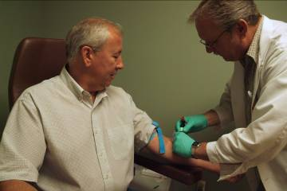
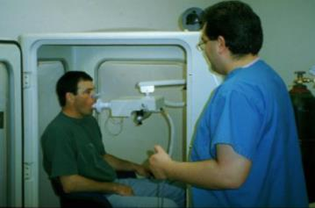
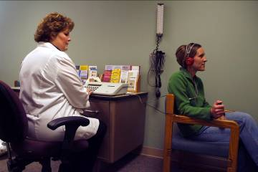
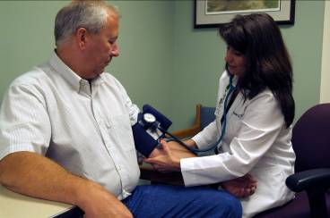
Prevention
Cholesterol and
Cholinesterase Screening
Pulmonary Function Testing
Hearing Testing
Blood Pressure Height-Weight Evaluation and other Vital Signs

Slide 7
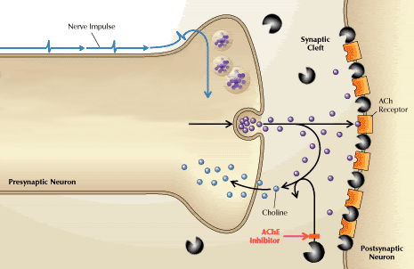
What is Cholinesterase?

Slide 8

What is cholinesterase?
.
Cholinesterase is an enzyme necessary for proper nerve impulse transmission.
If the amount of this enzyme is reduced below a critical level, nerve impulses to the muscles can no longer be controlled, resulting in serious consequences and even death.
Depression of cholinesterase below the critical level may occur from a single large exposure, such as spilling the concentrate insecticide on yourself, or from a series of
small exposures over a long period of time, such as applying these materials throughout an entire growing season.

Slide 9
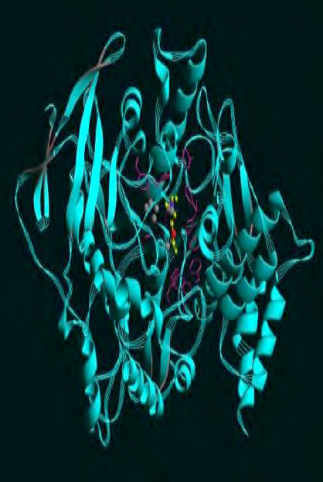
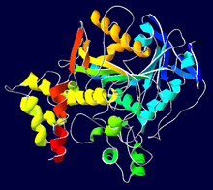
Plasma and Acetyl cholinesterase

Slide 10
Toxicity of Cholinesterase Inhibitors
Organophosphates /Carbamates
Muscarinic SXs
Miosis
Diaphoresis
Salivation
Lacrimation
Urination
Defecation
Gastroenteric cramping
Emessis
Nicotinic SXs
Diaphoresis
Salivation
Headaches
Weakness
Nausea
Resp Paralysis
Fasciculations
Notes:
Source: Matt Kiefer

Slide 11
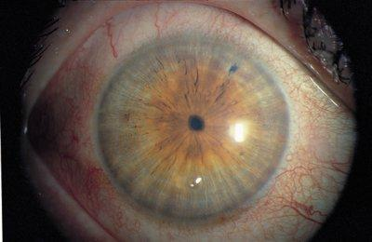
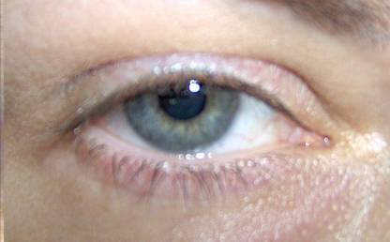
Miosis: a characteristic of OP and Carbamate poisoning

Slide 12
Route and Toxicity
Oral vs. Dermal LD₅₀ of some OPs
Organophosphate | Oral | Dermal | Dermal/Oral
Phorate | 2 mg/kg | 6 mg/kg | 3
Azinphos-Methyl | 13 mg/kg | 220 mg/kg | 17
Methamidaphos (rat) | 32 mg/kg | 94 mg/kg | 3
Oxydemeton (rat) | 75 mg/kg | 250 mg/kg | 3
Diazinon (rat) | 108 mg/kg | 900 mg/kg | 9
Phosalone (rat) | 130 mg/kg | 1500 mg/kg | 12
Chlorpyrifos (rat) | 155 mg/kg | 202 mg/kg | 1.3
Malathion (rat) | 1375 mg/kg | 4444 mg/kg | 3
Aldecarb (rat) | 0.5mg/kg | 3.5 mg/kg | 3
Notes:
Source – Matt Kiefer

Slide 13

Pesticide Exposure Health Risk
Some of the most toxic pesticides are insecticides
Some of the most toxic insecticides are cholinesterase inhibitors (LD₅₀ 0.5 -1000 mg/kg)
Organophosphates (OP) and N-methyl – carbamates are the insecticidal cholinesterase inhibitors
Notes:
Sources for the LD 50:
Furman J. Cholinesterase Monitoring for Agricultural Pesticide Handlers: Guidelines for Health Care Providers in Washington State. Olympia, Washington: Washington State Department of Labor and Industries, Division of Occupational Safety and Health; January, 2010.
Cholinesterase Health Monitoring Program for USDA Employees. (2004). Cholinesterase Testing Program. Washington, DC: U.S. Department of Agriculture: Animal, Plant and Health Inspection Service.
The Scientific Advisory Committee for Cholinesterase Monitoring formed under RCW 49.17.288. Cholinesterase Monitoring
of Pesticide Handlers in Agriculture: 2004 – 2006. Final Report to the Washington Department of Labor and Industries, November 1, 2006.

Slide 14

Benefits of Che Monitoring
Remove overexposed workers before illness begins
Identify failures in worker protection
Raise awareness of hazards of chemicals monitored
Diagnose acute overexposure
Drives the financial equation toward safer chemicals
© E. Zurowesete
© E. Zuroweste
Notes:
MCN has permission to use photo

Slide 15
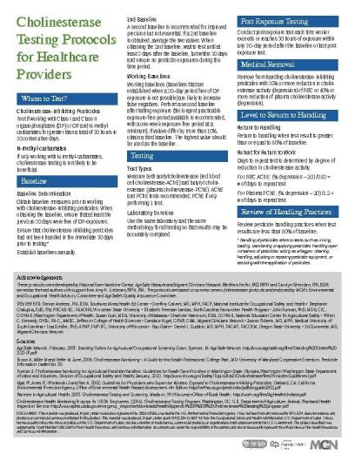
Cholinesterase Protocol for Healthcare Providers
Whom to Test?
Testing
Post Exposure Testing
Medical Removal
Level of Return to Handling
Review of Handling Practices
Notes:
We developed this protocol after review of 7 different protocols and came up with one national standard.

Slide 16
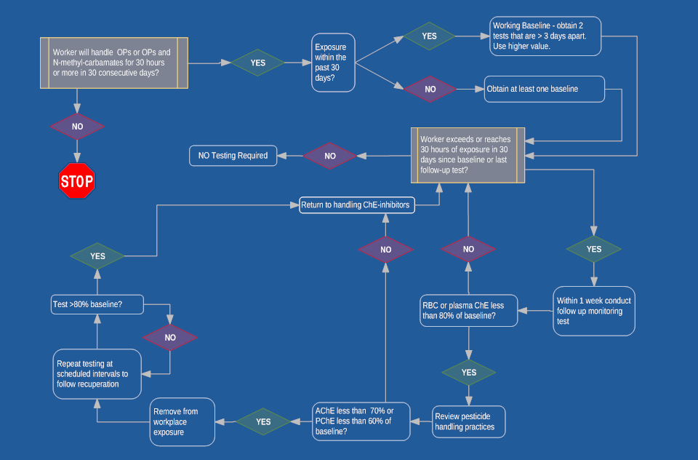
Cholinesterase Algorithm

Slide 17
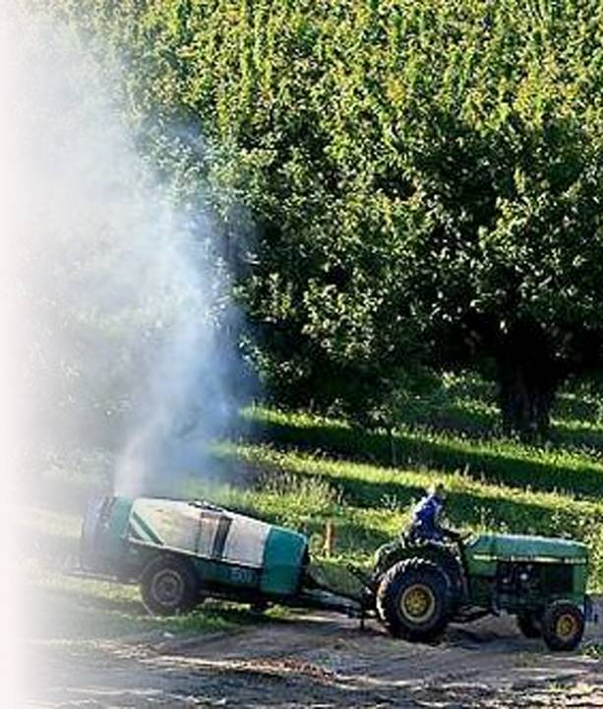
Who to Monitor?
  Individuals who apply Class I or II Organophosphate pesticides or Organophosphates and N-methyl-Carbamates
  Working 30 or more hours within any 30-day period

Slide 18
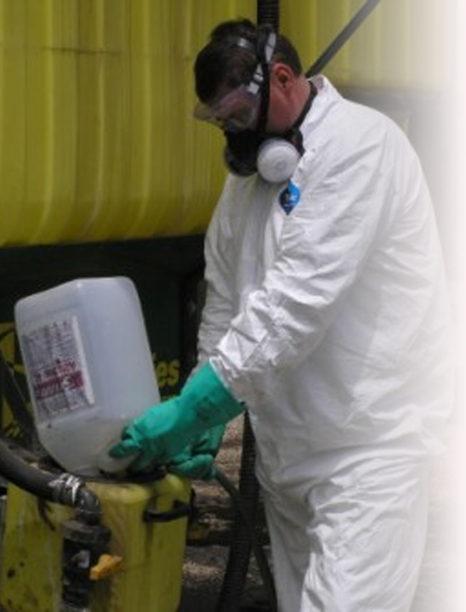
Why Not Carbamates
Inhibition of cholinesterase by carbamates, while potentially serious, is less persistent and probably will not be detected by regular monitoring. If an applicator is exposed only to carbamates and not OPs,
Cholinesterase monitoring may provide a false sense of security because the extent of inhibition from each exposure
Notes:
AgriSafe photo with known source of photograph and permission to use photo

Slide 19

What to Measure
Measure both acetylcholinesterase (red blood cell cholinesterase-AChE) and butyryl cholinesterase (plasma cholinesterase-PChE)
Use the same laboratory and the same methodology for all testing so that results may be accurately compared. Repeat baselines yearly

Slide 20

Working Baseline Guidelines
  Perform a 2nd baseline after halting exposure. If values differ by more than 10%, obtain a third baseline.
  The highest value should be used as the baseline.
  Attempt to obtain longest non exposure interval before baseline testing.
Notes:
How long after halting exposure – because this is a “working baseline” - As long as you can – workers are in the field so halt the exposure as long as possible –no set time frame.

Slide 21
AChE versus PChE
Red blood cell turnover is slow (about 3 months)
  AChE measurements reflect this slow replacement rate. 100/120= 0.83% recovery per day
PChE turnover is quicker. Estimates are about 1.2% recovery per day
  PChE is a more sensitive to certain organophosphates.
Obtain a baseline reading of both measures during the non-exposed period, at least 30 days since the last exposure to OP pesticides. Two baseline values ideal. Average the values.

Slide 22
Post Exposure Testing Guidelines
Ideal: Test within 3 days of any 30-day period in which individual has met or exceeded handling hours threshold.
Compare each reading to individual’s baseline and calculate per cent of activity relative to baseline.
% act.= BL act – PE act/BL act x100
Notes:
pre exposure

Slide 23

Action Levels
Evaluate Work Place
  >20% decrease from baseline in AChE or PChE = Evaluate work practices
Medical Removal
  >30% decrease in AchE or >40% decrease in PChE
  Remove worker from exposure to OPs and carbamates until levels return to within 80% of baseline
© earldotter.com
Notes:
MCN has permission to use photo

Slide 24

Return to Work
Level to Return to Work
  Return to work when test result is greater than or equal to 80% of baseline.
Retest for Return to Work
  Days to repeat test is determined by degree of ChE activity reduction.
  RBC: (% depression - 20) /0.83 = # of days to repeat test
  plasma: (% depression - 20) / 1.2 = # of days to repeat test
Notes:
MCN has permission to use photo
24

Slide 25

Review Work Practices
Review work practices when test result is less than 80% of baseline.
  Reading and understanding label
  Use of personal protective equipment
  Pesticide handling practices
  Precautions taken with chemical spills
  Reporting symptoms
  Reporting exposures
© earldotter.com
Notes:
MCN has permission to use photo
An important part of the cholinesterase protocol is to Review work practices. The work practices that need to be evaluated and discussed are:
- Understanding the label – the label provides the information needed to wear appropriate personal protective equipment
Wearing the protective equipment recommended on the label including making sure the personal protective equipment is the right fit. (gloves, respirator)
- Pesticide handling practices to reduce risks of exposures
- when there are chemical spills - take the appropriate precautions
- report symptoms to employer and/or health care professional so appropriate follow can occur in a timely manner
- reporting exposure to employer/ health care provider and other agencies as appropriate

Slide 26
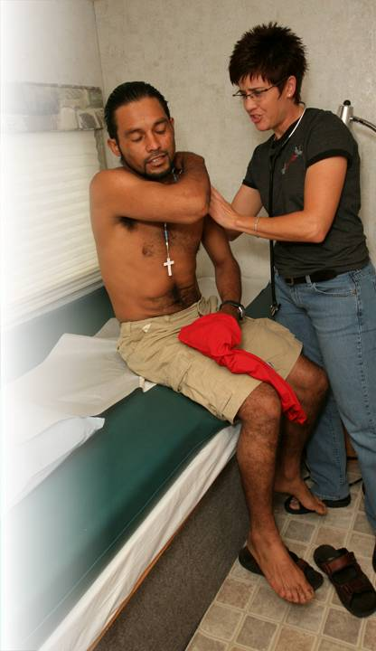
Role of Clinician
Monitor Cholinesterase levels
Understand signs and symptoms
Review protective measures with patient
Review protective measures with employer
Report
Remember – No need to be an expert
  Plenty of resources!
© earldotter.com
Notes:
MCN has permission to use photo
For the clinicians in the audience, let’s just review your role. One of the points we have not made thus far is that the clinician plays a critical role in making sure suspected and confirmed pesticide exposures are not only identified but also reported. In most cases you are the first line in the identification of symptoms and determining the appropriate course of treatment and follow up. Reporting is also an important role – in fact in over 30 states there is a law requiring clinicians to report suspected and confirmed pesticide exposures This has a very important impact on the kinds of pesticides that remain on the market. The good thing is there is no need to be expert on this topic and there are plenty of resources.

Slide 27
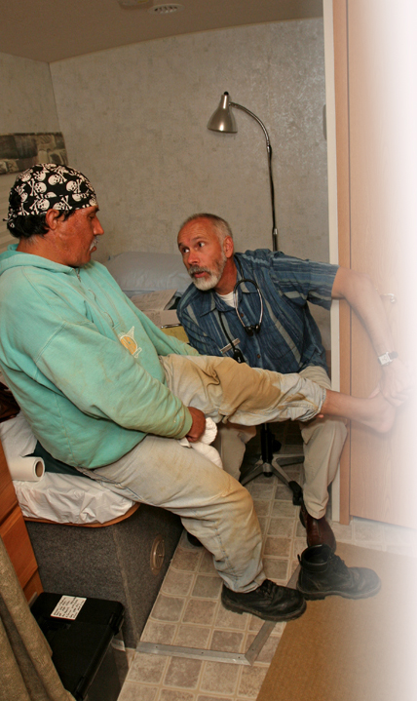
MCN’s Environmental and Occupational Health Program
SIMPLE, Flexible, Effective
Partnerships with Health Centers
Practical Training for Primary Care Providers
Resources
Connecting Primary Care to Occupational and Environmental Medicine
Technical Assistance
© earldotter.com
Notes:
MCN has permission to use photo
EOH = Environmental and Occupation Health
EPA has partnered with the Migrant Clinicians Network to develop a very simple program for frontline clinicians. The have trained hundreds of clinicians and the have a number of resources on this topic.

Slide 28
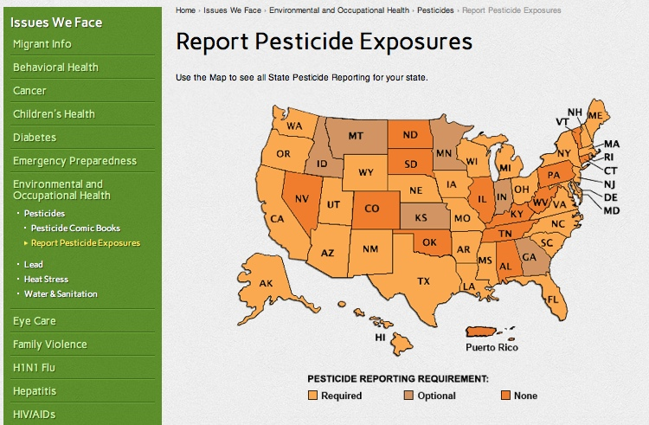
MCN’s Pesticide Exposure Reporting Map www.migrantclinician.org
Notes:
28
MCN’s Pesticide Exposure Reporting Map offers a user-friendly tool to access information to report suspected pesticide exposures to the proper surveillance agency. To navigate to the map from the MCN homepage, click on [Issues We Face] and then click on [Environmental and Occupational Health] in the drop down bar. Next, click on [Pesticides] located in the left hand bar, and then click on [Report Pesticide Exposures].
The data contained in the map includes pesticide reporting requirements for each state (denoted by color), the proper agency and contact information to help clinicians easily report and the allowable timeframe by law to report pesticide exposures.
Using Nebraska as an example, we will see the information the map is able to provide us.

Slide 29
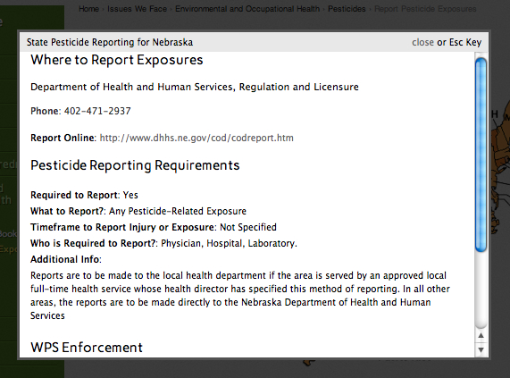
Pesticide Reporting Information
Notes:
29
After selecting the appropriate state, a window will appear containing information about how and where to report pesticide exposures in a given state. Nebraska, for example, is a state which requires clinicians to report any pesticide-related exposures. In Nebraska, reports of pesticide exposures are to be made to the Department of Health and Human Services, Regulation and Licensure division. Any additional information available about pesticide reporting protocol in a particular state is also contained on this screen. As indicated in the ‘Additional Info’ section for Nebraska, some reports of pesticide exposures are to be made to local health departments if the area is served by an approved local full-time health service whose health director has specified this method of reporting. In all other areas, the reports are to be made directly to NDHHS as previously indicated.
This screen also has information about Worker Protection Standard enforcement procedures in each state. For each state, a Field Sanitation Enforcement Agency will be listed, in addition to the appropriate agency to which you can make referrals if you encounter a suspected WPS violation.

Slide 30

EPA Worker Protection Standard
Information available at www.epa.gov
Regulation aimed at reducing the risk of pesticides and injuries among agricultural workers and pesticide handlers.
Contains requirements for:
  pesticide safety training
  notification of pesticide applications
  use of PPE
  restricted entry after pesticide application
  decontamination supplies
  emergency medical assistance
Notes:
EPA (United States Environmental Protection Agency)
The mission of EPA is to protect human health and the environment.
EPA's purpose is to ensure that:
all Americans are protected from significant risks to human health and the environment where they live, learn and work;
When Congress writes an environmental law, the EPA implements it by writing regulations. Often, they set national standards that states and tribes enforce through their own regulations. If they fail to meet the national standards, the EPA can help them. The EPA also enforces their own regulation, and help companies understand the requirements

Slide 31
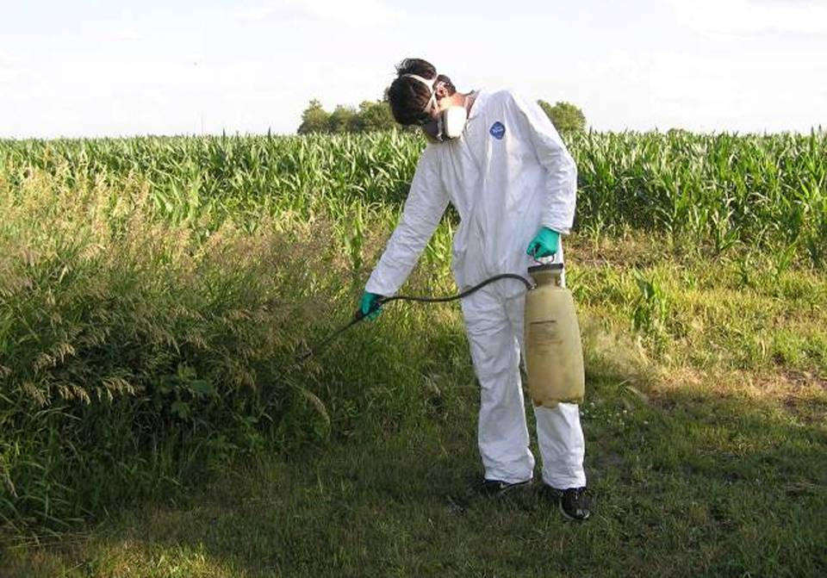
Prevent Exposure
Notes:
Photo AgriSafe Network – permission to use:
Part of review of Review of Work Practices
Prevent exposure.
Educate about the label
follow label directions for preventing exposure

Slide 32
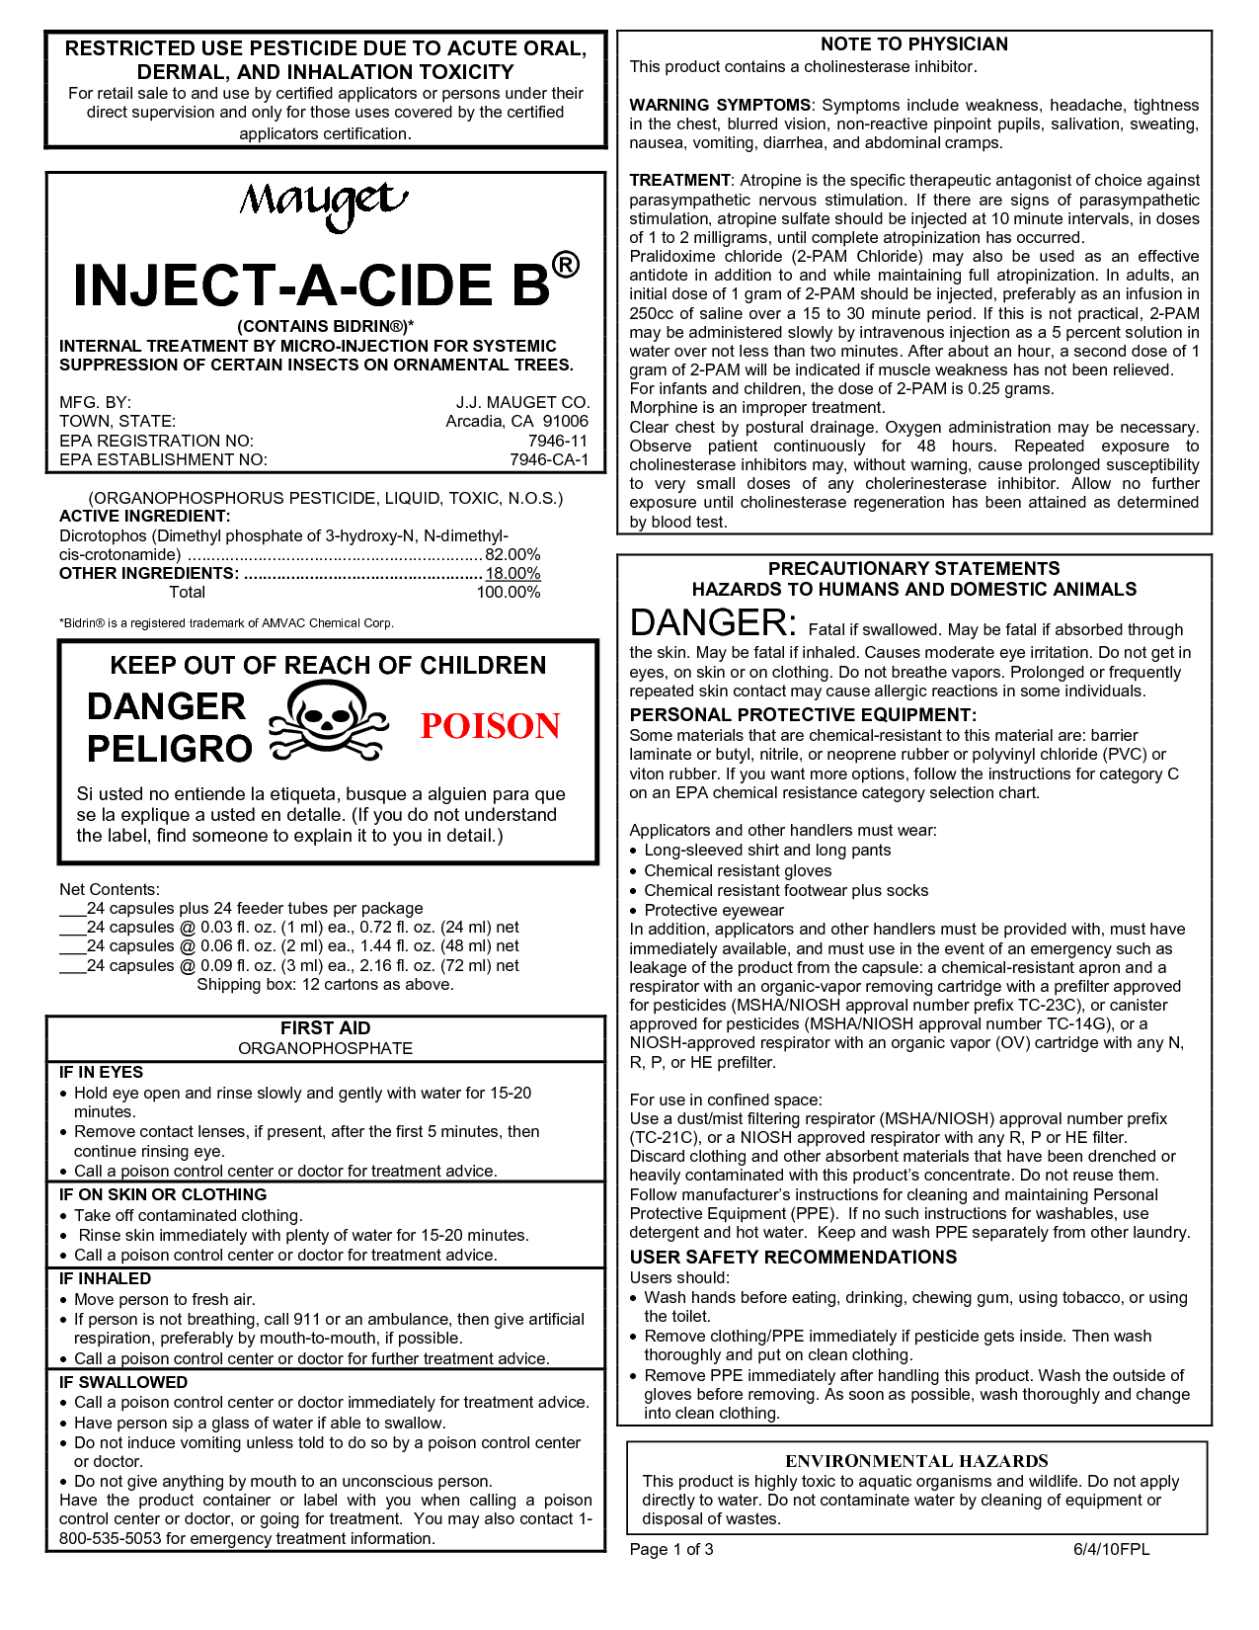
Education
Read the Label
  Look for "precautionary statement” which describes how poisonous the product is and how to best protect yourself
  Use of Restricted Pesticides requires specialized training and certification
Partner with organization offering the Pesticide Applicator Training
Notes:
Review of what the label looks like

Slide 33
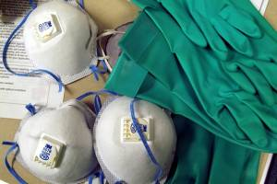


Personal Protective Equipment
Head to Toe Protection
Notes:
All photos from AgriSafe
Work Practices
Appropriate use of the right Personal Protective Equipment
Head to Toe Protection as indicated by the label
Determine where to find PPE in your area – provide that information to clients
Available from AgrSafe Network.org

Slide 34

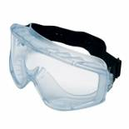


Reduce Chemical Risk
Wear head protection – waterproof disposable hood or plastic wide brim hat
Wear unlined, chemical resistant gloves (neoprene and nitrile are best) – do not wear cotton or leather
Chemical resistant aprons
Unlined rubber neoprene or PVC boots or shoes willing to discard
Wear eye protection – goggles with indirect vent and fog- free lenses
Disposable coveralls such as Tyvex or long sleeved shirts and pants
If label says wear a respirator – wear one
OSHA Standards: Agriculture Standards 29CFR1928 and
General Industry 29CFR 1910.132-139
Notes:
Reducing Chemical Risk
Examples of PPE that are used to Reduce Chemical / Pesticide risk
OSHA standards will reference the NIOSH and ANSI standards
Be sure to wear NIOSH and ANSI (American National Standards Institute) approved PPE
OSHA standards are law – where NIOSH and ANSI are consensus standards
OSHA Standard for PPE is Agriculture standards 29CFR1928
General 29CFR 1910.132 – 139 sub part H

Slide 35

Employee Rights and Responsibilities
You have the right to:
  A safe and healthful workplace
  Know about hazardous chemicals
  Information about injuries and illnesses in your workplace
  Complain or request hazard correction from employer
Notes:
35

Slide 36
Employee Rights and Responsibilities
You have the right to:
  Training
  Hazard exposure and medical records
  File a complaint with OSHA
  Participate in an OSHA inspection
  Be free from retaliation for exercising safety and health rights
Notes:
Eliminate picture that was here due to global harmonization which just came out
36

Slide 37
Employee Rights and Responsibilities
OSHA website: www.osha.gov and OSHA offices: Call or Write (800-321-OSHA)
Compliance Assistance Specialists in the area offices
National Institute for Occupational Safety and Health (NIOSH) – OSHA’s sister agency
OSHA Training Institute Education Centers
Doctors, nurses, other health care providers
Public libraries
Other local, community-based resources
Notes:
37

Slide 38


Resources
ChE Protocol
ChE Algorithm
EPA’s Recognition and Management of Pesticide Poisonings
Handbook of Pesticide Toxicology,1991
EPA Pesticide Guidelines
www.epa.gov/pesticides/
www.osha.gov
All Resources: www.migrantclinician.org/nutsandboltsresources
Notes:
Protocol and algorithm are available in PDF format
EPA Recognition and Management of Pesticide Poisonings is free of charge – contact EPA to have mailed – can also download on line. Will be updated soon. The new edition covers about 1,500 pesticide products in an easy-to-use format. Toxicology, signs and symptoms of poisoning, and treatment are covered in 19 chapters on major types of pesticides.
Handbook of Pesticide Toxicology:
EPA Pesticide Guidelines:
Resources are available online MCN web site and AgriSafe Network Website

Slide 39




The Nuts and Bolts of Cholinesterase Monitoring for Farmers, Ranchers and Agricultural Workers
March 28, 2012
Notes:
39

Slide 40
Disclaimers
This material was made possible, in part, from Grant Number U30CS09742 from the US Department of Health and Human Services, Bureau of Primary Health Care, Health Resources Services Administration. Its contents are solely the responsibility of the authors and do not necessarily represent the official views of the US Department of Health and Human Services.
This material was produced, in part, under Assistance Agreement No. X883487601 awarded by the U.S. Environmental Protection Agency. It has not been formally reviewed by EPA. EPA does not endorse any products or commercial services mentioned in this product.
This material was produced, in part, under grant SH-22284-11-60-F-19 from the Occupational Safety and Health Administration, U.S. Department of Labor. It does not necessarily reflect the views or policies of the U.S. Department of Labor, nor does mention of trade names, commercial products, or organizations imply endorsement by the U.S. Government.
Notes:
Material possible from
US Dept of Health and Human Services
EPA
OSHA

