Slide 1
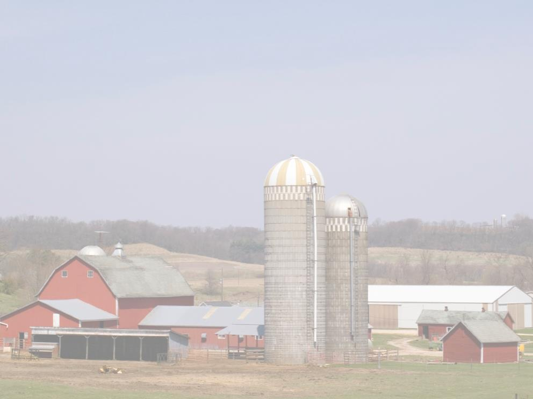
Grain Handling 29 CFR 1910.272
This material was produced under a grant (SH22284SH1) from the Occupational Safety and Health Administration, U.S. Department of Labor. It does not necessarily reflect the views or policies of the U.S. Department of Labor, nor does the mention of trade names, commercial products, or organization imply endorsement by the U.S. Government.

Slide 2
Program Objectives
At the conclusion of this presentation, participants will:
Be able to identify hazards associated with confined space work in the grain industry
Understand the process for confined space entry and lock out procedures
Be able to discuss the confined space housekeeping procedures involved in grain handling
Know where to look for OSHA references and resources related to confined space entry in the grain industry

Slide 3
Statistics: Involvement in Farming in the U.S.
2.1 Million farmers
2% of the population
Reference: http://www.epa.gov/oecaagct/ag101/demographics.html
Notes:
5
Here in the US it include about 2% of the population and we are seeing a shift from the family farm to larger production units.
Reference: http://www.epa.gov/oecaagct/ag101/demographics.html

Slide 4
Statistics of Injury/Mortality: U.S. in Agriculture
70,000 Disabling Injuries
596 Fatalities (2010)
26.8 deaths per 100,000 workers
Reference: www.bls.gov/news.release/pdf/cfoi.pdf
Notes:
7
Here in the US are injuries and fatality numbers are getting better but
Voluntary standard for tractor manufactures to install ROPS since 1985
26.8 deaths per 100,000 workers
Reference: www.bls.gov/news.release/pdf/cfoi.pdf

Slide 5
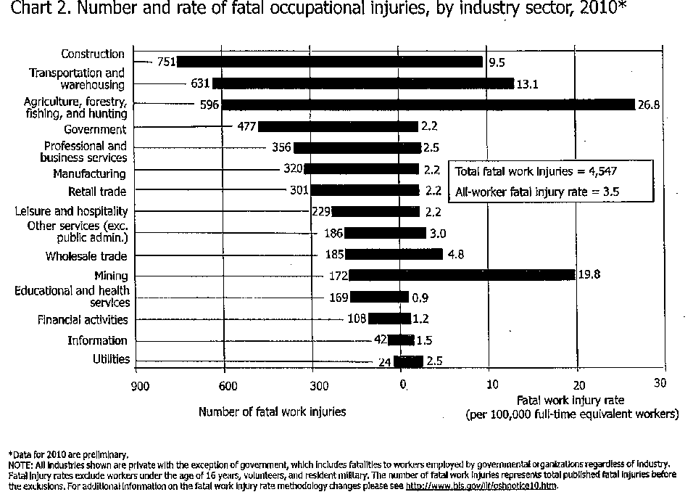
Notes:
Reference: www.bls.gov/news.release/pdf/cfoi.pdf

Slide 6
What is a Confined Space?
It is a space that:
Is large enough and so configured that an employee can enter and perform work;
Has limited or restricted means of entry and exit;
Is not designed for continuous human occupancy
Notes:
From the OSHA General Industry Standard 29 CFR 190.146’

Slide 7
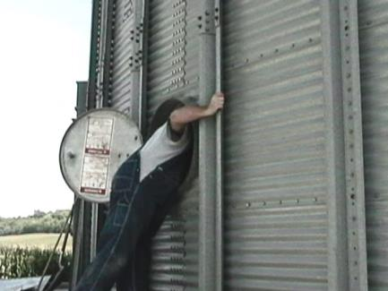
ENTRY
The act by which a person intentionally passes through an opening into a confined space.
Any part of the body passing through the opening is considered entry.
Notes:
From OSHA General Industry standard 29 CFR 1910.146

Slide 8
Potential Hazards in Confined Spaces
Oxygen Deficient
<19.5% oxygen
Oxygen Enriched
>23.5% oxygen
Flammable
Toxic Materials
Electricity
Mechanical Hazards
Temperature Extremes
Engulfment Hazards
Noise
Falling Objects
Slick/Wet Surfaces

Slide 9
IDLH
IMMEDIATELY DANGEROUS TO LIFE OR HEALTH
Any condition which poses an immediate threat to the life of an entrant, or;
Would cause irreversible adverse health effects, or;
Would interfere with an individual’s ability to escape unaided from a permit space.
Notes:
Source: NIOSH

Slide 10
IDLH
No person shall:
Enter – Work – or Remain
in an IDLH condition until such time that the condition has been eliminated or controlled.
Source: CDC/NIOSH
Notes:
Source:NIOSH

Slide 11
Confined Space - Hazards
O2
All living creatures require oxygen to live. One of the primary hazards of entering confined spaces is oxygen deficiency.
When oxygen is present in concentrations less than 19.5% the atmosphere is said to be oxygen deficient.
O2

Slide 12
Oxygen Deficient Atmospheres
19.5% Minimum acceptable oxygen level.
15 – 19% Decreased ability to work strenuously.
Impaired coordination.
12 – 14% Respiration increases - Poor Judgment.
10 – 12% Respiration increases – Lips Blue.
8 – 10% Mental failure – Fainting, Nausea, Unconscious, Vomiting.
6 – 8% Possible recovery 4-5 minutes, 50 percent fatal after 6 minutes, fatal after 8 minutes
4 – 6% Coma in 40 seconds – Death.
Source: NIOSH Datasheet
Notes:
Source: http://www.google.com/search?q=NIOSH+Oxygen+Deficient+Atmospheres+chart&ie=utf-8&oe=utf-8&aq=t&rls=org.mozilla:en-US:official&client=firefox-a

Slide 13
Confined Space - Hazards
Oxygen deficiency can be caused by several different processes:
Consumption: oxygen is used up by the person who is in the confined space and is turned into carbon dioxide.
Displacement: denser materials push the oxygen out of the confined space.
Reaction: oxygen reacts with other materials to make other compounds.

Slide 14
Flammable Atmospheres
Factors Needed:
Sufficient oxygen content
Flammable gas or vapor present
Proper air/gas mixture to cause fire or explosion
Typical Ignition Sources:
Sparking or electric tools
Static Electricity
Welding/Cutting Operations
Smoking
Ignition source from outside

Slide 15
Toxic Atmospheres
Toxic atmospheres can be caused by:
Product stored in a confined space.
Gases released drying grain.
Decomposition of materials stored.
Gases released when cleaning.
Oxidation of metals
Work Performed in a confined space.
Welding, cutting, painting, scraping, sanding, etc.
Toxic materials adjacent to a confined space.

Slide 16
Toxic Atmosphere - Carbon Monoxide
Odorless, Colorless Gas.
Is a Combustion By-Product.
People can quickly collapse at high concentrations.
PPM | Effect
50 | OSHA Permissible Exposure Level
200 | Slight headache, discomfort
600 | Headache, discomfort
1000 – 2000 | Confusion, nausea, headache Tendency to stagger Slight heart palpitation
2000 - 2500 | Unconsciousness (potentially fatal)
Notes:
Source:
Averaged over an 8 hour period

Slide 17
Temperature Extremes
Extremely hot or cold outside temperatures can magnify the temperature inside the confined space.
Steam cleaning can increase temperatures within a confined space.
Humidity factors can affect workers.
Work process inside the confined space can increase temperature extremes.
Wearing PPE can overheat the body.

Slide 18
Temperature Extremes
Attendant needs to keep a close watch on Entrant/Worker.
Worker will need frequent rest and water breaks.

Slide 19
Information from Dr. Charles Schwab, Iowa State University
Notes:
As you can see by the chart you can be buried waist deep in 15 seconds and completely submergered in 30 seconds
Permission to use this chart by Dr Chuck Schwab
Bury you with in minutes

Slide 20
Information from Dr. Charles Schwab, Iowa State University
Notes:
Note that you need 325 lbs of pressure to pull a 165 lb person trapped to their waist. You will injure a person trying to pull them out of the grain. Permission to use this chart by Dr Chuck Schwab

Slide 21
Three main reasons people get trapped in grain
1. Flowing Grain!
Notes:
This represents standing on top of the grain with the auger running (next slide)
Slide is used with permission of GSI INC

Slide 22
1. Flowing Grain!
Notes:
T he victim being the heaviest object in the bin sinks to the middle following the path of the grain to the auger. Slide is used with permission of GSI INC

Slide 23
2. Crusted Grain!
Notes:
These slide represent engulfment by crusted grain, where the grain is crusted at the top but fed out from the bottom of the bin. Slide is used with permission of GSI INC

Slide 24
2. Crusted Grain!
Notes:
The victim walked across the crusted or bridged grain and it collapses upon them engulfing them. Slide is used with permission of GSI INC

Slide 25
3. Grain Avalanche!
Notes:
Grain avalanche is the third way a victim can become entrapped by being inside the bin trying to loose the grain from the side of the bin. Slide is used with permission of GSI INC

Slide 26
3. Grain Avalanche!
Notes:
When they loosen the out of condition grain it collapses upon them engulfing the victim. Slide is used with permission of GSI INC

Slide 27
Rescue?
Notes:
Sending people into the bin for rescue could be dangerous for the victim and rescuer. Slide is used with permission of GSI INC

Slide 28
#1 - Stop Unloader
Notes:
Stop the auger using Lock out tag out procedures. Slide is used with permission of GSI INC
1910.272(g)(1)(ii)

Slide 29
#2 - Start Aeration
Notes:
If possible start the aeration system.
The electrical panel must be labeled to shut off the auger and turn on the aerations system
If the panel is not labeled you MUST Lock out and Tag out the whole system
Slide is used with permission of GSI INC

Slide 30
#3 - Call For Help!
Notes:
Mutual aid
Confined Space team
High Angle rescue team
More man power
Slide is used with permission of GSI INC

Slide 31

Rescue
Notes:
The rescuers must be tied off and have a helper at the door of the bin.
Care must be used when entering the bin as to not put more pressure on the victim or cause the grain to cone in around the victim.
If you are not trained in emergency response you should back out, call 911 and provide information to rescuers as they arrive on scene.
Slide is used with permission of GSI INC

Slide 32
Other Hazards
Noise
Amplified due to acoustics within the space.
Impairs effective communications.
Damages hearing.
Slick/Wet Surfaces
Slips and falls.
Increased chance of electrical shock.
Falling Objects
Topside openings expose workers inside confined space to falling objects.

Slide 33
General Requirements For Grain Structures
The employer shall issue a permit for entering bins, silos, or tanks, unless the employer or the employers representative is present during the entire operation.
The permit shall be kept on file until completion of the entry operations.
Notes:
272

Slide 34
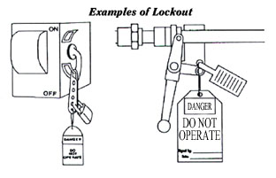
General Requirements
All mechanical, electrical, hydraulic and pneumatic which presents a danger to employees inside grain storage structures shall be de-energized and shall be disconnected, locked-out and tagged, blocked off, or otherwise prevented from operating from other equally effective means or methods.
Notes:
272

Slide 35
General Requirements
The atmosphere within a bin, silo or tank shall be tested for the presence of combustible gases, vapors and toxic agents when the employer has reason to believe they may be present.
Additionally the atmosphere within a bin, silo or tank shall be tested for oxygen content unless there is continuous natural air movement or continuous forced air ventilation before and during the period employees are inside.
Notes:
272
Still will want to test oxygen level during your time in the space

Slide 36
General Requirements
If the oxygen level is less than 19.5% or if combustible gas or vapor is detected in access of 10% of the lower flammable limit, or if toxic agents are present in excess of ceiling limits or present in concentrations that will cause health effects which prevent employees from effecting self-rescue or communication to obtain assistance then the following apply:

Slide 37
General Requirements
A - Ventilation shall be provided until the unsafe condition or conditions are eliminated, and the ventilation shall be continued as long as there is a possibility of recurrence of the unsafe condition while the bin, silo or tank is occupied by employees.
B - If toxic or oxygen deficiency cannot be eliminated by ventilation, employees entering the bin, silo or tank shall wear an appropriate respirator. Respirator use shall be in accordance with the requirements of 29 CFR.1910.134.

Slide 38
General Requirements
Walking down grain and similar practices where an employee walks on grain to make it flow within or out from a grain storage structure or where an employee is on moving grain are prohibited.

Slide 39
General Requirements
When ever an employee enters a grain storage structure from a level at or above the stored grain or grain products, or whenever an employee walks or stands on or in stored grain of a depth which poses an engulfment hazard, the employer shall equip the employee with a body harness with lifeline, or a boatswain’s chair.
The life line shall be so positioned and of sufficient length to prevent the employee from sinking further than waist-deep in the grain.
Exception – Where the employer can demonstrate that the protection required is not feasible or creates a greater hazard, the employer shall provide an alternative means of protection which is demonstrated to prevent the employee from sinking further than waist-deep in the grain.
Note – When the employee is standing or walking on a surface which the employer demonstrates is free from engulfment hazards, the lifeline or alternative means may be disconnected or removed.

Slide 40
General Requirements
An observer, equipped to provide assistance, shall be stationed outside the bin, silo or tank being entered by an employee. Communications (visual, voice, or signal line) shall be maintained between the observer and employee entering the bin, silo or tank.

Slide 41
General Requirements
The employee acting as an observer shall be trained in rescue procedures, including notification methods for obtaining additional assistance.

Slide 42
General Requirements
Employees shall not enter bins, silo, or tanks underneath a bridging condition, or where buildup of grain products on the sides could fall and bury them.

Slide 43
General Requirements
Entry into Flat Storage Structures -
each employee who walks or stands on or in stored grain where the depth of the grain poses an engulfment hazard, shall be equipped a lifeline or alternative means which the employer demonstrates will prevent the employee from sinking further than waist-deep in the grain.
Note – When the employee is standing or walking on a surface which the employer demonstrates is free from engulfment hazards, the lifeline or alternative means may be disconnected or removed.

Slide 44
General Requirements
Entry into Flat Storage Structures –
Whenever an employee walks or stands on or in stored grain or grain products of a depth which poses an engulfment hazard, all equipment which presents a danger to that employee shall be de-energized, and shall be disconnected , locked-out and tagged, blocked off, or otherwise prevented from operating by other equally effective means or methods.

Slide 45
General Requirements
Entry into Flat Storage Structures -
Walking down grain and similar practices where an employee walks on grain to make it flow within or out from a grain storage structure or where an employee is on moving grain are prohibited.
No employee shall be permitted to be either underneath a bridging condition, or in any other location where an accumulation of grain on the sides or elsewhere could fall and engulf that employee.

Slide 46
Training and Education
Employees assigned special tasks, such as bin entry and handling of flammable or toxic substances, shall be provided training to perform these tasks safely.
Note: training for an employee who enters grain storage structures includes training about engulfment and mechanical hazards and how to avoid them.
When Must Training Be Conducted?
New employees prior to starting work.
New and current employees, the employer shall provide training at least annually and when changes to job assignment will expose them to new hazards.

Slide 47
Confined Spaces Other Than Grain Storage Structures
Confined spaces other than grain storage structures such as boot pits, scale pits, tanks, and other are covered under:
29 CFR.1910.146 Permit Required Confined Spaces and as such Entry Permits, Atmospheric testing and other requirements must be followed as per 1910.146

Slide 48
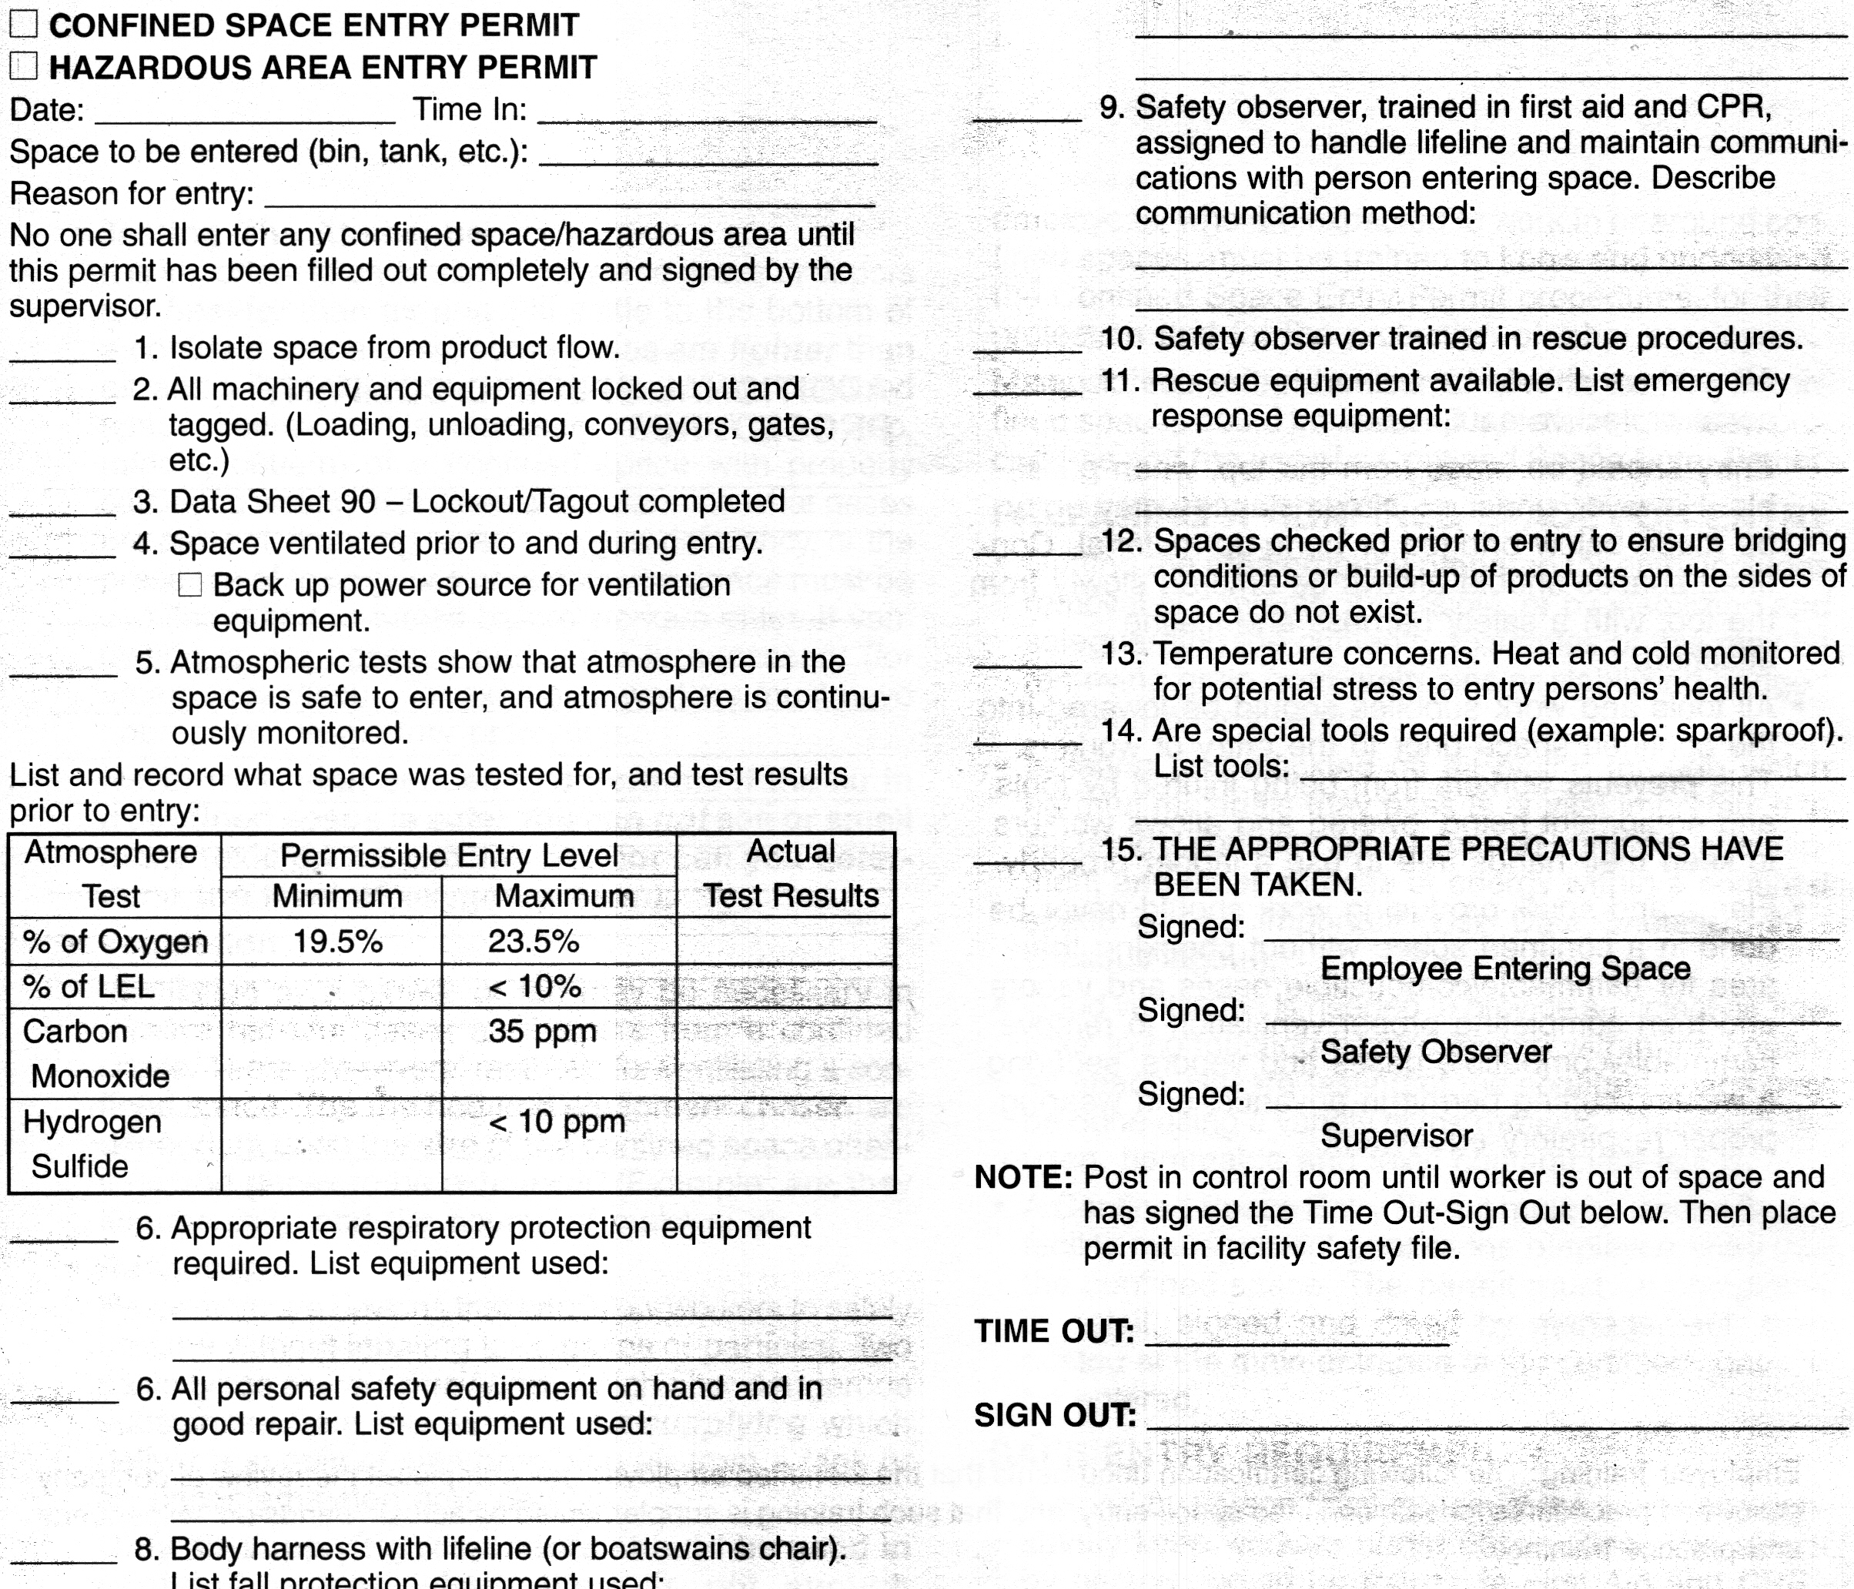
Permit-Required Confined Space Entry Procedure
Isolate the space
Ventilate the space
Test the atmosphere
Select PPE
Conduct Pre-Entry Briefing
Complete permit
Enter the space
Notes:
146

Slide 49
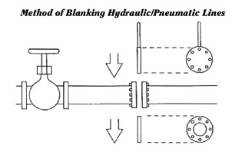
Isolate the Space from all hazards
Close Valves
Double block & bleed, or
Blank flange
Empty the Space
Depressurize, vent & drain
Lockout/Tagout Equipment
Electrical sources
Rotating/reciprocating parts
Hazardous materials
Clean residue from the space

Slide 50
Lockout/Tagout
OSHA Regulation 29 CFR 1910.147
“Lockout” To physically insure that all mechanical or electrical systems, that can be energized or started up, or release stored energy, are secured, isolated, disabled, or rendered inoperative.
“Tagout” The placement of a device to indicate that the energy isolating device and the equipment being controlled may not be operated until the tagout device is removed.
Notes:
This is the OSHA regulations to Lock out Tag out

Slide 51
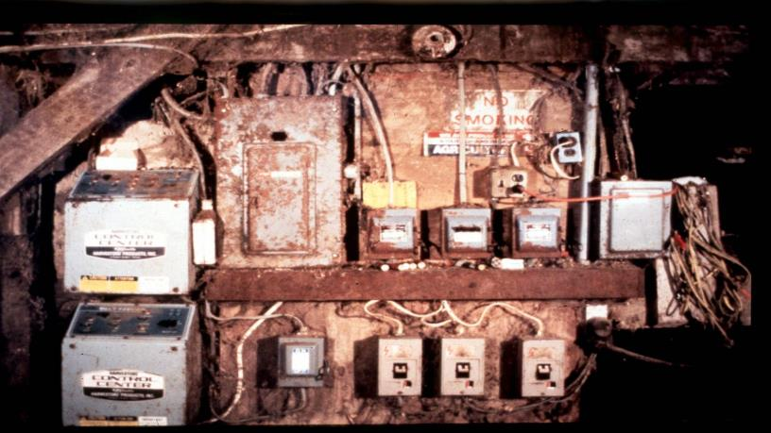
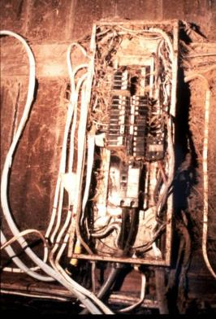
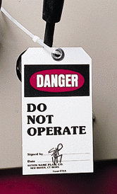
Lockout / Tagout
Where? How?
Notes:
Most farm electrical systems are not what you would call up to code. You may have to shut off power to the farm to be sure the bin is off.
Photo courtesy of GSI INC.

Slide 52
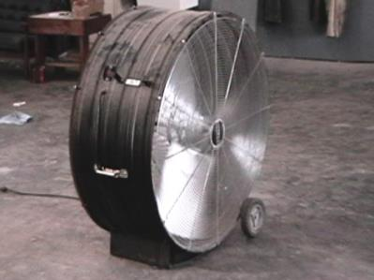
Ventilate the Space
Use mechanical ventilation
Fans
Ventilate at the rate of at least four (4) volumes per hour
Larger spaces require more ventilation
Make sure air supply is not contaminated
Ventilation air supply must be from fresh air uncontaminated with flammables, toxins, etc.
Gas powered fans can be Dangerous

Slide 53
Test the Atmosphere
In this order:
Check for Oxygen Content:
At least 19.5% and less than 23.5%
Check for Combustibles:
Less than 10% of the LEL
Check for Toxic Gases:
Most commonly carbon monoxide (PEL 50 ppm)
or any other hazardous materials as determined by the use of the space.
Notes:
The 4 gas detector needs to be tested regularly. Bump test (Calibration) before every use. Follow manufactures recommendation.

Slide 54
Atmosphere Testing Shall Be Performed:
Prior to every entry when the space is vacant;
At least hourly for permit-required confined spaces.
More frequently, if conditions or suspicions warrant.

Slide 55
Always test the
air at various levels
to be sure that the
entire space is safe.
Good Air
Poor Air
Good air near the opening does NOT mean there is good air at the bottom!
Deadly Air

Slide 56







Personal Protective Equipment
Hard Hats
Eye Protection
Hearing Protection
Respirator
Protective Coveralls
Gloves
Footwear
Safety Harness
Once all the hazards are identified, the space has been ventilated and the atmosphere checked, determine what personal protective equipment will be necessary.

Slide 57
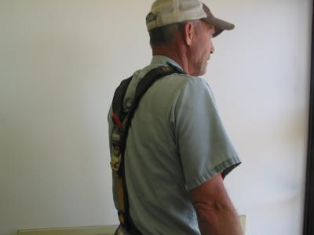
Personal Protective Equipment
Each entrant shall use a chest or full body harness or a boatswain’s chair, with a retrieval line attached to assist in removal.
Exception – Where the employer can demonstrate that the protection required is not feasible or creates a greater hazard, the employer shall provide an alternative means of protection which is demonstrated to prevent the employee from sinking further than waist-deep in the grain.
Notes:
Picture is from the National Education Center for Agricultural Safety. Permission given to use photo

Slide 58
Conduct a Pre-Entry Briefing
Entire crew must attend
Attendants, entrants, entry supervisor
Review hazards of entry and work
Review PPE
Review procedure for contacting rescue
verify rescue is available
Complete permit

Slide 59
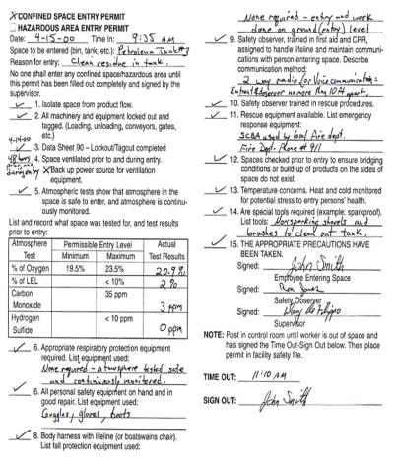
Complete Entry Permit Form
Permit must be correctly and completely filled out prior to entry.
Permit must be activated by Entry Supervisor’s signature to be valid.
No entry is allowed without a valid permit.
When work is completed, permit and evaluation form should be returned to your Safety Dept.
Cancelled permits must be kept on file for at least one year.
Notes:
146

Slide 60
Enter the Space and Proceed with work:
An attendant shall be posted near the entrance for the duration of the work. He shall be in constant communication with the entrants while the job is in progress.
All entrants shall sign a sign-in-log when entering the space and sign out when exiting.
The attendant shall maintain the permit and sign in log for the duration of the work.

Slide 61
When the Job is Done:
Remove all personnel, tools, and debris from the space. Sign off the permit.
Close the space.
Cancel the permit.
Review the job with all personnel (hazards, problems, etc.)

Slide 62
HOUSEKEEPING
Employer required to develop and implement a written housekeeping program
Determines the best process to reduce fugitive grain dust on all exposed surfaces
Establish housekeeping priority areas
Floor area within 35ft of bucket elevators
Enclosed grinding equipment
Interior enclosed grain drying areas
Notes:
272

Slide 63
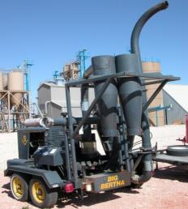
HOUSEKEEPING
Dust Accumulation
Fugitive grain dust accumulations exceeds 1/8 inch (.32 cm) must be removed immediately
Vacuuming or damp sweeping minimize dust being suspended in the air
Blow down of dust with compressed air, only permitted when all ignition sources are shut-down
Grain spills are not considered to be dust accumulations
Notes:
272
Do not dry sweep

Slide 64

PREVENTIVE MAINTENANCE
Effective means in reducing explosion hazards
Perform regularly scheduled inspections
Mechanical and safety control equipment
Lubrication and other appropriate maintenance
All failed equipment shall be repaired or removed from service
Out of Service

Slide 65
PREVENTIVE MAINTENANCE
Lock out of failed equipment
Prevent inadvertent application of energy or motion to equipment, which could result in employee injury
A lock is the positive means to prevent operation of the disconnected equipment
Tags inform employees why equipment is locked out
To ensure safety locks and tags only be removed by
Employees that placed them
or by their supervisor
Under Repair

Slide 66
Uniqueness of Working with Grain
Distinctive hazards
Dust accumulation – fire & explosion
Engulfment
Mechanical, electrical, hydraulic, & pneumatic equipment
Specialized work tasks
Hot works
Fall protection
Rescue
Confined spaces
Respirator use
Clearing chocked legs
General safety precautions related to working with grain

Slide 67
Confined Space Rescue
Means of emergency rescue
must be readily available
to the confined space
entry attendant for
emergency
extrication of
entrants.

Slide 68
Standby/Rescue Personnel
A worker who is assigned to remain outside a confined space must be:
In constant contact with the workers inside.
Know emergency procedures.
Be trained in the use of emergency rescue equipment and PPE.
50% of workers who die in confined spaces are would-be rescuers.

Slide 69
Confined Space Rescue
The attendant should
attempt to remove the
entrant from the confined
space using tripods, hoist, and
lifelines. Attendants are NOT
TO ENTER CONFINED
SPACES. Lethal hazards may
be present within the confined
space. Only properly equipped
and trained emergency rescue
personnel may enter confined
spaces to make rescues.

Slide 70
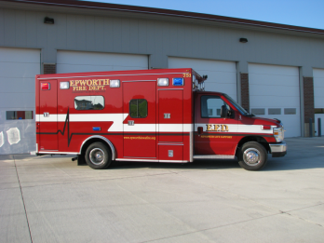
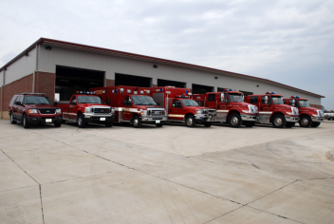
Confined Space Rescue - Who Will Respond -
In House Rescue?
Fire Department?
Rescue Squad?
Prior to confined space entry, rescue services must be identified.

Slide 71
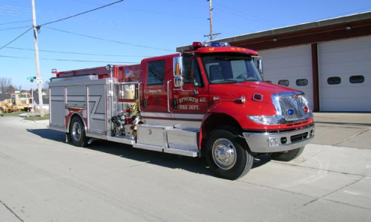
Confined Space Rescue Services
Must evaluate your confined spaces.
Be provided access for training at your facilities and …
If they don’t have the proper rescue equipment then you must provide it.

Slide 72
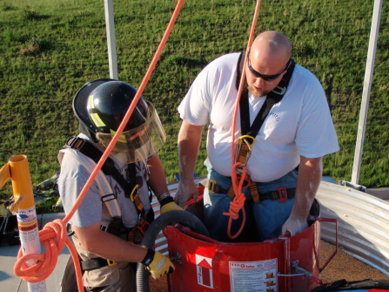
Confined Space Rescue
REMEMBER
Proper planning and training for confined space rescue can make the difference between rescue or recovery.
Notes:
Photo is from a NECAS training at the Epworth Iowa Fire department. Permission given for the use of the photo.

Slide 73
Employee Rights and Responsibilities
You have the right to:
A safe and healthful workplace
Know about hazardous chemicals
Information about injuries and illnesses in your workplace
Complain or request hazard correction from employer
Notes:
73

Slide 74
Employee Rights and Responsibilities
You have the right to:
Training
Access to Hazard exposure and medical records
File a complaint with OSHA
Participate in an OSHA inspection
Be free from retaliation for exercising safety and health rights
Notes:
74

Slide 75
Employee Rights and Responsibilities
OSHA website: www.osha.gov and OSHA offices: Call or Write (800-321-OSHA)
Compliance Assistance Specialists in the area offices
National Institute for Occupational Safety and Health (NIOSH) – OSHA’s sister agency
OSHA Training Institute Education Centers
Doctors, nurses, other health care providers
Public libraries
Other local, community-based resources
Notes:
75

Slide 76
Disclaimers
This material was produced under a grant (SH22284SH1) from the Occupational Safety and Health Administration, U.S. Department of Labor. It does not necessarily reflect the views or policies of the U.S. Department of Labor, nor does the mention of trade names, commercial products, or organization imply endorsement by the U.S. Government.
Notes:
Material possible from
US Dept of Health and Human Services
EPA
OSHA

Slide 77
Summary
Confined spaces are entered safely every day. However, for them to be entered safely, specific procedures must be followed.
It is hoped that the information provided in this program gives you the information needed to enter the spaces that you may encounter safely.

