Slide 1

Understanding OSHA’s Agriculture Exemption/Standards

Slide 2

Disclaimers
This material was produced under a grant (SH22284SH1) from the Occupational Safety and Health Administration, U.S. Department of Labor. It does not necessarily reflect the views or policies of the U.S. Department of Labor, nor does the mention of trade names, commercial products, or organization imply endorsement by the U.S. Government.

Slide 3

Occupational Safety and Health Act of 1970
The OSH Act was passed to prevent workers from being killed or seriously harmed at work. The law requires employers to provide their employees with working conditions that are free of known dangers. The Act created the Occupational Safety and Health Administration (OSHA), which sets and enforces protective workplace safety and health standards. OSHA also provides information, training and assistance to workers and employers. Workers may file a complaint to have OSHA inspect their workplace if they believe that their employer is not following OSHA standards or that there are serious hazards.
Source: OSHA.gov – OSH Act

Slide 4

Employee Rights and Responsibilities
You have the right to:
A safe and healthful workplace
Know about hazardous chemicals
Information about injuries and illnesses in your workplace
Complain or request hazard correction from employer

Slide 5
Employee Rights and Responsibilities
You have the right to:
Training
Access to hazard exposure and medical records
File a complaint with OSHA
Participate in an OSHA inspection
Be free from retaliation for exercising safety and health rights

Slide 6
Employee Rights and Responsibilities
OSHA website: www.osha.gov and OSHA offices: Call or Write (800-321-OSHA)
Compliance Assistance Specialists in the area offices
National Institute for Occupational Safety and Health (NIOSH) – OSHA’s sister agency
OSHA Training Institute Education Centers
Doctors, nurses, other health care providers
Public libraries
Other local, community-based resources

Slide 7
Objectives of Webinar
Identify OSHA standards specific to Agriculture
Identify General Industry OSHA standards that should be considered in Agriculture
Understand OSHA exemption
Differentiate between Federal OSHA, State OSHA, NIOSH, EPA (Environmental Protection Agency) and WPS (Worker Protection Standard)
Disseminate resources to aid in OSHA standard compliance
Notes:
State what the initials mean or spell out
WPS is Worker Protection Standard

Slide 8
Limitations
This one hour webinar is NOT intended to replace
Business research and investment into understanding OSHA standards
Trainings that reflect OSHA standards
Safety professional’s responsibility to follow standards
Notes:
Information is awareness level training and providing resources

Slide 9

Health Hazard Evaluation
NIOSH Health Hazard Evaluation Program
In addition to the resources available from OSHA to address workplace health concerns, assistance also is available from the Health Hazard Evaluation (HHE) program of the National Institute for Occupational Safety and Health (NIOSH).
Through the HHE program, NIOSH responds to requests for evaluations of workplace health hazards from employers, employees and their representatives, and government agencies. Workplace exposures studied include chemicals, biological agents, work stress, noise, radiation, and ergonomics. Upon completion of the study, NIOSH issues a report that includes recommendations for addressing identified problems, reducing exposure, and preventing disease..

Slide 10

How HHES Could be Helpful
HHEs can be especially helpful in the following situations:
Employees have an illness from an unknown cause.
Employees are exposed to an agent or working condition that is not regulated by OSHA.
Employees experience adverse health effects from exposure to a regulated or unregulated agent or working condition, even though the permissible exposure limit is not being exceeded.

Slide 11
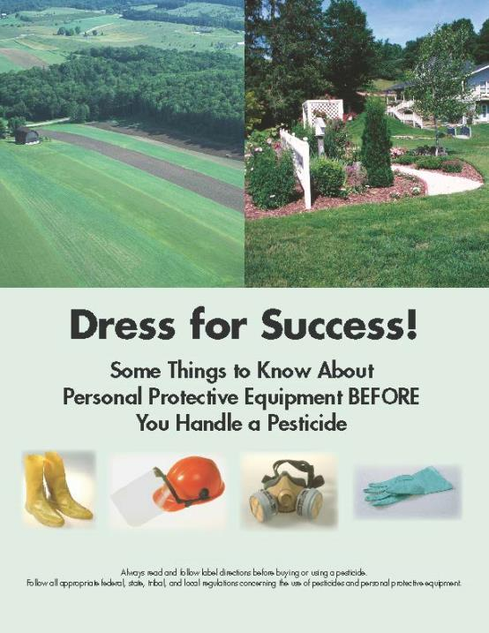
National Pesticide PPE Training Solutions Committee
Notes:
Brochure focuses on some of the basics of PPE but does not substitute for following the pesticide label, the PPE user instructions, and all applicable government regulations to reduce exposure, the required PPE must be handled properly from purchase through disposal, whether you apply a pesticide at home, or work in an agricultural or non-agricultural occupation.
The plan is to use it as a template for creating the comprehensive brochure with the committee.
1) Anyone can order quantities of the actual brochure from me for their pesticide safety/stewardship outreach efforts. The brochures are free.
2) The PDF version of the brochure will be available on the Pesticide Environmental Stewardship (PES) website, the NACAA website, and the Syngenta website in a week or so. Any other organization desiring to post the brochure or link to it is welcome to do so.
3) With the addition of this brochure, there will now be seven general pesticide stewardship brochures on the PES website (http://pesticidestewardship.org/Pages/Resources.aspx). Anyone can view or download these brochures from PES, or order quantities for pesticide stewardship outreach. PES also welcomes new partners that provide content, editorial assistance, or financial support, so any organization that assisted with the PPE brochure is already eligible to join!
4) All of the partners on these seven brochures have also agreed to provide the Word versions to any organization desiring to modify or extract content, and/or put their own logo on the brochure. The goal is widespread distribution of basic messages related to pesticide stewardship and safety.
It was a pleasure working with the National Pesticide PPE Training Solutions Committee. After committee members review the PPE brochure, we would welcome opinions on whether it should be translated to Spanish “as is�, or used to prepare a two-sided handout at the 6-8th grade reading level in English and Spanish. These were previous requests from members of the Committee.

Slide 12

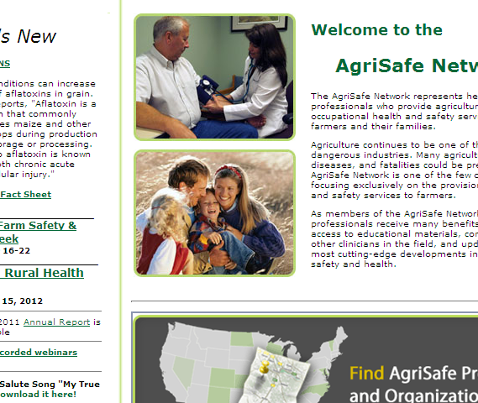
AgriSafe Website Resources

Slide 13

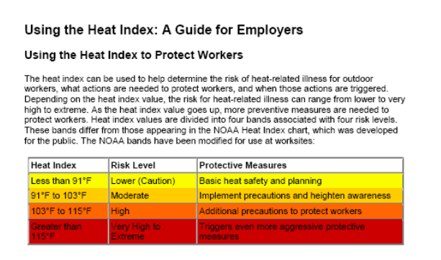
Modern Approach
OSHA Heat Index Application
Notes:
Source: OSHA.gov
If you haven’t spent time looking at what OSHA has to offer you may not be aware of all of the resources that are available to promote worker safety and health.
Safety and Health Topic pages
Water Rest Shade
Smart Phone application
This is a good example of how things change on the website and are based on current urgent topics.

Slide 14

Navigating OSHA Standards
Understanding standards, regulations, terminology, and definitions is not always easy
Understanding how OSHA relates to agriculture can be confusing…but there is help and access to resources
29 CFR refers to Title 29 Code of Federal Regulations (Standards)
Notes:
Introductory slide

Slide 15


Agriculture OSHA Resources
Available on www.OSHA.gov Website
In search bar type
Agriculture Operations Safety and Health Topics
Notes:
Go to our website to find more information

Slide 16

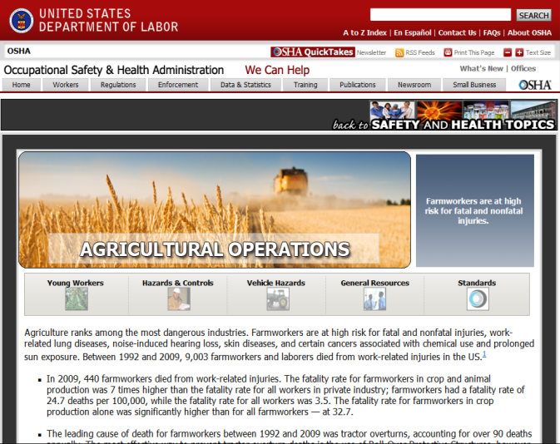
Agriculture Operations Safety and Health Topics Page
General Resources

Slide 17

Agriculture Operations Safety and Health Topics Page
Standards

Slide 18
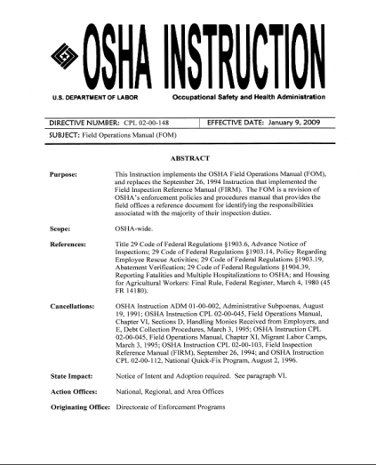
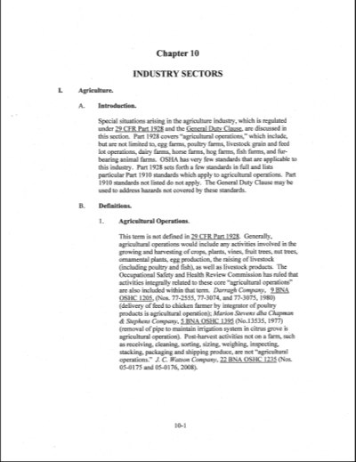
OSHA Instruction Field Operations Manual
Chapter 10
Agriculture

Slide 19

Polling Question
Do you work in a state that has a state OSHA program?
Notes:
Add as an evaluation question or cross reference report from Go to Webinar

Slide 20
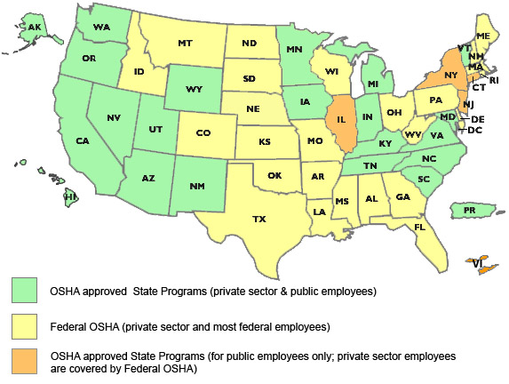
OSHA Approved State Programs
Alaska Arizona California Hawaii Indiana Iowa Kentucky | Maryland Michigan Minnesota Nevada New Mexico North Carolina Oregon | South Carolina Tennessee Utah Vermont Virginia Washington Wyoming Puerto Rico
Notes:
Source: OSHA.gov
How to get in contact with your state plan
Google
with in state department of labor

Slide 21
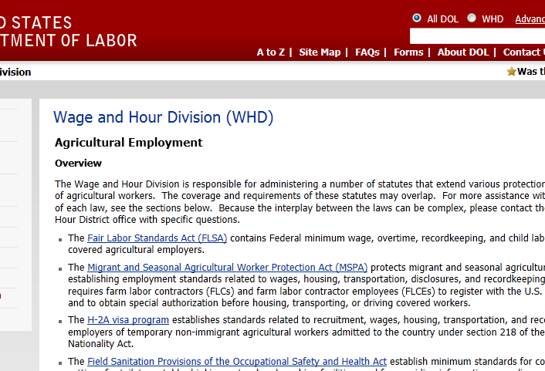

Wage and Hour Division (WHD) State Plan - State Information

Slide 22
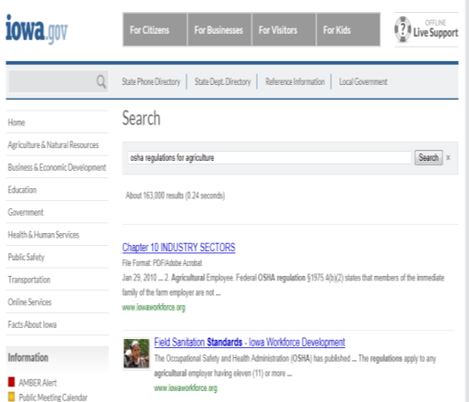
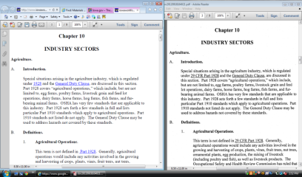
Example - Iowa
State plan must meet Federal Regulation and can exceed Federal
Chapter 10
State
Federal

Slide 23
Polling Question
Agricultural Businesses that have less than 10 employees do not need to have an understanding of OSHA standards.
Notes:
Yes
No
Show results – state how many said yes and said no
One of the reasons have this webinar
To get number of people who gained knowledge – will add as an evaluation questions

Slide 24

Ag Exemption
Enforcement Guidance for Small Farming Operations
The Appropriations Act exempts small farming operations from enforcement of all rules, regulations, standards or orders under the Occupational Safety and Health Act. A farming operation is exempt from all OSHA activities if it:
Employs 10 or fewer employees currently and at all times during the last 12 months; and
Has not had an active temporary labor camp during the proceeding 12 months.
Source: OSHA Instruction CPL 02-00-051

Slide 25

Enforcement
What does exempt from enforcement of all rules, regulations, standards or orders mean?
Can’t use Federal funds to inspect or cite.
A state plan can’t use federal funds to inspect - but the state plans can use state funds to inspect.
Notes:
If exempt – encourage to comply
Can’t use Federal funds to inspect or cite
A state plan can’t use federal funds to inspect ---- but the state plans can use state funds to inspect.
Can call local state plan to find out - contact information is located on OSHA.gov

Slide 26
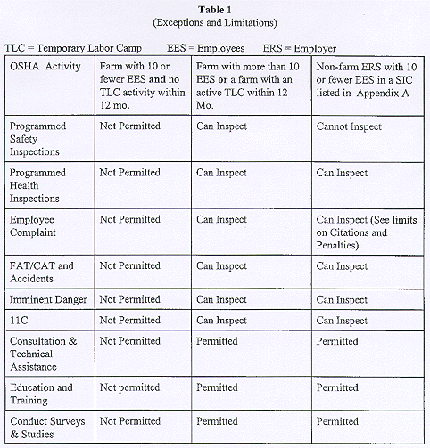
OSHA General Enforcement Guidelines Table
Source: OSHA.gov
Notes:
Appropriations Act
This table gives you the break down of Federal OSHA and how they can use federal funding for inspection and citation
Remember the state plan may have the ability to do something different

Slide 27

Injury or Fatality
Does the Exemption still hold true with injuries and a fatality? YES
Small farms, however, are not actually exempt from OSHA regulations because:
Legally OSHA covers all farms, even though OSHA cannot inspect or cite farms with 10 or fewer employees.
One important reason for understanding that small farms still fall under OSHA is that, in a court of law, OSHA rules and regulations may be used to identify safe and unsafe conditions on the farm.
State plan - state may be more stringent based on the state regulations.
Notes:
Federal OSHA may send someone out to confirm the information;
if they found out that it was actually agriculture SIC and there were 10 or fewer employees, then would back out at that time.
State OSHA may continue if use state funds and not federal funds
Personal liability issue
State plans may have more stringent regulations
Have to accept Federal OSHA (minimum standards)

Slide 28
Define your farming operation:
Do you have employees?
Source: Occupational Safety & Health Act 1970

Slide 29
Farming Operation
A "farming operation" means any operation involved in the growing or harvesting of crops, the raising of livestock or poultry, or related activities conducted by a farmer on sites such as farms, ranches, orchards, dairy farms or similar farming operations.
Source: OSHA.gov
Notes:
Find your SIC code to determine classification as a business
Workers Compensation insurance will know this
If a corporation – the corporation has to be registered in the state
It is your responsibility to know what classification your business is – you may be classified as general business versus agriculture.

Slide 30

Standard Industrial Classification (SIC)
These are employers engaged in businesses that have a two digit Standard Industrial Classification (SIC) of 01 (Agricultural Production - Crops), 02 (Agricultural Production - Livestock and Animal Specialties), and four digit SIC 0711 (Soil Preparation Services), 0721 (Crop Planting, Cultivating, and Protecting), 0722 (Crop Harvesting, Primarily by Machine), 07 61 ( Farm Labor Contractors and Crew Leaders), and 07 6 2 Farm Management Services).
Insurance policy – tax preparers
(example: Christmas Tree Growers)
Notes:
Need to know what classification is for the businesses
Workers comp insurance will know the code
Factory
agriculture

Slide 31
Employees
Do you employ 10 or fewer people (excluding family) at any time during the year?
Background. In providing funding for OSHA, Congress has placed restrictions on enforcement activities regarding two categories of employers:
small farming operations
small employers in low-hazard industries. The Appropriations Act contains limits for OSH Act activities on a year-by-year basis.

Slide 32

Family Members
Family members of farm employers are not counted when determining the number of employees.
Who are family members:
Children
Spouse
Parents
Grandparents
OSHA typically looks at blood relatives, spouses, or immediate relatives.
Notes:
OSHA typically looks at blood relatives and spouses.
Chapter 10 states – Immediate family members.
Case by case basis may take the EPA definition.
This can still be seen as a gray area.
Legally a family member (step child, adopted)

Slide 33

WPS definition
However under the Worker Protection Standard their family exemption states the following:
The Agricultural Worker Protection Standard 40 CFR Parts 156 & 170 Interpretive Policy 7.17 Immediate family exemption states the following:
The rule defines immediate family as including only spouse; children; step children; foster children; parents; stepparents; foster parents; brothers; and sisters. (40 CFR part 170.3)
source: EPA.gov
Notes:
WPS defines this differently that OSHA

Slide 34

Temporary Labor Camp
A "temporary labor camp" means farm housing directly related to the seasonal or temporary employment of farm workers. "Housing" includes both permanent and temporary structures located on or off the property of any employer who meets the above definition.
Source: OSHA.gov --- http://www.osha.gov/pls/oshaweb/owadisp.show_document?p_table=DIRECTIVES&p_id=1519#GEN
Notes:
Use OSHA.gov Search box and put in your topic

Slide 35
Housing on Farm
Scenario: Farmer employs a hired man. He and his family live in a house on the farm with his wife and children. The hired man does not pay rent or utilities.
This is not considered a temporary labor camp according to OSHA.
Temporary labor camp is considered a group of people who come in to do a specific task.
Leave after the job is done. Mobile
Notes:
Temporary labor camp is considered a group of people who come in to do a specific task. Leave after the job is done. Mobile

Slide 36

Polling Question
Is the OSHA General Duty Clause ever applicable to Agriculture
Notes:
Add this as an evaluation question
Yes or No
Answer is Yes

Slide 37
General Duty vs Ag Standards
OSHA has an Agriculture standard (29 CFR 1928)
If the hazard cannot be addressed in the Agriculture Standard (29 CFR 1928) OSHA defers to the General Industry Standard (29 CFR 1910)
If there is not a standard that is applicable to agriculture in the General Industry Standards then go to the General Duty Clause Section 5(a)(1)
Each employer shall furnish to each employee a place of employment which is free from recognized hazards that are causing or are likely to cause death or serious harm
Each employer shall comply with defined OSHA standards
Notes:
If you look at the Ag operations standard tab
1928 standards (limited number)
handful of general industry standards that are applicable to Ag (7)
If outside of those 7standards then go to the general industry (general duty clause) standard
So if you do not fall under the AG Exemption and your state is not more stringent than Federal OSHA – this is how OSHA would work to determine if they can cite or fine you.
If your state is more stringent you may have to follow additional standards even if you meet the Ag Exemption
- Example is California

Slide 38

General Duty Clause
Section 5(a)(1) of the OSH Act, often referred to as the General Duty Clause, requires employers to "furnish to each of his employees employment and a place of employment which are free from recognized hazards that are causing or are likely to cause death or serious physical harm to his employees".
Section 5(a)(2) requires employers to "comply with occupational safety and health standards promulgated under this Act".

Slide 39


State to State
Important to check with your state OSHA since there are 25 states that match or exceed this OSHA Instruction

Slide 40

Ag standards
Occupational Safety & Health Act of 1970 – Federal Laws & Regulations Affecting Agricultural Employers (29 CFR 1928)
8 sections
. 1 Purpose and Scope
. 21 Applicability and standards
Followed by 6 specific Agriculture standards

Slide 41
OSHA Standards Specific to Agriculture
29 CFR 1928.51: Roll over protective structures (ROPS) for agricultural tractors – refers to 2 or 4 wheel drive or track vehicles of over 20 horsepower
29 CFR 1928.52: Protective frames for wheel-type agricultural tractors
29 CFR 1928.53: Protective enclosures for wheel-type agricultural tractors

Slide 42
OSHA Standards Specific to Agriculture
29 CFR 1928.57: Guarding of farm field equipment, farmstead equipment, and cotton gins
29 CFR 1928.110: Field Sanitation – refers to provision of drinking water, hand washing and toilet facilities for hand labor workers.
29 CFR 1928.1027: Cadmium – refers to exposure to toxic metal fumes; some phosphate sources in fertilizer may contain cadmium(*also identified under General Industry 29 CFR 1910.1027)

Slide 43
General Industry
Some standards are general industry standards (29 CFR 1910)
Need to be aware of these because OSHA can cite under the General Industry standards
Examples

Slide 44

General Industry applicable standards
29 CFR 1910.142: Temporary Labor Camps
29 CFR 1910.111(a) and (b): Storage & Handling of Anhydrous Ammonia
29 CFR 1910.266: Logging Operations
29CFR 1910.145: Slow Moving Vehicles
29 CFR 1910.1201: DOT Markings
29 FR 1910.1200: Hazard Communication (changes)
29 CFR 1910.1027 Cadmium (welding, grinding, painting)
These standards can be cited directly
Reference Chapter 10

Slide 45

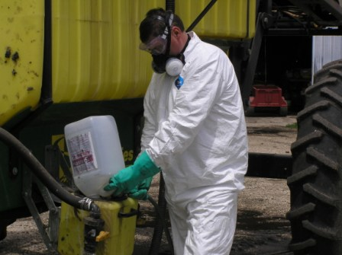
Hazard Communication
What is the new Hazard Communication Standard?
How does it impact Agriculture?
Notes:
Photo property of AgriSafe Network

Slide 46

Hazard Communication
1910.1200, Hazard communication
The purpose of this section is to ensure that the hazards of all chemicals produced or imported are classified, and that information concerning classified hazards is transmitted to employers and employees.
This transmittal of information is to be accomplished by means of comprehensive hazard communication programs, which are to include container labeling and other forms of warning, safety data sheets and employee training.

Slide 47

Hazard Communication
New changes to the Occupational Safety and Health Administration's (OSHA) Hazard Communication Standard are bringing the United States into alignment with the Globally Harmonized System of Classification and Labeling of Chemicals (GHS)
The Hazard Communication Standard in 1983 gave the workers the ‘right to know,' but the new Globally Harmonized System gives workers the ‘right to understand.‘
OSHA Fact Sheet
Hazard Communication Standard Final Rule http://www.osha.gov/dsg/hazcom/HCSFactsheet.html
Notes:
New changes to the Occupational Safety and Health Administration's (OSHA) Hazard Communication Standard are bringing the United States into alignment with the Globally Harmonized System of Classification and Labeling of Chemicals (GHS), further improving safety and health protections for America's workers. Building on the success of OSHA's current Hazard Communication Standard, the GHS is expected to prevent injuries and illnesses, save lives and improve trade conditions for chemical manufacturers. The Hazard Communication Standard in 1983 gave the workers the ‘right to know,' but the new Globally Harmonized System gives workers the ‘right to understand.'

Slide 48

Hazard Communication
For Agriculture, the labeling of pesticides will remain the same
The only exemption is the labeling requirement for pesticides covered under FIFRA (Federal Insecticide, Fungicide, Rodenticide Act) ; other chemical hazards would be required to have the new labeling.
If it is a pesticide, and the employer would be covered under OSHA (more than 10 people), then the other requirements, such as new Safety Data Sheets (SDSs), formerly MSDSs, and training would be needed under the new standard.
Notes:
The only exemption is the labeling requirement
Need to comply with everything else including training

Slide 49



Additional OSHA Standards related to Agriculture
29 CFR 1910.134: Respiratory Protection
29 CFR 1910.95: Hearing Conservation & Noise Exposure
29 CFR 1910.133: Eye & Face Protection
29 CFR 1910.132: General Requirements for Personal Protective Equipment

Slide 50
Additional General Industry Standards to be aware of
29 CFR 1910.22 -28: Slips, Trips, & Falls – refers to walking surfaces, working surfaces, ladders, and scaffolding.
29 CFR 1910.14 6 -147: Confined Space Entry – refers to definition of confined space, hazards, lock out/tag out.

Slide 51
Webinars
AgriSafe Network Webinars related to these topics
Personal Protective Equipment for Agricultural Producers
Cholinesterase Monitoring
Slips, Trips, and Falls Prevention
Respiratory Protection for Agricultural Producers

Slide 52
Polling Question
OSHA establishes Worker Protection Standards in Agriculture?

Slide 53


OSHA and EPA
Notes:
Relationship
Role of OSHA – primary role for worker protection
Role of EPA – primary purpose – environmental – cover other things such as Worker Protection (will cover next)
How they work together
Memorandum of understanding
In 1991, EPA and OSHA signed a Memorandum of Understanding, The purpose of this interagency Memorandum of Understanding (MOU) is to establish and improve the working relationship between the Office of Enforcement of the Environmental Protection Agency (EPA) and the Occupational Safety and Health Administration (OSHA) of the Department of Labor.
The goals of the agencies are to improve the combined efforts of the agencies to achieve protection of workers, the public, and the environment at facilities subject to EPA and OSHA jurisdiction; to delineate the general areas of responsibility of each agency; to provide guidelines for coordination of interface activities between the two agencies with the overall goal of identifying and minimizing environmental or workplace hazards.

Slide 54
Worker Protection Standard
Regulation aimed at reducing the risk of pesticides and injuries among agricultural workers and pesticide handlers.
Contains requirements for:
pesticide safety training
notification of pesticide applications
use of PPE
restricted entry after pesticide application
decontamination supplies
emergency medical assistance
Recognition and Management of Pesticide Poisonings Manual
Information available at: www.epa.gov

Slide 55

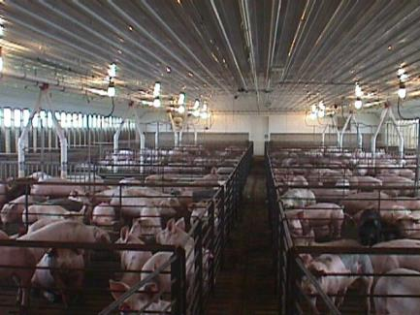
Case Study – Hog confinement
Hog confinement farm
8 full time employees
5 Seasonal workers – live in trailer on site.
Notes:
Photo property of AgriSafe Network

Slide 56

Hog case study response
Does not meet Agriculture exemption
OSHA has ability to follow general enforcement activities
No family members
More than 10 employees
Temporary labor camp in past 12 months

Slide 57

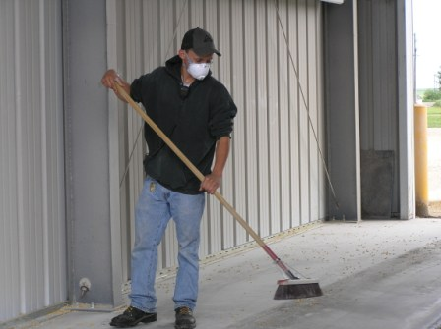
Case Study- Grain Elevator
Grain Elevator with 22 employees
5 employees are seasonal
Notes:
Photo property of AgriSafe Network

Slide 58
Grain Elevator Case Response
OSHA has ability to follow general enforcement activities
If Grain Elevator will fall under General Industry 29CFR. 1910.272
Classified as Industry under SIC code
Even with 1 employee
Agriculture Exemption does not apply

Slide 59
Family Farm Case Study
Family Farm (grain and hogs)
Father and son equal partnership in farming operation
Son and daughter in law work on farm
Grandson / son works on farm after school and in summer
2nd son helps during harvest season

Slide 60

Family Farm Response
Mets the Agriculture exemption
All family members qualify as family
(son, daughter in law, grandson)
Continuum of Life

Slide 61
Family and Hired Worker Case Study
Family Farm
6 hired workers (3 couples)
1 Hired worker his and family live on the farm in house and they do not pay rent or utilities.
2nd and 3rd couples live in own home
2 High school age sons and 1 daughter work on farm
Wife works on farm
Father works on farm seasonally

Slide 62
Family – Hired Case Response
Meets agriculture exemption
11 workers but less than 10 employees by OSHA standards
Family members are not part of count towards 10 employees
Not a temporary labor camp
Paying Health Insurance or Social Security does not impact

Slide 63

Resources
Occupational Safety & Health Administration www.osha.gov
Institute for Occupational Safety & Health www.cdc.gov/niosh ~ home for NIOSH Ag Centers
AgriSafe – www.agrisafe.org
National Education Center for Agricultural Safety www.necasag.org
National Safety Council- www.nsc.org
National Safety Compliance - (training materials)- http://www.osah-safety-training.net

Slide 64
Information Resources
OSHA website: http://www.osha.gov and OSHA offices: 1-800-321-OSHA
Compliance Assistance Specialists in Regional Offices
OSHA Training Institute Education Centers
National Institute for Occupational Safety & Health: www.CDC.gov/NIOSH

