Slide 1

Personal Protective
Equipment Selection
2012

Slide 2
Disclaimers
This material was produced under a grant (SH22284SH1) from the Occupational Safety and Health Administration, U.S. Department of Labor. It does not necessarily reflect the views or policies of the U.S. Department of Labor, nor does the mention of trade names, commercial products, or organization imply endorsement by the U.S. Government.

Slide 3
Lecture Focus Points
Important to provide education to the agricultural worker to help them select the right PPE, and store it properly
Eye and Face Protection
Respiratory Protection (separate section)
  Includes Respiratory Selection Guide
Hearing Protection
Hand/Skin Protection
Foot Protection
Storing PPE
Cholinesterase Testing Protocol

Slide 4
Agriculture Exemption
Enforcement Guidance for Small Farming Operations
The Appropriations Act exempts small farming operations from enforcement of all rules, regulations, standards or orders under the Occupational Safety and Health Act. A farming operation is exempt from all OSHA activities if it:
Employs 10 or fewer employees currently and at all times during the last 12 months; and
Has not had an active temporary labor camp during the proceeding 12 months.
  Note: Family members of farm employers are not counted when determining the number of employees.
  Important to check with your state OSHA since there are 25 states that match or exceed this OSHA Instruction
Source: OSHA Instruction CPL 02-00-051
Notes:
Agricultural Exemption - Appropriations Act
Enforcement Guidance for Small Farming Operations. The Appropriations Act exempts small farming operations from enforcement of all rules, regulations, standards or orders under the Occupational Safety and Health Act.
A farming operation is exempt from all OSHA activities if it:
Employs 10 or fewer employees currently and at all times during the last 12 months; and
Has not had an active temporary labor camp during the proceeding 12 months.
Note: Family members of farm employers are not counted when determining the number of employees.
Important to check with your state OSHA since there are 25 states that match or exceed this OSHA Instruction
Consider giving an example from a state – California is typically more stringent

Slide 5
OSHA Standards
Agriculture has an OSHA standard (29 CFR 1928)
If there is not a standard in Agriculture (29 CFR 1928) OSHA defers to General Industry (29 CFR 1910)
If not found in General Industry then go to General Duty Clause Section 5(a)(1)
Source: www.OSHA.gov
Notes:
Agriculture has an OSHA standard for enforcement and regulations which are applicable to employers with 10 or more employees.
Most of the OSHA standards related to Agriculture deal with machinery, SMV (slow moving vehicle) , anhydrous ammonia, ROPS(roll over protection standard)temporary labor camps, really very few standards.
If during inspection there is not an Agricultural standard -- then OSHA will go to the General Industry Standards
The General Duty Clause can also be referred to if the standard is not found in the other two.
Just because not an Agricultural standard does not mean cannot be held accountable.
Different ways to cite a violation.

Slide 6
OSHA Standards
Section 5(a)(1) of the OSH Act, often referred to as the General Duty Clause, requires employers to "furnish to each of his employees employment and a place of employment which are free from recognized hazards that are causing or are likely to cause death or serious physical harm to his employees".
Section 5(a)(2) requires employers to "comply with occupational safety and health standards promulgated under this Act".
Notes:
If during inspection there is not an Agricultural standard -- then OSHA will go to the General Industry Standards
The General Duty Clause can also be referred to if the standard is not found in the other two.
Just because not an Agricultural standard does not mean cannot be held accountable.
Different ways to cite a violation.
Indicate where to find this information – now available online – it is not necessary to purchase the big book

Slide 7
Personal Protective Equipment
Head to Toe
  Scalp
  Face
  Eyes
  Ears
  Lungs
  Skin
  Feet

Slide 8
Eye and Face Protection
Jobs that increase risk of eye injury – grinding, sawing, drilling, mowing, welding, spray paint, chemicals, batteries, handling equipment
Chemical Splashes and Flying objects = Safety Glasses and Goggles
  Must meet ANSI Z87.1 standards Safety
Sun damage = Sunglasses with UV absorbent material.
  ANSI UV requirements block at least 99% of UV radiation
Welding = exposure to visible, infrared (IR) and sometimes UV light
  Welding filter lenses rated from 2-14
  NIOSH recommends at least a 4 rating

Slide 9
OSHA Standard - Eyes
29 CFR Occupational Health Standards, Personal Protective Equipment
1910.133(a) General requirements.1910.133(a)(1) The employer shall ensure that each affected employee uses appropriate eye or face protection when exposed to eye or face hazards from flying particles, molten metal, liquid chemicals, acids or caustic liquids, chemical gases or vapors, or potentially injurious light radiation.1910.133(a)(2) The employer shall ensure that each affected employee uses eye protection that provides side protection when there is a hazard from flying objects. Detachable side protectors (e.g. clip-on or slide-on side shields) meeting the pertinent requirements of this section are acceptable.1910.133(a)(3) The employer shall ensure that each affected employee who wears prescription lenses while engaged in operations that involve eye hazards wears eye protection that incorporates the prescription in its design, or wears eye protection that can be worn over the prescription lenses without disturbing the proper position of the prescription lenses or the protective lenses.1910.133(a)(4) Eye and face PPE shall be distinctly marked to facilitate identification of the manufacturer.1910.133(a)(5) The employer shall ensure that each affected employee uses equipment with filter lenses that have a shade number appropriate for the work being performed for protection from injurious light radiation. The following is a listing of appropriate shade numbers for various operations.

Slide 10
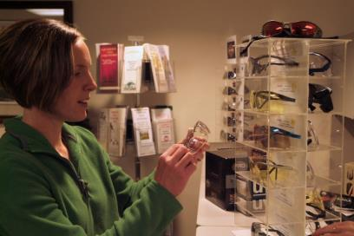
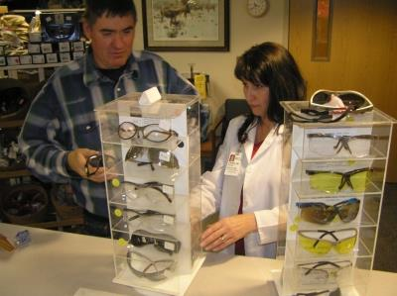
Eye Protection
Find a size that fits your face
Find shape that fits your face

Slide 11
Hearing Protection
In Industry - Personal hearing protectors must be provided and properly worn by workers whenever they are exposed to excessive noise and engineering or administrative controls are not available or effective at reducing noise levels.
In Agriculture the individual has the choice to wear or NOT to wear hearing protectors.
In both cases hearing protection may become ineffective without the knowledge of the wearer.

Slide 12
OSHA Standard - Hearing
Standards 29 CFR Occupational Safety and Health Standards
1910.95 The employer shall administer a continuing, effective hearing conservation program, as described in paragraphs (c) through (o) of this section, whenever employee noise exposures equal or exceed an 8-hour time-weighted average sound level (TWA) of 85 decibels measured on the A scale

Slide 13
Educate
You can still hear the important sounds of your equipment
You can still communicate
Noise is too loud when:
  Ears ring or buzz after exposure
  Temporary muffling of speech or sound
  Difficulty following normal conversation
  Good Resource: NIOSH – Janet Ehlers

Slide 14
Need Choices
How to choose hearing protection
Classes of Hearing Protection
  Enclosures (entire head)
  Aural inserts (ear plugs)
  Superaural protectors or canal caps
  Circumaural protectors (ear muffs)

Slide 15
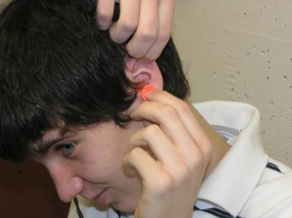
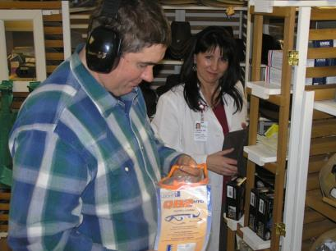
Hearing Protection
Proper Insertion
Variety of Choices
Wearing muff over plugs only adds 5-10 dB more protection

Slide 16
Noise Reduction Rating (NRR)
Need to know these facts about NRR:
  The Noise Reduction Rating (NRR) is a single number indicator of attenuation developed by the EPA to assess the adequacy of noise attenuation of particular hearing-protective devices.
  The NRRs are based on data under laboratory conditions - so a correction factor (7 dB) must be applied
  In the real world, no controls exist, users may not be well motivated or trained, and the hearing protection devices are not consistently inserted.

Slide 17
Sun Safety
Hats -wide brim of at least 3 inches made with a fabric that will block UV rays
  Provide choices
Sun Screen – at least 15 sun protection factor (SPF) with UVA and UVB protection
  spray on – greaseless - reapply
Wear clothing that covers your body and choose clothing with UV protection
  Provide options
Limit the time you spend in the sun between 10am and 4pm (not practical)

Slide 18
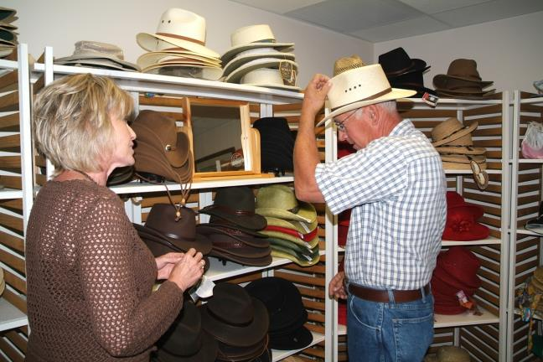
Sun Safety

Slide 19
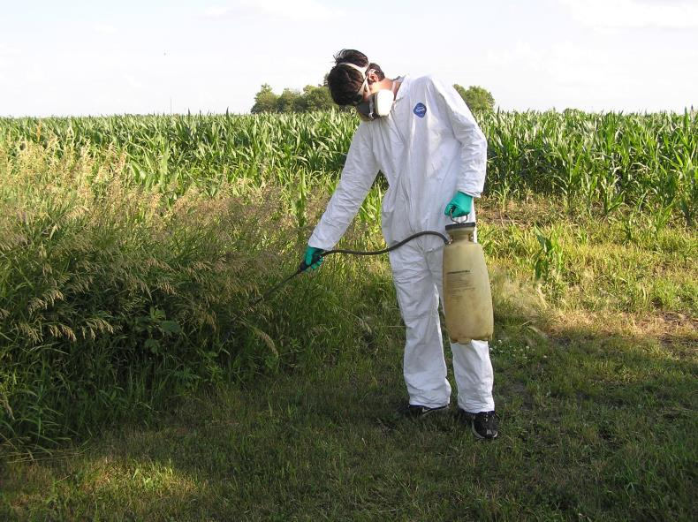
Reduce Chemical Risk

Slide 20
OSHA Standard Chemicals
1910.111, Storage and handling of anhydrous ammonia
  1910.111(a), General
  1910.111(b), Basic rules
This standard is intended to apply to the design, construction, location, installation, and operation of anhydrous ammonia systems including refrigerated ammonia storage systems.

Slide 21
Hazard Communication
1910.1200, Hazard communication
  The purpose of this section is to ensure that the hazards of all chemicals produced or imported are evaluated, and that information concerning their hazards is transmitted to employers and employees.
  This transmittal of information is to be accomplished by means of comprehensive hazard communication programs, which are to include container labeling and other forms of warning, material safety data sheets and employee training.

Slide 22
Pesticide Exposure Health Risk
Pesticides can cause serous health problems if they are not handled properly
Pesticides enter the body through the mouth, nose, skin and eyes.
Certain pesticides can accumulate in the body, damaging the respiratory and nervous systems.
  Cholinesterase testing may be necessary

Slide 23
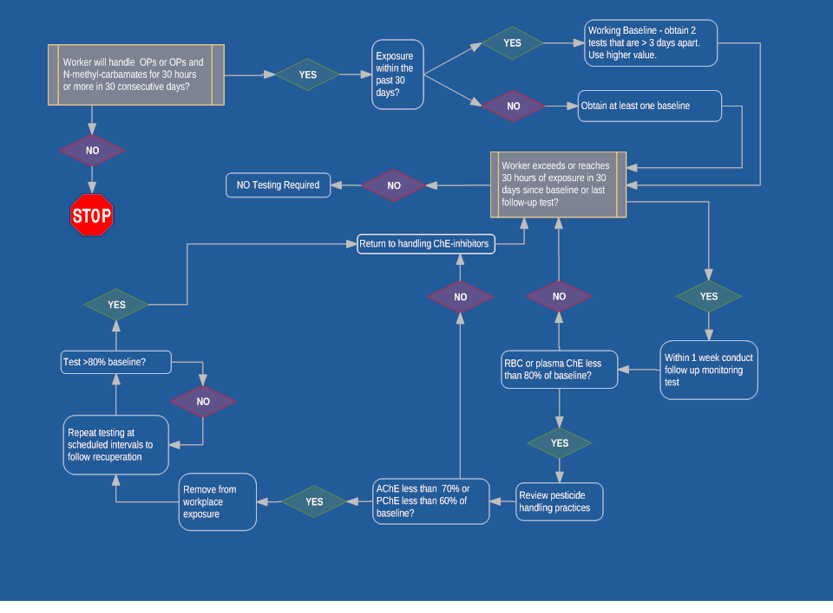
Cholinesterase Algorithm

Slide 24
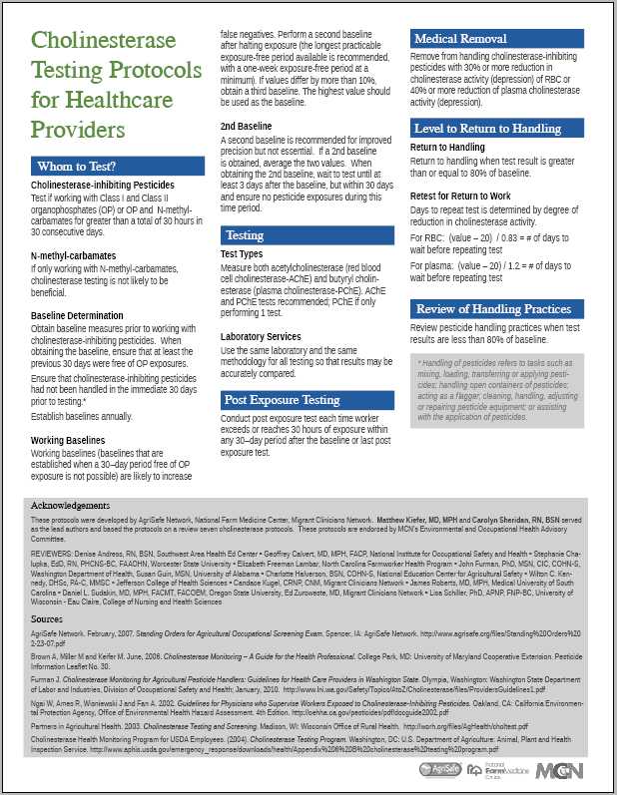
Cholinesterase Protocol for Healthcare Providers
Whom to Test?
Testing
Post Exposure Testing
Medical Removal
Level of Return to Handling
Review of Handling Practices
Notes:
We developed this protocol after review of 7 different protocols and came up with one national standard.

Slide 25

Benefits of Che Monitoring
Remove overexposed workers before illness begins
Identify failures in worker protection
Raise awareness of hazards of chemicals monitored
Diagnose acute overexposure
Drives the financial equation toward safer chemicals
© E. Zurowesete
© E. Zuroweste
Notes:
MCN has permission to use photo

Slide 26
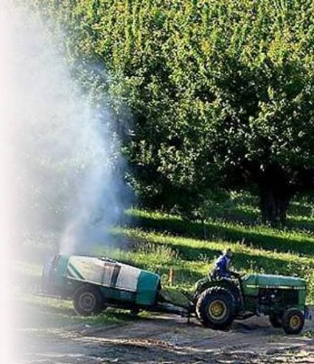
Who to Monitor?
  Individuals who apply Class I or II Organophosphate pesticides or Organophosphates and N-methyl-Carbamates
  Working 30 or more hours within any 30-day period

Slide 27

Review Work Practices
Review work practices when test result is less than 80% of baseline.
  Reading and understanding label
  Use of personal protective equipment
  Pesticide handling practices
  Precautions taken with chemical spills
  Reporting symptoms
  Reporting exposures
© earldotter.com
Notes:
MCN has permission to use photo
An important part of the cholinesterase protocol is to Review work practices. The work practices that need to be evaluated and discussed are:
- Understanding the label – the label provides the information needed to wear appropriate personal protective equipment
Wearing the protective equipment recommended on the label including making sure the personal protective equipment is the right fit. (gloves, respirator)
- Pesticide handling practices to reduce risks of exposures
- when there are chemical spills - take the appropriate precautions
- report symptoms to employer and/or health care professional so appropriate follow can occur in a timely manner
- reporting exposure to employer/ health care provider and other agencies as appropriate

Slide 28
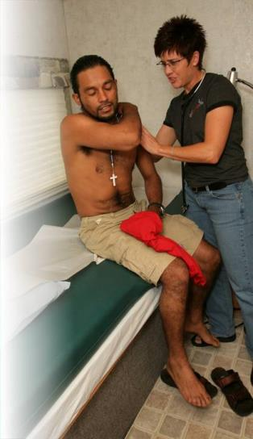
Role of Clinician
Monitor Cholinesterase levels
Understand signs and symptoms
Review protective measures with patient
Review protective measures with employer
Report
Remember – No need to be an expert
  Plenty of resources!
© earldotter.com
Notes:
MCN has permission to use photo
For the clinicians in the audience, let’s just review your role. One of the points we have not made thus far is that the clinician plays a critical role in making sure suspected and confirmed pesticide exposures are not only identified but also reported. In most cases you are the first line in the identification of symptoms and determining the appropriate course of treatment and follow up. Reporting is also an important role – in fact in over 30 states there is a law requiring clinicians to report suspected and confirmed pesticide exposures This has a very important impact on the kinds of pesticides that remain on the market. The good thing is there is no need to be expert on this topic and there are plenty of resources.

Slide 29
Worker Protection Standard
Regulation aimed at reducing the risk of pesticides and injuries among agricultural workers and pesticide handlers.
Contains requirements for:
  pesticide safety training
  notification of pesticide applications
  use of PPE
  restricted entry after pesticide application
  decontamination supplies
  emergency medical assistance
  Recognition and Management of Pesticide Poisonings Manual
  Information available at: https://www.epa.gov

Slide 30
Education
Important Education
Read the Label
  Look for “precautionary statement which describes how poisonous the product is and how to best protect yourself
  Use of Restricted Pesticides requires specialized training and certification.
    Partner with organization offering the Pesticide Applicator Training

Slide 31
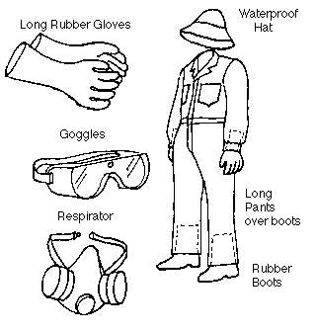
Labels
Using the wrong respiratory equipment can lead to inhalation exposure.
Rubber gloves are not chemically resistant to all pesticide products.
Chemically resistant boots and gloves can trap fumigant pesticides near the skin and cause burns.
Training for pesticide workers should emphasize PPE is selected based on label requirements and product use
Notes:
Ann –Use of Label:
Large Label on easel in front of room
Would you recommend pesticide workers wear chemical protective gloves, rubber boots, and a dust masks for all pesticide use? Check answers from audience. If no, why?
Pesticide products have varied toxicity levels, each with specific PPE requirements, proper selection of protective equipment can be difficult. Proper training for pesticide handlers should emphasize:
there is no single assembly of personal protective equipment that can be used for all pesticides or all applications of a single pesticide
PPE should be selected based on the requirements of a specific product label and how the product will be used.

Slide 32
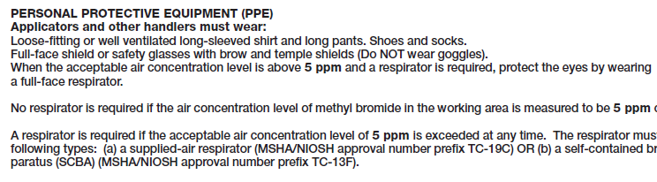
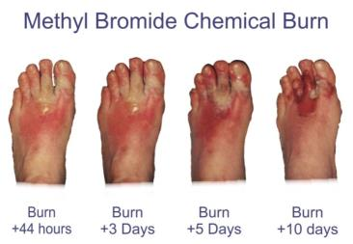
Labels – Proper PPE
Example: Chemical-resistant gloves and footwear should not be worn when handling certain fumigant gasses, such as methyl bromide.
Methyl Bromide Label
PPE should be selected based on the requirements of a specific product label and how the product will be used
Notes:
Ann- Use of Label:
While many pesticide labels require the use of chemical-resistant PPE, some fumigants prohibit the use of chemical-resistant PPE. Methyl bromide and other fumigant gases can become trapped inside chemical protective gloves or boots and can cause chemical burns to the skin. Since some pesticide handling activities increase the chance of exposure, such as mixing and loading, the label may require higher levels of protection during these activities. Levels of respiratory protection also vary among different pesticides and different levels of exposure for a single pesticide.
Wearing inappropriate PPE can lead to overexposure. Adequate training is needed to ensure pesticide handlers properly select the PPE that must be worn with each product and each product use.

Slide 33
Fumigant use
Tobacco
Peanuts
Sweet potatoes
Tomatoes
Strawberries

Slide 34
Tobacco
Exposures
  Fumigants
  Suckering with chemical (take off the flowers on the top of the plant) results in eye exposures
  Green tobacco sickness , absorb tobacco through skin exposure even more likely in am when wet when picking tobacco

Slide 35
Green Tobacco sickness
Symptoms
  Headache
  Nausea
  Dizziness
  Dehydration
Prevention
  Long pants
  Long sleeve shirts
  Don’t pick tobacco when leaves are wet
  Wear gloves
  Wear rain suit until leaves dry off

Slide 36
Migrant Workers
H2A Program
  workers allowed to be in US – working visas for 11 months
NC has largest number in US
  Issue is education needs to be done in Spanish
  Pesticide education program – interactive program (demonstrations)

Slide 37
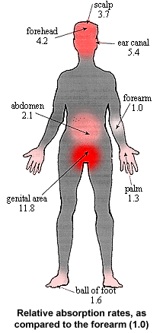
Head to Toe Protection
Absorption rates of body - why PPE is important
Donning and Doffing proper methods of putting PPE on and taking PPE off
Practical use - Long sleeve long pants – when is that okay.

Slide 38
Personal Protective Equipment
Have correct PPE available
Have correct sizes available
  Glove sizing
  Coverall sizing
  Respirators
Notes:
Robert:
Having a wide variety of PPE available is key to learning by doing
Use of audience participation allows individuals to touch and examine PPE
Finding correct glove size provides an excellent example of the importance of finding the right size and fit
Ann – use of label to demonstrate and practice how to chose the right PPE
Audience member

Slide 39
Reduce Chemical Risk
Wear head protection – waterproof disposable hood or plastic wide brim hat
Wear unlined, chemical resistant gloves (neoprene and nitrile are best) – do not wear cotton or leather
Chemical resistant aprons
Unlined rubber neoprene or PVC boots or shoes willing to discard
Wear eye protection – goggles with indirect vent and fog- free lenses
Disposable coveralls such as Tyvex or long sleeved shirts and pants
If label says wear a respirator – wear one

Slide 40
A Word About Take Home Exposure
Leave boots/shoes outside
Designate a special place in or outside the house for changing clothes
Shower immediately after applying fumigants
If you have a splash, change clothes immediately
Don’t pick up children/pets or hug the wife until clothes have been changed

Slide 41
Additional Tips
  Clean personal protective equipment inside and out with soapy water
  Wash gloves before and after removal
  Wash hands and face often when working with pesticides
  Wash before eating, drinking, using tobacco and going to the bathroom or touching others
  Shower and wash hair before changing into clean clothes

Slide 42
Laundering
  Discard clothing if thoroughly soaked
  Remove work clothes and gear immediately after handling pesticides
  Wash work clothes as soon as possible after each day’s use
    Keep pesticide work clothes separated from other family water
    Clean washer before laundering other clothes
    Line dry clothes
    Keep pesticides, personal protective equipment and contaminated clothing out of reach of children and pets.

Slide 43
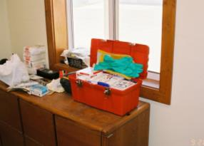
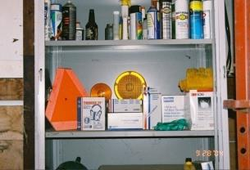
Proper Storage
We recommend a central location on the farm for storing most PPE supplies.
This could be a cabinet in the office or machine shed or a tackle box or rubber maid container – the main thing is that PPE is clean and easily accessible.

Slide 44
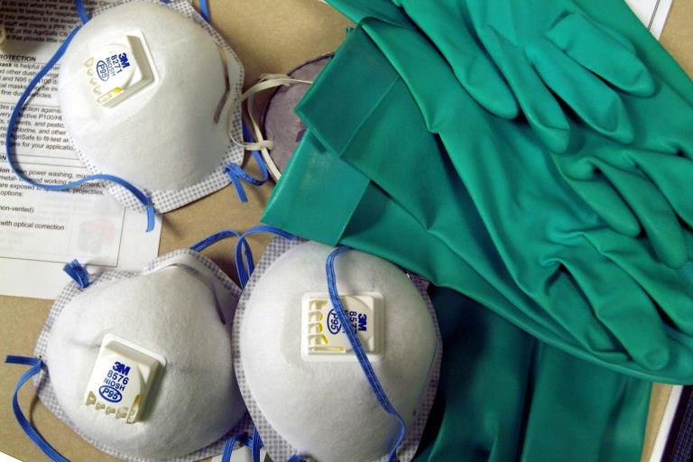
Protection from Hazards

Slide 45
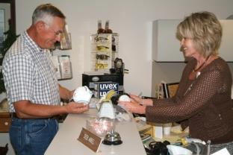

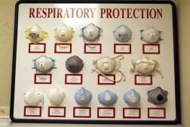
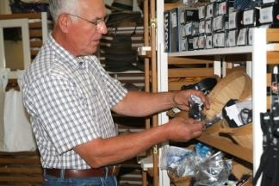
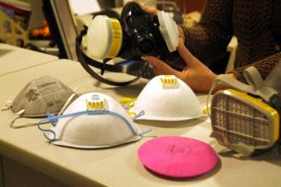
Right PPE for the Job

Slide 46
Employee Rights and Responsibilities
You have the right to:
  Training
  Access to hazard exposure and medical records
  File a complaint with OSHA
  Participate in an OSHA inspection
  Be free from retaliation for exercising safety and health rights
Notes:
Eliminate picture that was here due to global harmonization which just came out
46

Slide 47
Employee Rights and Responsibilities
You have the right to:
  A safe and healthful workplace
  Know about hazardous chemicals
  Information about injuries and illnesses in your workplace
  Complain or request hazard correction from employer
Notes:
47

Slide 48
Employee Rights and Responsibilities
OSHA website: www.osha.gov and OSHA offices: Call or Write (800-321-OSHA)
Compliance Assistance Specialists in the area offices
National Institute for Occupational Safety and Health (NIOSH) – OSHA’s sister agency
OSHA Training Institute Education Centers
Doctors, nurses, other health care providers
Public libraries
Other local, community-based resources
Notes:
48

Slide 49
Resources for You
Occupational Safety & Health Administration www.osha.gov
Institute for Occupational Safety & Health www.cdc.gov/niosh ~ home for NIOSH Ag Centers
AgriSafe – www.agrisafe.org
National Education Center for Agricultural Safety – www.necasag.org
National Safety Council- www.nsc.org
National Safety Compliance - (training materials)- http://www.osah-safety-training.net

Slide 50
References
American National Standards Institute www.ansi.org
Occupational Safety & Health Administration www.osha.gov
Bureau of Labor Statistics www.bls.gov
Center for Disease Control/National Institute for Occupational Safety & Health ww.cdc.gov/niosh
National Safety Council –Injury Facts 2010,2011www.nsc.org
National Safety Council – 2006 S. Harwood Training Grant
Penn State College of Agricultural Sciences. Animal Handling Tips. 2007 www.abe.psu.edu
University of Iowa Agricultural Medicine program manual ,2010.
Donham,K and Thelin,A. Agricultural Medicine – Occupational and Environmental Health for the Health Professions. Blackwell Publishing. 2006

Slide 51
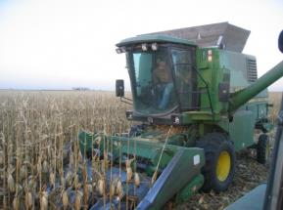
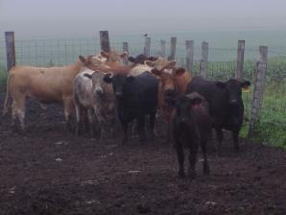
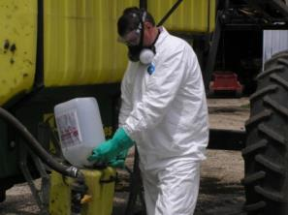
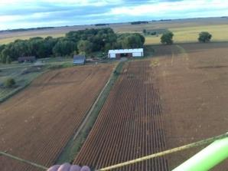
Farming is an Occupation
Not just a Life Style
Work Place is also Home

