Slide 1

Agriculture
Slips, Trips & Falls
6-19-12
Notes:
Introduction / Describe AgriSafe / NECAS partnership / Support from Susan Harwood training grant

Slide 2
Disclaimers
This material was produced under a grant (SH22284SH1) from the Occupational Safety and Health Administration, U.S. Department of Labor. It does not necessarily reflect the views or policies of the U.S. Department of Labor, nor does the mention of trade names, commercial products, or organization imply endorsement by the U.S. Government.

Slide 3
Objectives
At the conclusion of this presentation, you will
Be able to identify some actions you can integrate to prevent slips, trips, and fall.
Have the opportunity to begin an action plan to diminish or eliminate workplace hazards that could result in fall injuries
Know where to find resources to help in eliminating fall hazards
Know the resources to find the OSHA standards pertaining to slip, trip, and fall incidents
Notes:
Based on these objectives, you will be asked to evaluate this presentation

Slide 4
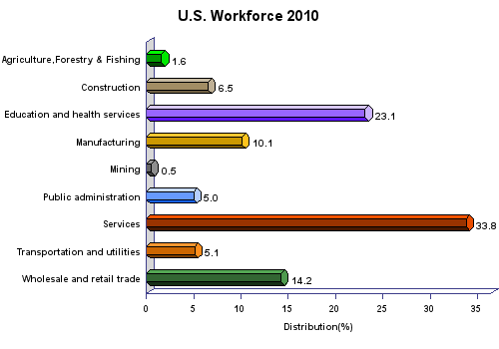
Source: US Census Bureau 2010
Notes:
Overall, agriculture is a small percentage of the U.S. workforce – less than 2% - U.S. Census Bureau & NIOSH

Slide 5
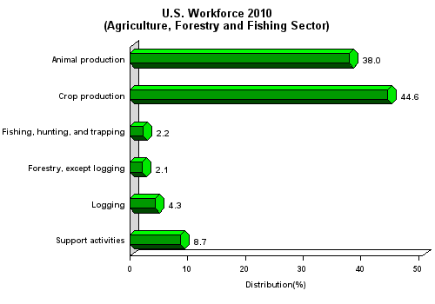
Source: CDC/NIOSH
Notes:
Work force in ‘Agriculture is primarily animal production and crop production
Within agriculture, animal production and the grain industry comprise the major components
Source is - CDC/NIOSH

Slide 6
Prevalence of Injury
Agriculture consistently ranks in the top three occupations for disabling injury and death
Notes:
What seems out of proportion – is the place that agriculture holds in the rate of occupational injury and death
With lower numbers of workers/employment still have a high prevalence of injury

Slide 7
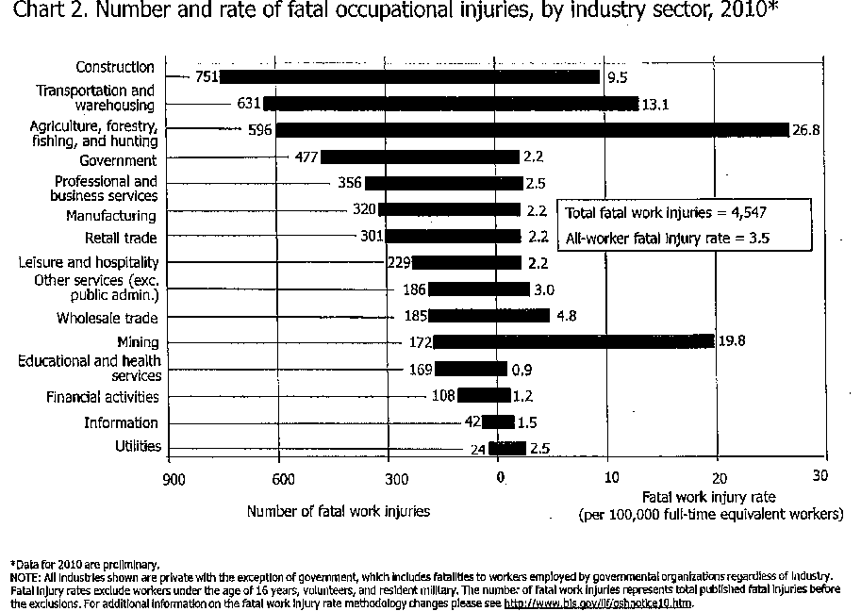
Notes:
From the Bureau of Labor Statistics

Slide 8
Statistics of Injury/Mortality: U.S. Agriculture
70,000 Disabling Injuries (2010)
596 Fatalities (2010)
26.8 deaths per 100,000 workers (2010)
Source: Bureau of Labor Statistics/Census of Fatal Occupational Injuries
Notes:
7
From BLS / CFOI (Census of Fatal Occupational Injuries)

Slide 9
Slips, Trips, Falls
National Safety Council
2006 (S. Harwood Training Grant) reported 1,400 worker deaths and 300,000 disabling injuries due to slips, trips, falls
Bureau of Labor Statistics
2009 report showed 605 deaths and 212,760 serious injuries due to slips, trips, and falls
Notes:
These stats are for all reported work related incidents

Slide 10
Incidents Under Reported
It is believed that the number of unreported injuries exceeds reported numbers
Why do you think that is the case?
Notes:
Discussion ?
Key words to help the trainer with this slide and discussion:
-In this population and the smaller communities – unless fatal or very serious injury people don’t go to doctor
- not all hospitals or physicians use the same reporting system
- not all injuries are recognized as related to agricultural work

Slide 11
Incidents Under Reported
Enforcement Guidance for Small Farming Operations
The Appropriations Act exempts small farming operations from enforcement of all rules, regulations, standards or orders under the Occupational Safety and Health Act. A farming operation is exempt from all OSHA activities if it:
Employs 10 or fewer employees currently and at all times during the last 12 months; and
Has not had an active temporary labor camp during the proceeding 12 months.
Note: Family members of farm employers are not counted when determining the number of employees.
Important to check with your state OSHA since there are 25 states that match or exceed this OSHA Instruction
Source: OSHA Instruction CPL 02-00-051
Notes:
Agricultural Exemption - Appropriations Act
Enforcement Guidance for Small Farming Operations. The Appropriations Act exempts small farming operations from enforcement of all rules, regulations, standards or orders under the Occupational Safety and Health Act. A farming operation is exempt from all OSHA activities if it: Employs 10 or fewer employees currently and at all times during the last 12 months; and Has not had an active temporary labor camp during the proceeding 12 months.
Note: Family members of farm employers are not counted when determining the number of employees.
Important to check with your state OSHA since there are 25 states that match or exceed this OSHA Instruction
Consider giving an example from a state – California is typically more stringent

Slide 12
OSHA Standards
OSHA has an Agriculture standard (29 CFR 1928)
If the hazard cannot be addressed in the Agriculture Standard (29 CFR 1928) OSHA defers to the General Industry Standard (29 CFR 1910)
If there is not a standard that is applicable to agriculture in the General Industry Standards then go to the General Duty Clause Section 5(a)(1)
Source: www.OSHA.gov
Notes:
Agriculture has an OSHA standard for enforcement and regulations which are applicable to employers with 10 or more employees.
Most of the OSHA standards related to Agriculture deal with machinery, SMV (slow moving vehicle) , anhydrous ammonia, ROPS(roll over protection standard)temporary labor camps, really very few standards.
If during inspection there is not an Agricultural standard -- then OSHA will go to the General Industry Standards
The General Duty Clause can also be referred to if the standard is not found in the other two.
Just because not an Agricultural standard does not mean cannot be held accountable.
Different ways to cite a violation.

Slide 13
OSHA Standards
Section 5(a)(1) of the OSH Act, often referred to as the General Duty Clause, requires employers to "furnish to each of his employees employment and a place of employment which are free from recognized hazards that are causing or are likely to cause death or serious physical harm to his employees".
Section 5(a)(2) requires employers to "comply with occupational safety and health standards promulgated under this Act".
Notes:
If during inspection there is not an Agricultural standard -- then OSHA will go to the General Industry Standards
The General Duty Clause can also be referred to if the standard is not found in the other two.
Just because not an Agricultural standard does not mean cannot be held accountable.
Different ways to cite a violation.
Indicate where to find this information – now available online – it is not necessary to purchase the big book

Slide 14
Farmers Invented Multi-Tasking!
Multi-disciplinary experts:
Machinist
Chemist
Biologist
Veterinarian– large & small
Heavy equipment operator
Grain & feed expert
Electrician
Weight lifter
Marketing manager
Office administrator
Legal eagle
Notes:
Others?

Slide 15
Contributing Factors to Injury
Physiological & Social Factors
Working alone
“Shift time” varies frequently and is seldom an 8 hour day
Age
Hearing acuity
Visual acuity
Arthritis
Notes:
The average age of farmers in many states is 56 – 57 years old. That means many are in their late sixties, seventies, and eighties… reflexes, hearing ability, and vision can be compromised

Slide 16
Contributing Factors to Injury
Environmental Factors
Weather frequently changes
Extreme heat or cold
Humidity
Slippery surfaces
Uneven surfaces
Dusty conditions
Higher elevation work site
Notes:
Others/

Slide 17
Contributing Factors to Injury
Environmental Factors
Poorly lit travel areas and walkways
Steps or walkways in poor repair
Ladders not in optimal condition
ie: ladders on bins loose or rusty
Distraction by other activity – weather, animals , crops, loud or unfamiliar noise
Others?
Notes:
Are there other environmental factors that you can think of for this population group?
Oil spills on shop floors
Poorly designed work places
Tight places awkward places

Slide 18
Contributing Factors to Injury
Personal or Habitual Factors
Running
Carrying objects that are too heavy or cumbersome
Distraction by other individuals or groups of people
Not using handrails when present
Improper ladder/equipment dismount
Clothing entanglement dangers
Cleaning or working on equipment with tools placed out of reach
Exiting moving equipment or equipment designed for only one person
Mobile device conversations/texting

Slide 19
Where Do Falls take Place?
Elevated areas: over 60% of elevated falls are from 10 feet or less – Falls that are over 10 feet are of lower frequency but higher level of severity
Ladders
Machinery
Tractors
Truck beds
Barn roofs
Silos
Source: National Safety Council –Injury Facts 2010,2011www.nsc.org
CDC/NIOSH 2002

Slide 20
Where Do Falls Take Place?
Same level or low level falls :(also referred to as slips and trips): higher level of frequency but typically* lower level of severity
Steps
Curbs
Uneven surfaces
Slippery surfaces (water, oil spill, ice)
Objects in walk path (shovels, rakes, rope, cords, boxes)
Trip over small or shorter animals ( pets, young pigs, etc.)
Falls from horses – extremely dangerous as they are usually in motion!
* Even low level falls can result in severe head and spinal injury, serious fractures, or the loss of vision(ie: upturned rakes)

Slide 21
What Can Happen?
Slips from machinery can cause a worker to fall into or against dangerous or moving equipment resulting in severe lacerations, amputations, or fatalities
Combine heads
Grain Augers
Gears / belts
PTO (Power Take Off)
Others
Falls in a grain storage structure or wagon can result in a suffocation death

Slide 22
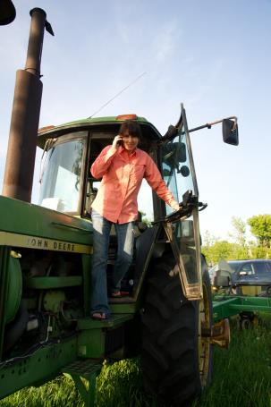
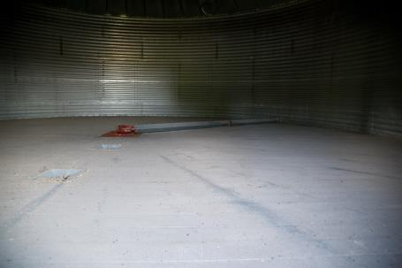
Machinery
Notes:
Photos property of AgriSafe Network

Slide 23
What Can Happen?
Slips in an animal space will startle and /or agitate an animal into running or charging a human …
Trampling will result in severe or debilitating injuries or death
Moving or working in the kicking/flight zone of a large animal can result in injury
Improper rope / harness handling can potentially result in a fall or arm and shoulder injury
A fall from a horse can result in boots caught in stirrups, dragging, head injuries, spinal injuries, fractures

Slide 24
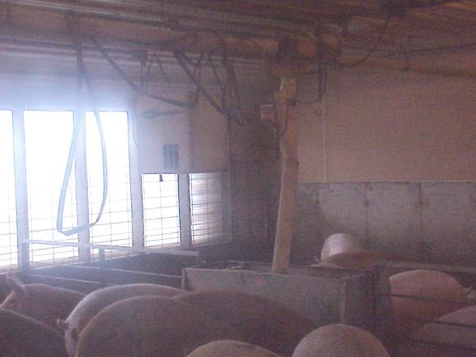
Moisture and low visibility issues
Notes:
Photo property of AgriSafe Network

Slide 25
Tripping Hazards
Slips and falls on electrical cords can cause musculoskeletal damage or be potential electrocution hazards
Tripping over equipment in a walkway can result in anything from minor sprains or scrapes to severe head and musculoskeletal injuries – upturned rakes & shovels have potential for internal injuries, puncture wounds, eye injuries
Notes:
Examples

Slide 26
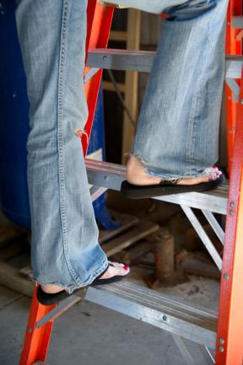
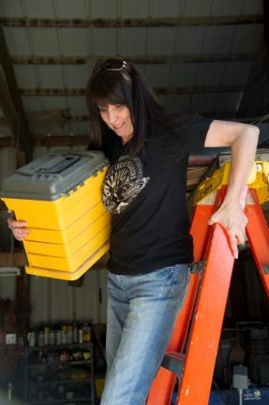
Mounting or dismounting a ladder improperly can result in a slip that causes severe head or spinal injuries
Notes:
Photos property of AgriSafe Network

Slide 27
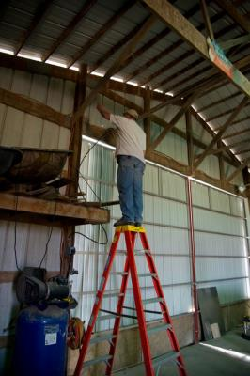
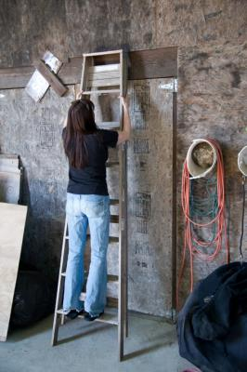
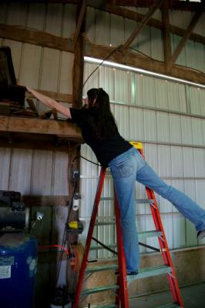
Improper use of ladder
Notes:
Photos property of AgriSafe Network

Slide 28
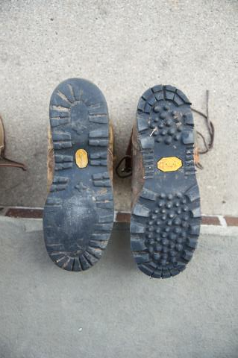
Tread Carefully
Well worn footwear will not have necessary traction on damp or uneven surfaces – resulting in a variety of hazardous slipping injuries
ANSI Standard 1-75 C-25
Notes:
ANSI is an organization that provides National Standards for Occupational Safety Practices for occupational or education
ANSI (American National Standards Institute ---- the voice of the U.S. standards and conformity assessment system, the American National Standards Institute (ANSI) empowers its members and constituents to strengthen the U.S. marketplace position in the global economy while helping to assure the safety and health of consumers and the protection of the environment.
Mission To enhance both the global competitiveness of U.S. business and the U.S. quality of life by promoting and facilitating voluntary consensus standards and conformity assessment systems, and safeguarding their integrity.

Slide 29
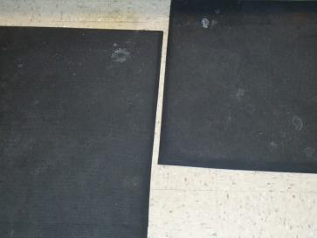

What Can Happen?
Floor mats that are buckled or cracked can cause tripping injuries
Notes:
Floor mats are beneficial because help with static injuries
Different types of mats such as door mats can be a tripping hazard. Going from a mat to a slick surface such as tile can create problems. Use care in placement of the floor mat.
Can be a hazard if not well maintained

Slide 30
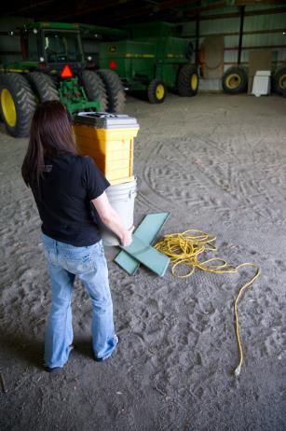
Heave Ho!
Carrying improper load levels can not only cause back injuries but may result in head injuries, lacerations, or fractures
Notes:
Falls related to the load being carried. Back injuries
Photo Property of AgriSafe Network

Slide 31
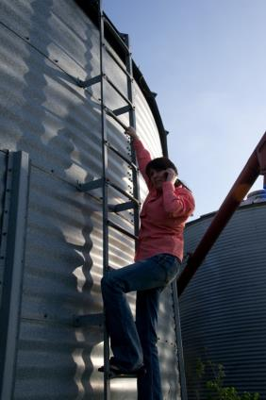
Distractions Are Costly!
Not paying attention and being distracted can have disastrous results
Notes:
Photo property of AgriSafe Network

Slide 32
Safety Considerations ~ What Can We Do?
Engineer dangers out of environment if at all possible!
Walkways:
Clear clutter and objects from walking paths
Install railings where appropriate
Increase lighting in dim areas
Maintain surface area
Steps: Keep them clear of objects and in good repair
Long handled tools: store on secure wall hooks and smaller items in drawers or adequate shelves

Slide 33
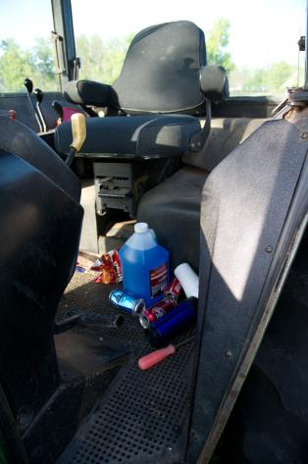
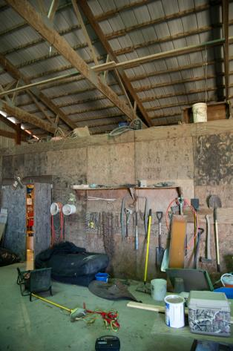
Clutter
Notes:
Photos property of AgriSafe Network

Slide 34
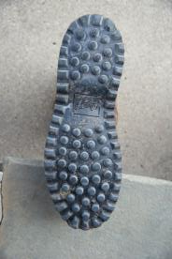
Safety Considerations What Can we Do?
Footwear:
Wide grooves to channel water
Large flat soles
No heel (with exception of riding and horse work boots)
Nitrile rubber compound soles of shoes

Slide 35
Safety Considerations ~ What Can We Do
Gloves:
Secure grips and good fit to prevent slippage when reaching
Good fitting gloves can prevent ergonomic related injures
Clothing:
avoid ragged or torn legs and sleeves to prevent catching in equipment
Notes:
Gloves also need to fit properly for ergonomic reasons. Improperly fitting gloves can lead to hand and wrist injuries

Slide 36
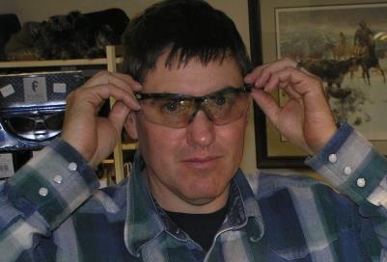
Safety Considerations ~ What Can We Do?
Eyewear:
Sunglasses: remove when entering low lit areas
Wear approved impact resistant safety glasses or goggles
ANSI Standard Z87
Regular eye exams will assure visual acuity
get used to bifocals prior to wearing in work areas
Notes:
Photos property of AgriSafe Network

Slide 37
Safety Considerations ~ What Can We Do
Keep riding tack, saddles in good repair – check them frequently
Figure 8 lead harnesses – never wrap them around your hand
Carry loads that are not too heavy and that do not obstruct your vision

Slide 38
Grain Bins
Grain bins OSHA – 29 CFR 1910.272 and ANSI – Z359.1-2007
should have grip handles
chains in place and approved
PFP (Personal Fall Protection) harnessing available for trained individual (OSHA 29 CFR 1926.500-503)
Notes:
For grain businesses, employees must be 18 or older & trained in lock out/tag out, tie off, fall distance, and be skilled in using Personal Fall Protection. Family farm operators are encouraged to have and use PFP – with comprehensive education is its use.
PFP (Personal Fall Protection) harnessing available for trained individual (OSHA 29 CFR 1926.500-503) – this is a Construction Standard

Slide 39
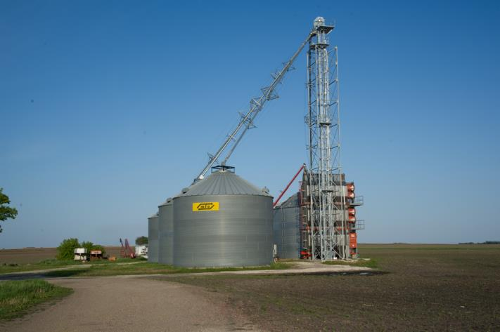
Grain Bins
Notes:
Picture property of AgriSafe

Slide 40
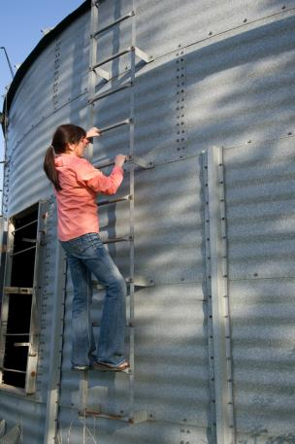
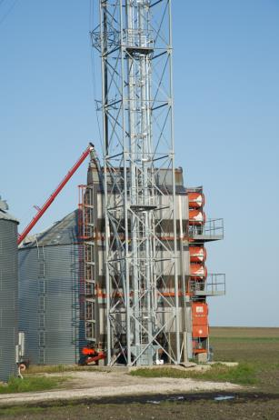
Grain Bin Ladders
Notes:
Pictures taken by AgriSafe Staff of AgriSafe Staff and farm location approved

Slide 41
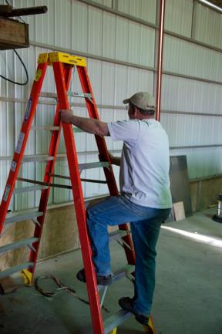
Safety First with Ladders
Always face a ladder when climbing
Always utilize a 3-point contact approach
Notes:
Photo property of ‘AgriSafe

Slide 42
Safety Considerations ~ Awareness
Does someone know where you are?
Do you have a communication plan?
Is the phone call that urgent ?
If an injury occurs, is there a first aid kit nearby?
Are you familiar with emergency service numbers in your community?
Are you on a 911 grid?
Notes:
Planning ahead as prevention
911 doesn’t always work
If not on a 911 grid – know how to direct people to your location
What if you are calling from your cell phone.

Slide 43
Financial Impact
Injuries to you, a family worker, or your employee can be disabling, cause lost time hours, and huge costs in medical care and insurance!
Notes:
OSHA's $afety Pays Program OSHA's "$afety Pays" program can help employers assess the impact of occupational injuries and illnesses on their profitability. This program uses a company's profit margin, the average costs of an injury or illness, and an indirect cost multiplier to project the amount of sales a company would need to cover those costs. The program is intended as a tool to raise awareness of how occupational injuries and illnesses can impact a company's profitability, not to provide a detailed analysis of a particular company's occupational injury and illness costs. The "$afety Pays" program will: Allow users to pick an injury type from a drop-down list or to enter their workers' compensation costs
Prompt users for information to do the analysis, including their profit margin and number of injuries
Generate a report of the costs and the sales needed to cover those costs

Slide 44
Safety Pays
$afety Pays" uses a sliding scale to calculate the indirect costs of the injuries and illness
Allow users to pick an injury type from a drop-down list or to enter their workers' compensation costs
Prompt users for information to do the analysis, including their profit margin and number of injuries
Generate a report of the costs and the sales needed to cover those costs (see handouts)
OSHA Safety Pays http://www.osha.gov/dcsp/smallbusiness/safetypays/index.html
Notes:
If there is an internet connection available, use the hyperlink to access interactive documents: click “begin” and use the drop down boxes

Slide 45
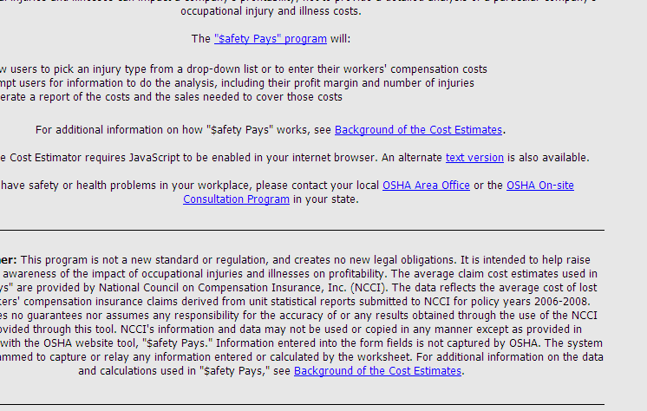

Slide 46
What Does An Injury Cost?
National Safety Council
2006 Data: Taking into account direct and indirect expenses, each lost workday can cost $34,000!
Notes:
This is the latest information from NSC…we can assume the cost has not decreased!

Slide 47
What Does An Injury Cost?
Direct costs
Medical costs
Workers’ Compensation
Indirect costs
Cost of replacing staff and training time
Loss of productivity due to learning curves
Accommodating injured employee
Wages paid to employee not covered by workers’ compensation
Cost of work stoppage
Cost of replacing damaged materials, equipment & property

Slide 48
Return On Investment
Take time to assess and evaluate what an injury will cost your operation
Communicate safety to family and employees – involve them in safety plan
Take time now to write an outline or update for your farm/operation safety plan

Slide 49
Action Plan
Action Needed | Barriers to Overcome | How Will I Remove Barriers | Action Taken | Cost of Project

Slide 50
Employee Rights and Responsibilities
You have the right to:
Training
Access to hazard exposure and medical records
File a complaint with OSHA
Participate in an OSHA inspection
Be free from retaliation for exercising safety and health rights
Notes:
Eliminate picture that was here due to global harmonization which just came out
50

Slide 51
Employee Rights and Responsibilities
You have the right to:
A safe and healthful workplace
Know about hazardous chemicals
Information about injuries and illnesses in your workplace
Complain or request hazard correction from employer
Notes:
51

Slide 52
Employee Rights and Responsibilities
OSHA website: www.osha.gov and OSHA offices: Call or Write (800-321-OSHA)
Compliance Assistance Specialists in the area offices
National Institute for Occupational Safety and Health (NIOSH) – OSHA’s sister agency
OSHA Training Institute Education Centers
Doctors, nurses, other health care providers
Public libraries
Other local, community-based resources
Notes:
52

Slide 53
Resources for You
Occupational Safety & Health Administration www.osha.gov www.osha.gov/dte/grant_materials/fy06/46e0-ht10-06.html
www.ehow.com
Institute for Occupational Safety & Health www.cdc.gov/niosh ~ home for NIOSH Ag Centers
AgriSafe – www.agrisafe.org
National Education Center for Agricultural Safety – www.necasag.org
National Safety Council- www.nsc.org
National Safety Compliance - (training materials)- http://www.osah-safety-training.net

Slide 54
References
American National Standards Institute www.ansi.org
Occupational Safety & Health Administration www.osha.gov
Bureau of Labor Statistics www.bls.gov
Center for Disease Control/National Institute for Occupational Safety & Health ww.cdc.gov/niosh
National Safety Council –Injury Facts 2010,2011www.nsc.org
National Safety Council – 2006 S. Harwood Training Grant
Penn State College of Agricultural Sciences. Animal Handling Tips. 2007 www.abe.psu.edu
University of Iowa Agricultural Medicine program manual ,2010.
Donham,K and Thelin,A. Agricultural Medicine – Occupational and Environmental Health for the Health Professions. Blackwell Publishing. 2006

