Slide 1

Physical Assessment and Wellness Programs for Agricultural Businesses

Slide 2

Disclaimers
This material was produced under a grant (SH22284SH1) from the Occupational Safety and Health Administration, U.S. Department of Labor. It does not necessarily reflect the views or policies of the U.S. Department of Labor, nor does the mention of trade names, commercial products, or organization imply endorsement by the U.S. Government.

Slide 3

Objectives
Upon conclusion of this webinar, participants will be able to:
Identify AgriSafe Network and OSHA health/wellness resources that are appropriate to production agriculture
Analyze the Return on Investment (ROI) and benefits of workplace wellness programs
Understand the role of workplace physical assessments, including pre-employment/ post-offer physicals
Notes:
We will discuss two main areas:
1- wellness programs and
2- non-mandatory physical assessment programs and
3. some things about employee physicals

Slide 4

Webinar Audience
      This webinar is not designed to address program development specifics, but will provide resources to initiate or enhance existing programs. The main focus is on smaller Ag related businesses; as most large companies have a well-established in-house program or department.

Slide 5

Why Have a Wellness Program?
    Employers, particularly small business employers, have been affected by increasing costs
    Providing health care benefits
    Lost time injuries
    Chronic health issues
    Recent studies indicate that almost 50% of company profits now support health care benefits compared to less than 10% thirty years ago
    Source: e-resources.com/articles/Nov 2.htm; Sullivan, S. September 2012
Notes:
Resource is used by businesses
Check to be sure can use this resource

Slide 6

Management Perspective
    Wellness programs have the potential to:
    Decrease absenteeism
    Reduce medical claims
    Improve productivity
    Improve employee retention
    Source: HRresources.com. “Economic Benefits for Employee Wellness Programs”
Notes:
Employers have reported decreases in errors, improved efficiency, and improved decision making

Slide 7

Return on Investment
    A review of corporate wellness programs reported that comprehensive disease management programs yielded the highest return on investment
    Findings suggested the need for:
      Health education
      Early detection
      Appropriate intervention
      Health programs
      Source: Goetzel, R.Z. et al. “What is ROI? A Systematic Review of Return on Investment Studies of Corporate Health & Productivity Management Initiatives.” A WHP’s Worksite Health Vol.6, 1999

Slide 8

Return on Investment (ROI)
    75 % of employers’ health care costs and productivity losses are related to employee lifestyle choices
    - CDC/NIOSH
    A $1 (one dollar) investment in wellness programs saves $3 (three dollars) in health care costs
    - Wellness Council of America
    ROI is usually seen in 18 – 24 months
    - Forbes.com 2012
Notes:
These are conservative numbers… some businesses report $5 to $6 ROI

Slide 9

Types of Wellness Programs
      Blood Pressure Checks
      Nutrition Programs
      Physical Activity Projects
      Weight Management Programs
      Smoking Cessation Programs
      Cancer Screenings
      Mental Health Information/Depression Screenings
      Information to employers should be in aggregate format to insure confidentiality
Notes:
Check with local health care professionals and wellness educators for programs and materials
Key factor:
Confidentiality - employer will not get specific information about the employee but will get back a general report of aggregate data.
Plan strategically! How to keep confidential

Slide 10

Resources for Wellness Program Development
    AgriSafe Network
    www.agrisafe.org
    Center for Disease Control
    www.cdc.gov/workplacehealthpromotion/references
    www.cdc.gov/workplacehealthpromotion/assessment
    Company Wellness ROI
    http://wellnessproposals.com/wellness-articles
    National Heart, Lung, Blood Institute
    http://nhlbi.nih.gov/guidelines
    Wellness Council of America
    www.welcoa.org

Slide 11

High Cost of Workplace Injuries & Illnesses
      In 2007, the total estimated cost of fatal and non-fatal injuries at work was $250 billion
        Fatal injuries - $6 billion
        Non-fatal injuries - $186 billion
        Fatal illnesses - $46 billion
        Non-fatal illnesses - $46 billion
        Source: National Institute for Occupational Safety & Health(NIOSH) 2011
Notes:
In 2007 this is the cost and it is more today. Injuries and Illness may have gone down but the actual cost per injury would have gone up.

Slide 12
Polling Question
    Worker’s Compensation pays for:
      less than 25%
      a little over 30%
      50%
      of the combined amount of medical costs
Notes:
Answer = a. Less than 25%

Slide 13

The High Cost of Workplace Injuries & Illnesses
    Direct medical costs - $67 billion
    Indirect costs - $ 183 billion
    Worker’s Compensation – pays for less than 25% of the combined amount of medical costs
    U.S. Bureau of Labor Statistics (BLS), Center for Disease Control (CDC), National Council on Compensation Insurance, Economic Burden of Occupational Injury & Illness in the U.S. 2011

Slide 14
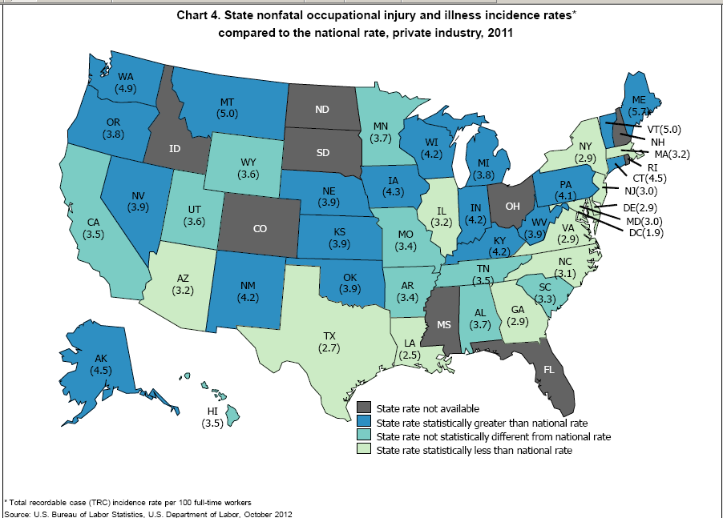
Notes:
National rate – 3.5 private industry; Agricultural is 5.5 per 100 FT workers

Slide 15

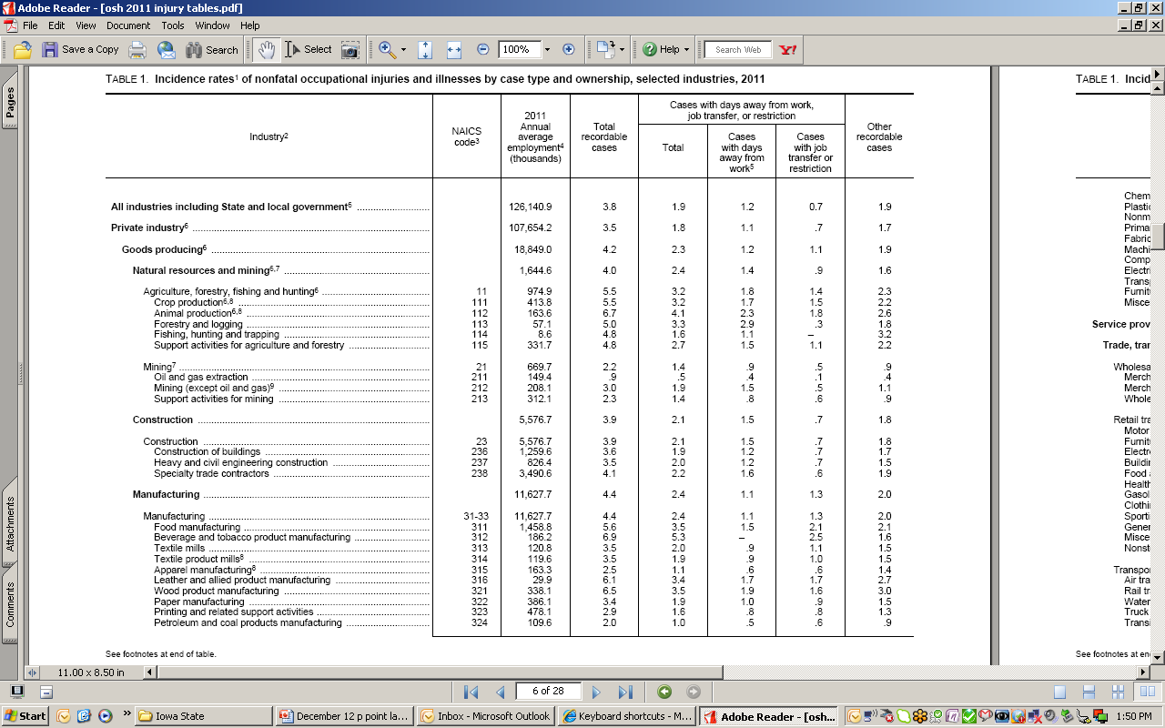

National Non-fatal Rates

Slide 16
Un-reported Injuries & Illnesses
Paul Leigh, PhD, UC Davis: BLS surveys miss nearly 45% of non-fatal occupationally injuries in agriculture…unreported injuries
Source: Leigh, J. Paul. University of California, Davis. “Costs of Occupational Injury & Illnesses Combining All Industries..” Presentation November 3, 2008

Slide 17

Challenges
    The size of a business may impact program type and implementation
    Not all businesses can afford an in-house physical assessment program
    Few can support an in-house workplace medical exam/physicals
    Do need to be aware of some federal mandates that affect employment

Slide 18
OSHA Safety Pays
“$afety Pays" uses a sliding scale to calculate the indirect costs of the injuries and illness
  Allows users to pick an injury type from a drop-down list or to enter their workers' compensation costs
  Prompt users for information to do the analysis, including their profit margin and number of injuries
  Generates a report of the costs and the sales needed to cover those costs
  www.osha.gov - search “Safety Pays”

Slide 19
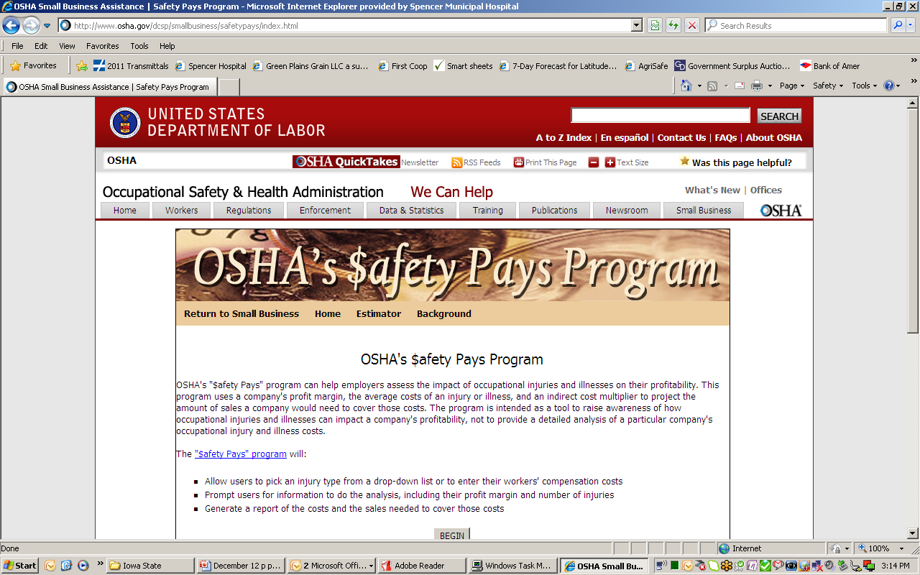

Slide 20

Are You OSHA Exempt?
Federal Ag Exemption
Enforcement Guidance for Small Farming Operations
The Appropriations Act exempts small farming operations from enforcement of all rules, regulations, standards or orders under the Occupational Safety and Health Act. A farming operation is exempt from all OSHA activities if it:
  Employs 10 or fewer employees currently and at all times during the last 12 months; and
  Has not had an active temporary labor camp during the proceeding 12 months.
Source: OSHA Instruction CPL 02-00-051

Slide 21

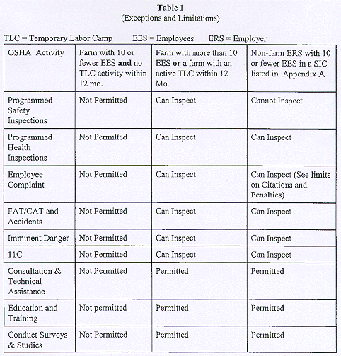
OSHA General Enforcement Guidelines Table
Source: OSHA.gov
Notes:
Appropriations Act
This table gives you the break down of Federal OSHA and how OSHA can use federal funding for inspection and citation
Remember the state plan may have the ability to do something different

Slide 22

Injury or Fatality
Does the Exemption still hold true with injuries and a fatality? YES
  Small farms, however, are not actually exempt from OSHA regulations because:
    Legally OSHA covers all farms, even though OSHA cannot inspect or cite farms with 10 or fewer employees.
Notes:
Federal OSHA may send someone out to confirm the information;
if they found out that it was actually agriculture SIC and there were 10 or fewer employees, then would back out at that time.
State OSHA may continue if use state funds and not federal funds
Personal liability issue
State plans may have more stringent regulations
Have to accept Federal OSHA (minimum standards)

Slide 23
Understanding Liability
  One important reason for understanding that small farms still fall under OSHA is that, in a court of law, OSHA rules and regulations may be used to identify safe and unsafe conditions on the farm.
  State plan - state may be more stringent based on the state regulations.
Notes:
Prosecution in a court of law might refer to the recognized OSHA standards for Agriculture, OSHA standards for General Industry, OSHA standards for Construction, General Duty clause

Slide 24
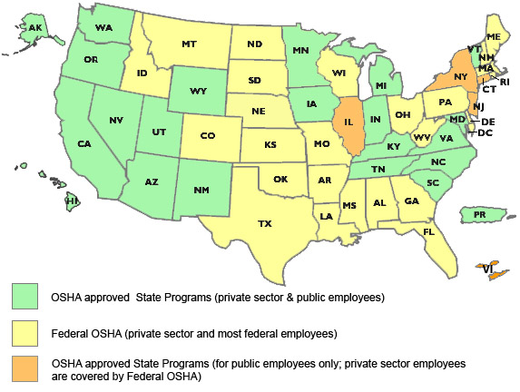
OSHA Approved State Programs
27 states have state based OSHA programs
Alaska Arizona California Hawaii Indiana Iowa Kentucky | Maryland Michigan Minnesota Nevada New Mexico North Carolina Oregon | South Carolina Tennessee Utah Vermont Virginia Washington Wyoming Puerto Rico
State programs must meet or exceed federal OSHA standards
Notes:
Source: OSHA.gov *All state plans must meet or exceed national OSHA standards
How to get in contact with your state plan
Google
with in state department of labor

Slide 25


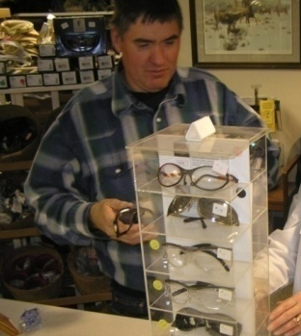
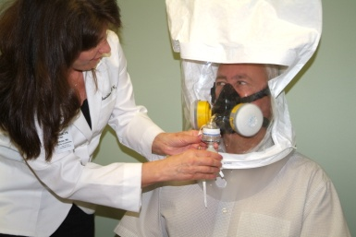
Additional OSHA Standards related to Agriculture
29 CFR 1910.95: Hearing Conservation & Noise Exposure
29 CFR 1910.132: General Requirements for Personal Protective Equipment
29 CFR 1910.133: Eye & Face Protection
29 CFR 1910.134: Respiratory Protection
Notes:
Additional Standards

Slide 26
What do I (the employer) need to provide?
    Depends on:
      Numbers of employees
      Exemption status
      Hazard exposure levels – ie: dust, endotoxins, chemicals, noise

Slide 27
OSHA Compliance Quick Start
    Provides 7 steps to identify major General Industry requirements
    Provides guidance materials that may apply to your workplace
    Easy to access
    Web based: www.osha.gov

Slide 28

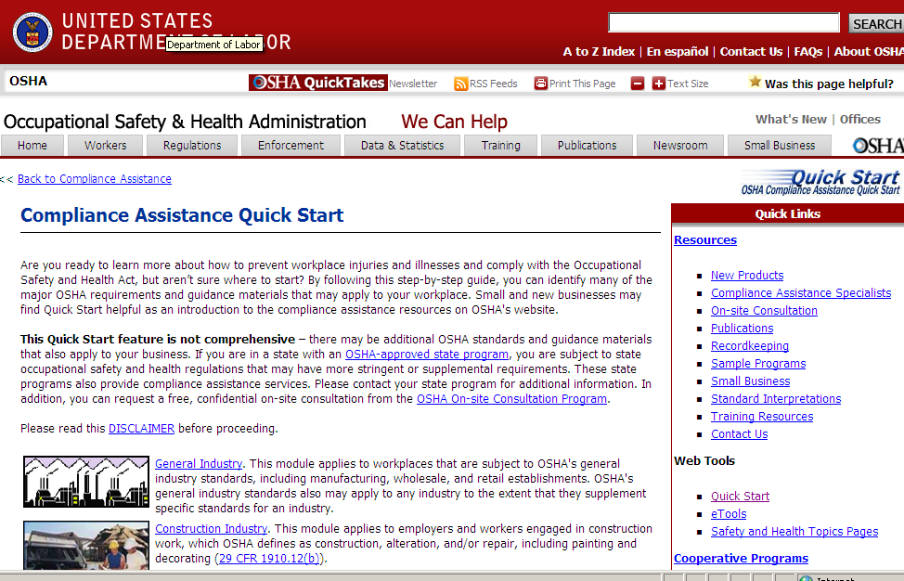
Example
Use the A-Z tab
Under Small Business

Slide 29
Small Business Handbook Publication
Small Business Handbook:
OSHA 2209-02R 2005 (publication number)
  Provides information on safety & health management systems, compliance assistance, and record keeping
  “A safety and health program is a plan put into practice”
      - Source: www.osha.gov/publications
Notes:
Resource is used by businesses
Check to be sure can use this resource

Slide 30
SBREFA
Under the Small Business Regulatory Enforcement Fairness Act (SBREFA), OSHA must:
Produce small entity compliance guides for OSHA rules
Have a penalty reduction policy for small businesses
Involve small businesses in development of proposed rules
Notes:
Passed by Congress in 1996. Note: If you are a small business, you may participate in the regulatory process & comment on OSHA actions: 1-888-REG-FAIR

Slide 31
Polling Question
The EEOC/ADA regulations affect employers with:
10 or more employees
15 or more employees
50 or more employees
Notes:
Equal Employment Opportunity Commission / American with Disabilities Act
Answer: b. 15 or more employees

Slide 32
Equal Employment Opportunity
Commission /American Disability Act of 1990
Be aware of pre- and post- hire limitations
Affects employers with 15 or more workers
Employer must provide reasonable accommodation unless it will cost significant difficulty or expense
Once a person is hired, an employer cannot require a medical exam unless documentation is needed to support a request
      Source: www.eeoc.gov//laws/types/disability
Notes:
Employers have reported decreases in errors, improved efficiency, and improved decision making

Slide 33
Health Hazard Evaluation Program
CDC NIOSH /HHE responds to requests for evaluations of workplace health hazards
Requests can be initiated by employees, managers, or employers
      Source: www.cdc.gov/niosh

Slide 34

Components of an Employee Physical
Medical history
Physical exam
Hearing test
Vision test
Pulmonary function test**
Exam interpretation
May need to be renewed every 1 to 2 years
** determined by physician
Urinalysis / Drug screen
Range of Motion (ROM)
Cumulative trauma
Grip strength
(lead or asbestos exposures)
Sources: www.osha.gov
www.ushealthworks.com
Screening & Surveillance: A Guide to OSHA Standards www.osha.gov
Publication: OSHA 3162 12R 2009
Notes:
**OSHA 29CFR 1910.134 Standard will not say you have to have pulmonary function test. Most physicians will not clear someone for work without it . Some areas such as the asbestos standard will require it

Slide 35

Screening surveillance
Notes:
Good tool to use to assist in maintaining compliance

Slide 36
Polling Question
OSHA has a federal ergonomics standard that affects all businesses:
True____
False____
Notes:
Answer: False – OSHA has no national standards that are specific to Ergonomics

Slide 37

Ergonomics Standards
OSHA has no national ergonomics standards but can draw on specific standards from General Industry, Construction, or the General Duty clause
Only California has a state ergonomics standard – Article 106:Ergonomics
      Source: www.osha.gov/SLTC/ergonomics/state_plan.html

Slide 38
How Do I Locate Service Providers?
Many companies have in-house safety & health professionals (usually larger companies)
Some businesses may contract with area occupational health services (OHS) for physicals, hearing tests, pulmonary function tests, ergonomic screening, wellness programs
Some businesses will direct employees to access services, then reimburse them
Some OHS services have staff specialized in agricultural health services (such as AgriSafe)

Slide 39
Pro-active Workplace Safety & Health
Programs Pay Dividends
Assess the cost of an injury – look at Safety Pays
Review any OSHA reports, worker comp reports, Human Resource records
Ask employees what they feel are major issues
Visit with an OSHA education specialist or a workplace safety officer in your area
Review existing tools for program development & educational resources
    Example: OSHA Office of Training & Education- Tools for a Safety & Health Program

Slide 40
NIOSH Resources
National Institute for Occupational Safety & Health: www.CDC.gov/NIOSH
Health Hazard Evaluation (HHE)
Simple Solutions for Farmworkers

Slide 41

OSHA Resources
OSHA website: http://www.osha.gov and OSHA offices: 1-800-321-OSHA
Compliance Assistance Specialists in Regional and Area Offices
OSHA Training Institute Education Centers

Slide 42
www.osha.gov
.
OSHA Training & Reference Materials Library
Tools for a Safety & Health Program Assessment
Noise & Hearing Conservation
Water, Shade, Rest – A Guide for Employers Compliance Assistance Quick Start

Slide 43
Additional Resources
www.bls.gov
www.agrisafe.org
http://smallbusiness.chron.com
www.welcoa.com
www.healthylife.com/template

Slide 44
Other Resources
www.epa.gov/agriculture/twor.html
http://www.ama-assn.org/ama/pub/physician-resources/medical-sciences/genetics-molecular/family-history
www.forbes.com/2006/04/21/wellness-programs
http://wellnessproposals.com/wellness-articles/company-roi
http://businessknowlegesource.com/health/benefits
http://ohsonline.com

Slide 45

Employee Rights and Responsibilities
You have the right to:
  A safe and healthful workplace
  Know about hazardous chemicals
  Information about injuries and illnesses in your workplace
  Complain or request hazard correction from employer

Slide 46
Employee Rights and Responsibilities
You have the right to:
  Training
  Access to hazard exposure and medical records
  File a complaint with OSHA
  Participate in an OSHA inspection
  Be free from retaliation for exercising safety and health rights

Slide 47

Employee Rights and Responsibilities
OSHA website: www.osha.gov and OSHA offices: Call or Write (800-321-OSHA)
Compliance Assistance Specialists in the area and regional offices
National Institute for Occupational Safety and Health (NIOSH) – OSHA’s sister agency
OSHA Training Institute Education Centers
Doctors, nurses, other health care providers
Public libraries
Other local, community-based resources

Slide 48

AgriSafe Website Resources

