Slide 1
Preventing Runovers and Backovers
Productivity

Slide 2
ITCPs Improve Productivity
The key concept behind Internal Traffic Control is PLANNING for worker safety.
ITCPs integrate other aspects of planning to coordinate on-site activities so they run in a safe, smooth, efficient manner.
ITCPs improve safety and productivity if they are well conceived.
Notes:
ITCPs integrate other aspects of planning to coordinate on-site activities so they run in a safe, smooth, efficient manner. Increased productivity is a by-product of ITCPs as the process of setting up an ITCP translates into smoother operations unrelated to internal traffic control.

Slide 3
Integrated Process
Project Management and Scheduling
Quality
Control
Worker Safety
Temporary Traffic Control Plan
Occupational Safety and Health
Subcontractor
Communications
Notes:
When considered during the planning and design phases, ITCP integrates easily into other planning processes such that it does not require significantly more time or resources to implement. Anticipating ITCP/worker safety needs will improve delivery schedules and processes, minimize disruptions, improve safety, and create more efficiency.

Slide 4

Productivity and Efficiency
Better internal traffic routing and strict control over backing reduces time-consuming incidents.
Notes:
In addition to minimizing risk to workers, there are other hazards that ITCP will protect against, including hidden dangers such as catch basins and open holes. ITCPs will guard against excavation work in or around wall openings. The plan will reduce hazardous exposures to site visitors.

Slide 5
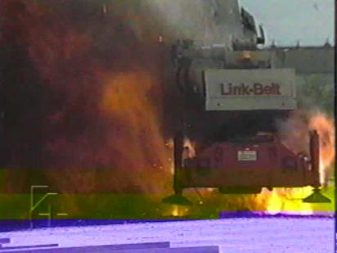

Productivity and Efficiency
Well executed ITCPs will control for- and alert workers to overhead and buried hazards such as power lines, cranes & other utilities.
Notes:
ITCP planning will ensure operators do not operate equipment around overhead power lines unless they are authorized and trained to do so. These plans can also alert workers to other overhead and buried hazards such as cranes, utilities, excavations, etc.

Slide 6
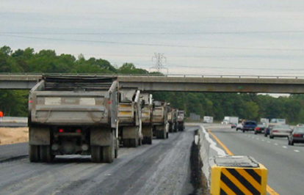
Productivity and Efficiency
Can improve efficiency through reduced repositioning.
Notes:
ITCPs work in tandem with project scheduling processes. In addition to assigning dates to project activities, project scheduling is intended to match the resources of equipment, materials and labor with project work tasks over time. Good scheduling can eliminate problems due to production bottlenecks, facilitate the timely procurement of necessary materials, and otherwise insure the completion of a project as soon as possible. Inasmuch as ITCPs require timely communication with delivery vehicles (dump trucks), ITCP coordination and project scheduling fit together easily.

Slide 7

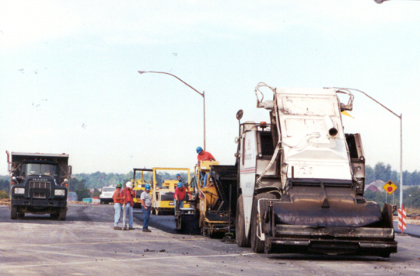
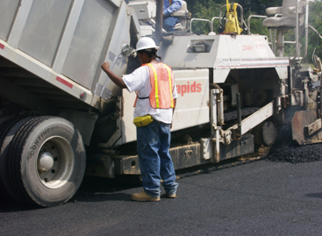
Productivity and Efficiency
One of the greatest contributions of ITCPs is improved communications.
Notes:
An important part of and internal traffic control plan is how you will handle communications on site. The large photo shows an asphalt truck arriving at the paving site. In developing and ITCP, one must consider how you will communicate with drivers before they arrive. Planning for this communication will translate into overall better communication with all subcontractors with regards to other on-site scheduling and activities. One solution is to install a CB on the paver or other onsite equipment. Another is to identify a “lead driver” who will communicate with others in the fleet.

Slide 8
Communications Management Elements Addressed
Chain of command
On-site equipment and personnel
Contact information, including on-site contractors,
Contracting agency
Emergency response services
The location, time table, and scope of the project
Assignment of responsibilities
Notes:
The process required for setting up an ITCP communications plan can translate into better communications and productivity for the overall project. ITCP elements such as creating notifications for the chain of command, creating lists of key contact persons and emergency responders, and organizing daily communications with site personnel create a process for dealing with day-to-day project management issues.

Slide 9
Communications Management Elements Addressed
ITCP operations communication plan should include the following:
Communications regarding changes to the ITCP
A means for workers on foot to talk with operators, truck drivers and others coordinating access and egress of vehicles, and the movement of heavy equipment within the work space
A means for equipment operators to communicate with each other and with key site personnel
A plan for orienting independent truck drivers and subcontractors to the work space and the ITCP
Notes:
The ITCP communications plan requires specific items that may not be considered for other project communications. The ITCP will anticipate a means to communicate with workers, operators, truck drivers, etc. about routine changes to the plan. It will cover worker-to-operator/driver communications when traffic and worker paths cross. This includes hand signals, radio communications, lighting, etc. A very simple communications tool is an air horn, which can be sounded if there is a problem with instruction to stop all operations. The ITCP will cover a process for communicating with the truck boss and truck drivers daily to explain the routes and precautions they should take.

Slide 10
Discussion and Questions
End Module Four
“This material was produced under the grant SH-22285-11-60-F-11 from the Occupational Safety and Health Administration, U.S. Department of Labor, and contract 212-2009-M-32109 from the National Institute for Occupational Safety and Health. It does not necessarily reflect the views or policies of the U.S. Department of Labor or U.S. Department of Health and Human Services, respectively, nor does mention of trade names, commercial products, or organizations imply endorsement by the U.S. Government.”

