Slide 1
Preventing Runovers and Backovers
Roles and Responsibilities

Slide 2
Who Is Responsible for ITCPs?
A good ITCP program may involve a number of key people:
Safety Professional
Inspectors/Quality Control
Superintendent/ Project Manager
Supervisor and Lead Person
Workers on Foot
Truck Drivers
Notes:
In order for the ITCP to be successfully implemented, many people need to be included in executing the ITCP. If possible, key people should meet together to discuss the pros and cons of the ITCP process. ITCPs will be developed in phases: Planning, Developing the Construction Work Plan, and Site Operations. Though most ITCP work occurs in the Site Operations phase, some work may be necessary well before the first site worker arrives.

Slide 3
Others Involved in ITCP
Equipment Operators
Spotters
Site “visitors”
Surveyors
OSHA
Senior Management
Notes:
Most every person who is regularly on the construction site should be trained with regards to the ITCP, and in some cases, involved in the planning process. While the safety officer is responsible for ensuring company personnel understand, are able to develop, and actually implement ITCPs at the project level, the responsibility for developing, maintain, and changing ITCPs rests with those responsible for site safety—primarily the foreman in collaboration with the site superintendent. As conditions change and/or as operations change, so does the ITCP. As the project changes, responsibility for administering the ITCP may shift depending upon who is on site when conditions and/or operations change.

Slide 4

Safety Professional
PRIMARY ROLE: Training/Oversight
Ensure site-specific ITCP is created
Train on-site personnel in ITCP concepts
Ensure all construction supervisors are familiar with the plan
Notes:
One candidate for helping to create the plan is a safety professional. This person should meet the OSHA requirements of a “competent person” meaning one who is capable of identifying existing and predictable hazards in the surroundings or working conditions that are unsanitary, hazardous, or dangerous to employees, and who has authorization to take prompt corrective measures to eliminate them. The safety professional will support the job supervisor (or other designated competent person) throughout the project's duration and should have a role in the development and monitoring of the ITCP. Other onsite personnel, such as lead persons and foreman, are those most likely to directly administer and modify the ITCP as site conditions change.

Slide 5
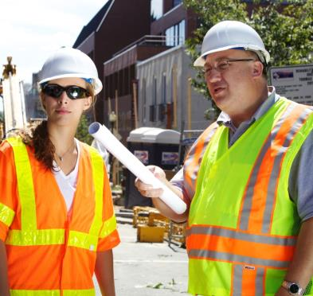
DOT – Quality Control & Inspector
PRIMARY ROLE: LIAISON
Consider ITCP needs during the site operations phase
Assist and advise in plan execution
Communicate with the road owner the importance of ITCP implementation
Notes:
In some jurisdictions the inspector is required to be on site at all times; in other states the inspector makes periodic visits. The primary role of the DOT Inspector and/or Quality Control Engineer is that of Liaison with the owner/agency. In most situations, QC and inspectors are regularly on site, often there everyday for a good portion of the day as they take load tickets, measure asphalt being laid or conduct QC. In some states and on some jobs, the state inspector is required to be on the site all day; in other states, the state inspector is not so active.

Slide 6
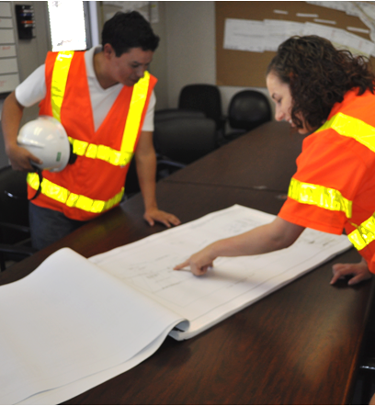
Superintendent/ Project Manager
PRIMARY ROLE: OVERSIGHT
Oversee ITCP Implementation
Ensure Subcontractor Coordination and “Buy-in”
Assign personnel to carry out the plan
Notes:
The project superintendent and/or project manager is a key person in ensuring an ITCP is implemented properly on the site. While the superintendent/manager may assign one or more foremen to directly implement the plan, he/she controls the various factors that must be coordinated to ensure cooperation in ITCP implementation. To properly implement the plan, workers, operators, dump truck drivers, inspectors – virtually all site visitors must be apprised of the plan and made aware of its basic operation. Such coordination and implementation is greatly facilitated with support of the person in charge of site operations and the project schedule.

Slide 7
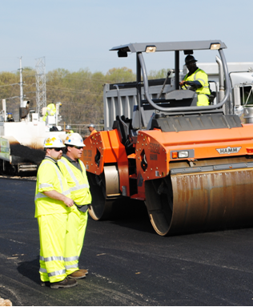
Supervisor and Lead Person
PRIMARY ROLE: IMPLEMENTATION
Plan and implement the ITCP site
Responsible for coordination among personnel and subcontractors at the construction site
Ensure changes are made to ITCP as site conditions change
Notes:
With direct responsibility for on-site operations, compliance with the project schedule and coordinating personnel, the supervisor or lead person will play the most important role in developing and executing the ITCP. He/she should be involved in initial planning activities. The supervisor/lead person will implement the plan by directing onsite operations and ensuring workers on foot, operators, dump truck drivers and other onsite workers are apprised of the ITCP and know where and how they should carry out their duties in compliance with the plan. The lead person/foreman will be responsible to ensure the plan is updated as work progress and site conditions change. He/she is also responsible for general work place safety.

Slide 8
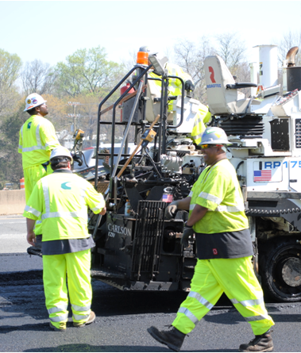
Workers on Foot
PRIMARY ROLE: UNDERSTAND, COMPLY and CORRECT DEFIENCIES
Learn the elements of ITCPs and how to comply
Understand the hazards of working around equipment
Take responsibility for personal safety; apply safety training lessons
Notes:
The ITCP concept was conceived and designed to protect workers on foot from being struck by dump trucks and other construction equipment while working. These workers must be trained and disciplined to understand the basic elements of an ITCP – both in terms of how it protects them and the specifics of what has been planned for the site where they are assigned to work. For workers on foot to be able to comply with ITCP protections, they must 1) understand the plan; 2) be supported in their efforts to comply; 3) be provided with site conditions that allow for their protection (including access to restrooms, coolers, parking, etc.). In other words, workers on foot need to understand the hazards of working around equipment including blind areas, stopping speeds, and communications with operators.

Slide 9
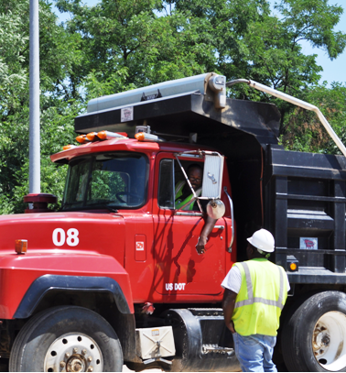
Truck Boss
PRIMARY ROLE: COMMUNICATE WITH OTHER DRIVERS
Share ITCP instruction on where drivers should operate
Assist in communicating safe site procedures with all truck drivers
Notes:
The truck boss needs to be informed about the daily plan as well as the initial planning of the site. He will provide vital information affecting operation safety that should be considered in the planning process. In the training process those involved need to recognize the primary purpose of the truck drivers: to deliver material. They want to do this as efficiently as possible so they can return with another load. Their focus is aligned with the ticket taker on site, and the dump man once the truck is in the queue.

Slide 10
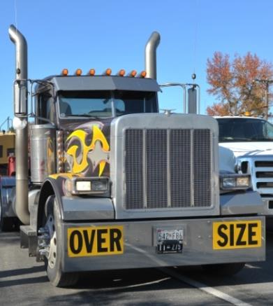
Truck Drivers
PRIMARY ROLE: KEEP A SAFE DISTANCE FROM WORKERS ON FOOT
Receive ITCP instruction on where they should operate
Receive navigation assistance (spotters) when appropriate
Never operate into a blind area without checking for pedestrians
Notes:
Dump truck drivers present the greatest risk to workers on foot. According to data from the Bureau of Labor Statistics, dump trucks are responsible for over ¼ of all runover or backover deaths in this industry. This is primarily because dump trucks have large blind areas into which the driver cannot see; they are “visitors” to the site (bringing asphalt, aggregate and other materials) and may not be aware of current site conditions and operations, and they are in constant movement on the site as they enter, back-up, empty materials, and then exit the work area. With regard to ITCPs, it is critical that drivers be informed of the plan and know where they should and should not go. Drivers should be provided with ITCP instructions and receive navigation assistance (spotters) when driving in the work space when appropriate. Simply, truck drivers on site need to understand the ITCP and operate under the guidelines of the ITCP. This means it needs to be reasonable, understandable, and communicated.

Slide 11
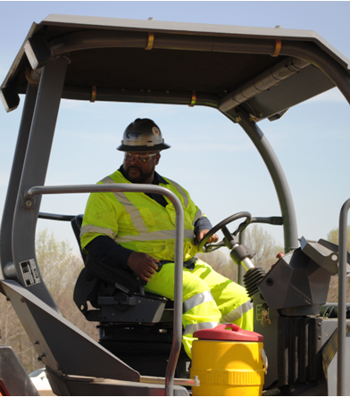
Equipment Operators
PRIMARY ROLE: KNOW THE LOCATION OF WORKERS ON FOOT
Do not move until the blind area is checked or a spotter is designated.
Know blind area for equipment you are operating.
Stay out of areas designated for workers on foot.
Do a 360° “walk-around” before moving equipment.
Notes:
Like dump truck drivers, equipment operators can easily strike workers on foot because he/she is unaware they are laboring near the equipment. Construction equipment also has blind areas where the operator cannot see workers or objects. While operators may be more familiar with site conditions than truck delivery drivers, they must also understand ITCP procedures to ensure safe operations. These include using spotters or performing a visual check when entering blind areas; not allowing workers to approach them without a clear signal to do so, and staying outside of areas designated for workers on foot.
Remember, operators are paying close attention to their task. When the operator is focused on the task at hand, he or she may not see you even in plain sight.

Slide 12
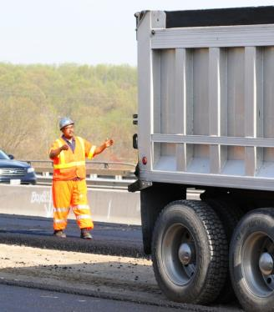
Spotters
PRIMARY ROLE: SAFE BACKING
Ensure operator knows where you are and will be located; make eye contact
Ensure workers know your responsibilities and wait for permission to enter area
Receive training in safe spotting procedures and know the signals
Stay in continuous communication with operator and remain visible at all times
Notes:
Spotters are recommended by ANSI and other organizations for backing operations, particularly those with large blind areas. They should be trained in standard signaling procedures. Some states (Virginia and Washington) require a spotter when camera/radar systems not used. Remember, spotters can also be in danger from vehicles – who is spotting the spotter? Spotters can help when you must work with your back to equipment or traffic. If a driver/operator looses visual contact with the spotter, he/she must stop immediately until the spotter is located.

Slide 13


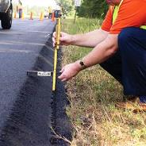

Site Visitors
PRIMARY ROLE: GET INFORMED
Check in with site supervisor when you arrive
Ascertain proper location to park your vehicle
Do not enter blind areas
Stay in areas designated for workers on foot
Notes:
The occasional visitor to the roadway construction site is likely to be least familiar with current site conditions, designated areas for parking, locations where workers on foot are laboring, etc. Early communication with these people is important to let them know an ITCP is in effect on the site. Responsibility for communicating this information should reside primarily with the project manager as he/she is most likely to know who will be visiting the site and when. Visitors may include safety personnel, superintendents, company owners, and other contractors.
Procedures for handling and storing construction material deliveries at the site should also be discussed. Visitors should park at an off-site staging area and receive a ITCP briefing. If they enter the work space, there should be a designated entrance point, parking area and pathway for their duties at the site. Visitors need to know or be instructed on where to park once they enter the worksite. The choice of parking location may impede the production process, cause unnecessary hazards to workers on foot or equipment operators, or cause hazards for drivers on the roadway.
When visitors arrive on site, the foreman or lead person should immediately approach them to make sure they understand ITCP rules and do not place themselves or a vehicle in a location that will impede proper operation of the plan.

Slide 14
Class Activity
What Are Your Duties
Notes:
Have the class members break into teams identify the job(s) they typically perform at work with their partner. Working together, have the team identify several roles and responsibilities each person might assume on the jobsite. Have them share their findings with the class and discuss.

Slide 15
Discussion and Questions
End Module Five
“This material was produced under the grant SH-22285-11-60-F-11 from the Occupational Safety and Health Administration, U.S. Department of Labor, and contract 212-2009-M-32109 from the National Institute for Occupational Safety and Health. It does not necessarily reflect the views or policies of the U.S. Department of Labor or U.S. Department of Health and Human Services, respectively, nor does mention of trade names, commercial products, or organizations imply endorsement by the U.S. Government.”

