Slide 1
Preventing Runovers and Backovers
Technology Solutions
Notes:
NIOSH has been heavily engaged in research and product testing to review the practicality and effectiveness of various technologies designed to warn operators when they are near workers on foot. This module reviews some of those technologies that are now available—or will soon be available—for roadway construction applications.
Credit: Much information in this presentation is taken from research conducted by Todd Ruff, NIOSH Office of Mine Safety and Health Research.

Slide 2
Are there technological solutions?
There are a variety of technologies—old and new—that have been developed to warn drivers and operators when workers on foot are near, including:
Alarms
Cameras
Radar
Sonar
Tag Systems
Notes:
The role of technology in the ITCP is essentially one of communication. Through cameras, radar, sonar and other warning technologies, workers and operators have enhanced ability to see each other and be warned when a dangerous situation arises. Technology will not necessarily “protect” against a runover or backover incident, but it can provide an additional level of warning and notification in those instances where either workers on foot, operators or truck drivers do not follow the ITCP, or where the ITCP did not fully anticipate or control for a hazardous situation that arises.

Slide 3
Terminology
Proximity Detection: Detection of personnel, vehicles and other objects near a machine using a sensor technology
Proximity Warning (Collision Warning): Detection of personnel, vehicles and other objects near a machine resulting in alarms
  Warn only operator
  Warn operator and nearby personnel (two-way)
Notes:
Proximity Detection: Detection of personnel, vehicles and other objects near a machine using a sensor technology.
Proximity Warning (Collision Warning): Detection of personnel, vehicles and other objects near a machine resulting in alarms.

Slide 4
Terminology (continued . . .)
Collision Avoidance: The processing of sensor information resulting in control signals or actions that alter machine status/movement to avoid a collision
  Computer Control
  Human Control
Notes:
Collision Avoidance is the processing of sensor information resulting in control signals or actions that alter machine status/movement to avoid a collision.

Slide 5
Proximity Detection
Independent or stand alone systems
Network-based systems requiring supporting infrastructure
Actions range from simple alarms to machine control (setting brakes, limiting movement, etc.)
Notes:
There are a variety of proximity detection systems, some are stand along while others are network based.

Slide 6
Proximity Detection Approaches
Independent systems:
  Passive sensing of obstacles and personnel
    Reflected Signals
    Non-discriminating
  Cooperative systems require communication between machine-mounted systems and systems on obstacles or personnel (which participate in detection)
Notes:
Independent systems may have passive sensing of obstacles and personnel. Cooperative systems require communication between machine-mounted systems and systems on obstacles or personnel.

Slide 7
Proximity Detection Approaches
Network-Based Systems:
  Cooperative and require other infrastructure on the job-site (GPS or other communication system)
Notes:
Network-Based Systems are cooperative and require other infrastructure on the job-site.

Slide 8
Collision Avoidance Approaches
Increase situational awareness:
  Visual, audible, tactile alarms
  Two-way alarming
  Human in the loop
Machine Control
  Processing of sensor information
  Automatic control of machine functions
Combination of both
Notes:
Collision avoidance technologies are designed to increase situational awareness using visual, audible or tactile alarms.

Slide 9
Considerations
The approach to avoiding runovers, backovers, or pinning workers depends upon the type of equipment and its associated risks:
  Operator on board
  Operator adjacent to equipment
  Blind Areas
  Speed of machine
  Risk to near-by workers or vehicles
Notes:
The approach to avoiding runovers, backovers, or pinning workers depends upon the type of equipment and its associated risks. The system will be contingent upon factors such as whether the operator is on board or adjacent to equipment. One should consider hazards such as blind areas, speed of the machine and the risk to near-by workers or vehicles.

Slide 10
Camera Systems
Use of cameras to see blind spots is a proven technology that is used in many industries. Special considerations for roadway construction applications include:
  Appropriate mounting locations (especially dump trucks)
  Keeping camera clear of dirt and grime
  Ensuring drivers/operators look at monitor
Challenges:
  Cameras get dirty
  Operator must look at monitor to be aware of workers
Notes:
Though cameras are a very useful tool in eliminating blind spots, they also have limitations. For example, it may require the use of multiple cameras for the operator to see all blind areas around his or her equipment. Also, as construction work is very dirty, camera lenses can get covered with dirt, mud, asphalt etc. effectively blinding them. Finally, even though the camera may capture an image of a worker on foot and display it on the monitor, if the operator is focused on his task, he may not look at the monitor.

Slide 11
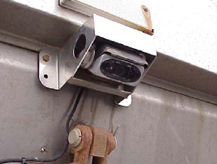
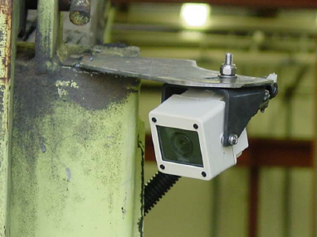
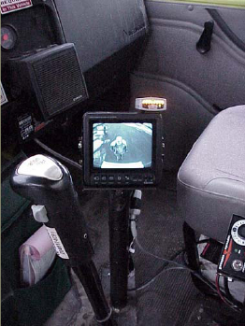
Camera Systems
Notes:
There are a growing number of manufacturers of camera/video systems and pricing is getting more competitive.

Slide 12
Sonar
Sonar devices use sonic waves to detect a person or object that enters their field of perception. When something is detected in the field, it sounds an alarm.
Challenges with this technology:
  Detection cannot discriminate as to what “objects” will trigger alarm
  Operator hears “false alarms” when object in field is not a hazard
  Has a relatively short detection distance
  Detector must be carefully mounted so as not to detect the ground or parts of the equipment.
Notes:
Sonar devices use sonic waves to detect a person or object that enters their field of perception. When something is detected in the field, it sounds an alarm.

Slide 13
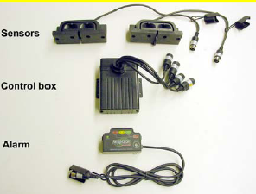
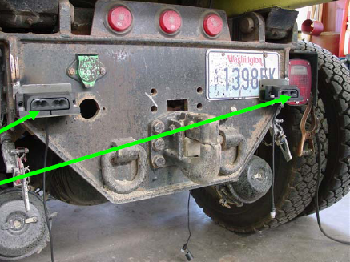
Sonar
Sonar Sensors
Notes:
Sonar devices are not so common as cameras, but their use continues to grow.

Slide 14
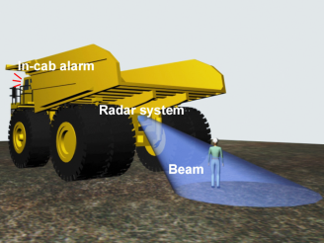
Radar
Radar-based proximity detection:
  Pulsed or continuous wave
  Multiple antennas positioned to monitor blind areas
  Display in cab provides audible and visual warnings, often with graded alarms
  Typically short range for slow moving scenarios (25-75 feet)
Challenge
  Detector must be carefully mounted so as not to sense the ground or parts of the equipment.
Notes:
Like sonar, radar waves create a field that will detect an object when it enters the area and create an alarm to warn the operator. The challenge in working with radar or sonar alone is the system will alert the driver to any object in the monitored area, including cones, piles of dirty, shovels, etc. Because radar and sonar do not discriminate, the operator will receive false alarms, which can cause him or her to become complacent.

Slide 15
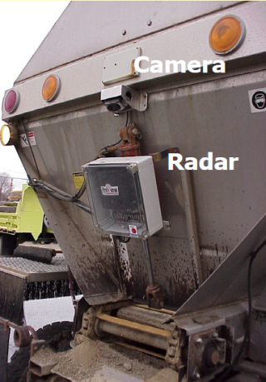
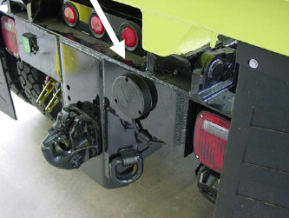
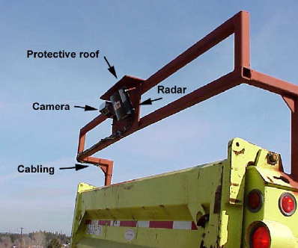
Radar
Best: Radar and Camera Used in Combination
Radar Antenna
Notes:
Radar and sonar systems function best when coupled with camera technology. The radar or sonar sensing devices send an alarm when an object enters their sensor field. The alarm alerts the operator to look into his monitor to see the person or object in his blind spot so he can take appropriate action.

Slide 16
Available Technologies
An emerging technology with effective results in other industries involves two-way communication between a system mounted on equipment and detectors on workers (or other machines).
This is known as a “Tag Based” system
Notes:
An emerging technology with effective results in other industries involves two-way communication between a system mounted on equipment and detectors on workers (or other machines).
This is known as a “Tag Based” system.

Slide 17
Available Technologies
Radio Frequency Transceivers and Tags
  Radio Frequency Identification
  Heavy equipment and light vehicles are fitted with transceivers
  UHF or VHF
Challenges with this technology:
  Every worker must be tagged and each piece of equipment must have a detection device
Notes:
As a technology, RFID show a lot of promise. Some systems have a two-way alarm warning feature, which enables both the equipment operator and the worker to receive individual warning alarms. The driver receives an alarm from a device installed in the truck cab, and the worker receives an alarm from a device or tag that he uses on his belt.

Slide 18
RFID Technology
RF Tags mounted on equipment (multiple locations) and workers
Two-way alarms warn operator and others near-by
Location determined by the RF unit that detects the other tag (front, rear, left, right) and shown on display
Adjustable Range
Used with Cameras
Notes:
RFID systems offer the most comprehensive collision avoidance protection because they alert both the driver/operator and the worker on foot when they are in close proximity to one another.

Slide 19

How it Works
Signals sent to detect other tags.
Location identified by tag location
Notes:
The RFID technology has two components: (1) a reader, which is a device used to communicate with the (2) tag.

Slide 20
Tag – Identifies Worker Near-by
Communications Link
Audible sounds or vibration warn worker and
operator. Operator warned to look in monitor.
Notes:
The reader has at least one antenna that emits radio waves and receives signals back from the tag. The tag is a microchip attached to an antenna that can be incorporated into a product, animal, person, etc. It contains a unique serial number and can be either a passive or an active tag.

Slide 21
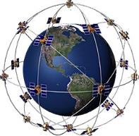
Global Positioning System (GPS)
Equipment or vehicle location determined using GPS
Location broadcast to other nearby equipment
Proximity warning alarms and location displays
Challenges with this technology:
  Every worker must be tagged and each piece of equipment must have a detection device
Notes:
Like the GPS unit used for finding addresses or locations, equipment or vehicle locations can be determined using GPS. The location of equipment is broadcast to other nearby equipment or workers. Proximity warning alarms are sounded and locations displayed to may and warn of hazardous situations.

Slide 22
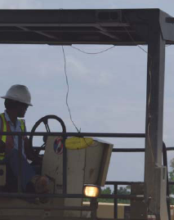
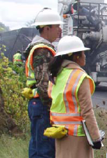
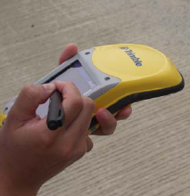
Global Positioning System (GPS)
GPS installed on equipment (dump trucks, pavers, rollers)
GPS receivers installed on Workers
Notes:
GPS technology can be mounted on equipment and workers.

Slide 23
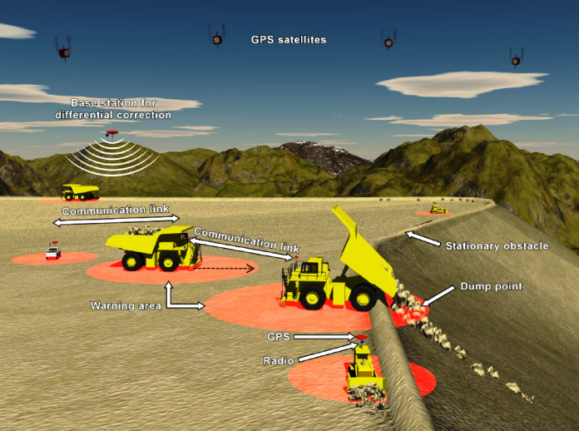
GPS Technology
Notes:
GPS systems provide locations and warnings for equipment and workers operating in close proximity.

Slide 24
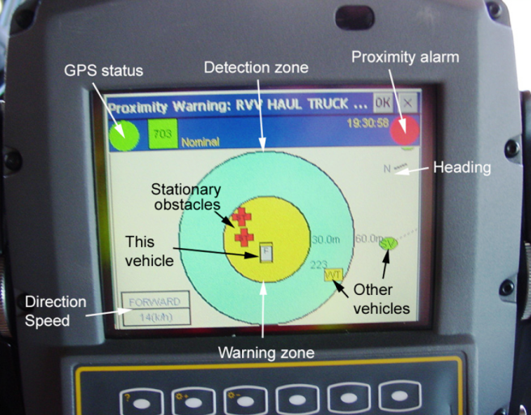
GPS Technology
Notes:
This is a sample of a GPS locating device.

Slide 25
Emerging Technologies
Intelligent Video Systems
  Computer-assisted stereovision cameras
  Video signal processing allows for detection based on 3D position
  Provides view of blind area near equipment and proximity warning using only cameras
  HAZ CAM system trials on haul trucks
Notes:
There are other technologies which are relatively new that show promise for our industry. One is an intelligent video system which uses computer-assisted stereovision cameras. The video signal processing allows for detection based on 3D position and provides view of blind area near equipment and proximity warning using only cameras.

Slide 26
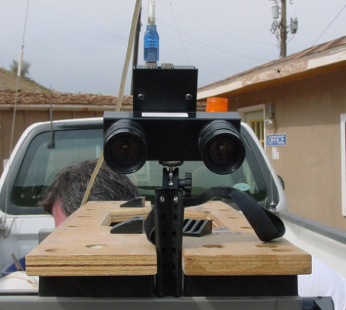
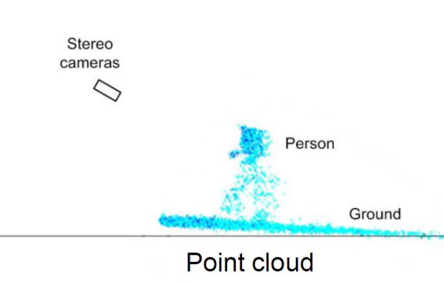
Intelligent Video Systems
Notes:
Sample of the camera and a person as he/she appears in the monitor.

Slide 27
Additional Work & Considerations
Reduce nuisance alarms and false stops
Effective alarm presentation and context considerations
Operator interfaces and combined displays
Are systems overloading operators? Are they distractions?
Behavior changes in operators
Wearable sensors appropriate for tasks and environment
Notes:
As with any technology, special consideration must be given for the location and manner in which the technology will be used. Some considerations might include a need to reduce nuisance alarms and false stops in urban areas. Nevertheless, there is a balance between using technology and distracting the operator with too many interfaces. Are systems overloading operators? Are they distractions?

Slide 28
Resources
NIOSH Proximity Detection Web Page:
www.cdc.gov/niosh/topic/highwayworkzones/
www.cdc.gov/niosh/mining/topicspage58.htm

Slide 29
Discussion and Questions
End Module Seven
“This material was produced under the grant SH-22285-11-60-F-11 from the Occupational Safety and Health Administration, U.S. Department of Labor, and contract 212-2009-M-32109 from the National Institute for Occupational Safety and Health. It does not necessarily reflect the views or policies of the U.S. Department of Labor or U.S. Department of Health and Human Services, respectively, nor does mention of trade names, commercial products, or organizations imply endorsement by the U.S. Government.”

