Slide 1

Safety Training Presentations
Institute of Occupational Safety and Health
Construction Hazards

Slide 2

FY-11 OSHA Susan Harwood
Grant Program
This material was produced under grant number SH-22297-11 from OSHA. It does not necessarily reflect the views or policies of the U.S. Department of Labor, nor does mention of trade names, commercial products, or organizations imply endorsement by the U.S. Government
Notes:
This presentation emphasizes hazard identification, avoidance, and control – not standards.

Slide 3
Objectives
Participants will:
Identify the four major hazards of construction and how to avoid them
Describe ways to protect themselves from hazards
Learn how to select and use Personal Protective Equipment (PPE)
Apply safety procedures when working in or around Trenches, Electrical equipment, Scaffolds and Power Tools
Notes:
To students:
What do you consider to be one of the four major hazards of construction?
-Falls, Electrocution, Trenching crushed by … and hit by falling objects

Slide 4
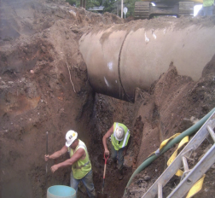
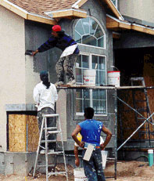
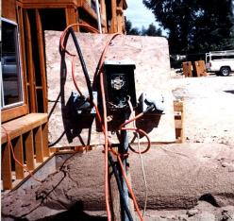
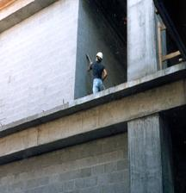
Major hazards of construction
Falls
Electrocution
Being struck by falling objects
Trapped during excavation
Notes:
What are the four major hazards :
Electrical, Excavation/Trenches, Falls, Being struck by objects or vehicles
Knowing the major hazards, tell me What’s wrong with these pictures?
Possible answers:
1- No support for the walls – caved in possible, no additional support for pipes
2- Overloaded electrical outlets
3- No guardrails to support worker or prevent fall
No safety harness

Slide 5



Major hazards of construction
1
Notes:
What are the four major hazards :
Electrical, Excavation/Trenches, Falls, Being struck by objects or vehicles
Knowing the major hazards, tell me What’s wrong with these pictures?
Possible answers:
1- No support for the walls – caved in possible, no additional support for pipes
2- Overloaded electrical outlets
3- No guardrails to support worker or prevent fall
No safety harness

Slide 6
Fall Protection
This section will discuss:
Conditions that required use of fall protection
Options available to protect workers
Notes:
How to provide adequate fall protection for employees at construction sites is difficult because there are many different types of work being conducted and different levels of experience;
From roofing to maintenance work on buildings and residences. Fall protection is a must

Slide 7
Fall Protection
Falls are the leading cause of fatalities in the construction industry
Conditions that required use of fall protection
A fall from as little as 4-6 feet
Can cause loss of work
In some cases death
Notes:
In the United States there are approximately xxx deaths every day due to falls at workplace.
Conditions: When performing work that requires the use of scaffolds, cranes, ladders, scissor lifts etc, the implementation of fall protection is required.
And not to mentioned work on stairways and ladders.

Slide 8
When fall protection is needed?
Walkways & ramps
Open sides & edges
Holes
Concrete forms & rebar
Excavations
Roofs
Wall openings
Bricklaying
Residential Construction

Slide 9
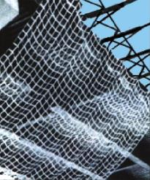
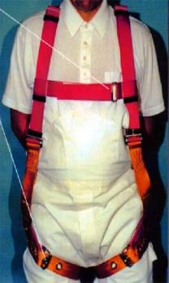
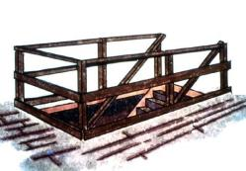
Fall protection and prevention options
Safety Nets
Hand Rails
Safety Harness (PFAS)
Equipment guards
Fall protection systems must be in place before work start
Notes:
General Rule: If an employee can fall 6ft or more feet, fall protection measures are to be implemented by the employer or competent person.
What safety equipment I need:
Safety nets, Personal Fall arrest system, Guardrails
All safety equipment must be in place before work starts. Employer must provide safety equipment and periodic inspections should be conducted by competent person before work stars.
YOU MUST BE PROTECTED FROM FALLING BY ONE OR MORE OF THESE SYSTEMS

Slide 10
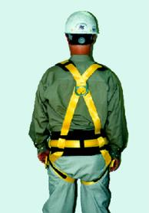
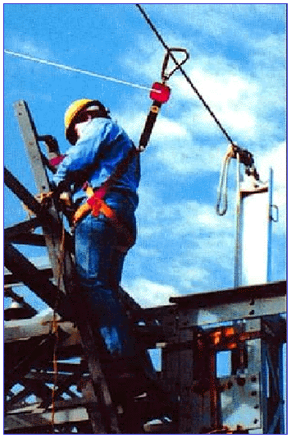
Personal Fall Arrest System, PFAS
Must be properly trained
Key requirements
No free fall more than 6 feet
Must be inspected prior to use
Safety line must be able to support 5000 lbs
Notes:
Personal Fall Arrest System (PFAS)
Reference 1926.502(d)
PFAS is a body harness that is fastened to a secure anchorage so that he/she cannot fall
Cannot be used until inspection by competent personnel (foreman) is completed.
Do not use is any of the harness parts is defective, frayed or broken.
Do not use if PFAS does not fit properly or cannot be adjusted.

Slide 11
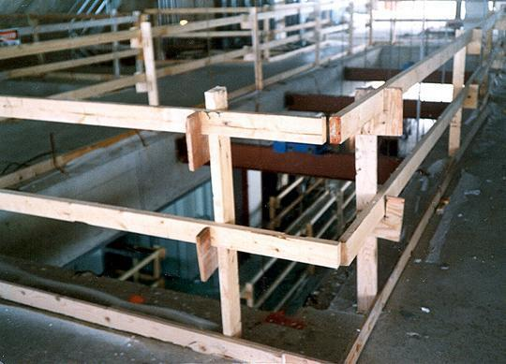
Guardrails
Top rail between 39 to 45 inches tall
Toeboards at least 3 inches tall
Top rail
Mid Rail
Toe board
Notes:
Used to prevent workers from falling
The protective barriers must be strong enough to support an prevent an employee from falling.
Wood, chain and wire rope may be used for top rails and mid-rails.
If wire rope is in used, slack must not exceed xxx inches from edge of work area.

Slide 12
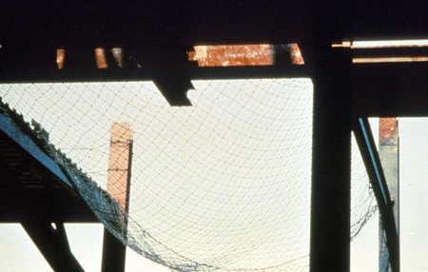
Safety Nets
Used to catch falling workers
Placed not more than 30 FT below work area
Placed not more than 8-13 ft from edge of working area
Notes:
The safety nets:
- Must be strong enough to support a falling employee;
- Must have sufficiently small mesh openings so the employee cannot fall through the net;
- Must be close enough to the surface of the walking/working surface so that the fall into the safety net will not still
injure the employee (never more than 30 feet below the walking/working level);
- Must be close enough to the edge of the working surface (the outer edge of the net between 8-13 feet from the
edge of the walking/working surface, depending on the distance to the walking/working surface) so that the
falling employee will not slip past the net.

Slide 13
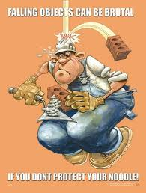
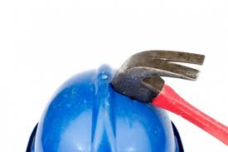
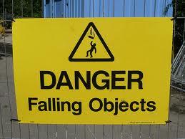
Falling Objects
Hardhats are required
Use of canopies is authorized
Barricade the area to prevent unauthorized entry

Slide 14
SUMMARY
A fall of 6 ft or more protection is needed
Use fall protection on:
Walkways, ramps, open sides, edges, excavations,

Slide 15
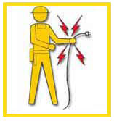
Electrical Safety
This section will discuss:
Safety requirement
Hazard prevention and control
Most common injuries
Personal Protective Equipment
Notes:
This presentation addresses electrical safety requirements that are necessary for the safety of construction employees and is divided into major divisions as follows:
Overview. Includes why electricity is dangerous and how it works.
Hazard / Controls. Covers the main hazards and explains the best ways to prevent these hazards from occurring.
General Planning and Controls.

Slide 16
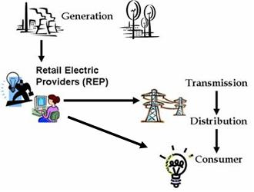
How it works
Electricity is the flow of energy from one place to another
Requires a source of power (generating station, power station or portable generator)
Travels in a close circuit
Notes:
Electricity is like turning on a water faucet
Behind the faucet (or switch) there is a source of water (or electricity). The faucet’s water source is a reservoir or pumping station. A pump provides enough pressure for the water to travel through the pipes. For electricity the source is the power generating station. A generator provides the pressure (voltage) for the electrical current to travel through electric conductors (wires).

Slide 17
Electrical Safety
Always assume that all overhead wires are energized
Never touch a down power line
Never operate electrical equipment while standing in water
Coming in contact with an electrical voltage can cause current to flow through the body, resulting in electrical shock and burns. Serious injury or even death may occur.
Notes:
Do’s and Don’ts
Use common sense when working around electricity

Slide 18
ELECTRICAL ACCIDENTS Most Frequent Causes
Contact with Power Lines
Lack of Ground Fault Protector
Missing Ground on electric cords
Improper use of equipment
Improper use of electric cords
Notes:
On the job injuries occurred due to lack of training or l

Slide 19
Electrical Hazards
Electrical accidents are caused by a combination of three factors:
Unsafe equipment and/or installation,
Workplaces made unsafe by the environment, and
Unsafe work practices
Notes:
Electrical shocks, fires, or falls result from these hazards:
Exposed electrical parts
Overhead power lines
Inadequate wiring
Defective insulation
Improper grounding
Overloaded circuits
Wet conditions
Damaged tools and equipment
Improper PPE

Slide 20
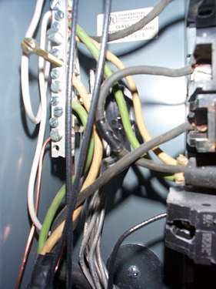
Hazard: Exposed electrical parts
Isolate electrical parts
Use guards or barriers
Replace covers
Notes:
Live parts of electric equipment operating at 50 volts or more shall be guarded against accidental contact by cabinets or other forms of enclosures
All pull boxes, junction boxes, and fittings shall be provided with covers and be

Slide 21
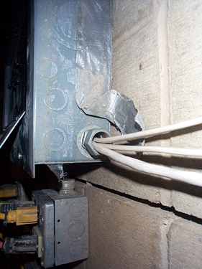
HAZARD: Conductors entering boxes
Shall be protected from abrasion
All openings shall be closed to prevent access

Slide 22
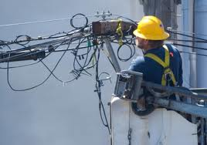
HAZARD: Overhead Power Lines
Usually not insulated
Carry extremely high voltage
80% of all lineman deaths were caused by contacting a live wire with a bare hand.
Notes:
Fatal electrocution is the main risk, but burns and falls from elevation are also hazards. Using tools and equipment that can contact power lines increases the risk.
Overhead power lines must be de-energized and grounded by the owner or operator of the lines, or other protective measures must be provided before work is started. Protective measures (such as guarding or insulating the lines) must be designed to prevent contact with the lines.
PPE may consist of rubber insulating gloves, hoods, sleeves, matting, blankets, line hose, and industrial protective helmets.

Slide 23
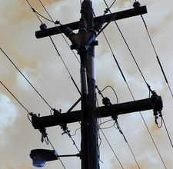
HAZARD: Overhead Power Lines (Cont)
Equipment that could contact power lines:
Cranes
Scaffolds
Ladders
Scissor lift
Notes:
Equipment Includes:
Cranes, Ladders, Poles, scaffolds.

Slide 24
MOST COMMON INJURIES
DIRECT
Electrocution or death
Shock
Burns
INDIRECT
Falls
Notes:
Electrocution results in internal and external injury to body parts or the entire body – often resulting in death.
After receiving a “jolt” of electricity all or part of the body may be temporarily paralyzed and this may cause loss of grip or stability therefore causing an fall
Indirect injuries are caused by falls into electrical lines or wires
Power line falls on top of a car
Stay inside
Wait for emergency rescue

Slide 25
Most Common injuries Electric shock/Electrocution
Electric shock is received when electrical current passes through the body.
Can cause severe damage or death.
You will get an electrical shock if a part of your body completes an electrical circuit by…
Touching a live wire and an electrical ground,
Touching a live wire and another wire at a different voltage.

Slide 26
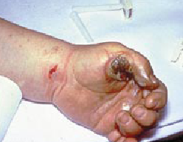
Most Common injuries: Burns
Most common shock-related injury
*Electrical Burns, Arc or Flash Burns, Thermal Burns
Occurs when you touch electrical wiring or equipment that is improperly used or maintained
Very serious injury that needs Immediate attention
Notes:
The most common shock-related injury is a burn.
Burns suffered in electrical incidents may be one or more of the following three types.
Electrical, Arc, Thermal
Electrical burns cause tissue damage, and are the result of heat generated by the flow of electrical current through the body. These are one of the most serious injuries you can receive and require immediate attention.
Arc or Flash burns are caused by high temperatures near the body produced by an electrical arc or explosion. Attend to them immediately.
Thermal contact burns occur when skin comes in contact with overheated electric equipment, or when clothing is ignited by an electrical incident.

Slide 27
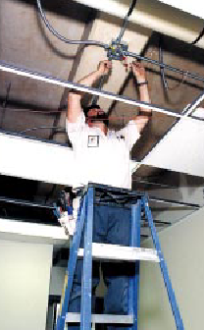
Most Common injuries Falls
Caused by involuntary electric shock
Occurs on personnel working in elevated locations (ladder, scaffolds, etc)
May result in serious injury or death

Slide 28
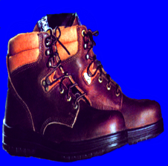
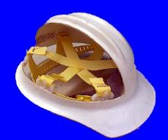
PERSONAL PROTECTIVE: EQUIPMENT
PPE should always be first line of defense
Rubber gloves
Rubber Insulated work boots,
Hoods, sleeves or blankets
Notes:
When it is necessary to handle or come close to wires with a potential live electrical charge, it is essential to use proper insulating PPE to protect employees from contact with the hazardous electrical energy.
Safety shoes
Nonconductive and protect your feet from completing an electrical circuit to ground.
They can also protect against open circuits of up to 600 volts in dry conditions.
Should be used with other insulating equipment to reduce or eliminate the potential for hazardous electrical energy.
Hard hats are needed when performing electrical work.
A “Class B” Electrical/Utility type hard hat protects against falling objects and high-voltage shock and burns.

Slide 29
SAFETY WORK PRACTICES
Only qualify person should work on electrical equipment
Use special insulated tools when working on fuses with energized terminals
Don’t use worn or frayed cords and cables
Don’t fasten extension cords with staples, hang from nails, or suspend by wire.
Notes:
Reference CRF 1926.416, 1926.417

Slide 30
SAFETY WORK PRACTICES
De-energize live parts before commencing work
Lock or Tag out circuits (or both)
Inspect extension cords
Avoid contact with overhead lines
Avoid wet conditions
Check switches and insulation
Notes:
Extension cords shall be visually inspected before use on any shift for external defects (such as loose parts, deformed and missing pins, or damage to outer jacket or insulation) and for evidence of possible internal damage (such as pinched or crushed outer jacket).

Slide 31
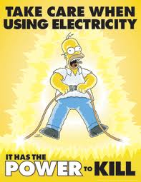
SUMMARY
Electrical equipment must be:
Listed and labeled
Free from hazards
Used in the proper manner
If you use electrical tools you must be:
Protected from electrical shock
Provided necessary safety equipment

Slide 32
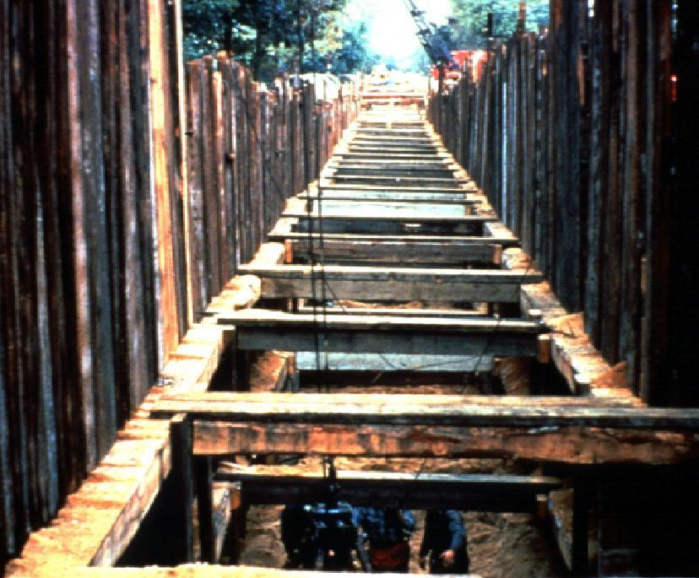
Notes:
1926 Subpart P ‑ Excavations

Slide 33
TRENCHING & EXCAVATION HAZARDS
Risks of excavation
How to protect employees from cave-ins
Factors that pose a hazard to employees working in excavation
Role of competent person
Notes:
Reference 29 CFR 1926.652.
This section will discuss, risk, prevention, factors
At the conclusion of the training, you should be able to:
State the greatest risk that is present at an excavation.
2. Briefly describe the three main methods for protecting employees from cave-ins.
3. Name at least three factors that pose a hazard to employees working in excavations, and at least one way to eliminate or reduce each of the hazards.
4. Describe the role of a competent person at an excavation site.

Slide 34
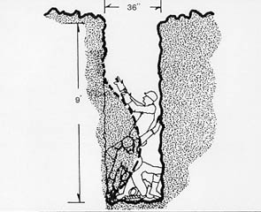
EXCAVATION HAZARDS Risks
Most hazardous construction operation
Cave-ins are the greatest risk
Most accidents occurred in
5-15 ft deep
Notes:
Usually there is no warning before a cave-in
Some of the risks involves:
Asphyxiation due to lack of oxygen
Being crushed by weight of dirt
Inhalation of toxic materials
Fire
Moving machinery near the edge of the excavation can cause a collapse
Accidental severing of underground utility lines

Slide 35
EXCAVATION HAZARDS Employee Protection
Employees should be protected from caves-in by using a well designed protective system
Systems must be able to support expected loads to the system
Notes:
What is a protective system?
Protective system is a method of protecting employees from cave-ins from material that could fall or roll from an excavation face or into an excavation, or from the collapse of adjacent structures.
Protective systems include support systems, sloping and benching systems, shield systems, and other systems that provide the necessary protection.

Slide 36
EXCAVATION HAZARDS Protective System Design
A well designed system will have a correct design of sloping and benching systems
Correct design of support systems
Handle materials and equipment
Notes:
Reference 1926.652, 1926.652(b), 1926.652(c)
Benching -- excavating the sides of an excavation to form one or a series of horizontal levels or steps, usually with vertical or near-vertical surfaces between levels.
Shoring or shielding is used when the location or depth of the cut makes sloping back to the maximum allowable slope impractical. There are two basic types of shoring, timber and aluminum hydraulic.
Trench boxes (shielding) are different from shoring because instead of supporting the trench face, they are mostly serve to protect workers from cave-ins. The excavated area between the outside of the trench box and the face of the trench should be as small as possible. The space between the trench box and the excavation side may be backfilled (or other means may be used) to prevent lateral movement of the box. Shields may not be subjected to loads exceeding those which the system was designed to withstand. Trench boxes may be used in combination with sloping and benching.

Slide 37
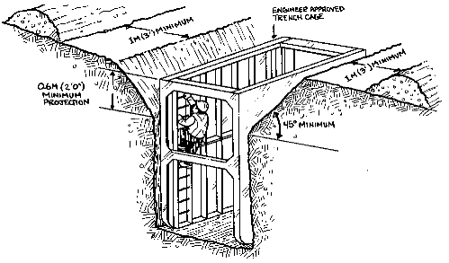
EXCAVATION HAZARDS Employee Protection
Protect employees from potential cave-ins
Slope or bench sides of excavation
Place shields between the side
of the excavation and work area
Notes:
Instructors Note:
Each employee in an excavation shall be protected from cave-ins by an adequate protective system except when:
Excavations are made entirely in stable rock; or
Excavations are less than 5 feet in depth and examination of the ground by a competent person provides no indication of a potential cave-in.
Protective systems shall have the capacity to resist without failure all loads that are intended or could reasonably be expected to be applied or transmitted to the system.

Slide 38
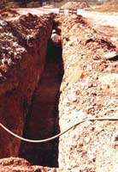
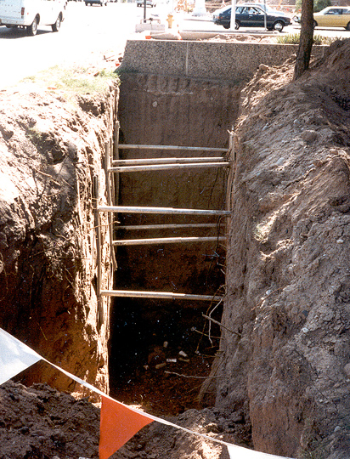
Inadequate Worker Protection
Notes:
There is worker in a trench with no protective system, that is not sloped or benched and has no means of egress. A protective support system should have been designed before work begin
Inadequate shoring support, no egress

Slide 39
Factors that pose hazards to employees
Soil classification
Depth of cut
Water content of soil
Changes due to weather and climate
Other operations in the vicinity
Notes:
The employer or his designee must select and construct designs of support systems, shield systems, and other protective systems
Trenches more than 5 feet require shoring or must have a stabilized slope
Trenches less than 5 feet - a competent person must inspect to determine that a protection system is not necessary in soils where there is no indication of a potential cave-in

Slide 40
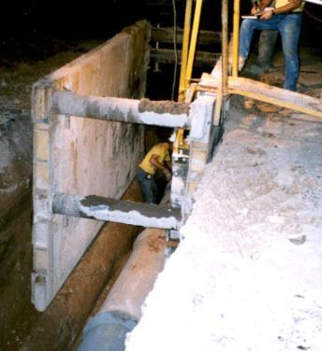
Types of Protection Trench Shield
A trench shield was built around this work area

Slide 41
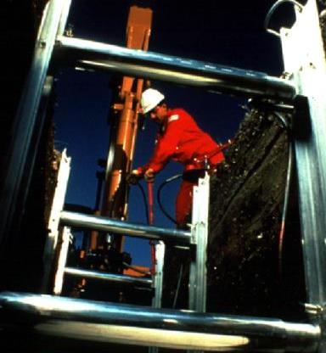
Hydraulic Jacks
Hydraulic Jacks
Easily dropped in place and adjusted
Trench pins installed in case of hydraulic failure
Notes:
Using hydraulic jacks the operator can easily drop the system into the hole
Once in place, hydraulic pressure is increased to keep the forms in place
Trench pins are installed in case of hydraulic failure

Slide 42
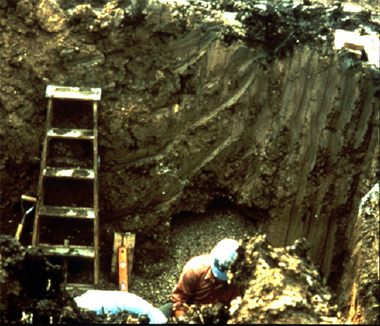
Egress Systems
A stairway, ladder, or ramp must be present in excavations that are 4 or more feet deep, and within 25 feet of the employees
Must extend 3FT above excavation
This ladder does not meet the requirements of the standard

Slide 43
EXCAVATION HAZARDS Competent Person
Must have had specific training in and be knowledgeable about:
Soils classification
The use of protective systems
The requirements of the standard
Must be capable of identifying hazards, and authorized to immediately eliminate hazards
Notes:
Reference 1926.650(b) "Competent person"
One who is capable of identifying existing and predictable hazards in the surroundings, or working conditions which are unsanitary, hazardous, or dangerous to employees, and who has authorization to take prompt corrective measures to eliminate them.

Slide 44
EXCAVATION HAZARDS Competent Person
A competent person must make daily inspections of excavations, areas around them and protective systems:
Before work starts and as needed
After rainstorms, high winds or other occurrence which may increase hazards
When you can reasonably anticipate an employee will be exposed to hazards.
Notes:
Daily inspections of excavations, the adjacent areas, and protective systems shall be made by a competent person for evidence of a situation that could result in possible cave-ins, indications of failure of protective systems, hazardous atmospheres, or other hazardous conditions. An inspection shall be conducted by the competent person prior to the start of work and as needed throughout the shift. Inspections shall also be made after every rainstorm or other hazard increasing occurrence. These inspections are only required when employee exposure can be reasonably anticipated

Slide 45
SUMMARY
The greatest risk in an excavation is a cave-in.
Employees can be protected through sloping, shielding, and shoring the excavation.
A competent person is responsible to inspect the excavation.
Other excavation hazards include water accumulation, oxygen deficiency, toxic fumes, falls, and mobile equipment

Slide 46
OSHA Contact Numbers
To report Unsafe Working Conditions, Safety and Health Violations Contact OSHA @:
1-800-321-OSHA (6742) / TTY1-877-889-5627
To File a Complaint Form:
To file an OSHA-7 report online, see how to file a complaint with OSHA (www.osha.gov)
For more information regarding your rights, see Worker Rights
Notes:
OSHA is here to assist you in preventing injuries by providing training and assistance to ALL individuals. For more in formation please contact OSHA.

Slide 47
References
29 CFR 1926 Safety and Health Regulations for construction
29 CFR 1926.Subpart E- Personal Protective Equipment
29 CFR 1926 Subpart K – Electrical
29 CFR 1926 Subpart L – Scaffold
29 CFR 1926 Subpart M – Fall Protection
29 CFR 1926 Subpart P – Excavations
29 CFR 1926 Subpart T - Demolition

