Slide 1

Safety Training Presentations
Institute of Occupational Safety and Health
Heavy Equipment Safety Awareness

Slide 2


FY-12 OSHA Susan Harwood Grant Program
This material was produced under grant number SH22297-SH1 from OSHA. It does not necessarily reflect the views or policies of the U.S. Department of Labor, nor does mention of trade names, commercial products, or organizations imply endorsement by the U.S. Government.

Slide 3
Objectives:
Participants will:
Recognize potential hazards of various equipment
Implement hazard prevention and controls
Be familiar with OSHA’s role and standards regarding heavy equipment hazards
Prevent other potential hazards
Notes:
In this presentation we will also discuss the hazards workers on foot encountered by backing vehicles
The use of spotters
Common Hand signals used by spotters

Slide 4
Heavy Equipment Hazards
Mobile heavy equipment at construction sites is a major cause of fatalities:
Electrocuted if equipment touches an overhead power line
Crushed if vehicle overturns
Run over by a backing vehicle
Crushed if caught between a wall or other vehicle or structure
Notes:
Approximately 100 fatalities occur each year by mobile heavy equipment
Major causes:
Struck by equipment while backing up (blind side)
Roll over: While working on steep inclines, loading / Offloading of equipment from /to transport trucks
Operator is often trapped between machine and ground resulting in fatalities. Removal of safety equipment (ROPS) Roll Over Protection System
Dump trucks and cranes are the kinds of equipment that hit overhead power lines most often.

Slide 5
Hazard Prevention and Controls
Pre-Construction work site analysis.
Spotters Provided for in-the-blind, backing machines and/or equipment.
Perimeter Fencing, Enclosures, signs
Temporary Barricades around Hazards.
Notes:
The main problem with reversing vehicles and equipment is the driver or operator's restricted
view.
Around dump trucks and heavy equipment such as bulldozers and graders there are blind spots
where the operator has no view or only a very limited view.
The operator may not see someone standing in these blind spots.
Anyone kneeling or bending over in these areas would be even harder to see.
Consequently the driver or operator must rely on mirrors or spotters to back up without running
Over someone or into something.

Slide 6
Hazard Prevention and Controls Pre-Construction site analysis
Identify Potential Known Hazards.
Employee Training?
Job Conditions: Haul Roads, Access Points, Proper light if working at night
Location of Storage Areas, office buildings.
Tool, Storage and Change Trailers.
Notes:
Known Hazards;
Buildings, overhead power lines, trenches
Are your employees trained and experienced. Often times workers are provided by temporary
agencies and are not fully qualified or experienced to work in a construction site. These are the
people who often get hurt
Established speed limit at work site

Slide 7
Hazard Prevention and Controls Spotters
Necessary around vehicles or equipment when:
A driver or operator does not have a full view of the intended path of travel
Backing with limited visibility or space
Backing or maneuvering trailers
Maneuvering with limited space
Notes:
Also spotters are necessary when operating near power lines
Spotters need to know what to look for
Spotters need to be aware of all hazards
Anticipate situations which a spotter would help prevent an incident
Spotters should be located in an area where the driver easily sees the spotter.
Spotter can not perform any other duties while directing a backing vehicle
Must be a competent person

Slide 8

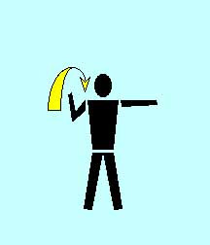
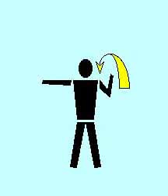
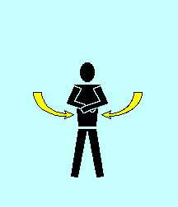
Spotters Hand Signals
Back Left
Straight Back
STOP
Back Right

Slide 9
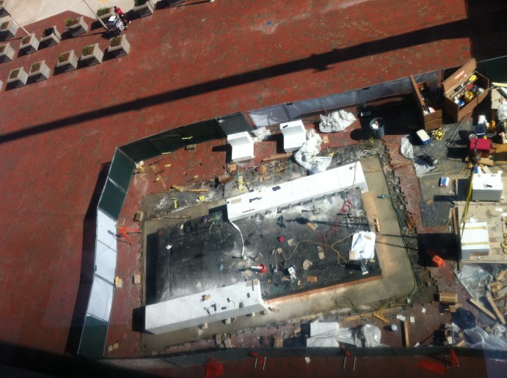
Hazard Prevention and Controls Perimeter Fencing
Necessary around vehicles or equipment to safeguard employees
Notes:
In addition to perimeter fencing, security cameras can be use. Signs can be use to establish
restricted areas were only authorized personnel should enter. Safety signs are also another way
to safeguard employees.
Maintain foot traffic and vehicle traffic separated whenever possible.
If working in close quarters or public areas where pedestrian could be at risk, increase distance for perimeter fencing, attach safety nets when falling objects could be a hazard to anyone.

Slide 10
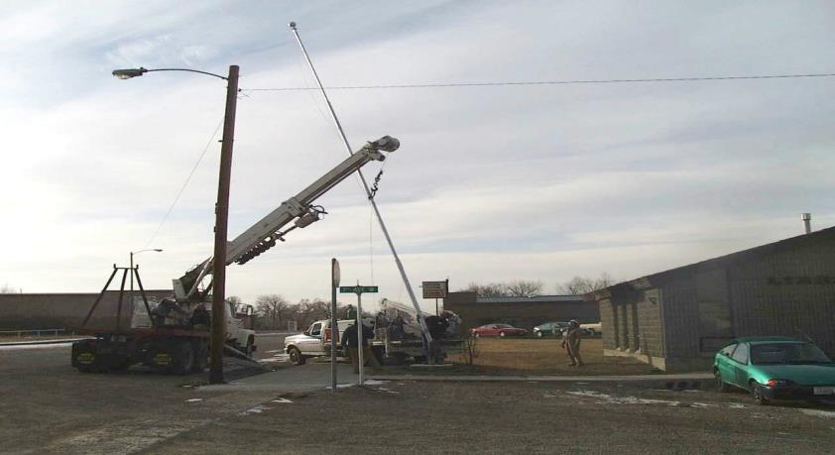
Working Around power lines

Slide 11
Working Near Power Lines
A spotter must be present
Must have a clear view of the power line and the equipment operator, and be able to immediately inform the operator of any danger.
A dedicated power line spotter may be required to watch distance to power lines.
Notes:
Working around power lines could be deadly if the operator accidentally touches a power line with the equipment. Maintain 10 ft from power lines OSHA standard.
Companies may increase distance from power lines but cannot decrease mandated distances.
Must follow OSHA standard 29 CFR 1926.1419/1428/

Slide 12
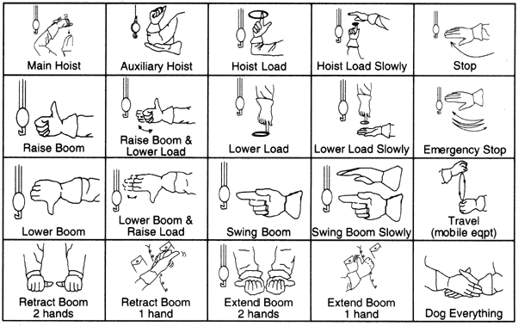
Crane Hand Signals (Spotters)

Slide 13
OSHA Prevention Videos (V-Tool)
Struck by accidents – Vehicle Back up

Slide 14
OSHA Prevention Videos (V-Tool)
Struck by accidents – Swinging Crane
www.osha.gov
Notes:
Insert video

Slide 15
Prevention Videos
Heavy Equipment and Crane Accidents
www.heavyconstructionacademy.com/certfications/
Notes:
Insert video

Slide 16
Summary
Be aware of your surroundings
Always use a spotter when backing up Heavy Equipment
The use of spotters can save lives
Safeguard working area by establishing a safety perimeter

Slide 17
Helpful OSHA Resources
OSHA has many helpful programs, including assistance about safety and health programs, state plans, workplace consultations, voluntary protection programs, strategic partnerships, training and education, and more
OSHA Heavy Equipment E-Tool: http://www.osha.gov/SLTC/etools/hurricane/heavy-equip.html

Slide 18
OSHA Contact Numbers
To report Unsafe Working Conditions, Safety and Health Violations Contact OSHA @:
1-800-321-OSHA (6742) / TTY1-877-889-5627
To File a Complaint Form:
To file an OSHA-7 report online, see how to file a complaint with OSHA (www.osha.gov)
For more information regarding your rights, see Worker Rights
Notes:
OSHA is here to assist you in preventing injuries by providing training and assistance to ALL individuals. For more in formation please contact OSHA.

Slide 19
References
29 CFR 1926 Subpart O, Motor vehicles, mechanized equipment, and marine operations. OSHA.
29 CFR 1926.251, Rigging equipment for material handling. OSHA Standard.
29 CFR 1910.178, Powered industrial trucks. OSHA Standard.
29 CFR 1926,
29 CFR 1926.61 Retention of DOT Markings

