Slide 1

Safety Training Presentations
Institute of Occupational Safety and Health
Respiratory Protection Awareness
Notes:
Introduce yourself
Briefly describe location of emergency exits, restrooms, smoking and eating facilities State classroom rules.
Relate any applicable experience with class and start participant introductions.

Slide 2


FY-11 OSHA Susan Harwood Grant Program
This material was produced under grant number SH22297-SH1 from OSHA. It does not necessarily reflect the views or policies of the U.S. Department of Labor, nor does mention of trade names, commercial products, or organizations imply endorsement by the U.S. Government.

Slide 3
Objectives: Participants will:
Analyze current OSHA standards for respiratory protection
State the purpose and use of respirators
Identify and select different types of respirators
Identify requirements for the use of respiratory protection

Slide 4
OSHA Standards: 29 CFR 1910.134
Standard for respiratory protection at the workplace
Employer provides respirators to employees
The employer shall be responsible for the establishment and maintenance of a respiratory protection program.
Notes:
This standard applies to General Industry, (part 1910), Shipyards (part 1915), Marine Terminals (part 1917), Longshoring (part 1918), and Construction (part 1926).
29 CFR provides guidelines and procedures for the use of respirators, also provides instructions on how to create an effective program at the work place.

Slide 5
OSHA Standards: 29 CFR 1910.134
Primary employer safety goal is engineering and administrative controls
Annual fit test and whenever conditions change
Must be worn whenever you are working in a hazardous atmosphere
Notes:
Engineering controls:
Mechanical ventilation (fans, exhaust systems, etc)
Isolate hazard in specific building
Use of less toxic chemicals
Administrative controls
Provide respirators to employees
Training
Evaluations

Slide 6

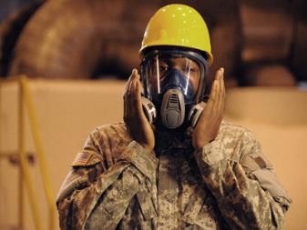
Respirator Safety: Public Knowledge DVD
Coastal DVD: www.coastal.com
Notes:
Respirators can be hot, bulky, heavy and just an overall hassle. But they can also be the difference between life and death. Give your workers a straight-forward look at why they need respirators, how to properly fit and maintain them and when to use certain types. Airborne hazards Control and respirator selection Fit test and fit check Care and maintenance

Slide 7
Respirator Purpose
A respirator protects the user from harmful inhalation of toxic atmosphere hazards such as:
Dusts, fogs, fumes, mists, gases, smokes, sprays, fibers or vapors
The primary objective shall be to prevent contamination from toxic vapors
Notes:
A respirator is a device to protect the wearer from the inhalation of harmful atmospheres.
Before implementing a respiratory program, all efforts should first be made to engineer out the hazards either by providing ventilation or isolating source.
Respirators must be approved for the type and severity of conditions in which they are to be used

Slide 8
Respiratory Hazards
Must be evaluated by supervisor
When First Hired
If you are a New user
Working with new chemicals
If any conditions changed, stop and contact supervisor
Notes:
Respiratory hazards at the workplace should be evaluated by your supervisor or a person designated by the employer at the following times
New hire. This is when you’re provided with your respirator. Employer conducts a fit test, positive and negative test and a medical evaluation is conducted.
A new user will be provided with a respirator and same as the new hire fit test and medical evaluation will be conducted
When working with new chemicals, the supervisor should consult MSDS provided with the chemical and ensure appropriate protection is supplied to employees.
Failure to comply with established guidelines could result in death.

Slide 9
Major types of respirators
Two Types:
Air Purifying
Atmosphere supplying respirators
Must be approved by NIOSH
Medical evaluation required
Notes:
NIOSH : National institute of Occupational Safety and Health must approved all respirators.
Atmosphere supplying: Air supply is received from compressed air, oxygen tank or compressor driven air not from the atmosphere.

Slide 10
Air Purifying
Air Purifying respirators: removes contaminants by passing ambient air through the air purifying filter, cartridge or canister.
Includes dust mask
Notes:
Air purifying respirators filters atmospheric air: Single Strap dust mask can be used to provide comfort during pollen season. Not intended for Lead
Dust mask must be NIOSH approved. Single strap mask are not NIOSH approved.

Slide 11

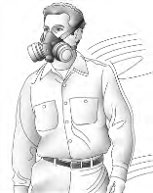
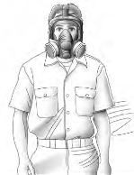
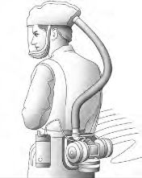
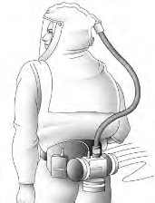
Air Purifying
Dust Mask
Half Mask
Full Face
Loose Fitting
Powered
Hood Powered
Notes:
Dust mask, Half Mask and Full Face respirators need to be test fitted to the user

Slide 12
Atmosphere Supplying
Supplies the user with breathing air from other sources (compressors, compressed air) not ambient air
For IDLH environments
Notes:
Must be test fitted
Includes SCBA (Self Contained Breathing Apparatus)
IDLH – Immediate Danger to Life and Health
Poses immediate threat to life
Would cause irreversible adverse health effects
Would impair ability to escape from dangerous situation

Slide 13
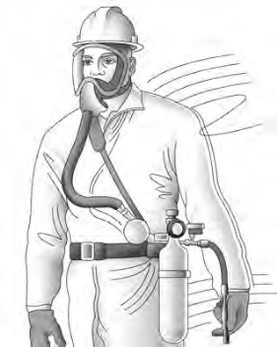
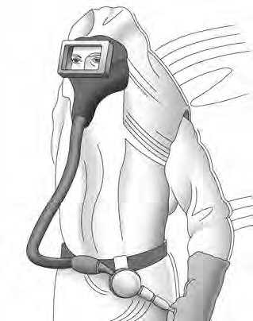
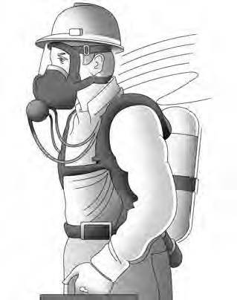
Atmosphere Supplying
Supplied Air Respirator
Abrasive Blasting
Continuous flow
Self Contained
Breathing Apparatus
(SCBA)
Notes:
SCBA minimum service life 30 minutes

Slide 14
Selection of respirators
Selected based on respiratory hazards workers is exposed
Only NIOSH certified respirators should be used
Selected from different models and sizes so it properly fits employee
If exposure cannot be identified, the atmosphere should be considered IDLH
Notes:
NIOSH – National Institute of safety and health
An oxygen deficient atmosphere should be considered IDLH

Slide 15
Selection of respirators
For Immediate Danger of Life or Health, (IDLH) atmospheres:
Full face pressure demand SCBA with minimum service life of 30 minutes.
Supply on demand (SAR) with self contained air supply.
Notes:
An oxygen deficient atmosphere should be considered IDLH
SAR – Atmosphere supplying respirator where source of breathing is not carried by the user…

Slide 16
Selection of respirators
For Non-IDLH atmospheres:
Employer provides a respirator that is adequate for the protection of employee health.
Dust Mask, Full Face piece
Notes:
In other words use a respirator that meet or exceeds required level of protection

Slide 17
Requirements: Evaluation
Must be or will work in an environment that requires a respirator
Medical Evaluation is provided by the employer to determine the employee ability to use a respirator
A medical evaluation questionnaire is mandatory
Notes:
Employee need to be working in an environment that requires the use of a rerspirator
Using a respirator may place physiological stress on the employee and varies with type of respirator, workplace conditions and medical status of the employee.
Evaluations is conducted before any fit test takes place by a physician designated by the employer.
Students refer to the provided attachment ( OSHA respirator questionnaire)

Slide 18
Requirements: Fit Tested
Must be Fit Tested with same brand, model and size that will be used
Tested before first use
Note: Facial hair may not be permitted if employee will use a respirator that requires tight seal
Notes:
Must also pass a qualitative fit test
Additional test should be conducted if any changes are noted, employee reports changes, or if a supervisor visually notes changes in employee condition or behavior
Not only facial hair but also any other conditions like corrective glasses, dentures, or any condition that interfere with with a tight seal of the respirator.

Slide 19
Requirements: Maintenance
Respirators should be clean and disinfected as often as necessary if used by one employee.
After each use if used by more than one employee
Stored and protected from damage, dust, sunlight
Inspected before use and if found defective do not use and notify supervisor
Notes:
Employer provide cleaning and disinfecting material for respirators
Example of used by multiple employee will be training and fit testing
Inspected before use include:
Check for proper function
Check all rubber parts for deterioration
SCBA should be inspected montly

Slide 20
Summary
Re-cap current OSHA standards for respiratory protection, state the purpose and use of respirators, different types of respirators and discuss key requirements for the use of respiratory protection
Notes:
This slide lists the main points to remember when working with electricity.

Slide 21
Helpful OSHA Resources
OSHA has many helpful programs, including assistance about safety and health programs, state plans, workplace consultations, voluntary protection programs, strategic partnerships, training and education, and more

Slide 22
OSHA Contact Numbers
To report Unsafe Working Conditions, Safety and Health Violations Contact OSHA @:
1-800-321-OSHA (6742) / TTY1-877-889-5627
To File a Complaint Form:
To file an OSHA-7 report online, see how to file a complaint with OSHA (www.osha.gov)
For more information regarding your rights, see Worker Rights
Notes:
OSHA is here to assist you in preventing injuries by providing training and assistance to ALL individuals. For more in formation please contact OSHA.

Slide 23
References
OSHA Website: www.osha.gov
OSHA 29 CFR 1910.134 – Respiratory Protection
OSHA 3389- Small Entity Compliance Guide for the Respiratory Protection Standard
OSHA E-Tool

