Slide 1

Road Safety & Awareness Training
Institute of Occupational Safety and Health
Your “Right to Know”
29 CFR 1926 / DOT MUTCD
This material was produced under grant number SH22297-SH1 from OSHA. It does not necessarily reflect the views or policies of the U.S. Department of Labor, nor does mention of trade names, commercial products, or organizations imply endorsement by the U.S. Government.
Notes:
During this presentation we will briefly discuss the requirements and safety awareness for highway workers working in road construction. This include and is not limited to flaggers, maintenance crews, Department of Transportation employees (DOT), Heavy Equipment operators, supervisors, contractors, etc.
This training does not replace OSHA training requirements and/or State or district requirements regarding training.

Slide 2
Objectives: Participants Will:
Describe purpose of traffic control devices
Interpret OSHA’s role and standards regarding road safety / hazards
Implement and define basic fundamentals of road safety
Identify road hazards
Recognize and implement safety methods to protect themself and co-workers from road hazards
Notes:
We will also discuss were a flagger can safely perform his/her duties.

Slide 3
Work zone Traffic Safety
According to the Bureau of Labor Statistics, workers struck by vehicles or mobile equipment account for the highest number of fatal work injuries
844 killed from 1995-2002
Notes:
During the 1995 to 2002 period, 844 workers were killed while working at a road construction site. During this same period there were 9325 deaths in the construction industry.
The 844 worker deaths in road construction represent 9% of all deaths in construction.
More than half of these fatalities were attributable to a worker being struck by a vehicle or mobile equipment.
Workplace fatalities that occur at a road construction site typically account for 1.5 percent to 2.0 percent of all workplace fatalities annually.

Slide 4
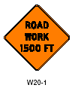
Traffic Control Devices
Promote highway safety
Notify road users of regulations
Provide warning and guidance needed for the operation of the traffic stream
Is intended to minimize crashes
Ref: MUTCD (Manual of Uniform Traffic Control Devices
Notes:
MUTCD is the national standard for highway safety.
also provides guidance for flagger training and safety procedures (CH 6E).

Slide 5
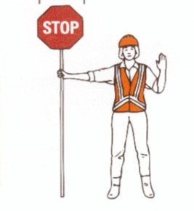
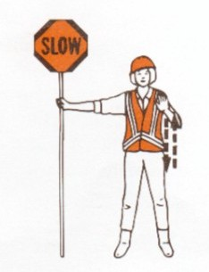
Flaggers
Notes:
Flaggers are responsible for public safety in the highways and must be properly trained in safe traffic control practices and public contact techniques.
Must be qualified either by third party or employer. (OSHA guidelines)
Prior to performing duties, must have knowledge of the work area

Slide 6
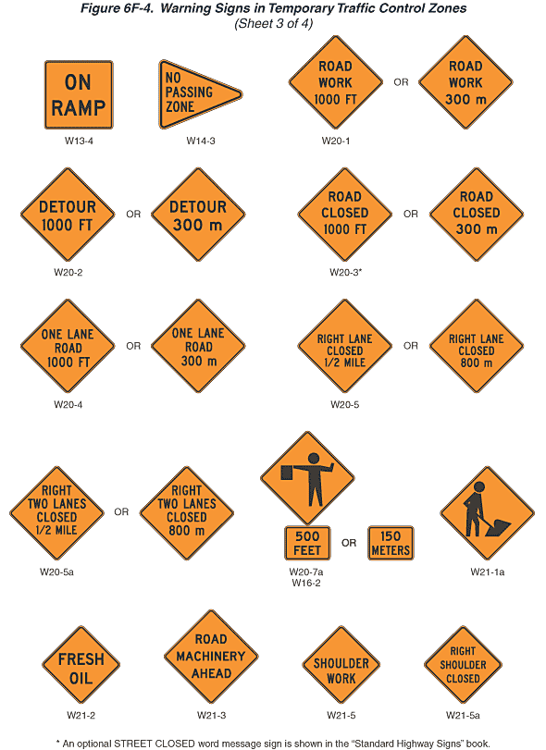
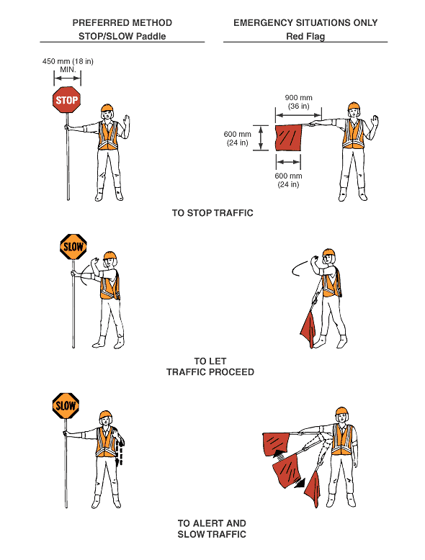
Signs and Signals
1926.201 and MUTCD Part VI
Notes:
Photo: http://www.osha.gov/SLTC/images/workzone_traffic_fig6e1.gif

Slide 7
Flaggers
Responsible for public safety
Must received proper training
Able to recognize dangerous traffic situations and warn workers
Must not be assigned any other duties
Notes:
Flaggers are responsible for public safety in the highways and must be properly trained in safe traffic control practices and public contact techniques.
Flaggers are to be used only when other reasonable …methods will not adequately control traffic…” When signs do not provide adequate protection.

Slide 8
Work Safety Consideration Flagger Training
All workers should be trained on:
Working safely adjacent to vehicular traffic
Work zone traffic control techniques
Device Usage
Safety devices
Traffic control devices
Placement of traffic control devices
Relevant OSHA Regulation
29 CFR 1926.21, Safety Training and Education
Notes:
The workers assuming specific temporary traffic control responsibilities shall be trained on appropriate temporary traffic control techniques, using the safety devices and the placement of traffic control devices appropriately to meet the expectations of drivers while entering to and traveling through the work zone.

Slide 9
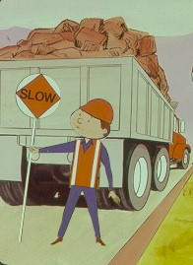
Flaggers
Must stand in the closed lane/shoulder
Exception: when road use have stopped
When directing backing vehicles, flagger must remain visible to the driver
Notes:
Flaggers are responsible for public safety in the highways and must be properly trained in safe traffic control practices and public contact techniques.
Flags are no longer accepted as means of controlling traffic except when an emergency.

Slide 10
Flaggers
Flaggers must not use devices which may distract the vision, hearing or attention
Cell phones
Pagers
Radios
Headphones

Slide 11
Single and Two Flagger Operations
Single Flagger Operations
Low volume traffic (country roads, single lane)
Two Flagger Operations
High volume roads
Intersections
Long Distance
Notes:
Flaggers must not use devices which may distract the vision, hearing or attention
Cell phones
Pagers
Radios
Headphones
Where Flaggers Must Stand
Shoulder
Exception: when road users have stopped
While acting as a flagger when their becomes a excess amount of traffic it my become necessary to
Flaggers and others providing temporary
traffic control should wear high visibility
clothing with a background of fluorescent
orange-red or yellow-green and retro-reflective material of orange, yellow, white, silver,
or yellow-green. In areas of traffic movement, this personal protective equipment
will make the worker visible for at least
1,000 feet, so that the worker can be seen
from any direction, and make the worker
stand out from the background. Check the
label or packaging to ensure that the garments are performance class 2 or 3.
Drivers should be warned in advance with
signs that there will be a flagger ahead.
Flaggers should use STOP/SLOW paddles,
paddles with lights, or flags (flags should be
used only in emergencies.) The STOP sign
should be octagonal with a red background
and white letters and border. The SLOW
sign is the same shape, with an orange
background and black letters and a border
Equipment / Clothing
Neat apperance
If you keep a need apperance drivers are more likely to respect your athority
Reflective Vest
Orange is the standard color for contraction site warnings
Hard Hat
Not only to protect your self and give the construction worker appearance but, can all so act as a communications device telling other flaggers with in visual sight that you are releasing traffic.
Air Horn
Warning tool in case a rouge car is heading into the work area.
Consider situations where Two Flaggers are Needed
Short Distances where visual communication can be used consider use these visual quires to stop, slow and release traffic.
Removing you hard hat
Giving a thumbs up
Or other predetermined hand signals.
Single Flagger Operations
Know what is around you and how you are feeling.
Longer Distances
Were visibility is limited it is a good idea to use radios in order to communicate how to slow, stop, and release traffic. Or if radios are not available use the flag hand off method. With this method the flagger that released the traffic hands of a small flag to the last car. This car then takes the flag to the other flagger signaling him that it is safe to release traffic.

Slide 12
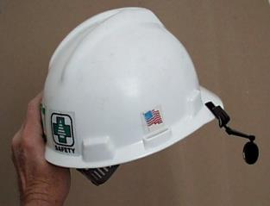
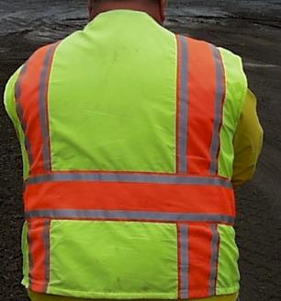
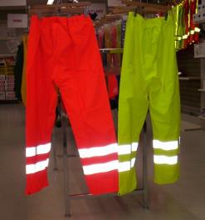
Flaggers Safety Equipment
Notes:
A variety of safety equipment is used by flaggers depending on the environment.
Safety gear must be provided by the employer.
Not picture:
Safety goggles
Hearing protection
Whistle
Paddles

Slide 13
Work Zones
Advance warning area
Transition area
Buffer space
Activity area
Termination area
Notes:
Advance warning Area - Advises drivers about what to expect in the upcoming work zone area
Transition area- Redirect traffic from a normal traffic flow to a new flow
Buffer space - Provides protection for traffic and workers
Activity area - The area where work takes place.
Termination area - Used to return road users to their normal path

Slide 14
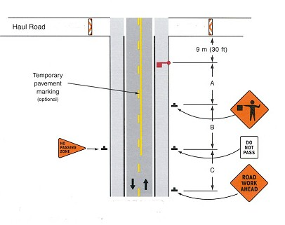
Work Traffic Control
Termination
Buffer Space
Transitional Area
Warning Area
Notes:
Advance warning Area - Advises drivers about what to expect in the upcoming work zone area
Transition area- Redirect traffic from a normal traffic flow to a new flow
Buffer space - Provides protection for traffic and workers
Activity area - The area where work takes place.
Termination area - Used to return road users to their normal path

Slide 15
Advanced work zone Transition Area
Temporary Traffic Control (TTC) Plan
Barricades, Barriers and Vertical Panels
Revised lane markings
Signs
Cones
Flagger
Notes:
Traffic control plan is required if work will last more than one day
Traffic control plan (TCP) is used for the movement of vehicles in areas where workers conducting other tasks.
The construction project manager will determine the internal traffic control plan within the construction/demolition worksite.
TTC plans should be prepared by qualified person or engineer.

Slide 16
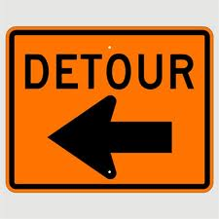
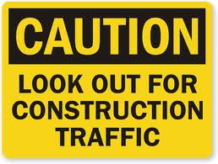
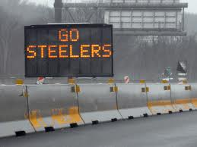
Highway construction warning signs
Must be visible
Electronic signs must not be used to promote business
Notes:
Traffic control plan (TCP) is used for the movement of vehicles in areas where workers conducting other tasks.
The construction project manager will determine the internal traffic control plan within the construction/demolition worksite.
TTC plans should be prepared by qualified person or engineer.

Slide 17
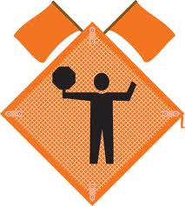
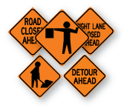
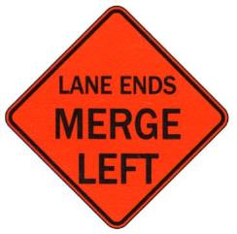
Warning Signs
Notes:
These are some of the enhanced traffic signs you may encounter when approaching a highway construction project

Slide 18
Summary
Flaggers must be trained
Only used when other methods (signs, signals and barricades) do not provide necessary protection
Maintain situational awareness
Protective clothing
Additional information provided in the MUTCD

Slide 19
References
29 CFR 1926 – Signs , Signals & Barricades (1926.200)
DOT Manual Uniform Traffic and Control devices 2009 edition
29 CFR 1926.21, Safety Training and Education

