Slide 1
Fall Protection for the Construction Industry
Hispanic Contractors Association
de San Antonio/OSHA
Susan Harwood Training Grant
SH-22298-11-60-F-48
Prepared by SHORM Consulting
Notes:
Present the course,
Introduce yourself and the other trainer. Brief background/experience of trainers. Briefly let each student introduce themselves, occupation and who they work for.
Review the rules of the class:
• Cell phones off/vibrate
• Restroom location
• Closest emergency evacuation point and meeting location to account
for all attendees in the case of an emergency.
• When the attendees will have time for questions
• That you will be available after the session as well
Mention the dynamics of the training, time and schedule of the day

Slide 2
Disclaimer
This material was produced under grant SH-22298-11-60-F-48 from the Occupational Safety and Health Administration, U.S. Department of Labor. It does not necessarily reflect the views or policies of the U.S. Department of Labor, nor does the mention of trade names, commercial products, or organizations imply endorsement by the U.S. Government.
Notes:
Instruct students to read the disclaimer.

Slide 3
Need for Training:
FALLS! are the Leading Cause of Death in Construction (BLS CFOI Data).
Economic conditions are pushing small businesses to take on larger and more complex projects. In order to stay competitive, subcontractors may unintentionally sacrifice safety for production. This in term, may increase injuries and fatalities on the job.
Notes:
Why the emphasis for training?
Falls are leading cause of death in the construction industry.

Slide 4
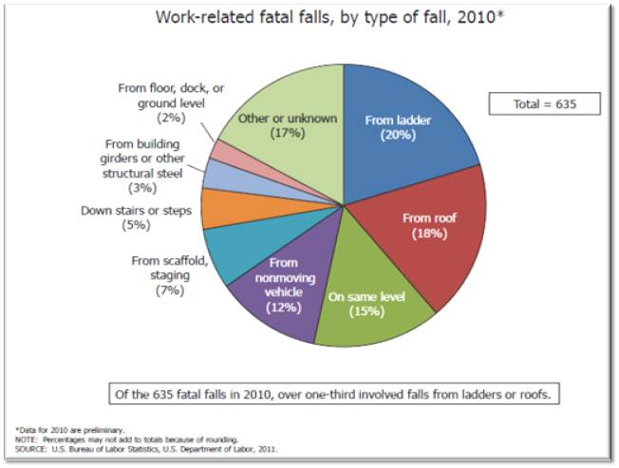
Notes:
Discuss the total number of work-related fatal falls for 2010.
Emphasize the fall fatalities from roofs and ladders.
Mention that out of the 635 fatalities, 265 of those happened in the construction industry.
Mention the source: BLS, U.S. Bureau of Labor Statistics.

Slide 5
Objectives:
Identify the OSHA Fall Protection Standard for Construction Industry (29 CFR 1926, Subpart M).
Recognize Fall Hazards in order to avoid, abate, and prevent falls from ladders, roofs, scaffolds, and other potential situations.
Identify Fall Protection issues while handling, installing and bracing trusses.
Notes:
Objectives:
Indicate each objective on its own.
Mention if there will be any practical approach to the objective

Slide 6
Objectives Continued:
Recognize and Prevent Fall Protection Issues during Residential Construction.
Discuss the New Residential Fall Protection Guidelines
Understand some of the different types of fall protection systems available to contractors.
Understand how to develop a Fall Protection Plan.
Notes:
Objectives:
Indicated each objective on its own.
Mention if there will be any practical approach to the objective

Slide 7
Training Content
Rights and Responsibilities
Compliance Standards for Fall Protection
Types of Fall Protection
Recognition and Prevention of Falls from Scaffolds, Ladders and Roofs
Fall Protection in Residential Construction
Prevent Falls When Handling Trusses
Development of Fall Protection Plans
Notes:
Inform the students of the training content and the order in which it will be discussed.

Slide 8
Rights & Responsibilities
EMPLOYERS
Provide a workplace free from recognized hazards and comply with OSHA standards
Provide training required by OSHA standards
Protect all employees by using conventional fall protection methods
Provide the necessary Personal Protective Equipment (PPE)
EMPLOYEES
Have a safe and healthful workplace
Receive training
Obey and comply with all OSHA laws and regulations
Identify and report safety hazards
Request hazard correction
Notes:
Discuss the General Duty Clause 29 USC 654
“SEC. 5. Duties
(a) Each employer --
(1) shall furnish to each of his employees employment and a place of employment which are free from recognized hazards that are causing or are likely to cause death or serious physical harm to his employees;
(2) shall comply with occupational safety and health standards promulgated under this Act.
(b) Each employee shall comply with occupational safety and health standards and all rules, regulations, and orders issued pursuant to this Act which are applicable to his own actions and conduct.”
Make a distinction between employers responsibilities and employee’s rights

Slide 9
Laws & Regulations
29 CFR 1926, Subpart M- Fall Protection Standard for Construction.
29 CFR 1926.501(b)(13)- Residential Fall Protection. It has always existed, but now there is clear guidance for compliance.
STD 03-11-002, Compliance Guidance for Residential Construction issued December 16, 2010.
Notes:
Have in hand the 1926 Standards book to show students the location of the regulations for fall protection.
Mention the Residential Fall Protection standard.
Mention the new compliance guidance for fall protection in residential construction.

Slide 10
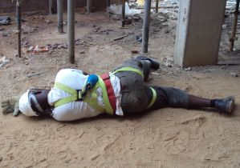
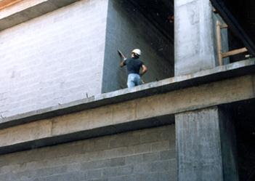
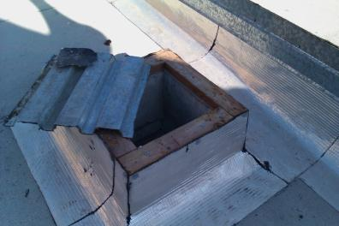
General Fall Hazard Recognition
Workers can be killed by falling from open-sided floors and through floor openings.
Notes:
Point the photo of the fallen worker. The worker had a harness on…? Look for probable causes from your students.
Stress that this fall could have been prevented.
Other examples of situations where employees need to be protected from falls.

Slide 11
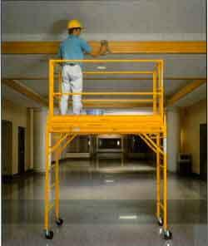
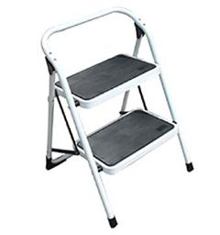
General Fall Hazard Recognition
Workers can be hurt or killed if they fall from as little as 4 to 6 feet.
11
Notes:
Many workers think that just because they are close to the ground, even at a distance of 4-6ft, they cannot get hurt.
Indicate that you can die or become paralyzed if you fall from just a step stool, which only has 2 steps.

Slide 12
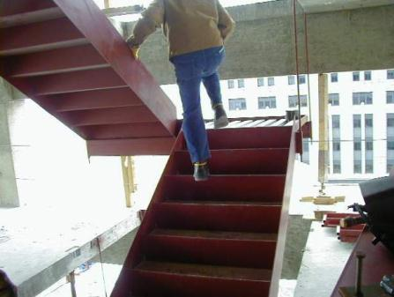
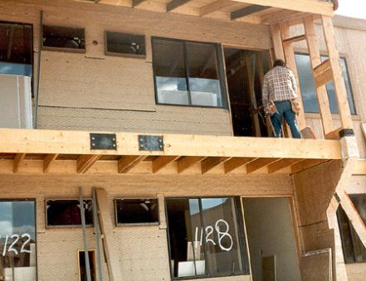
General Fall Hazard Recognition
Open-sided floors and platforms 6 feet or more in height must have a guard to protect from falls.
12
Notes:
Continue to go over the different fall hazard situations for the photos.
Important to mention at this point the requirement for fall protection in construction of 6 feet or more. The worker needs to be protected from a possible fall.
Ask the class if they find anything wrong in the images.

Slide 13
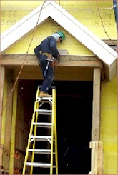
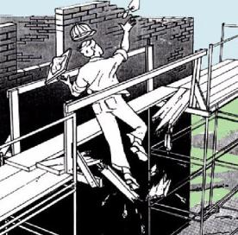
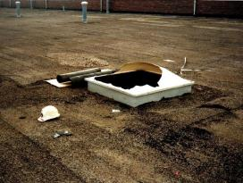
Fall Hazards Include
Scaffold ladders and platforms
Holes-floor & walls
Skylights
Edges
Roofs
Elevator shafts
Ladder sides
Decking and plywood
Installation of trusses
Excavations
Bricklaying
Residential Construction
Notes:
Mention the other types of fall hazards that can be encountered during construction activities.

Slide 14
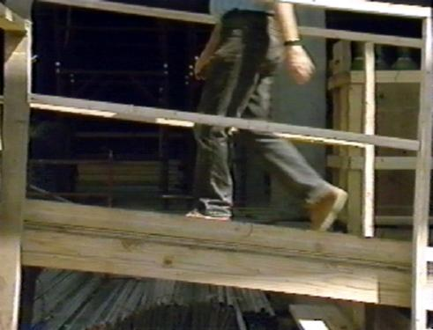
Fall Hazard- Walkways and Ramps
Notes:
Ramps, runways, and other walkways must be protected by guardrail systems when employees can fall 6 feet or more.
The walking/working surface must be strong enough to support employees safely. If not, employees may not work on the surface. This knowledge will be gained during frequent and regular inspections made, as required, by competent persons designated by the employer.

Slide 15
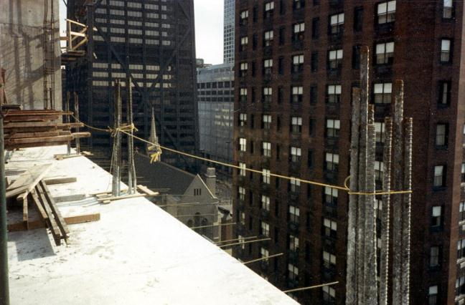
Fall Hazard- Sides & Edges
Notes:
Ask the class what’s wrong with this?
¼ inch rope is allowed, but it does not meet the standard criteria
no midrail
no toeboards
- sagging is not allowed

Slide 16
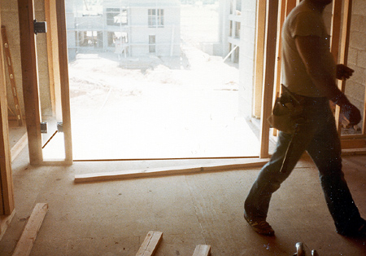
Fall Hazard- Wall Openings
Wall opening
Notes:
Employees working on, at, above, or near wall openings (including those with chutes attached) where the outside bottom edge of the wall opening is 6 feet or more above lower levels and the inside bottom edge of the wall opening is less than 39 inches above the walking/working surface must be protected from falling by the use of
either a guardrail system, a safety net system, or a personal fall arrest system.

Slide 17
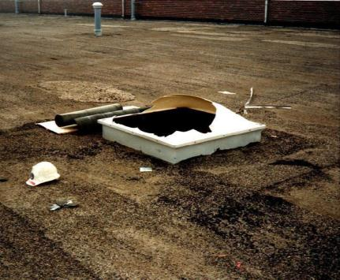
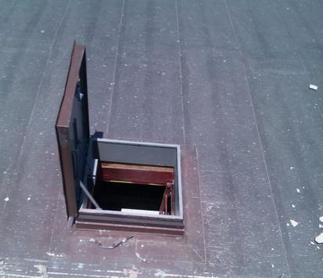
Fall Hazard- Sky Lights and Other Openings
Notes:
Covers must be:
-- able to support at least twice the weight of employees, equipment, and materials that may be imposed on them at one time.
-- secured to prevent accidental displacement from wind, equipment, or workers’ activities.
-- color coded or bear the markings “HOLE” or “COVER.”
Holes:
Personal fall arrest systems, covers, or guardrail systems shall be erected around holes (including skylights) that are more than 6 feet above lower levels.

Slide 18
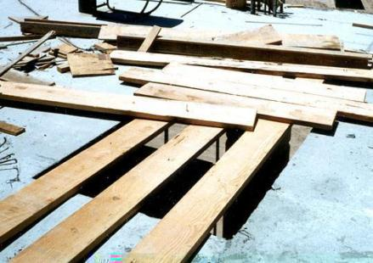
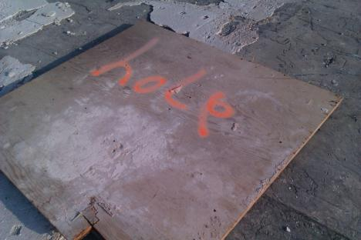
Fall Hazard- Floor Holes
Notes:
Covers must be:
-- able to support at least twice the weight of employees, equipment, and materials that may be imposed on them at one time.
-- secured to prevent accidental displacement from wind, equipment, or workers’ activities.
-- color coded or bear the markings “HOLE” or “COVER.”
Holes:
Personal fall arrest systems, covers, or guardrail systems shall be erected around holes (including skylights) that are more than 6 feet above lower levels.
NOTE – All floor holes larger than 2 inches must be protected against slips/trips – even if less than 6 feet

Slide 19
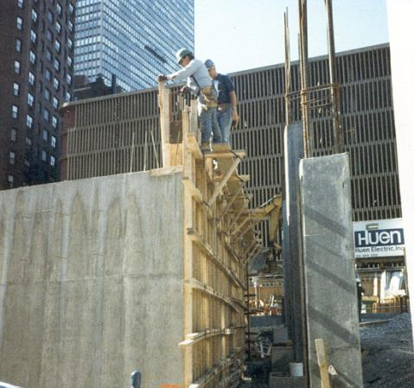
Fall Hazard- Concrete Forms and Rebar
Notes:
Employees on a form scaffold exposed to falls of more than 10 feet, need fall protection.

Slide 20
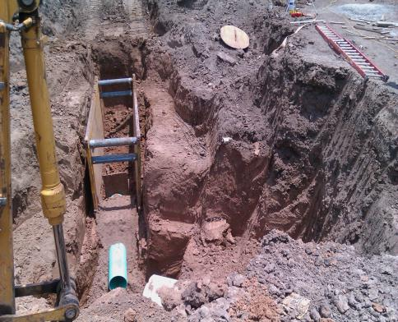
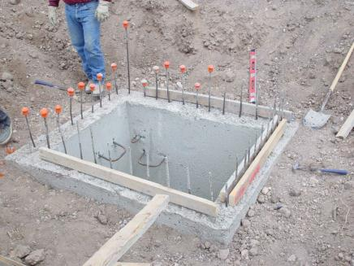
Fall Hazard- Excavations
Notes:
Employees at the edge of an excavation 6 feet or more deep shall be protected from falling by guardrail systems, fences, barricades, or covers.
If walk-ways are used to permit workers to cross over excavations, guardrails are required on the walkway if the fall would be 6 feet or more to the lower level.

Slide 21
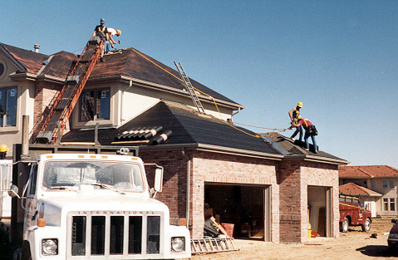
Fall Hazard- Roofs
Notes:
If workers are working on roofs with unprotected sides and edges 6 feet or more above lower levels, they shall be protected from falling by using conventional fall protection methods such as:
Guardrail systems
Personal Fall Arrest Systems (PFAS)
Safety Net Systems
Or by combining conventional with unconventional methods such as:
Warning Line Systems
Safety Monitoring Systems
Its important to mention here that the slope of the roof will dictate what specific type of fall protection can be used while performing roofing work.
Tell the class that you will discuss the slope-fall protection type factor later during the class.

Slide 22
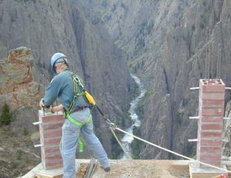
How to prevent falls?
Do an assessment of the jobsite
Take necessary steps to mitigate, eliminate or control the fall hazard
If hazard cannot be eliminated, then provide fall protection
Which type of fall protection?
Notes:
After seeing the different situations where fall protection may be needed, provide the student with some general instructions on how to prevent falls.
Be clear on the fact that the main objective should be to prevent the exposure to the fall or eliminate the fall hazard.
Inform the student that you will discuss the various types of fall protection.

Slide 23
Types of Fall Protection
GUARDRAILS
FALL ARREST SYSTEMS
RESTRAINING & POSITIONING DEVICES
SAFETY NETS
CONTROLLED ACCESS ZONES (CAZ)
CONTROLLED DECKING ZONES (CDZ)
WARNING LINES
SAFETY MONITORS
Notes:
Mention the different types of fall protection and that you will discuss each one in detail.
Good time to mention that some of these systems will be available during the class for students to become familiar with them and practice their implementation.

Slide 24
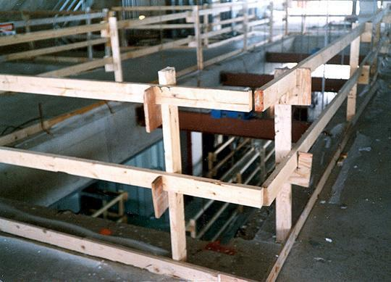
Guardrails
Top Rail
Mid- Rail
Toeboard
Verticals
Notes:
Discuss all 3 parts of the guardrail system, what function they serve, and the specs of each part.
Top Rail
42 inches, +/- 3 inches
be able to withstand 200 lbs. of force
Mid Rail
Middle of top rail and ground (21 inches)
be able to withstand 150 lbs. of force
Toeboards
at least 3 ½ inches tall (quick fix: 2 x 4 lumber)
be able to withstand 50 lbs. of force
Verticals- not more than 8 feet apart

Slide 25

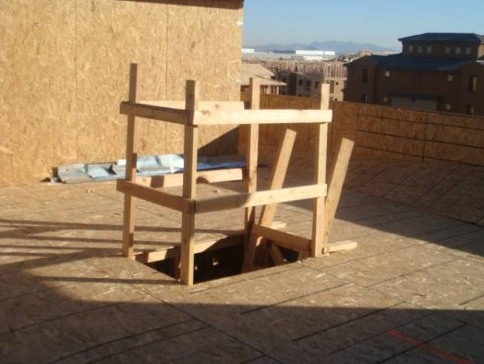
Temporary Guardrails
24
Notes:
Show how guardrails can be erected around floor openings in order to prevent a fall and at the same time they help the worker who is accessing the level to have a structure where to hold on in case the person looses his/her balance.
VIDEO: HYPERLINK TO OSHA’S ANIMATED VIDEO: FALLS THRU FLOOR OPENINGS

Slide 26
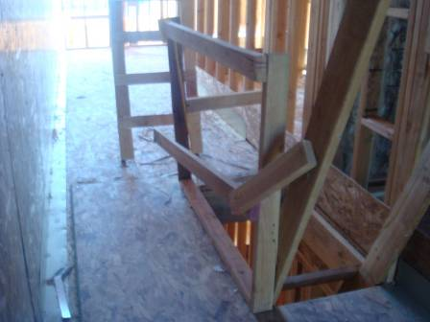
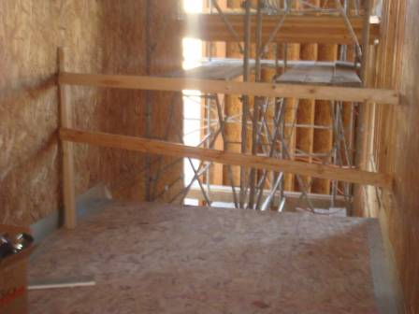
Examples of Improper Installation of Temporary Guard Rails
Notes:
Let the students recognize the hazards of improper installation of guardrails,
1st- Midrail not placed correctly, protruding rail & loosely attached
2nd – Midrail is not properly placed, wall connectors at different heights

Slide 27
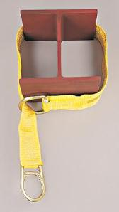
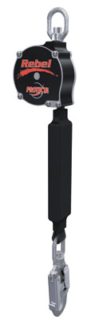
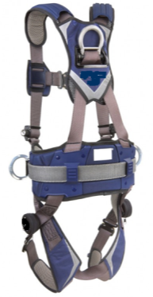
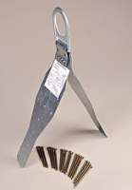
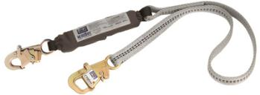
Personal Fall Arrest Systems
You must be trained how to properly use PFAS.
PFAS = anchorage, lifeline/connector and body harness.
27
Notes:
State what PFAS stands for (Personal Fall Arrest Systems).
Briefly mention each component of the PFAS:
Anchor
Lanyard/connector
Full Body Harness
Indicate the equipment and fall protection training requirement

Slide 28
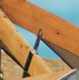
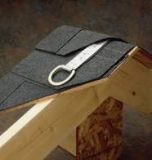
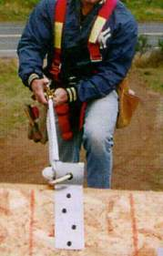
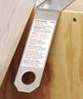
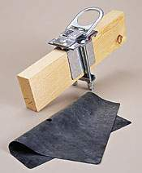
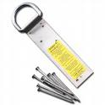
Personal Fall Arrest System- Anchor Points
28
Notes:
Show the different images for anchors, and briefly name each one.

Slide 29
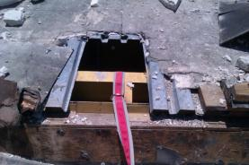
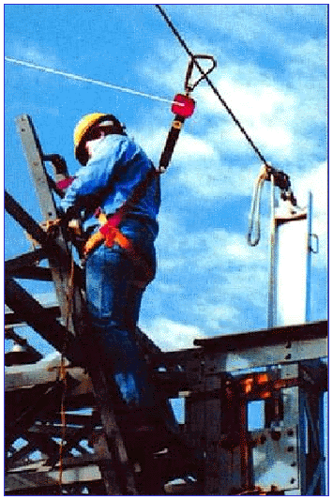
Personal Fall Arrest System- Anchor Points
Must be independent of any platform anchorage and capable of supporting at least 5,000 lbs. per worker
Notes:
Must be capable of supporting at least 5,000 pounds per employee attached
Or
Must be designed and used as follows:
As part of a complete personal fall arrest system which maintains a safety factor of at least two.
Under the supervision of a qualified person.
Care must be taken when placing an anchor. Use the right anchor for the right job and location. In the photo, a webbing anchor strap was placed adjacent to sharp sheet metal and anchor is not properly secured.

Slide 30
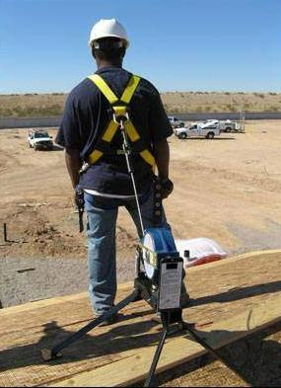
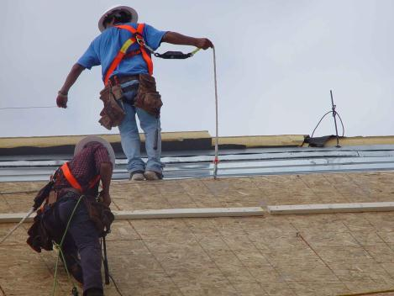
Personal Fall Arrest System- Full Body Harness
PFAS in use during roofing and re-roofing activities.
Notes:
Next, the Full Body Harness – Here we see Personal Fall Arrest Systems during use for roofing and re-roofing operations.
As you can see, the harness has to be attached to a connector and this itself to an anchor point.
Depending on the application, there are specific devices designed for attachment or connection.

Slide 31
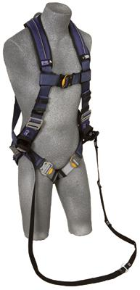
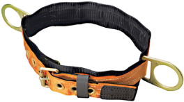
Personal Fall Arrest System- Full Body Harness
A full body harness distributes the force of the fall over the thighs, pelvis, waist, chest and shoulders
Body belts have not been allowed as part of an arrest system since January 1998.
Notes:
A full body harness is designed to minimize the impact on the body during a fall by distributing the force of the fall over the entire torso.
And remember, body belts have not been allowed as part of an arrest system since Jan 1998. They can still be used as part of a fall restraint system and we’ll cover that in just a few minutes.

Slide 32
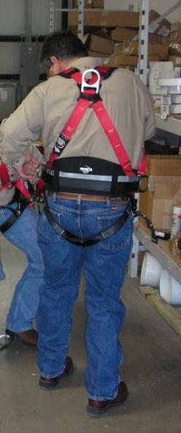
Personal Fall Arrest System- Full Body Harness
The attachment point on a full body harness is a D-ring in the center of your upper back.
Be sure to use a size that fits properly.
Use with compatible equipment.
Notes:
Workers must be trained in the proper wear and use of the body harness.
They are not a one size fits all component.
Proper sizing is critical to preventing injuries. The harness must fit snugly across the chest and around the thighs and the D-ring must be positioned in the center of the back between the shoulder blades.
Employers must ensure workers use a size that fits properly.
Emphasize the weight limitation of 310 pounds for a standard harness. Higher weight limit harnesses are available in the market.

Slide 33
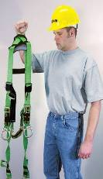
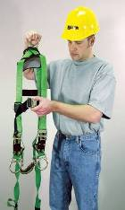
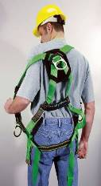
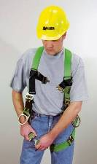
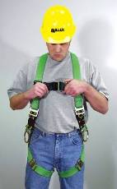

How to don harness – 6 Steps
1
1. Hold by back D-Ring and let hang feely to untangle.
2
3
3. Place harness over each shoulder.
2. Unlatch any connectors.
4
4. Secure leg straps. Not too tight. Should be able to place hand between strap and legs. SNUG!
5
5. Chest strap should be mid to lower area of the chest. This strap holds you in the harness in case of a fall.
6
6. Complete adjustment of harness by tightening the shoulder straps. Not to tight as to restrict movement. SNUG!
Notes:
During the presentation of this slide, the other instructor or a class participant can demonstrate the proper method or donning a harness.
Instructor should cover basic mistakes done when securing the harness, mention what would happen to your back, neck, pelvic area if the harness is not snug on the body.

Slide 34

Personal Fall Arrest System- Full Body Harness- Right vs. Wrong
Which worker is wearing the harness correctly?
34
Notes:
Which one of these workers is wearing his harness correctly? The one on left … or the one on the right?

Slide 35
Personal Fall Arrest System Full Body Harness
35
Notes:
Which one of these workers is wearing his harness correctly? The one on left … or the one on the right?

Slide 36

Full Body Harness
Once a Personal Fall Arrest System has been used in a fall, it must be removed from service right away.
36
Notes:
Establish the importance of this…
If a harness has been involved in any type of falls, then it must be removed from service right away.
Harnesses shall be inspected before every use.
Demonstrate how to properly inspect a harness and what to look for.

Slide 37



Personal Fall Arrest System- Connector/Lanyard
Notes:
Lanyards shall have a minimum breaking strength of 5,000 pounds.
Self-retracting lifelines and lanyards which automatically limit free fall distance to 2 feet (0.61 m) or less shall be capable of sustaining a minimum tensile load of 3,000 pounds applied to the device with the lifeline or lanyard in the fully extended position.
Self-retracting lifelines and lanyards which do not limit free fall distance to 2 feet (0.61 m) or less, rip stitch lanyards, and tearing and deforming lanyards shall be capable of sustaining a minimum tensile load of 5,000 pounds applied to the device with the lifeline or lanyard in the fully extended position.
Ropes and straps (webbing) used in lanyards, lifelines, and strength components of body belts and body harnesses shall be made from synthetic fibers.

Slide 38


Personal Fall Arrest System- Connector/Lanyards
Inspect it every time you use it.
There shouldn’t be:
Cracks or tears in the lines
Ripped stitches
Alteration of the equipment
Burrs on the metal
Notes:
Now for the device that ties the anchorage and the body harness together … the connector or lanyard.
Dee-rings and snap hooks shall have a minimum tensile strength of 5,000 pounds.
Snap hooks must be size compatible with the connection point to prevent unintentional disengagement, or shall be a locking type snap hook.
Unless the snap hook is a locking type and designed for the following connections, snap hooks shall not be engaged:
Directly to webbing, rope or wire rope
To each other
To a Dee-ring to which another snap hook or other connector is attached
To a horizontal lifeline or,
To any object which is incompatibly shaped or dimensioned in relation to the snap hook such that unintentional disengagement could occur by the connected object being able to depress the snap hook keeper and release itself.

Slide 39

Personal Fall Arrest System- Vertical Lifelines/lanyards
Each worker must be attached to a separate vertical lifeline, except during the construction of an elevator shaft
Notes:
Vertical lifelines/lanyards must have a minimum breaking strength of 5,000 lbs.

Slide 40

Personal Fall Arrest System- Vertical Lifelines/lanyards
During the construction of an elevator shaft, if two workers are attached to the same lifeline in the hoistway, then
Both workers are working atop a false car that is equipped with guardrails
The strength of the lifeline is 10,000 lbs

Slide 41


Personal Fall Arrest System- Vertical Lifelines/rope grab
Trailing rope grab
Manual rope grab
Notes:
Rope grabs move easily up and down vertical lifelines providing continuous fall protection.
Rope grabs can be of 2 types:
Trailing- offer complete hands-free operation. In the event of a fall, Miller rope grabs lock quickly.
Manual- user controls the grab, can lock & unlock the mechanism.

Slide 42


Personal Fall Arrest System- Horizontal lifeline
Notes:
Horizontal Lifeline
Qualified person should design and install.
Safety factor of at least 2.
Mention how a horizontal lifeline is attached to the anchor point of at least 5,000 pounds per worker
Discuss the tension factor:
More tension on the line, smaller the sag angle = more pressure and load on the anchor
Less tension (30 degrees max.), bigger the angle = less pressure and load on the anchor, preferred method

Slide 43

Personal Fall Arrest System- Horizontal Lifeline
On work platforms, the devices used to connect to a horizontal lifeline must be able to lock in both directions on the lifeline.
Notes:
This will be demonstrated during the hands-on experience in the laboratory.

Slide 44




Restraining/Positioning Devices: Mitigating the Hazard!
A fall restraint system consists of equipment/systems used to keep an employee from reaching a fall point, such as the edge of a roof or the edge of an elevated working surface.
Notes:
Fall restraint can be a body belt or full body harness.
Must be tied off so that the worker cannot go past the unprotected side or edge, no matter where the work is on the walking/working surface.
Lanyards should be adjustable to take up slack when workers move about.

Slide 45

Personal Fall Arrest System- Calculating Fall Clearance
45
Notes:
Discuss with class how to calculate fall clearance, and the importance of using the correct size components when working in different scenarios.
Different lanyard sizes are available to fit the needs of specific fall distance situations. A 6ft lanyard with a deceleration device should not be used when the fall distance is less than 18ft.
Whether using shock-absorbing lanyards or self-retracting lifelines, it is very important to position your anchorage point directly overhead whenever possible to minimize swing falls.
If this overhead position is not attained employees can suffer injuries from a swing fall.

Slide 46


Personal Fall Arrest System- Swing Calculation
Notes:
Swing fall is the pendulum motion that results when a worker takes a fall when not directly below the anchor point.
Swing needs to be properly understood and accounted when designing and implementing a fall plan/program.

Slide 47
Personal Fall Arrest System- Inspection
All components/systems of a PFAS need to be inspected before each use.
------Instructors will demonstrate proper methods for inspection of equipment-----
47
Notes:
Provide the students with a blank inspection sheet for their use.
They can use this form at their workplace.
So far we have seen systems that help prevent a fall. The next system we are going to show you is used when a fall is imminent and/or expected of the work in progress. This system is another example of conventional fall protection methods.
Although it should be noted that one should always avoid the fall.

Slide 48



Safety Nets
Assumes the fall will occur
48
Notes:
Make sure these are installed as close as possible under the surface on which you are working.
Nets should never be more than 30 feet below the work surface.
The mesh size must not be bigger than 6 inches by 6 inches.
Installers should test each safety net to make sure it can hold a worker who falls

Slide 49

Safety Nets
Test the net
Remove objects fallen into the safety net
Inspect at least once a week
There should be a recent certification record for each net installation
Notes:
How to conduct the test:
Each net must be drop-tested at the jobsite:
- After initial installation and before being used
- Whenever relocated
- After major repair
- At 6-month intervals if left in one place
A 400 pound (180 kg) bag of sand 30 + or - 2 inches (76 + or - 5 cm) in diameter dropped into the net not from less than 42 inches (1.1 m) height

Slide 50

Safety Nets
Notes:
Must extend outward from the outermost projection of the work surface as follows:
Explain the drawing

Slide 51

Safety Nets
Notes:
Remember, when using a safety net, you can assume that a fall will occur.
Employee is put under great stress and can cause traumatic injury to the worker (physically and emotionally)
Employers should be concerned for any employee that has fallen from any elevated work area unto a safety net, observation and retraining should follow the incident.
Training should be for all workers, not just the employee involved in the fall.

Slide 52


Controlled Access Zones/Controlled Decking Zones (Steel Erection)
Controlled Access Zone (CAZ)
Controlled Decking Zone (CDZ)
Notes:
Controlled Access Zone:
May only be used when employer demonstrates that conventional fall protection methods are not feasible or create a greater hazard.
A fall protection plan needs to be developed.
Shall be defined by a control line or by any other means that restricts access
Controlled Decking Zone:
A CDZ can be established as a substitute for fall protection where metal decking is initially being installed and forms the leading edge of a work area over 15 and up to 30 feet above a lower level
Used to control access to areas where leading edge and initial securement of metal deck and other operations connected with leading edge work are taking place.
Boundaries of the CDZ must be marked by the use of control lines or the equivalent and must clearly designate the CDZ.
Be no more than 90 feet wide and 90 feet deep from any leading edge
Not exceed 3,000 square feet of unsecured decking
Have designated and clearly marked boundaries with control lines or the equivalent

Slide 53


Control Lines
Notes:
Control Lines:
Must control access to a specific work area
Serve as visual warning/be highly visible
Must clearly demarcate the boundaries of the CAZ or CDZ
Recommended to have a tensile strength of 200 lbs (1926 Subpart M, Appendix D)
Not a rigid, physical barrier
Not the same as a Warning Line!

Slide 54

Warning Line
November 15, 2002, letter of interpretation to Mr. Keith Harkins, OSHA stated that a warning line system set 15 feet from an unprotected edge is permitted to be used instead of conventional fall protection to protect employees engaged in non-roofing activities.
Notes:
Warning Line:
They provide direct physical contact with employees.
Must have a minimum tensile strength of 500 pounds [see §1926.502(f)(2)(iv)]
Must be "substantially stronger and more rigid than a system whose primary function is to limit access by a visual warning" (control line)

Slide 55


Control Lines vs. Warning Lines
Notes:
Comment on the two images
Mention that for use of equipment/machinery, the minimum distance from leading edge will increment from 6 to 10 feet.
Indicate the use of sandbags for base support of the stanchion (vertical posts)

Slide 56

Safety Monitor
Designated by the employer to monitor other employees; and SHALL:
be a Competent Person
warn the employee when it appears that the employee is unaware of a fall hazard or is acting in an unsafe manner
be on the same walking/working surface and within visual sighting distance of the employee being monitored
be close enough to communicate orally with the employee
not have other responsibilities which could take the monitor's attention from the monitoring function
1926.502(h)
Notes:
Discuss the duties of the safety monitor
Cannot be used at all times.

Slide 57

Lanyards and PFAS in use
Notes:
Are the workers doing the right thing? Are they protected correctly?

Slide 58

58
Notes:
Ask the class what do they see wrong in this image.
How would they do it better and safer.

Slide 59

Scaffolds
Notes:
Scaffolds. Lady Liberty during its 1980’s renovation. From 1984-1986.

Slide 60

What Is A Scaffold?
An elevated, temporary work platform
Three basic types:
Supported scaffolds -- platforms supported by rigid, load bearing members, such as poles, legs, frames, & outriggers
Suspended scaffolds -- platforms suspended by ropes or other non-rigid, overhead support
Aerial Lifts -- such as “cherry pickers” or “boom trucks”
Notes:
Supported scaffold - one or more platforms supported by outrigger beams, brackets, poles, legs, uprights, posts, frames, or similar rigid support.
Suspension scaffold - one or more platforms suspended by ropes or other non-rigid means from an overhead structure(s)
Aerial lifts – Vehicle-mounted devices used to get a worker to an elevated position, — referred to as “cherry pickers” or “boom trucks”

Slide 61

Scaffolds
Supported Scaffolds
Notes:
Review the different types of configurations for supported scaffolds.
Ask the class if they are familiar with any of the scaffolds in the image.

Slide 62

Scaffold Construction
Suspended Scaffold
Notes:
Review the different types of configurations for suspended scaffolds.
Ask the class if they are familiar with any of the scaffolds in the image.

Slide 63

Scaffolds
Suspended Scaffold
Notes:
A suspended scaffold.
On suspended scaffolds each worker needs to have his own separate lifeline.
Lifeline cannot be attached to scaffold.

Slide 64


Scaffolds
Aerial Lift Scaffold
Notes:
Are aerials lifts scaffolds? Yes they are. Mobile Platforms.
What is wrong with these 2 pictures?
What can happen to these workers? How would you do it?

Slide 65

Scaffolds- Fall Hazards
Falls may occur:
While climbing on or off the scaffold
Working on unguarded scaffold platforms
When scaffold platforms or planks fail
Notes:
Falls may occur:
While climbing on or off the scaffold
Working on unguarded scaffold platforms
When scaffold platforms or planks fail
What is wrong with this picture?

Slide 66

Scaffolds- Avoiding Falls
Follow manufacturer's instructions.
Install guardrail systems along all open sides and ends of platforms.
Personal fall arrest system should be used on scaffolds higher than 10 feet.
Notes:
Install guardrail systems along all open sides and ends of platforms.
Personal fall arrest system should be used on scaffolds higher than 10 feet.

Slide 67

Scaffolds- Avoiding Falls
Height can’t be more than 4 times the base width unless guys, ties, or braces are used
Do not work on snow or ice covered platforms during storms or high winds
Notes:
Height of the scaffold should not be more than four times its minimum base dimension unless guys, ties, or braces are used.
Do not work on snow or ice covered platforms during storms or high winds.
What can happen if you do?
Slips, falls, flying projectiles

Slide 68


Scaffolds- Avoiding Falls
Notes:
Scaffolds need to:
Be on a firm foundation with base plates
Be plumb, square and adequately braced
Have a fully planked work deck

Slide 69

Scaffolds- Avoiding Falls
Planks must be at least 18 inches wide.
Each plank end that abuts another must rest on a separate support surface
Planks must be made of scaffold grade wood
Notes:
Avoiding Falls
Planks must be at least 18 inches wide.
Each abutted end of plank must rest on a separate support surface
Overlap platforms at least 12 inches over supports, unless restrained to prevent movement.
Only scaffold grade wood is to be used
Each end of a platform, unless cleated or otherwise restrained by hooks, must extend over its support by at least 6 inches.

Slide 70


Scaffold- Avoiding Falls
Leveled Mud Sills
Notes:
The scaffold is not erected on an even base.
Scaffold legs and plates can be adjusted to compensate.

Slide 71

Scaffolds- Protecting Workers
If a worker on a scaffold can fall more than 10 feet, protect them by:
Guardrails, and/or
Personal Fall Arrest Systems (PFAS)
Notes:
The type of fall protection required depends on the kind of scaffold being used.
Is this worker using the right equipment. Is he protected from falls?
No guardrails. No PFAS!
VIDEO: HYPERLINK TO OSHA’S ANIMATED VIDEO: FALLS FROM SCAFFOLD

Slide 72

Scaffolds- Guardrails
Install along open sides & ends
Front edge of platforms not more than 14 inches from the work, unless using guardrails and/or PFAS
Top rails - 39 to 45 inches tall
Midrails halfway between toprail and platform
Toeboards at least 3-1/2 inches high
Notes:
Scaffold Guardrails:
39 inch minimum guardrail height where guardrail is primary fall protection.
36 inch minimum guardrail height where fall arrest systems are primary fall protection.
Protect from falling between the top rail and surface, by using midrails, screens or mesh.
Protective barriers must be strong enough to support a falling employee. Wood, chain and wire rope may be used for top rails and midrails.
Top rails - 39-45 inches tall when using the crossbracing as the top rail
When crossbracing is used as a midrail, it must be between 20 and 30 inches above the work platform.
Guardrails are not required:
• when the front end of all platforms is less than 14 inches from the face of the work
• when outrigger scaffolds are three inches or less from the front edge
• when employees are plastering and lathing 18 inches or less from the front edge

Slide 73

Scaffolds- PFAS
Can use PFAS instead of guardrails on some scaffolds
Use PFAS & guardrails on suspension scaffolds
Use PFAS on erectors and dismantlers where feasible
The ends of this scaffold are not properly guarded
Notes:
What fall protection will I need when working on scaffolds?
Boatswains’ chair, catenary scaffold, float scaffold, needle beam scaffold, ladder jack scaffold – personal fall arrest system.
Single-point or two-point adjustable scaffold – personal fall arrest system and a guardrail system.
Crawling board (chicken ladder) – personal fall arrest system, a guardrail system or by a three-fourth inch diameter grabline or equivalent handhold securely fastened beside each crawling board.
On a walkway within a scaffold – guardrail system installed within 9 ½ inches of and along at least one side of the walkway
On a supported scaffold when performing overhand bricklaying operations – personal fall arrest system or guardrail system on all open sides and ends of the scaffold.
For all other scaffolds, a personal fall arrest system or a guardrail system

Slide 74



Scaffolds- PFAS
74
Notes:
Mention the different types of connectors that can be used in a scaffold.
Notice the wider pelican clip for the scaffold frame

Slide 75


Scaffolds-Access
Notes:
Scaffold Access: (discuss both images, the good and the bad)
No access by cross braces
Bottom rung can not be more than 24" high
You must use a ladder or frames designed to be used as ladders

Slide 76




Scaffolds- Proper Access
Ladder Tower
with gate
Ladder
Platform
Ladder Frame
Stairway Frame
Notes:
Ladder frame must be uniform and less than 16-3/4 inches.
You should check with the manufacturer’s requirements.
Ladder needs to be properly attached and secured to scaffold frame.
If you use a stairway frame there has to be resting platforms every 25 vertical feet.

Slide 77
Scaffolds- Baker-type
Baker scaffolds can be unstable
Never use a double stack without outriggers
Notes:
Baker Scaffold:
A minimum of three wheels must be locked when employees are working on the platform.
Where possible, consider the use of scissor lifts when a mobile scaffold is required.

Slide 78

Scaffold-Falling Objects
Notes:
Falling Object Protection:
Wear hardhats
Barricade area below scaffold
Use panels or screens if material is stacked higher than the toe board.
Toe board is the board used at the bottom side edge of the scaffold. If the material is stacked above it, there is a possibility that the materials will fall below and can hurt the workers worker below the scaffold.

Slide 79


Seriously?
REMEMBER: SCAFFOLDS NEED TO BE ERECTED, MAINTAINED, DISMANTLED BY TRAINED WORKERS AND INSPECTED BY A COMPETENT PERSON!!!
Notes:
What is wrong in these pictures?
In correct scaffold construction
Incorrect ladder use
No use of Personal Fall Arrest System
Working very dangerously

Slide 80
Scaffolds
REMEMBER:
SCAFFOLDS NEED TO BE ERECTED, MAINTAINED & DISMANTLED BY TRAINED WORKERS UNDER GUIDANCE OF A
COMPETENT PERSON!!!
INSPECTED BY THE COMPETENT PERSON
80
Notes:
Briefly discuss competent person.
Designated, trained, be able to recognize hazards and stop work.

Slide 81


Stairways & Ladders
81
Notes:
Make note of the difference between a stairway and a ladder.

Slide 82
Stairways & Ladders
Fall Hazards
Stairways and ladders cause many injuries and fatalities among construction workers
About half the injuries caused by slips, trips and falls from ladders and stairways require time off the job
82
Notes:
Stairways and ladders cause many injuries and fatalities among construction workers
About half the injuries caused by slips, trips and falls from ladders and stairways require time off the job

Slide 83
Stairways- Fall Prevention
Handrail vs. Stair rail
Notes:
Handrail -
A rail used to provide employees with a handhold for support.
Stair rail system -
A vertical barrier erected along the unprotected sides and edges of a stairway to prevent employees from falling to lower levels.

Slide 84
Stairways- Fall Prevention
Handrail and
Top Rail Strength
Rails must be able to withstand a force of 200 pounds
Notes:
Handrails and the top rails of the stair rail systems must be capable of withstanding, without failure, at least 200 pounds of weight applied within 2 inches of the top edge in any downward or outward direction, at any point along the top edge.

Slide 85

Stairways- Fall Prevention
Stairways with four or more risers or more than 30 inches high must have a stair rail along each unprotected side or edge.
Notes:
All stairways of 4 steps or more must have a handrail. If there is a fall hazard of 6 feet or more on an exposed side of the stairs, then a stair rail system must be provided to prevent workers from falling off the side.

Slide 86
Ladders
Account for 360 deaths every year
151,327 reported injuries per year caused by falls from ladders.
Result of careless or improper ladder use
Notes:
Account for 360 deaths every year
151,327 reported injuries per year caused by falls from ladders.
Result of careless or improper ladder use
Ask the class if anyone has ever fallen off a ladder? You ok? How it happened?

Slide 87




Portable Ladders
Step Ladder Platform Ladder Extension Ladder Trestle Ladder
Ladders of different types work in different ways and are designed for specific tasks.
Notes:
Portable Ladders:
Step ladders are self-supporting portable ladders that do not adjust in length.
Platform ladders are for special purposes and have a large stable platform from which you can work while standing.
Extension ladders are not self-supporting and are adjustable in length.
Trestle ladders are self-supporting ladders that are not adjustable in length and have two hinged sections at the top so the legs form equal angles at the ladder’s base.

Slide 88

Ladder Types
Type I-AA ladders are extra heavy duty and can handle up to 375 lbs.
Type I-A ladders are heavy-duty and can handle up to 300 lbs.
Type I ladders can hold up to 250 lbs.
Type II ladders can hold 225 lbs.
Type III ladders are for light duty only and can hold up to 200 lbs.
Notes:
Ladders should be chosen with the weight of a worker and his or her tools in mind. Many companies disallow the use of aluminum ladders due to their conductivity and ease of damage.
Type I-AA ladders are extra heavy duty and can handle up to 375 lbs.
Type I-A ladders are heavy-duty and can handle up to 300 lbs.
Type I ladders can hold up to 250 lbs.
Type II ladders can hold 225 lbs.
Type III ladders are for light duty only and can hold up to 200 lbs.

Slide 89


Ladder- Climbing & Use
Notes:
Use both hands to climb a ladder
Always face the ladder when climbing, descending or working
Avoid the top two steps of a stepladder and the top four rungs on other ladders
Always read and follow manufacturer’s requirements.
Be sure that ladders are secured before climbing, and that extension ladders extend at least 3 feet above the landing surface, or that a suitable grabrail is available.

Slide 90

Ladder- Climbing & Use
Notes:
Can you use a self supported ladder (A-frame), like this?
What can happen to the ladder and to you?
The support leg can contact the ground causing the step leg to kick out
Also employees should not work from the top or second step

Slide 91

Ladder- Climbing & Use
Secure ladders to prevent accidental movement due to workplace activity
Only use ladders on stable and level surfaces, unless secured
Do not use ladders on slippery surfaces unless secured or provided with slip-resistant feet
This Ladder Is Not on a Stable Surface
Notes:
Ladders placed in areas such as passage-ways, doorways, or driveways, or where they can be displaced by workplace activities or traffic must be secured to prevent accidental movement, or a barricade must be used to keep traffic or activities away from the ladder.

Slide 92


Ladder- Climbing & Use
Firm Base
Set both feet level and on the pads
Soft Base
Set on the spikes and seat the ladder in the ground.
Notes:
Mention each setup, and its purpose. What can happen if the base is set up wrong?
Firm Base:
concrete, tile, hardwood floor, carpet, or any other firm flat ground
Soft Base:
grass, dirt, soft grounds, or uneven terrain

Slide 93
Ladder- Climbing & Use
www.laddersafety.org
93
Notes:
Use this image to discuss:
Proper ladder placement against a structure/wall.
The 4:1 rule (for every 4 feet of vertical distance, the ladder shall extend 1 foot away from the structure)
3 feet at least on the top or a grab rail need to be provided
Properly secure the ladder on top and bottom
Cleats need to be ok

Slide 94

Notes:
Discuss with students the 12 steps to follow when inspecting a ladder and how to properly maintain inspection records.

Slide 95


Look Closely
Notes:
Dangers?
Ladder on top of a scaffold. NO, NO, NO!

Slide 96

Notes:
Is he strong enough to hold his friend?

Slide 97

Notes:
This guy should be in the circus, good balance but poor setup. No ladders on top of awnings, ladder not secured.

Slide 98

Roofs
98
Notes:
If you work on roofs and can fall more than 6 feet, you must be protected

Slide 99

Methods of Roof Fall Prevention
Safety Monitors
Fall Arrest
Guardrails and warning lines
Notes:
Discuss each method of fall prevention.
Warning Lines/Control Lines/Safety Monitors
Employees performing roofing work outside warning lines must be protected by fall restraint or positive fall protection systems.
OSHA allows the use of safety monitoring systems in certain limited instances.
This practice must be closely supervised, and must comply with all requirements of the fall protection standard.

Slide 100


Outside Warning Lines
Parapet up to at least 39"
Fall Restraint
Safety Monitors
Notes:
Warning Lines/Control Lines/Safety Monitors
Roofs with Parapets lower than 39 inches must be protected by guardrails. Or install warning lines at least 6 feet away from the edge.
Notice in these pictures, examples of both, one using warning lines only and a second photo using both guardrails and warning lines. Note the employee that crossed the warning line is exposed to a fall hazard. Protection can be afforded by the installation of a guardrail or providing the employee with a fall restraint mechanism.

Slide 101

Stay Back from Edges
Stay away from edges unless work requires it
Always face the edge
Work from your knees
Fall Hazard
Notes:
Some work practices, such as precast concrete erection, allow employees to work under a fall protection plan without being positively protected.
It is imperative that all employees are properly trained and equipped to work in these instances, and that they follow all recommended procedures.

Slide 102


Roof Guardrails
Notes:
Roof guardrails can be easily installed and moved as needed.

Slide 103


Guardrail Systems
Notes:
Temporary Guardrails:
The ability to be either side mounted or deck mounted allows flexibility to employers when using the engineered guardrail systems we just observed.
Either way, consult the manufacturer’s instructions or a registered professional engineer to ensure proper installation.

Slide 104

Don’t Create a Greater Hazard
Notes:
Simply tying off does not necessarily eliminate the hazard of a fall.
Poor planning, improper equipment, and lack of coordination and communication can create hazards as well.
Is there any hazard in this image? Is there proper coordination between workers, materials.

Slide 105


Access Ways
Notes:
Ladderways and stairwells should planned well in advance to ensure their safe operation from phase to phase.
Additionally, proper guardrails and handrail systems should be installed and maintained throughout the project.
Offset guardrail systems are an ideal way to protect areas where access must be made through perimeter protection.

Slide 106

Falls While Decking
Leading edges must be protected
Notes:
Shear connectors and other protrusions from the structure constitute a tripping hazard, and additional precautions should be taken.

Slide 107


Holes
Covers
Guardrails
Notes:
Covers must be properly marked, positively affixed, and capable of supporting twice the intended load
Any signage used onsite should be adequately communicated to all employees, including those who may not speak or read English.
Cover any hole larger than 2 inches
And talking about work on roofs, there is another type of elevated work that requires the use of fall protection systems. Residential work.

Slide 108

Residential Construction
Notes:
Residential construction is another area where fall protection is usually overlooked. Residential contractors need to understand the requirements for residential fall protection. These requirements are nothing new, they have been in place for many years and these provide guidance for employee protection.

Slide 109

Notes:
Lack of Fall Protection, steep roof.

Slide 110
Residential Fall Protection Program Update
STD 03-11-002, Compliance Guidance for Residential Construction was issued December 16, 2010.
STD 03-11-002 rescinds STD 03-00-001, dated June 18, 1999, Interim Fall Protection Compliance Guidelines for Residential Construction.
All letters that reference the canceled directive will be revised or withdrawn, as appropriate.
Notes:
On December 16, 2010, OSHA rescinded policy directive STD 03-00-001, the Plain Language Revision of OSHA Instruction STD 3.1, Interim Fall Protection Compliance Guidelines for Residential Construction, dated June 18, 1999.
The old guidance, which allowed employers engaged in certain residential construction activities to use specified alternative methods of fall protection, was replaced by STD 03-11-002, Compliance Guidance for Residential Construction.
The Agency is also reviewing all letters of interpretation that referenced the cancelled directive and will either revise, or withdraw, them as needed.

Slide 111
Residential Fall Protection Program Update
Effective June 16, 2011, employers utilizing alternative fall protection found in the rescinded 1999 Interim Fall Protection Compliance Guidelines for Residential Construction will be subject to OSHA citations if they fail to comply with 29 CFR 1926.501(b)(13).
Notes:
Enforcement of the new directive will begin on June 16, 2011.
OSHA and State Compliance Safety and Health Officers have attended training, such as this one, to help ensure consistency in enforcement throughout the country.

Slide 112
What 1926.501(b)(13) indicate?
"Residential construction." Each employee engaged in residential construction activities 6 feet (1.8 m) or more above lower levels shall be protected by guardrail systems, safety net system, or personal fall arrest system unless another provision in paragraph (b) of this section provides for an alternative fall protection measure.
Exception: When the employer can demonstrate that it is infeasible or creates a greater hazard to use these systems, the employer shall develop and implement a fall protection plan which meets the requirements of paragraph (k) of 1926.502.
Notes:
It is important to mention that it has always been required to comply with this portion of the Standard.
Residential fall protection methods will also vary depending on the type of roof slope. Roofs vary in pitch, elevation, and other architectural elements. This variation in design and construction will greatly affect how each contractor implements a fall protection system. Roof slopes can be separated into 2 categories:
Low-slope roofs, and;
High slope roofs.
OSHA has specific standards that address fall protection requirements for both types of roofs. Before we cover these requirements, we need to establish a clear definition of what is considered residential construction.

Slide 113
Definition of Residential Construction
In order to be classified as residential construction, two elements must be met:
The end-use of the structure being built must be as a home, i.e., a dwelling; and
The structure being built must be constructed using traditional wood frame construction materials and methods.
The limited use of steel I-beams to help support wood framing does not disqualify a structure from being considered residential construction.
Notes:
What is considered Residential Construction?
The end use of the structure being built must be as a home, i.e., a dwelling … and,
The structure must be constructed using traditional wood frame construction materials and methods.
The limited use of steel I-beams to help support wood framing does not disqualify a structure from being considered residential construction.

Slide 114

Roof Fall Protection
Low-slope roofs:
“A roof having a slope less than or equal to 4 in 12 ft. (vertical to horizontal).”
Use conventional Fall Protection Methods:
Guardrails
Personal Fall Arrest Systems (PFAS)
Safety Nets
“On roofs 50-feet or less in width: the use of a safety monitoring system alone [i.e. without the warning line system] is permitted.”
1926.501(b)(10)
12 Ft.
4 Ft.
>50 Ft.
114
Hispanic Contractors Association de San Antonio Fall Protection in the Construction Industry
Notes:
In summary, the new directives simply states that all employers must protect their workers who are engaged in residential construction 6 feet or more, above lower levels by conventional fall protection systems (guardrail systems, safety net system, or personal fall arrest system).
… or, by other fall protection measures allowed under 1926.501(b) for particular types of work.
Gone are the special alternative procedures allowed under the old directive for certain residential construction activities.
Now, employers must first demonstrate that it is infeasible to comply with the provisions of the standard, or that it creates a greater hazard.
Then they can use those systems as part of a written, site-specific fall protection plan that meets the requirements of 1926.502(k).
More simply put, all employers doing residential construction now have a clear pathway to compliance.
For roofs 50ft. or less in width, Appendix A, of Subpart M, provides a non-mandatory guideline that can be used to calculate the roof width of non-conventional roofs. The next slide provides a look into this appendix.

Slide 115



How to Determine Roof Width
1926 Subpart M, Appendix A: How to Determine Roof Width (Non-mandatory Compliance Guidance)
Notes:
Use the OSHA 29 CFR 1926 written Standard book to show students the location of the Appendix A inside the standard and take the time to go over 1 or 2 of the sample images shown in the slide.
The examples included in the slide are (from left to right):
Example B- sloped-rectangular shaped roofs
Example D- separate, non-contiguous roof areas
Example F- irregular, non-rectangular roof area

Slide 116
Roof Fall Protection
Steep roofs:
“A roof having a slope greater than 4 in 12 (vertical to horizontal)”
“Each employee on a steep roof with unprotected sides and edges 6 feet (1.8 m) or more above lower levels shall be protected from falling by guardrail systems with toe-boards, safety net systems, or personal fall arrest systems.” 1926.501(b)(11)
+12 Ft.
+4 Ft.
Notes:
Steep roofs are roofs having a slope greater than 4:12 (vertical to horizontal).
Each employee on a steep roof with unprotected sides and edges 6 feet (1.8 m) or more above lower levels shall be protected from falling by guardrail systems with toe-boards, safety net systems, or personal fall arrest systems.
Steep roof work needs to comply with 1926.501(b)(11).

Slide 117


Residential-type Roof Repairs
Notes:
Temporary Fall Protection Systems can be incorporated into roof structures during repair or replacement of roof components, such as shingles.
Reminder to students: roof work needs to comply with:
1926.501(b)(10) for low-slope roofs; and
1926.501(b)(11) for steep roofs.
And, all residential roof work needs to comply with 1926.501(b)(13).
VIDEO: HYPERLINK TO OSHA’S ANIMATED VIDEO: RE-ROOFING WORK

Slide 118

Roof Trusses Handling, installing and bracing
Handling of roof trusses can be
VERY DANGEROUS because:
Truss construction occurs high above the ground
Trusses are not stable until they are properly restrained & braced
Notes:
Roof Trusses, Fall Protection during handling, installing and bracing
(PFAS) are the most widely used form of fall protection in residential construction. They might not be suitable when workers begin installing roof truss sections because there may not be a stable place to attach an anchor.
Trusses are designed to support weight from the top down.
Until trusses are properly restrained and braced, they are weak if pulled from the side (i.e., subjected to lateral
force) as can occur when a truss-mounted fall protection system bears the full weight of a falling worker.
No anchor with a single connection point, such as a strap anchor or a bolt-on anchor, will protect a falling worker
who is attached to a single truss.

Slide 119

Notes:
Roofers installing trusses with no Fall Protection

Slide 120



Roof Trusses Collapse
Notes:
Truss Collapse:
If a worker falls while using a single truss as an anchor point, the whole truss assembly can collapse.
Such a structural failure puts workers’ lives and entire buildings at risk.

Slide 121





Trusses- Reducing the Risk
Ground assembly
Aerial Lifts
Scaffolds
Spreader Bar
Ladders
Notes:
To reduce the risk do:
Ground assembly: By assembling a truss section on the ground
Lifts: provide a stable, elevated platform from which workers can operate. Workers must follow all safety procedures and conduct all operations from inside the lift basket.
Scaffolds: When properly constructed and used, internal and external scaffolds can provide suitable protection for truss-setting tasks. For example, bracket scaffolds placed on the inside or outside of a building provide large, stable walking and working areas for workers.
Ladders: For certain truss-setting jobs, platform and stepladders can provide a stable work platform for workers.
Spreader: An engineered spreader, when installed in accordance with the manufacturer’s instructions, distributes the force of a PFAS across multiple trusses. The roof trusses do not need to be sheathed to use a spreader. These engineered anchorage devices are reusable and can be uninstalled and reinstalled quickly. A qualified person should decide if the spreader is suitable for use as an anchor.

Slide 122




Trusses- Reducing the Risk
PFAS- can be used after a truss section (typically 4 trusses) has been restrained, braced & sheathed
Anchors can be fixed to the finished truss section
Notes:
Types of anchors that can be used after truss section has been braced and secured are:
Peak anchors
Strap anchors
Bolt-on anchors
Discuss how each one works

Slide 123


Trusses- Reducing the Risk
Notes:
Some anchors can be left permanent for future work or roof access

Slide 124
Fall Protection Plan 1926.502(k)
If an employer can demonstrate that conventional fall protection is infeasible or presents a greater hazard, the employer shall develop and implement a fall protection plan that complies with 1926.502(k).
Only for leading edge work, pre-cast concrete erection and residential construction.
The employer bears the burden of establishing that it is appropriate to implement a fall protection plan for a particular workplace situation.
THE PLAN MUST BE WRITTEN AND BE SITE-SPECIFIC
Notes:
Hopefully we shared several ways workers can be protected while exposed to potential fall hazards.
But, if employers can still demonstrate that using conventional fall protection is infeasible or presents a greater hazard to their employees, they must develop and implement a fall protection plan.
Employers bear the burden of proving that a fall protection plan is needed for a particular workplace situation.

Slide 125
Fall Prevention Planning
Fall prevention systems and work practices must be in place before you start work.
These must be prepared by a qualified person.
Plan shall be maintained at the job site
Qualified person should supervise the plan
Notes:
Discuss what makes a person “qualified.”
“Qualified" , means one who, by possession of a recognized degree, certificate, or professional standing, or who by extensive knowledge, training and experience, has successfully demonstrated his ability to solve or resolve problems relating to the subject matter, the work, or the project.

Slide 126
Fall Prevention Planning
A fall prevention plan identifies places where regular fall prevention methods, such as guardrails, cannot be used.
These are called Controlled Access Zones.
Safety monitoring system should be installed in Controlled Access Zones
Notes:
Fall Prevention Plan should address controlled zones.

Slide 127
Fall Prevention Planning
If a fall occurs, the employer must investigate (look into).
Investigation will show whether the fall prevention plan needs to be changed.
Notes:
If fall occur, do accident investigation and root cause analysis.
Modify the plan if needed.

Slide 128
Fall Protection Plan 1926.502(k)
A sample plan is in Appendix E to Subpart M and can be reviewed @
https://www.osha.gov/pls/oshaweb/owadisp.show_document?p_table=STANDARDS&p_id=10927
Notes:
OSHA included Appendix E in Subpart M to show employers and employees what a compliant fall protection plan might look like.

Slide 129

Fall Rescue Procedures
What is the most amount of time for an employee to remain hanging from a harness and lanyard after falling or being ejected from a work platform?
The employee should not be hanging more than four minutes after being found.
Notes:
What’s good about having a fall protection plan if you do not include a rescue plan just in case someone falls.

Slide 130
Fall Rescue Procedures
If the worker may be hurt, call 9–1–1.
Figure out the best way to rescue the fallen worker.
Locate the nearest rescue anchor
Look for the nearest safe working level for the fallen worker
Identify equipment needed to get the fallen worker to a safe working level
Notes:
Explain what a rescue anchor is.
Explain what a rescue self support is. Show item to students. And how to use one.

Slide 131
Fall Rescue Procedures
Manage the people needed to operate the rescue equipment
Protect rescue personnel during rescue operations
Emergency medical technicians should give first aid if needed.
The fall prevention plan must include provisions for quick rescue.
Notes:
Discuss

Slide 132
Planning For Rescue
Worst Case Scenario
Notes:
This guys is alive because a rescue plan was in place. BEFORE HE FELL!

Slide 133

When Everything Works Right!
Notes:
WORKER HAS FALLEN AND IS HANGING FROM HIS PFAS.
CIRCULATION STARTS TO GET AFFECTED

Slide 134

Rescue Plan Put Into Motion
Notes:
MAN BASKET IS BEING LOWERED TO ACCESS EMPLOYEE

Slide 135

Safe Rescue
Notes:
EMPLOYEE GETS INTO THE BASKET. ONCE IN THE BASKET LANYARD CAN BE RELEASED FROM ANCHOR.

Slide 136

On The Ground and Still Alive!

Slide 137

Training
Employers must provide fall protection training
The training is to teach you:
How to recognize hazards
How to minimize hazards
The training must cover:
Fall hazards
Fall protection systems
Use of fall protection devices
What about rescue training?
Notes:
How should I be trained?
Training must be provided to each employee who might be exposed to fall hazards. In construction, this will involve most employees. The training by a competent person must enable each employee to recognize the hazards of falling and train employees in the procedures to be followed to minimize these hazards.
The training must include:
The nature of fall hazards in the work area;
The correct procedures for erecting, maintaining, disassembling, and inspecting the fall protection systems to be used;
The use and operation of guardrail systems, personal fall arrest systems, safety net systems, warning line systems, safety monitoring systems, controlled access zones, and other protection;
The role of each employee in the safety monitoring system when this system is used;
The limitations on the use of mechanical equipment during the performance of roofing work on low-sloped roofs;
The correct procedures for the handling and storage of equipment and materials and the erection of overhead protection; and
The role of employees in fall protection plans.
The standards of Subpart M
The employer must verify compliance with the training requirements by preparing a written certification record.
The employer must retrain any employee when the employer has reason to believe that the trained employee does not have the understanding and skill required.

Slide 138
Summary
If you can fall more than 6 feet, you must be protected.
Use fall prevention on:
walkways & ramps, open sides & edges, holes, concrete forms & rebar, excavations, roofs, wall openings, bricklaying, residential construction
Protective measures include guardrails, covers, safety nets, and Personal Fall Arrest Systems
Notes:
Do a brief summary.

Slide 139
It’s Your Life, Stay Safe
Know your work area
Utilize your fall arrest equipment when necessary
Use the protection you need
Inspect fall protection equipment prior to each use
Report problems and replace defective equipment
Listen for, watch for, and recognize hazards
Notes:
Know your work area: where are the bridges, ramps, stairs, rails or obstacles in your area?
Remember how to use your fall arrest equipment properly. This equipment will keep you safe from serious injury only when you know how to use it the right way.
Use safety devices. The equipment only helps keep you safe if you use it.
Make sure that your equipment works. A harness with ripped stitches, a line with tears or cracks, a ring with burrs that can cut your line are all items that lead to equipment failure. If your equipment fails, you get hurt.
Use the right equipment for the location/job. Your equipment has to be certified for your weight and the height you work at.
And look for, watch for and report problems.

Slide 140
QUESTIONS…
Notes:
Any questions.
Continue to practical exercises.

Slide 141
Disclaimer
This material was produced under grant SH-22298-11-60-F-48 from the Occupational Safety and Health Administration, U.S. Department of Labor. It does not necessarily reflect the views or policies of the U.S. Department of Labor, nor does the mention of trade names, commercial products, or organizations imply endorsement by the U.S. Government.
Notes:
Instruct students to read the disclaimer.

