Slide 1
Prevention of Machine Guarding Injuries and OSHA Compliance
This material was produced under grant numbers SH-22300-11-60-F-17 from the Occupational Safety and Health administration, U.S. Department of Labor. It does not necessarily reflect the views or policies of the U.S. Department of Labor, nor does mention of trade names, commercial products, or organizations imply endorsement by the U.S. Government.

Slide 2
Purpose of the Training:
The purpose of the training is to protect machine operators and employees in the work area from hazards created by ingoing nip points, rotating parts, flying chips, and sparks.
And to address the recognition, avoidance, abatement and
prevention of safety and health hazards related to machine guarding and safety devices .

Slide 3
OSHA Regulations
Subpart O, Machinery and Machine Guarding
Subpart P, Hand and Portable-Powered Tools and other Hand-Held Equipment
OSHA standards related to Machinery and Machine Guarding may be found in the 29 CFR 1910.211through .244. Also sections 1910.211 – are definitions on Machinery and Machine Guarding.
1010.133 PPE
1910.147 Lockout Tagout
1910.212 – General requirements for all machines.
1910.213 – Wood working Machinery requirements
1910.217 – Mechanical power presses
1910.219 – Mechanical power transmission apparatus
Appendix G – Employer Self Inspection Checklist

Slide 4
Worker Rights Under OSHA
Workers, or their representatives, may file a complaint and ask OSHA to inspect their workplace if they believe there is a serious hazard or that their employer is not following OSHA standards.
OSHA does not reveal the name of the complaint to the employer.
It is a violation of the Act for an employer to fire, demote, transfer or discriminate in any way against a worker for filing a complaint or using other OSHA rights.
You can file a complaint by calling the nearest OSHA office or you can file it online; download the form [En Espanol*] and mail or fax it to the nearest OSHA office; or call 1-800-321-OSHA (6742).

Slide 5
Filing an OSHA Complaint:
What Information Must the Employee Provide?
Employees or their representatives must provide enough information for OSHA to determine that a hazard probably exists. Workers do not have to know whether a specific OSHA standard has been violated in order to file a complaint.

Slide 6
Serious Injuries are possible and preventable.
Death, as a result of improper or lack of guarding
Crushed hands and arms
Severed fingers
Blindness could occur from splashing of chemical or by being struck by projectile parts striking the face or eyes.
Amputations,
Lacerations,
Evulsions,
De-gloving,
Scalping due to entanglement of hair.

Slide 7
Hazardous Mechanical Motions/Actions
A wide variety of mechanical motions and actions may present hazards to the worker.
These can include the movement of rotating members, reciprocating arms, moving belts, meshing gears, cutting teeth, and any parts that impact or shear.
These different types of hazardous mechanical motions and actions are basic in varying combinations to nearly all machines, and recognizing them is the first step toward protecting workers from the danger they present.

Slide 8
Where Mechanical Hazards Occur
The point of operation
Power transmission apparatus
Other moving parts

Slide 9
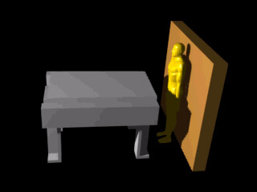
Hazardous Mechanical Motions/Actions
Reciprocating motions may be hazardous because, during the back-and-forth or up-and-down motion, a worker may be struck by or caught between a moving and a stationary part.

Slide 10
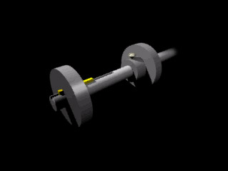
Hazardous Mechanical Motions/Actions
Rotating motion can be dangerous; even smooth, slowly rotating shafts can grip hair and clothing, and through minor contact force the hand and arm into a dangerous position. Injuries due to contact with rotating parts can be severe.

Slide 11
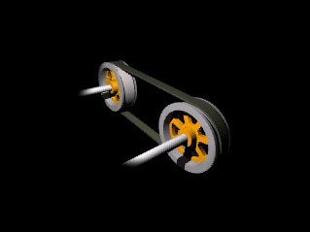
Hazardous Mechanical Motions/Actions
Transverse motion (movement in straight, continuous line) creates a hazard because a worker may be struck or caught in a pinch or shear point by the moving part.

Slide 12
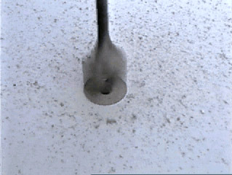
Hazardous Mechanical Motions/Actions
Cutting action may involve rotating, reciprocating, or transverse motion. The danger of cutting action exists at the point of operation where finger, arm and body injuries can occur and where flying chips or scrap material can strike the head, particularly in the area of the eyes or face.

Slide 13
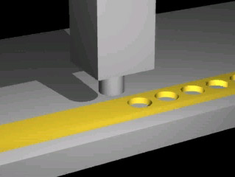
Hazardous Mechanical Motions/Actions
Punching action results when power is applied to a slide (ram) for the purpose of blanking, drawing, or stamping metal or other materials.

Slide 14
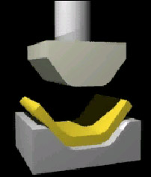
Hazardous Mechanical Motions/Actions
Bending action results when power is applied to a slide in order to draw or stamp metal or other materials.

Slide 15
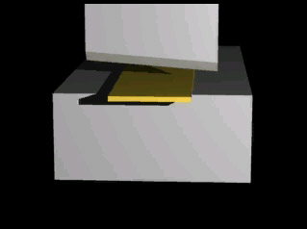
Hazardous Mechanical Motions/Actions
Shearing action involves applying power to a slide or knife in order to trim or shear metal or other materials.

Slide 16
Machine Guarding Methods: Five Groups
Guards—physical barriers prevent access to danger zone or area
Safety devices—stop, restrain, physical barrier, operator must use both hands
Guarding by location—hazardous areas are not accessible due to physical distance from the operator and the hazardous area where there is rotating or moving part
Feeding and ejection methods – a gravity fed chute; semi-automatic and automatic feeding and ejection equipment – minimizes the need for employees to be in a hazard area.
Miscellaneous aids—such as an awareness barrier

Slide 17
Machine Guarding Methods:
Guards: Physical barriers that prevent access to a danger zone or area and are fixed, interlocked, adjustable and self-adjusting. Safeguards must meet these minimum general requirements:
Prevent contact: The safeguard must prevent hands, arms, and any other part of a worker's body from making contact with dangerous moving parts.
Secure: Workers should not be able to easily remove or tamper with the safeguard, because a safeguard that can easily be made ineffective is no safeguard at all. Secure or fasten guards to equipment, and guards should be tamper proof so that they are not bypassed by employees
Protect from falling objects: The safeguard should ensure that no objects can fall into moving parts.

Slide 18
Machine Guarding Methods:
Guards—physical barriers prevent access to danger zone or area and are fixed, interlocked, adjustable and self-adjusting. Safeguards must meet these minimum general requirements:
Create no new hazards: A safeguard defeats its own purpose if it creates a hazard of its own such as a shear point, a jagged edge, or an unfinished surface which can cause a laceration.
Create no interference: Any safeguard which impedes a worker from performing the job quickly and comfortably might soon be overridden or disregarded.
Allow safe lubrication: If possible, one should be able to lubricate the machine without removing the safeguards.

Slide 19
Safety Devices
A safety device may perform one of several functions. It may:
Stop the machine if a body part is placed in the danger area.
Restrain the body part from the danger area during operation.
Require the operator to use both hands on machine controls
Provide a barrier fitting the operating cycle of the machine to prevent entry of body part during hazardous part of cycle. (Page 151).

Slide 20
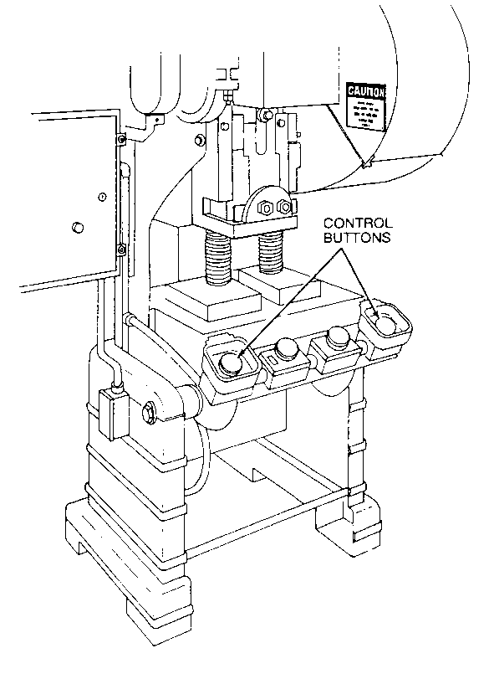
Pictures of Safety Devices

Slide 21
Engineering Controls
Engineering controls that eliminate the hazard at the source and do not rely on behavior for their effectiveness offer the best and most reliable means of safeguarding.
Therefore, engineering controls must be the employers first choice for eliminating machine hazards.

Slide 22
Personal Protective Equipment:
If PPE is used, it may create a hazard by being caught in the machine.
A protective glove can be caught between rotating parts, or
A face piece respirator can hinder the wearers’ vision.
Eye and face protection must be provided to each employee when exposed to eye or face hazards from flying particles. [29 CFR 1910.133(a)]

Slide 23
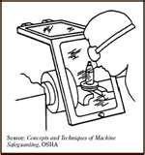
Example with Guard and PPE

Slide 24
Importance of Training:
Even the most elaborate safeguarding system cannot offer effective protection unless the worker knows how to use it and why.
Specific and detailed training is therefore a crucial part of any effort to provide safeguarding against machine-related hazards.

Slide 25
Importance of training
Thorough operator training should involve instruction or hands-on training in the following:
a description and identification of the hazards associated with particular machines;
the safeguards themselves, how they provide protection, and the hazards for which they are intended;
how to use the safeguards and why;
how and under what circumstances safeguards can be removed, and by whom (in most cases, repair or maintenance personnel only); and
what to do (e.g., contact the supervisor) if a safeguard is damaged, missing, or unable to provide adequate protection.

Slide 26
Importance of Training:
This kind of safety training is necessary for new operators and maintenance or setup personnel, when any new or altered safeguards are put in service, or when workers are assigned to a new machine or operation.
Workers should know what to do if guards are damaged and who may remove the guards under what context.

Slide 27
Resource Page
The Machine Guarding E-Tool that is available on the OSHA website at
https://www.osha.gov/SLTC/etools/machineguarding/scope.html

