Slide 1


Occupational Safety & Health Administration (OSHA)
OSHA Orientation
This material was produced under grant number SH-22300-11-60-F-17 from the Occupational Safety and Health Administration, U.S. Department of Labor. It does not necessarily reflect the views or policies of the US Department of Labor, nor does mention of trade names, commercial products, or organization imply endorsement by the U.S. Government.
Notes:
Participants sign-in for the orientation, and receive the information folder.
The facilitators begin by welcoming all the attendees to the orientation and introducing themselves to the group.
Inform the participants that:
This material was produced under an OSHA grant.
Ask participants about their occupational background, to get a feel of which industries are represented in the group.

Slide 2

OSHA Pre-Test
Before we talk more in depth about OSHA, we will like to know what you currently understand about OSHA.
Please look through the folder and find the OSHA Pre-Test.
You will have 10 minutes to complete it.
Do Not Worry about Passing or Failing…We will review all the material in this presentation.
Notes:
Ask the participants to take out the OSHA pre-test and have them complete it; allow 10 minutes, or more, if necessary.
Explain that it is not a pass or fail test; it is just a small assessment of their background knowledge on OSHA.
While the participants complete the test, the facilitators will walk around and provide assistance, if necessary.
When the group finishes with the test, one facilitator will grade it while the other continues with the PPT presentation.

Slide 3

OSHA Topics
What is OSHA?
Rights Under OSHA
What is a Hazard?
How to Control Hazards?
Worker’s Rights

Slide 4

What is OSHA?
The Occupational Safety and Health Act of 1970 (OSH Act) was passed to prevent workers from being killed or seriously harmed at work.
The law requires employers to provide their employees with working conditions that are free of known dangers.
The Act created the Occupational Safety and Health Administration (OSHA), which sets and enforces protective workplace safety and health standards.
OSHA also provides information, training and assistance to workers and employers.
Workers may file a complaint to have OSHA inspect their workplace if they believe that their employer is not following OSHA standards or that there are serious hazards.
You have the right
to a safe workplace!
Notes:
Ask the participants if they know what OSHA stands for?
Provide fact sheet: OSHA It’s the Law! http://www.osha.gov/Publications/osha3165.pdf
If they do know, then engage in a small question/answer session about OSHA.
If not, assure the participants that it is ok:
State that OSHA stands for Occupational Safety and Health Administration.
Indicate that by the end of this orientation they will have a better understanding of OSHA.

Slide 5

Workers' Rights Under OSHA
To help assure a safe and healthful workplace, OSHA also provides workers with the right to:
Ask OSHA to inspect their workplace
Use their rights under the law without retaliation and discrimination
Receive information and training about hazards, methods to prevent harm, and the OSHA standards that apply to their workplace. The training must be in a language you can understand
Get copies of test results done to find hazards in the workplace;
Review records of work-related injuries and illnesses
Get copies of their medical records
Notes:
Say: Workers are entitled to working conditions that do not pose a risk of serious harm.
Provide Fact Sheet Job Safety and Health (2 pages) http://www.osha.gov/OshDoc/data_General_Facts/jobsafetyandhealth-factsheet.pdf

Slide 6


Employer Responsibilities
Employers have the responsibility to provide a safe workplace.
Employers MUST provide their employees with a workplace that does not have serious hazards and follow all relevant OSHA safety and health standards.
Employers must find and correct safety and health problems.
OSHA further requires employers to try to eliminate or reduce hazards first by making changes in working conditions rather than just relying on masks, gloves, ear plugs or other types of personal protective equipment (PPE).
Notes:
After last bullet point, say: Switching to safer chemicals, enclosing processes to trap harmful fumes, or using ventilation systems to clean the air are examples of effective ways to get rid of or minimize risks.

Slide 7
Employers MUST also:
Inform employees about hazards through training, labels, alarms, color-coded systems, chemical information sheets and other methods.
Keep accurate records of work-related injuries and illnesses.
Perform tests in the workplace, such as air sampling required by some OSHA standards.
Provide hearing exams or other medical tests required by OSHA standards.
Post OSHA citations, injury and illness data, and the OSHA poster in the workplace where workers will see them.
Notify OSHA within 8 hours of a workplace incident in which there is a death or when three or more workers go to a hospital.
Not discriminate or retaliate against a worker for using their rights under the law.

Slide 8
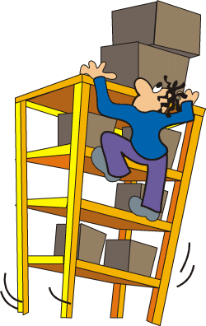
Health and Safety Hazards
Safety Hazards:
Cause physical injuries and accidents
Cause immediate harm
Examples: broken bones, cuts, bruises, sprains or electrocutions
Health Hazards:
Cause internal injuries like diseases or illnesses
Cause long-term harm, may take years to develop
Examples: Cancer, heart disease, loss of hearing or reproductive problems
Notes:
Explain the definitions of safety and health hazards.

Slide 9

Pair and Share Activity (5 minutes)
Think of your personal experience with health and safety hazards at your current or past workplace.
Please find a partner to share your experiences.
We will discuss those experiences as a whole group.
Together, complete “Health & Safety Hazards” document
Notes:
Turn the lights on!
Ask participants to pair and share their own personal experiences with health and safety hazards for 5 minutes.
Complete the Health and Safety Hazards document (open Microsoft Word file “Pair and Share Activity about Hazards for PPT of Manufacturing Works”) by asking participants to categorize the health and safety hazards that they discussed.
At the end of the activity, ask: Think about it: What is the main difference between a safety hazard and a health hazard? Time!!

Slide 10

Types of Hazards Fact Sheet
In your folders, you will find an extensive list of the various types of hazards
Please use this as a reference
Notes:
Provide the participants with Microsoft Word Document “Types of Hazards Fact Sheet for PPT of Manufacturing Works”
Fact Sheet adapted from http://www.iwj.org/doc/HEALTH%20AND%20SAFETY%20IN%20THE%20WORKPLACE.pdf Page 22-27

Slide 11

Risk Mapping of a Warehouse Store
Risk mapping is a method that employees use to identify hazards by drawing a layout of the workplace.
Please find the handout in your folder.
In groups of 3-4 people, label the various hazards that you see in this warehouse.
  Physical/Safety Hazard
  Biological/Chemical Hazard
  Other Hazards
Notes:
Form groups of 3-4 people (if possible, according to their common line of work) and provide each group with “Sample Risk Map of a Warehouse Store” handout to identify some hazards; remind participants that they may use “Types of Hazards Fact Sheet” Handout.
For each group, ask students to:
Label the locations of hazards on the floor plans:
Indicate “physical and safety hazards”
Indicate “biological and chemical hazards”
Indicate “other hazards” as stress
Each group will share their selected hazards from the map, explaining what the workplace is and what dangers are represented

Slide 12
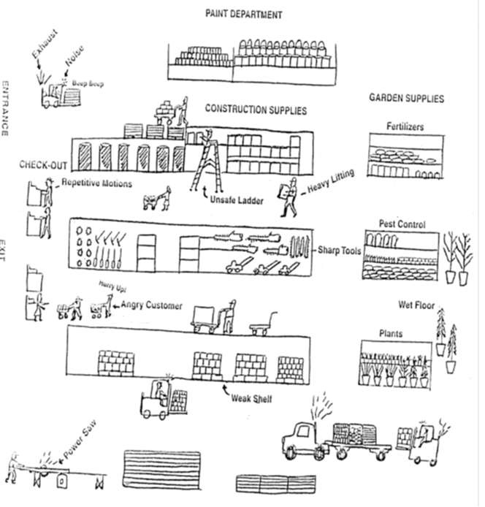
Notes:
Wrap up by having a discussion; sample questions to ask the class:
Did you see hazards that you expected?
Were you surprised by hazards that you had not thought of before?
How would you propose to reduce or solve some of the hazards depicted in the maps?
What did you learn from this activity?

Slide 13

Reducing Hazards
Employers must keep the workplace safe for workers.
There are different ways they can do this.
Some ways work better than other ways.

Slide 14


How to Reduce Hazards Handout
More Effective Least Effective
(best) (worst)
***** Elimination of Hazard | **** Substitution | *** Engineering | ** Labor Practices/ Administrative Controls (Training & Procedures) | * Personal Protective Equipment (PPE)
Notes:
Provide the participants with the Microsoft Word Document “How to Reduce Hazards for PPT of Manufacturing Works”

Slide 15


Top 2 Controls
Substitution
Elimination
When a hazard cannot be eliminated completely, the second best alternative is substituting the dangerous condition.
The idea is to substitute chemicals, equipment, or hazardous materials with ones that are less hazardous.
Example: using paint that does not contain lead-based pigments
The best way to control a hazard is to eliminate it entirely. It is best to do this as early as possible.
Example: use an electric forklift truck rather than a gas operated forklift truck to eliminate carbon monoxide in a warehouse
Notes:
Another example for Elimination: use a chain from the floor to open an elevated valve rather than using a ladder to climb up and open the valve.
Addition information for Substitution: A potential problem is when the product being used as a substitute is as dangerous as the original. For this reason, it is important to find out if the product is truly less hazardous than the original.

Slide 16


More Controls, but not as effective
Engineering Controls
Administrative Controls or Changing Labor Practices
Engineering controls is another way that technology can be used to change the work environment, a machine, or some equipment in order to reduce the hazard.
Examples: machine guards, backup alarms, guardrails, covers, slip resistant surfaces, and using machine to move heavy objects instead of carrying them.
Means changing the way and the structure of how work is done.
Example: instead of one employee exposed to a particular hazard for eight hours a day, the employer could assign four workers to work for two hours each; this could be used for repetitive tasks or for any exposure to a chemical hazard.

Slide 17
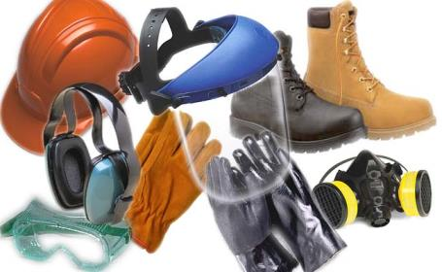
Least Effective Control: PPE
Personal Protective Equipment (PPE):
This is equipment or clothing to protect the worker, such as respirators, eye goggles, gloves, knee pads, hard hats, steel toed shoes, harnesses.
Notes:
It can include respirators, and protective wear for the eyes, ears, and face, gloves, and protective rope.

Slide 18
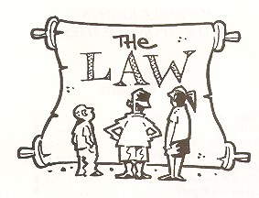
What legal rights do workers have to a safe job?
Workers in the U.S. have a legal right to a safe and healthy job.
  □ True □ False
If you are an immigrant, you are not protected by any workplace safety laws.
□ True □ False
Notes:
True & False. There is a federal (national) law called OSHA. It protects millions of workers from hazards/dangers on the job. If you work for a company or a business, you are covered by this law. But, the federal OSHA law does not apply to all workers. If you work for yourself, you are not covered by this law. For example, domestic workers are not covered by OSHA. If you work for state or city government in Illinois, you are not covered by the federal OSHA law, but there is a state OSHA law to protect you instead. If you are a miner, railroad worker or atomic energy worker, you are covered by other safety laws, not the OSHA law.
False. OSHA covers immigrant workers, whether they have papers or not.

Slide 19

What legal rights do workers have to a safe job?
3. Legally, who is responsible for providing a safe and healthy workplace?
□ The Employer
□ The Workers
□ The Union
□ OSHA
□ All of The Above
Notes:
The Employer. The OSHA law says that employers are responsible; it is their legal duty to provide a workplace free of hazards. If employers don’t protect workers from workplace dangers, they are breaking the law. They have the fix the hazards and pay fines. Employees can do their part to help make the workplace safe by following work rules of their employer and OSHA standards.

Slide 20

What legal rights do workers have to a safe job?
4. Workers can call in the government to inspect a workplace for hazards.
□ True □ False
5. When workers call OSHA to request an
inspection of the workplace, they don’t have
o tell their name.
□ True □ False
6. Government inspectors must always tell the
employer before they come to inspect the
workplace.
□ True □ False
Notes:
True. Anyone who works in a workplace covered by the OSHA law has the right to call in OSHA. Some organizations such as unions and worker centers can also call OSHA for the workers they represent. Family members can also call OSHA.
True. OSHA will not tell the employer who asked for an inspection. However, it is a good idea to have a contact person representing the workers who can walk around with the inspector on the inspection. The person should be someone who knows the hazards at the workplace and is not afraid to speak out. If the workers are represented by a union at the workplace, the contact person would be a union representative, such as a shop steward.
False. Inspectors usually make unannounced inspections. But, sometimes the inspectors have to tell the company they are coming: if the condition is an imminent danger (a worker could die), if the inspection must be conducted after regular work hours, or if management and worker reps are not likely to be there when the inspector comes.
Image Found: http://blogs.msdn.com/b/willy-peter_schaub/archive/2009/02/26/sdlc-software-development-lifecycle-designing-the-blueprint-part-7-of-many.aspx

Slide 21

What legal rights do workers have to a safe job?
7. Workers have the legal right to refuse to do unsafe or unhealthful job tasks.
□ True □ False
8. Workers have the right to know about the chemicals they work with, and employers must train employees how to work safely with chemicals.
□ True □ False
Notes:
True. But there are some rules you have to follow:
You must believe that there is an imminent danger (a worker could die or have a very bad injury).
You must first ask the employer to fix the problem
It’s not possible to do the task another way.
There is not enough time for OSHA to get there
You offered to do another task, and you did not leave your workplace.
True. OSHA has created rules (called standards) for employers. These standards explain what the employer must do to fix hazards. One of the standards says that employees have the right to information about the chemicals they work with and how to work safely with chemicals.
OSHA standards exist for some safety and health hazards, but not all of them. OSHA standards are found in the Code of Federal Regulations.
Image Found: http://www.fotosearch.com/illustration/explaining.html

Slide 22

What legal rights do workers have to a safe job?
9. Workers can be fired if they request a safety inspection from the government, and there’s nothing that can be done about it.
□ True □ False
Notes:
False. It is illegal to fire an employee or treat them unfairly for using their rights under the OSHA law. There is a section of the OSHA law that applies to this situation. (It’s called Section 11 [c].) Workers have 30 days to file a complaint with OSHA about discrimination.

Slide 23
Two Main Points to Keep in Mind
OSHA gives employees the right to complain about an unsafe working environment.
  But in the Real World, it is more affective and protective to complain as a group…Why?
    Because if it affects one person, it most likely affects many people
    Because a group complaint gets more attention

Slide 24

Two Main Points to Keep in Mind cont.
If an employee is fearful, afraid of getting fired, there are organizations, called Worker Centers, that can represent him/her anonymously.
  Unions can also represent employees

Slide 25
Taking Action on Unsafe Working Conditions
These are local grassroots organizations, Workers’ Centers, advocate for workers’ rights on many employment issues, including wage theft (wage and hour violations), and worker health and safety.
They can file OSHA complaints on workers; behalf and make referrals to workers’ compensation lawyers.
Notes:
Most workers’ centers listed below are local affiliates of national networks which campaign for fair working conditions for low wage immigrant workers.
Provide participants with Microsoft Document “

Slide 26
Local Worker Centers
Arise Chicago info@arisechicago.org (773) 769-6000 1020 W. Bryn Mawr Chicago, IL 60660 | Latino Union info@latinounion.org (773) 588-2641 3416 W. Bryn Mawr Chicago, IL 60659
Centro de Trabajadores Unidos centrodetrabajadores@gmail.com (773) 297-3379 3200 E. 91st Street Chicago, IL 60617 | Restaurant Opportunities Center (ROC) ROC Chicago veronica@rocunited.org (312) 629-2892 77 W. Washington Street, Suite 812 Chicago, IL 60602
Chicago Workers Collaborative postmaster@chicagoworkerscollaborative.org (877) 775-8242 Chicago, Waukegan, Rolling Meadows | Warehouse Workers for Justice www.warehouseworkers.org 37 S. Ashland Ave. Chicago, IL 60607

Slide 27
Contact OSHA if you have questions or want to file a complaint.
They will keep your information confidential.
They are here to help you.

Slide 28
OSHA Contact Info
Regional Office
230 South Dearborn Street,
Room 3244
Chicago, Illinois 60604
(312) 353-2220
(312) 353-7774 FAX
Calumet City Area Office
1600 167th Street, Suite 9
Calumet City, Illinois 60409
(708) 891-3800
(708) 862-9659 FAX
Chicago North Area Office
701 Lee Street - Suite 950
Des Plaines, Illinois 60016
(847) 803-4800
(847) 390-8220 FAX
Or visit http://www.osha.gov

Slide 29
OSHA Topics Covered
What is OSHA?
Rights Under OSHA
What is a Hazard?
How to Control Hazards?
Worker’s Rights

Slide 30

Any Questions?

Slide 31
OSHA Post-Test &
Presentation Evaluation
Now that we have covered the various topics of OSHA, we will like to know how much you understood.
We would also like to know your opinion about our presentation.
This data will help us improve our future sessions.
Thank you for your cooperation!!

