Slide 1
Youth Health and Safety
Training Workshop
DAY 1
This material was produced under grant number SH-22300-11from the Occupational Safety and Health Administration, U.S. Department of Labor. It does not necessarily reflect the views or policies of the U.S. Department of Labor, nor does mention of trade names, commercial products, or organizations imply endorsement by the U.S. Government.

Slide 2
Find the hazards
in these workplaces.

Slide 3
Notes:
Display this slide on the screen.
Ask the group to call out all of the hazards they see.
Make a list on flip chart or whiteboard.
Fill in any hazards that the group misses.
Hazards:
Wet floor by oven & oven door open: someone could slip & fall and also get hit by the oven door (Safety)
Electrical cord should not be near a faucet (Safety)
Unlabeled chemical products (Safety & Health) & they may be improperly stored (too close to heat of oven) (Safety)
Greasy floor at the frying area & stove burners are turned up high. Worker could slip and also burn himself on the stove. (Safety)
Having to reach up high for the box; worker could get back strain if box is heavy. Box could slip out of hands and hit the fry cook.(Safety)
If there are a lot of customers and there is pressure to produce the orders quickly, or customers if are angry, the work atmosphere can become stressful (Health)
Extra knife on counter; if worker slips while cutting, she could get hurt by the extra knife

Slide 4
Notes:
Instructions:
Ask the group to call out all of the hazards they see.
Make a list on flip chart or whiteboard.
Fill in any hazards that the group misses.
Hazards:
Hose on ground near icy puddles and near oily areas in front of car. Worker could slip in oily areas or on the icy puddles, and/or trip on hose and stumble. (Safety)
Worker pumping gas near person who is smoking. If customer throws lighted cigarette near oily area, could cause fire. (Safety)
Worker exposed to second hand smoke from smoker. (Health)
Gas can and washer fluid on the island make the work area cluttered. (Safety)
Fire extinguisher should be mounted on wall, not propped up by tire (Safety)
Cold outside. Worker doesn’t have coat. (Health)
Worker should have work gloves to protect hands from gasoline, motor oil, windshield fluid and from cold (Health)
Customers sometimes try to rob gas stations, especially at night. (Safety for injury, Health for psychological trauma)

Slide 5
What is the difference
between a safety hazard
and a health hazard?
Notes:
Instructions:
Review flipchart list of hazards identified in fast food and gas station illustration . Ask whole group to call out whether each hazard is a safety or health hazard. Ask the group why they think so.
Label each hazard a health or safety hazard.
3) Are often not visible
Examples: bacteria; viruses; microscopic particles of chemicals in the air; radiation; noise

Slide 6
SAFETY HAZARDS | HEALTH HAZARDS
Cause injuries and accidents | Cause illnesses and diseases
2) Cause immediate harm Examples: Broken bones Cuts/Amputations Sprains Electrocutions | 2) Can cause long term harm & may take years to develop Examples: Cancer Hearing loss Reproductive problems
3) Are often visible Examples: Broken ladder Frayed electrical cord Blocked fire exit | 3) Are often not visible Examples: Bacteria Viruses Chemicals in the air Radiation Noise
Notes:
Instructions:
Instructions:
Summarize discussion from previous slide.
Display this slide on the screen.
Outline key differences between safety and health hazards.
Ask if there are questions and give more examples.

Slide 7
Youth Health and Safety Training Workshop
DAY 2

Slide 8
What are some examples of safety hazards and health hazards on the job?
Notes:
Instructions:
Ask volunteers in whole group to call out a job they (or their family members) have done and to give one example of a hazard in that job. They can also use information from their interviews on Day 1. Make a list of jobs and hazards.
Go down the list. Ask the class to identify each hazard as either a health hazard or safety hazard.

Slide 9
Types of Safety Hazards | Examples |  | Types of Health Hazards | Examples
Fire |  |  | Chemical (dusts, fumes, sprays)
Electrical |  |  | Biological (bacteria, viruses)
Tripping, Slipping, Falling |  |  | Physical (noise, radiation, vibration)
Machines, Vehicles |  |  | Ergonomic (lifting, pushing pulling, repetition)
Sharp objects |  |  | Psychological (stress, violence)
Confined spaces
Notes:
Instructions:
Ask the group to look at this chart. Explain unfamiliar terms, especially ergonomics and confined spaces.
Divide the class into small groups.
Pass out handout of the picture of the office. (Slide #9)
Ask small groups to work together and fill in the chart on this slide, using the handout.
Remind people that they may not find every type of hazard on the chart.
6) Allow 3-5 minutes to fill in the chart, discussing in small groups. Allow 5-10 minutes to report back to whole group

Slide 10
Source: Youth @ Work: Talking Safety
http://www.cdc.gov/niosh/talkingsafety/states/il/default.html
Notes:
Instructions:
Check to see that these hazards are covered when the groups report back:
Safety:
--Falls: file cabinet drawers open. the cabinet can tip over and fall on someone
--Trips: electrical cord lying in the middle of the room
--Slips: Paper clutter on the floor by copy machine
--Sharp objects: paper cutter blade is up; scissors are open
--Crowded work area: narrow space between worker’s desk and table
--Emergency exit/fire: cubicle exit partially blocked by items leaning against cubicle wall
Health hazards:
--Ergonomic: Awkward posture because computer is too high. Worker can get neck, shoulders, hand strain with long term damage to muscles
--Psychological: Possible stress if there is too much work, not enough breaks, lots of typing
10

Slide 11
Notes:
Instructions:
Review differences between health and safety hazards. Ask whole group what they remember from the previous discussion.
Ask volunteers to call out information. Correct any misinformation and fill in gaps.
Hand out copies of grocery store slide (#12)
4) Ask the small groups to look at the illustration and make a list of the safety hazards & health hazards. (Allow 3 minutes).
5) Ask small groups to report back. Fill in gaps and correct any misinformation.
Safety hazards:
--Electrical: electric cord near faucet
--Sharp object: meat cleaver
--Crowded work area: aisle not clear
Health hazards:
--Ergonomic: prolonged/repeated bending over to put prices on cans
--Ergonomic: carrying heavy sack on shoulder
--Ergonomic: repeated crouching down to open cartons of goods
--Chemical: bottles next to sink not labeled and may be improperly stored
Heatlh haza

Slide 12
How can workplace hazards get inside your body to make you sick?
Notes:
Instructions:
Draw a large figure on the flipchart.
Ask whole group what ways do hazards get inside the body. First give one example: You are working with turpentine to clean some paint brushes. What’s the hazard and how can it get inside your body? (Hazard: turpentine. Route of entry: through the skin, breathing in fumes)
Ask for more examples of ways hazards can get in the body in general. List all of the routes of entry and label them on the figure you have drawn: --(inhalation) breathing; --(ingestion) eating, smoking; --(absorption) through the skin pores, through cuts or open sores in the skin; --(contact) through contact in the eyes or on the skin

Slide 13
Maria works tying up cauliflower leaves on a 16 acre farm.
One day she was sent into the field too soon after it had
been sprayed. No one told her that the moisture in the plants
was a highly toxic pesticide.
Soon after she began to work, Maria’s arms and legs started shaking. When she stood up, she got dizzy and stumbled. She was taken by other farmworkers to a nearby clinic.
Three weeks later she continues to have headaches, cramps, and trouble breathing.
Notes:
Instructions:
Show slide #14. Then ask someone to read Maria’s story.
Ask the group to say what the hazard is and how the body was exposed to it. (Answer: skin absorption from touching pesticide; breathing in pesticide fumes)

Slide 14
Chris works for a city public works department.
One afternoon the temperature reached 98 degrees.
While Chris was shoveling dirt in a vacant lot, he started
to feel dizzy. He fainted due to the heat.
Source:
Youth @ Work: Talking Safety
http://www.cdc.gov/niosh/talkingsafety/states/il/default.html
Notes:
Instructions:
Show slide #15. Then ask someone to read Chris’ story.
Ask the group to identify the hazard and how the body was exposed to it. (Answer: heat absorbed through the skin. Body became dehydrated.)

Slide 15
Francisco’s Story
Notes:
Instructions:
1) Display slide #16 and #17 and pass out copies for small groups.
2) Ask a volunteer to read Francisco’s story (#17) out loud.
3) Ask class to call out ways that Francisco got exposed to the cleaning product.
Two routes of exposure:
--Inhalation: breathing in chemical fumes
--Eye contact: splash from pouring

Slide 16
Francisco’s Story
Francisco cleans office in a large high rise building. He was given a new cleaning product today by his boss. Soon after he opened the bottle he felt dizzy, but he kept working. When he poured the cleaning product into a container, it splashed. He was blinded and couldn’t work for two weeks.

Slide 17
Youth Health and Safety
Training Workshop
Day 3

Slide 18
How do you prevent or reduce your risk of getting injured or sick from your job?

Slide 19
Reducing Hazards
Employers must keep the workplace safe for
workers.
There are different ways they can do this.
Most effective Least effective
***** Elimination of Hazard | **** Substitution | *** Engineering Controls | ** Labor Practices & Administrative Controls (Training, Signs, Procedures) | * Personal Protective Equipment (PPE)
Source; UFCW; A Safety Committee Guide for the Workplace
Notes:
Instructions:
Explain that there are three types of controls: Engineering controls, Administrative Controls, and Personal Protective Equipment. The first three on the chart are most effective because they remove the hazard. Employers must choose this approach whenever possible.
Administrative controls do not remove the hazard but help workers to be aware and cautious. The third type of control, personal protective equipment may be used when other types of controls are not available. PPE includes equipment, such as respirators, harnesses or hard harts and clothing, such as safety shoes.

Slide 20
Controlling Hazards
1st choice 2nd choice 3rd choice
Remove hazards • Design safer machines • Use less toxic chemicals | Improve work policies • Safety training • Warning signs • Work rules & procedures | Use personal protective equipment • Gloves • Respirators • Goggles • Hard hats • Knee pads
Source: Adapted from Youth @ Work: Talking Safety
http://www.cdc.gov/niosh/talkingsafety/states/il/entireIL.pdf
Overhead #15
Notes:
Instructions:
Explain that workers have a right to ask for personal protective equipment if there are no other controls in place.
Explain that personal protective equipment must be provided free of charge by the employer (except for safety shoes.)
Explain that equipment should fit the worker. It should be the right size and it should be protective enough to reduce the hazard.
Explain that workers must be trained how to use the equipment.

Slide 21
How would you control the hazards
in these situations?
What are your ideas for
removing the hazards
improving work policies and procedures
using personal protective equipment
Notes:
Instructions:
Divide the class into small groups and give each group a different colored set of post-its.
Play the $25,000 Safety Pyramid game. See NIOSH Talking Safety lesson plan, pp. 23-31 for instructions.
http://www.cdc.gov/niosh/talkingsafety/states/il/entireIL.pdf
There are five situations (slides 23-31). Show the first illustration and ask a volunteer to read the story out loud.
Play as many rounds as you have time for.

Slide 22
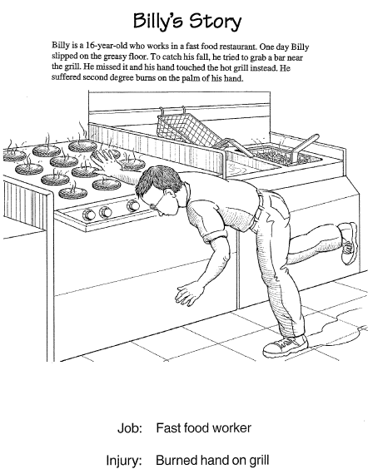
Notes:
Source: Youth @ Work: Talking Safety http://www.cdc.gov/niosh/talkingsafety/states/il/default.html

Slide 23
Billy’s Story
Billy is a 16 year old who works in a fast food restaurant. One day Billy slipped on the greasy floor. To catch his fall, he tried to grab a bar near the grill. He missed it, and his hand touched the hot grill instead. He suffered second degree burns on the palm of his hand.
Notes:
Source: Youth @ Work: Talking Safety http://www.cdc.gov/niosh/talkingsafety/states/il/default.html

Slide 24
Notes:
Source: Youth @ Work: Talking Safety http://www.cdc.gov/niosh/talkingsafety/states/il/default.html

Slide 25
Terry’s Story
Terry is a 16 year old who works in the deli department of a grocery store. Her supervisor asked her to clean the meat slicer, although she had never done this before and had not been trained to do it. She thought the meat slicer was turned off before she began cleaning it. Just as she started to clean the blades, the machine started up. The blade cut a finger on Terry’s left hand all the way to the bone.
Notes:
Source: Youth @ Work: Talking Safety http://www.cdc.gov/niosh/talkingsafety/states/il/default.html

Slide 26
Notes:
Source: Youth @ Work: Talking Safety http://www.cdc.gov/niosh/talkingsafety/states/il/default.html

Slide 27
Sara’s Story
Sara works as a nursing aide at a local hospital. She is expected to clean bedpans and sometimes change sheets, which requires lifting patients. Lately she has been feeling twinges in her back when bending over or lifting. She knows she is supposed to get help when lifting a patient, but everyone is so busy that she is reluctant to ask. At home, as she is going to sleep, she often feels shooting pains in her back, neck, and
shoulders. The pains seem to be getting worse every day.
Notes:
Source: Youth @ Work: Talking Safety http://www.cdc.gov/niosh/talkingsafety/states/il/default.html

Slide 28
Notes:
Source: Youth @ Work: Talking Safety http://www.cdc.gov/niosh/talkingsafety/states/il/default.html

Slide 29
Jamie’s Story
Jamie is a 17 year dish washer in a hospital kitchen.
To clean cooking pans, she soaks them in a powerful
chemical solution. She uses gloves to protect her hands
and arms. One day, as Jamie was lifting three large pans out of the sink at once, they slipped out of her hands and back into the sink. The cleaning solution splashed all over the side of her face and got into her right eye. She was blinded in that eye for two weeks.
Notes:
Source: Youth @ Work: Talking Safety http://www.cdc.gov/niosh/talkingsafety/states/il/default.html

Slide 30
Notes:
Source: Youth @ Work: Talking Safety http://www.cdc.gov/niosh/talkingsafety/states/il/default.html

Slide 31
James’ Story
James is a 16 year old who works in a busy
pizza shop. His job is to pat dough into pans.
He prepares several pans per minute. Lately he has noticed that his hands, shoulders and back are hurting from the repetitive motion and from standing for long periods of time.
Notes:
Source: Youth @ Work: Talking Safety http://www.cdc.gov/niosh/talkingsafety/states/il/default.html

Slide 32
Warning signs about workplace safety are one way to help control your risk of getting hurt on the job.
Let’s look at some signs.
Do you know what they mean?

Slide 33
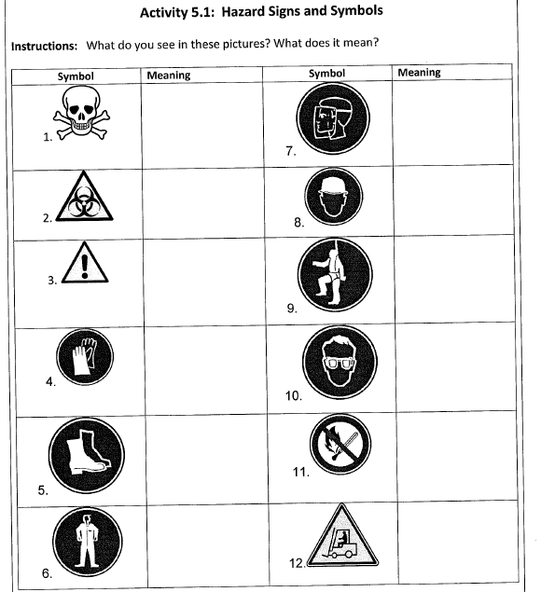
Notes:
Instructions:
1)Ask students about road signs they see if they are driving or if they are passengers; What is the purpose of the signs? (to be careful, to watch out, to prevent the driver from making a mistake). Ask them to call out examples of traffic signs (such as, stop sign, speed limit., pedestrian crossing, road narrowing, yield).
2)Then display slide #35 on the screen. Explain that signs and symbols in the workplace have the same function as a road signs: to warn
people, to prevent them from doing something. ) These workplace signs examples of administrative controls. They don’t remove the hazard
from the workplace, but they give information and warnings, like traffic signs for drivers.
3) Divide the class into pairs or small groups.
Pass out this hand out to students.
Give them 3 minutes to fill in the answers.
4) Ask each group to report an answer. Discuss each answer: ask if students have ever seen the symbol in a workplace. Ask what kinds of
workplaces they would likely see such a sign. .

Slide 34
Youth Health and Safety
Training Workshop
DAY 4
Notes:
Instructions:
Follow lesson plan notes for this day.

Slide 35
Notes:
Source: Youth @ Work: Talking Safety http://www.cdc.gov/niosh/talkingsafety/states/il/default.html

Slide 36
Health and Safety Awareness Post Test Answers
Theme 1: OSHA
Question 1.1
The law covering workplace safety and health is the OSHA Act.
Federal OSHA covers private and federal workers. True/False
Question 1.2
Section 5 (a) (1) General Duty Clause of the OSHA Act requires
that employers provide a workplace free of hazards. True/False
Question 1.3
Workers can act on health and safety concerns by contacting OSHA.
They can file a complaint with OSHA if they are discharged or
discriminated by their employer and it will be investigated.
True/False

Slide 37
Theme 2: Identifying Hazards
Question 2.1 Safety Hazards: Cause physical injuries and accidents and cause immediate harm.
True/False
Question 2.2 Health Hazards: Cause internal injuries like diseases or illnesses and cause long-term harm, may take years to develop.
True/False

Slide 38
Theme 3: Effects of Health Hazards
Question 3.1
Which is a route of entry for worker exposures to chemicals
or other workplace hazards:
Air/Inhalation: breathing in a chemical through the nose or mouth
Mouth/Ingestion: eating/swallowing a chemical
Skin/Direct contact with skin: absorbing a chemical through the skin or eyes
All of the above.

Slide 39
Theme 4: Reducing Hazards
Question 4.1
Rank these approaches from best to least effective with
best being 1 and least being 5
--Labor Practices/Administrative Controls
(Training and Procedures) #4
--Personal Protective Equipment (PPE) #5
--Engineering #3
--Elimination of Hazard #1
--Substitution #2

Slide 40
Theme 5: Common Workplace Hazards
Question 5.1
Symbol Meaning
No Fire or Flames Allowed
Mandatory Hands/Palms Protection

Slide 41
Summing Up
• Know Your Rights.
The factsheets about OSHA and child
labor laws are important resources.
Show them to your friends and family.
• Know Your Responsibilities.
It’s your responsibility to follow safety rules and report any problems you see.
Know Your Employer’s Responsibilities.
Your employer must keep the workplace safe and give you safety training.
Notes:
Source: Youth @ Work: Talking Safety http://wwwcdc.gov/niosh/talkingsafety/states/il/detault.htmi

Slide 42
• Know How To Solve Problems
Resources include co-workers, friends, parents, teachers, worker centers and government agencies such as OSHA and state labor law enforcement agencies.
Notes:
Source: Youth @ Work: Talking Safety http://wwwcdc.gov/niosh/talkingsafety/states/il/detault.htmi

