Slide 1
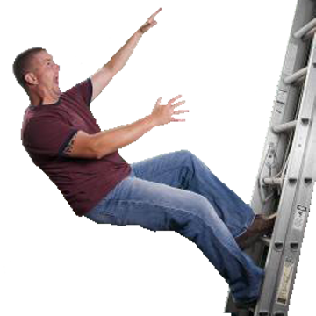
Big Four Construction Hazards: Fall Hazards
This material was produced under grant number 46F5-HT03 and edited under grant number SH22301-11-60-F-36 from the Occupational Safety and Health Administration, U.S. Department of Labor. It does not necessarily reflect the views or policies of the U.S. Department of Labor, nor does mention of trade names, commercial products, or organizations imply endorsement by the U.S. Government.
Notes:
Image Source: http://www.on-line-classes.com/store.php?crn=226&rn=477&action=show_detail
Image Source: http://www.on-line-classes.com/store.php?crn=226&rn=477&action=show_detail

Slide 2
Introduction
The following presentation is focused on the fall hazards in the construction industry. Falls are one of the main four hazards in construction.
The training material will cover the fall hazards seen regularly on construction sites and will focus on the methods for the recognition and the prevention of these common hazards.
This material was produced under grant number 46F5-HT03 and modify under grants numbers SH-16596-07-60-F-72 and SH22301-11-60-F-36 all from the Occupational Safety and
Health Administration, U.S. Department of Labor. It does not necessarily reflect the views or policies of the U.S. Department of Labor, nor does mention of trade
names, commercial products, or organizations imply endorsement by the U.S. Government.
This material was produced under grant number 46F5-HT03 and edited under grant number SH22301-11-60-F-36 from the Occupational Safety and Health Administration, U.S. Department of Labor. It does not necessarily reflect the views or policies of the U.S. Department of Labor, nor does mention of trade names, commercial products, or organizations imply endorsement by the U.S. Government.

Slide 3
Fall Hazards – Overview
Fall Hazards
1. Building Structures
2. Exterior Construction Areas
3. Scaffolds
4. Stairs
5. Ladders
B. Accident Prevention
1. Guardrail Systems
2. Warning Lines
3. Personal Fall Arrest Systems
4. Floor Covers
This material was produced under grant number 46F5-HT03 from the Occupational Safety and Health Administration, U.S. Department of Labor. It does not necessarily reflect the views or policies of the U.S. Department of Labor, nor does mention of trade names, commercial products, or organizations imply endorsement by the U.S. Government.

Slide 4

Fall Hazards
Falls are one of the greatest hazards on construction sites.
This program will help you recognize common fall hazards.
The symbols will tell you if the situation in the picture is either safe or not safe.
Safe
Not safe
This material was produced under grant number 46F5-HT03 from the Occupational Safety and Health Administration, U.S. Department of Labor. It does not necessarily reflect the views or policies of the U.S. Department of Labor, nor does mention of trade names, commercial products, or organizations imply endorsement by the U.S. Government.
Notes:
Fall hazards are one of the most serious and most common hazards found on a construction site. Fall hazards may cause you to fall onto the same level you are working on, or you may fall from one level to another. When you trip and fall while working you may receive nothing more than a scratch or a slight bruise. Unfortunately, that is not always the outcome. If you fall from one level to another, your risk of a serious injury or possibly even death has greatly increased. It may surprise you to know that falls are a leading cause of death for construction workers.
This program will help you recognize common fall hazards and show you ways to decrease those hazards at your job site. By the end of this program, you will be able to recognize and control these fall hazards.
Throughout this program, you will be shown examples of safe and unsafe conditions. Two different symbols will be used to represent safe and unsafe conditions. The red “No” symbol is used to denote unsafe conditions, and the green “Yes” checkmark will be used to show safe conditions.

Slide 5
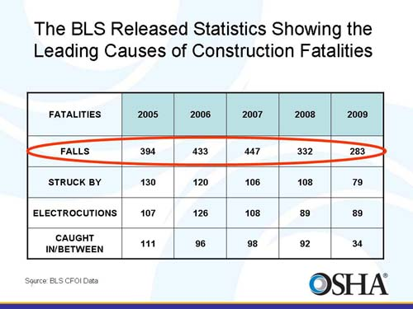
Fall Hazards Statistics
This material was produced under grant SH22301-11-60-F-36 from the Occupational Safety and Health Administration, U.S. Department of Labor. It does not necessarily reflect the views or policies of the U.S. Department of Labor, nor does mention of trade names, commercial products, or organizations imply endorsement by the U.S. Government.
Notes:
Each year workers in all industries die from falls. According to the latest Bureau of Labor Statistics, during 2006 there were 5,703 occupational fatalities. Of all occupational fatalities, 809 deaths were caused by falls which represents 39 more deaths from falls than 2005. Of those occupational deaths, 428 were in the construction industry. That means that more than 50% of all deaths from falls occur on construction sites. Overall, more than 14% of all occupational fatalities are from falls.

Slide 6
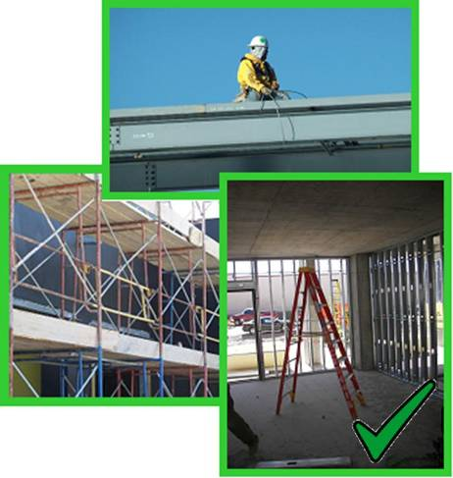
Fall Hazards
Work conditions 6’ or more above lower level require the use of fall protection:
Unprotected sides, edges
Leading edges
Walking/working surfaces
Regardless of height, fall protection must be used when working above:
Dangerous equipment
Sharp objects
Piercing objects
This material was produced under grant number 46F5-HT03 and edited under grant number SH22301-11-60-F-36 from the Occupational Safety and Health Administration, U.S. Department of Labor. It does not necessarily reflect the views or policies of the U.S. Department of Labor, nor does mention of trade names, commercial products, or organizations imply endorsement by the U.S. Government.
Notes:
Fall hazards can be found on almost any construction site. Some of the areas where fall hazards are found include:
*Building structures and exterior construction – Many times working on the exterior of a building can expose you to falls from greater heights. You may be on the roof of a building exposed to a fall of 10, 20, 30 feet or even more. You may be working on concrete forming with no scaffolding.
*Scaffolds and other work platforms – Scaffold and other elevated work platforms expose you to fall hazards since you are working at greater heights. If the scaffolding or work platforms are not properly constructed or maintained, your fall hazards are increased.
*Store-bought and job made ladders – Ladders are used regularly in construction and since we use them often we become very comfortable when using them. Because we are so comfortable we often overlook the hazards of using either a manufactured or a job made ladder.

Slide 7
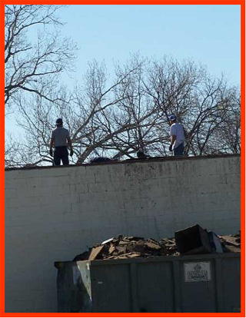
Lets work together, Identify the Hazard
What type of protection do you need when working unprotected sides?
This material was produced under grant number 46F5-HT03 and edited under grant number SH22301-11-60-F-36 from the Occupational Safety and Health Administration, U.S. Department of Labor. It does not necessarily reflect the views or policies of the U.S. Department of Labor, nor does mention of trade names, commercial products, or organizations imply endorsement by the U.S. Government.

Slide 8
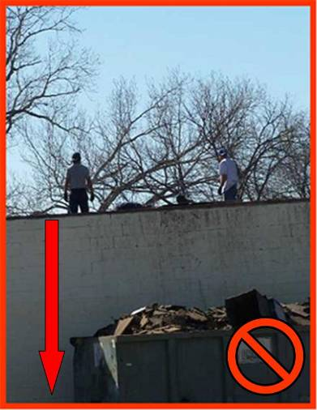
Building Structures
Work conditions 6’ or more above lower level require the use of fall protection:
Unprotected sides,
edges
Leading edges
Walking/working
surfaces
Regardless of height, fall protection must be used when working above:
Dangerous equipment
Sharp objects
Piercing objects
This material was produced under grant number 46F5-HT03 and edited under grant number SH22301-11-60-F-36 from the Occupational Safety and Health Administration, U.S. Department of Labor. It does not necessarily reflect the views or policies of the U.S. Department of Labor, nor does mention of trade names, commercial products, or organizations imply endorsement by the U.S. Government.
Notes:
Work conditions 6 feet or higher above the lower level requires the use of fall protection. Some areas where you might need fall protection of some sort include:
*Unprotected sides and edges: These are the sides and edges of walking and working surfaces that do not have walls, guardrail systems or other means of protection. "Guardrail system" means a vertical barrier, consisting of, but not limited to, top rails, mid rails, and posts, erected to prevent employees from falling off a scaffold platform or walkway to lower levels.
*Leading edges: These are the edges of a floor, a roof, the formwork for a floor or other walking surface that changes locations as additional floor, roofing, decking, or formwork sections are placed.
*Excavations: Excavations are any man-made cut, cavity, trench or depression in the surface of the earth. Excavations have their own hazards associated with them.
*Walking/working surfaces: These are any surfaces, whether vertical or horizontal, where employees work. Depending on the heights of these surfaces, you may be exposed to falls.
All of the conditions listed will increase your risk of falling. However, these are not the only areas where you may be exposed to falls. Regardless of height, fall protection must be used when working above:
* Dangerous equipment
* Sharp objects
* Piercing objects
In this photograph the workers have no fall protection and are exposed to falls greater than 6 feet. Additionally, both workers have positioned themselves where they cannot see the edge of their working surface. It would be easy for each of them to back off the edge and fall. An acceptable means of fall protection for this situation would be the installation of guardrail system.

Slide 9
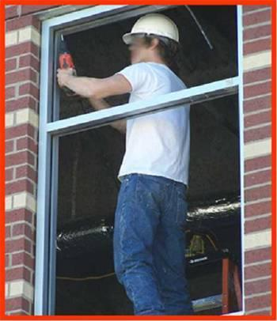
What risk can you identify?
This material was produced under grant number 46F5-HT03 and edited under grant number SH22301-11-60-F-36 from the Occupational Safety and Health Administration, U.S. Department of Labor. It does not necessarily reflect the views or policies of the U.S. Department of Labor, nor does mention of trade names, commercial products, or organizations imply endorsement by the U.S. Government.

Slide 10
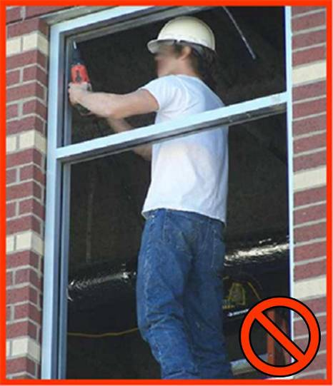
Building Structures
This worker is working 6’ above the lower level without using fall protection.
A personal arrest system is a fall-protection system that prevents the user from falling any distance. The system includes either a body belt or body harness, anchorage, connectors, and any other equipment as deemed necessary.
This material was produced under grant number 46F5-HT03 and edited under grant number SH22301-11-60-F-36 from the Occupational Safety and Health Administration, U.S. Department of Labor. It does not necessarily reflect the views or policies of the U.S. Department of Labor, nor does mention of trade names, commercial products, or organizations imply endorsement by the U.S. Government.
Notes:
In this example of an unsafe condition, the worker is standing in the window opening at the edge of his working surface with no means of fall protection. The worker is exposed to a fall of greater than 6 feet because he is working on the second level of this building.
One way this worker would be protected from a fall and possible injury is by using a personal fall arrest system. A personal arrest system is a fall-protection system that prevents the user from falling any distance. The system includes either a body belt or body harness, anchorage, connectors, and any other equipment as deemed necessary.

Slide 11
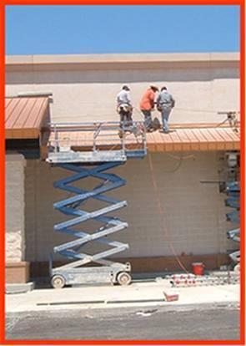
What risk can you identify? What advise would you provide to prevent an accident?
This material was produced under grant number 46F5-HT03 and edited under grant number SH22301-11-60-F-36 from the Occupational Safety and Health Administration, U.S. Department of Labor. It does not necessarily reflect the views or policies of the U.S. Department of Labor, nor does mention of trade names, commercial products, or organizations imply endorsement by the U.S. Government.

Slide 12
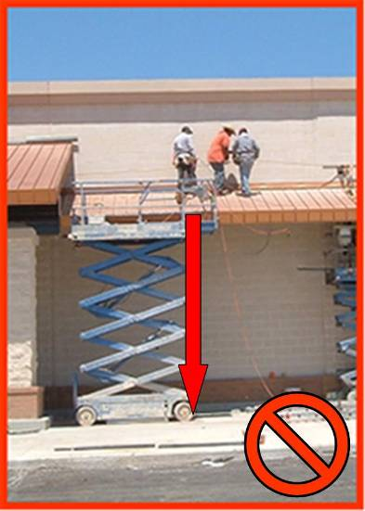
Building Structures
When working at a height of 6’ above the lower level you must use fall protection:
Personal fall arrest systems
Guardrail systems
This material was produced under grant number 46F5-HT03 from the Occupational Safety and Health Administration, U.S. Department of Labor. It does not necessarily reflect the views or policies of the U.S. Department of Labor, nor does mention of trade names, commercial products, or organizations imply endorsement by the U.S. Government.
Notes:
As stated previously, if you are working at a height of 6 feet or more you must have some form of fall protection. These workers were protected from a fall until they stepped outside of the lift. Once they exited the lift they lost all of their fall protection.
For these workers to be safe, some form of fall protection must be used. They could install a guardrail system or use personal fall arrest systems.

Slide 13
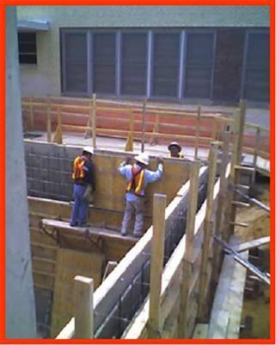
Help your co-workers what risks can you identify?
This material was produced under grant number 46F5-HT03 and edited under grant number SH22301-11-60-F-36 from the Occupational Safety and Health Administration, U.S. Department of Labor. It does not necessarily reflect the views or policies of the U.S. Department of Labor, nor does mention of trade names, commercial products, or organizations imply endorsement by the U.S. Government.

Slide 14
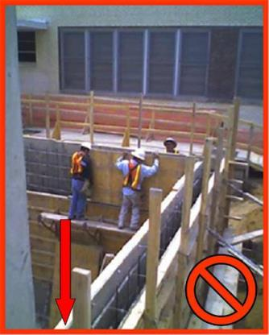
Building Structures
When working at a height of 6’ above the lower level you must use fall protection.
By using a personal fall arrest system, the workers would only fall six feet if they would fall off their working surface. This is assuming the workers were wearing a body harness with a lanyard (a flexible line of rope, wire rope, or strap which generally has a connector at each end for connecting the body belt or body harness to a deceleration device, lifeline, or anchorage) attached that was shorter than 6 feet.
This material was produced under grant number 46F5-HT03 and edited under grant number SH22301-11-60-F-36 from the Occupational Safety and Health Administration, U.S. Department of Labor. It does not necessarily reflect the views or policies of the U.S. Department of Labor, nor does mention of trade names, commercial products, or organizations imply endorsement by the U.S. Government.
Notes:
Here we have workers building concrete forms who are exposed to a fall greater than 6 feet and who do not have any form of fall protection. One way to protect them is to utilize a personal fall arrest system. By using a personal fall arrest system, the workers would only fall six feet if they would fall off their working surface. This is assuming the workers were wearing a body harness with a lanyard (a flexible line of rope, wire rope, or strap which generally has a connector at each end for connecting the body belt or body harness to a deceleration device, lifeline, or anchorage) attached that was shorter than 6 feet.

Slide 15
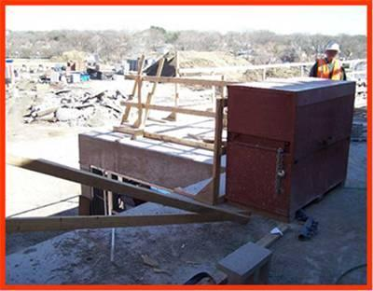
Lets learn about guardrail systems to prevent falls, what are the Do’s and don’ts of the picture?
This material was produced under grant number 46F5-HT03 and edited under grant number SH22301-11-60-F-36 from the Occupational Safety and Health Administration, U.S. Department of Labor. It does not necessarily reflect the views or policies of the U.S. Department of Labor, nor does mention of trade names, commercial products, or organizations imply endorsement by the U.S. Government.

Slide 16
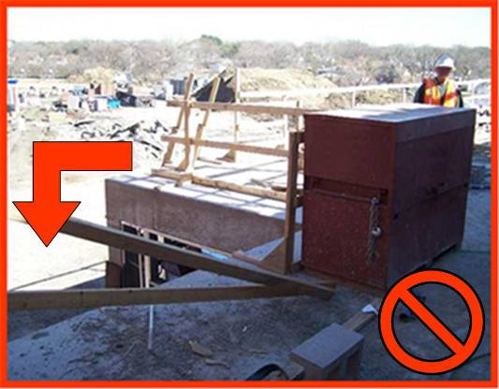
Building Structures
Guardrail systems must be maintained when working 6’ above lower level, or when working above dangerous equipment and sharp objects.
This material was produced under grant number 46F5-HT03 from the Occupational Safety and Health Administration, U.S. Department of Labor. It does not necessarily reflect the views or policies of the U.S. Department of Labor, nor does mention of trade names, commercial products, or organizations imply endorsement by the U.S. Government.
Notes:
Guardrail systems must be properly maintained to provide protection for workers. These are used to prevent the worker from falling by using a physical barrier. If this barrier is damaged or removed, the system no longer provides protection.
As you can see in this photograph, the guardrail has been removed and the fall protection is no longer provided.
The requirements for guardrail systems will be discussed later in this program.

Slide 17
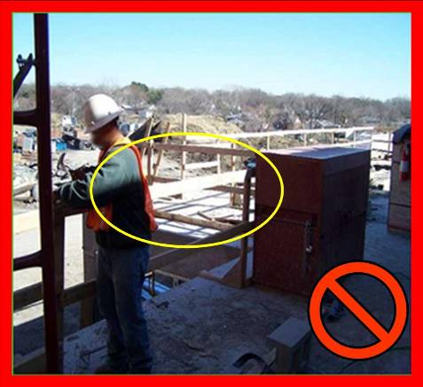
Building Structures
Damaged or missing guardrails must be fixed immediately.
When materials can be kicked off or pushed out and fall on any worker below, toe boards, screens and/or netting must be used.
This material was produced under grant number 46F5-HT03 from the Occupational Safety and Health Administration, U.S. Department of Labor. It does not necessarily reflect the views or policies of the U.S. Department of Labor, nor does mention of trade names, commercial products, or organizations imply endorsement by the U.S. Government.
Notes:
Since guardrails that are broken or removed provide no protection, it is important that they be well constructed and properly maintained at all times.
This photograph is the same as on the previous slide, however, now the guardrail has been repaired and the workers working on that level of the building are protected.
The slide however, still presents a dangerous scenario since some materials could be kicked off and fall on any worker below. In these situations toe boards and/or other means of protection such as screens and netting must be provided.

Slide 18
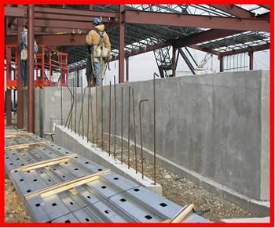
Do you think this is a Fall Hazard if you are working less than 6’ why?
This material was produced under grant number 46F5-HT03 and edited under grant number SH22301-11-60-F-36 from the Occupational Safety and Health Administration, U.S. Department of Labor. It does not necessarily reflect the views or policies of the U.S. Department of Labor, nor does mention of trade names, commercial products, or organizations imply endorsement by the U.S. Government.

Slide 19
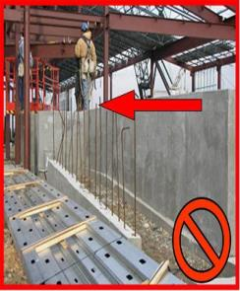
Exterior Construction Areas
All workers must be protected from falling onto sharp materials or onto dangerous equipment.
When a worker falls onto rebar or other sharp objects, he/she may be impaled. The force of the falling worker will drive the rebar or other sharp object into the body. Depending on the height of the fall and length of the rebar, it may go completely through the worker.
Two levels of protection must be put into place to protect workers from falling onto sharp objects. The first is to install a fall protection system to prevent the workers from falling. The second is to cover the sharp objects so workers cannot be impaled. The covers must be strong enough to withstand 250 pounds dropped from a height of 10 feet. Some types of rebar caps are not strong enough and will only make a larger hole as the rebar goes through the worker’s body.
This material was produced under grant number 46F5-HT03 and edited under grant number SH22301-11-60-F-36 from the Occupational Safety and Health Administration, U.S. Department of Labor. It does not necessarily reflect the views or policies of the U.S. Department of Labor, nor does mention of trade names, commercial products, or organizations imply endorsement by the U.S. Government.
Notes:
There are two types of falls that need to be considered: (1) falls to the same level, such as when walking on the ground and you trip, and (2) falls to a lower level, such as when you fall off a roof and land on the ground. Serious injuries can occur with each type of fall. The severity of the injury greatly increases if you fall onto a sharp object such as rebar or onto a dangerous equipment.
When a worker falls onto rebar or other sharp objects, he/she may be impaled. The force of the falling worker will drive the rebar or other sharp object into the body. Depending on the height of the fall and length of the rebar, it may go completely through the worker.
Two levels of protection must be put into place to protect workers from falling onto sharp objects. The first is to install a fall protection system to prevent the workers from falling. The second is to cover the sharp objects so workers cannot be impaled. The covers must be strong enough to withstand 250 pounds dropped from a height of 10 feet. Some types of rebar caps are not strong enough and will only make a larger hole as the rebar goes through the worker’s body.
This photograph shows footings with rebar extending from it exposing workers to impalement hazards.

Slide 20
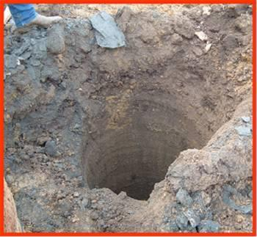
What could happen to a fellow worker with…
This material was produced under grant number 46F5-HT03 and edited under grant number SH22301-11-60-F-36 from the Occupational Safety and Health Administration, U.S. Department of Labor. It does not necessarily reflect the views or policies of the U.S. Department of Labor, nor does mention of trade names, commercial products, or organizations imply endorsement by the U.S. Government.

Slide 21
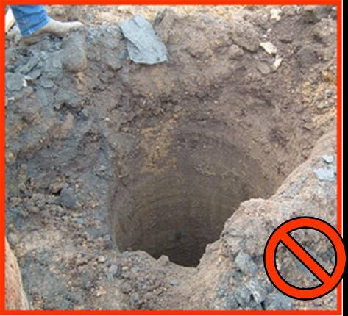
Exterior Construction Areas
All open excavations and pier holes must be guarded or protected.
This material was produced under grant number 46F5-HT03 from the Occupational Safety and Health Administration, U.S. Department of Labor. It does not necessarily reflect the views or policies of the U.S. Department of Labor, nor does mention of trade names, commercial products, or organizations imply endorsement by the U.S. Government.
Notes:
Open excavations and pier holes must be guarded or protected to prevent workers from falling into them. One way to guard a pier hole such as this, is to build a guardrail system around it. The guardrail will keep workers away from the edge so they cannot fall into the hole.
This photograph shows a 30 inch wide pier hole with no fall protection. This pier hole is also a serious hazard because it is greater than 40 feet deep with nothing to prevent the worker from falling in.

Slide 22
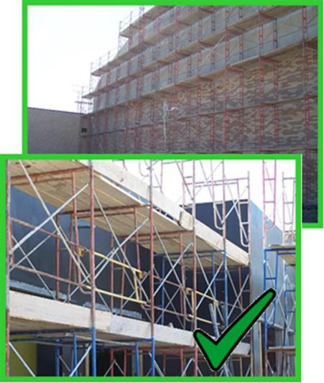
Scaffolds
Scaffolds are elevated, temporary work platforms:
Supported scaffold
Guardrail Systems
Access ladders
Powered work
platforms
The role of the competent person during erection
This material was produced under grant number 46F5-HT03 from the Occupational Safety and Health Administration, U.S. Department of Labor. It does not necessarily reflect the views or policies of the U.S. Department of Labor, nor does mention of trade names, commercial products, or organizations imply endorsement by the U.S. Government.
Notes:
Before the scaffold is used, direct connections shall be evaluated by a competent person who shall confirm, based on the evaluation, that the supporting surfaces are capable of supporting the loads to be imposed.
The employer shall provide safe means of access for each employee erecting or dismantling a scaffold where the provision of safe access is feasible and does not create a greater hazard. The employer shall have a competent person determine whether it is feasible or would pose a greater hazard to provide, and have employees use a safe means of access. This determination shall be based on site conditions and the type of scaffold being erected or dismantled.
Scaffolds and scaffold components shall be inspected for visible defects by a competent person before each work shift, and after any occurrence which could affect a scaffold's structural integrity.
Scaffolds shall be erected, moved, dismantled, or altered only under the supervision and direction of a competent person qualified in scaffold erection, moving, dismantling or alteration. Such activities shall be performed only by experienced and trained employees selected for such work by the competent person.
Work on or from scaffolds is prohibited during storms or high winds unless a competent person has determined that it is safe for employees to be on the scaffold and those employees are protected by a personal fall arrest system or wind screens.
Employers shall have a competent person determine the feasibility and safety of providing fall protection for employees erecting or dismantling supported scaffolds. Employers are required to provide fall protection for employees erecting or dismantling supported scaffolds where the installation and use of such protection is feasible and does not create a greater hazard.

Slide 23
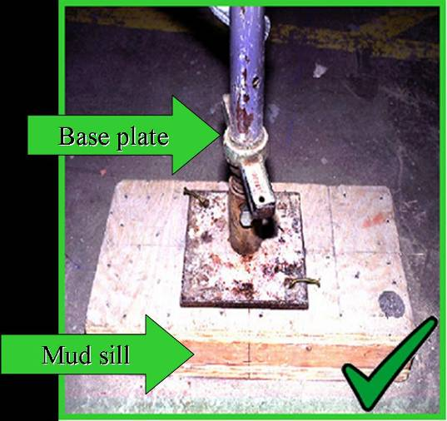
Scaffolds
Scaffold bases must rest on a base plate and a mud sill.
The base plate is designed to level and support the scaffold.
This material was produced under grant number 46F5-HT03 from the Occupational Safety and Health Administration, U.S. Department of Labor. It does not necessarily reflect the views or policies of the U.S. Department of Labor, nor does mention of trade names, commercial products, or organizations imply endorsement by the U.S. Government.
Notes:
Scaffolds must be safely constructed. The legs or poles of scaffolding must have a firm foundation in order to support the scaffold, the equipment placed on the scaffold and the workers working on the scaffold.
The foundation begins with the base plate. The base plate must then rest on mud sills or other firm foundation. Never place the scaffold legs on items such as rocks, sand, uneven surfaces, or cement blocks.

Slide 24
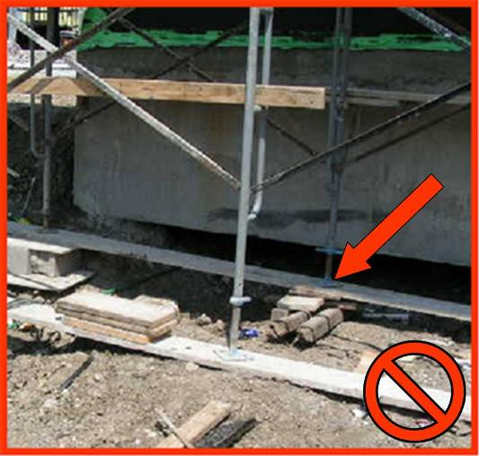
Scaffolds
Only work from scaffolds that are properly constructed and supported.
This material was produced under grant number 46F5-HT03 from the Occupational Safety and Health Administration, U.S. Department of Labor. It does not necessarily reflect the views or policies of the U.S. Department of Labor, nor does mention of trade names, commercial products, or organizations imply endorsement by the U.S. Government.
Notes:
To avoid falls and other hazardous conditions, you should only work from scaffolds that are properly constructed and supported. If the scaffold does not have a stable foundation, then the scaffold may move or shift causing the scaffold and you to fall.
This scaffold has a base plate but it is not resting on a firm foundation. The base plate is resting on blocks, uneven timbers and planking over uneven ground.

Slide 25
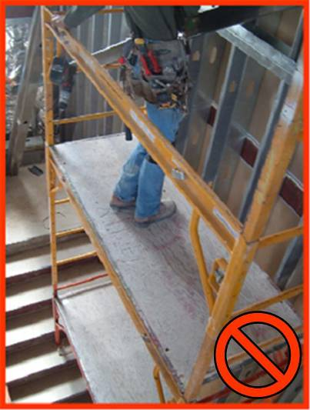
Scaffolds
Scaffolds used in stair wells must be properly constructed.
This material was produced under grant number 46F5-HT03 from the Occupational Safety and Health Administration, U.S. Department of Labor. It does not necessarily reflect the views or policies of the U.S. Department of Labor, nor does mention of trade names, commercial products, or organizations imply endorsement by the U.S. Government.
Notes:
If you use scaffolding in a stair well, you must ensure that it is constructed properly. It must be leveled and properly supported to provide a safe working surface. When trying to level scaffolding, never use bricks, blocks, or other unstable materials.
This photograph shows a scaffold set up in a stair well that is not properly supported and is leaning to one side. It would be easy for this worker to lose his balance and fall. In addition, an improperly supported scaffold may collapse.
Furthermore, this scaffold is missing toe boards and yet materials are or may be placed on the scaffold and can hit workers climbing up the stairs.

Slide 26
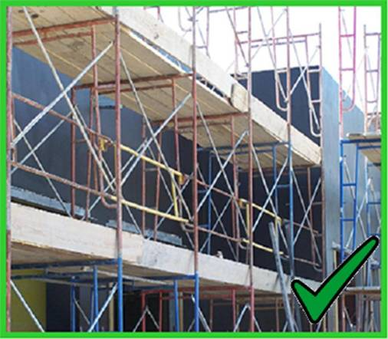
Scaffolds
When working on scaffolds 10’ above lower level, guardrail systems must be installed.
This material was produced under grant number 46F5-HT03 from the Occupational Safety and Health Administration, U.S. Department of Labor. It does not necessarily reflect the views or policies of the U.S. Department of Labor, nor does mention of trade names, commercial products, or organizations imply endorsement by the U.S. Government.
Notes:
When working on scaffolding at heights of 6 feet or more above a lower level, guardrail systems must be installed. The guardrail systems will provide a physical barrier to prevent you from falling. The guardrail system must be installed along all open sides and ends of the platforms.
The guardrail system must be installed before the scaffold can be used by workers.

Slide 27
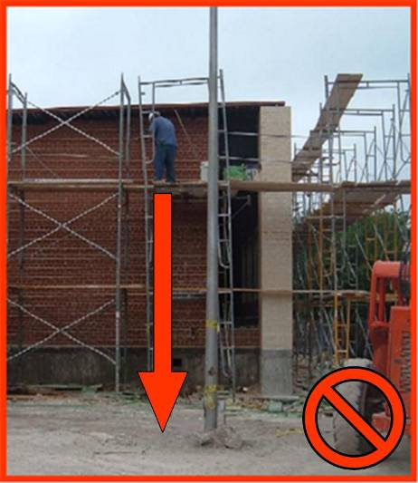
Scaffolds
Never use scaffolds that do not have a proper guardrail system installed.
This material was produced under grant number 46F5-HT03 from the Occupational Safety and Health Administration, U.S. Department of Labor. It does not necessarily reflect the views or policies of the U.S. Department of Labor, nor does mention of trade names, commercial products, or organizations imply endorsement by the U.S. Government.
Notes:
Guardrail systems are required for your protection. Never use a scaffold that does not have a proper guardrail system installed. Many workers will use a scaffold without a guardrail system because they think nothing will happen to them and the guardrail system is not really needed. The guardrail systems may be the only thing between you and a fall to your death.
In this photograph the worker is on the third level of the scaffold and working unsafely. There is no guardrail system in place to prevent him from falling.

Slide 28
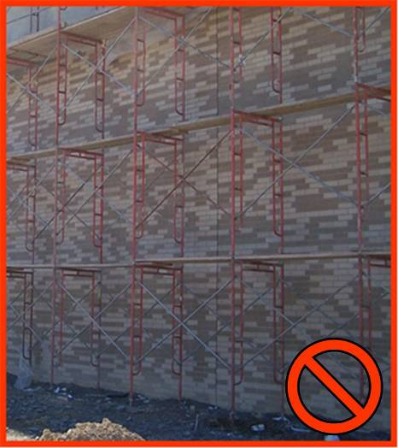
Scaffolds
Scaffold platforms must be fully and properly planked.
This material was produced under grant number 46F5-HT03 from the Occupational Safety and Health Administration, U.S. Department of Labor. It does not necessarily reflect the views or policies of the U.S. Department of Labor, nor does mention of trade names, commercial products, or organizations imply endorsement by the U.S. Government.
Notes:
Scaffold platforms must be fully and properly planked. The planks must fully cover the platform to create a safe working surface. Gaps between the planks and the uprights must not be greater than 1 inch wide.
In addition, scaffolding planks must be maintained in good condition. They must not be broken, cracked, warped or painted.
This photograph shows scaffolding 3 sections high that is not fully planked on the lower 2 sections.
In addition, we can observe that there is some overlap between scaffold planks. In that sense, on scaffolds where platforms are overlapped to create a long platform, the overlap shall occur only over supports, and shall not be less than 12 inches (30 cm) when the planks are shorter than 10 feet and 18 inches when planks are longer than 10 feet, unless the platforms are nailed together or otherwise restrained to prevent movement.

Slide 29
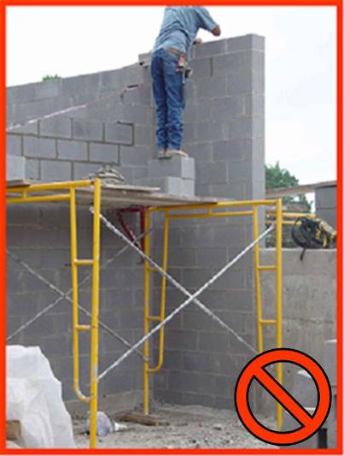
Scaffolds
Never stack blocks, bricks, or use ladders on top of scaffolds for extra height.
This material was produced under grant number 46F5-HT03 from the Occupational Safety and Health Administration, U.S. Department of Labor. It does not necessarily reflect the views or policies of the U.S. Department of Labor, nor does mention of trade names, commercial products, or organizations imply endorsement by the U.S. Government.
Notes:
Scaffolding is designed to allow workers to reach their work safely. When you stand on blocks, boxes, buckets or ladders you are no longer working safely. Blocks, boxes, buckets, ladders and other objects where workers might stand on, are very unstable and will probably cause a fall.
Also, you may be raised above the level of the guardrails, and in the event of a fall, you would go over the rails without them stopping you. If you need to reach a level higher than the scaffolding allows, you must raise the height of the scaffold.
In this photograph the worker has created a serious fall hazard by standing on blocks while on a scaffold platform that is not fully planked and has no guardrail system. In addition, a guardrail system is needed, and the competent person should have never allowed these hazards to be created during erection and throughout the work.

Slide 30
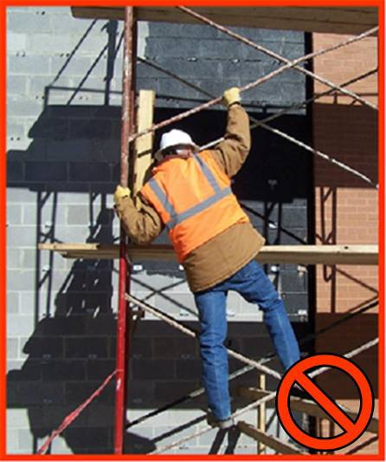
Scaffolds
Workers must have a safe way to access the scaffold.
This material was produced under grant number 46F5-HT03 from the Occupational Safety and Health Administration, U.S. Department of Labor. It does not necessarily reflect the views or policies of the U.S. Department of Labor, nor does mention of trade names, commercial products, or organizations imply endorsement by the U.S. Government.
Notes:
When working from a scaffold you must have a safe way to access the working level. Always use a ladder that is designed for use with the scaffold and is safely attached to the scaffold.
Never climb a scaffold using the cross braces like the worker in this picture.
Workers must always have a safe way to access the scaffold.

Slide 31
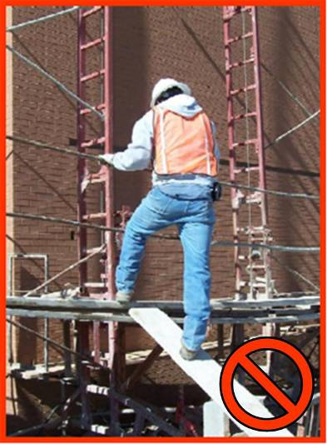
Scaffolds
Never use blocks, bricks, walk boards, and other unsafe methods to access a scaffold.
This material was produced under grant number 46F5-HT03 from the Occupational Safety and Health Administration, U.S. Department of Labor. It does not necessarily reflect the views or policies of the U.S. Department of Labor, nor does mention of trade names, commercial products, or organizations imply endorsement by the U.S. Government.
Notes:
No matter how high the scaffold is, always use safe means to access the scaffold. Safe methods of accessing a scaffold are the use of ladders or stairs. Never use blocks, bricks, walkboards, and other unsafe methods to access a scaffold.
In this photograph the worker is using a board placed on top of a wall block as a ramp to access the scaffold. The “ramp” may slip from the edge of the scaffold, the board may break or the blocks may fall or break. If any of these happen, the worker may fall. Also, the worker may fall at anytime while walking on the “ramp”.

Slide 32
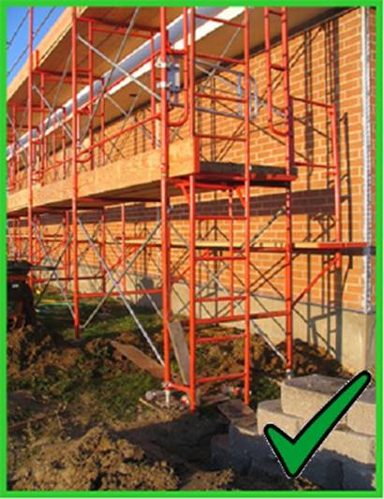
Scaffolds
Use only ladders designed for use with scaffolds.
The ladder must be firmly secured to the scaffold.
This material was produced under grant number 46F5-HT03 from the Occupational Safety and Health Administration, U.S. Department of Labor. It does not necessarily reflect the views or policies of the U.S. Department of Labor, nor does mention of trade names, commercial products, or organizations imply endorsement by the U.S. Government.
Notes:
When scaffold platforms are more than 2 feet above or below a point of access, portable ladders, hook-on ladders, attachable ladders, or other means of safe access must be provided. Other types of access may include stair towers, ramps, or walkways. Cross braces cannot be used as a means of access.
When using portable hook-on ladders, they must be positioned so they do not tip the scaffold over.
In addition, the spacing of the ladder rungs must be 16 ¾ inches or less and have a minimum length of 11 ½ inches.
Following these guidelines will allow you to safely access scaffolding and reduce your risk of falls.

Slide 33
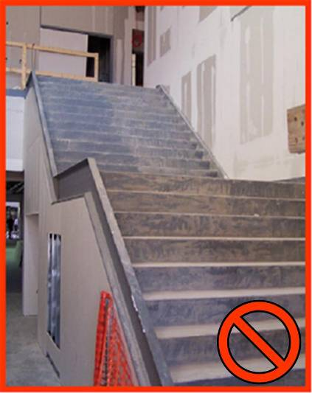
Stairs
Stairways must have a stair rail along each unprotected side or edge.
This material was produced under grant number 46F5-HT03 from the Occupational Safety and Health Administration, U.S. Department of Labor. It does not necessarily reflect the views or policies of the U.S. Department of Labor, nor does mention of trade names, commercial products, or organizations imply endorsement by the U.S. Government.
Notes:
When stairs are under construction they are dangerous and should not be used unless fall protection is provided. Stairways having 4 or more risers must have a stair-rail system and/or guardrail system that protects the worker from falling off the unprotected edge.
During construction, all worker points of access where there is a break in elevation of 19 inches or higher, must have means of access that can be either a stairway, a ladder, a ramp, an embankment, or a personnel hoist.
Workers must not use a stairway with pan stairs that are not filled and where treads have not been placed or secured. These stairways are unsafe and expose you to fall hazards.
In this photograph, the stairway does not have a stair rail on the open side and the stairs are not completed, so they are not safe to use.
In addition:
All stairway parts must be free of dangerous projections such as protruding nails.
A stair rail must be installed along each unprotected side or edge.
When the top edge of a stairwell system also serves as a handrail, the height of the top edge must be between 36 and 37 inches from the upper surface of the stair rail to the surface of the tread.
Mid rail or equivalent intermediate structural members must be provided midway between the top rail and stairway steps of the stair rail system. Intermediate vertical members, such as balusters, when used must be installed so that there are no openings more than 19 inches wide.
Handrails and top rails of the stair rail systems must withstand 200 pounds applied on the top edge downward and outward along the top edge.
Unprotected sides and edges of stairway landings must be provided with standard 42 inch guardrail systems.

Slide 34
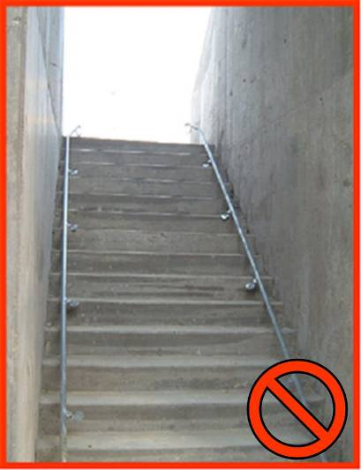
Stairs
Stairs that have walls on both sides must have at least one hand rail on the right-hand side when climbing down.
This material was produced under grant number 46F5-HT03 from the Occupational Safety and Health Administration, U.S. Department of Labor. It does not necessarily reflect the views or policies of the U.S. Department of Labor, nor does mention of trade names, commercial products, or organizations imply endorsement by the U.S. Government.
Notes:
A stairway of 4 or more risers must have a handrail. When only one rail is provided, it must be placed on the right-hand side when climbing down. The majority of falls on stairs occur while the person is descending the stairs and the majority of the workers are right handed. That is why the handrail is to be placed on the right side descending.
This photograph shows a stairway that is enclosed on both sides. It also shows the rails that are to be placed in the stairway. These stairs may not be used by workers because they are incomplete and unsafe.

Slide 35
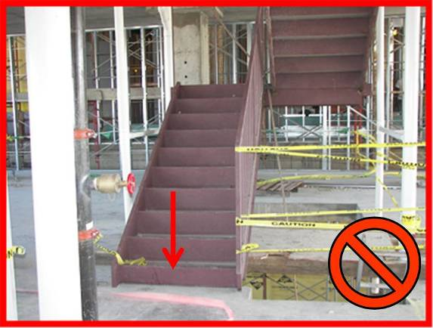
Stairs
Never use stairs that are not complete or unsafe.
This material was produced under grant number 46F5-HT03 from the Occupational Safety and Health Administration, U.S. Department of Labor. It does not necessarily reflect the views or policies of the U.S. Department of Labor, nor does mention of trade names, commercial products, or organizations imply endorsement by the U.S. Government.
Notes:
Using stairs that are incomplete or unfinished exposes you to fall hazards. As stairs are being constructed, workers are often tempted to use them instead of using the safe access that has been provided. The unfinished stairs are convenient, however, they are very hazardous. Stairs that do not have handrails expose you to falls. Stairs that have empty pans expose you to tripping hazards. You should never use stairs that are incomplete; they are unsafe.

Slide 36
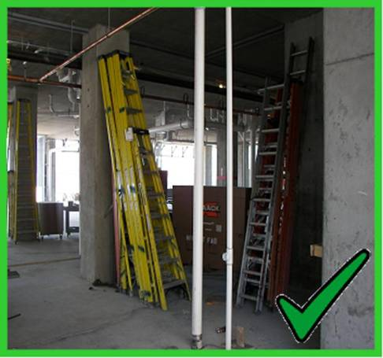
Ladders
Ladders must be inspected prior to use.
Ladders must be kept in a good condition and safe location.
This material was produced under grant number 46F5-HT03 from the Occupational Safety and Health Administration, U.S. Department of Labor. It does not necessarily reflect the views or policies of the U.S. Department of Labor, nor does mention of trade names, commercial products, or organizations imply endorsement by the U.S. Government.
Notes:
Ladders are used on construction sites to access overhead work surfaces because they are convenient, portable and can be used almost anywhere on the site. Ladders used on construction sites must be in good condition and free from defects that could make them unstable or unsafe.
Always inspect ladders before using them. When inspecting ladders look for cracks in the frame, breaks in any area, missing or broken rungs, protruding objects that can catch you or your clothing, and oil, grease, or mud that can make the steps slippery. If you find any defects on the ladder take it out of service immediately and dispose of it. Never use a broken ladder!

Slide 37
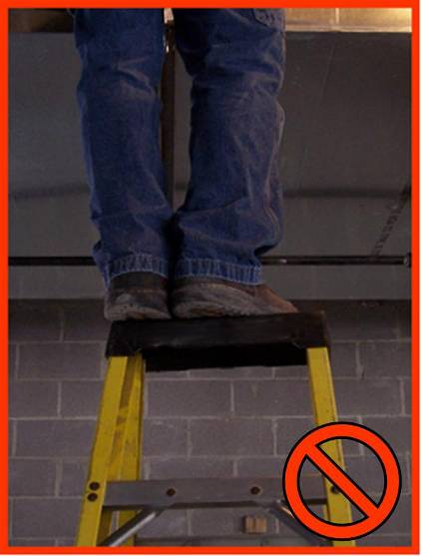
Ladders
Do not stand on the top of a ladder.
In this photograph you can see the worker is standing on the top of a step ladder. This is a very unsafe practice because the worker can lose his balance, fall, and be seriously injured.
This material was produced under grant number 46F5-HT03 and edited under grant number SH22301-11-60-F-36 from the Occupational Safety and Health Administration, U.S. Department of Labor. It does not necessarily reflect the views or policies of the U.S. Department of Labor, nor does mention of trade names, commercial products, or organizations imply endorsement by the U.S. Government.
Notes:
As previously stated, ladders are one of the most commonly used work platforms in construction. They are also one of the most commonly misused pieces of equipment. The safe use of ladders will help prevent many common work accidents. Standing on the top or the first step of a ladder is not safe.
Do not use the top step of a ladder as a step and do not stand on the top of a ladder.
In this photograph you can see the worker is standing on the top of a step ladder. This is a very unsafe practice because the worker can lose his balance, fall, and be seriously injured.

Slide 38
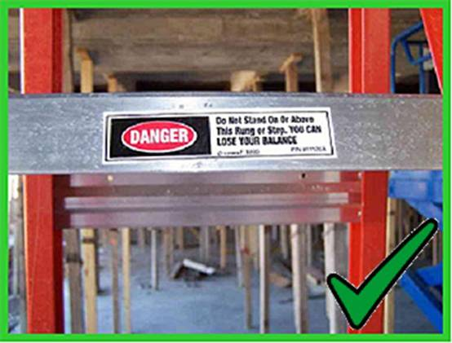
Ladders
Read labels on ladders for instructions to ensure proper use.
This material was produced under grant number 46F5-HT03 from the Occupational Safety and Health Administration, U.S. Department of Labor. It does not necessarily reflect the views or policies of the U.S. Department of Labor, nor does mention of trade names, commercial products, or organizations imply endorsement by the U.S. Government.
Notes:
All store-bought ladders have safety labels on them. Be sure to read the labels for instructions and to ensure proper use. Look for a sticker on the ladder, like the one in this photograph, that will state where not to stand on the ladder. Usually the 2nd rung from the top is the highest step on a step ladder that is safe to use.

Slide 39
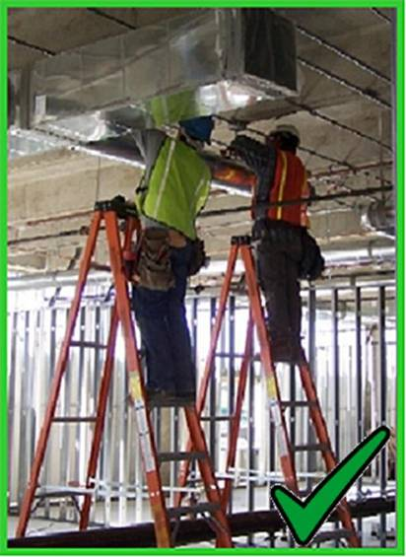
Ladders
Always maintain good footing on a step ladder.
Use the correct size ladder for the work that is to be done.
This material was produced under grant number 46F5-HT03 from the Occupational Safety and Health Administration, U.S. Department of Labor. It does not necessarily reflect the views or policies of the U.S. Department of Labor, nor does mention of trade names, commercial products, or organizations imply endorsement by the U.S. Government.
Notes:
When using step ladders, be sure to open the ladder completely. Lock the cross braces to ensure the ladder remains open. Place the feet of the ladder on a firm foundation. Never use the cross braces or the back side of the ladder for climbing.
Once the ladder is properly placed, you can use the ladder safely. Be sure to maintain good footing while on the step ladder.
Also, use the correct size ladder for the job to be done. If your ladder is too short, you will be tempted to stand on the top to further your reach. If your ladder is too tall, it may not fit in the space you are trying to work in.
In this photograph you can see two workers correctly using step ladders. They have their ladders properly placed, cross braces locked and they are standing on the correct steps.

Slide 40
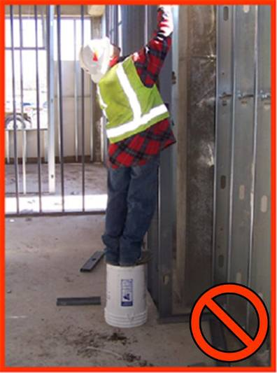
Ladders
Always use the right equipment for the job:
Ladders
Lifts
Scaffolds
This material was produced under grant number 46F5-HT03 from the Occupational Safety and Health Administration, U.S. Department of Labor. It does not necessarily reflect the views or policies of the U.S. Department of Labor, nor does mention of trade names, commercial products, or organizations imply endorsement by the U.S. Government.
Notes:
Always use the right equipment for the job. Scaffolds and ladders are designed to create safe work platforms so workers can reach the job safely. But sometimes workers take a shortcut and try to make a temporary scaffold out of saw horses, blocks, boards, ladders, 5 gallon buckets or whatever is at hand. Never take a short cut because it takes too much time or effort to do the job correctly. Do it right the first time! Short cuts lead to hazardous situations where you may be injured or possibly even killed.
In this photograph, the worker chose to use a 5 gallon bucket to access a workspace above his head. By making this choice, the worker has put himself at risk of falling and hurting himself.

Slide 41
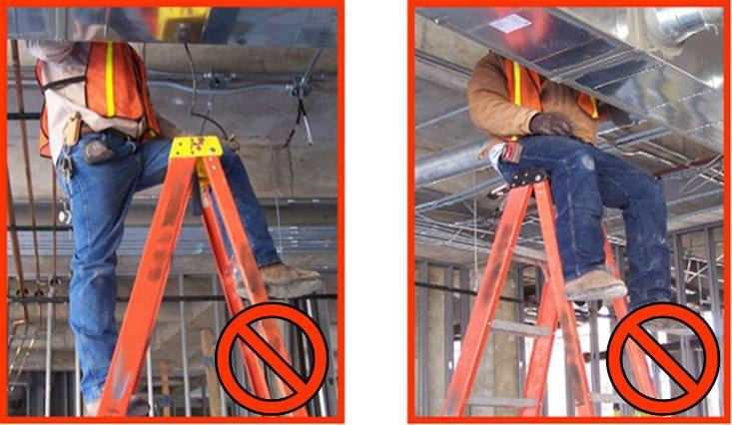
Ladders
Never straddle or sit on top of a step ladder.
This material was produced under grant number 46F5-HT03 from the Occupational Safety and Health Administration, U.S. Department of Labor. It does not necessarily reflect the views or policies of the U.S. Department of Labor, nor does mention of trade names, commercial products, or organizations imply endorsement by the U.S. Government.
Notes:
As mentioned previously, it is not safe to stand on the top of a ladder. It is also not safe to sit on the top of a ladder. The top of a ladder was not designed to be used as a step or a seat. Sitting on top of a step ladder or straddling across the step ladder is an extremely dangerous practice. The most hazardous part of sitting on the top of a ladder is the act of sitting down. While climbing from one side to the other and then sitting down, it is easy to lose your balance and fall.
When straddling a ladder, as in the photograph on the left, you have shifted the weight from the center of the ladder to one side of it, thus making a once stable ladder very unstable. Once the ladder has become unstable, your chance of falling with it has greatly increased.

Slide 42
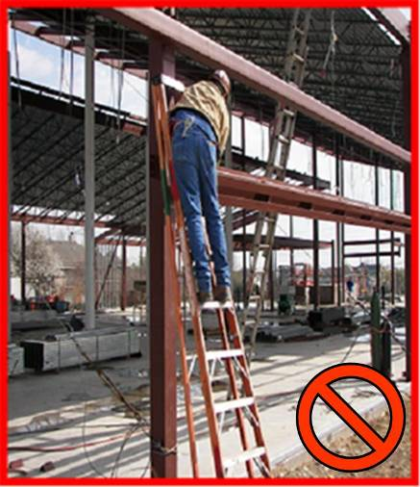
Ladders
An A-Frame ladder must be fully opened and locked into position.
Use ladders only for their designed purpose.
This material was produced under grant number 46F5-HT03 from the Occupational Safety and Health Administration, U.S. Department of Labor. It does not necessarily reflect the views or policies of the U.S. Department of Labor, nor does mention of trade names, commercial products, or organizations imply endorsement by the U.S. Government.
Notes:
Always use ladders for their intended purposes. A step ladder is designed to be used in a fully opened, locked position.
As you can see in this photograph the step ladder is folded and leaning against a scaffold. Using a step ladder this way is a dangerous practice. Always make sure the ladder is fully opened and locked into position.

Slide 43
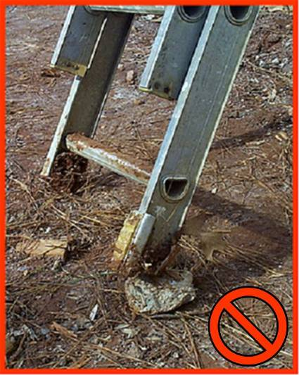
Ladders
Only use ladders on stable and level surfaces to prevent accidental movement.
This material was produced under grant number 46F5-HT03 from the Occupational Safety and Health Administration, U.S. Department of Labor. It does not necessarily reflect the views or policies of the U.S. Department of Labor, nor does mention of trade names, commercial products, or organizations imply endorsement by the U.S. Government.
Notes:
Always place ladders on stable and level surfaces to prevent accidental movement. Place the feet on a level flat surface.
In this photograph, the ladder is resting on a rock which is very unstable and can cause the ladder to tip and fall.

Slide 44
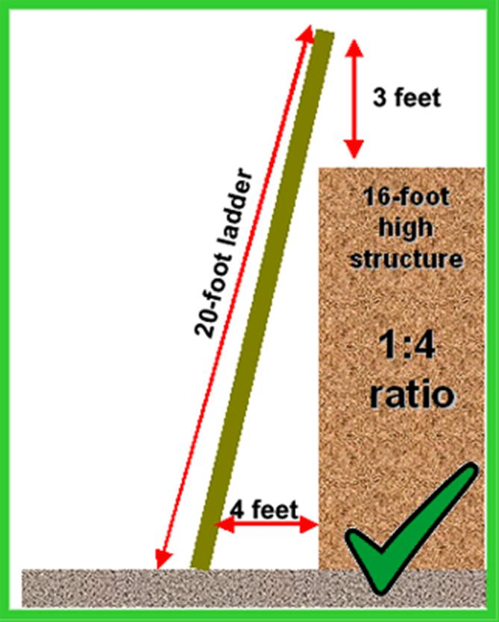
Ladders
Ladders must be positioned at a safe angle to avoid potential fall hazards when climbing.
Extension ladders must extend 3’ over the landing for safe access.
This material was produced under grant number 46F5-HT03 from the Occupational Safety and Health Administration, U.S. Department of Labor. It does not necessarily reflect the views or policies of the U.S. Department of Labor, nor does mention of trade names, commercial products, or organizations imply endorsement by the U.S. Government.
Notes:
Ladders must be positioned at a safe angle to avoid potential fall hazards when climbing. This drawing shows a ladder that is properly leaning against a structure. The structure is 16 feet high and the ladder is extended properly 3 feet over the edge.
In this example the ladder must be placed with the feet at least 4 feet away from the structure to maintain a safe angle. This angle is a 1 to 4 ratio. This means that for every 4 feet of height on the structure you should move the feet or base of the ladder 1 foot away from the structure.

Slide 45
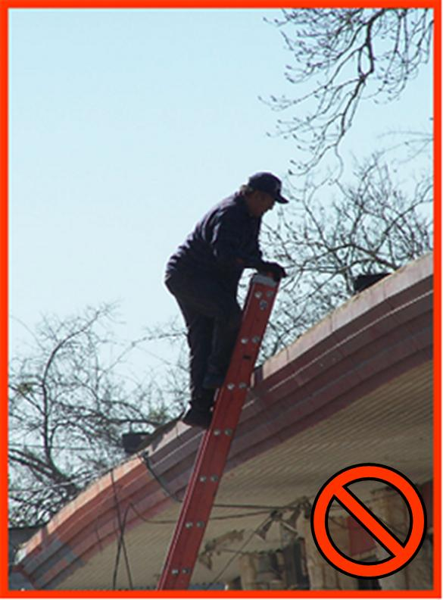
Ladders
When using a portable ladder for access to an upper landing surface, the side rails must extend at least 3’ above the upper landing surface.
This material was produced under grant number 46F5-HT03 from the Occupational Safety and Health Administration, U.S. Department of Labor. It does not necessarily reflect the views or policies of the U.S. Department of Labor, nor does mention of trade names, commercial products, or organizations imply endorsement by the U.S. Government.
Notes:
When using a ladder to access an upper landing such as a roof, the side rails of the ladders must extend at least 3 feet above the landing surface to allow for safe access. If a ladder cannot be extended 3 feet above the landing surface, the ladder must be secured to the top of the landing to prevent the ladder from slipping. A grab rail for workers to use while mounting and dismounting the ladder is also required.
This photograph shows a worker accessing the roof of a building with the ladder not extending 3 feet above the roof surface. The ladder is not secured and there is no grab rail for him to use.
Remember Rule 33 = 3 points of contact, 3 feet above the landing surface.

Slide 46
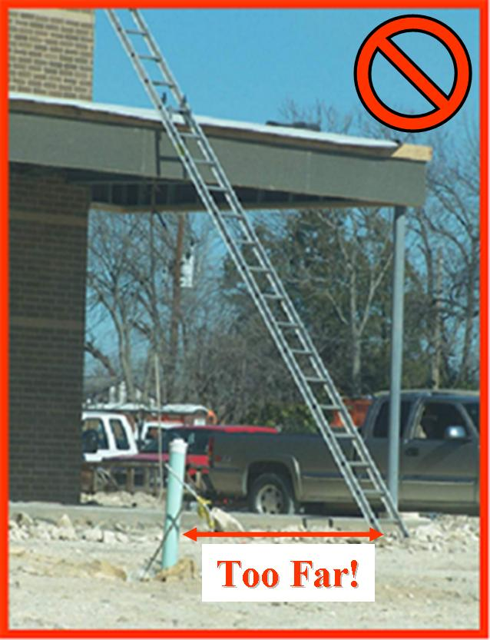
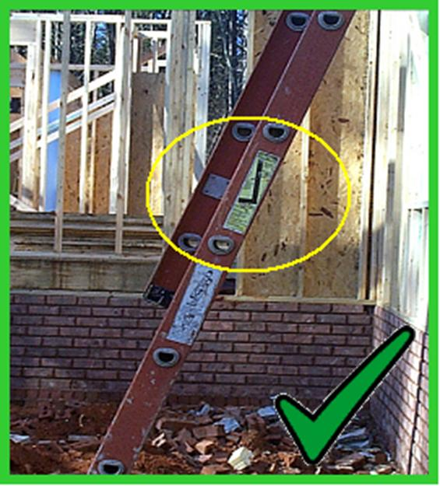
Ladders
Proper use vs. improper application
This material was produced under grant number 46F5-HT03 from the Occupational Safety and Health Administration, U.S. Department of Labor. It does not necessarily reflect the views or policies of the U.S. Department of Labor, nor does mention of trade names, commercial products, or organizations imply endorsement by the U.S. Government.
Notes:
This slide shows both correct and incorrect ladder placement. The photograph on the left shows correct placement and is a good example. The ladder is placed on a firm level surface at a proper 1:4 distance from the wall. The yellow circle shows the manufacturers instructions for safe ladder placement.
The photograph on the right is a bad example showing improper ladder placement. The ladder is placed on a firm level surface, however, the ladder is placed too far from the structure. This creates an angle greater than a 1:4 ratio. The incline is unsafe when climbing the ladder. This angle may also cause the ladder to flex and slide off the structure.

Slide 47
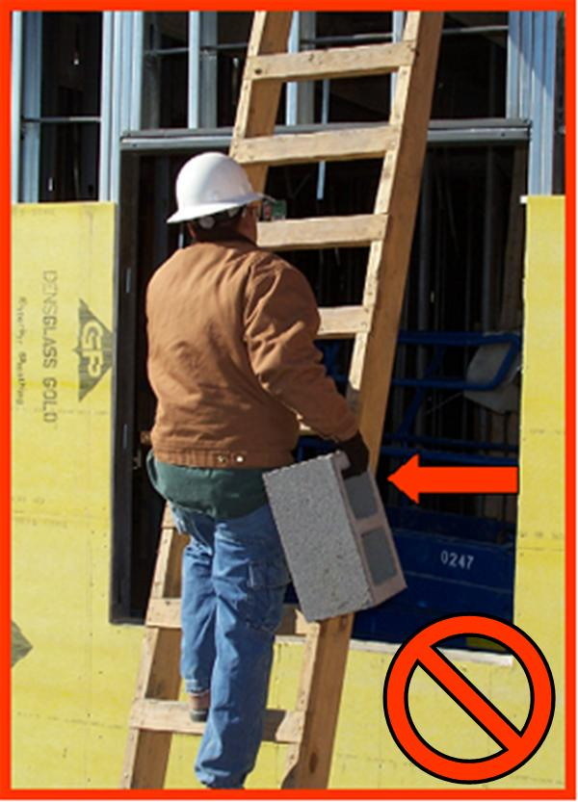
Ladders
Maintain contact with the ladder using both hands to keep a safe grip.
Face ladder when going up or down.
Never climb a ladder while carrying any materials.
This material was produced under grant number 46F5-HT03 from the Occupational Safety and Health Administration, U.S. Department of Labor. It does not necessarily reflect the views or policies of the U.S. Department of Labor, nor does mention of trade names, commercial products, or organizations imply endorsement by the U.S. Government.
Notes:
Many ladder accidents happen when workers try to carry tools or materials while climbing the ladder. You must maintain contact with the ladder using both hands to keep a safe grip. Always face the ladder when going up or down. Never go down a ladder as if going down stairs.
Never climb a ladder while carrying any materials. In order to safely climb a ladder, you must keep three points of contact with the ladder at all times. This means that a combination of 2 feet and 1 hand or 2 hands and 1 foot must be contacting the ladder at all times. If you are carrying a tool or building materials up or down a ladder it is impossible to maintain three points of contact.
This photograph shows a worker climbing a ladder while carrying a block. At this moment, he has three points of contact. The moment he raises a foot to move up the ladder, he only has 2 points of contact. He is at risk of falling and hurting himself.

Slide 48
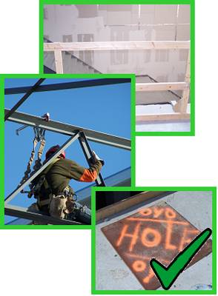
Preventing Fall Accidents
Construction work performed at 6’ or higher above a lower level requires fall protection.
Some fall protection methods include:
Guardrail systems
Warning lines
Fall arrest systems and
Floor covers
This material was produced under grant number 46F5-HT03 from the Occupational Safety and Health Administration, U.S. Department of Labor. It does not necessarily reflect the views or policies of the U.S. Department of Labor, nor does mention of trade names, commercial products, or organizations imply endorsement by the U.S. Government.
Notes:
Remember, when construction activities are performed at 6 feet or higher above a lower level, fall protection must be provided to protect the worker.
But what is “fall protection”? Fall protection is a method that has been put in place to keep you, the worker, from falling to a lower level. Fall protection may be a physical barrier or a system of rules put in place to keep you from entering an area that exposes you to a fall. Some methods of fall protection are:
Guardrail systems: Physical barriers that are put into place to prevent you from falling.
Warning lines: A physical barrier that keeps you a safe distance from an open edge. Warning lines do not keep you from falling, they are used to keep you out of a hazardous area.
Fall arrest systems: Fall arrest systems do not keep you from falling. They arrest, or stop your fall if they are designed and installed properly.
Floor covers: Physical barriers used to cover a hole in a floor or other walking/working surface. The floor openings can be a mere trip hazard or may be large enough that you can fall through to a lower level. An example of a large floor opening is a skylight. An uncovered skylight exposes you to a fall through the roof to a lower level.

Slide 49
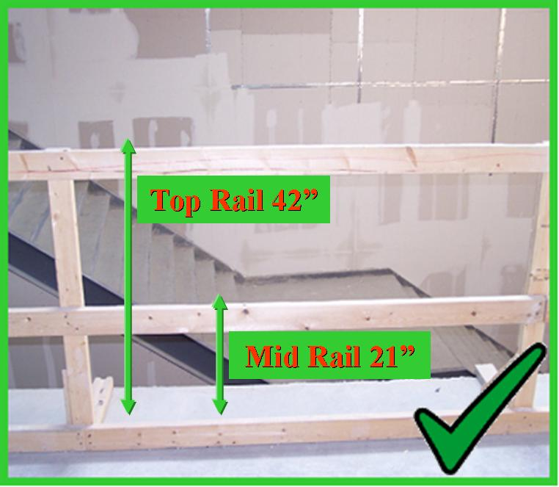
Guardrail Systems
Guardrail systems must have a top rail, a mid rail and a toe board.
The top rail must be at least 42” from the working surface.
Why do you think we need 3 guardrails?
This material was produced under grant number 46F5-HT03 and edited under grant number SH22301-11-60-F-36 from the Occupational Safety and Health Administration, U.S. Department of Labor. It does not necessarily reflect the views or policies of the U.S. Department of Labor, nor does mention of trade names, commercial products, or organizations imply endorsement by the U.S. Government.
Notes:
As stated earlier, guardrail systems are a physical barrier used to prevent you from falling. They are an excellent system designed to keep workers from falling more than 6 feet to a level below. Guardrail systems are typically made of wood or steel cables.
The guardrail system includes guardrails, such as the top rail, the mid rail, the posts and footings. We will be discussing the top rail and the mid rail in more detail as we go. The guardrail must be constructed with a top rail (non-cable) at approximately 42 inches (plus or minus 3 inches). This height is designed to prevent workers from going over the top of the guardrail system. If workers are working on stilts, then the top rail must be elevated to accommodate the workers extended height.
The mid rail is designed to prevent fallen workers from going under the top rail and falling to the lower level. The mid rail must be midway between the top rail and the working surface.
A toe board must also be installed to protect workers below from falling objects such as nails, tools and other equipment.

Slide 50
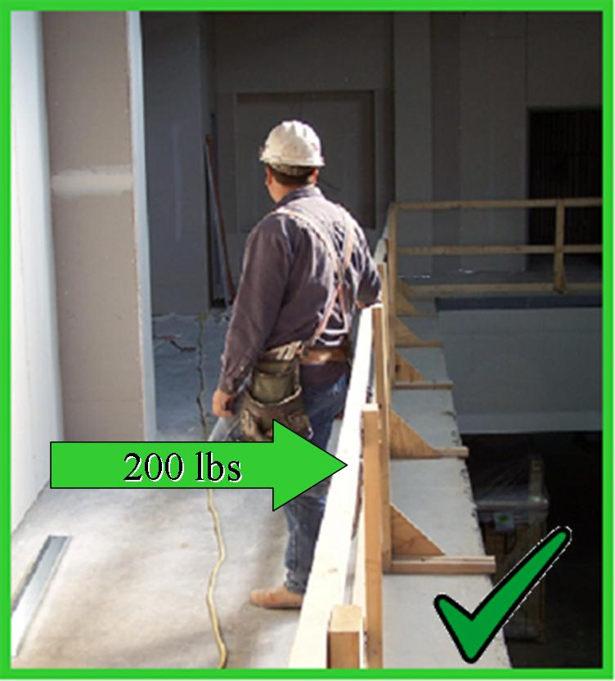
Guardrail Systems
All guardrail systems must be constructed with a top rail and a mid rail.
The top rail must support 200 lbs. of force downward and outward.
The mid rail must support 150 lbs of force.
This material was produced under grant number 46F5-HT03 from the Occupational Safety and Health Administration, U.S. Department of Labor. It does not necessarily reflect the views or policies of the U.S. Department of Labor, nor does mention of trade names, commercial products, or organizations imply endorsement by the U.S. Government.
Notes:
A guardrail system must be strong enough to prevent a worker from falling through. Remember, guardrail systems are a physical barrier. That barrier must not be weak. Both the top rails and the mid rails must be strong. The top rails must be able to support 200 lbs. of force downward and outward. Downward force is the force applied to the top of the rail and pushing or pulling down. This means that if a 200 lb. weight was hanging from the top rail, the rail would support the weight without breaking. Mid rails shall be capable of withstanding, without failure, a force of at least 150 pounds applied in any downward or outward direction at any point along the mid rail. Outward force is the force that is applied from the side pushing the rail out. This is the equivalent of a worker falling into the side of the rail.
The guardrails must be smooth so workers are not cut and nothing snags on clothing. The guardrails must not overhang the end of the system. This causes a hazard because workers can get caught on the projecting ends.
Guardrails cannot be made of steel banding or plastic banding.

Slide 51
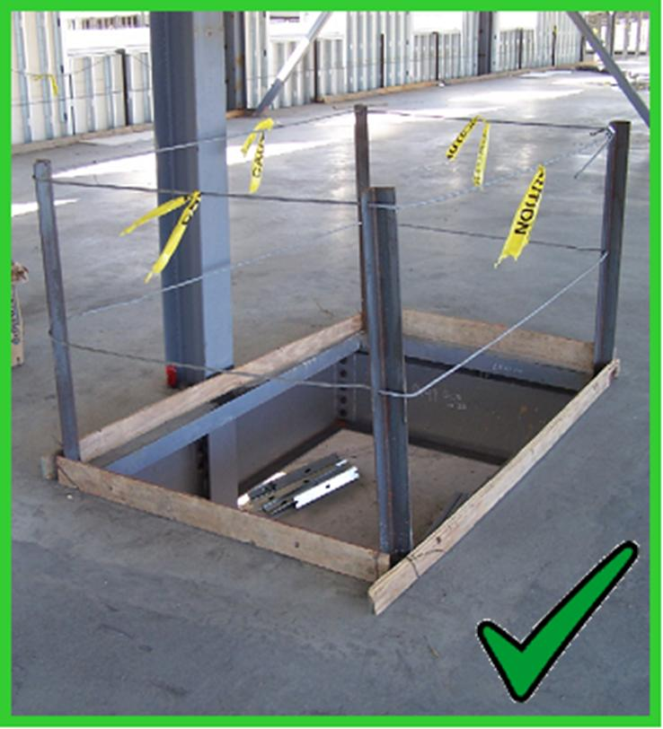
Guardrail Systems
Cable guardrails must meet the same rules as wood guardrails.
The top rail must be at least 42 inches high and resist up to 200 lbs.
When guardrail systems are used to protect a floor opening, the opening must be guarded on all sides.
This material was produced under grant number 46F5-HT03 and edited under grant number SH22301-11-60-F-36 from the Occupational Safety and Health Administration, U.S. Department of Labor. It does not necessarily reflect the views or policies of the U.S. Department of Labor, nor does mention of trade names, commercial products, or organizations imply endorsement by the U.S. Government.
Notes:
When a guardrail system is constructed out of cables, they must meet similar requirements as guardrails constructed from wood. The top rail is at the same height and must meet the 200 lbs. downward and outward force requirement. Cable top rails must be at least 42 inches in height whereas wood top rails must be 42 inches (+/- 3 inches) in height.
It is very important that the cables remain tight. Cables can loosen over time and then they will droop or sag. When this happens, the rail height can be less than 42 inches. Additionally, the cable will have play in it that will allow it to move and not prevent a worker from falling.
When guardrail systems are used to protect a floor opening, the opening must be guarded on all sides.
This photograph shows a floor opening that is guarded on all open sides with a cable guardrail system. Notice the toe boards are in place to prevent objects from falling onto workers below.

Slide 52
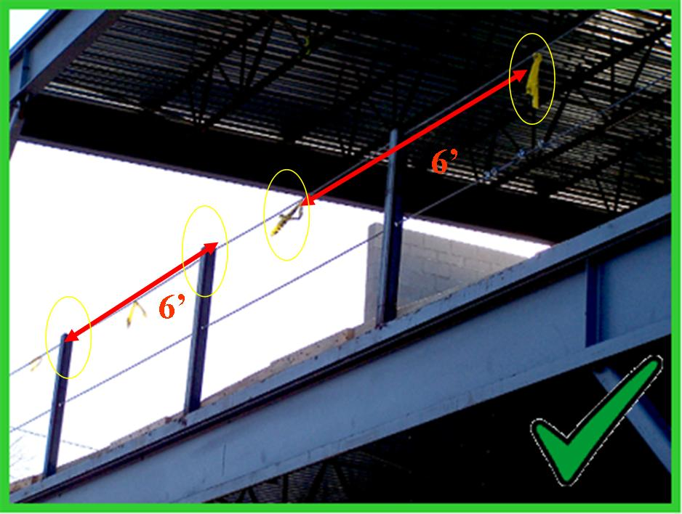
Cable Guardrails
Steel cable guardrails must have the top rail flagged every 6 feet.
This material was produced under grant number 46F5-HT03 from the Occupational Safety and Health Administration, U.S. Department of Labor. It does not necessarily reflect the views or policies of the U.S. Department of Labor, nor does mention of trade names, commercial products, or organizations imply endorsement by the U.S. Government.
Notes:
Steel cables are smaller in diameter than wooden rails and cannot be seen as easily from a distance. So if you use steel cables, the top rail must be flagged with a high visibility material. The flags must be placed every 6 feet for the entire length of the rail. The flags can be made of highly visible caution tape, reflective tape, manufactured flag banners or any other material that is highly visible and can be seen from a distance.
In this photograph, yellow caution tape is placed every 6 feet along the length of the rail.

Slide 53

Cable Guardrails
The clamps used for a steel cable system must be placed correctly.
Dead end
U-bolt
Saddle
Dead end
This material was produced under grant number 46F5-HT03 from the Occupational Safety and Health Administration, U.S. Department of Labor. It does not necessarily reflect the views or policies of the U.S. Department of Labor, nor does mention of trade names, commercial products, or organizations imply endorsement by the U.S. Government.
Notes:
When using steel cables, or wire rope, you must know how to properly secure the end of the cable. A cable cannot be tied in a knot or left to hang freely. The cable will run the post and then back over itself to be secured. Clamps are used to secure the ends of a steel cable.
The clamps used consist of a U-bolt, a saddle, and nuts. The U-bolt is placed on the “dead end” of the cable. The “dead end” is the short end of the cable. The saddle is placed on the load bearing cable. This is the long end or the “live end” of the cable. The nuts are placed on the U-bolt and tightened to hold the clamp assembly in place.
One way to remember which side the U-bolt and saddle go on is to remember the phrase “Never saddle a dead horse”. You would never saddle a dead horse, so why would you saddle a “dead end?” You can take the analogy further and think of the U-bolt as the “cowboy” who sits on the dead end or the dead horse, the saddle is placed on the live end or the live horse and the cowboy’s boots or the nuts are put on to hold the saddle.
It may seem goofy at the moment, but if you remember to “Never saddle a dead horse” you will always place the clamps in the correct position. Additionally, all clamps must be placed in the same direction.

Slide 54

Warning Lines
Warning lines are used to keep workers away from an unsafe edge.
The warning line must be at least 6’ away from the edge.
Warning lines are a physical barrier designed to keep workers from getting close to the edge, not from falling over the edge. They do not physically prevent a worker from gaining access to the edge.
This material was produced under grant number 46F5-HT03 and edited under grant number SH22301-11-60-F-36 from the Occupational Safety and Health Administration, U.S. Department of Labor. It does not necessarily reflect the views or policies of the U.S. Department of Labor, nor does mention of trade names, commercial products, or organizations imply endorsement by the U.S. Government.
Notes:
Warning lines are used to keep workers away from an unsafe edge. Warning lines are a physical barrier designed to keep workers from getting close to the edge, not from falling over the edge. They do not physically prevent a worker from gaining access to the edge. They do not stop a fall. They are designed to work with a comprehensive program and serve as a warning that hazards lie beyond the line.
The parts of the warning line system include the ropes, wires or chains supported by stanchions and must be erected a minimum of 6 feet from the edge. Workers are never to be in the area between the warning line and the edge.

Slide 55

Warning Lines
Warning lines must withstand 16 lbs. of tipping force.
The warning line must be at least 34” from the ground.
This material was produced under grant number 46F5-HT03 from the Occupational Safety and Health Administration, U.S. Department of Labor. It does not necessarily reflect the views or policies of the U.S. Department of Labor, nor does mention of trade names, commercial products, or organizations imply endorsement by the U.S. Government.
Notes:
The warning line must be sturdy enough to withstand 16 lbs. of force. The line must be at least 34 inches from the ground and at the highest 39 inches. The warning lines must be flagged for visibility.
Remember to set warning lines 6 feet from the edge.

Slide 56

Warning Lines
Warning lines must be maintained.
Report any unsafe condition to your supervisor.
This material was produced under grant number 46F5-HT03 from the Occupational Safety and Health Administration, U.S. Department of Labor. It does not necessarily reflect the views or policies of the U.S. Department of Labor, nor does mention of trade names, commercial products, or organizations imply endorsement by the U.S. Government.
Notes:
Warning lines must be kept up and maintained. Never work in an area if the warning line has been knocked down or damaged.
Report any unsafe condition to your supervisor.

Slide 57

Warning Lines
Never work in an area if the warning line has been knocked down or damaged.
Warning lines must be repaired or replaced immediately when damaged.
You should report unsafe conditions to your supervisor.
Never work in an area if the warning line has been knocked down or damaged.
This material was produced under grant number 46F5-HT03 and edited under grant number SH22301-11-60-F-36 from the Occupational Safety and Health Administration, U.S. Department of Labor. It does not necessarily reflect the views or policies of the U.S. Department of Labor, nor does mention of trade names, commercial products, or organizations imply endorsement by the U.S. Government.
Notes:
Since warning lines do not keep you from falling over the edge but they warn you to keep a safe distance, they do no good if they are not properly maintained. A warning line that has fallen to the ground or is in disrepair does not properly warn workers of the hazard.
Warning lines must be repaired or replaced immediately when damaged. You should report unsafe conditions to your supervisor. Never work in an area if the warning line has been knocked down or damaged.
This photograph shows a warning line that has fallen. It does no good lying on the ground!

Slide 58

Personal Fall Arrest Systems
The fall arrest system components are:
body harness,
lanyard, and
anchorage point.
This material was produced under grant number 46F5-HT03 from the Occupational Safety and Health Administration, U.S. Department of Labor. It does not necessarily reflect the views or policies of the U.S. Department of Labor, nor does mention of trade names, commercial products, or organizations imply endorsement by the U.S. Government.
Notes:
Another common system for protecting workers from falls is the use of a personal fall arrest system. The fall arrest system does not prevent falls. The design of a fall arrest system is to stop the worker from falling any further. The worker has to fall before this system operates. A properly designed fall arrest system will allow a worker to fall only a short distance and then stop the fall.
The fall arrest system consists of a body harness, lanyard, and an anchorage point. Each of these components must be properly maintained and used.
Remember, before using any fall arrest system you must inspect the equipment and be trained by your employer.

Slide 59

Personal Fall Arrest Systems
Body harness must be worn properly.
D-ring must rest between the shoulders and the chest strap must be secured.
Chest
strap
D-ring
This material was produced under grant number 46F5-HT03 from the Occupational Safety and Health Administration, U.S. Department of Labor. It does not necessarily reflect the views or policies of the U.S. Department of Labor, nor does mention of trade names, commercial products, or organizations imply endorsement by the U.S. Government.
Notes:
Body harnesses come in different sizes and styles. But each harness, no matter the style, is designed to hold your body securely after you have fallen and are hanging from an anchorage point waiting for rescue. After you have fallen and are suspended, your harness will protect your body from further damage. The harness design allows your body to maintain its blood flow and does not put pressure on internal organs.
In order for your harness to help you and not cause further harm, you must wear it properly. It must be snug and not loose. The D-ring, where the snap hook of a lanyard connects to the body harness, must be worn between the shoulder blades, not low on the back. If you fall, you will be hanging from that D-ring. If it is positioned properly, you will hang in an upright position. If the D-ring is positioned further down the back, you will hang more horizontally.
If your harness has a chest strap like this one, it must be secured and in the proper position. If the strap is not secured, you may fall out of the harness. If the strap is positioned too high, you may choke yourself if you fall.

Slide 60

Personal Fall Arrest Systems
Body harness must be:
inspected before use (Look for worn or torn areas, cuts and abrasions, grease or paints, sun damage, or any other visible damage. If any of these things are found, do not use the harness)
adjusted to fit the worker, and
free from other visible damage.
This material was produced under grant number 46F5-HT03 and edited under grant number SH22301-11-60-F-36 from the Occupational Safety and Health Administration, U.S. Department of Labor. It does not necessarily reflect the views or policies of the U.S. Department of Labor, nor does mention of trade names, commercial products, or organizations imply endorsement by the U.S. Government.
Notes:
Your fall protection is only as good as its components. A harness that is not worn properly will not protect you and may cause more harm. If the harness is too large or too small it will not protect you properly. A harness that is too large or is not adjusted will allow a worker to fall out of it during a fall. A harness that is too small or too tightly adjusted will injure a worker who falls.
Before a harness is worn it must be inspected. Look for worn or torn areas, cuts and abrasions, grease or paints, sun damage, or any other visible damage. If any of these things are found, do not use the harness. Get a new one before working at elevated heights.
When wearing a harness, it must be adjusted properly. The shoulder straps must not be twisted and must be snug. The leg straps should be positioned high on the legs, not twisted, and snug. Other straps must not be twisted and must be snug. The D-ring should be between the shoulder blades.
This photograph shows a harness that is worn improperly. The straps are loose and twisted. In the event of a fall, this worker would fall out of his harness.

Slide 61

Personal Fall Arrest Systems
Lanyards must be in good condition
and free from visible damage.
Look for worn or torn areas, cuts and abrasions, grease or paints, sun
damage, or any other visible damage.
If any of these things are found, do
not use the harness.
Some lanyards are equipped with a shock absorber that will lessen the forces of the fall on the workers body. These shock absorbers are only used once and then must be replaced. Never use a lanyard with a shock absorber that has been used.
This material was produced under grant number 46F5-HT03 and edited under grant number SH22301-11-60-F-36 from the Occupational Safety and Health Administration, U.S. Department of Labor. It does not necessarily reflect the views or policies of the U.S. Department of Labor, nor does mention of trade names, commercial products, or organizations imply endorsement by the U.S. Government.
Notes:
The lanyard connects the harness to the anchorage point. If a worker falls, the lanyard is the critical piece holding the suspended worker. The lanyards are designed with a minimum breaking strength of 5,000 lbs. and are made of synthetic materials. The lanyard hooks to the D-ring on the harness with a locking snap-hook. The snap-hook must lock and be able to handle 3,600 lbs.
Some lanyards are equipped with a shock absorber that will lessen the forces of the fall on the workers body. These shock absorbers are only used once and then must be replaced. Never use a lanyard with a shock absorber that has been used.
Lanyards must be inspected before each use for visible damage. Look for cuts, burns, oil, grease or any other defect. Make sure to test the locking snap-hook and carabiner to see that they are working properly. Never use a damaged lanyard and report any defects to your supervisor.

Slide 62

Personal Fall Arrest Systems
Lanyard must attach to the D-ring on the body harness.
If the lanyard you are using has a shock absorber, be sure to attached the lanyard to the harness with the D-ring closest to the shock absorber. You want the shock absorber close to the body.
This material was produced under grant number 46F5-HT03 and edited under grant number SH22301-11-60-F-36 from the Occupational Safety and Health Administration, U.S. Department of Labor. It does not necessarily reflect the views or policies of the U.S. Department of Labor, nor does mention of trade names, commercial products, or organizations imply endorsement by the U.S. Government.
Notes:
Once the harness has been inspected, has been fitted and properly adjusted and the lanyard has been inspected, the lanyard is then attached to the D-ring on the body harness. Keep in mind that if you fall you will be suspended by the lanyard and body harness. You want the D-ring of the body harness in the proper position so you will hang vertically.
If the lanyard you are using has a shock absorber, be sure to attached the lanyard to the harness with the D-ring closest to the shock absorber. You want the shock absorber close to the body.

Slide 63

Personal Fall Arrest Systems
Never anchor or tie off to pipes, wood structures, electrical wires, or other areas not designed for anchorage points.
An anchorage point must not move and must be very strong. Your life may depend on the anchorage point you choose. The anchorage point must hold at least 5,000 lbs of force. Never anchor or tie off to pipes, wood structures, electrical wires, or other areas not designed for anchorage points because they will not hold the minimum of 5,000 lbs. required in the event of a fall.
This material was produced under grant number 46F5-HT03 and edited under grant number SH22301-11-60-F-36 from the Occupational Safety and Health Administration, U.S. Department of Labor. It does not necessarily reflect the views or policies of the U.S. Department of Labor, nor does mention of trade names, commercial products, or organizations imply endorsement by the U.S. Government.
Notes:
The anchorage point is the place where you tie off to or hook to. This is where the other end of your lanyard is connected. The anchorage point must be able to withstand the force of a worker falling and the force of the worker hanging on the lanyard.
An anchorage point must not move and must be very strong. Your life may depend on the anchorage point you choose. The anchorage point must hold at least 5,000 lbs of force. Never anchor or tie off to pipes, wood structures, electrical wires, or other areas not designed for anchorage points because they will not hold the minimum of 5,000 lbs. required in the event of a fall.
In this photo, the worker has incorrectly tied off to a wooden guardrail – this anchorage point will not hold a minimum of 5,000 lbs. if the worker falls.

Slide 64

Personal Fall Arrest Systems
The anchorage point is the place where you tie off to or hook to.
Use structural steel members, concrete pillars or specially designed or designated areas for anchorage points.
The anchorage point must support the force of a person falling.
This material was produced under grant number 46F5-HT03 and edited under grant number SH22301-11-60-F-36 from the Occupational Safety and Health Administration, U.S. Department of Labor. It does not necessarily reflect the views or policies of the U.S. Department of Labor, nor does mention of trade names, commercial products, or organizations imply endorsement by the U.S. Government.
Notes:
As stated previously, the anchorage point you choose may save your life or end it. Use structural steel members, concrete pillars or specially designed or designated areas for anchorage points. You may need to ask your supervisor for help in choosing a proper anchorage point.
The worker in this photograph is using a good anchorage point that could withstand the force of a fall.

Slide 65

Personal Fall Arrest Systems
A life line is used to allow a worker to stay tied off while he moves through the work area.
This material was produced under grant number 46F5-HT03 from the Occupational Safety and Health Administration, U.S. Department of Labor. It does not necessarily reflect the views or policies of the U.S. Department of Labor, nor does mention of trade names, commercial products, or organizations imply endorsement by the U.S. Government.
Notes:
A horizontal life line is used to allow a worker to stay tied off while he moves through the work area. These are used on bridges, building structures, and other areas to allow workers the freedom to move around. The horizontal life line systems must be designed, installed, and used under the supervision of a qualified person. These lines must be maintained and kept free from abrasions and cuts.
A horizontal life line system will allow a worker to move freely, but will protect him in the event of a fall. The lanyard is connected to the life line as the anchorage point. You must always be tied off when using a personal fall arrest system.

Slide 66

Personal Fall Arrest Systems
Workers must always be tied off when working with a personal fall arrest system.
In this picture the workers are using a Self Retracting Lanyard (SRL) – commonly known on construction sites as a ‘yoyo’. The SRL will allow the workers to stay tied off while they work near an unprotected edge of a building. Workers must always be tied off when working with a personal fall arrest system.
This material was produced under grant number 46F5-HT03 and edited under grant number SH22301-11-60-F-36 from the Occupational Safety and Health Administration, U.S. Department of Labor. It does not necessarily reflect the views or policies of the U.S. Department of Labor, nor does mention of trade names, commercial products, or organizations imply endorsement by the U.S. Government.
Notes:
In this picture the workers are using a Self Retracting Lanyard (SRL) – commonly known on construction sites as a ‘yoyo’. The SRL will allow the workers to stay tied off while they work near an unprotected edge of a building. Workers must always be tied off when working with a personal fall arrest system.

Slide 67

Floor Covers
The cover must be marked to make sure
everyone knows it is a safety device
Covers located in roadways and vehicular
aisles shall be capable of supporting,
without failure, at least twice the maximum
axle load of the largest vehicle expected to cross over the cover.
All other covers shall be capable of supporting, without failure, at least twice the weight of employees, equipment, and materials that may be imposed on the cover at any one time.
All covers shall be secured when installed so as to prevent accidental displacement by the wind, equipment, or employees.
All covers shall be color coded or they shall be marked with the word "HOLE" or "COVER" to provide warning of the hazard.
This material was produced under grant number 46F5-HT03 and edited under grant number SH22301-11-60-F-36 from the Occupational Safety and Health Administration, U.S. Department of Labor. It does not necessarily reflect the views or policies of the U.S. Department of Labor, nor does mention of trade names, commercial products, or organizations imply endorsement by the U.S. Government.
Notes:
Holes are defined as a gap or void 2 inches or more in a floor, roof or other walking or working surface. Holes can be small and cause tripping hazards that cause workers to fall to the same level. In this case, the appropriate protective measure would be the installation of a hole cover. Covers for holes in floors, roofs, and other walking/working surfaces shall meet the following requirements:
Covers located in roadways and vehicular aisles shall be capable of supporting, without failure, at least twice the maximum axle load of the largest vehicle expected to cross over the cover.
All other covers shall be capable of supporting, without failure, at least twice the weight of employees, equipment, and materials that may be imposed on the cover at any one time.
All covers shall be secured when installed so as to prevent accidental displacement by the wind, equipment, or employees.
All covers shall be color coded or they shall be marked with the word "HOLE" or "COVER" to provide warning of the hazard.

Slide 68

Floor Covers
The cover must be marked to make sure everyone knows it is a safety device.
This material was produced under grant number 46F5-HT03 from the Occupational Safety and Health Administration, U.S. Department of Labor. It does not necessarily reflect the views or policies of the U.S. Department of Labor, nor does mention of trade names, commercial products, or organizations imply endorsement by the U.S. Government.
Notes:
Holes can also be large and cause workers to fall through them to another level. Workers must be protected from falling through holes that are 6 feet or greater from another level. Protective measures in this case can be hole covers as previously discussed or guardrail systems:
When guardrail systems are used at holes, they shall be erected on all unprotected sides or edges of the hole.
In case the holes are used for the passage of materials, the hole shall have not more than two sides provided with removable guardrail sections to allow the passage of materials. When the hole is not in use, a guardrail system shall be provided along all unprotected sides or edges.
In case holes are used as points of access (such as ladder ways), guardrail systems shall be provided with a gate, or be so offset that a person cannot walk directly into the hole
This photograph shows a floor hole that has been covered and labeled.

Slide 69

Floor Covers
All floor holes where an employee could fall through must be covered or guarded.
This material was produced under grant number 46F5-HT03 from the Occupational Safety and Health Administration, U.S. Department of Labor. It does not necessarily reflect the views or policies of the U.S. Department of Labor, nor does mention of trade names, commercial products, or organizations imply endorsement by the U.S. Government.
Notes:
All floor holes where an employee could fall through must be covered or guarded. The cover must be marked to make sure everyone knows it is a safety device.

Slide 70

Floor Covers
Sky-lights are another form of floor holes.
Never sit, stand, or place any materials on sky-lights.
This material was produced under grant number 46F5-HT03 from the Occupational Safety and Health Administration, U.S. Department of Labor. It does not necessarily reflect the views or policies of the U.S. Department of Labor, nor does mention of trade names, commercial products, or organizations imply endorsement by the U.S. Government.
Notes:
Another type of floor hole includes sky-lights. If workers are working in an area with skylights, the skylights are considered floor holes. The covering on a skylight is designed to let light in and is not designed to hold the weight of a worker. Many times workers do not realize that sky-lights cannot support their weight and will sit or stand on them. While working during construction around skylights, a guardrail system around all edges of the skylight would be the appropriate protective measure to protect workers from falling through the skylight.
Never place tools or other items on a skylight. The weight of the tool or object may be enough to break the skylight and cause the items to fall on workers below.

Slide 71


Floor Covers
Pier holes must be guarded or protected.
Either a guard rail system or floor hole cover can be used.
This material was produced under grant number 46F5-HT03 from the Occupational Safety and Health Administration, U.S. Department of Labor. It does not necessarily reflect the views or policies of the U.S. Department of Labor, nor does mention of trade names, commercial products, or organizations imply endorsement by the U.S. Government.
Notes:
Pier holes and other footing holes that are more than 6 feet deep must also be protected. These types of holes may be protected with guardrail systems protecting all sides or may be covered.
If using a guardrail system, be sure to have the top rail at approximately 42 inches (plus or minus 3 inches) from the working surface, it must be able to handle 200 lbs of force, and it must be maintained.
If using a floor cover, to cover the hole, be sure the cover can withstand the weight of the workers, is marked properly, and secured so it does not move.
These photographs show pier holes. The one on the right is protected using a guardrail system while the one on the left is open exposing workers to a fall.

Slide 72
PLAN ahead to get the job done safely!
When working from heights, such as ladders, scaffolds, and roofs, employers must plan projects to ensure that the job is done safely. Begin by deciding how the job will be done, what tasks will be involved, and what safety equipment may be needed to complete each task.
When estimating the cost of a job, employers should include safety equipment, and plan to have all the necessary equipment and tools available at the construction site. For example, in a roofing job, think about all of the different fall hazards, such as holes or skylights and leading edges, then plan and select fall protection suitable to that work, such as personal fall arrest systems (PFAS).
This material was produced under grant number 46F5-HT03 and edited under grant number SH22301-11-60-F-36 from the Occupational Safety and Health Administration, U.S. Department of Labor. It does not necessarily reflect the views or policies of the U.S. Department of Labor, nor does mention of trade names, commercial products, or organizations imply endorsement by the U.S. Government.

Slide 73
PROVIDE the right equipment
Workers who are six feet or more above lower levels are at risk for serious injury or death if they should fall. To protect these workers, employers must provide fall protection and the right equipment for the job, including the right kinds of ladders, scaffolds, and safety gear.
Different ladders and scaffolds are appropriate for different jobs. Always provide workers with the kind they need to get the job done safely. For roof work, there are many ways to prevent falls. If workers use personal fall arrest systems (PFAS), provide a harness for each worker who needs to tie off to the anchor. Make sure the PFAS fits, and regularly inspect all fall protection equipment to ensure it's still in good condition and safe to use.
This material was produced under grant number 46F5-HT03 and edited under grant number SH22301-11-60-F-36 from the Occupational Safety and Health Administration, U.S. Department of Labor. It does not necessarily reflect the views or policies of the U.S. Department of Labor, nor does mention of trade names, commercial products, or organizations imply endorsement by the U.S. Government.

Slide 74
TRAIN everyone to use the equipment safely!
Falls can be prevented when workers understand proper set-up and safe use of equipment, so they need training on the specific equipment they will use to complete the job. Employers must train workers in hazard recognition and in the care and safe use ladders, scaffolds, fall protection systems, and other equipment they'll be using on the job.
This material was produced under grant number 46F5-HT03 and edited under grant number SH22301-11-60-F-36 from the Occupational Safety and Health Administration, U.S. Department of Labor. It does not necessarily reflect the views or policies of the U.S. Department of Labor, nor does mention of trade names, commercial products, or organizations imply endorsement by the U.S. Government.

Slide 75
Big Four Construction Hazards: Fall Hazards
This concludes the Fall Hazards Module
“THE END”
This material was produced under grant number 46F5-HT03 from the Occupational Safety and Health Administration, U.S. Department of Labor. It does not necessarily reflect the views or policies of the U.S. Department of Labor, nor does mention of trade names, commercial products, or organizations imply endorsement by the U.S. Government.

