Slide 1
HEAT ILLNESS
School of Continuing Education & Professional Development
Miami Dade College North Campus
OSHA - Susan Harwood Training Grant

Slide 2
Disclaimer
This material was produced under grant # SH 208 32–SH–0 from the Occupational Safety and Health Administration, U.S. Department of Labor. It does not necessarily reflect the views or policies of the U. S. Department of Labor, nor does mention of trade names, commercial products, or organizations imply endorsement by the U. S. Government. The U.S. Government does not warrant or assume any legal liability or responsibility for the accuracy, completeness, or usefulness of any information, apparatus, product, or process disclosed.
COPYRIGHT INFORMATION: This material is the copyrighted property of Miami Dade College. By federal regulation, OSHA reserves a license to use and disseminate such material for the purpose of promoting safety and health in the workplace. Miami Dade College hereby authorizes employers and workplace safety and health professionals to use this material, distributed by or through OSHA, in their workplaces or practices in accordance with the guidance contained in the material.
To this end, permission is granted to use such copyrighted material solely for non-commercial, instructional, personal, or scholarly purposes. The material may be used and incorporated into other workplace safety and health programs on the condition that no fee may be charged for the subsequent use of the material. Use of the material for any other purpose, particularly commercial use, without the prior, express written permission of the copyright owner/s is prohibited. Furthermore, any modification to the material is prohibited without the prior, express written permission of the copyright owners.
OSHA - Susan Harwood Training Grant

Slide 3
Class overview
What is Heat Illness?
OSHA Guidelines
Who is affected?
Identify Symptoms
What to do
Preventive Methods

Slide 4
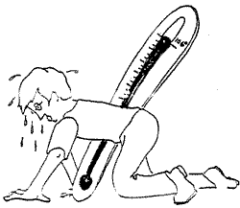
What is Heat Illness?
The body normally cools itself by sweating. During hot weather, especially with high humidity, sweating isn't enough. Body temperature can rise to dangerous levels if precautions are not taken. Heat illnesses range from heat rash and heat cramps to heat exhaustion and heat stroke. Heat stroke can result in death and requires immediate medical attention

Slide 5
OSHA Standards
General Industry 29 CFR 1910 highlights OSHA standards, Federal Registers (rules, proposed rules, and notices), and standard interpretations (official letters of interpretation of the standards) related to heat stress.
29 CFR 1910.132 (d) mandates the employer to perform a hazard assessment of the workplace to determine if the use of PPE is necessitated; select and mandate employee use of the necessary PPE; communicate selection of PPE decisions to employees; and select PPE that properly fits the employees.
OSHA requires the use of personal protective equipment (PPE) to reduce employee exposure to hazards when engineering and administrative controls are not feasible or effective in reducing these exposures to acceptable levels. Employers are required to determine if PPE should be used to protect their workers.
If PPE is to be used, a PPE program should be implemented. This program should address the hazards present; the selection, maintenance, and use of PPE; the training of employees; and monitoring of the program to ensure its ongoing effectiveness. PPE is addressed in specific standards for the general industry, shipyard employment, marine terminals, and longshoring.
Twenty-five states, Puerto Rico and the Virgin Islands have OSHA-Approved State Plans and have adopted their own standards and enforcement policies. For the most part, these States adopt standards that are identical to Federal OSHA. However, some States have adopted different standards applicable to this topic or may have different enforcement policies.

Slide 6
The General Duty Clause
The General Duty Clause describes the employer's obligation to "furnish to each of his employees employment and a place of employment which are free from recognized hazards that are causing or are likely to cause death or serious physical harm to his employees." This clause from the OSH Act is utilized to cite serious hazards where no specific OSHA standard exists to address the hazard, as is the case with ergonomic stressors.
When OSHA uses the General Duty Clause to cite an employer, OSHA must demonstrate that:
1) The employer failed to keep the workplace free of a hazard to which employees were exposed.
2) The hazard was causing or likely to cause death or serious physical harm.
3) The hazard was recognized.
4) A feasible means of abatement for that hazard exists.

Slide 7
Industries
Operations involving high air temperatures, radiant heat sources, high humidity,
direct physical contact with hot objects, or strenuous physical activities have a high potential for inducing heat stress in employees engaged in such operations. Such places include:
Iron and steel foundries
Nonferrous foundries
Brick-firing
Ceramic plants
Glass products facilities
Rubber products factories
Electrical utilities (particularly boiler rooms)
Bakeries
Confectioneries
Commercial kitchens
Laundries
Food canneries
Chemical plants
Mining sites
Smelters
Steam tunnels

Slide 8
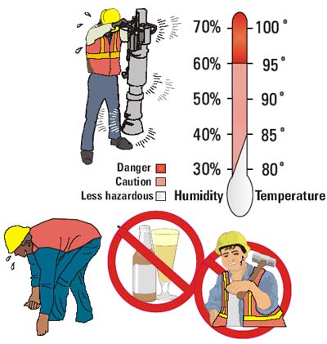
Who is affected?
Workers exposed to hot and humid conditions are at risk of heat illness, particularly those doing heavy work tasks or using bulky protective clothing and equipment. Some workers might be at greater risk than others if they have not built up a tolerance to hot conditions.

Slide 9
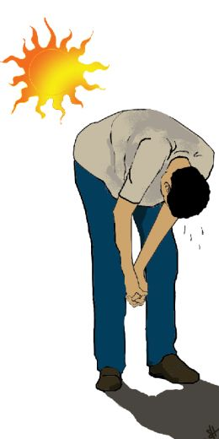
Why is it important to prevent heat illness?
Heat illness can be a matter of life and death.
The frequency of accidents in general appears to be higher in hot environments than in more moderate temperatures.
Heat tends to promote accidents that occur because of sweaty palms, dizziness, or the fogging of safety glasses.
Employees can get burned from accidental contact with hot materials such as steam or metal surfaces.
When heat stroke doesn’t kill immediately, it can shut down major body organs causing acute heart, liver, kidney and muscle damage, nervous system problems, and blood disorders.
Having a serious injury or death occur at work affects everyone at a worksite.
Workers suffering from heat exhaustion are at greater risk for accidents, since they are less alert and can be confused.
Mental confusion, tiredness, and irritability may occur when an employee becomes overheated.

Slide 10
Facts & Statistics
Heat is the leading weather-related killer, ending more lives than do hurricanes, floods, tornadoes, and lightning combined.
Extreme hot weather strains the heart and lungs, causing heart attacks, strokes and respiratory disease in vulnerable individuals.
There were about 3,400 total deaths between 1999 and 2003.
EPA simulations estimate that heat-related deaths could increase by 3,500 to 27,000 deaths per year by mid-century.

Slide 11


Slide 12
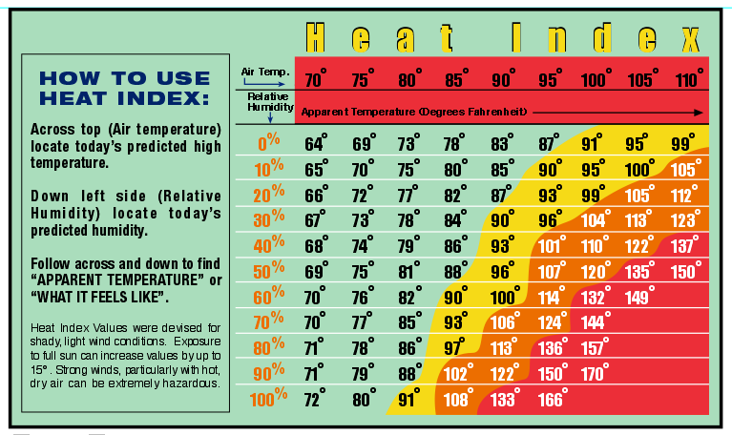

Slide 13
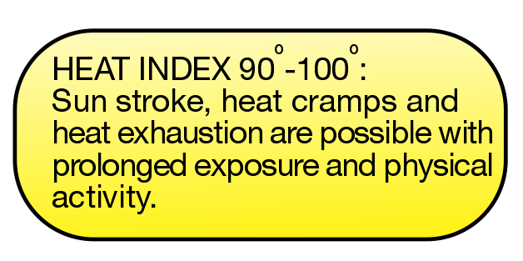

Slide 14
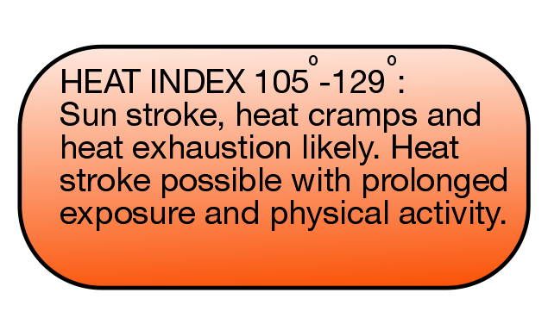

Slide 15
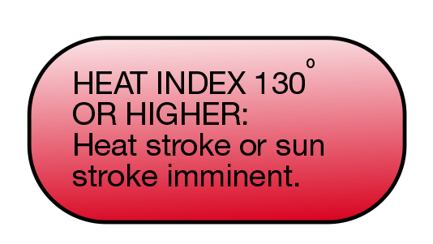

Slide 16
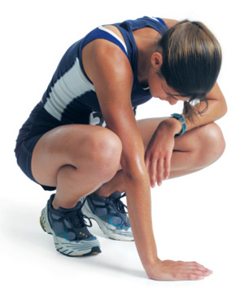
Excessive exposure to a hot environment can bring about a variety of heat-related health problems and illnesses
Heat Cramps
Fainting
Heat Rash
Heat Exhaustion

Slide 17
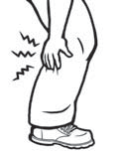
Heat Cramps
Heat cramps may occur alone or simultaneously with other heat-related illnesses. Heat cramps are painful muscle spasms caused by sweating while performing hard physical labor in a hot environment. The cramps may be caused by either too much or too little salt. Tired muscles are very susceptible to heat cramps.

Slide 18
Fainting
Fainting may occur when an employee who is not used to the heat stands in one position for an extended period of time. An employee who has fainted should recover after a brief period of sitting or lying down. Moving around, rather than standing still, will reduce the possibility of fainting.

Slide 19
Heat Rash
Heat Rash (also known as prickly heat) often occurs in hot, humid environments where sweat does not easily evaporate from the skin. The sweat ducts become clogged, resulting in a rash. Heat rash can be very uncomfortable if the rash is extensive or complicated by infection. Taking frequent breaks in a cool place during the work day and bathing and drying the skin regularly can help prevent heat rash.

Slide 20
Heat Exhaustion
Heat Exhaustion is caused by the loss of large amounts of fluid by sweating, sometimes with excessive loss of salt. An employee suffering from heat exhaustion still sweats but may experience the signs and symptoms listed below:
• headache
• dizziness
• weakness
• mood changes (confused or irritable)
• feeling sick to stomach
• vomiting
• decreased and dark-colored urine
• light-headedness or fainting
• pale clammy skin

Slide 21
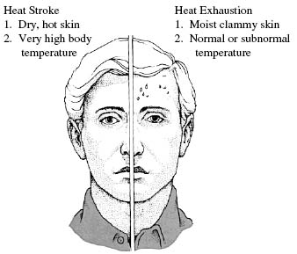
Signs & Symptoms of Heat Stroke & Heat Exhaustion

Slide 22
Heat Cramps
Heavy sweating drains the body of salt, which cannot be replaced by simply drinking water. Painful cramps occur in the arms, legs, or stomach while on the job, or later at home. Move to a cool area at once if cramping is experienced. Loosen clothing and drink cool, lightly-salted water or a commercial fluid replacement beverage. Seek medical aid if the cramps are severe, or don't go away.

Slide 23
Heat Exhaustion
Insufficient water and salt intake causes the body's cooling structure to break down.
Symptoms: Heavy sweating, cool, moist skin, body temperature over 38 degrees, weak pulse, and normal or low blood pressure.
A person is likely to be tired, weak, clumsy, upset, or confused. They will be very thirsty, and will pant or breath rapidly. Their vision may be blurred.
Get medical help immediately!

Slide 24
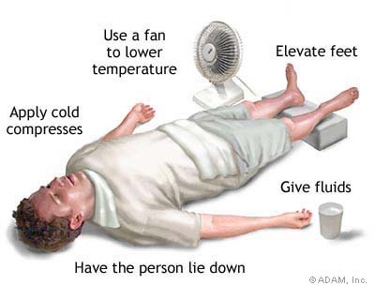
Heat Exhaustion First Aid
Move the victim to a cool place.
Keep the victim lying down with legs straight and elevated 8-12 inches.
Cool the victim by applying cold packs or wet towels or cloths. Fan the victim.
Give the victim cold water if he or she is fully conscious.
If no improvement is noted within 30 minutes, seek medical attention.

Slide 25
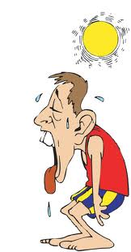
Heat stroke can kill a person quickly
Once the body uses up all its water and salt, sweating ceases. Temperature can rise quickly. You can assume a person is suffering from heat stroke if their body temperature is over 41 degrees, and any of the following symptoms are present: weakness, confusion, distress, strange behavior.
Hot, dry, red skin.
Rapid pulse.
Headache or dizziness.
In later stages of heat stroke, a victim
may pass out and have convulsions.

Slide 26
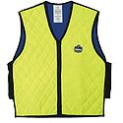
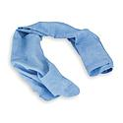
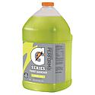
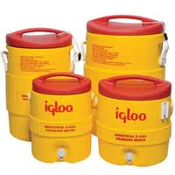
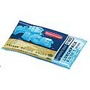
Heat Stroke First Aid
Move the victim to a cool place. Remove heavy clothing; light clothing can be left in place.
Immediately cool the victim by any available means. Such as placing ice packs at areas with abundant blood supply (neck, armpits, and groin). Wet towels or sheets are also effective. The cloths should be kept wet with cool water.
To prevent hypothermia continue cooling the victim until their temperature drops to 102 degrees Fahrenheit.
Keep the victim's head and shoulders slightly elevated.
Seek medical attention immediately. All heat stroke victims need hospitalization.
Care for seizures if they occur.
Do not use aspirin or acetaminophen.

Slide 27
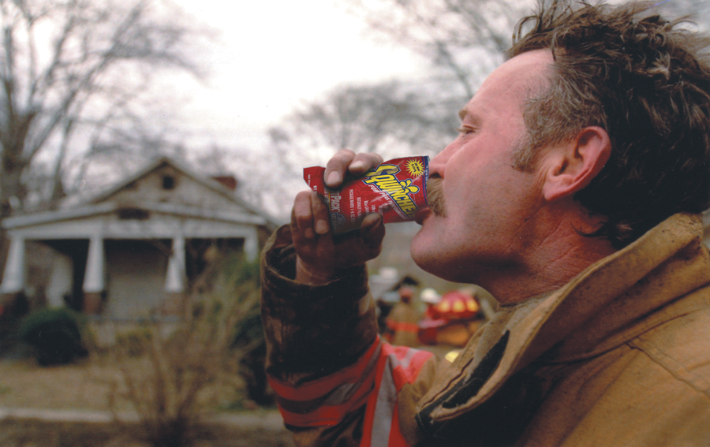
How To Keep Working Muscles Working When The Heat Is On

Slide 28
The Effect of Fluid Loss On Performance
2% - Impaired Performance
4% - Capacity for muscular work declines
6% - Heat Exhaustion
8% - Hallucination
10% - Circulatory collapse and heat stroke

Slide 29
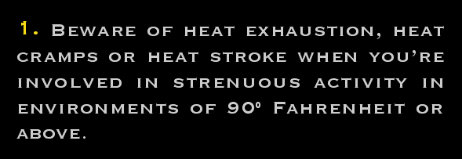
How To Keep Working Muscles Working When The Heat Is On

Slide 30
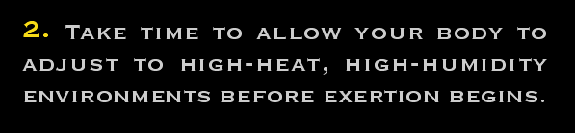
How To Keep Working Muscles Working When The Heat Is On

Slide 31
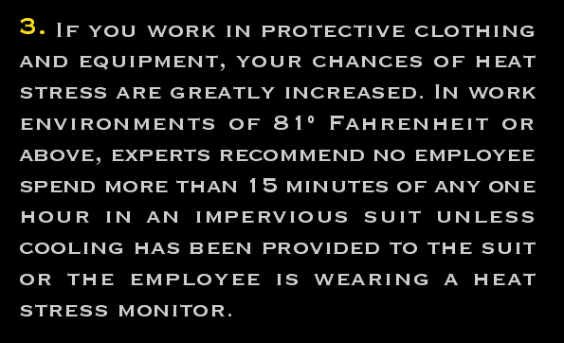
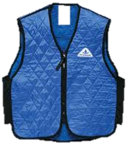
How To Keep Working Muscles Working When The Heat Is On

Slide 32
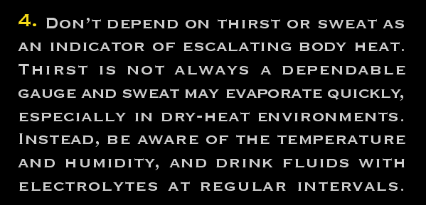
How To Keep Working Muscles Working When The Heat Is On

Slide 33
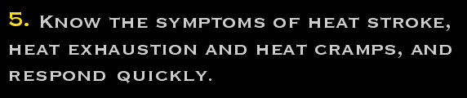
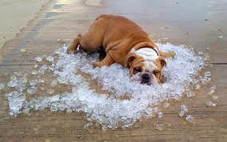
How To Keep Working Muscles Working When The Heat Is On

Slide 34
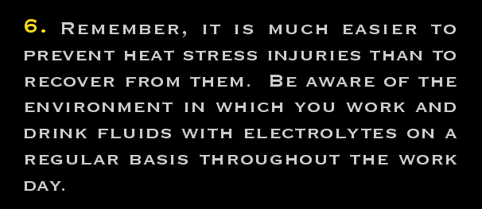
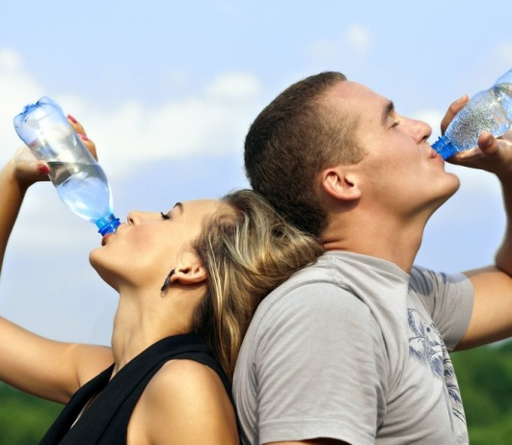
How To Keep Working Muscles Working When The Heat Is On

Slide 35

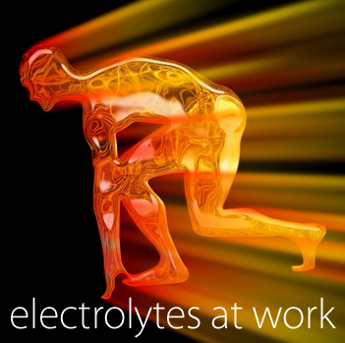
Electrolytes

Slide 36
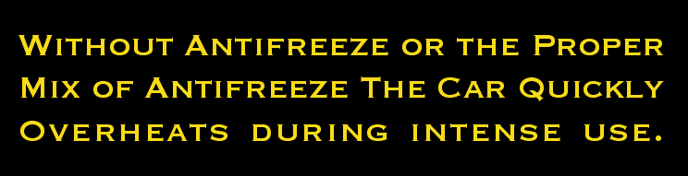

Electrolytes

Slide 37
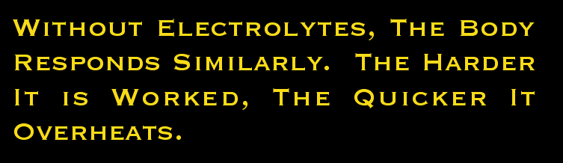

Electrolytes

Slide 38
Do’s & Don’ts
DO
DON’T
Drink plenty of water.
Take breaks in a cool, shady area.
Watch for symptoms of a heat stress, both in yourself and co-workers
Ignore symptoms of heat stress.
Try to get a suntan while working.
Try to "keep up" with the rest of the crew, even though you feel ill.

Slide 39
Heat Illness can be Prevented!
Remember three simple words: WATER, REST, SHADE.
Drink water often
Rest in the Shade
Take breaks
Limit time in the heat

Slide 40
Questions?

Slide 41
THANK YOU!

