Slide 1
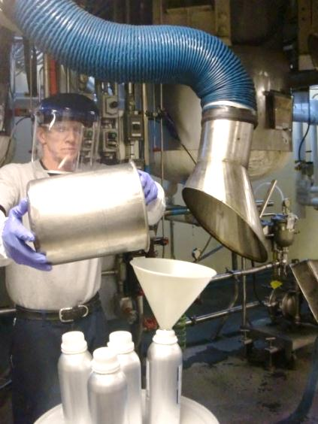
Recognition and Control of Respiratory Hazards in the Flavoring Industry
Training Developed by:
Photo by National Jewish Health used with written permission.
Notes:
Welcome to our training on recognition and control of respiratory hazards in the flavoring industry. This training was developed specifically for the flavoring industry by National Jewish Health in Denver, Colorado. Funding for these training materials was provided by a grant from the U.S. Department of Labor, OSHA, under the Susan Harwood Targeted Topic Training Grant Program.

Slide 2
Disclaimers
This presentation was produced under grant number SH-22304-11-60-F-8 from the Occupational Safety and Health Administration, U.S. Department of Labor. It does not necessarily reflect the views or policies of the U.S. Department of Labor, nor does mention of trade names, commercial products, or organizations imply endorsement by the U.S. Government.
Notes:
This presentation was produced under grant number SH223041160F8 from the Occupational Safety and Health Administration, U.S. Department of Labor. It does not necessarily reflect the views or policies of the U.S. Department of Labor, nor does mention of trade names, commercial products or organizations imply endorsement by the U.S. government.

Slide 3
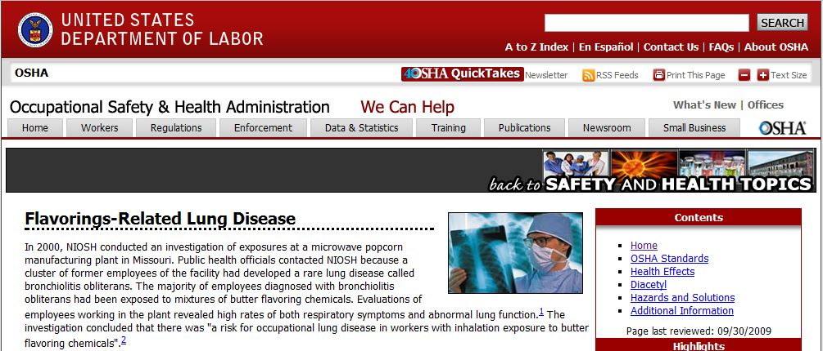
Why are we here?
http://www.osha.gov/SLTC/flavoringlung/index.html accessed 3/28/2012
Provide information to workers:
Signs and symptoms of potential flavor-related lung disease
Ways to detect lung disease that may be related to flavoring exposure
Methods to reduce exposure to flavorings associated with lung disease
Notes:
You may wonder why we’re providing training on this topic. OSHA is very interested in flavorings. In fact, they have dedicated an entire web page to flavorings-related lung disease. So we’re here to provide information to workers about the signs and symptoms of potential flavoring-related lung disease, ways to detect lung disease that may be related to flavoring exposure, and methods to reduce exposure to flavorings associated with lung disease.

Slide 4
Outline
Introduction to OSHA
Overview of flavoring exposures
Health effects of flavorings
Medical surveillance (testing) for possible flavoring-related health effects
Recognizing and controlling flavoring exposures
Notes:
This outline will discuss how we’re going to proceed with the training today. Since this training was funded by OSHA, we’ll start with a brief introduction to OSHA. Next, we’ll go over an overview of flavoring exposures. Then, we’ll take a look at health effects of flavorings. We will also cover medical surveillance which is a special type of medical testing for possible flavoring-related health effects. And lastly, we’ll cover recognizing and controlling flavoring-related exposures.

Slide 5
Definitions
Part per million (ppm)
Small unit of concentration
1 ppm = 1 drop in 13 gallon gas tank
Flavoring exposure
Inhalation of flavoring vapors or particles
Bronchiolitis Obliterans Syndrome (BOS)
An uncommon lung disease where scars form in the small airways
Notes:
Before we start with our training today, we need to cover a few definitions that are important to our training. We are first going to talk about a part per million. When we’re talking about parts per million, you can think of that like a percentage but a whole lot smaller. It’s a very small unit of concentration. One part per million is like one drop in a 13 gallon gas tank, which is not very much at all. When we talk about flavoring exposures, we’re talking about the inhalation of flavoring vapors or particles; like the stuff you smell out there when you’re working. When we talk about bronchiolitis obliterans syndrome or BOS, it’s an uncommon lung disease where scars form in the small airways.

Slide 6
Introduction to OSHA Training Goals
Understand the role of OSHA in occupational safety and health
Describe employer responsibilities and employee rights provided by OSHA
Understand specific OSHA and industry standards for handling flavorings
Notes:
In this section of the training, we’re going to cover an introduction to OSHA. We have training goals for this section, and these are: to understand the role of OSHA in occupational safety and health, to describe employer responsibilities and employee rights provided by OSHA, and to understand specific OSHA and industry standards for handling flavorings.

Slide 7
What is OSHA?
Occupational Safety and Health Administration
Government agency within the U.S. Department of Labor
Responsible for worker safety and health protection
Created in 1970 by the Occupational Safety and Health (OSH) Act
OSH Act allows states to take responsibility for implementing OSH Act providing their regulations are at least as stringent as Federal OSHA
Notes:
I’m sure most of you have already heard of OSHA. OSHA is the Occupational Safety and Health Administration. It’s a government agency within the U.S. Department of Labor. OSHA is responsible for worker safety and health protection. It was created in 1970 by the Occupational Safety and Health Act or OSH Act. The OSHA Act allows states to take responsibility for implementing the OSH Act, providing their regulations are at least as stringent as federal OSHA. Examples of states that have their own OSHA rules are California, Michigan, and Maryland.

Slide 8
What does OSHA do?
Requires employers to implement programs to reduce workplace safety and health hazards
Investigates workplace fatalities or catastrophic accidents
Enforces safety and health standards through workplace inspections by compliance officers
Monitors job-related injuries and illnesses through required record-keeping
Provides assistance, training, and other support programs to help employers and workers
Notes:
So what does OSHA do? Well they require employers to implement programs to reduce workplace safety and health hazards. They investigate workplace fatalities or catastrophic accidents. OSHA enforces safety and health standards through workplace inspections by compliance officers, and they monitor job-related injuries and illnesses through required record-keeping. They also provide assistance, training and other support programs to help employers and workers, like this training program that we’re providing you today.

Slide 9
What are employers’ responsibilities under OSHA?
Provide employment and a workplace that is:
In compliance with established OSHA standards.
Free from recognized hazards that are causing or are likely to cause death or serious physical harm to employees.
Notes:
Now we’re going to cover what the employers’ responsibilities are under OSHA. They have two responsibilities: 1) to provide employment in a workplace that is in compliance with the established OSHA standards, 2) to provide a workplace that is free from recognized hazards that are causing or are likely to cause death or serious physical harm to employees. The bottom line is that employers are required to provide a safe workplace for the employees

Slide 10
What are employees’ rights under OSHA?
Get training from your employer as required by OSHA standards
Request information from your employer about OSHA standards, worker injuries/illnesses, and job hazards
Request action from your employer to correct hazards or violations of OSHA standards
File a complaint with OSHA if you believe there are violations of OSHA standards or serious hazards
Must be submitted in writing, signed by a current employee or employee representative, and state the reason for the inspection request
Forms and more information available at www.osha.gov
Notes:
You may ask what are your rights under OSHA as an employee? You have the right to get training from your employer as required by the OSHA standards. You also have the right to request information from your employer about OSHA standards, worker injuries, illnesses, and job hazards. In addition, you can request action from your employer to correct hazards or violations of OSHA standards. You have a right to file a complaint with OSHA if you believe there are violations of OSHA standards, or serious hazards. This complaint must be submitted in writing, signed by a current employee, or an employee representative, and state the reason for the inspection request. Forms and more information on how to do this are available at www.osha.gov. This website has a lot of information on filing complaints if someone needs this information.

Slide 11
What are employees’ rights under OSHA?
Be involved in OSHA’s inspection of your workplace
Find out results of an OSHA inspection
Get involved in meetings or file a formal appeal concerning your employer’s timely abatement of OSHA citations
File a discrimination complaint
Request a research investigation by the National Institute for Occupational Safety and Health (NIOSH)
Provide comments and testimony to OSHA during rulemaking on new standards
Notes:
Other rights you have as an employee under OSHA are to be involved in OSHA’s inspection of your workplace, find out results of an OSHA inspection, get involved in meetings or file a formal appeal concerning your employers’ timely abatement of OSHA citations, and to file a discrimination complaint. You can also request a research investigation by the National Institute for Occupational Safety and Health, or NIOSH. And lastly, you can provide comments and testimony to OSHA during rule-making on new standards.

Slide 12
Are there specific OSHA standards that apply to my workplace?
Recordkeeping
Housekeeping
Medical & First Aid
Walking/Work Surfaces
Emergency Action
Noise
Hazardous materials
Compressed gases
Flammable liquids
Personal protective equipment
Confined spaces
Lockout/tagout
Fire protection
Powered industrial trucks
Cranes
Machine guarding
Electrical
Respiratory protection
Exposure to toxic substances
Hazard communication
There may also be others that apply to your workplace!
Notes:
You might be wondering if there are specific OSHA standards that apply to your workplace. There is a whole list of OSHA standards on this slide and it’s not a complete list, but I’m just going to point out a few that may apply to your workplace. For example, personal protective equipment if you have to wear a respirator, gloves, or any type of protective clothing. Also, extinguishers—are your fire extinguishers in the proper places? Lock-out tag-out—is a piece of machinery locked out when something is wrong and you need to fix it? And lastly, we’re going to look at hazard communication, because you as an employee must be informed about the hazards in your workplace. This is really the focus of this training. I just want to say that there are a lot of other standards that may apply to your workplace, but these are just a few.

Slide 13
How are exposures regulated?
OSHA sets legally enforceable limits
Limits the total amount of flavoring you can inhale in a work day
Permissible Exposure Limit (PEL)
Maximum permitted 8-hour time-weighted average concentration
Short-Term Exposure Limit (STEL)
15-minute time-weighted average concentration not to be exceeded at any time during a workday
Ceiling Limit
Maximum concentration to which an employee may be exposed at any time
Makes sure that you don’t inhale too much flavoring in a short time
Protects you from immediate irritation
Notes:
You may wonder how exposures are regulated. OSHA sets legally enforceable limits, and we’re going to cover these today. The first one we’re going to talk about is the permissible exposure limit, or PEL. This is a maximum permitted 8-hour time-weighted average concentration. This limits the total amount of flavoring you can inhale in a work day. Next, we’re going to talk about a short-term exposure limit, or a STEL. This is a 15-minute time-weighted average concentration not to be exceeded at any time during a work day. This makes sure that you don’t inhale too much of a flavoring in a short period of time. And, lastly we’re going to talk about a ceiling limit. This is a maximum concentration to which an employee may be exposed at any time. And this is to protect you from immediate irritation. The most important one to remember today is the permissible exposure limit, or the PEL.

Slide 14
Does OSHA have a standard for diacetyl?
OSHA – No PEL or Federal OSHA Standard
Currently working on developing a standard
CalOSHA (2010), No PEL
Exposure monitoring for airborne diacetyl
Regulated areas for all diacetyl processes
Controls to reduce exposures to lowest feasible levels
Medical surveillance (every 6 months) for workers
Respirators for workers
At all times when working with diacetyl-containing powders
When there are measurable diacetyl levels
8-hour exposures are greater than 0.012 ppm
15-minute exposures are greater than 0.035 ppm
Notes:
You may wonder if OSHA has a standard for diacetyl. Currently, there is no PEL or “pel” or federal OSHA standard for diacetyl. OSHA’s currently working on developing a standard, but it’s not complete at this point. CalOSHA has a diacetyl standard, but they have no PEL. In their standard, CalOSHA requires employers to do several things: 1) exposure monitoring for airborne diacetyl, 2) have regulated areas for all diacetyl processes, 3) have controls to reduce exposures to the lowest feasible levels, 4) and they have to perform medical surveillance every six months for workers. In addition, respirators are required for workers at all times when they’re working with diacetyl-containing powders or when there are measureable diacetyl levels which are defined as 8-hour exposures greater than 0.012 parts per million, and 15 minute exposures that are greater than 0.035 parts per million.

Slide 15
Are there other groups that recommend exposure levels for diacetyl and substitutes?
Agency or Organization | 8-hour Limit (ppm) | 15-min Limit (ppm)
NIOSH (2011, Draft) | 0.005 | 0.025
ACGIH (2012) | 0.01 | 0.02
TERA (2010) | 0.2 | N/A
NIOSH (2011, Draft) | 0.009 | 0.031
Diacetyl
2,3-Pentanedione
NIOSH=National Institute for Occupational Safety and Health
ACGIH=American Conference of Governmental Industrial Hygienists
TERA=Toxicology Excellence for Risk Assessment
We don’t know which of these recommendations will be effective.
Best approach is to reduce exposures as low as possible using these numbers to measure progress.
Notes:
You may wonder if there are other groups that recommend exposure levels for diacetyl and diacetyl substitutes. In 2011, NIOSH recommended an 8-hour limit of 0.005 parts per million for diacetyl. This year in 2012, ACGIH, the American Conference of Governmental Industrial Hygienists, adopted an 8-hour limit of 0.01 parts per million. In 2010 TERA, the Toxicology Excellence for Risk Assessment group proposed a level of 0.2 parts per million. For the substitutes like 2,3-pentanedione, in 2011, NIOSH developed a level of 0.009 parts per million. The point is we really don’t know which of these recommendations will be effective, so the best approach is to reduce exposures to as low as possible using these numbers to measure progress. We recommend using the ACGIH limit as an industry best practice standard until a more formal standard is adopted. Also, you’ll notice that that 0.01 ppm for diacetyl is very similar to the 0.009 ppm for the 2,3-pentanedione developed by NIOSH. Throughout this training today, I want you to remember 0.01 ppm as the exposure limit that we’re going to compare everything to.

Slide 16
Are there OSHA standards for other flavorings?
Chemical | OSHA PEL 8-hour (ppm) | ACGIH TLV 8-hour/STEL (ppm) | CalOSHA PEL 8-hour/STEL (ppm)
Acetaldehyde | 200 | 25 (c) | 25 (c)
Acetic Acid | 10 | 10/15 | 10/15 & 40 (c)
Formic Acid | 5 | 5/10 | 5/10
Furfural | 5 | 2 | 2
Phosphoric acid | 0.25 | 0.25/0.75 | 0.25
Propionic acid | N/A | 10 | 10
Sulfur dioxide | 5 | N/A/0.25 | 2/5
> 2,000 individual flavorings and < 100 with exposure limits
Notes:
You may also wonder if there are other OSHA standards for other flavorings. There are OSHA standards for chemicals such as acetaldehyde, acetic acid, formic acid, furfural, and sulfur dioxide. There may also be OSHA PELs for other chemicals that you use in the flavoring industry, but notice as we take a look at the OSHA permissible exposure limits or PELs for 8 hour average exposures, we see that the exposure levels are a lot higher for these chemicals as compared to diacetyl. Looking at 200 ppm for acetaldehyde, 10 ppm for acetic acid, and 5 ppm for formic acid—we compare that to 0.01 ppm that we were talking about in the previous slide for diacetyl exposures. These limits are set a lot higher, and important for work with high quantities of these materials. However, for normal work in flavoring facilities, our biggest concern is really diacetyl since you can have an exposure exceeding the 0.01 ppm exposure limit with very small quantities. It is also important to realize that there are more than 2,000 individual flavorings, and less than 100 of these flavorings have exposure limits.

Slide 17
Overview of Flavoring Exposures Training Goals
Understand that some flavorings may cause lung injury under some conditions
Know where to find a listing of flavorings that may cause lung injury
Notes:
For this next part, we’re going to give you an overview of flavoring exposures. Our training goals for this section are to understand that some flavorings may cause lung injury under some conditions, and to know where to find a listing of flavorings that may cause lung injury.

Slide 18
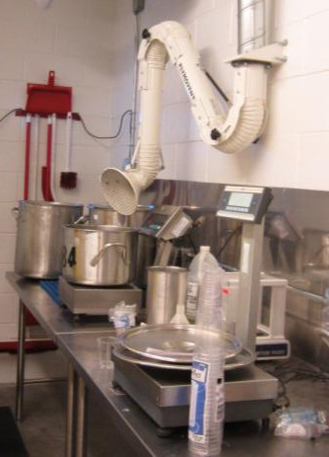
Why are exposures hard to predict in flavoring manufacturing?
More than 2,000 flavorings
Some have irritant properties
Small number have exposure limits
Many with not enough information to determine whether they are a respiratory health hazard
Exposures to different forms
Pure flavorings
Concentrated liquid and powder mixtures
Low concentration final products
Multiple processes
Mixing, heating, packaging, etc.
Batch processes
Volumes vary
Daily and seasonal variability
Photo used by National Jewish Health with written permission.
Not much information on possible hazards from breathing flavorings.
Notes:
So why are exposures hard to predict in flavoring manufacturing? Like we said before, there are more than 2,000 flavorings. Some have irritant properties that cause you to cough or cause burning in your nose or throat. Others, like diacetyl don’t cause irritation. A small number of flavorings have exposure limits. For many other flavorings, we don’t have enough information to determine whether or not they are a respiratory health hazard. Working in the flavoring industry, you have exposures to different forms of these flavorings including pure or neat flavorings, concentrated liquid and powder mixtures, and low concentration final products. You also have multiple processes, like mixing, heating, and packaging, each of which likely have very different exposures even when using the same flavorings. Finally, since most of your work involves batch processes—with production volumes and finished flavorings varying both day-to-day, and by season, exposures can be very different on any given day. As you listen to the presentation today, it is very important to remember that there has been only limited research on hazards from breathing flavorings, most of it on diacetyl.

Slide 19
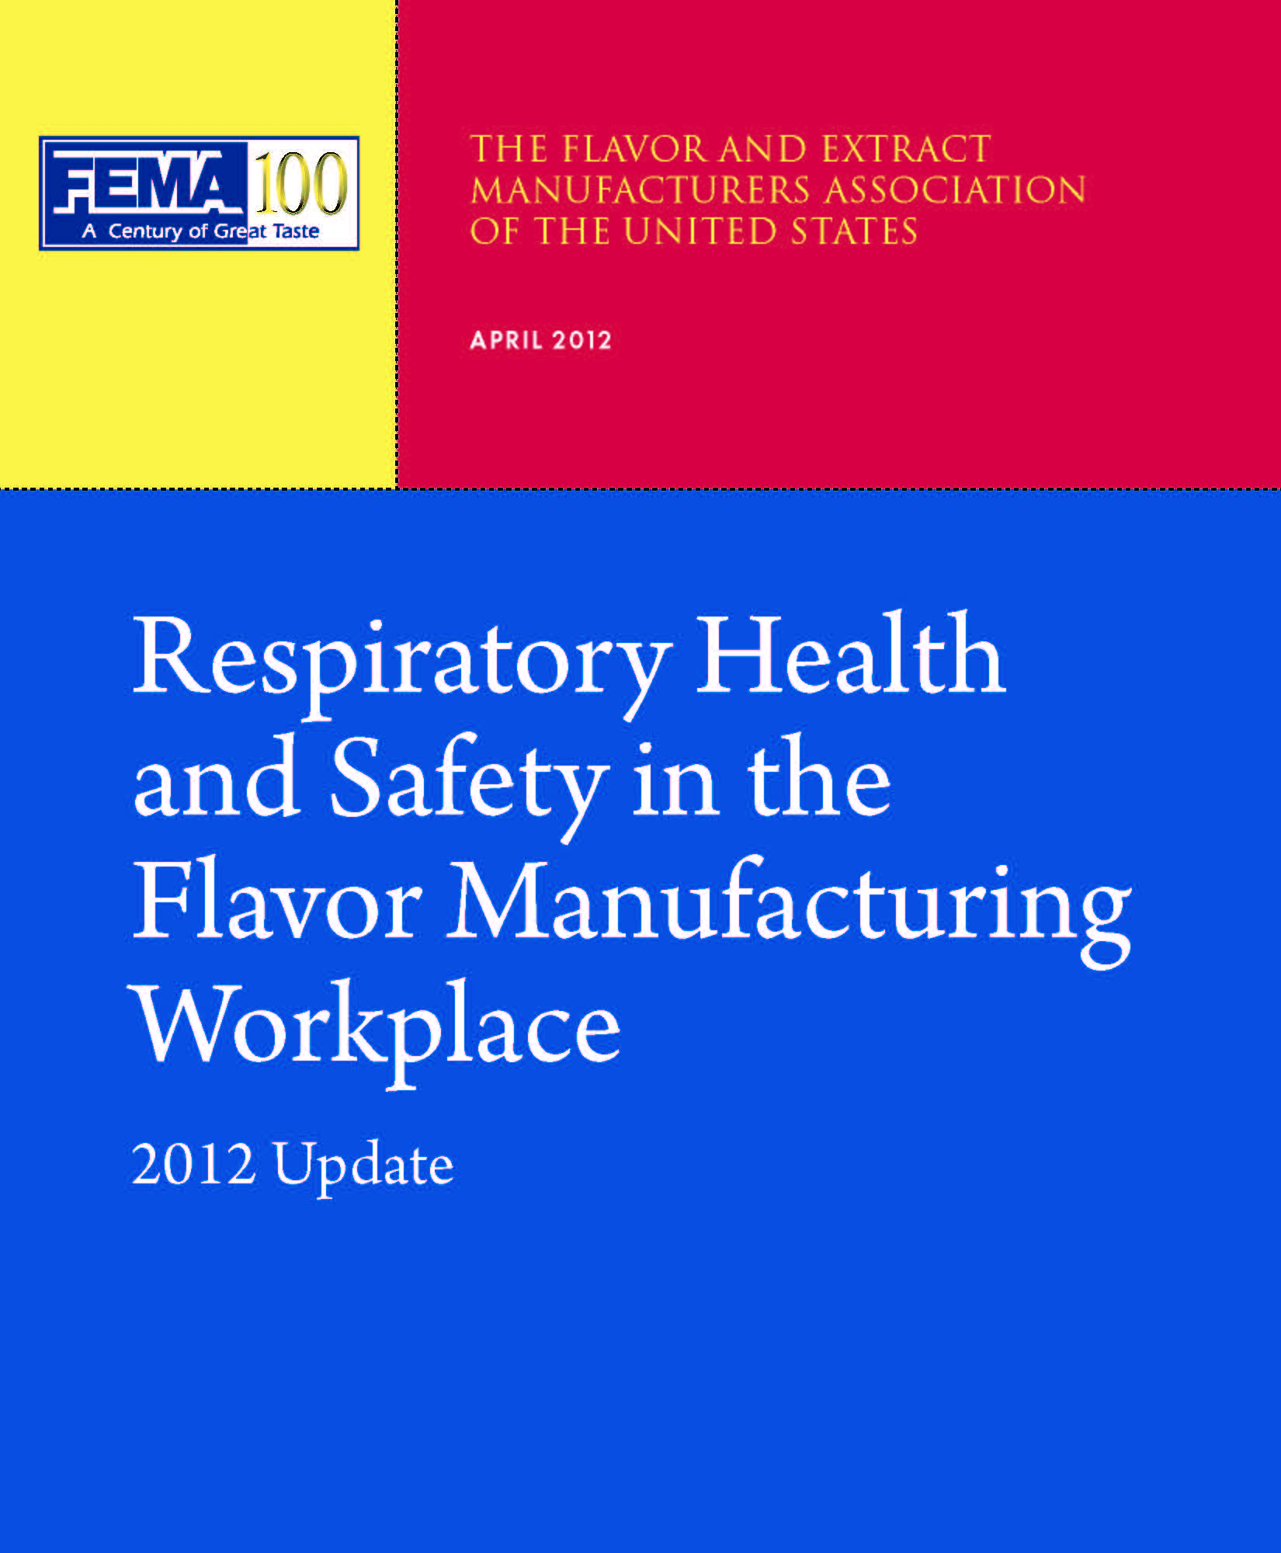
Is there a list of flavorings that might be hazardous when inhaled?
The Flavor and Extract Manufacturers Association (FEMA) has a list of “High Priority” flavorings
“High Priority” flavorings may cause respiratory injury when:
Exposure levels are high
Repeated exposures at lower levels
Processed using heat
Processed without proper exposure controls
Image by the Flavor and Extract Manufacturers Association
Used with written permission
“High Priority” flavorings should be labeled to alert workers that they require careful handling.
Notes:
So you might want to know if there is a list of flavorings that might be hazardous when inhaled. The Flavor and Extract Manufacturers Association or FEMA has a list of High Priority flavorings. They define High Priority flavorings as flavorings that may cause respiratory injury when: exposure levels are high, with repeated exposures at lower levels, and when flavorings are processed using heat, when they’re processed without proper exposure controls. These High Priority flavorings should be labeled to alert workers that they require careful handling. This list covers most of the major exposures at flavoring facilities. However, it is important to realize that this list is not comprehensive and each flavoring company should use other sources of information to determine if flavorings not listed may be a respiratory hazard.

Slide 20
What are the “High Priority” flavorings?
Diacetyl & Substitutes
Acetoin
Diacetyl
Diacetyl Trimer
2,3-Heptanedione
2,3-Hexanedione
3,4-Hexanedione
2,3-Pentanedione
FEMA LISTED
HIGH PRIORITY
MATERIAL
FOLLOW APPROPRIATE ENGINEERING AND PROCEDURAL CONTROLS TO MINIMIZE EXPOSURE
Other Flavorings
Acetaldehyde
Acetic Acid
Benzaldehyde
Butyric Acid
Ethyl Acrylate
Formic Acid
Furfural
Hydrogen Sulfide
Isobutyraldehyde
Isobutryic Acid
Methyl Mercaptan
Methyl Sulfide
2,4-Pentadienal
2-Pentenal
Phosphoric Acid
Propionaldehyde
Propionic Acid
Sulfur Dioxide
Triethylamine
Valeraldehyde
Figure by National Jewish Health
These flavorings may cause respiratory injury when not handled properly.
Notes:
What are the FEMA High Priority flavorings? There is a list of 27 different flavorings, at the top you have a list of diacetyl and diacetyl substitutes. That makes up seven of the 27 flavorings, examples are: acetoin, diacetyl, and some of the substitutes like diacetyl trimers, 2,3-heptanedione, 2,3-hexanedione. The other 20 flavorings are things like acetic acid, acetaldehyde, formic acid and several other flavorings. It is extremely important that you watch out for these flavoring chemicals and make sure that you use proper exposure controls when working with them. These flavorings may cause respiratory injury when not properly handled.

Slide 21

What about natural flavoring complexes?
Capsaicin
Oils
Balsam fir
Bitter almond
Garlic
Grapefruit
Lemon
Lime
Mustard
Onion
Orange
Photo by Scott Bauer available under public domain from Wikimedia Commons
Natural flavoring complexes may also cause irritation and respiratory symptoms when not handled properly.
Notes:
What about natural flavoring complexes? Things like capsaicin and some of the different oils like balsam fir, bitter almond, garlic, grapefruit, lemon, lime, mustard, onion, or orange. These natural flavoring complexes may also cause irritation and respiratory symptoms when they are not handled properly. However, unlike diacetyl, most of these have warning properties like nose or throat irritation that alert workers to reduce their exposure.

Slide 22
Health Effects and Medical Surveillance Training Objectives
Learn about respiratory health effects
Learn methods to detect possible flavoring-related health effects
Understand the importance of medical surveillance
22
Notes:
22
22
The training objectives of this section on health effects and medical surveillance are to 1) learn about respiratory health effects, 2) learn methods to detect possible flavorings-related health effects and 3) understand the importance of medical surveillance.

Slide 23
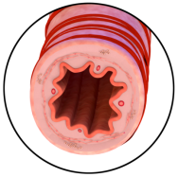
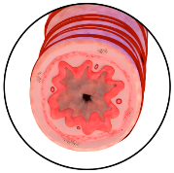
Definitions
Normal Airway
Airways
The tubes that carry air into and out of
your lungs
Airway Disease
Airways become narrowed.
Causes slowing of the flow of air into
and out of your lungs
Bronchiolitis Obliterans Syndrome (BOS)
Airway disease in small airways in the lungs
Injury from a chemical or infection
Scars form, causing airways to narrow.
Associated with exposure to diacetyl
Possibly diacetyl substitutes
Image by National Jewish Health
Narrow Airway
Permanent
Scarring
Image by National Jewish Health
Notes:
We will start with some definitions. The airways are tubes that carry air into and out of your lungs. At the top right of the slide is a diagram of normal airway. It has a large hollow opening to allow for the flow of air. Note that the airway walls contain muscles, which will be discussed in the section on asthma. In airway disease, the airways become narrowed. This narrowing causes a slowing of the flow of air into and out of your lungs. Bronchiolitis Obliterans Syndrome, abbreviated BOS, is a rare type of airway disease in the small airways in the lungs. It can be caused by injury from a chemical or from an infection. After injury, scars form causing the airways to narrow. One of the chemical causes of injury that leads to BOS is diacetyl, and there is increasing evidence this may be true for at least some of the diacetyl substitutes as well. The diagram on the lower right shows an airway that has been narrowed due to scarring.

Slide 24
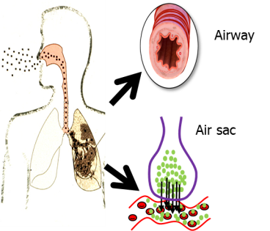
Respiratory Health Effects
Irritation
Eyes, nose, throat
Chest
Skin irritation (high exposure)
Airway diseases
Bronchiolitis Obliterans Syndrome (BOS)
Asthma
Allergies
Allergic reactions
Asthma
Diagram of a Normal Lung
Image by National Jewish Health
Air travels through the small airways to the air sacs and into the blood stream.
24
Notes:
24
24
To better understand respiratory health effects, we will first review how the lungs work. Normal lungs and airways are shown in the diagram on the right. You breathe air in through your nose and mouth. The air travels down through the throat, through the windpipe (trachea) and down into the airways in the lungs. The airways get smaller and smaller before they finally end in the air sacs (alveoli). The airway diseases we are discussing affect these smaller airways deep in the lungs. From the air sacs, the air travels into the blood stream to be carried where it is needed throughout the body. The three major categories of respiratory health effects that may be seen with flavorings are 1) irritation, 2) airway disease and 3) allergy. Airway irritation is common. You most often feel irritation in the eyes, nose, and throat. With higher exposure, you can feel irritation in the chest. With even higher exposure, you may even feel some irritation on the skin. The airway diseases that we will talk about in detail are BOS and asthma. Allergies will be discussed briefly.

Slide 25
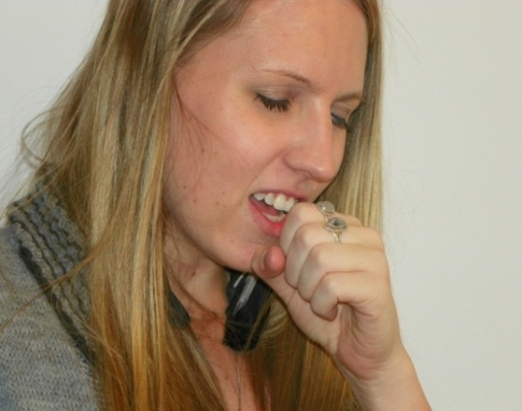
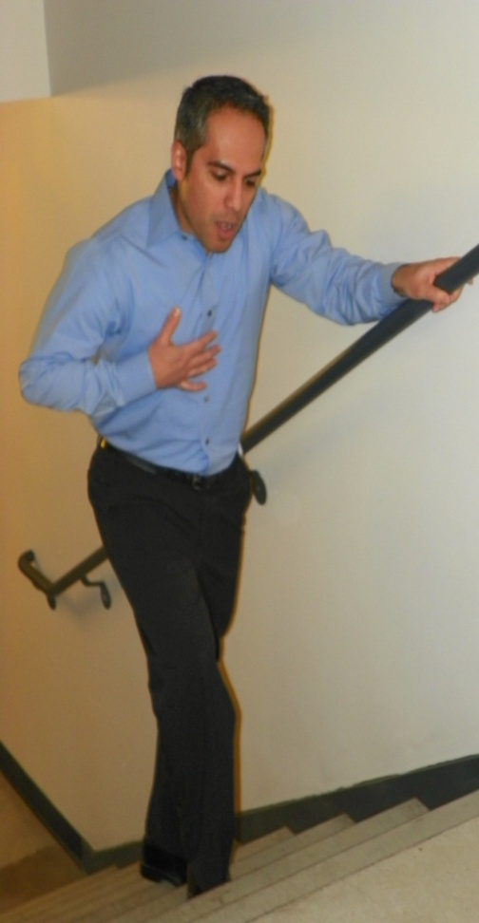
Airway irritation and airway diseases cause breathing symptoms.
Cough
Dry cough
Cough with phlegm
Wheeze
Chest tightness
Shortness of breath
Photo by National Jewish Health
Photo by National Jewish Health
There are many causes of breathing symptoms.
25
Notes:
25
25
Both airway irritation and airway disease cause breathing symptoms. Breathing symptoms are 1) cough, either a dry cough or a cough with phlegm, 2) wheeze, 3) chest tightness, or whistling in the chest, and 4) shortness of breath. There are many different causes of breathing symptoms.

Slide 26

A medical evaluation is needed to know the cause of the symptoms.
Colds and other infections
Cigarette smoking
Airway Irritation
Asthma
Bronchiolitis Obliterans Syndrome (BOS)
Allergies
Other lung diseases
Chronic obstructive pulmonary disease
Photo by National Jewish Health
26
Notes:
26
26
Common causes of breathing symptoms include colds and other respiratory infections, cigarette smoking, as well as the three health effects that we are discussing today: airway irritation; the airway diseases asthma and BOS, and allergies; environmental allergies such as hayfever; and other lung diseases such as chronic obstructive pulmonary disease (COPD). COPD is a common disease in smokers. However, the medical tests for COPD show similar results to BOS from flavoring chemicals. A medical evaluation is often needed to know the cause of the breathing symptoms, and it is important that you tell your doctor about your exposure to flavorings if you develop breathing symptoms.

Slide 27
It is important to find BOS early!
This is the true story of one worker
29 years old with no lung problems. He never smoked.
He worked for 2 years as a flavor compounder.
When he used a respirator, his beard prevented a good fit.
He began to have breathing symptoms.
He was treated for bronchitis.
His symptoms continued to worsen.
He had to stop working.
He saw a doctor who knew about flavorings and BOS.
He already had severe airway disease (BOS).
He was not able to work or do many other things again.
If his BOS had been diagnosed earlier, the ending to the story might have been different.
27
Notes:
27
It is important to diagnose BOS early! This is the true story of a worker who had BOS that was found too late. He was 29 years old. He had no lung problems and he never smoked. He worked for 2 years as a flavor compounder. He did not often use a respirator, and when he did his beard prevented a good seal on his face. He started to have breathing symptoms. The symptoms were mild at first. He saw his doctor and was treated for bronchitis. This did not help. His symptoms got worse and worse. They got so bad that he had to stop working. At that time he saw a doctor who knew about flavorings and BOS, and he was diagnosed with BOS. But he already had severe disease. Because there is no treatment for BOS, there was nothing that could be done to make his breathing better. He was not able to work or do many other things that he liked to do again, like play ball with his children. If his disease had been diagnosed early when his symptoms were mild, he would have still been able to do a lot more things.

Slide 28
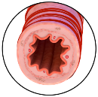

Flavorings can cause irritation and injury.
Usually, there is only irritation
Burning in the throat, nose, and eyes
Burning in the chest, cough, and chest tightening
Symptoms get better away from exposure
Airway injury can occur
High levels of exposure
Very irritating flavorings
Normal Airway
Figure by National Jewish Health
Photo by Cliff Hutson available under public domain from Wikimedia Commons
Not all “High Priority” flavorings are irritating.
28
Notes:
28
28
Flavorings can cause irritation and sometimes even injury. Irritation is the most common health effect from flavorings. The diagram on the right shows an airway. It is a normal airway. The airway does not change when there is just irritation. The first symptoms of irritation are burning in the throat, nose and eyes, and sometimes there can also be burning in the chest, cough and chest tightness. Breathing symptoms due to irritation are usually mild and the symptoms get better away when you get away from the exposure that is causing the irritation. Injury to the airway can occur when there is a high level of exposure to very irritating flavorings. Irritating flavorings have good warning properties. This means that they cause symptoms at lower levels of exposure, which can warn you about the exposure before injury occurs. Some, but not all, of the high priority flavorings cause irritation.

Slide 29
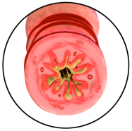
Some flavorings can trigger asthma “attacks”.
Airways inflamed
and narrowed
Normal airway
Asthma
Medications
Muscle
tightening
Mucus
Swelling
Figures by National Jewish Health
During an asthma “attack”:
Airway muscles tighten.
Airways become inflamed and narrowed.
Symptoms may be mild or severe.
Treatment with medications is often needed.
Airways return to normal.
29
Notes:
29
29
Some flavorings can trigger asthma attacks. During an asthma attack, the muscles in the wall of the airway tighten, the airways become inflamed, and they narrow. The symptoms may be mild or severe depending on how much inflammation and narrowing occur. Treatment with medications is often needed. There is good medical treatment for asthma. As shown by the green arrow, with medications, the airways return to normal.

Slide 30

Asthma “attacks” can be triggered in workers who already have asthma.
Triggered by irritant flavorings
Capsaicin
Some natural oils
Some “High Priority” Flavorings
Acetic acid
Acetaldehyde (aldehydes)
The higher the exposure, the higher the risk.
Workers with asthma should be extra careful to avoid breathing in irritating flavorings.
Photo by Cliff Hutson available under public domain from Wikimedia Commons
30
Notes:
30
30
Asthma attacks can be triggered by irritating flavorings in workers who already have asthma. These irritating flavorings include some of the high priority flavorings, some of the natural oils described in the first section and capsaicin. The higher the irritant exposure, the higher the risk. Workers with asthma should be extra careful to avoid breathing in irritating flavors.

Slide 31
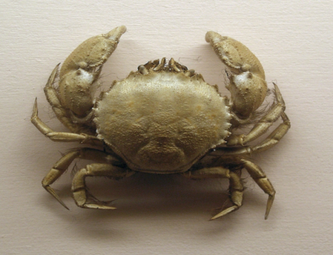

Some natural flavorings can cause allergic reactions.
Not common in this industry
Runny nose (rhinitis)
Asthma
Allergic reactions to
Shellfish, fish, eggs, flour, some spices
Rarely, a body-wide allergic reaction
Hives
Swelling of the mouth and throat
Chest tightness, shortness of breath
Allergic reactions to
Shellfish, fish, some spices
Peanuts and other tree nuts
Photo available under public domain from Wikimedia Commons
Photo by Bierfaß available under public domain from Wikimedia Commons
31
Notes:
31
31
Workers who have an allergy to some natural flavorings can develop symptoms of allergy when they work around them. Allergic reactions are common in some industries, but not very common in the flavor industry. Symptoms can be like hayfever, with runny nose and itchy eyes. Allergies can also trigger asthma. The natural flavorings that can trigger allergies include shellfish, fish, eggs, flour, and certain spices. Rarely, a more severe body-wide allergic reaction can occur, called anaphylaxis. In anaphylaxis, hives (welts) often form on the skin. There can also be swelling of the mouth or throat, chest tightness and shortness of breath. Anaphylaxis can be triggered by shellfish, fish, certain spices, peanuts and tree nuts.

Slide 32
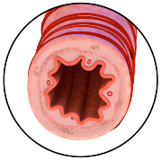
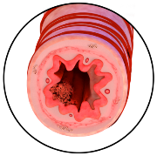
Bronchiolitis Obliterans Syndrome (BOS) is scarring in small airways.
Normal airway
Early BOS
Late BOS
Airway
injury
Early
Scarring
Permanent
Scarring
Inflammation
Images by National Jewish Health
Diacetyl, possibly diacetyl substitutes
After injury, scars form.
Scars cause airways to narrow.
Diacetyl and diacetyl substitutes do not have good warning properties.
32
Notes:
32
32
The diagrams show the scarring that forms in the small airway in BOS. BOS is less common than airway irritation or even the triggering of asthma. As described in the story, BOS can be a very severe disease for which there is no treatment. In early BOS, injury due to chemicals such as diacetyl and possibly diacetyl substitute causes inflammation in the airways and scars start to form. As more scars form, the airways get more narrow. In late BOS, the airways are very narrow due to scarring. Unlike irritating flavorings, diacetyl and diacetyl substitutes do not have good warning properties. This means that it is possible to be exposed to them at levels that are high enough to cause injury to the airway and you are not aware of it at the time.

Slide 33
It is important to find BOS early!
Normal airway
Early BOS
Late BOS
Airway
injury
Early
Scarring
Permanent
Scarring
Figures by National Jewish Health
Inflammation
Early: Mild airway narrowing
Mild breathing symptoms
Removal from exposure can help prevent worsening.
Late: Severe airway narrowing
Severe breathing symptoms
Nothing makes BOS better -- medications do not help.
33
Notes:
33
33
It is important to find BOS early. In early BOS, breathing symptoms are typically mild. Although it will not make it better, removal from exposure can help prevent it from getting worse. In late BOS, breathing symptoms are severe. There is no treatment for BOS. Notice that there is no green arrow like there was on the asthma slide that showed medications help return the airway back to normal. Nothing makes BOS better. That’s why both early diagnosis and prevention are so important.

Slide 34
Avoid breathing in diacetyl and substitutes.
BOS has been found in workers exposed to butter flavorings.
Popcorn manufacturing workers
Flavor manufacturing workers
Diacetyl production workers
Photo by NIOSH available under public domain
These workers had exposure to high levels of diacetyl.
In animals, diacetyl causes airway injury and scars.
Diacetyl substitutes may not be better.
It is important to keep exposures to diacetyl and diacetyl substitutes as low as possible.
34
Notes:
34
34
We strongly recommend that you avoid breathing in diacetyl and diacetyl substitutes. BOS has been found in workers exposed to butter flavorings. BOS was identified in a group of popcorn manufacturing workers in 2001. BOS was then found in flavor manufacturing workers. At first it was not clear if diacetyl was the problem because these workers were exposed to many other flavorings in addition to high levels of diacetyl. BOS was then found in some diacetyl production workers whose primary exposure was diacetyl. Finally, the role of diacetyl in BOS was confirmed by animal studies, when diacetyl put into the airways of mice caused the same type of injury and scarring seen in human BOS. At this time we no longer have any doubt that diacetyl can cause BOS. There is concern that some of the diacetyl substitutes, which are chemically similar to diacetyl, may also have this same effect. At this time we really do not know which of the diacetyl substitutes are safe and which ones are not safe. Until this is known, we strongly recommend that you keep your exposure to diacetyl and diacetyl substitutes as low as possible.

Slide 35
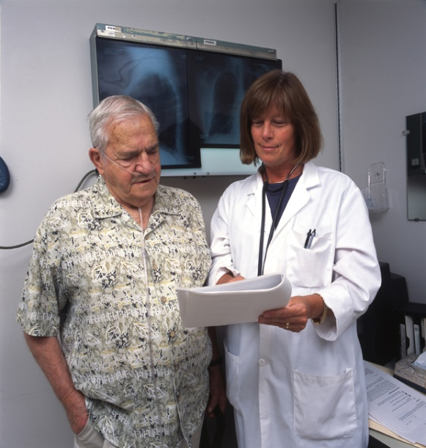
It is important to find BOS early!
If you are exposed to diacetyl or diacetyl substitutes:
Report unexplained breathing symptoms to Human Resources or Health and Safety and to your doctor.
Participate in medical surveillance.
Photo by National Jewish Health
35
Notes:
35
35
In order to find BOS early, we recommend that if you are exposed to diacetyl or diacetyl substitutes, you report unexplained breathing symptoms to your company’s human resources or health and safety people and to your doctor. We also recommend that you participate in regular medical surveillance programs targeted at detecting lung disease.

Slide 36
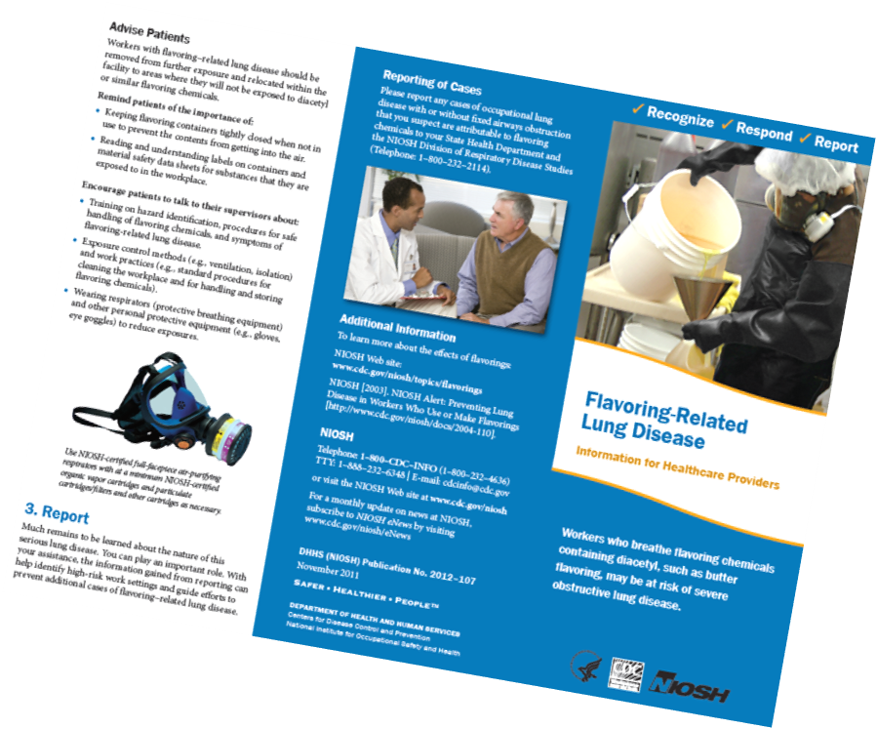
Talk to your doctor about your symptoms and your work with flavorings
NIOSH 2011
Flavoring-Related Lung Disease (NIOSH)
Available on the NIOSH website (www.cdc.gov/niosh)
36
Notes:
36
36
We recommend that you talk to your doctor about your symptoms and your work with flavorings. BOS is a rare disease and the link with diacetyl was only recently discovered. Because many doctors and other health care providers do not know about flavoring-related lung disease, the National Institute for Occupational Safety and Health (NIOSH) has made a brochure that provides information for them. The brochure is available on the NIOSH website.

Slide 37
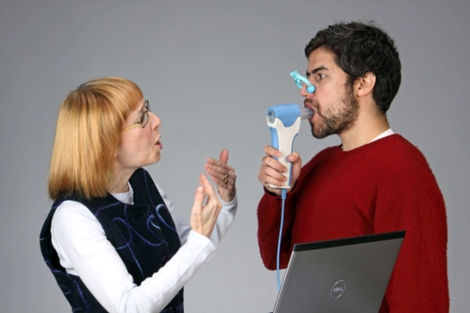
Medical Surveillance: Questionnaires and Breathing Tests
Breathing Test (Spirometry)
How much air you can breathe in and out
How fast you can blow air out
Testing is recommended at least every year.
Every 6 months (CalOSHA)
Are the results normal?
Compared to other people who are your same age, height, and gender
Are the results normal for you?
Are the results similar to your past test results?
Photo by National Jewish Health
37
Notes:
37
37
Medical surveillance is done using a respiratory symptom questionnaire and a breathing test called spirometry. The picture on the right shows a person doing the breathing test. When you blow into the tube, the machine measures how much air you can breathe in and out as well as how fast you can blow the air out. Many of you have likely done this breathing test and know that it is a hard test to do. It is important that you follow the instructions given to you by the technician carefully to get reliable test results. Testing is recommended at least every year. In California, CalOSHA requires testing every 6 months. When you get your test results, there are two questions you want to ask about them: 1) Are the results normal? and 2) Are the results normal for you? “Normal” means the result we expect compared to other people who are your same age, gender and height. “Normal for you” means the results are similar to your past test results.

Slide 38
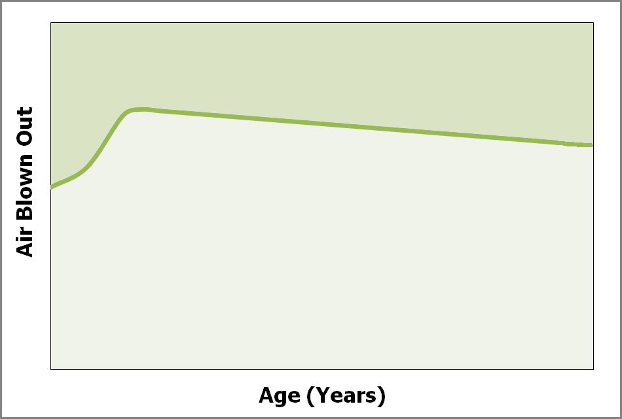
Repeated breathing tests are needed.
Normal
Test After 5 Years of Work
1) Is the result normal?
YES
First
Test
2) Is the result normal for you?
NO
YES
25 years of age
Keep your test results.
38
Notes:
We will go through an example to show why repeated breathing tests are needed. Along the side of the graph is the amount of air you can blow out in the first second, which is a measure of how fast you can blow air out. Age in years is shown along the bottom. As you grow up, the amount of air you can blow out in the first second continues to increase until you reach about age 25. After age 25, there is a slow gradual decline in the amount of air you can blow out in the first second each year. Test results in the green area at the top of the graph are normal. Results below the line are not normal.
In this example, a worker had breathing test and a second test 5 years later. We will ask two questions about the results of that second breathing test. 1) Is the result normal? The result is in the green area, so the answer is “yes”. 2) Is the result normal for you (this worker)? To answer the question, you want to compare the results of the second test to the first test. The second test result is a little lower than the first test. But, we know that after age 25, the results will go down a little bit each year. When we compare the amount of change that we see between the two tests with the amount that we expect to see, the amount of change is the same. Put another way, the slope of those two lines are parallel. So, the answer to the second question is “yes, the result is normal for you”.
In the second example, the second test result after 5 years is the same, but the first test result had been much higher. Is the result of the second test normal? The answer is still “yes”; the result is normal. Is the result normal for you (the worker)? This time when we look at the amount of change from the red star to the black star, that line is much steeper, indicating there has been much more of a change than expected. The answer is “no”; the results are not normal for you. The importance of repeated breathing tests every year or 6 months is that if you start to see test results that are not normal for you, the result is more likely to still be in the normal range, rather than later when the results have gone down more and the results are no longer in the normal range. We recommend that you keep your test results to know what has been normal for you.

Slide 39

Special tests are needed to diagnose work-related lung disease.
If your test results are not normal for you
Repeat the breathing test.
If the test is still not normal for you, the doctor will do more testing to find out the cause.
Photo by National Jewish Health
Photo by National Jewish Health
39
Notes:
39
If your test results are not normal for you, the first step is to repeat the breathing test. There are a number of reasons why your results may be lower and not mean that there has been a permanent change in your lungs, such as if you had a cold or allergies at the time of the test or if the testing was not done correctly. If the repeat breathing test results are still not normal for you, your doctor will need to do more testing to determine the cause. Additional tests are needed to diagnose work-related lung disease.

Slide 40
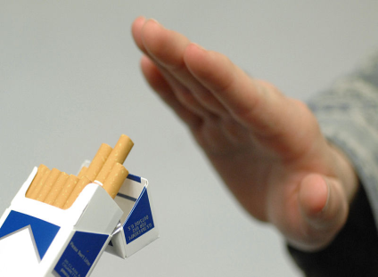
Protect Your Lungs!
Keep your exposure to all “High Priority” flavorings as low as possible.
Do not rely on smell or irritation to warn you about exposure.
Report new or worsening breathing symptoms.
Don’t smoke!
FEMA LISTED
HIGH PRIORITY
MATERIAL
FOLLOW APPROPRIATE ENGINEERING AND PROCEDURAL CONTROLS TO MINIMIZE EXPOSURE
Image by National Jewish Health
Photo available under public domain from Wikimedia Commons
40
Notes:
40
We strongly recommend that you protect your lungs. We recommend that you keep your exposure to all High Priority flavorings as low as possible. Remember, the definition of High Priority flavorings is that they may cause respiratory injury when not handled properly. Please do not rely on smell or symptoms of irritation to warn you about exposure. Report new or worsening breathing symptoms to your doctor. Also, please do not smoke. Smoking causes lung, heart and other diseases. If you do smoke, please discuss ways to help you stop smoking with your doctor.

Slide 41
Flavoring Exposure Recognition and Control Training Goals
Recognize flavorings and work processes where you might be exposed
Understand the methods used to measure flavoring exposure
Understand the proper use of control methods to reduce exposure to flavorings
Notes:
In this section we’re going to cover flavoring exposure recognition and control. Our training goals are to recognize flavorings and work processes where you might be exposed, understand the methods used to measure flavoring exposure, and understand the proper use of control methods to reduce exposure to flavorings.

Slide 42



How do I know if it is hazardous?
Hazard Communication
Labeling of individual flavorings and compounded flavors
Handling precautions on batch sheets
Health effects
Proper handling
Necessary precautions
MSDS or SDS readily available
Figures by Torsten Henning available under public domain from Wikimedia Commons
WARNING – This flavor may pose an inhalation hazard if improperly handled. Please contact your workplace safety officer before opening and handling, and read the MSDS. Handling of this flavor that results in inhalation of fumes, especially if the flavor is heated, may cause severe adverse health effects.
Workers need to be alerted when working with “High Priority” flavorings
Figure by National Jewish Health
Notes:
How do you know if something is hazardous? Hazard Communication is the process where workers are provided with information on the hazards or potentially hazardous exposures associated with their jobs. This includes labeling of individual flavorings and compounded flavors to ensure workers know exactly what they are working with. It should also include instructions on batch sheets that include things like health effects, proper handling, and necessary precautions. Another place you can look for information regarding the hazard of a substance is on the MSDS or SDS sheet, the Material Safety Data Sheet or the Safety Data Sheet. These must be readily available to employees. These safety data sheets are going to be replacing MSDS sheets in the future with the adoption of the Globally Harmonized System or GHS and as you notice on this slide, there are symbols that you might not have seen before. These are symbols that are associated with the new GHS labeling system, using these symbols on flavoring containers and teaching workers the meanings of these symbols will help ensure workers can quickly identify the hazards of the flavorings they are working with. It is extremely important that flavoring companies adopt a standardized system to alert workers when they are working with High Priority flavorings.

Slide 43
What does exposure to flavorings look like?
Possible exposure anywhere “High Priority” flavorings are:
Sampled
Weighed
Mixed
Poured
Transferred
Packaged
Flavoring particles and vapors quickly move into a worker’s breathing zone unless removed at the source.
Notes:
What do flavoring exposures look like? We’re going to take a look at this video to see what these exposures really look like. This video’s going to show a powder dropping from the top tube down into the bucket below. And what I want you to realize is that the same exposure is happening when you’re pouring a liquid from one container to another container down below. So as you watch this powder come out of this container, it’s hitting the bottom of the bucket and splashing or coming back up into the worker’s breathing zone. That exact same thing is happening when you’re working with a liquid and pouring from above into another container down below. Notice the big cloud of dust that’s been generated; that same cloud is generated in the liquid but you just aren’t seeing it the same way as you do with a powder. These types of exposures are possible anywhere High Priority flavorings are sampled, weighed, mixed, poured, transferred, or packaged. And as you can see from this video, flavoring particles and vapors quickly move into a worker’s breathing zone unless they’re removed at the source.

Slide 44
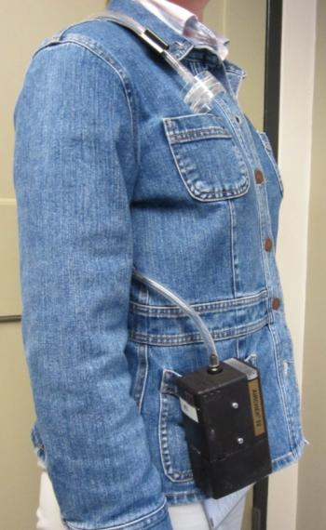
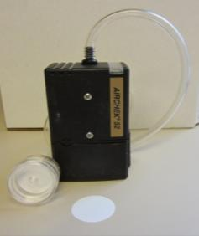
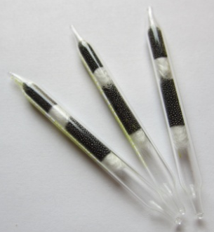
How are exposures measured?
Personal air samples
Estimate the amount of flavoring a worker might inhale into their lungs
Workers wear sampling pump for entire work shift
Different air sampling collectors for different flavorings
Currently, no method for diacetyl powders
Sample collector in “breathing zone”
Worker “wears” sampling pump
Photos by National Jewish Health
Exposures can change depending on the tasks performed and the products produced.
Particle/Dust Collectors
Gas/Vapor Collectors
Notes:
How are exposures measured? Personal air samples are used to estimate the amount of flavoring a worker might inhale into their lungs. Workers wear a sampling pump for the entire work shift. Different air sampling collectors are used for different flavorings. It’s important to note that currently, there is no method available for diacetyl powders. Notice in the picture on the left that the worker is wearing the sampling pump on their belt, and a tube connects that to the sampling collector which is up by the lapel, or in the breathing zone. The worker would wear this pump for the entire work shift. The bottom pictures show different types of collectors, so you see on the left that you have collectors for particle or dust collection, and then the picture on the right shows different types of tubes that are used for gas or vapor collection. It’s important to note that exposures can change depending on the task performed and the products being produced. Because of this, it is important to do routine air sampling and since the exposure from one day is not necessarily representative of another day, multiple sets of samples are needed to adequately assess the exposure.

Slide 45
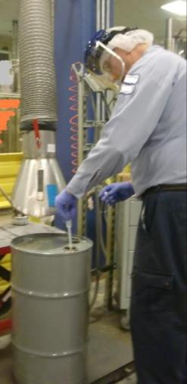
What does the level of exposure depend on?
Amount of “High Priority” flavoring used
Amount of time exposed
How well the vessels are sealed
Ventilation
Liquids
Pouring distance
Use of funnels
Powders
Hand scooping
Sifting
Packaging
Short-term high exposures AND longer term lower exposures are both important.
Photo used by National Jewish Health with written permission.
Notes:
What does the level of exposure depend upon? It depends on the amount of High Priority flavoring that’s used the amount of time you’re exposed, how well the vessels are sealed, and the ventilation you are using. For liquids, pouring distance is important so if you’re pouring like a diner waitress way up high into a container down below, it will increase your exposure, or if you’re using funnels these greatly reduce exposure. For powder exposures, if you’re hand scooping, sifting, or packaging, these processes result in higher exposures and should be avoided for diacetyl-containing powders. It’s important to note that short-term high exposures and longer-term lower exposures are both important.

Slide 46
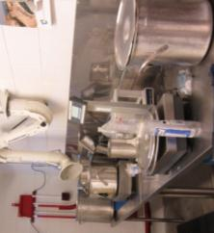
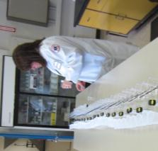
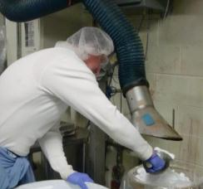
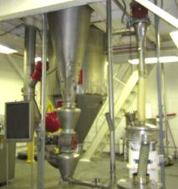
What levels of diacetyl have been measured in flavorings?
8-Hour Exposure Limits
NIOSH: 0.005 ppm
ACGIH: 0.01 ppm
TERA: 0.2 ppm
NJH
OSHA
NIOSH
Liquid Compounding
QA Laboratories
Average
8-Hour Exposures
Average
8-Hour Exposures
0.91 ppm (n=63)
0.99 ppm (n=2)
0.46 ppm (n=3)
0.099 ppm (n=21)
0.030 ppm (n=2)
0.004 ppm (n=7)
0.07 ppm (n=3)
0.009 ppm (n=3)
Photo used by National Jewish Health with written permission.
Photo used by National Jewish Health with written permission.
Powder Processing
Spray Drying
Average
8-Hour Exposures
8-Hour Exposure
1.5 ppm (n=1)
0.71 ppm (n=31)
0.05 ppm (n=10)
0.34 ppm (n=3)
0.22 ppm (n=9)
2-Hour Exposures
2.6 ppm (n=6)
Photo used by National Jewish Health with written permission.
Photo used by National Jewish Health with written permission.
Many flavor worker tasks have short-term diacetyl exposures over 2 ppm.
Little information available on exposures to other “High Priority” flavorings.
Notes:
What levels of diacetyl have been measured in the flavoring industry? We’re going to take a look at some different samples, samples taken by National Jewish Health, OSHA, and NIOSH. It’s important to note that the samples we at National Jewish took, these measurements were taken at least 5 years ago in about 13 companies. This is important because during this time many companies did not have exposure controls in place. The other thing I want you to remember is the ACGIH 8-hour exposure limit of 0.01 ppm when we we’re looking at these exposures.
The first exposure is in liquid compounding, the average 8-hour exposure that National Jewish saw was 0.91 ppm. The average exposure OSHA saw was 0.99 ppm. And the average exposures NIOSH saw were anywhere between 0.03 and 0.46 ppm. Now, you’ll notice that these exposures are well over the 0.01 ppm level that ACGIH has in place. Next, we’re going to take a look at powder processing. The average 8-hour exposure that National Jewish saw was 0.71 ppm. And NIOSH saw exposures from 0.05 to .34 ppm; again well over the 0.01 ppm level. For the QA laboratories, it’s important to note that National Jewish didn’t take many samples, so we really can’t generalize the exposure, but the samples we did take resulted in an average 8-hour exposure of 0.004 ppm. NIOSH saw exposures from 0.009 to 0.07 ppm. So, in the QA area, some processes can definitely result in an exposure that’s above the 0.01 ppm level. For spray drying, National Jewish Health only took one sample and it was an 8-hour exposure. The result was 1.5 ppm. NIOSH took some 2-hour exposures that resulted in 2.6 ppm. Very few samples have been taken, but the few samples that have been taken suggest that the exposure is very high in the spray-drying area. Looking at all of these samples, it’s important to note that many flavor worker tasks have short-term diacetyl exposures over 2 ppm, and little information is available on exposures to other High Priority flavorings.

Slide 47
How are flavoring exposures controlled?
High Exposure
Elimination & Substitution
Engineering Controls
Work Practice Controls
PPE
Changes in raw materials or flavorings
Changes that capture or enclose the source of exposure
Decreasing Effectiveness
Changes in procedures or worker behavior to reduce exposure
Increasing dependence on worker behavior
Personal protective equipment: respirators, gloves, goggles, and protective clothing
Acceptable Exposure
Notes:
How are flavoring exposures controlled? As an industrial hygienist, we have a certain way we like to try and reduce exposures. We like to take things from a high exposure and bring them down to an acceptable exposure. In order to do this, we like to use a certain set of controls in a certain order to bring that exposure from a high one to an acceptable one. We’re going to look at these individually, so the first is elimination and substitution. This is the change in raw materials or flavorings. Now this is probably not possible in your industry, because the customer wants a certain flavor to taste a certain way, and in order to do that, you have to use specific flavorings. Since substitution is probably not possible, we’ll move on to the next thing, which are the engineering controls. These are changes to the process that capture or enclose the source of the exposure, things like suction. The next step is work practice controls; these are changes in procedures or worker behavior to reduce exposure. An example of a work practice control would be to encourage somebody not to pour like a diner waitress but to pour closely to the other container, or to use a funnel. The last thing we like to use is personal protective equipment. These are things like respirators, gloves, goggles and other protective equipment. This is because as you move down the chart, you really have decreasing effectiveness because you’re requiring increasing dependence on the worker behavior.

Slide 48
Does substitution work?
Diacetyl Substitutes
O
Diacetyl
Larger molecules
Pros:
Lower exposures
Less evaporation at room temperature
Cons:
Chemically similar to diacetyl
May have similar health effects
O
2,3-Pentanedione
O
O
O
2,3-Hexanedione
O
Until there is more information available, diacetyl and diacetyl substitutes should be controlled the same.
O
2,3-Heptanedione
O
Figures by National Jewish Health
Notes:
So, you may say, “Does substitution work?” Well they’ve tried in your industry to replace diacetyl with things like 2,3-pentanedione, 2,3-hexanedione and 2,3-heptanedione. Now, if we take a look at these molecules on the left, the first one we see is diacetyl. It’s got a carbon chain with a couple of oxygens off the side. We look at the next molecule, 2,3-pentanedione, it looks very similar. It’s a little bit longer carbon chain with still two oxygens off of it. And again, with 2,3-heptanedione, it has a longer carbon chain with a couple oxygens on it. Now, we see these chemicals are very similar to diacetyl. The pros are that you have lower exposures because you have less evaporation at room temperature due to larger molecules. The cons are that these structures are still very chemically similar to diacetyl, and they may have similar health effects, so until there’s more information available, diacetyl and diacetyl substitutes should be controlled the same.

Slide 49
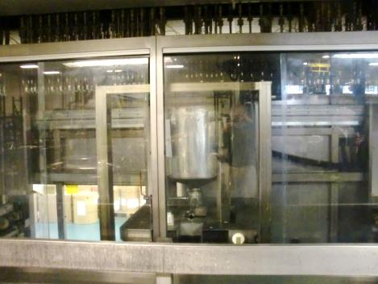
What is the best solution?
Completely Enclosed Processes
Closed lines for all ingredients and finished products
Closed vessel cleaning system
Containment verified with air sampling
Maintenance workers may still be exposed.
Photo by National Jewish Health used with written permission.
May not be a realistic solution due to cost and production variability.
Notes:
So, what is the best solution? The best solution if we had all the money and all the resources would be to have a completely enclosed process. This means closed lines for all ingredients and finished products, having a closed vessel cleaning system, and containment of the entire process verified with air sampling. Now the importance of that is if you have this totally enclosed system, you don’t want to give a false sense of security to your workers, meaning that when they’re working outside of this containment area and if there’s a leak in one of the hoses, then they would be exposed without the knowledge of that. Another point is that maintenance workers may still be exposed because they are the ones who have to go in and fix something when something malfunctions. Now, this solution may not be a realistic solution due to the cost and the production variability that you have in your industry. You may be using larger containers one day and smaller containers the next, or from hour to hour you may have different size containers that you need to run through this thing, so it may not be optimal. However, the more you can enclose and automate your process, the lower you can maintain exposures at your facility.

Slide 50
What is the next best solution?
Work Practice Controls
Combination of controls used to reduce exposures to acceptable levels
Local Exhaust Ventilation
Process Isolation
Notes:
The next best solution is to use a combination of controls to reduce exposure to acceptable levels. So, in this instance, we’re going to be looking at using things like local exhaust ventilation, along with things like process isolation and work practice controls to try to reduce exposures to acceptable levels. You’ll notice that the local exhaust ventilation cog is a lot larger than the other two because it’s the most important piece of the puzzle for reducing exposures to flavorings.

Slide 51
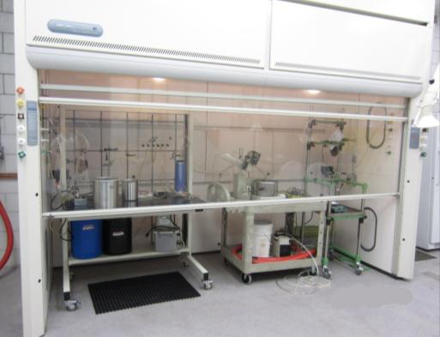
What is process isolation?
Designated area or room for work with “High Priority” flavorings
Separate ventilation system from offices or other production areas
Lidded tanks and vessels
Flavorings stored in sealed containers
Volatile “High Priority” flavorings kept in cold storage
Photo by National Jewish Health used with written permission.
Reduces exposure levels and the number of exposed workers
Notes:
Process isolation is taking a designated area or a room for work with these High Priority flavorings. This room would ideally have a separate ventilation system from offices and other production areas. You would have lidded tanks and vessels, and flavorings would be stored in sealed containers, with volatile High Priority flavorings kept in cold storage. This reduces exposure levels and the number of workers who are exposed.

Slide 52
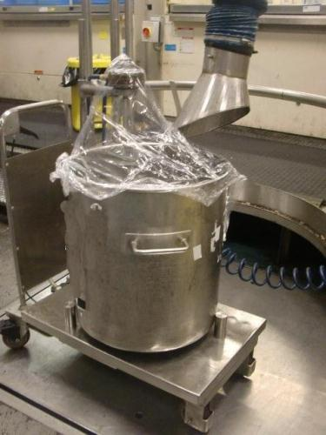
What is local exhaust ventilation?
Suction to remove flavoring prior to worker exposure
Effective if properly designed and used
Requires worker training
Photo used by National Jewish Health with written permission.
Most important control to reduce exposure to flavorings!
Notes:
Local exhaust ventilation is suction to remove flavoring exposure prior to worker exposure. It is very effective if it’s properly designed and used. It does require worker training and it’s the most important control to reduce exposure to flavorings.

Slide 53
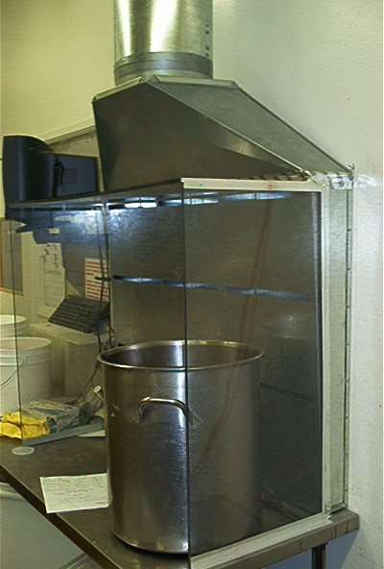
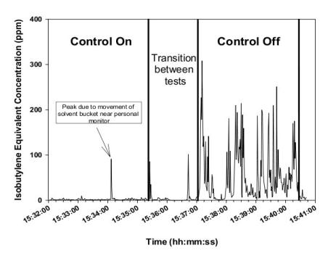
Does ventilation reduce exposure?
Figure by NIOSH available under public domain.
Ventilation reduces exposures when properly designed and used correctly!
Photo by NIOSH available under public domain.
Notes:
Does ventilation work to reduce exposure? NIOSH decided they wanted to answer this question, so they built a ventilation system above a compounding station like the one pictured on the left. The graph on the right shows when they had the control on, you had very little exposure and when they turned that control off, you could see exposures clearly increased. So these ventilation systems can really reduce exposures when properly designed and used correctly.

Slide 54
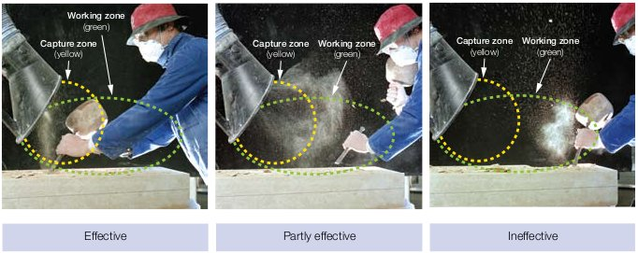
How do I use ventilation correctly?
Contains public sector information published by the Health and Safety Executive and licensed under the Open Government Licence v1.0
Capture depends on distance from the capturing hood
Capture greatly decreases at a distance of two duct diameters
Cross drafts reduce the capture of flavorings
Work as closely as possible to the ventilation hood!
Notes:
So how do you use ventilation correctly? We’re going to take a look at this series of photos to determine how you can use your ventilation system correctly. If we look at the photo on the left, we see that the worker is working within the working zone, and within the capture zone, and notice that the particles from his process are going to into the ventilation system so that is effective. Now, if we look at the next guy in the middle, he’s working just outside the capture zone, but he’s still in the working zone, and notice half of the particles from his process are being captured, so it’s partially effective. Now, if we look at the guy in the photo on the right, he’s working outside of the capture zone and on the very edge of the working zone. Notice the ventilation system is not capturing any of the particles from his process, so this is very ineffective. You can see from these photos that capture depends on distance from the capturing hood and capture greatly decreases at a distance of about 2 duct diameters. In addition, it is important to remember that even slight cross drafts can reduce the capture of flavorings, so if you’re working in your production area and you’re using a fan to try to keep cool, you’ll be actually blowing these contaminants back into your breathing zone. Cross drafts don’t just occur from fans, they can occur from a worker passing by. They can also be coming from your ventilation supply above your work area so it’s very important to note these things when you’re doing your work. And the most important thing is to work as closely as possible to the ventilation hood.

Slide 55
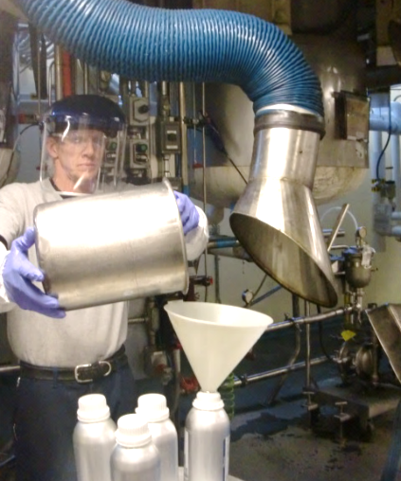
What can I do to reduce exposure?
Keep temperatures of liquids as low as possible.
Replace lids immediately after adding flavorings.
Pour slowly and use funnels.
Add “High Priority” flavorings last.
Avoid pouring from 55 gallon drums.
Avoid hand scooping powders.
Make sure other workers in your area know when you are using “High Priority” flavorings.
Photo used by National Jewish Health with written permission
Use engineering controls properly all of the time!
Notes:
What can you as a worker do to reduce exposure? You can keep temperatures of liquids as low as possible. It’s also important to replace lids immediately after adding flavorings. It’s critical that you pour slowly and use funnels, and add High Priority flavorings last if at all possible to reduce the exposure time. It’s also important to avoid pouring from 55 gallon drums and to avoid hand scooping powders. When we conducted air monitoring in the flavoring industry, we saw that these two tasks resulted in some of the highest exposures. It’s also important to make sure that other workers in your area know when you’re using these High Priority flavorings so that they can protect themselves as well, and to make sure you use engineering controls properly all of the time.

Slide 56

What if I am a laboratory worker?
Use the lab hood for handling “High Priority” flavorings.
Keep containers closed as much as possible.
Avoid odor evaluations of high concentration or neat “High Priority” flavorings.
Photo by New-Tech™ used with written permission.
Laboratory workers can have high exposures!
Notes:
What if you’re a laboratory worker? It’s important to use the lab hood for handling High Priority flavorings. It’s also important to keep containers closed as much as possible and to avoid odor evaluations of high concentration or neat High Priority flavorings because laboratory workers can have high exposures too.

Slide 57
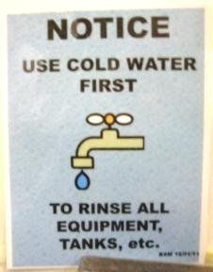
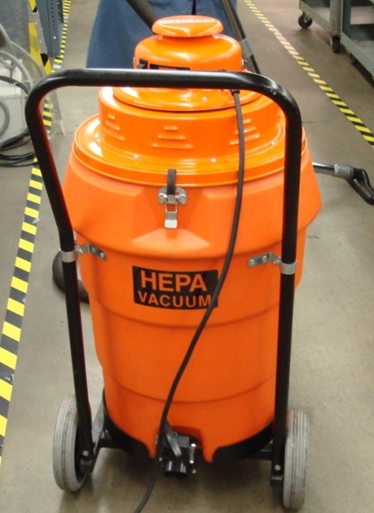
What about cleaning?
Use HEPA vacuum for cleaning powder spills.
Use cold water to pre-rinse mixing vessels prior to cleaning with hot water.
Keep work areas where flavorings are handled clean.
Clean-up spills immediately to prevent unnecessary exposure.
Photos used by National Jewish Health with written permission
Notes:
What about cleaning? It’s important to use a HEPA vacuum for cleaning powder spills. It’s also important to use cold water to pre-rinse mixing vessels prior to cleaning with hot water. This will reduce the amount of chemicals that are volatilized off of the mixing vessel. It’s also important to keep work areas where the flavorings are handled clean, and to clean up spills immediately to prevent any unnecessary exposure.

Slide 58
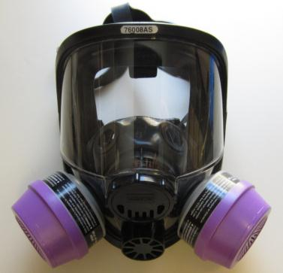
When should I use a respirator?
When exposures cannot be controlled in other ways
When employees complain of irritation regardless of exposure level
When using diacetyl and diacetyl substitutes
Always with diacetyl or diacetyl substitute powder exposures
Always when exposures have not been measured
To keep exposures as low as possible
Photo by National Jewish Health
Respirators are a last choice for controlling exposures, but may be an important part of the solution in the flavoring industry.
Notes:
When should you use a respirator? When exposures cannot be controlled in other ways, when employees complain of irritation regardless of the exposure level, anytime when using diacetyl or diacetyl substitutes, always when working with diacetyl or diacetyl substitute powders, always when exposures have not been measured, and when it is desired to keep exposures as low as possible. It is difficult to control exposures to diacetyl down to the 0.01 ppm exposure level, so it might be important to use respirators at least temporarily when implementing other controls. Although respirators should be the last choice for controlling exposures, they may be an important part of the solution in the flavoring industry to keep exposures as low as possible.

Slide 59


How do I know my respirator is working?
Yearly training
Must fit properly
Fit tested annually
No facial hair
Must have the right cartridges
Organic vapor for liquid exposures
Organic vapor + P100 for powder exposures
Cartridges don’t last forever
Need change-out schedule
If you can smell it, you should change it.
Figure by National Jewish Health
Photo by Jeanne Mozier available under public domain.
Photo by Stuart Butterfield available under CCA-2.0.
Respirators are only effective when used properly!
Notes:
In order to ensure respirators work properly, your respirator must fit properly which is verified through a yearly fit-test, and you must have no facial hair. So if we look at the graphic on the top left, we see a relative size figure showing that the size of a human hair is a lot larger than the size of the glass fiber or the asbestos fiber or the fume particles. You can imagine trying to put a respirator over that human hair, thinking of it as a piece of facial hair, and if you do that, it’s going to allow space for any of those other smaller particles to get inside the respirator. Thus, the respirator’s letting in the contaminants that you’re trying to protect yourself from. So, we’re not just concerned with “Cousin It” who’s in the bottom left corner of this slide, but we’re also concerned with the other guy who’s got maybe a couple days of stubble growth on his face. His respirator would not protect him either. Another important point is you must have the right cartridges for the exposure. It’s important to use organic vapor for liquid exposures and it’s important to use organic vapor and P100 filters for the powder exposures. Cartridges don’t last forever, you need to change them out and you need to have a change-out schedule. If you can smell it, you should change it. Now, we’ve been into these flavoring industries and we’ve walked up to people that are using respirators and asked them how the respirator’s working for them. They say, “it works great!” and when we talk to them a little bit more, we say “now that stuff you’re working with, how’s that smell?” and the guy says “oh man, it smells nasty,” so you know if the guy can smell it through his respirator he needs to change out that cartridge and the respirator’s not protecting him. Another thing that can affect cartridge is humidity. It can really decrease the cartridge life, so it’s important to take into account how humid your atmosphere is when planning your change out schedule. And finally, as with engineering controls, respirators are only effective when they’re used properly.

Slide 60
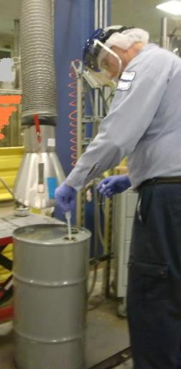
What about skin and eye protection?
Use gloves and aprons appropriate for flavoring exposure
Chemical resistant gloves and aprons are made from:
Nitrile
Butyl rubber
Teflon™
Tychem ™
Tight-fitting eye goggles not safety glasses
Photo used by National Jewish Health with written permission
PPE is only effective when used properly!
Notes:
What about skin and eye protection? Well, it’s important to use gloves and aprons that are appropriate for the flavoring exposure. Chemical resistant gloves and aprons can be made from nitrile, butyl rubber, Teflon, or Tychem, and tight-fitting eye goggles, not safety glasses are important. I can’t emphasize enough that PPE is only effective when it’s used properly.

Slide 61
How does it all fit together?
Use of “High Priority” Flavors
Exposure Recognition
Temporary controls when not enough exposure measurements
Exposure Monitoring
High Exposure
Elimination & Substitution
Engineering Controls
Work Practice Controls
PPE
Medical surveillance:
Helps protect workers
when little is known about
exposure
No controls needed
Acceptable Exposure
Notes:
So how does all this fit together? You use High Priority flavorings in your industry, so you recognize you have an exposure. You conduct exposure monitoring to determine how high your exposures are to these High Priority flavorings. Exposure monitoring can tell you either that exposures are well below recommended limits which means that no exposure controls are necessary. Or, exposure monitoring can tell you that you have significant exposures close to or exceeding recommended limits which means that controls are needed to reduce the exposure to an acceptable level. If you don’t have enough exposure monitoring results to determine whether or not the exposure is acceptable, then you may need to institute some temporary controls to reduce exposures as low as possible until more monitoring can be done. The permanent solution to reduce unacceptable exposures is to implement controls like elimination or substitution, engineering controls, work practice controls, or PPE as we discussed in this presentation. Now it’s also important to note that medical surveillance also has a very important role in protecting workers when little is known about the exposure as is the case with many flavorings. Medical surveillance helps to identify health effects early, before workers become severely impaired. The key messages of this entire presentation are: 1) make sure you know the possible health effects of the flavorings you are using; 2) make sure you understand the controls necessary to control exposure to flavorings at your workplace; 3) make sure you understand the limitations of the exposure controls that have been implemented at your workplace; and 4) make sure you understand that medical surveillance for lung disease that has been associated with exposure to flavorings is provided to ensure that lung injury is detected at an early enough stage to prevent significant disability.
`

Slide 62
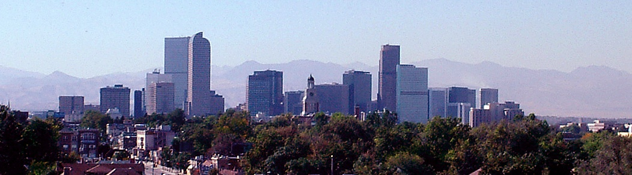
Questions?
Photo by National Jewish Health
This material was produced under grant number SH-22304-11-60-F-8 from the Occupational Safety and Health Administration, U.S. Department of Labor. It does not necessarily reflect the views or policies of the U.S. Department of Labor, nor does mention of trade names, commercial products, or organizations imply endorsement by the U. S. Government.

