Slide 1
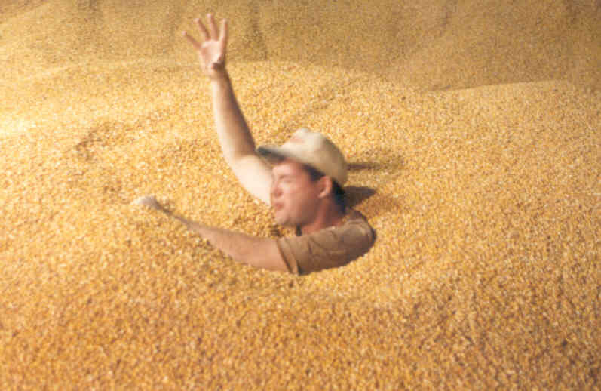
Basic First Responder Training Curriculum for Incidents Involving
Grain Storage and Handling Facilities
Unit 1
Developed by:
  Purdue University
  Agricultural Safety and Health Program
  Department of Agricultural and Biological Engineering
  West Lafayette, IN
This material was produced under grant number SH-22307-11 from the Occupational Safety and Health Administration, U.S. Department of Labor. It does not necessarily reflect the views or policies of the U.S. Department of Labor, nor does mention of trade names, commercial products, or organizations imply endorsement by the U.S. Government.

Slide 2
Basic First Responder Training for Incidents Involving Grain Storage and Handling Facilities
Unit 1: Summary of Grain-related Incidents

Slide 3
Purpose
Identify types of potential emergencies at grain/feed storage and handling facilities
Describe scope of the problem of entrapments, engulfments, entanglements, and falls at grain/feed storage and handling facilities
Identify key contributing factors
Describe nature and characteristics of free flowing agricultural materials
Identify most frequent types of flowing grain/feed entrapments

Slide 4
Emergencies at Grain/Feed Storage and Handling Facilities
Partial entrapments
Full engulfments
Falls
Explosions and fires
Entanglements
Electrocutions
Respiratory/cardiac distress
Crushing injuries/railroad
Chemical/pesticide exposure
Others_____________________

Slide 5
Summary of Grain Entrapments in the United States
Purdue University’s Agricultural Safety & Health Program documents entrapment cases annually.
Nearly 950 fatal and non-fatal grain entrapments have been entered into the National Grain Entrapment Database dating back to 1964.
No less than 51 entrapments occurred in 2010.
Highest recorded since 1993 when 42 were documented.
An average of 15-20 document entrapments occur each year.

Slide 6
Summary of Grain Entrapments in the United States
Unlike many other types of farm-related injuries and fatalities, fatal and non-fatal grain entrapments are not showing a declining trend
As in past years this data does not reflect all grain-related entrapments, due to the lack of a comprehensive reporting system
Many non-fatal incidents go unreported

Slide 7
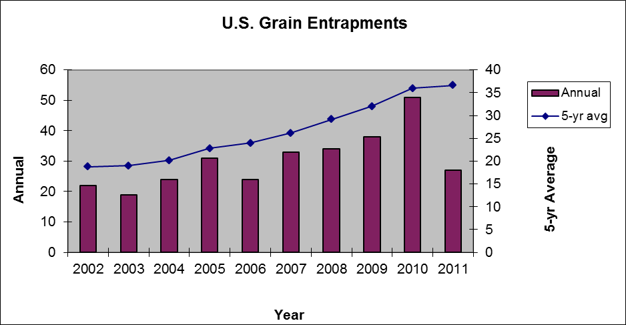
Summary of Grain Entrapments in the United States

Slide 8
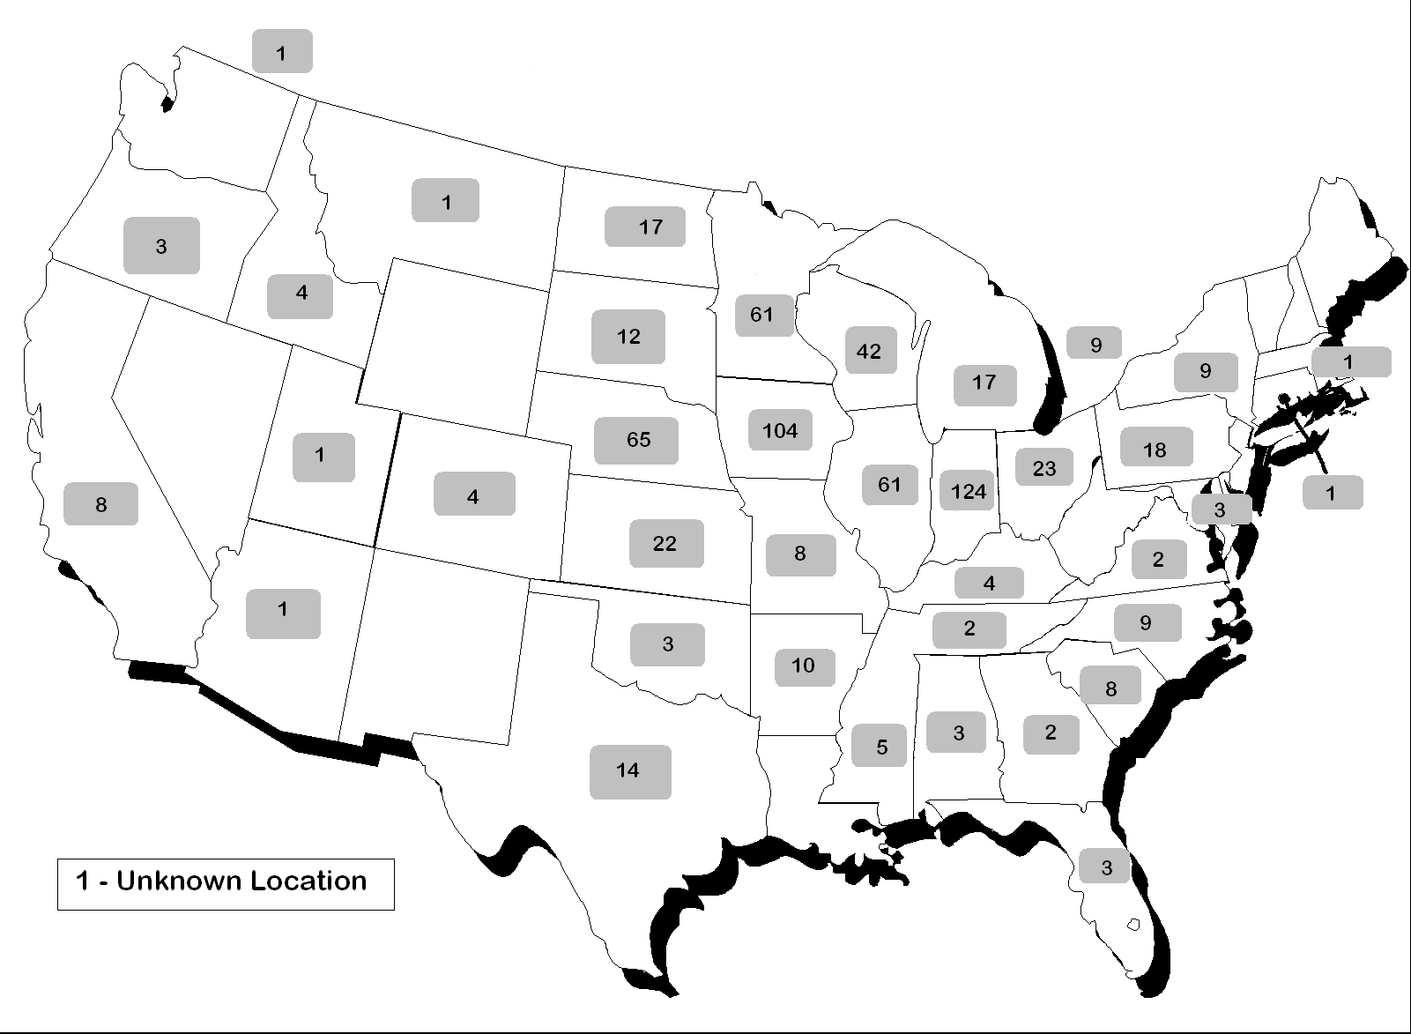
Entrapments by Geographic Location

Slide 9
Summary of Grain Entrapments in the United States
In 2011, the states with the most fatal and non-fatal grain documented entrapments were Illinois (2), South Dakota (2), North Dakota (2), North Carolina (4), Iowa (4), Nebraska (2), Texas (2)
Primarily in the Corn Belt
Overall, grain entrapments were documented in 15 states in 2011
Historically, 70% of the documented entrapments have occurred on exempt farms, while 30% occurred at non-exempt commercial facilities

Slide 10
Where Entrapments Happen
Historically, 70% reported on farms, and 30% commercial facilities
In recent years, 49% reported on farms, and 51% at commercial facilities
  Fewer farms
  Fewer elevator employees with agriculture background
  Larger facilities
  High volume handling equipment

Slide 11
Summary of Grain Entrapments in the United States
The primary grain entrapment medium is yellow corn:
  Other bulk materials involved in grain entrapments include soybeans, milo, processed feed, and soybean meal
There is a direct relationship between out-of-condition grain and a greater probability of entrapment

Slide 12
Entanglements
Less than 10% of grain handling-related emergencies involve an entanglement in energized equipment such as sweep augers, in-floor unload augers or stirators
It is rare to have an entrapment or engulfment victim injured by the unload auger, but it has occurred

Slide 13
Falls
Falls from grain storage and handling facilities are not well documented
Due to the height of many facilities, injuries from falls can be severe

Slide 14
Key Contributing Factors
Increase volume of grain/feed being handled
Larger capacity storage facilities
Larger capacity handling equipment
Increase in the volume of exempt, on-farm storage
Longer term storage
Out-of-condition grain/feed
Workers entering storage spaces alone
Farmers storing wetter corn to reduce energy costs
Changing workforce at commercial facilities

Slide 15
Nature and Characteristics of Free-Flowing Agricultural Material
Weight
Bulk density
Angle of repose
Potential for bridging, crusting, and free standing
Plug vs. funnel flow
Host for toxic biological agents

Slide 16
Most Frequent Types of Flowing Grain/Feed Entrapment
Entrapment in a free flowing column of grain
Bridging/crusted entrapment
Avalanche entrapment
Entrapment in free standing pile of material
Entrapment in grain transport vehicle
Entrapment due to unintended release of material or structural failure
Entrapment while using a grain vacuum machine

Slide 17
Questions?

