Slide 1
Basic First Responder
Training for Incidents Involving Grain Storage Handling Facilities
Unit 4: Rescue Strategies
This material was produced under grant number SH-22307-11 from the Occupational Safety and Health Administration, U.S. Department of Labor. It does not necessarily reflect the views or policies of the U.S. Department of Labor, nor does mention of trade names, commercial products, or organizations imply endorsement by the U.S. Government.

Slide 2
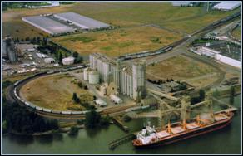
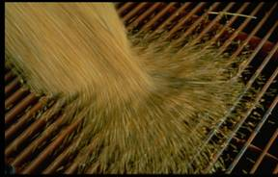
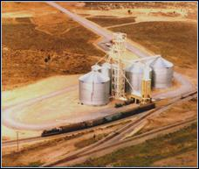
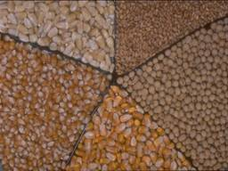
Responding to Entrapments in Grain Storage and Handling Facilities

Slide 3
Definitions
Flowable agricultural material – free flowing agricultural crops or material including grain
Engulfment - events in which an individual is submerged, i.e. fully buried in agricultural flowable material, such as corn, small grains, or feed
Entrapment - used in a broader way to describe events in which an individual is trapped, possibly due to engulfment, inside a structure considered a confined space such as a silo, bin, grain transport vehicle, outdoor pile, or bunker silo, where self extrication is not possible

Slide 4
Types of Documented Entrapments
Flowing grain
Collapse of horizontally crusted grain surface
Collapse of vertically crusted grain surface
Grain transport vehicles
Use of grain vacuum machines
Outdoor pile avalanche
Storage structure failure

Slide 5

Flowing Grain

Slide 6
Flowing Grain Entrapments
Flowing grain increases the risk of entrapment and suffocation
Unsuspecting farmer enters grain bin with unloader running and may be caught in grain flow before realizing what has happened
Takes 4 or 5 seconds to submerge to the point where he or she is helpless
Takes fewer than 20 seconds to be completely submerged at the center of the bin

Slide 7
Engulfment in a Flowing Column of Grain
Individual enters bin during unloading process
Drawn into a flowing column of grain
As the bin empties, a rapidly moving column of grain forms over outlet
Vertical column of grain somewhat like a fluid
Grain mass flows at nearly the rate of the unloading auger
Flow rate at top of a bin is so great that once a person is trapped in flow, escape is impossible

Slide 8
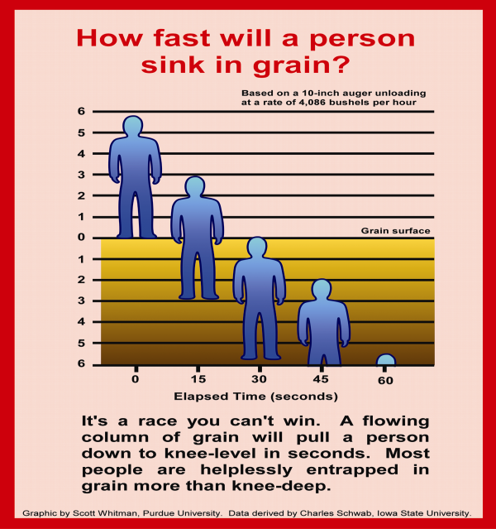

Slide 9
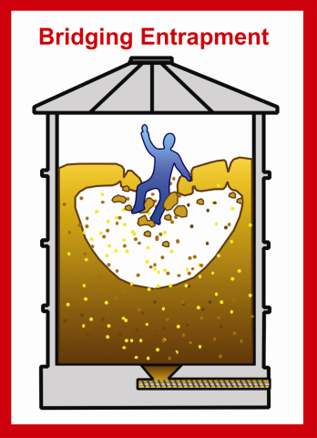
Collapse of Horizontally Crusted Grain Surface

Slide 10
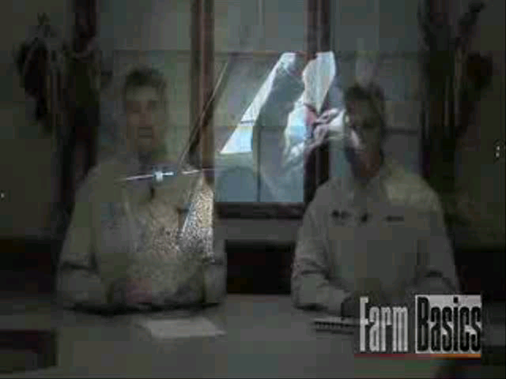

Slide 11
Collapse of Horizontal Crusted Grain Surface
Entrapments and suffocations are possible when an individual enters a bin that grain has become caked because of spoilage
Surface appears solid, but can, in fact, be a thin crust concealing a void that forms
Victim breaks through crust and is quickly covered by the avalanche of grain into the cavity
Often the unloading equipment is still operating, which causes the victim to be pulled in deeper

Slide 12
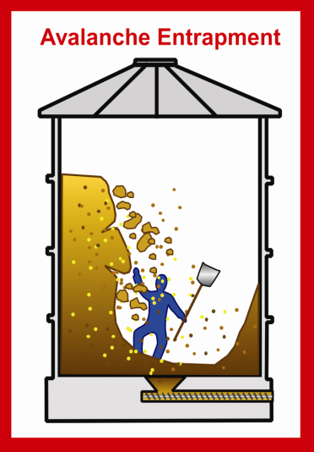
Collapse of Vertically Crusted Grain Surface

Slide 13
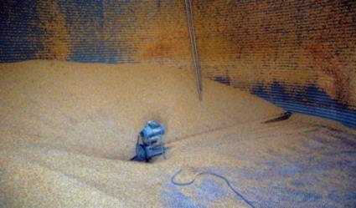
Collapse of Vertical Crusted Grain Surface
Dry grain in good condition will pile at a 30 degree angle, but spoiled or caked grain can stand almost vertical
When grain is removed from base of a caked mass, the potential for avalanche and engulfment increases
This type of engulfment can take place inside bins where spoiled grain is clinging to walls.
Attempting to remove these
chunks of grain using a long pole can be extremely dangerous

Slide 14
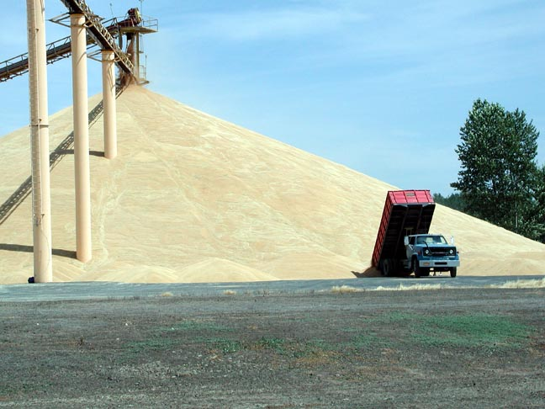
Outdoor Pile Avalanche
Picture From:www.wheatfarm.com/

Slide 15
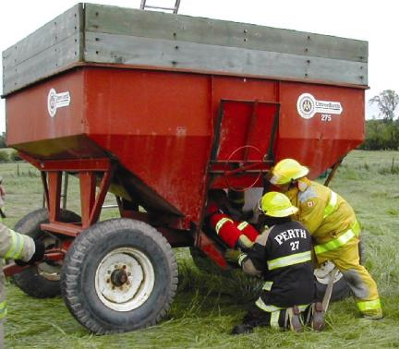
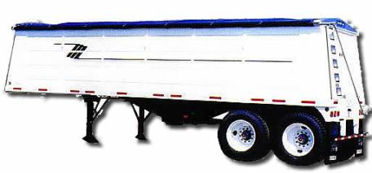
Grain Transport Vehicles
Pictures From: www.ofm.gov.on.ca/
www.vanderhaags.com/

Slide 16
Entrapment or Suffocation in Grain Transport Vehicles
Engulfment also is present around any transport vehicles such as wagons, trucks and hopper wagons
High-Volume capacity of grain handling equipment can bury someone in seconds
It’s not difficult to imagine someone being covered in seconds during an unloading process
Many victims of this type of suffocation, historically, have been children
As an example, death occurred when, a wagon loaded with grain flipped over onto the operator, caused by crusted grain stacked on one side causing the wagon to be unbalanced

Slide 17
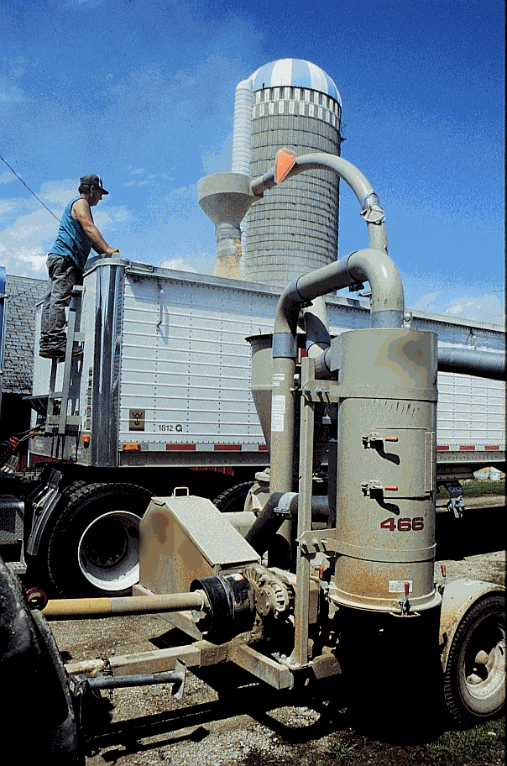
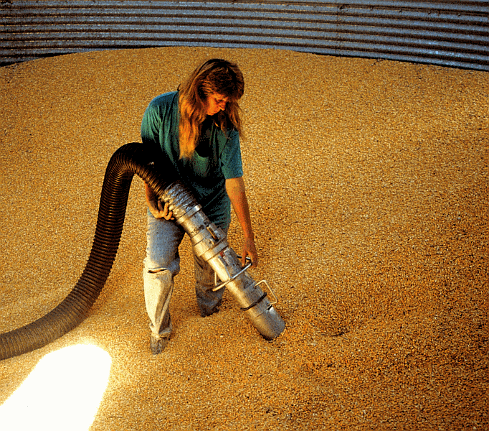
Use of Grain Vacuum
Picture From: www.public-health.uiowa.edu/

Slide 18
If Someone Is Trapped In Flowing Grain…
    An appropriate and timely response is critical
    First shut off all equipment
    Second call emergency assistance
    Inform Dispatcher of nature of accident
    Give locations and directions if needed
    Turn on aeration blower to increase the flow of air through bin, if so equipped
    This may help the entrapped person to breath

Slide 19
    While waiting on emergency rescue units
    Assemble any equipment that will assist with rescue
    Front-end loaders, shovels, plywood for coffer dams, and portable augers
    Successful technique for removal of a person
    Cut the bin and remove the grain around the victim
    This should be by trained rescuers with consideration of the structure involved

Slide 20
Partial Entrapment Rescue
Don’t jump into the bin, the victim could get buried deeper due to avalanching grain
Victim cannot be pulled free without injury
Don’t waste time digging without a grain retaining device/rescue tube
Construct a retaining device with what is available
Stabilize the victim

Slide 21
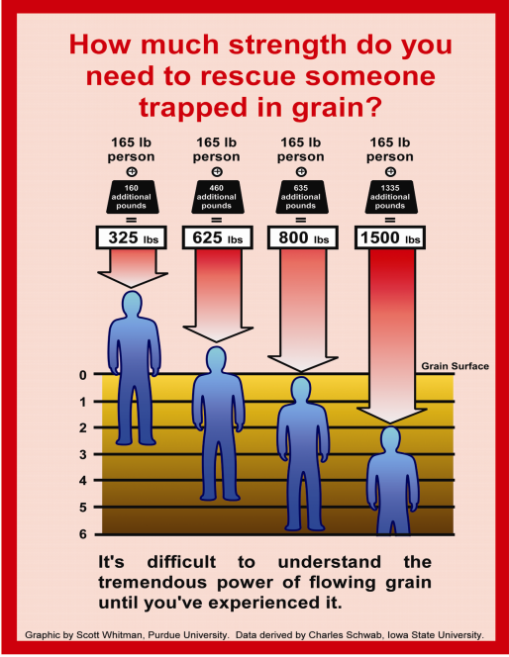

Slide 22
Two Primary Rescue Techniques
Removing the grain from around the victim by emptying the structure
Utilize a grain rescue tube to extricate victim from the grain

Slide 23
Removing The Grain From Around The Victim
Substantial need for manpower
Need for large capacity material handling equipment
Need to understand structural limitations
Need for cutting equipment
Potential use of grain vacuum equipment

Slide 24
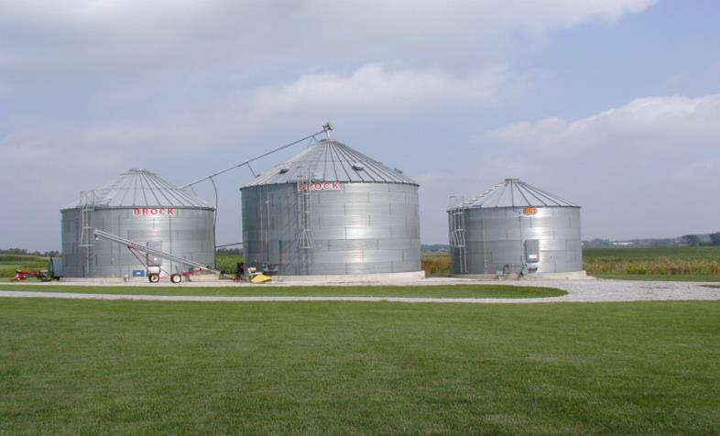
Standard Bin Design – Stacked Rings

Slide 25
DANGER
The consequences of cutting corrugated steel bins or tanks larger than 20,000 bushels in capacity are unknown

Slide 26
Cutting smaller bins
What size of V to cut?
30 – 40 inches
31 inches max
Cut on bottom edges of V

Slide 27
Things to Keep in Mind
Bins can be replaced
Cut 4 V’s evenly placed around bin
Make initial cuts at approximate level of victim if known
Never cross rings when cutting V’s
Never cut through stiffeners
Use Extreme caution when cutting bins larger than 36’ diameter and taller than 20’ (20,000 + bushels) BINS CAN COLAPSE!

Slide 28
DANGER
Keep all rescuers out of bin during rapid evacuation of grain to avoid secondary entrapments

Slide 29
Emptying Larger Structures
Determine grain level within bin:
By visual observation thru the bin hatch
By climbing outside ladder and tapping on bin
Use a ladder truck and cut 4 evenly spaced V’s two ring below level of grain surface or location of victim – whichever is higher
Work down the bin in this manner, rotating the 4 cuts 45 degrees from the previous cuts until the victim is uncovered

Slide 30
Responding to Complete Engulfment
On-Site Response Plan
Stop – Do not enter structure until hazard assessment is done
Shut down and lock out equipment
Activate local emergency fire rescue services
Turn on aeration fans
Assemble employees
Assess situation and resources
Implement situation-specific action plan

Slide 31
Responding to Complete Engulfment
When arriving on scene, talk with employees of operation
    They know the layout and how things work
    They know characteristics of grain, they work with it
Work with employee to lock out all equipment but fans

Slide 32
Responding to Complete Engulfment
Turn on fans at the storage structure
    Note: Just because someone is buried doesn’t mean they’re dead
Do not enter the structure if it will cause the victim to be buried deeper

Slide 33
Potential Rescue Hazards
Bin steps and ladders (350 Lb limit)
Flowing grain, secondary entrapment
Hazardous atmosphere, dust, and chemicals
Overexertion
Exposure to grain handling equipment

Slide 34
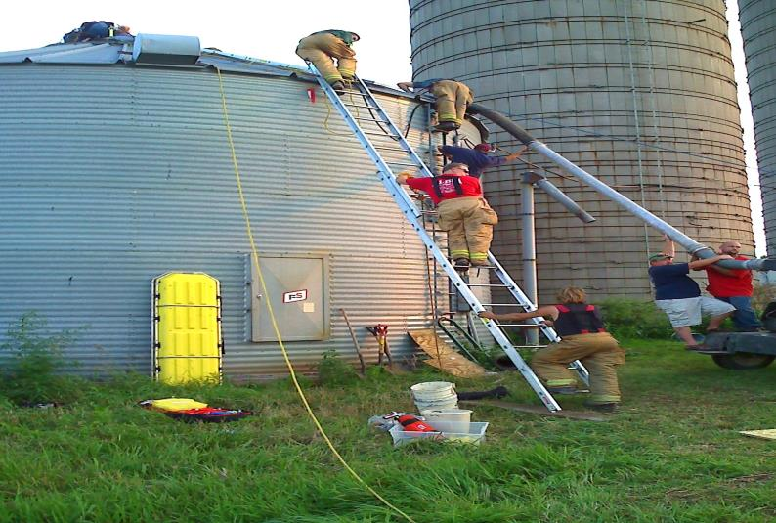
Example 1 – Successful Grain Bin Rescue

Slide 35
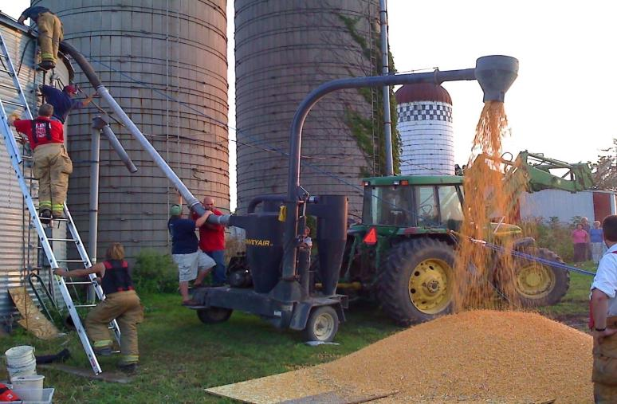
Example 1 – Successful Grain Bin Rescue

Slide 36
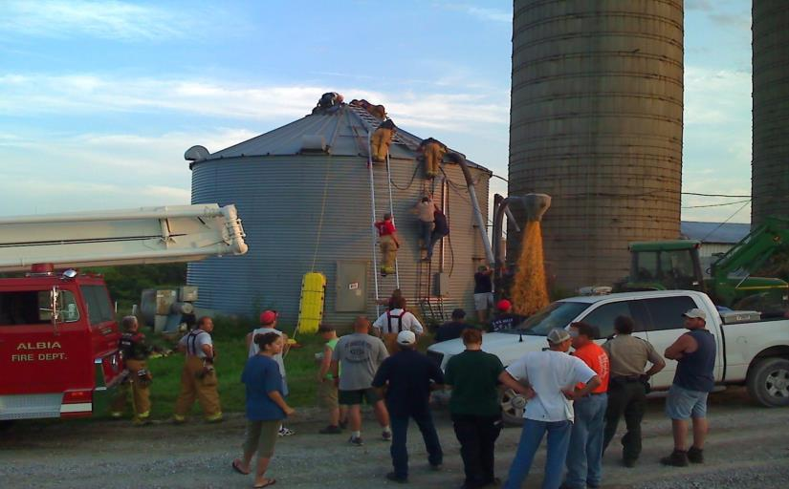
Example 1 – Successful Grain Bin Rescue

Slide 37
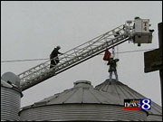
One Option for Overhead Grain Bin Rescue

Slide 38
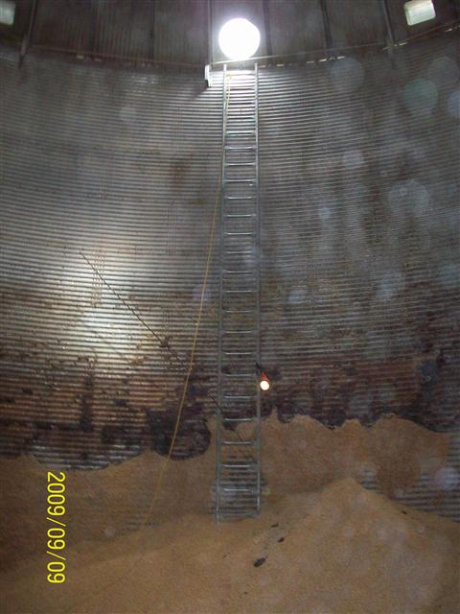
Example 2 – Successful Grain Bin Rescue

Slide 39
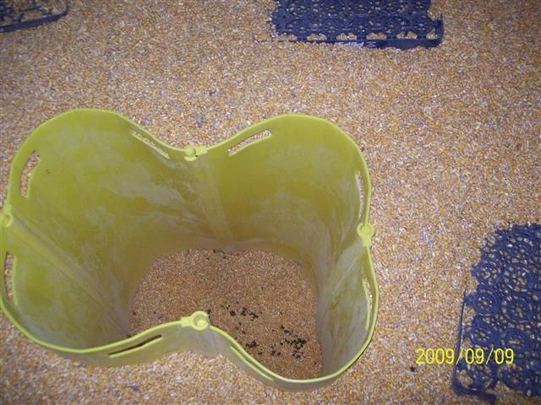
Example 2 – Successful Grain Bin Rescue

Slide 40
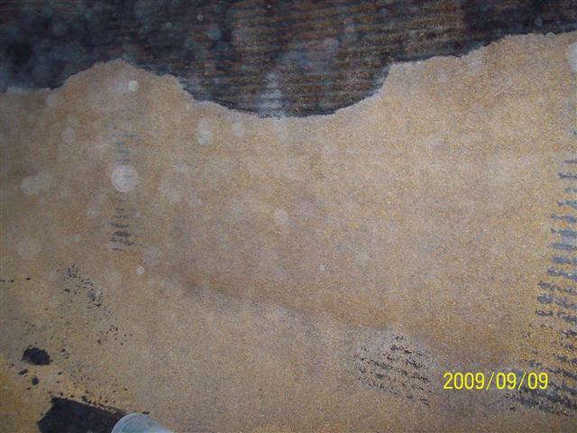
Example 2 – Successful Grain Bin Rescue

Slide 41
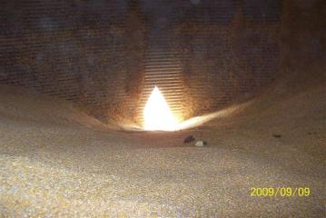
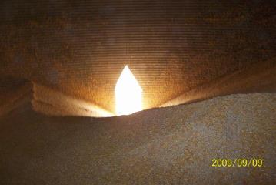
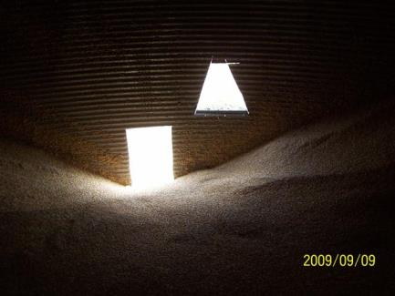
Example 2 - Grain Bin Rescue

Slide 42
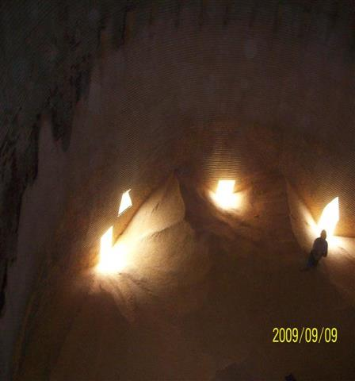
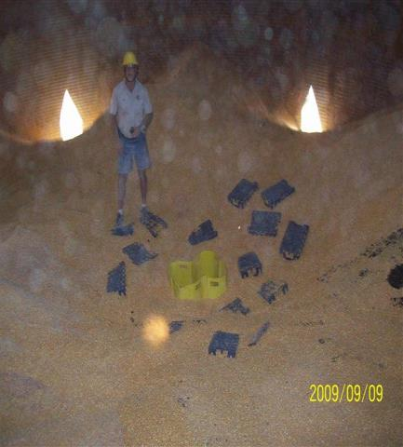
Example 2 - Successful Grain Bin Rescue

Slide 43
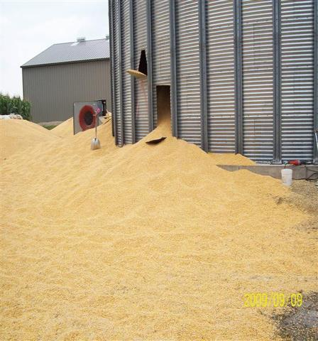
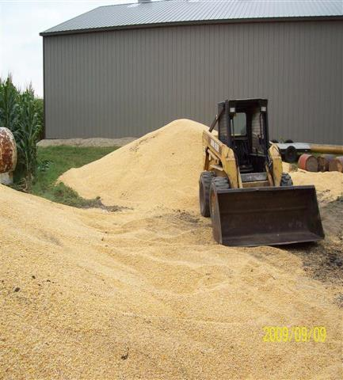
Example 2 – Successful Grain Bin Rescue

Slide 44
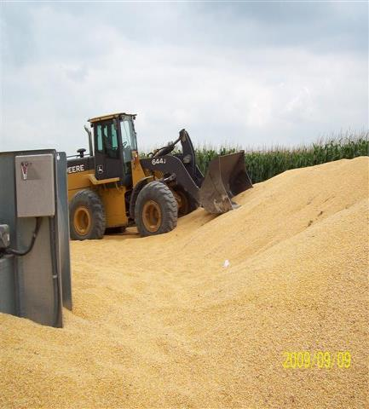
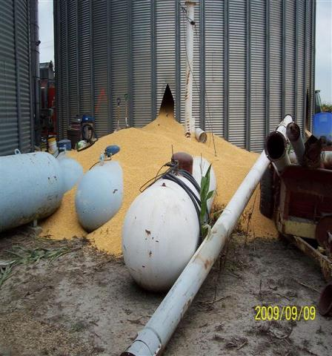
Example 2 – Successful Grain Bin Rescue

Slide 45
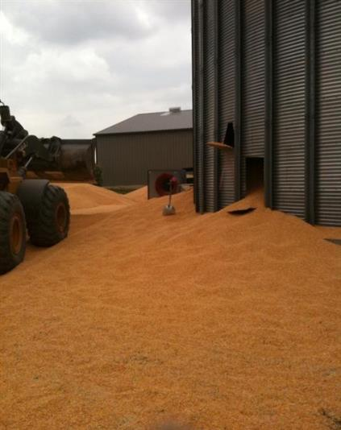
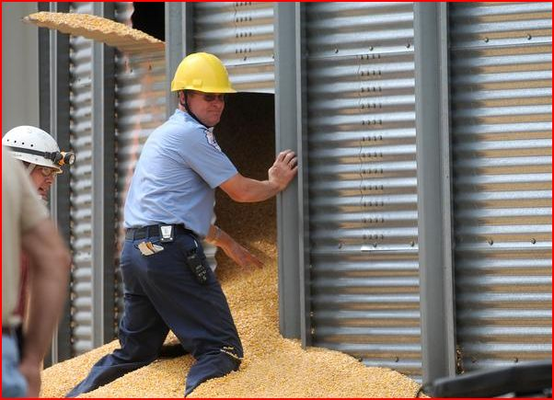
Example 2 – Successful Grain Bin Rescue

Slide 46
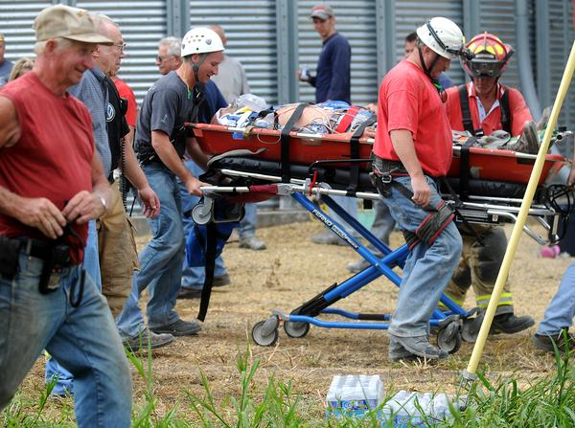
Example 2 – Successful Grain Bin Rescue

Slide 47
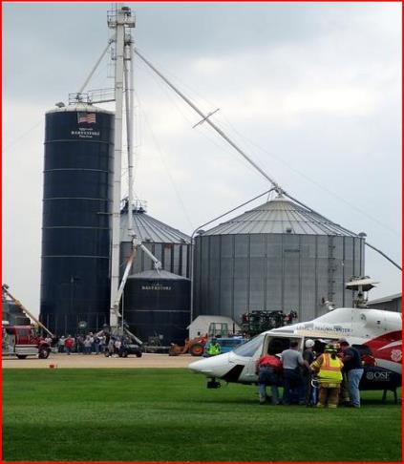
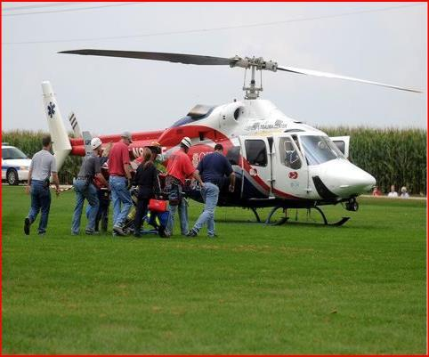
Example 2 – Successful Grain Bin Rescue

Slide 48
Summary
The best rescue is one that never happens
Never enter an emergency situation alone
Use confined space entry procedures or best practices available
Conduct a hazard assessment
Remember who is the most important: YOU!

