Slide 1

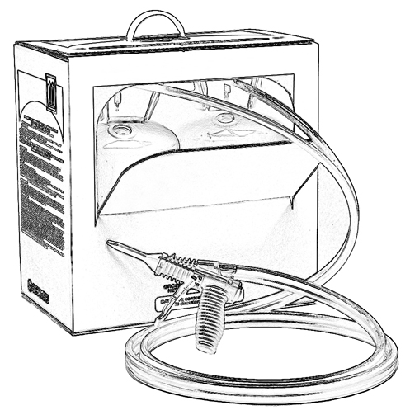


Unit 10:
General First Aid

Slide 2

Grant Provided by the Occupational Safety and Health Administration (OSHA), U.S. Department of Labor (DOL)
This material produced under grant SH-22308-SH1 from the Occupational Safety and Health Administration (OSHA), U.S. Department of Labor.
It does not necessarily reflect the views or policies of the U.S. Department of Labor, nor does mention of trade names, commercial products, or organizations imply endorsement by the U.S. Government.

Slide 3
Welcome to Unit 10
In this unit, you will learn about general first aid procedures in the event a worker experiences:
difficulty breathing
ingestion
skin contact
eye contact
Always consult the Safety Data Sheet (SDS) for specific first aid instructions.
Notes:
Narration:
In this unit, you will learn about first aid procedures in the event a worker experiences:
difficulty breathing
ingestion
skin contact
or eye contact
Always consult the Safety Data Sheet (SDS) for specific first aid instructions.

Slide 4


First Aid
The following slides include general first aid advice for chemicals that you may encounter at a spray polyurethane foam job site.
For specific first aid instructions for the chemical with which you are working, always refer to the SDS.
Notes:
Narration:
The following slides include general first aid advice applicable to chemicals that you may encounter at an SPF job site. For specific instructions on the chemical with which you are working, always refer to the SDS.

Slide 5
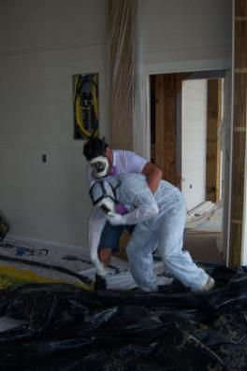
First Aid: Difficulty Breathing
What if someone is experiencing difficulty breathing?
Move affected person to an area with fresh air
Notes:
Narration:
What if someone is experiencing difficulty breathing? Immediately help move the person into fresh air, away from the spray application zone and help take off his respirator.

Slide 6

First Aid: Difficulty Breathing
What should you do next?
Seek immediate medical attention if the person has difficulty breathing. Remember to bring the SDS.
Notes:
Narration:
Immediately seek medical attention if the person is having difficulty breathing.
Remember to bring the SDS with you when seeking medical attention.

Slide 7


First Aid: Ingestion
What if someone gets chemicals in his/her mouth?
Refer to SDS for specific information
DO NOT induce vomiting
If person is conscious, flush mouth out with water
Seek medical attention if needed. Remember to bring the SDS with you.
Notes:
Narration:
What do you do if someone gets chemicals in his or her mouth?
Refer to the SDS for specific information.
If they have swallowed any chemical, do NOT induce vomiting.
If the person is conscious, flush the mouth out with lots of water.
Seek medical attention if needed. Remember to bring the SDS with you when seeking medical attention.

Slide 8

First Aid: Skin Contact
What if someone get chemicals on skin?
Refer to the SDS for specific information
Remove contaminated clothing
Wash skin thoroughly with soap and/or water. Do not use solvents!
Seek medical attention if irritation develops. Remember to bring the SDS.
Notes:
Narration:
What if someone gets chemicals on skin?
Refer to the SDS for specific information regarding first aid for skin contact.
Remove contaminated clothing. In many cases, wash skin thoroughly with soap and/or water. DO NOT USE SOLVENTS!
Seek medical attention if irritation develops. Remember to bring the SDS with you when seeking medical attention.

Slide 9
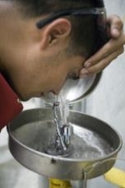
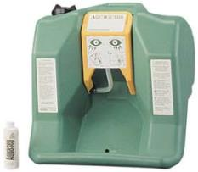
First Aid: Eye Contact
What if someone get chemicals in his/her eye?
Refer to the SDS for specific information about first aid for eye contact
Typically, wash the eye with water, preferably from an eyewash fountain, for up to 15 minutes
Seek medical attention if irritation develops. Remember to bring the SDS.
Notes:
Narration:
What if someone gets chemicals in his or her eye?
Refer to SDS for specific information about first aid for eye contact.
Wash with water, preferably from an eyewash fountain, for up to 15 minutes. Seek medical attention if irritation develops and remember to bring the SDS with you.

Slide 10
Unit 10 Summary
In this unit, you learned about general first aid procedures in the event a worker experiences:
difficulty breathing
ingestion
skin contact
eye contact
Always consult the SDS for specific
first aid instructions.
Notes:
Narration:
In this unit, you learned about first aid procedures in the event a worker experiences:
difficulty breathing
ingestion
skin contact
or eye contact
Always consult the SDS for specific first aid instructions.

Slide 11
Unit 10 Review
Knowledge
Into
Action
Notes:
Narration:
It is time to put your knowledge into action.

Slide 12
Unit 10: Q1 Debrief
For specific first aid instructions for the chemical with which you will be working, ________.
refer to the Safety Data Sheet (SDS)
ask your co-worker
do a computer search on the topic of first aid for chemical exposure
None of the above
Notes:
For specific first aid instructions for the chemical with which you are working, _____.
refer to the Safety Data Sheet (SDS)
ask your co-worker
do a computer search on the topic of first aid for chemical exposure
None of the above

Slide 13
Unit 10: Q1 Debrief
For specific first aid instructions for the chemical with which you will be working, ________.
refer to the SDS
ask your co-worker
do a computer search on the topic of first aid for chemical exposure
None of the above
Notes:
The correct answer is A. Refer to the Safety Data Sheet for specific first aid instructions for the chemical with which you will be working.

Slide 14
Unit 10 Completed
Continue to Unit 11
Return to the Main Menu
Notes:
Narration:
You have completed Unit 10.

