Slide 1

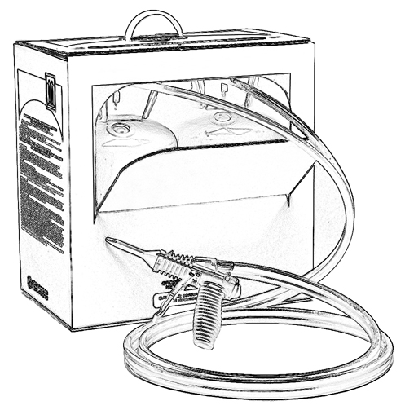


Unit 12:
Responding to Emergencies
When Using Two-Component
Low Pressure SPF

Slide 2

Grant Provided by the Occupational Safety and Health Administration (OSHA), U.S. Department of Labor (DOL)
This material produced under grant SH-22308-SH1 from the Occupational Safety and Health Administration (OSHA), U.S. Department of Labor.
It does not necessarily reflect the views or policies of the U.S. Department of Labor, nor does mention of trade names, commercial products, or organizations imply endorsement by the U.S. Government.

Slide 3
Welcome to Unit 12
In this unit, you will learn about:
how to respond should there be an emergency when applying low pressure SPF.
Notes:
Narration:
In this unit, you will learn about:
how to respond if there is an emergency when applying low pressure spray polyurethane foam.
Let’s begin.

Slide 4
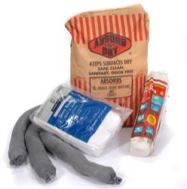
Spill Containment
Have a spill plan in place before starting the job. An accidental spill could occur (e.g., a hose rupture or a
loose fitting on a connection).
refer to manufacturer’s instructions for specific information
identify trained spill responders
keep spill containment and
clean up materials available at the job site
Notes:
Narration:
It is a good idea to have a spill plan in place before starting the job. An accidental spill of SPF chemicals could occur when using a two-component low pressure system, perhaps due to a hose rupture or a loose fitting, for example.
If a spill occurs, refer to the manufacturer’s instructions for specific information.
Identify the trained spill responders so they can respond quickly. Keep spill containment and clean up materials at the job site. This includes absorbent materials, barriers, as well as personal protective equipment for the responders.

Slide 5

What should you do if there is a spill?
Identify the spilled material
Notes:
Narration:
First, identify the chemical that spilled. For example, determine if the spill is actually an SPF chemical or some other material on the job site. If it is an SPF chemical, is it from the A-side or the B-side? You will handle the spill differently based on what chemical was spilled.

Slide 6
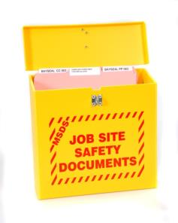
Safety Data Sheets (SDS)
Be familiar with information
on the SDS before work begins.
If a spill does occur, refer to the SDS for specific information on how to clean up the spilled chemical.
Notes:
Narration: Be familiar with information on the SDS before beginning a job. If a spill does occur, refer to the SDS for specific information on how to clean up the spilled chemical.

Slide 7
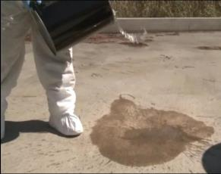
Implement Spill Clean up Plan
What do you do if there is a chemical spill?
Determine the spill size
With your employer’s permission, you may want to consider cleaning up the spill if it is a manageable quantity and you have received appropriate training
Notes:
Narration:
First you will want to determine the size of the spill.
With your employer’s permission, you may want to consider cleaning up the spill if it is a manageable quantity and you have received appropriate training.

Slide 8
Chemical Spill: Protection
Consider the following:
refer to SDS
protect all people present
clear the area of everyone not involved with the spill clean up
wear appropriate PPE in the spill clean up area
Notes:
Narration:
For chemical spill protection, consider the following:
Refer to the SDS for information on spills.
Protect all people that are present. Clear the area of everyone who is not involved in cleaning up the spill.
Wear proper personal protective equipment before starting to clean up the spill.

Slide 9
Chemical Spill: Personal Protective Equipment (PPE)
Refer to the SDS for information on PPE for the spilled chemical. Typical PPE during spill clean up includes:
chemical-resistant gloves
protective clothing that covers skin
eye protection and a face shield if potential for splash
respiratory protection may be needed
Notes:
Narration:
Always refer to the SDS for information on appropriate PPE for the specific chemical that spilled.
Typical PPE during spill clean up includes: chemical-resistant gloves, protective clothing and eye protection. If there is a potential for splash, a face shield may be needed. Respiratory protection also may be needed.

Slide 10


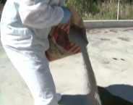
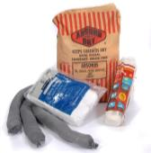
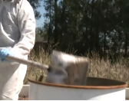
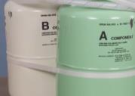
Considerations for Cleaning up Small Spills
1. Refer to SDS for specific instructions
2. Contain and neutralize the spill
3. Cover spill with absorbent
4. Collect waste material in a container
5. Decontaminate the surface
6. Dispose of waste per applicable regulations
Notes:
Narration:
The following are considerations that may be helpful when cleaning up a small spill.
1. Always refer to the SDS for specific instructions for the chemicals with which you are working.
2. Contain and neutralize the spill, if applicable. Refer to the SDS for specific information.
3. Cover the spill with an absorbent material.
4. Collect the waste absorbent and spilled material in a container. Be careful not to overfill the container.
5. Decontaminate the surface where the spill occurred with a neutralization solution. Refer to the SDS for information regarding appropriate decontamination solutions.
6. Finally, dispose of the waste according to applicable federal, state, and local waste regulations.

Slide 11
Unit 12 Summary
In this unit, you learned about:
how to respond should there be an emergency when applying low pressure SPF.
Notes:
Narration:
In this unit, you learned about:
how to respond to should there be an emergency when applying low pressure SPF.

Slide 12
Unit 12 Review
Knowledge
Into
Action
Notes:
Narration:
It is time to put your new knowledge into action.

Slide 13
Unit 12: Q1 Debrief
If a spill does occur, which of the following is an appropriate action to take?
Identify the spilled material.
Refer to the manufacturer’s instructions and SDS for guidance on clean up.
With your employer’s permission, consider cleaning up the spill if it is a manageable quantity and you have appropriate training.
All of the above.
Notes:
If a spill does occur, which of the following is an appropriate action to take?
Identify the spilled material.
Refer to the manufacturer’s instructions and SDS for guidance on clean up.
With your employer’s permission, consider cleaning up the spill if it is a manageable quantity and you have appropriate training.
All of the above

Slide 14
Unit 12: Q1 Debrief
If a spill does occur, which of the following is an appropriate action to take?
Identify the spilled material.
Refer to the manufacturer’s instructions and SDS for guidance on clean up.
With your employer’s permission, consider cleaning up the spill if it is a manageable quantity and you have appropriate training.
All of the above.
Notes:
The correct answer is D. All of the above are appropriate actions to take in the event of a spill.

Slide 15
Unit 12: Q2 Debrief
PPE typically worn when cleaning up a chemical spill includes all of the following except:
chemical-resistant gloves
hearing protection
eye protection
protective clothing
Notes:
PPE typically worn when cleaning up a chemical spill includes all of the following except:
chemical-resistant gloves
hearing protection
eye protection
protective clothing

Slide 16
Unit 12: Q2 Debrief
PPE typically worn when cleaning up a chemical spill includes all of the following except:
chemical-resistant gloves
hearing protection
eye protection
protective clothing
Notes:
The correct answer is B. PPE typically worn when cleaning up a chemical spill includes chemical-resistant gloves, eye protection and protective clothing. Respiratory protection also may be needed in certain instances. Always refer to the SDS for guidance.

Slide 17
Unit 12 Completed
Continue to Unit 13
Return to the Main Menu
Notes:
Narration:
You have completed Unit 12.

