Slide 1

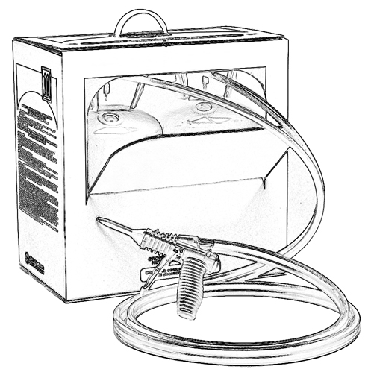


Unit 14:
Other Safety Considerations for Low Pressure SPF Application

Slide 2

Grant Provided by the Occupational Safety and Health Administration (OSHA), U.S. Department of Labor (DOL)
This material produced under grant SH-22308-SH1 from the Occupational Safety and Health Administration (OSHA), U.S. Department of Labor.
It does not necessarily reflect the views or policies of the U.S. Department of Labor, nor does mention of trade names, commercial products, or organizations imply endorsement by the U.S. Government.

Slide 3
Welcome to Unit 14
In this unit, you will learn about other important safety considerations when using low pressure SPF products such as:
Working in confined spaces
Protecting yourself from slips and falls
Avoiding temperature stress
Notes:
Narration:
In this unit, you will learn about other important safety considerations when using low pressure SPF products such as:
Working in confined spaces
Protecting yourself from slips and falls
Avoiding temperature stress

Slide 4
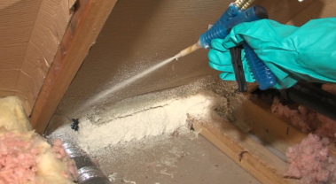
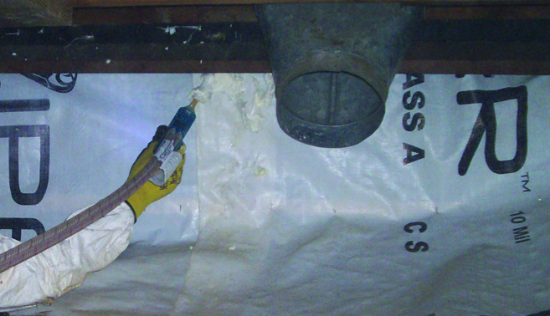
Confined Spaces
Air sealing and insulating with low pressure SPF may take place in confined or enclosed spaces, such as attics or crawlspaces.
This can pose unique safety challenges since air movement is limited. Therefore, SPF vapors may not dissipate as quickly.
Notes:
Narration:
In addition to the safety guidance covered in the previous units, there are some additional considerations when working with low pressure spray polyurethane foam for weatherization projects. Air sealing and insulating may take place in confined or enclosed spaces, such as attics or crawlspaces.
This can pose unique safety challenges. Air movement is limited and therefore SPF vapors may not dissipate as quickly.

Slide 5
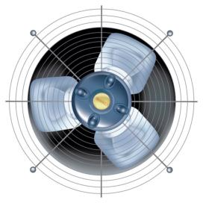
Considerations When Working in Confined Spaces
Refer to the product instructions and SDS for specific information.
Ventilate attics and crawlspaces using best efforts recommended by product manufacturer (e.g., Use fans to move vapor away from applicators. Vent exhaust to unoccupied areas.)
Wear proper PPE, including an approved respirator. (refer to Unit 9)
Keep entry and exit points accessible.
Notes:
Narration:
Here are some considerations when working in confined spaces:
Always refer to the instructions and the Safety Data Sheet for the low pressure product with which you are working. Follow all safety guidance.
Use best efforts to ventilate when working in a confined space, such as an attic or crawlspace. This may include the use of fans to move vapor away from the applicator. Vent fan exhaust to unoccupied areas.
Spray two-component low pressure SPF while wearing proper personal protective equipment, including an approved respirator.
And keep entry and exit points free of equipment and debris so they remain accessible.

Slide 6
OSHA Information: Confined Spaces
Confined space hazards for typical low pressure SPF weatherization applications are addressed by the Occupational Health and Safety Administration (OSHA) in specific standards for the construction industry:
29 CFR 1926.21(b)(6)(i)
29 CFR 1926.21(b)(6)(ii)
For more information/resources, visit the OSHA website: http://www.osha.gov/SLTC/confinedspaces
Notes:
Narration:
Confined space hazards for typical low pressure SPF weatherization applications are addressed by the Occupational Health and Safety Administration in specific standards for the construction industry under 29 CFR 1926.21.
For more information and resources, visit OSHA’s website.

Slide 7
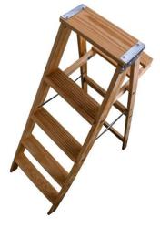
Slips and Falls – Don’t Put Yourself at Risk
“Falls are the most frequent cause of fatalities at construction sites and annually account for one of every three construction-related deaths.”
“In 2010, the Bureau of Labor Statistics reported that 751 construction workers died on the job, with 35 percent of those fatalities resulting from falls.”
- Occupational Health and Safety Administration (OSHA) -
Notes:
Narration:
Another consideration when applying low pressure SPF is the potential for injury due to slips and falls. In fact, according to OSHA citing Bureau of Labor Statistics or BLS, falls are the most frequent cause of fatalities at construction sites and annually account for one of every three construction-related deaths.* According to 2010 fatality data from the BLS, 751 construction workers died on the job, with 35% of those fatalities from falls.**
References listed below for statistics.
* http://www.osha.gov/doc/falls/preventingfalls.html
** http://www.osha.gov/SLTC/fallprotection/construction.html

Slide 8

Slips and Falls
Potential injuries from slips and falls can be caused by unsafe work practices such as:
an elevated work platform, such as scaffolding or a ladder, that is poorly constructed or used incorrectly
a worksite cluttered with debris
Notes:
Narration:
Sometimes a weatherization project may require you to apply the foam in an elevated location.
Potential injuries from slips and falls can occur from unsafe work practices. Examples could include use of an elevated work platform, such as scaffolding or a ladder, that is poorly constructed or used incorrectly.
Also, a worksite that is cluttered with debris can create tripping hazards. It is important to take steps to minimize the risk.

Slide 9
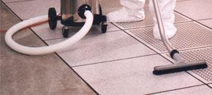
Considerations to Prevent Slips and Falls
Ladders and scaffolding must be constructed and used in accordance with OSHA standards.
All elevated work must comply with OSHA fall protection requirements.
Keep the worksite clean and free of tripping hazards.
Be observant. Watch for potential hazards and take preventative action.
Notes:
Narration:
Here are some considerations to help prevent potential slips and falls on the jobsite:
Ladders and scaffolding must be constructed and used in accordance with current OSHA standards.
All elevated work must comply with OSHA fall protection requirements.
Keep the worksite clean and free of tripping hazards.
And be observant. Watch for potential slip and fall hazards and take preventative action.

Slide 10
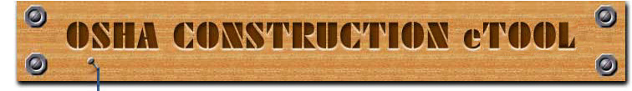
OSHA Fall Protection Requirements
For construction projects, OSHA requirements are described in Standard 29 CFR Part 1926.
Subparts: L (Scaffolds), M (Fall Protection) and X (Ladders)
Helpful resources include the OSHA Construction eTool, which suggests ways to help prevent slips and falls. Visit:
www.osha.gov/SLTC/etools/construction/falls/mainpage.html
Notes:
Narration:
For construction projects, fall protection requirements are described in OSHA Standard 29 CFR Part 1926.
Subparts “L” discusses scaffolds, “M” covers fall protection and “X” discusses ladder requirements.
OSHA provides a number of helpful resources including the OSHA Construction eTool, which covers a variety of safety topics, including ways to help prevent slips and falls. Visit the OSHA website for more information.

Slide 11

Temperature Stress
SPF application may take place outdoors or in work areas where the HVAC system is turned off or unavailable.
This may result in workers applying SPF in very hot or very cold conditions, which can contribute to potential health hazards caused by temperature stress.
To optimize product performance, an ideal ambient temperature to apply two-component LP SPF products is typically between 60°F-90°F. (Note: ideal chemical temperature for application is typically between
70°F-90°F)*
Follow the product manufacturer’s recommended application temperature since this can vary.
* Optimal temperature for standard LP systems
Notes:
Narration:
Application of low pressure spray foam may take place outdoors or in work areas where the HVAC system is turned off or unavailable.
This could result in an environment where you are applying SPF in very hot or very cold conditions, which can contribute to potential health hazards caused by temperature stress. Follow the product manufacturer’s recommended application temperature since this can vary.

Slide 12
Conditions That May Contribute to Temperature Stress
Conditions that may contribute to temperature stress include:
Increased physical labor due to spraying the foam
Extra weight of spray equipment and PPE
Elevated sweat rate which can increase cold or heat stress depending on worksite temperature, humidity and other conditions.
Low liquid intake
Limited ventilation or air flow in hot conditions
Notes:
Narration:
Some conditions that may contribute to temperature stress when applying spray foam include:
Increased physical labor due to spraying the foam
Extra weight of spray equipment and PPE while applying the foam
An elevated sweat rate which can increase cold or heat stress depending on worksite temperature, humidity and other conditions
Not drinking enough liquids to stay well hydrated
And limited ventilation and air flow in hot conditions. This can increase the potential for heat stress.

Slide 13
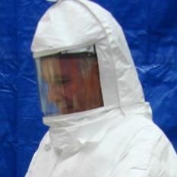
Suggested Ways to Avoid Heat Stress
Here are some suggested ways to avoid heat stress:
Know heat stress symptoms; monitor yourself; use a buddy system
Provide adequate ventilation
Consider a loose-fitting, hooded powered
air-purifying respirator (PAPR), which can circulate cool air
Drink plenty of fluids. Drink often and before you are thirsty. Avoid beverages with alcohol or caffeine
Schedule frequent rest periods in shaded or air conditioned areas
Notes:
Narration:
Let’s take a look at some ways to avoid heat stress when applying low pressure spray polyurethane foam:
Know heat stress symptoms. Monitor yourself and consider using a buddy system to watch out for coworkers.
Provide adequate ventilation through the use of fans and by opening windows and doors.
Consider wearing a loose-fitting, hooded powered air-purifying respirator (PAPR), which can circulate cool air.
Drink plenty of fluids. Drink often and before you are thirsty. Avoid beverages that contain alcohol or caffeine.
And schedule frequent rest periods in shaded or air conditioned areas.

Slide 14
Heat Illness – Typical Symptoms
Heat exposure can cause illness. The most serious heat illness is heat stroke, which can be life threatening. Here are some typical symptoms:
Symptoms of Heat Exhaustion Headache, dizziness, or fainting Weakness and wet skin Irritability or confusion Thirst, nausea or vomiting | Symptoms of Heat Stroke May be confused, unable to think clearly, pass out, or collapse May have seizures (fits) May stop sweating
Notes:
Narration:
Be aware that exposure to heat can cause illness. The most serious heat illness is heat stroke, which can be life threatening.
Here are some of typical symptoms a person may experience from heat exhaustion:
A headache, dizziness, or fainting
Weakness and wet skin
Irritability or confusion
Thirst, nausea or vomiting
A person suffering a heat stroke may experience symptoms such as:
Being confused, unable to think clearly, passing out
or collapsing
The person may have seizures or fits, and may stop sweating.

Slide 15
General First Aid Procedures for Heat Illness
What if someone appears to be suffering from heat illness?
Call your supervisor and stay with the person until help arrives
Move person into a cooler, shaded area (away from SPF vapors)
Remove personal protective clothing (PPE), including respirator
Fan and mist person with water; apply ice bags/towels
Provide cool drinking water, if person is conscious
If the person is not alert or seems confused, this may be a heat stroke. CALL 911 IMMEDIATELY and apply ice.
Notes:
Narration:
What should you do if someone appears to be suffering from heat illness?
Call your supervisor and stay with the person until help arrives
Move the person into a cooler, shaded area - away from any SPF vapors
Remove personal protective clothing (PPE), including the respirator
Fan and mist the person with water and apply ice bags and cool towels
Provide cool drinking water, if the person is conscious
If the person is not alert or seems confused, this may be a heat stroke. CALL 911 IMMEDIATELY, seek medical attention and apply ice.

Slide 16
OSHA Information: Heat Stress
OSHA does not currently have a specific standard or
regulation regarding heat stress in the workplace.
However, OSHA provides a standards interpretation letter:
“Acceptable methods to reduce heat stress hazards in the workplace.”
(Oct. 17, 2001)
It also offers many helpful resources, such as the OSHA
QuickCard “Protecting Workers from Heat Stress.”
For these resources and more information, visit:
http://www.osha.gov/SLTC/heatstress/index.html
Notes:
Narration:
OSHA does not currently have a standard or regulation regarding heat stress in the workplace. However, it does provide a standards interpretation letter, “Acceptable methods to reduce heat stress hazards in the workplace” which offers precautions that can be taken. OSHA also provides many other helpful resources, such as the OSHA QuickCard “Protecting Workers from Heat Stress.” Visit the OSHA website for more information.

Slide 17
Unit 14 Summary
In this unit, you learned about:
Working in confined spaces
Protecting yourself from slips and falls
Avoiding temperature stress
Notes:
Narration:
In this unit, you learned about:
Working in confined spaces
Protecting yourself from slips and falls
Avoiding temperature stress

Slide 18
Unit 14 Review
Knowledge
Into
Action
Notes:
Narration:
Now let’s put your knowledge into action.

Slide 19
Unit 14: Q1 Debrief
A unique safety challenge when applying two-component low pressure SPF in a confined space (e.g., attic or crawlspace) is ____________.
SPF vapors may not dissipate as quickly since air movement is limited (the use of fans can help move vapor away from the applicator)
ventilation may be limited (proper PPE, including an approved respirator is required)
entry and exit points may be more restricted (keeping these areas free of equipment and debris is very important)
all of the above
Notes:
A unique safety challenge when applying two-component low pressure SPF in a confined space such as an attic or crawlspace, is ____________.
SPF vapors may not dissipate as quickly since air movement is limited (the use of fans can help move vapor away from the applicator).
ventilation may be limited (proper PPE, including an approved respirator is required)
entry and exit points may be more restricted (keeping these areas free of equipment and debris is very important)
all of the above

Slide 20
Unit 14: Q1 Debrief
A unique safety challenge when applying two-component low pressure SPF in a confined space (e.g., attic or crawlspace) is ____________.
SPF vapors may not dissipate as quickly since air movement is limited (the use of fans can help move vapor away from the applicator)
ventilation may be limited (proper PPE, including an approved respirator is required)
entry and exit points may be more restricted (keeping these areas free of equipment and debris is very important)
all of the above
Notes:
The correct answer is D. All of the above pose unique safety challenges when applying two-component low pressure SPF in a confined space, such as an attic or crawlspace.

Slide 21
Unit 14: Q2 Debrief
The following are ways to help prevent potential injuries from slips and falls except:
Ladders and scaffolding must be constructed and used in accordance with OSHA standards.
Elevated work must comply with OSHA fall protection requirements.
Do not use eye protection when applying spray polyurethane foam so your visibility is better.
Keep the worksite clean and free of tripping hazards.
Notes:
The following are ways to help prevent potential injuries from slips and falls except:
Ladders and scaffolding must be constructed and used in accordance with OSHA standards.
Elevated work must comply with OSHA fall protection requirements.
Do not use eye protection when applying spray polyurethane foam so your visibility is better.
Keep the worksite clean and free of tripping hazards.

Slide 22
Unit 14: Q2 Debrief
The following are ways to help prevent potential injuries from slips and falls except:
Ladders and scaffolding must be constructed and used in accordance with OSHA standards.
Elevated work must comply with OSHA fall protection requirements.
Do not use eye protection when applying spray polyurethane foam so your visibility is better.
Keep the worksite clean and free of tripping hazards.
Notes:
The correct answer is C. Whenever you apply SPF, eye protection is required. Be sure that your eye protection is well maintained and provides good visibility while applying the foam.

Slide 23
Unit 14: Q3 Debrief
Which of the following is not a way to help avoid heat stress?
Provide adequate ventilation through the use of fans and by opening windows and doors.
Drink plenty of beverages that contain alcohol or caffeine.
Consider wearing a loose-fitting, hooded powered air-purifying respirator which can circulate cool air to the user.
Schedule frequent rest periods in shaded or air conditioned areas.
Notes:
Which of the following is NOT a way to help avoid heat stress?
Provide adequate ventilation through the use of fans and by opening windows and doors.
Drink plenty of beverages that contain alcohol or caffeine.
Consider wearing a loose-fitting, hooded powered air-purifying respirator which can circulate cool air to the user.
Schedule frequent rest periods in shaded or air conditioned areas.

Slide 24
Unit 14: Q3 Debrief
Which of the following is not a way to help avoid heat stress?
Provide adequate ventilation through the use of fans and by opening windows and doors.
Drink plenty of beverages that contain alcohol or caffeine.
Consider wearing a loose-fitting, hooded powered air-purifying respirator which can circulate cool air to the user.
Schedule frequent rest periods in shaded or air conditioned areas.
Notes:
The correct answer is B. Avoid drinking beverages that contain alcohol or caffeine. However, it is a good idea to drink fluids often and before you are thirsty.

Slide 25
Unit 14 Completed
You have completed Unit 14
Return to Main Menu
Notes:
Narration:
Congratulations. You have completed Unit 14. This is the final Unit of the low pressure SPF training.

