Slide 1

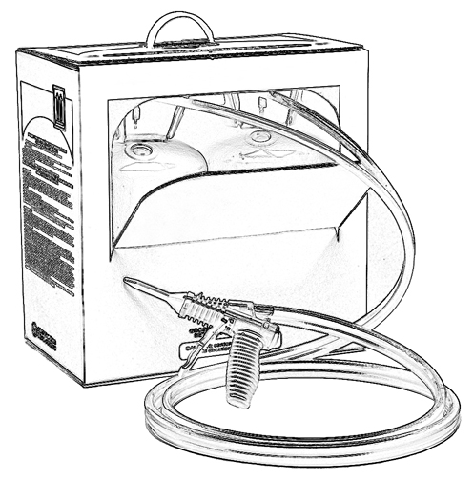


Unit 2: Hazard Communication
Safety Data Sheet (SDS) and Warning Labels

Slide 2

Grant Provided by the Occupational Safety and Health Administration (OSHA), U.S. Department of Labor (DOL)
This material produced under grant SH-22308-SH1 from the Occupational Safety and Health Administration (OSHA), U.S. Department of Labor.
It does not necessarily reflect the views or policies of the U.S. Department of Labor, nor does mention of trade names, commercial products, or organizations imply endorsement by the U.S. Government.

Slide 3
Welcome to Unit 2
In this unit, you will learn about:
Hazard Communication
Product labels and instructions
Safety Data Sheets (SDS)
Training
Notes:
Narration:
In this unit, you will learn about:
Hazard Communication
Product labels and instructions
Safety Data Sheets and
Training

Slide 4
Hazard Communication Standard
The Occupational Safety and Health Administration (OSHA) Hazard Communication Standard (HCS) was designed to provide employees with:
  Information on hazards of all chemicals used in the workplace, and
  Recommended protective measures
OSHA has modified the HCS to adopt the Globally Harmonized System of Classification and Labeling of Chemicals* (GHS). All covered employers are required to train employees on the new label elements and safety data sheet (SDS) format by December 1, 2013.
* Check www.osha.gov regularly for the most current version of the HCS.
Notes:
Narration:
The Occupational Safety and Health Administration Hazard Communication Standard was designed to provide employees with information on hazards of all chemicals they may use in the workplace and recommended protective measures. OSHA has modified the HCS to adopt the Globally Harmonized System of Classification and Labeling of Chemicals. All covered employers are required to train employees on the new label elements and safety data sheet (SDS) format by December 1, 2013.

Slide 5
OSHA Hazard Communications Standard - Written Program
OSHA Hazard Communications Standard requires all employers to have a written hazard communications program to address:
  Labels and other forms of warning
  Safety Data Sheets (SDSs) (formerly known as Material Safety Data Sheets or MSDSs)
  Employee training
OSHA REQUIRES YOUR EMPLOYER TO SHARE INFORMATION ABOUT ANY POTENTIALLY HAZARDOUS CHEMICALS IN YOUR WORKPLACE
Notes:
Narration:
OSHA Hazard Communications Standard requires all employers to have a written hazard communications program to address the following: labels and other forms of warning, Safety Data Sheets, and employee training.
OSHA requires your employer to share information about any potentially hazardous chemicals in your workplace.

Slide 6
Labels and Other Forms of Warning
The OSHA Hazard Communication Standard states that chemical containers be labeled and information be legible and clearly displayed in accordance with the Globally Harmonized System of Classification and Labeling of Chemicals* (GHS).
Chemical labels identify a container’s contents.
Labels are required to include information related to hazardous chemicals.
A good practice is to keep the original manufacturer’s product label on file.
* Visit www.osha.gov for additional information on OSHA’s GHS standards.
Notes:
Narration:
The OSHA Hazard Communication Standard states that chemical containers be labeled and information be legible and clearly displayed in accordance with the Globally Harmonized System of Classification and Labeling of Chemicals* (GHS).
Chemical labels identify a container’s contents.
Labels are required to include information related to hazardous chemicals.
A good practice is to keep the original manufacturer’s product label on file.

Slide 7

Safety Data Sheet (SDS)
The OSHA Hazard Communication Standard requires manufacturers to provide Safety Data Sheets, or SDSs, for hazardous chemicals they produce.
The SDS provides safety and health information.
BEFORE using any Spray Polyurethane Foam (SPF), read, understand and apply the SDS guidance.
If an SDS is not available at the job site for the SPF product you are about to use (or any other potentially hazardous chemicals), contact your employer.
Notes:
Narration:
The OSHA Hazard Communication Standard requires manufacturers to provide Safety Data Sheets, or SDS, for hazardous chemicals they produce.
SDS provides safety and health information.
Before using any Spray Polyurethane Foam (SPF) product, it is important to read, understand and apply the SDS guidance for the product.
If an SDS is not available at the job site for the SPF product you are about to use, or any other potentially hazardous chemicals, contact your employer before using the product.

Slide 8
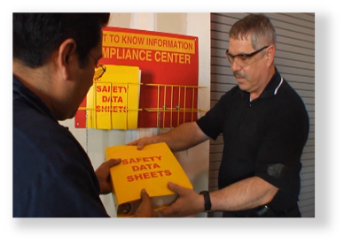
Reading the SDS
Reading the SDS helps you:
Understand potential hazards of chemicals you will be handling
Choose correct personal protective equipment (PPE) for the job
Understand first aid procedures
Learn how to handle, store and dispose of the product
Understand how to handle an emergency, such as a fire or chemical spill
Notes:
Narration:
Reading the SDS helps you:
Understand potential hazards of the chemicals you will be handling
Choose the correct Personal Protective Equipment (PPE) for the job
Understand first aid procedures in case you are exposed to a chemical
Learn how to handle, store and dispose of the product
And understand how to handle an emergency, such as a fire or a chemical spill.

Slide 9
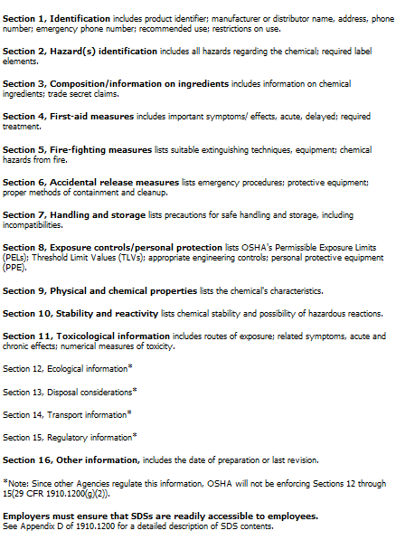
Safety Data Sheet (SDS)
As of June 1, 2015, the HCS will require new SDSs to be in a uniform format, and include section numbers, headings, and associated information under 16 required headings¹ as noted.
Read, understand and apply SDS guidance for chemicals you may use.
For detailed information contained in the SDS visit www.osha.gov.
¹Reference: OSHA QuickCard™ for example of SDS sections
Notes:
Narration:
As of June 1, 2015, the HCS will require new SDSs to be in a uniform format, and include section numbers, headings, and associated information under 16 required headings. Read, understand and apply the SDS guidance for chemicals you may use. For detailed information contained in the SDS visit www.osha.gov.

Slide 10
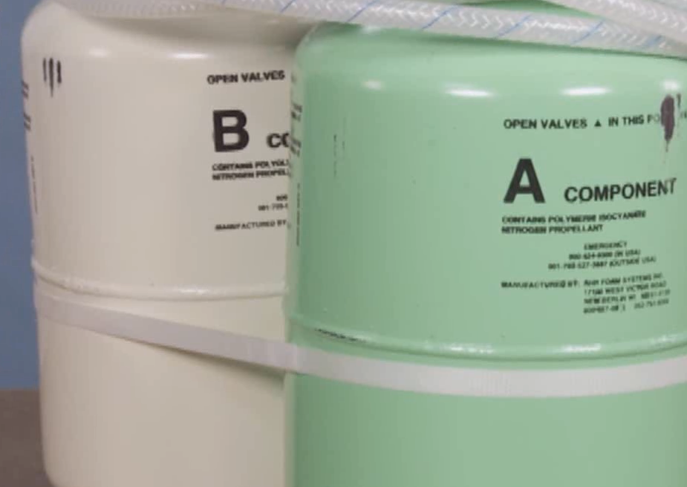

Where is chemical safety information found on low pressure SPF products?
Chemical safety information may be found in several places.
Labels/instructions may be found:
Directly on chemical tanks or cylinders
In or on the shipping box or package
Online (accessed with mobile/internet devices on the jobsite)
Safety Data Sheets may be found in several places:
With the product package/SPF kit box
In an SDS binder on the jobsite
Online
Notes:
Narration:
Chemical safety information may be found in several places. For example,
labels and instructions may be found:
Directly on chemical tanks or cylinders
Inside or on the shipping box or package or
Electronically online, so they can be accessed with mobile or other internet devices on the jobsite
Also, Safety Data Sheets may be found in several places, like the following:
With the product package or spray kit box
Or in an SDS binder on the jobsite or
Online

Slide 11
OSHA Hazard Communication Standard –
Employee Training
The OSHA Hazard Communication Standard requires employers to provide Hazard Communication training BEFORE employees start work.
OSHA requires that training be understandable, allow for questions and typically include:
Information on any hazardous chemicals
Ways to reduce potential for chemical exposure
How to read product labels and Safety Data Sheets (SDSs)
Job-site information such as good work practices, protective equipment to be used, and emergency procedures
Notes:
Narration:
The OSHA Hazard Communication Standard requires employers to provide Hazard Communication training BEFORE employees start work.
OSHA requires that training be understandable, allow for questions and typically include:
Information on any hazardous chemicals
Ways to reduce the potential for chemical exposure
How to read product labels and Safety Data Sheets
And job-site information such as good work practices, protective equipment to be used, and emergency procedures.
For those who are self-employed, proper training as outlined above is also suggested.

Slide 12
Unit 2 Summary
In this unit, you learned about:
Hazard Communication
Product labels and instructions
Safety Data Sheets
Training
Notes:
Narration:
In this unit, you learned about:
Hazard Communication
Product labels and instructions
Safety Data Sheets and
Training

Slide 13
Unit 2 Review
Knowledge
Into
Action
Notes:
Narration:
Now it is time to put your knowledge into action.

Slide 14
Unit 2: Q1 Debrief
The OSHA Hazard Communication Standard requires employers to have a written program to address:
Labels and other forms of warning
Employee training
Safety Data Sheets (SDS)
All of the above
Notes:
The OSHA Hazard Communication Standard requires employers to have a written program to address:
Labels and other forms of warning
Employee training
Safety Data Sheets (SDS)
All of the above

Slide 15
Unit 2: Q1 Debrief
The OSHA Hazard Communication Standard requires employers to have a written program to address:
Labels and other forms of warning
Employee training
Safety Data Sheets (SDS)
All of the above
Notes:
The correct Answer is D. All of the above.

Slide 16
Unit 2: Q2 Debrief
If a Safety Data Sheet (SDS) is not available for a hazardous chemical on the job site, contact _______ before using the product.
the homeowner
your employer
the building occupants
none of the above
Notes:
If a Safety Data Sheet (SDS) is not available for a hazardous chemical on the job site, contact _______ before using the product.
the homeowner
your employer
the building occupants
none of the above

Slide 17
Unit 2: Q2 Debrief
If a Safety Data Sheet (SDS) is not available for a hazardous chemical on the job site, contact _______ before using the product.
the homeowner
your employer
the building occupants
none of the above
Notes:
The correct answer is B. Contact your employer if an Safety Data Sheet (SDS) is not available for a hazardous chemical on the job site BEFORE using the product.

Slide 18
Unit 2: Q3 Debrief
Reading the Safety Data Sheet (SDS) will help you do all of the following except:
learn the potential hazards of the chemicals you will be handling
determine how far you are willing to travel for an SPF job
choose the correct PPE for the job
understand the proper way to clean up a spill
Notes:
Reading the Safety Data Sheet (SDS) will help you do all of the following except:
learn the potential hazards of the chemicals you will be handling
determine how far you are willing to travel for an SPF job
choose the correct PPE for the job
understand the proper way to clean up a spill

Slide 19
Unit 2: Q3 Debrief
Reading the Safety Data Sheet (SDS) will help you do all of the following except:
learn the potential hazards of the chemicals you will be handling
determine how far you are willing to travel for an SPF job
choose the correct PPE for the job
understand the proper way to clean up a spill
Notes:
The correct answer is B. Reading the Safety Data Sheet will not determine how far you are willing to travel for an SPF job.

Slide 20
Unit 2 Completed
Continue to Unit 3
Return to the Main Menu
Notes:
Narration:
You have completed Unit 2.

