Slide 1

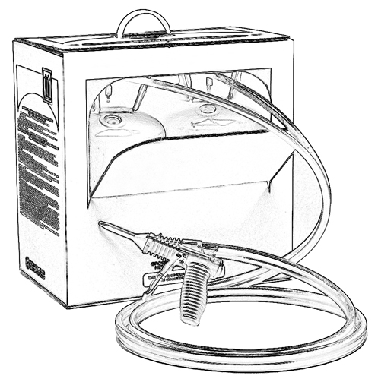


Unit 4:
Two-Component Low Pressure Spray Polyurethane Foam (SPF) Ingredients

Slide 2

Grant Provided by the Occupational Safety and Health Administration (OSHA), U.S. Department of Labor (DOL)
This material produced under grant SH-22308-SH1 from the Occupational Safety and Health Administration (OSHA), U.S. Department of Labor.
It does not necessarily reflect the views or policies of the U.S. Department of Labor, nor does mention of trade names, commercial products, or organizations imply endorsement by the U.S. Government.

Slide 3
Welcome to Unit 4
In this unit, you will learn about:
Two-component low pressure spray polyurethane foam (SPF) chemical ingredients
SPF physical and chemical properties
Notes:
Narration:
In this unit, you will learn about:
Two-component low pressure spray polyurethane foam chemical ingredients
And physical and chemical properties of SPF

Slide 4
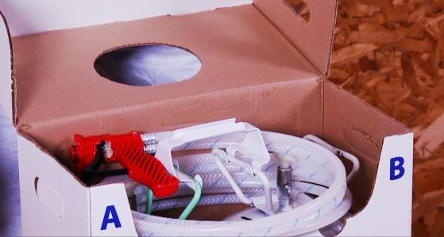
Two-Component Low Pressure
Spray Polyurethane Foam (SPF) Systems
Two-component low pressure spray polyurethane foam kits or systems contain an A-side and a B-side which mix together when sprayed.
Notes:
Narration:
Spray foam is made by mixing 2 batches of chemicals. These are sold together in what is known as a low pressure “kit” or “system.”
One cylinder is called the A-side and the second is called the B-side. Along with the two cylinders, the kit or system often includes instructions, a hose with a spray nozzle or nozzles and safety equipment.

Slide 5
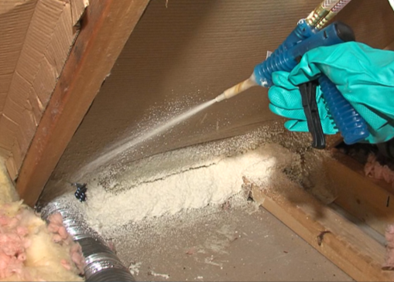
A-side Reacts with B-side
The A-side reacts with the B-side to form polyurethane foam.
Notes:
Narration:
The A-side reacts with the B-side to form polyurethane foam.

Slide 6
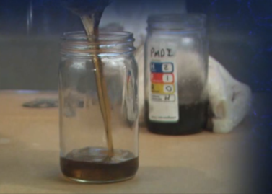
A-side (Iso) – Chemical Ingredients
The A-side or Isocyanate (Iso) is:
a mixture of methylene diphenyl diisocyanate (MDI) and polymeric diphenylmethane diisocyanate (pMDI)
commonly referred to as:
“Iso”, “MDI”, or “pMDI”
Notes:
Narration:
The A-side or Isocyanate is a mixture of chemicals known as methylene diphenyl diisocyanate or MDI and polymeric MDI. The ratio of the MDI and pMDI in the A-side may vary among the products. The important thing to note is that both MDI and pMDI are from a class of chemicals called isocyanates.
For short, the A-side is often referred to as Iso, MDI, or pMDI because of its chemical make-up.

Slide 7
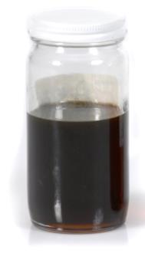
A-side (Iso) - Properties
Typical A-side (Iso) properties:
Brown or amber liquid unless colors have been added
Most people cannot smell the A-side (Iso) at room temperature
Is reactive and may undergo chemical reactions with various chemicals, including water
Notes:
Narration:
The A-side is typically a brown or amber liquid unless colors have been added.
Most people cannot smell the A-side at room temperature. However, just because you cannot smell something does not mean that it is not hazardous.
The A-side is a reactive chemical and it may undergo a chemical reaction with various chemicals, including water. In many cases, MDI spilled on a surface may react with the surface leaving a solid residue behind.

Slide 8
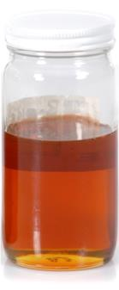
B-side - Chemical Ingredients
The B-side or polyol blend:
Is a mixture of several chemicals with the principal ingredient being a chemical called polyol
Contains additives to give certain physical characteristics to the foam:
  catalysts, blowing agents, flame
  retardants, and surfactants
Notes:
Narration:
The B-side or polyol blend is a mixture of several different chemicals with the main ingredient being a chemical called polyol.
The B-side contains additives that have specific roles in the reaction or give the foam important characteristics.
These include catalysts, blowing agents, flame retardants, and surfactants. These ingredients are discussed in more detail on the following slides.

Slide 9
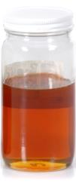
B-side Ingredients - Catalyst
The Catalyst affects how quickly the A-side (Iso) and B-side react.
Some people may smell an ammonia or fish-like odor when exposed to catalysts.
Notes:
Narration:
The Catalyst affects how quickly the A-side and B-side react.
Depending on the formulation, some people may smell an ammonia or fish-like odor when exposed to catalysts.

Slide 10
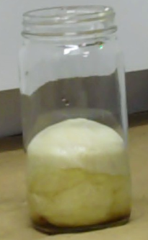
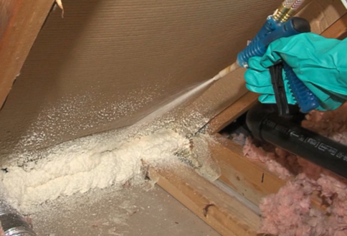
B-side Ingredients - Blowing Agent
The Blowing Agent makes the foam expand by making tiny bubbles, or cells, in the foam.
Notes:
Narration:
The blowing agent in the B-side makes the foam expand by making tiny bubbles, or cells, in the foam.

Slide 11

B-side Ingredients – Flame Retardant
Flame retardants affect how the finished, fully reacted foam resists combustion.
Notes:
Narration:
Flame retardants in the B-side affect how the finished, fully reacted foam resists combustion.

Slide 12
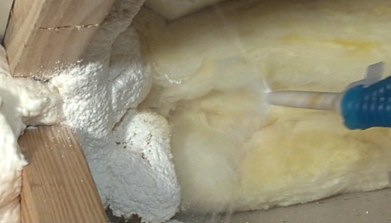
B-side Ingredients - Surfactant
Surfactants help the foam cells form and stabilize the cell structure.
Notes:
Narration:
And surfactants help the foam cells form and stabilize the cell structure.

Slide 13
B-side - Properties
B-side or polyol blend properties:
Color ranges from milky white to amber or dark brown unless colors have been added
May have a mild ammonia-like odor
Notes:
Narration:
The B-side or polyol blend may be milky white to amber or dark brown, unless colors have been added.
The B-side may have a mild ammonia-like odor.

Slide 14
Unit 4 Summary
In this unit, you learned about:
Two-component low pressure spray polyurethane foam (SPF) chemical ingredients
SPF physical and chemical properties
Notes:
Narration:
In this unit, you learned about:
Two-component low pressure spray polyurethane foam chemical ingredients
And the physical and chemical properties of SPF

Slide 15
Unit 4 Review
Knowledge
Into
Action
Notes:
Narration:
Now it’s time to put your knowledge into action.

Slide 16
Unit 4: Q1 Debrief
Two-component low pressure SPF kits or systems contain _________ which mix together to make foam when sprayed.
water and adhesives
A-side and B-side chemicals
alcohol and catalysts
none of the above
Notes:
Two-component low pressure SPF kits or systems contain _________ which mix together to make foam when sprayed.
water and adhesives
A-side and B-side chemicals
alcohol and catalysts
none of the above

Slide 17
Unit 4: Q1 Debrief
Two-component low pressure SPF kits or systems contain _________ which mix together to make foam when sprayed.
water and adhesives
A-side and B-side chemicals
alcohol and catalysts
none of the above
Notes:
The correct answer is B. Two-component low pressure SPF kits or systems contain A-side and B-side chemicals which mix together to make foam when sprayed.

Slide 18
Unit 4: Q2 Debrief
The A-side (Iso) of SPF contains _____.
ethanol
polyurethane foam dust
a chemical commonly referred to as “MDI”
a polyol blend
Notes:
The A-side (Iso) of SPF contains _____.
ethanol
polyurethane foam dust
a chemical commonly referred to as “MDI”
a polyol blend

Slide 19
Unit 4: Q2 Debrief
The A-side (Iso) of SPF contains _____.
ethanol
polyurethane foam dust
a chemical commonly referred to as “MDI”
a polyol blend
Notes:
The correct answer is C. The A-side (Iso) of SPF contains a chemical commonly referred to as “MDI”.

Slide 20
Unit 4: Q3 Debrief
Which of the following is not included in the B-side of two-component low pressure SPF?
flame retardant
surfactant
isocyanate
polyol
Notes:
Which of the following is not included in the “B-side” of spray polyurethane foam?
flame retardant
surfactant
isocyanate
polyol

Slide 21
Unit 4: Q3 Debrief
Which of the following is not included in the B-side of two-component low pressure SPF?
flame retardant
surfactant
isocyanate
polyol
Notes:
The correct answer is C. Isocyanate is not included in the B-side of spray polyurethane foam.

Slide 22
Unit 4 Completed
Continue to Unit 5
Return to the Main Menu
Notes:
Narration:
You have completed Unit 4.

