Slide 1

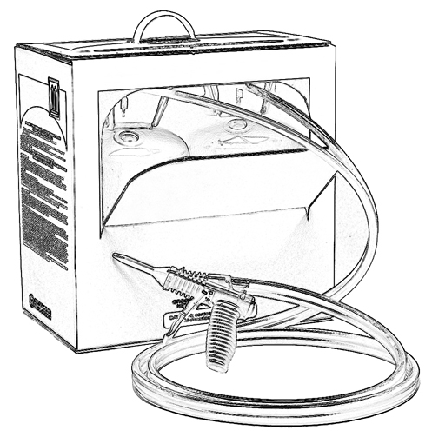


Unit 6:
Potential Effects of Exposure
to the B-side
Two-Component Low Pressure
Spray Polyurethane Foam (SPF)

Slide 2

Grant Provided by the Occupational Safety and Health Administration (OSHA), U.S. Department of Labor (DOL)
This material produced under grant SH-22308-SH1 from the Occupational Safety and Health Administration (OSHA), U.S. Department of Labor.
It does not necessarily reflect the views or policies of the U.S. Department of Labor, nor does mention of trade names, commercial products, or organizations imply endorsement by the U.S. Government.

Slide 3
Welcome to Unit 6
In this unit, you will learn about:
Potential effects of exposure to B-side ingredients in two-component low pressure spray polyurethane foam (SPF)
Notes:
Narration:
In this unit, you will learn about the potential effects of exposure to B-side ingredients of two-component low pressure spray polyurethane foam.

Slide 4

B-side Ingredients
The B-side is a blend of different chemicals with the main ingredient being polyol and various additives including:
Catalysts
Blowing agents
Fire retardants
Surfactants
Potential health effects from exposure to additives can vary.
Notes:
Narration:
The B-side is often referred to as the polyol blend, but it actually is made up of several different chemicals.
The main ingredient is polyol and there are various additives, including:
Catalysts
Blowing agents
Fire retardants
And surfactants
Potential health effects from exposure to additives can vary.

Slide 5

Exposure Effects - Polyol
There is a low potential for adverse effects due to exposure to polyol by inhalation, skin or eye contact.
Notes:
Narration:
Polyol is the main component of the B-side. There is a low potential for adverse effects due to exposure to polyol by inhalation, skin or eye contact.
Continue to follow proper safety precautions.

Slide 6

Skin Contact Effects - Catalysts
Catalysts in the B-side may cause skin irritation including:
Reddening
Itching
Swelling
Possible allergic reaction
Notes:
Narration:
Catalysts in the B-side may be irritating to the skin and may cause reddening, itching or swelling.
Skin contact with some catalysts may cause a possible allergic reaction.

Slide 7
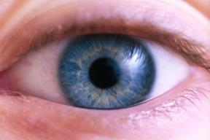

Eye Contact Effects - Catalysts
Catalysts in the B-side can cause eye irritation including:
Reddening
Tearing
Swelling
Burning
Temporary condition of impaired vision known as “Blue Haze” or “Halovision”
Notes:
Narration:
Eye contact with catalysts can cause eye irritation including reddening, tearing, swelling, or burning. A temporary condition referred to as “Blue Haze” or “Halovision” could also result from chemical exposure to catalysts.
This condition may cause you to temporarily see halos around objects.

Slide 8

Inhalation Exposure Effects - Catalysts
Catalysts in the B-side may cause respiratory irritation including:
Coughing
Sore throat
Runny nose
Notes:
Narration:
Inhalation exposure to some catalysts used in the B-side blend may cause respiratory irritation including: coughing, sore throat or runny nose.
Some reports have suggested more serious impairment of lung function may be caused by inhalation of some catalysts in the B-side.

Slide 9
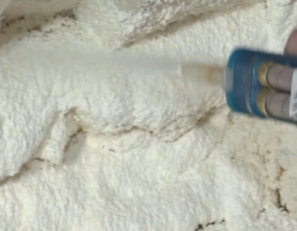
Blowing Agents
In two-component low pressure spray polyurethane foam, blowing agents help expand the foam cells.
There is low potential for adverse effects from exposure to low pressure SPF blowing agents by inhalation, skin or eye contact.
Notes:
Narration:
In two-component low pressure spray polyurethane foam, blowing agents help expand the foam cells.
There is low potential for adverse health effects from exposure to low pressure SPF blowing agents by inhalation, skin or eye contact.

Slide 10

Skin and Eye Contact Effects - Blowing Agents
Skin and eye contact with blowing agents can be slightly irritating.
Notes:
Narration:
Skin and eye contact with blowing agents can be slightly irritating.

Slide 11

Exposure Effects - Fire Retardants
Possible effects of exposure to fire retardants in the B-side include:
Respiratory irritation – coughing, sore throat, or a runny nose
Skin irritation
Eye contact is not usually irritating
Notes:
Narration:
When inhaled, flame retardants can cause coughing, sore throat or a runny nose. Skin contact with flame retardants can be irritating, while eye contact is not usually irritating.

Slide 12

Exposure Effects - Surfactants
There is a low potential for adverse effects after exposure to surfactants by inhalation, skin or eye contact.
Notes:
Narration:
There is a low potential for adverse effects after exposure to surfactants by inhalation, skin or eye contact.

Slide 13
Unit 6 Summary
In this unit you learned about:
Potential effects of exposure to B-side ingredients in two-component low pressure spray polyurethane foam (SPF)
Notes:
Narration:
In this unit you learned about:
Potential effects of exposure to the B-side ingredients in two-component low pressure spray polyurethane foam.

Slide 14
Unit 6 Review
Knowledge
Into
Action
Notes:
Narration:
It’s time to put your knowledge into action.

Slide 15
Unit 6: Q1 Debrief
The B-side is a blend of chemicals with the main ingredient being polyols. Which of the following is not a typical B-side additive?
catalyst
fire retardant
acetone
blowing agent
Notes:
The B-side is a blend of chemicals with the main ingredient being polyols. Which of the following is not a typical B-side additive?
catalyst
fire retardant
acetone
blowing agent

Slide 16
Unit 6: Q1 Debrief
The B-side is a blend of chemicals with the main ingredient being polyols. Which of the following is not a typical B-side additive?
catalyst
fire retardant
acetone
blowing agent
Notes:
The correct answer is C. Acetone is not a typical B-side chemical ingredient.

Slide 17
Unit 6: Q2 Debrief
Which of the following is not a potential effect of eye exposure to some catalysts in the B-side?
reddening or burning
near-sightedness
a blue haze or halovision
tearing
Notes:
Which of the following is not an effect of eye exposure to some catalysts in the B-side?
reddening or burning
near-sightedness
a blue haze or halovision
tearing

Slide 18
Unit 6: Q2 Debrief
Which of the following is not a potential effect of eye exposure to some catalysts in the B-side?
reddening or burning
near-sightedness
a blue haze or halovision
tearing
Notes:
The correct answer is B. Near-sightedness is not a potential effect of eye exposure to some B-side catalysts.

Slide 19
Unit 6: Q3 Debrief
Which symptom is a potential effect of exposure to the B-side?
skin irritation
eye irritation
respiratory irritation
all of the above
Notes:
Which symptom is a potential effect of exposure to the B-side?
skin irritation
eye irritation
respiratory irritation
all of the above

Slide 20
Unit 6: Q3 Debrief
Which symptom is a potential effect of exposure to the B-side?
skin irritation
eye irritation
respiratory irritation
all of the above
Notes:
The correct answer is D. All of the above.

Slide 21
Unit 6 Completed
Continue to Unit 7
Return to the Main Menu
Notes:
Narration:
You have completed Unit 6.

