Slide 1

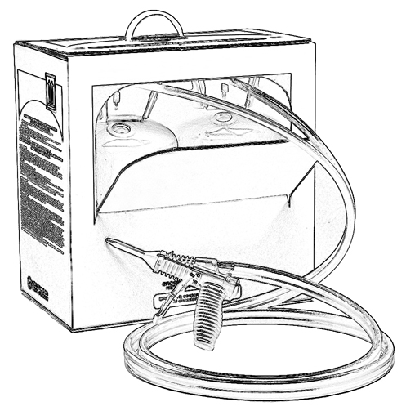


Unit 7:
Engineering Controls to Consider
When Using Two-Component
Low Pressure Spray Polyurethane Foam

Slide 2

Grant Provided by the Occupational Safety and Health Administration (OSHA), U.S. Department of Labor (DOL)
This material produced under grant SH-22308-SH1 from the Occupational Safety and Health Administration (OSHA), U.S. Department of Labor.
It does not necessarily reflect the views or policies of the U.S. Department of Labor, nor does mention of trade names, commercial products, or organizations imply endorsement by the U.S. Government.

Slide 3
Welcome to Unit 7
In this unit, you will learn about engineering controls including:
Containment
Ventilation
Notes:
Narration:
In this unit, you will learn about the engineering controls including:
Containment
Ventilation

Slide 4
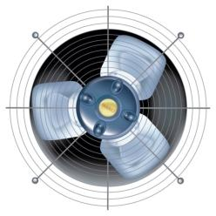
Engineering Controls
Engineering controls are changes in the design of a job to reduce the potential for chemical exposure.
Plan engineering controls prior to beginning work.
Notes:
Narration:
Engineering controls are changes in the design of a job to reduce the potential for chemical exposure.
The best time to plan engineering controls is prior to beginning work.

Slide 5
Job Site Factors to Consider
When selecting engineering controls, consider jobsite factors including:
Type of SPF product being used
Indoor vs. outdoor work
Wind direction and speed
Size of work area
Amount of natural ventilation available
Occupied building vs. vacant building
If other trade workers will be present
Notes:
Narration:
When selecting engineering controls for a particular job, consider factors including:
The type of spray foam product being used. Will the work take place indoors or outdoors? If outdoors, consider the impact of wind direction and wind speed on the application.
What is the size of the work area? On a large open construction site, the amount of ventilation needed will typically be different from the amount of ventilation needed in a crawl space. Will there be natural ventilation available? If not, how will the space be ventilated? There will be special considerations for work done in attics and crawl spaces due to the small area and limited ventilation.
Will the building be completely vacated at the time of application?
Will other trade workers be present? If so, you may want to set up a spray zone where occupants and other trade workers cannot enter.

Slide 6
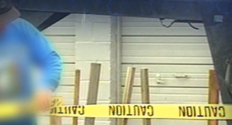
Contain the Spray Area
To contain the spray area so other trade workers/occupants are not potentially exposed to SPF chemicals, consider:
Using caution tape/warning signs
to mark off the area
Evaluating the HVAC system before
spraying to determine if it is
necessary to turn it off
Sealing HVAC supply and exhaust ducts
Notes:
Narration:
You may want to consider ways to contain the spray area so other trade workers and occupants in the vicinity are not potentially exposed to SPF chemicals.
Although this is not an exhaustive list, here are some suggestions:
Caution tape and signs are useful for warning people to stay away from the spray area.
Evaluate the Heating, Ventilating and Air Conditioning, or HVAC system, before spraying to determine if it is necessary to turn the system off.
If there is a potential for movement of chemical vapors to other areas of the building, consider sealing the HVAC supply and exhaust ducts.

Slide 7
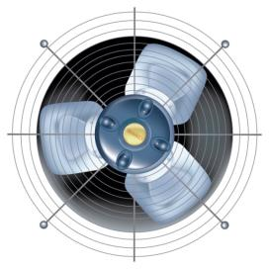
Maximize Ventilation
Maximizing ventilation of the spray area is an important part of the job.
Open windows and doors. The intent is for air currents to help move SPF vapors away to an unoccupied area.
Additional ventilation measures, like fans, can also improve ventilation and disperse vapors.
Notes:
Narration:
Maximizing ventilation of the spray area is an important part of the job.
Open windows and doors. The intent is for air currents to help move SPF vapors away to an unoccupied area.
Additional ventilation measures, like fans, can also improve ventilation and disperse vapors.

Slide 8
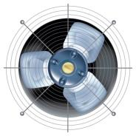
Tips for Setting Up Ventilation - During Low Pressure SPF Application
Here are some tips for setting up ventilation before applying two-component low pressure SPF. For example, consider:
Placing a filter over the fan to help protect it from overspray
Positioning fans to create an airflow across the entire spraying area or work room
Restricting access near fan exhaust points
Directing exhaust away from air intakes or occupants
Turning the fan on before you begin spraying
Notes:
Narration:
Here are some helpful tips to consider when setting up ventilation before applying two-component low pressure SPF.
Some sprayers find using a filter over the fan can help to protect the fan from overspray. If the fan is not protected, unwanted overspray can impact fan efficiency. Position fans to create an airflow across the entire spraying area or work room. The idea is to move air across the work space, rather than simply creating air turbulence that can disrupt the ventilation effectiveness.
It is a good idea to restrict access near fan exhaust points to prevent potential exposure.
In addition, directing exhaust away from air intakes helps to prevent recirculation of chemicals.
After setting up the ventilation system, consider turning the fan on before you begin spraying.

Slide 9
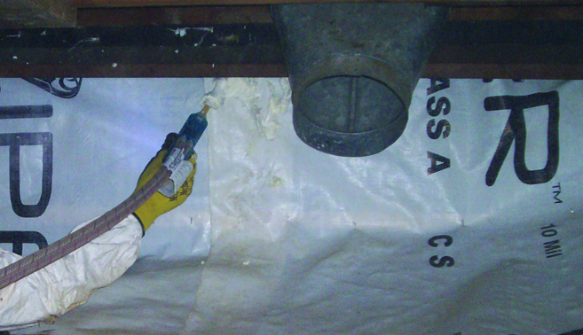
Attics and Crawlspaces
Consider ways to ventilate attics and crawlspaces.
DO NOT spray two-component low pressure SPF in a confined space without proper personal protective equipment, including an approved respirator. (See OSHA’s Respirator Protection Standard, 29 CFR 1910.134)
Work in confined spaces is subject to OSHA’s Permit-required Confined Spaces Standard, 29 CFR 1910.146.
(more in Units 9 and 14)
Notes:
Narration:
Consider ways to ventilate attics and crawlspaces. It takes longer to evaluate ventilation options because of the unique challenges, including limited access and smaller spaces. Do NOT spray two-component low pressure SPF in a confined space without proper personal protective equipment, including an approved respirator. Work in confined spaces is subject to OSHA’s Permit-required Confined Spaces Standard, 29 CFR 1910.146.

Slide 10
Ventilation Period
Contact the product manufacturer to determine how long to ventilate the spray area after spraying has stopped.
Restrict re-entry to the spray area to personnel wearing appropriate personal protective equipment (PPE) until after the foam has fully hardened and the ventilation period is over as determined by the product manufacturer.
Re-entry time can vary depending upon the SPF application, available ventilation, and other variables. After an interior application of two-component low pressure SPF, some manufacturers recommend a one hour re-entry time. Consult with the product manufacturer.
(more in later Units).
Notes:
Narration:
Contact the product manufacturer to determine how long to ventilate the spray area after spraying has stopped.
Restrict re-entry to the spray area to personnel wearing appropriate PPE until the foam has fully hardened and the ventilation period is over as determined by the product manufacturer.
Re-entry time can vary depending upon the SPF application, available ventilation, and other variables. After an interior application of two-component low pressure SPF, some manufacturers recommend a one hour re-entry time. Contact the product manufacturer to find out their recommended re-entry time.

Slide 11
Unit 7 Summary
In this unit, you learned about engineering controls including:
Containment
Ventilation
Notes:
Narration:
In this unit, you learned about engineering controls including:
Containment
Ventilation

Slide 12
Unit 7 Review
Knowledge
Into
Action
Notes:
Narration:
Let’s put your knowledge into action.

Slide 13
Unit 7: Q1 Debrief
Which of the following best describes engineering controls?
control switches on high-tech spray foam equipment
changes in the design of the job, such as containment and ventilation, to reduce the potential for chemical exposure
recommended spraying techniques to maximize product performance
D. all of the above
Notes:
Which of the following best describes engineering controls?
control switches on high-tech spray foam equipment
changes in the design of the job, such as containment and ventilation, to reduce the potential for chemical exposure
recommended spraying techniques to maximize product performance
all of the above

Slide 14
Unit 7: Q1 Debrief
Which of the following best describes engineering controls?
control switches on high-tech spray foam equipment
changes in the design of the job, such as containment and ventilation, to reduce the potential for chemical exposure
recommended spraying techniques to maximize product performance
D. all of the above
Notes:
The correct answer is B. Engineering controls are changes in the design of the job, such as containment and ventilation, to reduce the potential for chemical exposure.

Slide 15
Unit 7: Q2 Debrief
When is the best time to plan engineering controls?
soon after spraying your first low pressure kit so you are familiar with the job
before beginning work
at the end of the first day
none of the above
Notes:
When is the best time to plan engineering controls?
soon after spraying your first low pressure kit so you are familiar with the job
before beginning work
at the end of the first day
none of the above

Slide 16
Unit 7: Q2 Debrief
When is the best time to plan engineering controls?
soon after spraying your first low pressure kit so you are familiar with the job
before beginning work
at the end of the first day
None of the above
Notes:
The correct answer is B. The best time to plan engineering controls is before beginning work.

Slide 17
Unit 7: Q3 Debrief
Weatherization projects may take place in confined spaces, such as attics and crawl spaces. Which of the following is not true?
Ventilate confined spaces.
A respirator is unnecessary when spraying a two-component low pressure SPF kit in a confined space.
Fans can help improve ventilation and disperse vapors.
Consult the SPF product manufacturer to determine how long to ventilate the spray area after spraying has stopped.
Notes:
Weatherization projects may take place in confined spaces, such as attics and crawl spaces. Which of the following is not true?
Ventilate confined spaces.
A respirator is unnecessary when spraying a two-component low pressure SPF kit in a confined space.
Fans can help improve ventilation and disperse vapors.
Consult the SPF product manufacturer to determine how long to ventilate the spray area after spraying has stopped.

Slide 18
Unit 7: Q3 Debrief
Weatherization projects may take place in confined spaces, such as attics and crawl spaces. Which of the following is not true?
Ventilate confined spaces.
A respirator is not necessary when spraying a two-component low pressure SPF kit in a confined space.
Fans can help improve ventilation and disperse vapors.
Consult the SPF product manufacturer to determine how long to ventilate the spray area after spraying has stopped.
Notes:
The correct answer is B. Proper personal protective equipment, including an approved respirator, is recommended when spraying a two-component low pressure SPF kit in a confined space.

Slide 19
Unit 7 Completed
Continue to Unit 8
Return to the Main Menu
Notes:
Narration:
You have completed Unit 7.

