Slide 1

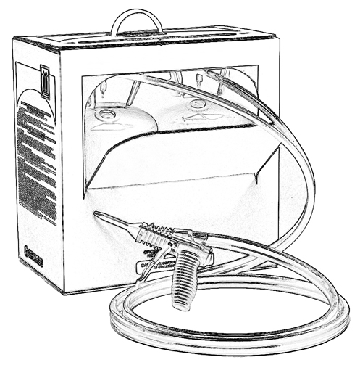


Unit 8:
Good Safety Practices to Consider
When Using Two-Component
Low Pressure Spray Polyurethane Foam

Slide 2

Grant Provided by the Occupational Safety and Health Administration (OSHA), U.S. Department of Labor (DOL)
This material produced under grant SH-22308-SH1 from the Occupational Safety and Health Administration (OSHA), U.S. Department of Labor.
It does not necessarily reflect the views or policies of the U.S. Department of Labor, nor does mention of trade names, commercial products, or organizations imply endorsement by the U.S. Government.

Slide 3
Welcome to Unit 8
In this unit, you will learn about good safety practices to consider when using two-component low pressure SPF including:
Planning ahead
Site preparation
Using low pressure SPF kits or systems
Post-spray guidance
Site safety
Notes:
Narration:
In this unit, you will learn about good safety practices to consider when using two-component low pressure including:
Planning ahead
Site preparation
Using low pressure kits or systems
Post-spray guidance
and site safety

Slide 4
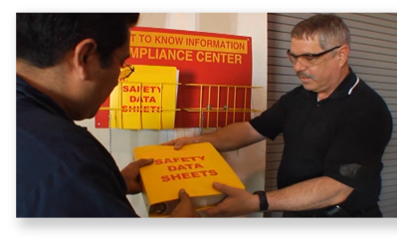
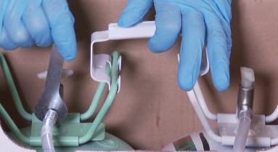
Planning Ahead
Before work begins, here are important considerations:
Review the Hazard Communications program, including SDSs, product labels and instructions.
Inspect the low pressure SPF kit or system and check that contents are complete and undamaged.
Plan for engineering controls, such as containment and ventilation (more in Unit 7)
Have personal protective equipment (PPE) ready for the job as described in the SDS. (more in Unit 9).
Notes:
Narration:
Before work begins, planning ahead is critical. Here are some important considerations:
Review the Hazard Communications program including Safety Data Sheets, product labels and instructions.
Inspect the low pressure SPF kit or system. Check that contents are complete and undamaged.
Plan engineering controls, such as containment and ventilation, as discussed in Unit 7.
and have personal protective equipment ready for the job as described in the SDS. More information about PPE will be covered in Unit 9.

Slide 5
Planning Ahead - Occupant and Worker Outreach
Prepare a detailed safety plan and review it with the homeowner or building manager and other workers. Some things to consider include:
factors such as size of the job, whether it is outdoors or inside, ventilation options, and any potential hazards
who will be on the job site (keep unprotected occupants and workers away from the spray area)
safety measures to be taken (e.g. have SDS readily available at the job site)
when the product manufacturer recommends that homeowners or occupants can re-enter after spraying is completed
Notes:
Narration:
As part of your planning, prepare a detailed safety plan and review it with the homeowner or building manager and other workers. Discuss topics like the following:
Factors such as size of the job, whether it is outdoors or inside, ventilation options, and any potential hazard associated with SPF application.
Consider who will be on the job site. Keep unprotected occupants and workers away from the spray area.
What safety measures will be taken? Where will the Safety Data Sheets be located at the job site? What are the cleanup plans?
When the product manufacturer recommends that homeowners or occupants can re-enter after spraying is completed.

Slide 6

Planning Ahead - Re-entry Guidance
Contact the product manufacturer to find out their recommended re-entry time.
Re-entry time can vary depending on the SPF type, the amount of foam applied per volume of space, ventilation, temperature, humidity and other variables. For an interior application using two-component low pressure SPF, some manufacturers recommend a one hour re-entry time.
Notes:
Narration:
As part of the safety planning discussion, discuss the product manufacturer’s recommended re-entry time after spraying.
Re-entry time can vary depending on the SPF type, the amount of foam applied per volume of space, ventilation, temperature, humidity and other variables.
For an interior application using two-component low pressure SPF, some manufacturers recommend a one hour re-entry time.

Slide 7
Preparing the Spray Area - Engineering Controls and Overspray
Preparation | Interior Applications | Exterior Applications
Apply Engineering Controls (See Unit 7). Warning signs/caution tape are useful in communicating site restrictions to workers not in PPE. |  | 
Consider shutting down the HVAC system and sealing air intakes/exhaust with plastic sheeting and tape. |  | 
It is a good idea to ventilate the spray area during and after spraying in interior applications (contact the SPF supplier for guidance). | 
To limit potential damage to surfaces, protect surfaces from potential SPF overspray. |  | 
Notes:
Narration:
This table explains some of the steps you may want to take when preparing the site for a low pressure SPF application.
As reviewed in Unit 7, plan to use Engineering Controls, such as containing the work area and planning good ventilation.
Warning signs and caution tape can be helpful in communicating site restrictions to workers not in PPE.
Evaluate the HVAC system to determine of it should be turned off. Consider sealing air intakes and exhaust ducts with plastic sheeting and tape.
For interior applications, the spray area may need to be ventilated during and for a period after application. Contact your SPF manufacturer for specific guidance for the products you are working with. In both exterior and interior applications, protect surfaces from potential damage by overspray.

Slide 8

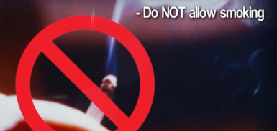
Preparing the Spray Area - Combustion Risks
Shut off ignition sources:
Extinguish heat sources, sparks and open flames in the spray area, adjacent rooms and behind neighboring walls.
This includes pilot lights on items such as gas stoves, dryers, furnaces and water heaters.
Minimize other combustion risks at the job site, like paints and solvents.
Do NOT smoke on the job.
Notes:
Narration:
Before work begins, shut off ignition sources:
This includes heat sources, sparks and open flames in the spray area, adjacent rooms and behind neighboring walls.
Extinguish pilot lights on items such as gas stoves, dryers, furnaces and water heaters.
Minimize other combustion risks at the job site, like paints and solvents, which can be flammable.
And refrain from smoking on the job site.

Slide 9
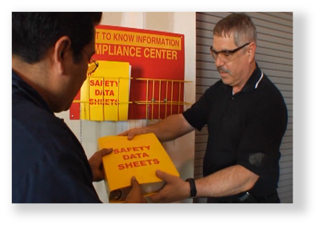
Preparing the Spray Area - SDS Availability and Surface Preparation
Review the Safety Data Sheets (SDSs):
Have SDSs readily available at the job site.
Clean the surface to be sprayed:
Clean dirt, oil or other debris from the surface to be sprayed. Be sure the surface is dry.
Notes:
Narration:
As you prepare to do the job, it is a good idea to review the Safety Data Sheets or SDS. Have them readily available at the job site.
Part of your preparation may also include cleaning the surface to be sprayed of dirt, oil and other debris. This helps maximize the foam’s performance and prevents it from sticking to unwanted debris. Be sure the surface is dry.

Slide 10
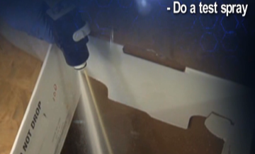
Using Low Pressure SPF Kits/Systems - Personal Protective Equipment and Test Spraying
Work practices in the spray area:
Use proper PPE (more in Unit 9)
To help prevent exposure, don’t eat, drink, or smoke in spray area
Do a test spray to check that your SPF kit/system is working properly (while using proper PPE)
Wash thoroughly after leaving spray area and before eating/drinking
Test spraying is often done into an empty waste bucket or kit box as shown.
Notes:
Narration:
Now that you have prepared the job site, you are ready to begin spraying the two-component low pressure SPF for your weatherization project. Here are some work practices to consider when working in the spray area:
Use proper personal protective equipment, or PPE, as described in the SDS. This includes eye protection, full-coverage clothing, nitrile gloves and a proper respirator.
To help prevent exposure to chemicals, don’t eat, drink, or smoke in the spray area.
It is a good idea to do a test spray to check that your low pressure kit or system is operating in accordance with the manufacturer’s instructions.
And wash thoroughly after leaving the spray area and before eating and drinking.

Slide 11
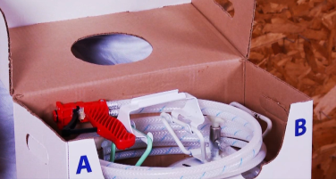
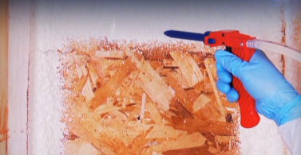
Using Low Pressure SPF Kits/Systems - Product Instructions
Follow manufacturer’s instructions on where and how to use the SPF kit/system.
For example, avoid installing near sources of high heat, such as around fireplaces, heaters, radiators, heat lamps, recessed lighting, bare copper wires, or inside electrical boxes
Avoid spraying too thickly in any one lift/pass (up to 2” maximum is common) and allow sufficient cooling time between each lift/pass.
Promptly clean surfaces that SPF overspray may contact.
Notes:
Narration:
As you begin your installation, follow manufacturer’s instructions on where and how to use the SPF kit or system.
For example, avoid installing spray foam near sources of high heat, such as around fireplaces, heaters, radiators, heat lamps, recessed lighting, bare copper wires, or inside electrical boxes. Avoid spraying too thickly in any one lift/pass and allow sufficient cooling time between each lift/pass.
And promptly clean surfaces that SPF overspray may contact. Refer to the manufacturer’s instructions to clean unfinished surfaces, which could include using paint thinner, acetone or nail polish remover. After the foam has fully hardened, mechanical removal may be suggested by the manufacturer.

Slide 12
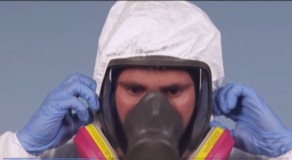
Using Low Pressure SPF Kits/Systems - Restricting Access to the Spray Area
Wear appropriate PPE in the spray area during and for a period after spraying. Consider the following:
Informing other trade workers and building occupants of access restrictions.
Having these restrictions while spraying and for an appropriate period afterward as described by the product manufacturer.
Monitoring the warning signs and barriers you set up before work began.
This is an example of good PPE selection for a typical interior
two-component low pressure SPF application. Additional PPE options are discussed in Unit 9.
Notes:
Narration:
As outlined in your safety plan and the SDS, workers wear appropriate PPE in the spray area during spraying and for an appropriate period afterward.
Consider having these restrictions while spraying and for an appropriate period afterward as described by the product manufacturer. Also consider monitoring the warning signs and physical barriers that you set up to contain the spray area. Adjust as needed.

Slide 13
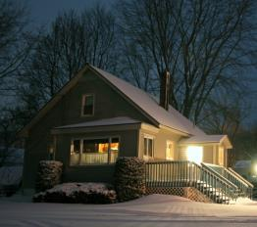
Low Pressure SPF Post-Spray Guidance
Keep workers and other occupants not in proper PPE away from the spray area.
Contact your product manufacturer for their recommended guidance on ventilation and re-entry time for the SPF product you are using.
For a typical interior two-component low pressure SPF application, some manufacturers recommend a one hour re-entry time.
Clean the job site thoroughly before occupants return.
Notes:
Narration:
Now let’s look at post-spray guidance. As covered earlier, re-entry time, also known as reoccupancy time, is the amount of time after spraying before allowing workers, homeowners, or occupants not in PPE to enter the spray area. This time may vary depending on the SPF application, available ventilation and other variables.
For an interior two-component low pressure SPF application, some manufacturers recommend a re-entry time of one hour. Within a few minutes of application, the foam will usually achieve a tack-free state and the surface may no longer be sticky. However, it may take up to an additional hour or more for the foam to sufficiently harden, or cure to a point that is safe for occupant re-entry.
Contact the product manufacturer for guidance on ventilation and re-entry time for SPF product you are using. Also, clean the job site thoroughly before occupants return.

Slide 14
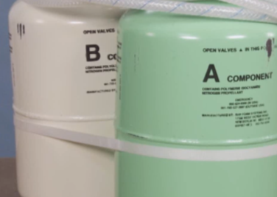
Low Pressure SPF Kits/Systems - Storage & Handling
Follow manufacturer’s instructions when storing and handling low pressure SPF kits/systems.
Avoid exposing pressurized SPF chemicals contained in the cylinders to open flame or high temperatures because high heat could potentially lead to a container explosion.
(more in Unit 13).
Notes:
Narration:
Follow the manufacturer’s instructions when storing and handling low pressure SPF kits or systems.
Avoid exposing pressurized SPF chemicals contained in the cylinders or tanks to open flame or high temperatures because high heat could potentially lead to a container explosion. Typically, storage of SPF products in a cool dry location is suggested by product manufacturers.

Slide 15
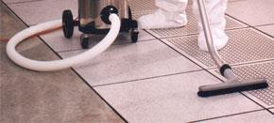
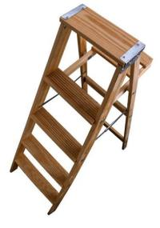
Site Safety
Keep the work site clean and free of debris.
Be aware of areas where falls could occur and take appropriate steps to reduce the hazards (more in Unit 14).
Notes:
Narration:
It is important to keep the work area clean and free of debris. Be aware of areas where falls could occur and take appropriate steps to reduce the hazards.

Slide 16
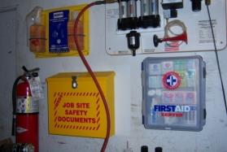
Site Safety - Supplies
Know the location of:
SDS for all chemicals on the job
first aid kit
emergency eye wash station or a portable eye wash bottle
fire extinguisher(s)
Notes:
Narration:
OSHA requires that SDSs for each chemical used at the jobsite be readily accessible to employees. This is important for your reference and use by emergency personnel in case of an incident. Know where to find the SDSs at your jobsite.
In case of emergency, know the location of a first aid kit, emergency eye wash station or a portable eye wash bottle and fire extinguishers.

Slide 17
Unit 8 Summary
In this unit, you learned about good safety practices which include:
Planning Ahead
Site preparation
Using low pressure SPF kits or systems
Post-spray guidance
Site safety
Notes:
Narration:
In this unit, you learned about good safety practices which include:
Planning ahead
Site preparation
Using low pressure kits or systems
Post-spray guidance
and other site safety considerations

Slide 18
Unit 8 Review
Knowledge
Into
Action
Notes:
Narration:
Let’s put your knowledge into action.

Slide 19
Unit 8: Q1 Debrief
Which of the following is a topic to discuss when reviewing the safety plan with the homeowner or building manager and other workers?
Who will be on the job site?
What safety measures will be taken?
When does the product manufacturer recommend that homeowners or occupants can re-enter after spraying is completed?
All of the above
Notes:
Which of the following is a topic to discuss when reviewing the safety plan with the homeowner or building manager and other workers?
Who will be on the job site?
What safety measures will be taken?
When does the product manufacturer recommend that homeowners or occupants can re-enter after spraying is completed?
All of the above

Slide 20
Unit 8: Q1 Debrief
Which of the following is a topic to discuss when reviewing the safety plan with the homeowner or building manager and other workers?
Who will be on the job site?
What safety measures will be taken?
When does the product manufacturer recommend that homeowners or occupants can re-enter after spraying is completed?
All of the above
Notes:
The correct answer is D. All of the above topics are important to discuss when reviewing the safety plan.

Slide 21
Unit 8: Q2 Debrief
How long should occupants typically wait before they can re-enter following an interior two-component low pressure SPF application?
until all of the foam dust has settled
consult the manufacturer since re-entry time can vary (some manufacturers recommend a one hour re-entry time)
one week
48 hours
Notes:
How long should occupants typically wait before they can re-enter following an interior two-component low pressure SPF application?
until all of the foam dust has settled
consult the manufacturer since re-entry time can vary (some manufacturers recommend a one hour re-entry time)
one week
48 hours

Slide 22
Unit 8: Q2 Debrief
How long should occupants typically wait before they can re-enter following an interior two-component low pressure SPF application?
until all of the foam dust has settled
consult the manufacturer since re-entry time can vary (some manufacturers recommend a one hour re-entry time)
one week
48 hours
Notes:
The correct answer is B. Consult the product manufacturer for guidance on when to allow occupants to re-enter following an interior two-component low pressure SPF application. Although re-entry time can vary depending on a number of factors, some manufacturers recommend a one hour re-entry time.

Slide 23
Unit 8: Q3 Debrief
_____________ is an example of how to prepare the spray area before applying of two-component low pressure SPF.
Applying engineering controls, such as containment and ventilation
Shutting off ignition sources
Protecting surfaces from potential overspray
All of the above
Notes:
_____________ is an example of how to prepare the spray area before applying of two-component low pressure SPF.
Applying engineering controls, such as containment and ventilation
Shutting off ignition sources
Protecting surfaces from potential overspray.
All of the above

Slide 24
Unit 8: Q3 Debrief
_____________ is an example of how to prepare the spray area before applying of two-component low pressure SPF.
Applying engineering controls, such as containment and ventilation
Shutting off ignition sources
Protecting surfaces from potential overspray
All of the above
Notes:
The correct answer is D. All of the above are examples of how to prepare the spray area before applying two-component low pressure SPF.

Slide 25
Unit 8 Completed
Continue to Unit 9
Return to the Main Menu
Notes:
Narration:
You have completed Unit 8.

